Slide 1

Using Subversion
for Source Code Control
Derrick Kearney
HUBzero® Platform for Scientific Collaboration
Purdue University
Original slides by Michael McLennan
This work licensed under
Creative Commons
See license online:
by-nc-sa/3.0

Slide 2




What is Subversion?
CVS on steroids
Created by developers at CollabNet
In development since 2000
In production (version 1.0) since Feb 2004
Open source (Apache/BSD-style license)
Unix/Linux, Win32, BeOS, OS/2, MacOS X
Home page: http://subversion.tigris.org/
Client/Server model:
Upload:
add/commit
Subversion
repository
Clients
Server
Download:
checkout/update

Slide 3
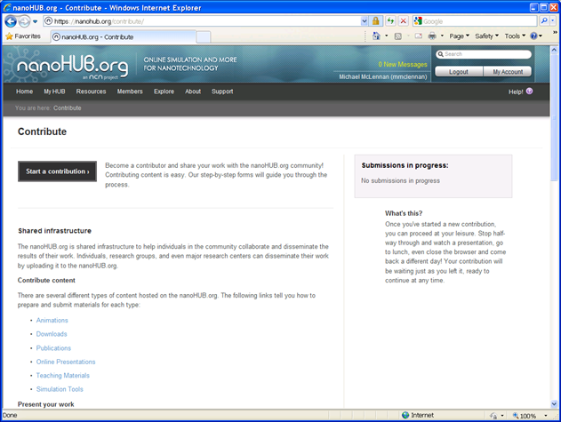
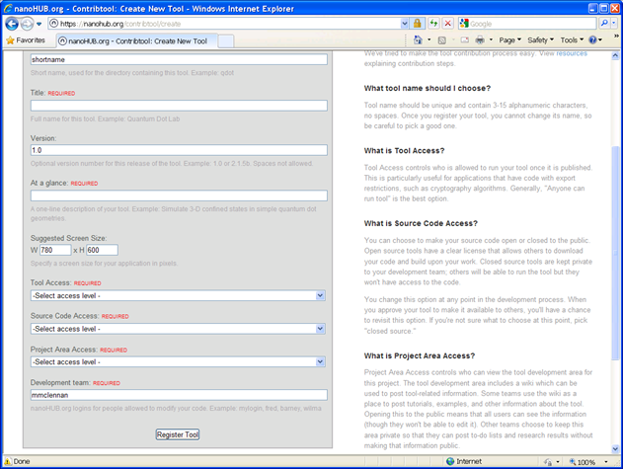

Getting Started
trunk
branches
yourtool
tags
Subversion
repository
Once you register your tool,
your repository is created automatically

Slide 4
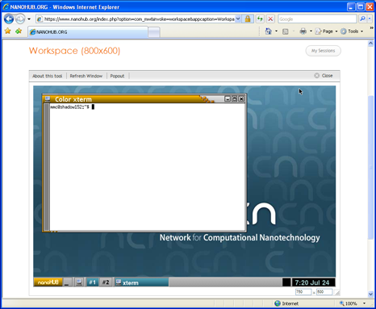

Check out your code
svn checkout https://ccehub.org/tools/yourtool/svn/trunk yourtool
A yourtool/rappture
A yourtool/doc
A yourtool/src
A yourtool/bin
A yourtool/data
A yourtool/middleware
A yourtool/examples
Checked out revision 1.
mkdir examples/ex1
vi examples/ex1/README
svn add examples/ex1
A examples/ex1
A examples/ex1/README
From any machine…
Instructions in your project area
at wiki/GettingStarted

Slide 5

Commit your changes
cd yourtool
svn status
A examples/ex1
A examples/ex1/README
? a.out
svn commit
Adding examples/ex1
Adding examples/ex1/README
Transmitting file data .
Committed revision 2.
commit at the top level, so you don’t miss anything
brings up your favorite editor:
Created ex1 directory and added the README file.
--This line, and those below, will be ignored--
A examples/ex1
A examples/ex1/README
Instructions in your project area
at wiki/GettingStarted

Slide 6

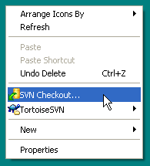
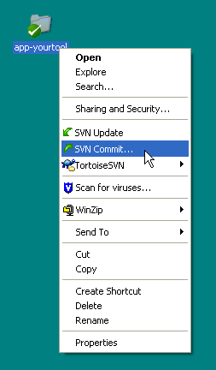
What about Windows?
More info:
http://tortoisesvn.net
Puts svn commands onto the right-mouse-button menu:
Like any other file on your
Desktop, but icon shows
Subversion control

Slide 7
Try it yourself: checkout
use -r -p geany
svn checkout https://ccehub.org/tools/bootcamp/svn/trunk bootcamp
A bootcamp/devteamone
A bootcamp/devteamtwo
A bootcamp/devteamthree
A bootcamp/devteamfour
A bootcamp/devteamfive
A bootcamp/devteamsix
A bootcamp/devteamseven
Checked out revision 2.
geany devteamone/README
svn add devteamone/README
A devteamone/README
From any machine…
Instructions in your project area
at wiki/GettingStarted

Slide 8
Try it yourself: commit
cd bootcamp
svn status
A devteamone/README
svn commit
Adding devteamone/README
Transmitting file data .
Committed revision 2.
svn update
Adding devteamone/README
commit at the top level, so you don’t miss anything
brings up your favorite editor:
Created README file for my team.
--This line, and those below, will be ignored--
A devteamone/README
Instructions in your project area
at wiki/GettingStarted

Slide 9
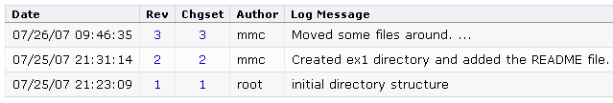
Moving and removing files
cd examples/ex1
svn mv README README.txt
A README.txt
D README
cd ../..
svn delete doc
D doc
svn status
D doc
A + examples/ex1/README.txt
D examples/ex1/README
svn commit
brings up your favorite editor:
Moved some files around.
--This line, and those below, will be ignored--
D doc
A examples/ex1/README.txt
D examples/ex1/README

Slide 10

Editing and updating
edit: Makefile
svn update
all:
gcc -g hello.c
gcc -O hello.c
svn commit
svn commit
all:
gcc -O hello.c
svn checkout https://nanohub.org/tools/yourtool/svn/trunk yourtool
Copy code around
Move code to new machines with “svn checkout”
Move changes around with “svn commit” and “svn update”

Slide 11
Looking for differences and reverting
svn status
M src/hello.c
svn diff src/hello.c
Index: src/hello.c
=====================================
--- src/hello.c (revision 4)
+++ src/hello.c (working copy)
@@ -4,6 +4,7 @@
int
main(int argc, char **argv)
{
- printf("Hello, World!\n");
+ /* say hello to everyone */
+ printf("Hello, Universe!\n");
exit(0);
}
Can also revert directory changes (adding/deleting files)
svn revert hello.c
Reverted 'hello.c'

Slide 12
Merging changes
edit: Makefile
all:
gcc –O hello.c
clean:
rm –f *.o a.out
CC=gcc
all:
$(CC) -O hello.c
svn commit
Whoever checks in first has no problem
Next “svn update” integrates compatible changes

Slide 13
Merging changes
edit: Makefile
all:
gcc –O hello.c
clean:
rm –f *.o a.out
CC=gcc
all:
$(CC) -O hello.c
svn update
clean:
rm –f *.o a.out
svn commit
Whoever checks in first has no problem
Next “svn update” integrates compatible changes
Use “svn commit” to commit the merged changes

Slide 14
Resolving merge conflicts
edit: Makefile
all:
gcc –O hello.c –o hello
clean:
rm –f *.o a.out
gcc –O hello.c –o hello
CC=gcc
all:
$(CC) -O hello.c
svn commit
$(CC) -O hello.c
Problem here:
both change
the same line
Whoever checks in first has no problem
Next “svn update” integrates changes

Slide 15
Resolving merge conflicts
svn update
C Makefile
Updated to revision 6.
svn commit
svn: Commit failed (details follow):
svn: Aborting commit: 'Makefile' remains in conflict
svn status
? Makefile.r5
? Makefile.r6
? Makefile.mine
C Makefile
conflict!
best guess at integrated changes

Slide 16
Resolving merge conflicts
vi Makefile
CC=gcc
all:
<<<<<<< .mine
$(CC) -O hello.c
=======
gcc -O hello.c -o hello
clean:
rm -f *.o a.out
>>>>>>> .r6

Slide 17
Resolving merge conflicts
vi Makefile
CC=gcc
all:
<<<<<<< .mine
$(CC) -O hello.c
=======
gcc -O hello.c -o hello
clean:
rm -f *.o a.out
>>>>>>> .r6

Slide 18
Resolving merge conflicts
vi Makefile
.
CC=gcc
all:
$(CC) -O hello.c -o hello
clean:
rm -f *.o a.out
svn resolved Makefile
Resolved conflicted state of 'Makefile'
svn commit
Sending src/Makefile
Transmitting file data .
Committed revision 7

Slide 19
Retrieving an old version
Get the whole distribution
svn checkout –r 3 https://nanohub.org/tools/yourtool/svn/trunk yourtool
get revision 3
Get a particular file
svn cat –r 5 Makefile
svn cat –r 5 Makefile > Makefile
show me revision 5
replace current file with revision 5
Which revision?
svn log Makefile
svn log
show me revisions for this file
show me revisions for current directory

Slide 20
Binary files
Good defaults. Subversion usually does the right thing:
cp diagram.jpg examples
svn add examples/diagram.jpg
A (bin) examples/diagram.jpg
svn commit
Adding (bin) examples/diagram.jpg
Transmitting file data .
Committed revision 8.
Recognized as a binary file:
no CR/LF translation
no merges, only replacements
When it fails, set properties yourself:
cp demo.dat examples
svn add examples/demo.dat
A examples/demo.dat
svn propset svn:mime-type application/octet-stream examples/demo.dat
svn propdel svn:eol-style examples/demo.dat

Slide 21
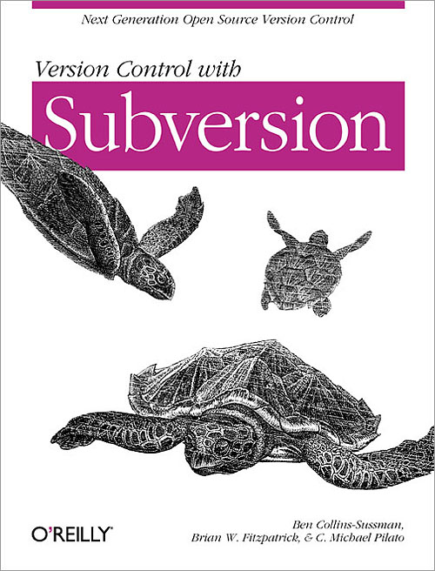
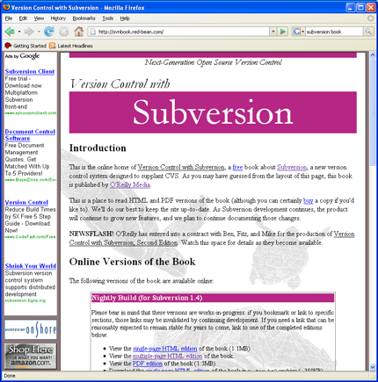
More Information
Web site: http://subversion.apache.org/
Subversion Book
From O’Reilly & Associates, and also online
Quick-start guide for your project:
https://ccehub.org/tools/bdw/wiki/GettingStarted

