Slide 1
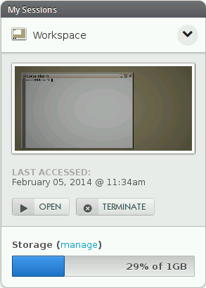
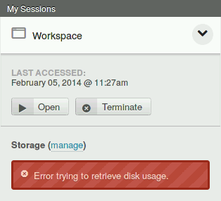
Quick start link
Container screenshot
Storage meter

Slide 2
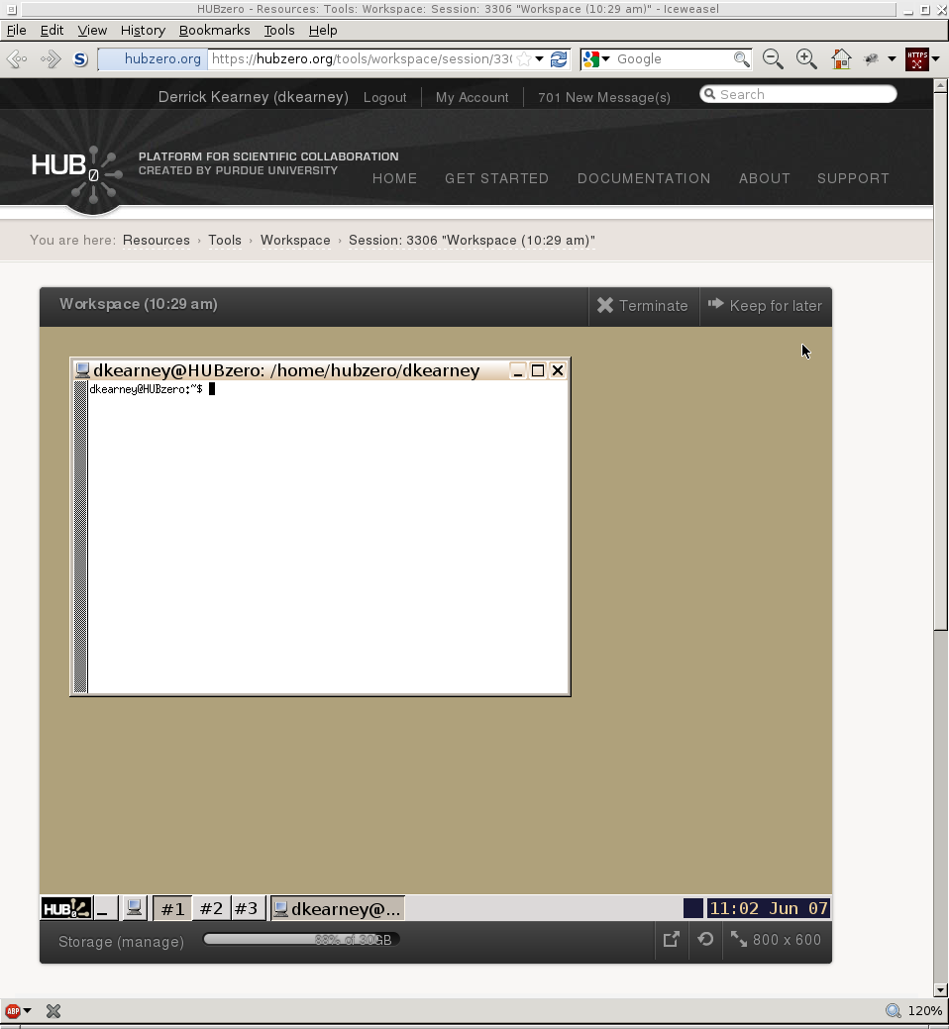
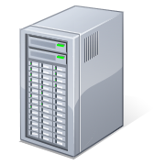

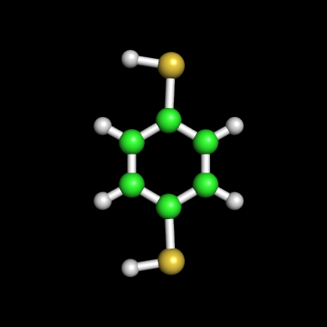
User's Web Browser
HUBzero Infrastructure
Web Server
Middleware
Grid
Submit
Proxy
Tool
Session
Containers
Visualization

Slide 3
User's Web Browser
HUBzero Infrastructure
Web Server
Middleware
Grid
Submit
Proxy
Tool
Session
Containers
Execution Hosts
Visualization
Servers

Slide 4
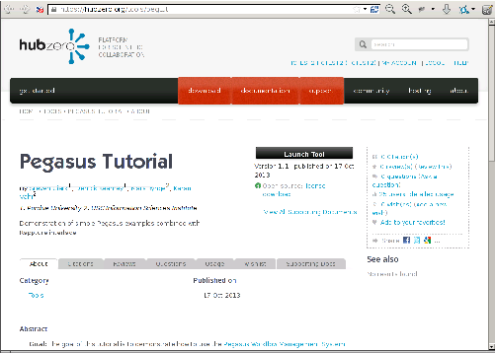
User's Web Browser
HUBzero Infrastructure
1
2
Web Server
3
Middleware
Grid
5
Submit
Proxy
4
Tool
Session
Containers
Visualization
Servers
Execution Hosts

