Slide 1
Automating Workspace Testing

Slide 2
HUB Tool Developement

Slide 3
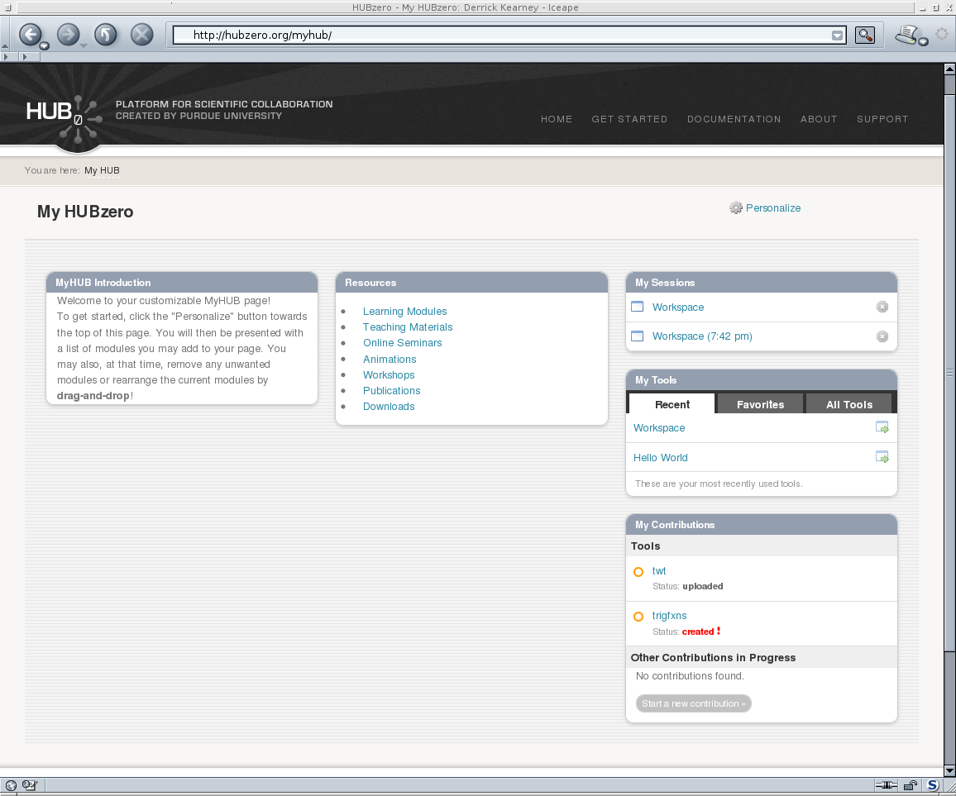
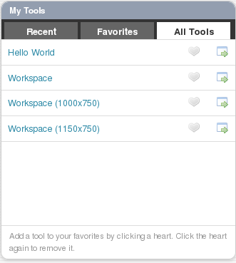



Accessing a Workspace
User's Web Browser
HUBzero Infrastructure
Web Server
Middleware
Grid
Submit
Proxy
Tool Session
Containers
Visualization

Slide 4
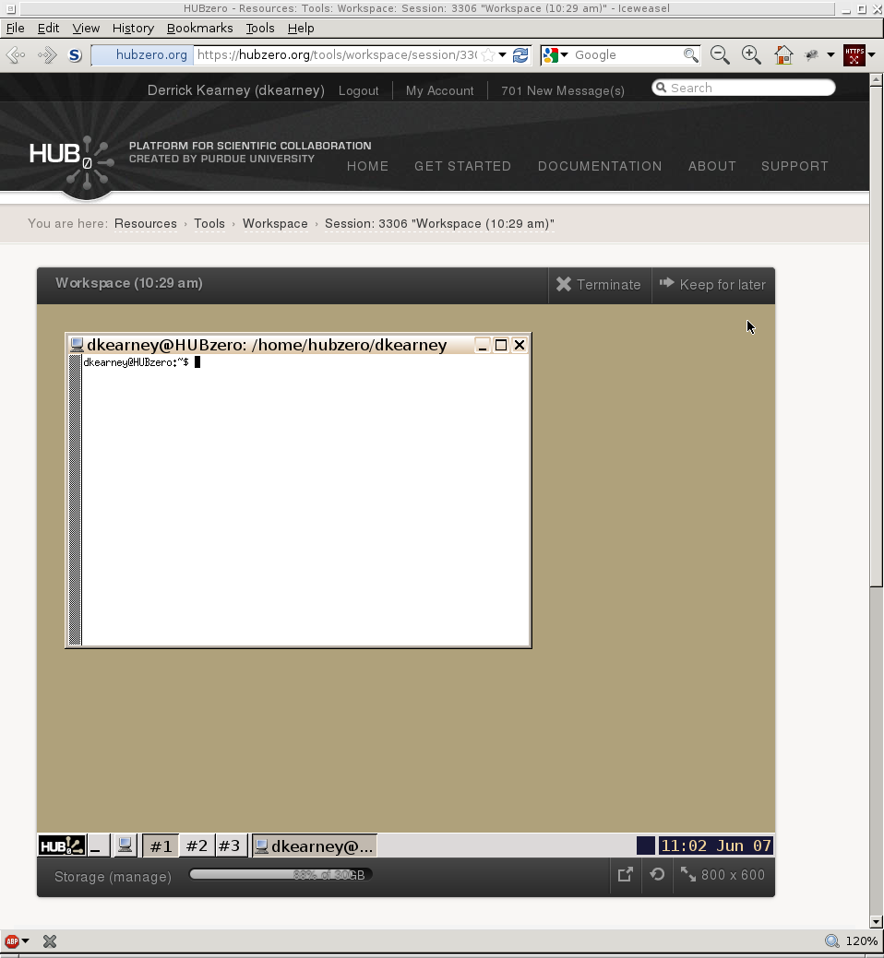
Workspace via Website
User's Web Browser
HUBzero Infrastructure
Web Server
Middleware
Grid
Submit
Proxy
Tool Session
Containers
Visualization

Slide 5
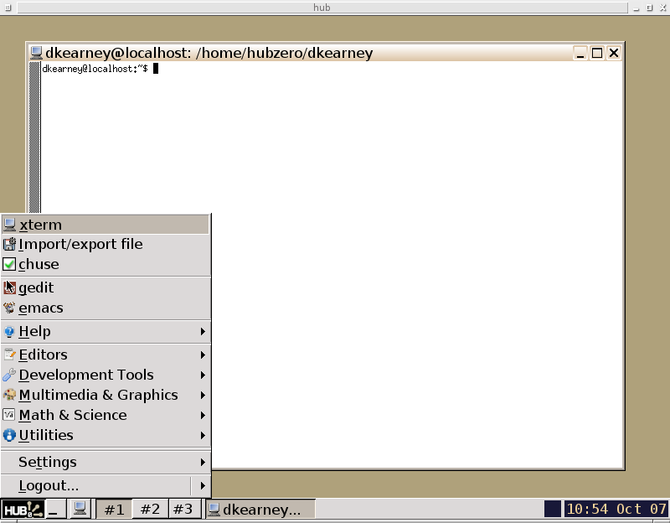
Using a Workspace
Development Tools Available
In Workspace:
* Editors: gedit, emacs, vim
* Debuggers: gdb, ddd, valgrind
* Compilers: gcc, g++, gfortran
* Interpreters: wish, python,
octave, irb, perl,

Slide 6
Workspace via VirtualSSH
User's Terminal
HUBzero Infrastructure
$ ssh username@hub session
Entering session 1234
hub $
Web Server
Middleware
Grid
Submit
Proxy
Tool Session
Containers
Visualization

Slide 7
Workspace via VirtualSSH
User's Terminal
HUBzero Infrastructure
$ ssh username@hub session
Entering session 1234
hub $
Web Server
Middleware
Grid
Submit
Proxy
Tool Session
Containers
Visualization

Slide 8
Workspace via Automated SSH
Expect/Tcl Script
HUBzero Infrastructure
set ws [hubcheck::workspace::new]
set snum [$ws enter]
set spawn_id [$ws cget spawn_id]
send “echo hi\r”
expect “hi”
Web Server
Middleware
Grid
Submit
Proxy
Tool Session
Containers
Visualization

Slide 9
Expect Basics
Written by Don Libes in early 1990's
Core is written in C
Language bindings for Tcl
Ported to Python, Perl, other languages
Expect Scripts Typically Have 3 Parts:
Spawn the interactive program
Expect phrase
Send response

Slide 10
Expect Example
Written by Don Libes in early 1990's
Core is written in C
Language bindings for Tcl
Ported to Python, Perl, other languages
Expect Scripts Typically Have 3 Parts:
Spawn the interactive program
Expect phrase
Send response
User's Terminal
Expect Script
$ passwd libes
Changing password for libes on thunder
New password:
Retype new password:
spawn passwd [lindex $argv 0]
set password [lindex $argv 1]
expect “password:”
send “$password\r”
expect “password:”
send “$password\r”
expect eof

Slide 11
Expect Example
Written by Don Libes in early 1990's
Core is written in C
Language bindings for Tcl
Ported to Python, Perl, other languages
Expect Scripts Typically Have 3 Parts:
Spawn the interactive program
Expect phrase
Send response
User's Terminal
Expect Script
$ passwd libes
Changing password for libes on thunder
New password:
Retype new password:
spawn passwd [lindex $argv 0]
set password [lindex $argv 1]
expect “password:”
send “$password\r”
expect “password:”
send “$password\r”
expect eof

Slide 12
Expect Example
Written by Don Libes in early 1990's
Core is written in C
Language bindings for Tcl
Ported to Python, Perl, other languages
Expect Scripts Typically Have 3 Parts:
Spawn the interactive program
Expect phrase
Send response
User's Terminal
Expect Script
$ passwd libes
Changing password for libes on thunder
New password:
Retype new password:
spawn passwd [lindex $argv 0]
set password [lindex $argv 1]
expect “password:”
send “$password\r”
expect “password:”
send “$password\r”
expect eof

Slide 13
Expect Example
Written by Don Libes in early 1990's
Core is written in C
Language bindings for Tcl
Ported to Python, Perl, other languages
Expect Scripts Typically Have 3 Parts:
Spawn the interactive program
Expect phrase
Send response
User's Terminal
Expect Script
$ passwd libes
Changing password for libes on thunder
New password:
Retype new password:
spawn passwd [lindex $argv 0]
set password [lindex $argv 1]
expect “password:”
send “$password\r”
expect “password:”
send “$password\r”
expect eof

Slide 14
Expect Example
Written by Don Libes in early 1990's
Core is written in C
Language bindings for Tcl
Ported to Python, Perl, other languages
Expect Scripts Typically Have 3 Parts:
Spawn the interactive program
Expect phrase
Send response
User's Terminal
Expect Script
$ passwd libes
Changing password for libes on thunder
New password:
Retype new password:
spawn passwd [lindex $argv 0]
set password [lindex $argv 1]
expect “password:”
send “$password\r”
expect “password:”
send “$password\r”
expect eof

Slide 15
hei: hubcheck Expect interface
hubcheck::hei::prompt $spawn_id
hubcheck::hei::parse_resources $spawn_id
hubcheck::hei::sshLogin $spawn_id $host $port $user $password $cmd
hubcheck::hei::sshLogout $spawn_id
hubcheck::hei::bashTurnOffHistory $spawn_id $prompt
hubcheck::hei::bashSourceSystemStartupFiles $spawn_id $prompt
hubcheck::hei::bashSetPrompt $spawn_id $prompt
hubcheck::hei::spawnBashLogin $prompt
hubcheck::hei::spawnBashLogout $spawn_id $bashpid
hubcheck::hei::bashLogin $spawn_id $prompt
hubcheck::hei::bashLogout $spawn_id

Slide 16
hubcheck workspace module
set ws [hubcheck::workspace::new]
cget
configure
enter
exit
importfile
exportfile
getSessionNumber
getenv
isInsideWorkspace
login
logout
start
stop

Slide 17
hubcheck + Expect
# create a new workspace command
set ws [hubcheck::workspace::new -username $username -password $password]
# enter into a workspace session as the user
set snum [$ws enter]
set spawn_id [$ws cget spawn_id]
# send/expect commands inside workspace
# … Expect code here ...
#
# logout of the workspace
$ws exit
hubcheck::workspace::delete ws

Slide 18
Testing in the Workspace
HUBzero Infrastructure
Web Server
Debian Squeeze Packages
Container Setup
Network Firewall
Rappture Toolkit
Submit
Filexfer
Middleware
Grid
Submit
Proxy
Tool Session
Containers
Visualization

Slide 19
Testing in the Workspace
HUBzero Infrastructure
Web Server
Debian Squeeze Packages
Container Setup
Network Firewall
Rappture Toolkit
Submit
Filexfer
Middleware
Grid
Submit
Proxy
Tool Session
Containers
Visualization

Slide 20
Testing Packages
HUBzero Infrastructure
Web Server
119 Debian Squeeze Packages
Compilers (gcc, g++, javac, gfortran)
Debuggers (gdb, valgrind)
Interpreters (python, perl, tcl, ruby)
Build tools (make, autoconf)
Editors (gedit, vim, emacs)
Utilities (zip, tar, ssh, rsync)
Window Managers (icewm, ratpoison)
Development tools
Middleware
Grid
Submit
Proxy
Tool Session
Containers
Visualization

Slide 21
Testing in the Workspace
HUBzero Infrastructure
Web Server
Debian Squeeze Packages
Container Setup
Network Firewall
Rappture Toolkit
Submit
Filexfer
Middleware
Grid
Submit
Proxy
Tool Session
Containers
Visualization

Slide 22
Testing Container Setup
HUBzero Infrastructure
Web Server
Check file locations and permissions
filexfer, importfile, exportfile
clientaction
pixelflip
mergeauth
startxvnc
xsetroot
icewm, icewm-captive, ratpoison
invoke_app
Testing for old installations
Middleware
Grid
Submit
Proxy
Tool Session
Containers
Visualization

Slide 23
Testing in the Workspace
HUBzero Infrastructure
Web Server
Debian Squeeze Packages
Container Setup
Network Firewall
Rappture Toolkit
Submit
Filexfer
Middleware
Grid
Submit
Proxy
Tool Session
Containers
Visualization

Slide 24
Testing Container Network Firewall
HUBzero Infrastructure
Web Server
3 User Configurations, 30 locations
Hub's website port 80 and 443
Rappture website
Google
Campus ssh ports
Hub nameservers
OpenDNS nameservers
Google nameservers
License servers
Visualization servers
Middleware
Grid
Submit
Proxy
Tool Session
Containers
Visualization

Slide 25
Testing in the Workspace
HUBzero Infrastructure
Web Server
Debian Squeeze Packages
Container Setup
Network Firewall
Rappture Toolkit
Submit
Filexfer
Middleware
Grid
Submit
Proxy
Tool Session
Containers
Visualization

Slide 26
Testing Rappture Toolkit
HUBzero Infrastructure
Web Server
Rappture Toolkit
Rappture Installation
Examples Run
Visualization Servers
Middleware
Grid
Submit
Proxy
Tool Session
Containers
Visualization

Slide 27
Testing in the Workspace
HUBzero Infrastructure
Web Server
Debian Squeeze Packages
Container Setup
Network Firewall
Rappture Toolkit
Submit
Filexfer
Middleware
Grid
Submit
Proxy
Tool Session
Containers
Visualization

Slide 28
Testing Submit
HUBzero Infrastructure
Web Server
Job submission to the Grid
Submit Installation
Submit job as registered user
Submit job as submit enabled user
Submit locally vs to the Grid
Collecting metrics from Submit
Middleware
Grid
Submit
Proxy
Tool Session
Containers
Visualization

Slide 29
Testing in the Workspace
HUBzero Infrastructure
Web Server
Debian Squeeze Packages
Container Setup
Network Firewall
Rappture Toolkit
Submit
Filexfer
Middleware
Grid
Submit
Proxy
Tool Session
Containers
Visualization

Slide 30
Testing Filexfer
HUBzero Infrastructure
Web Server
Transfer file between hub and desktop
Filexfer Installation
Filexfer GUI
exportfile: hub to desktop
importfile: desktop to hub
Requires Selenium and Expect
Middleware
Grid
Submit
Proxy
Tool Session
Containers
Visualization

Slide 33
Testing in the Workspace
submit -p @@vth=0:0.2:5 -p @@cap=10pf,100pf,1uf sim.exe @:indeck
Submit 78 jobs.
@@vth goes from 0 to 5 in steps of 0.2 (26 values).
@@cap takes on 3 values, 10pf, 100pf, 1uf.
26 x 3 = 78 jobs total.
@:indeck is treated as a template
values are substituted in place of @@vth and @@cap in that file.
Example indeck:
[inputs]
C = @@cap
Vin = @@vth

Slide 34
Virtual SSH
ssh [flags] [user@]hostname [command]
Virtual SSH related flags
-t Force pseudo-tty allocation
Virtual SSH Commands
session create [session_title]
session start
session [session_number] [command]
session list
session stop session_number
session help
create a new session
start and enter a new session
access session
list user's existing sessions
stop the specified session
print session help message

Slide 35
Virtual SSH → ToolSession
ssh [flags] [user@]hostname [command]
Virtual SSH related flags
-t Force pseudo-tty allocation
ts = ToolSession(...)
Virtual SSH Commands
session create [session_title]
session start
session [session_number] [command]
session list
session stop session_number
session help
ToolSession Object Methods
create(title=None)
start()
access(snum=None,command=None)
list()
stop(session_number)
help()

Slide 36
Virtual SSH - Create Session
ssh -t user@hostname session create
ssh -t user@hostname session create mytitle
ts = ToolSession(hostname,
username = username,
password = password)
(stdin,stdout,stderr) = ts.create()
(stdin,stdout,stderr) = ts.create('mytitle')

Slide 37
Virtual SSH - Start Session
ssh -t user@hostname session start
ts = ToolSession(hostname,
username = username,
password = password)
shell = ts.start()

Slide 38
Virtual SSH - Access Session
ssh -t user@hostname session
ssh -t user@hostname session 40032
ssh -t user@hostname session “echo hi”
ssh -t user@hostname session 40032 “echo hi”
ts = ToolSession(hostname,
username = username,
password = password)
shell = ts.access()
shell = ts.access(session_number=40032)
(in,out,err) = ts.access(command='echo hi')
(in,out,err) = ts.access(40032,'echo hi')

Slide 39
Virtual SSH - List Session
ssh -t user@hostname session list
ts = ToolSession(hostname,
username = username,
password = password)
(stdin,stdout,stderr) = ts.list()
print stdout.read(1024)

Slide 40
Virtual SSH - Stop Session
ssh -t user@hostname session stop 40032
ts = ToolSession(hostname,
username = username,
password = password)
(stdin,stdout,stderr) = ts.stop(40032)
print stdout.read(1024)

Slide 41
Virtual SSH – Session Help
ssh -t user@hostname session help
ts = ToolSession(hostname,
username = username,
password = password)
(stdin,stdout,stderr) = ts.help()
print stdout.read(1024)

Slide 42
ToolSession → ToolSessionShell
ts = ToolSession(hostname, username = username, password = password)
shell = ts.access()
ToolSessionShell Methods
shell.send(command)
shell.expect(patterns=[],flags=0)
shell.execute(commands)
Examples
shell.send('echo hi')

Slide 43
ToolSession → ToolSessionShell
ts = ToolSession(hostname, username = username, password = password)
shell = ts.access()
ToolSessionShell Methods
shell.send(command)
shell.expect(patterns=[],flags=0)
shell.execute(commands)
Examples
shell.send('echo hi')
shell.expect(['(\w+)'])
output = shell.match.groups()[0]

Slide 44
Examples – Execute Command
ts = ToolSession(hostname, username = username, password = password)
shell = ts.access()
command = 'submit --local echo hi'
output, error_code = shell.execute(command)
print output # hi
print error_code # 0

Slide 45
Examples – Transferring Files
from hubcheck import SFTPClient, ToolSession
ts = ToolSession(hostname, username = username, password = password)
shell = ts.access()
shell.execute('cd $SESSIONDIR')
sessiondir,error_code = shell.execute('pwd')
shell.importfile('./sim1.py', '../examples/sim1.py', mode=0o700)

Slide 46
Examples – Transferring Files
from hubcheck import SFTPClient, ToolSession
ts = ToolSession(hostname, username = username, password = password)
sftp = SFTPClient(hostname, username = username, password = password)
shell = ts.access()
shell.execute('cd $SESSIONDIR')
sessiondir,error_code = shell.execute('pwd')
sftp.chdir(sessiondir)
sftp.put('../examples/sim1.py', './sim1.py')
sftp.chmod('./sim1.py', 0700)

Slide 47
Examples – Writing Files
from hubcheck import SFTPClient, ToolSession
ts = ToolSession(hostname, username = username, password = password)
shell = ts.access()
shell.execute('cd $SESSIONDIR')
sessiondir,error_code = shell.execute('pwd')
exe_path = './sim1.py'
indeckfn = 'indeck.template'
indeck_template = '[inputs]\nC = @@C\n'
shell.importfile(indeck_template,indeckfn,mode=0o600,is_data=True)
command = 'submit --local -p @@C=10e-12,100e-12 %s --inputdeck @:%s' \
% (exe_path,indeckfn)
command += ' 0</dev/null'
output,error_code = self.ws.execute(command)

Slide 48
Examples – Writing Files
from hubcheck import SFTPClient, ToolSession
ts = ToolSession(hostname, username = username, password = password)
sftp = SFTPClient(hostname, username = username, password = password)
shell = ts.access()
shell.execute('cd $SESSIONDIR')
sessiondir,error_code = shell.execute('pwd')
sftp.chdir(sessiondir)
exe_path = './sim1.py'
indeckfn = 'indeck.template'
indeck_template = '[inputs]\nC = @@C\n'
f = sftp.open(indeckfn,mode='w')
f.write(indeck_template)
f.close()
command = 'submit --local -p @@C=10e-12,100e-12 %s --inputdeck @:%s' \
% (exe_path,indeckfn)
command += ' 0</dev/null'
output,error_code = self.ws.execute(command)

Slide 49
Writing Tests
import hubcheck
import os
class container_firewall_registered_user(hubcheck.TestCase):
def setUp():
…
def test_basic_connections():
…
def tearDown():
…

Slide 50
Writing Tests – setUp Fixture
def setUp(self):
self.remove_files = []
self.ws = None
# get user account info
hubname = self.testdata.find_url_for('https')
self.username,self.userpass = self.testdata.find_account_for('registeredworkspace')
cm = hubcheck.ContainerManager()
self.ws = cm.access(hubname, self.username, self.userpass)
# copy the checknet executable to the session directory
self.ws.execute('cd $SESSIONDIR')
sessiondir,es = self.ws.execute('pwd')
self.exe_fn = 'checknet.py'
local_exe_path = os.path.join(hubcheck.config.macros_dir,self.exe_fn)
self.exe_path = os.path.join(sessiondir,self.exe_fn)
self.remove_files.append(self.exe_path)
self.ws.importfile(local_exe_path,self.exe_path,mode=0o700)

Slide 51
Writing Tests – Test Method
def test_basic_connections(self):
"""
login to a tool session container and check basic network firewall
settings for a registered user in no network affecting groups.
"""
conns = [
# (desc, uri, port, expected_result)
('rappture', 'rappture.org', 80, True),
('ecn_systems', 'shay.ecn.purdue.edu', 22, False),
('google_https', 'google.com', 443, False),
('octave_ftp', 'ftp.octave.org', 21, False),
('localhost', 'localhost', 80, False),
('ecn_matlab', 'matlab-license.ecn.purdue.edu', 1703, False),
]
results = ''
for (desc,uri,port,eresult) in conns:
results += self._run_checknet(desc,uri,port,eresult)
self.assertTrue(results == '', results.strip())

Slide 52
Writing Tests – tearDown Fixture
def tearDown(self):
# remove the executable from the workspace
for fname in self.remove_files:
self.ws.execute('rm -f %s' % (fname))
# get out of the workspace
# shut down the ssh connection
if self.ws is not None:
self.ws.close()

Slide 54
Writing Tests – Test Method
def _run_checknet(self,desc,uri,port,eresult):
command = '%s --protocol tcp4 %s %s' % (self.exe_path,uri,port)
self.logger.debug('command = "%s"' % (command))
aresult,es = self.ws.execute(command)
if aresult == 'True':
aresult = True
else:
aresult = False
results = ''
if eresult != aresult:
results = '\n%s connection %s:%s received %s, expected %s' \
% (desc,uri,port,aresult,eresult)
return results

Slide 55
Writing Tests – Test Method
def test_basic_connections(self):
"""
login to a tool session container and check basic network firewall
settings for a registered user in no network affecting groups.
"""
conns = [
# (desc, uri, port, expected_result)
('rappture', 'rappture.org', 80, True),
('ecn_systems', 'shay.ecn.purdue.edu', 22, False),
('google_https', 'google.com', 443, False),
('octave_ftp', 'ftp.octave.org', 21, False),
('localhost', 'localhost', 80, False),
('ecn_matlab', 'matlab-license.ecn.purdue.edu', 1703, False),
]
results = ''
for (desc,uri,port,eresult) in conns:
results += self._run_checknet(desc,uri,port,eresult)
self.assertTrue(results == '', results.strip())

