Slide 1
Design Patterns in Selenium
GLOSSY Talks
August 2, 2014
Derrick Kearney

Slide 2
Page Object Design Pattern
Represent part of a web page as a class.
Two parts of the page object:
  Description of web elements
  Services provided
Goals:
  Separate specification and implementation.
  Take advantage of OOP features (encapsulation, inheritance, polymorphism).

Slide 3
Steps to create a Page Object
Identify the boundaries.
Locate the widgets.
Define the services.
Page Description
Page Services

Slide 4
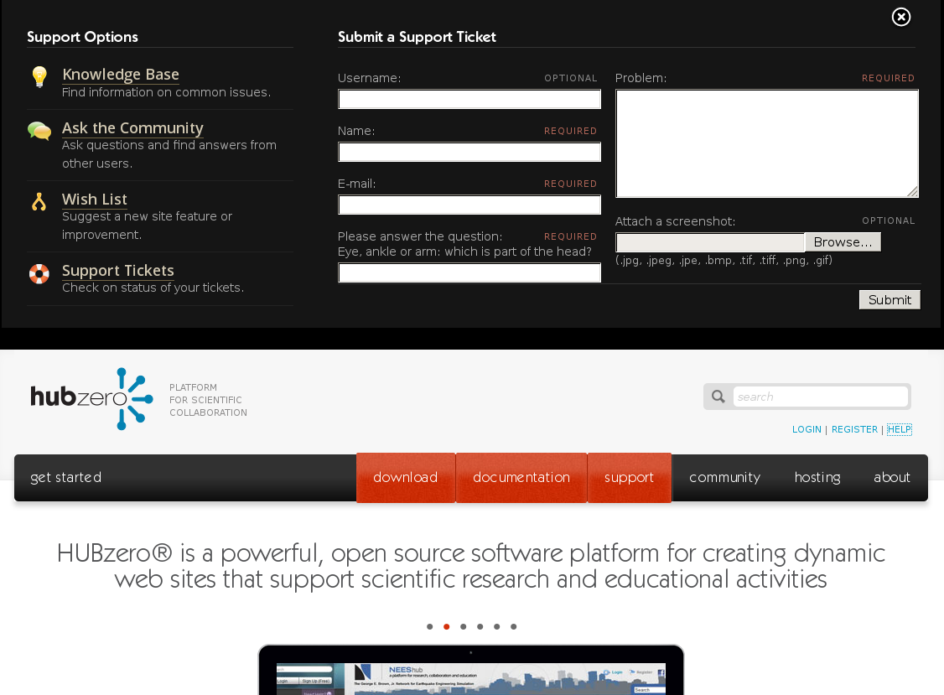

Slide 5

Widgets
Links

Slide 6
Widgets
Text Inputs

Slide 7
Widgets
Text Area

Slide 8
Widgets
File Upload

Slide 9
Widgets
Button

Slide 10
Services
Navigation:
  Knowledge Base
  Q&A
  Wishlist
  Support Tickets
Support Ticket:
  Populate Form
  Submit Form
Other:
  Close

Slide 11
Services
Navigation:
  Knowledge Base
  Q&A
  Wishlist
  Support Tickets
Support Ticket:
  Populate Form
  Submit Form
Other:
  Close

Slide 12
Services
Navigation:
  Knowledge Base
  Q&A
  Wishlist
  Support Tickets
Support Ticket:
  Populate Form
  Submit Form
Other:
  Close

Slide 13
class TroubleReportForm(BasePageWidget):
def __init__(self):
...
def goto_knowledge_base(self):
…
def goto_questions_answers(self):
…
def goto_wishlist(self):
…
def submit_ticket(self,data):
…
def open(self):
…
def close(self):
…
Page Description
Page Services

Slide 14
testuser
Writing to a Text Input:
1. Find the element
2. Clear the element
3. Send keys to the element
<label for=”trName”>
Name:
<span class=”required”>required</span>
<input id=”trName” type=”text” value=””
name=”reporter[name]”>
</label>
...
e = browser.find_element(by=BY.CSS, value=”input[id='trName']”)
e.clear()
e.send_keys(“testuser”)
...

Slide 15
testuser
tu@hubzero.org
Writing to a Text Input:
1. Find the element
2. Clear the element
3. Send keys to the element
<label for=”trEmail”>
E-mail:
<span class=”required”>required</span>
<input id=”trEmail” type=”text” value=””
name=”reporter[email]”>
</label>
...
e = browser.find_element(by=BY.CSS, value=”input[id='trEmail']”)
e.clear()
e.send_keys(“tu@hubzero.org”)
...

Slide 16
test problem
testuser
tu@hubzero.org
Writing to a Text Input:
1. Find the element
2. Clear the element
3. Send keys to the element
<label for=”trProblem”>
Problem:
<span class=”required”>required</span>
<textarea id=”trProblem”
name=”problem[long]”> </textarea>
</label>
...
e = browser.find_element(by=BY.CSS, value=”textarea[id='trProblem']”)
e.clear()
e.send_keys(“test problem”)
...

Slide 17
test problem
testuser
tu@hubzero.org
Pushing a button:
1. Find the element
2. Call the element's “click()” method
<div class=”submit”>
<input id=”send-form” type=”submit”
value=”Submit”>
</div>
...
e = browser.find_element(by=BY.CSS,value=”input[id='send-form']”)
e.click()
...

Slide 18
…
# File a Support Ticket
# Populate the Name field
e = browser.find_element(by=BY.CSS, value=”input[id='trName']”)
e.clear()
e.send_keys(“testuser”)
# Populate the Email field
e = browser.find_element(by=BY.CSS, value=”input[id='trEmail']”)
e.clear()
e.send_keys(“tu@hubzero.org”)
# Populate the Problem field
e = browser.find_element(by=BY.CSS, value=”textarea[id='trProblem']”)
e.clear()
e.send_keys(“test problem”)
# Click the Submit button
e = browser.find_element(by=BY.CSS,value=”input[id='send-form']”)
e.click()
...

Slide 19
…
# File a Support Ticket
# Populate the Name field
e = browser.find_element(by=BY.CSS, value=”input[id='trName']”)
e.clear()
e.send_keys(“testuser”)
# Populate the Email field
e = browser.find_element(by=BY.CSS, value=”input[id='trEmail']”)
e.clear()
e.send_keys(“tu@hubzero.org”)
# Populate the Problem field
e = browser.find_element(by=BY.CSS, value=”textarea[id='trProblem']”)
e.clear()
e.send_keys(“test problem”)
# Click the Submit button
e = browser.find_element(by=BY.CSS,value=”input[id='send-form']”)
e.click()
...
Text Input
Text Input
Text Input
Button

Slide 20
test problem
testuser
tu@hubzero.org
class Text(BasePageWidget):
def __init__(self, locator):
…
def value(self, text):
e = self.find_element(self.locator)
e.clear()
e.send_keys(text)
<label for=”trName”>
Name:
<span class=”required”>required</span>
<input id=”trName” type=”text” value=””
name=”reporter[name]”>
</label>
...
e = browser.find_element( by=BY.CSS,
value=”input[id='trName']”)
e.clear()
e.send_keys(“testuser”)
...
…
name = Text(“input[id='trName']”)
name.value('testuser')
...

Slide 21
test problem
testuser
tu@hubzero.org
class Button(BasePageWidget):
def __init__(self, locator):
…
def click(self):
e = self.find_element(self.locator)
e.click()
<div class=”submit”>
<input id=”send-form” type=”submit”
value=”Submit”>
</div>
...
e = browser.find_element( by=BY.CSS,
value=”input[id='send-form']”)
e.click()
...
…
submit = Button(“input[id='send-form']”)
submit.click()
...

Slide 22
…
# File a Support Ticket
# Populate the Name field
name = Text(“input[id='trName']”)
name.value(“testuser”)
# Populate the Email field
email = Text(“input[id='trEmail']”)
email.value(“tu@hubzero.org”)
# Populate the Problem field
problem = Text(“textarea[id='trProblem']”)
problem.value(“test problem”)
# Click the Submit button
submit = Button(“input[id='send-form']”)
submit.click()
...
Text Input
Text Input
Text Input
Button

Slide 23
…
# File a Support Ticket
# Populate the Name field
name = Text(“input[id='trName']”)
name.value(“testuser”)
# Populate the Email field
email = Text(“input[id='trEmail']”)
email.value(“tu@hubzero.org”)
# Populate the Problem field
problem = TextArea(“textarea[id='trProblem']”)
problem.value(“test problem”)
# Click the Submit button
submit = Button(“input[id='send-form']”)
submit.click()
...
Text Input
Text Input
Text Area
Button

Slide 24
class TroubleReportForm(BasePageWidget):
def __init__(self):
...
self.username = Text(self,'#trUsername')
self.name = Text(self,'#trName')
self.email = Text(self,'#trEmail')
self.problem = TextArea(self,'#trProblem')
self.upload = Upload(self,'#trUpload')
self.submit = Button(self,'#send-form')
…
def submit_ticket(self,data):
self.name.value(data['name'])
self.email.value(data['email'])
self.problem.value(data['problem'])
…
self.submit.click()
def open(self):
…
def close(self):
…
Page Description
Page Services

Slide 25
class TroubleReportForm(BasePageWidget):
def __init__(self):
...
self.username = Text(self,'username')
self.captcha = Captcha(self,'captcha')
self.problem = TextArea(self,'problem')
self.upload = Upload(self,'upload')
self.submit = Button(self,'submit')
…
def submit_ticket(self,data):
…
def open(self):
…
def close(self):
…
# open and close the need help pane
po = TroubleReportForm()
po.open()
po.close()

Slide 26
class TroubleReportForm(BasePageWidget):
def __init__(self):
...
self.username = Text(self,'username')
self.captcha = Captcha(self,'captcha')
self.problem = TextArea(self,'problem')
self.upload = Upload(self,'upload')
self.submit = Button(self,'submit')
…
def submit_ticket(self,data):
…
def open(self):
…
def close(self):
…
# submit a blank ticket
po = TroubleReportForm()
po.open()
data = {}
po.submit_ticket(data)

Slide 27
test problem
testuser
tu@hubzero.org
myscreenshot.png
class TroubleReportForm(BasePageWidget):
def __init__(self):
...
self.username = Text(self,'username')
self.captcha = Captcha(self,'captcha')
self.problem = TextArea(self,'problem')
self.upload = Upload(self,'upload')
self.submit = Button(self,'submit')
…
def submit_ticket(self,data):
…
def open(self):
…
def close(self):
…
# fill in the name, email, problem,
# upload a file, then submit the ticket
po = TroubleReportForm()
po.open()
data = {
'name' : 'testuser',
'email' : 'tu@hubzero.org',
'problem' : 'test problem',
'upload' : 'myscreenshot.png',
}
po.submit_ticket(data)

Slide 28
test problem
testuser
tu@hubzero.org
myscreenshot.png
class TroubleReportForm(BasePageWidget):
def __init__(self):
...
self.username = Text(self,'username')
self.captcha = Captcha(self,'captcha')
self.problem = TextArea(self,'problem')
self.upload = Upload(self,'upload')
self.submit = Button(self,'submit')
…
def submit_ticket(self,data):
…
def open(self):
…
def close(self):
…
# fill in the name, email, problem,
# upload a file, then submit the ticket
po = TroubleReportForm()
po.open()
po.name.value('testuser')
po.email.value('tu@hubzero.org')
po.problem.value('test problem')
po.upload.value('myscreenshot.png')
po.submit.click()

Slide 29
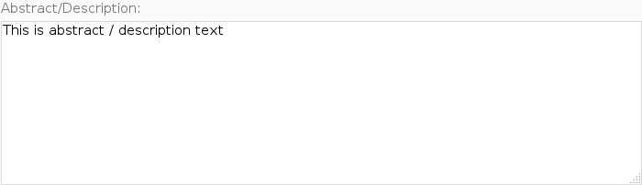

Interacting with Iframes

Slide 30
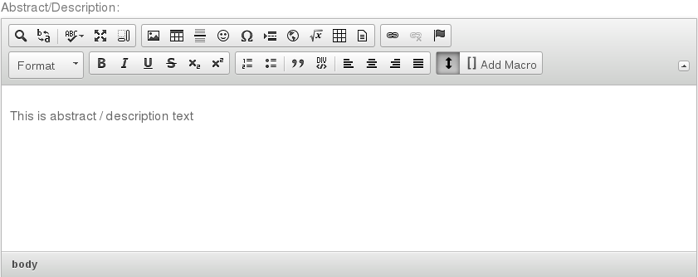
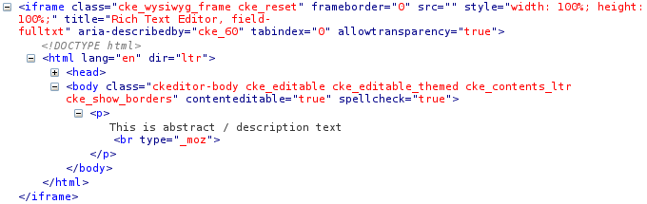
Interacting with Iframes

Slide 31
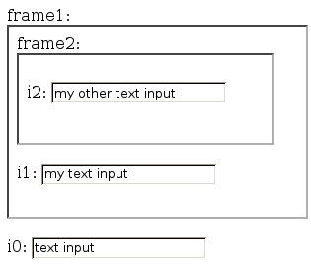
How do Iframes work

Slide 32
How do Iframes work
Default Context
<html>
<body>
<label for="frame1">frame1: </label>
<iframe id="frame1" src="inner_page.html"></iframe>
<br/><br/>
<label for="i0">i0: </label>
<input type="text" id="i0" value="text input"></input>
</body>
</html>

Slide 33
How do Iframes work
Frame1 Context
<html>
<body>
<label for="frame2">frame2: </label>
<iframe id="frame2" src="another_page.html"></iframe>
<br/><br/>
<label for="i1">i1: </label>
<input type="text" id="i1" value="my text input"></input>
</body>
</html>

Slide 34
How do Iframes work
Frame2 Context
<html>
<body>
<label for="i2">i2: </label>
<input type="text" id="i2" value="my other text input"></input>
</body>
</html>

Slide 35
Page Object for i0
class Text(BasePageWidget):
def __init__(self, locator):
…
# getter
def value(self):
e = self.find_element(self.locator)
return e.get_attribute('value')
# setter
def value(self, text):
e = self.find_element(self.locator)
e.clear()
e.send_keys(text)
def append(self, text):
e = self.find_element(self.locator)
e.send_keys(text)
Default Context

Slide 36
Page Object for i1
class Text1Frame(BasePageWidget):
def __init__(self, locator):
…
# getter
def value(self):
…
# setter
def value(self, text):
frame = self.find_element('#frame1')
self._browser.switch_to_frame(frame)
e = self.find_element(self.locator)
e.clear()
e.send_keys(text)
self._browser.switch_to_default_content()
def append(self, text):
…
Frame1 Context

Slide 37
Page Object for i2
class Text2Frame(BasePageWidget):
def __init__(self, locator):
…
# getter
def value(self):
…
# setter
def value(self, text):
frame1 = self.find_element('#frame1')
self._browser.switch_to_frame(frame1)
frame2 = self.find_element('#frame2')
self._browser.switch_to_frame(frame2)
e = self.find_element(self.locator)
e.clear()
e.send_keys(text)
self._browser.switch_to_default_content()
def append(self, text):
…
Frame2 Context

Slide 38
Dealing with Iframes
Enter / Exit frames to interact with elements
Must update all methods of page object.
Create new page objects for Iframes?!?
Default Context
Frame1 Context
Frame2 Context

Slide 39
IframeWrap Design Pattern
Use Decorator Pattern to wrap attributes of a page object with Enter / Exit Iframe calls.

Slide 40

Decorator Pattern
Attach additional responsibilities to an object dynamically and transparently.
class A (object):
def f (self):
do_some_stuff()
a = A()
a
a
f
function
f
wrapper
function
Before Decoration
After Decoration

Slide 41
IframeWrap Design Pattern
Use Decorator Pattern to wrap attributes of a page object with Enter / Exit Iframe calls.
class Text(BasePageWidget):
# setter
def value(self, text):
e = self.find_element(self.locator)
e.clear()
e.send_keys(text)
i1 = Text('#i1')
i1.value('new i1 text')
Frame1 Context

Slide 42
IframeWrap Design Pattern
class Text(BasePageWidget):
# setter
def value(self, text):
e = self.find_element(self.locator)
e.clear()
e.send_keys(text)
i1 = Text('#i1')
i1.value('new i1 text')
Frame1 Context
i1
i1
value
function
value
wrapper
function
Before Decoration
After Decoration

Slide 43
IframeWrap Design Pattern
def wrapper_method(self,f):
def wrapper(*args, **kwargs):
frame1 = self.find_element('#frame1')
self._browser.switch_to_frame(frame1)
rv = f(*args, **kwargs)
self._browser.switch_to_default_content()
return rv
return wrapper
i1 = IframeWrap(Text('#i1'),['#frame1'])
i1.value('new i1 text')
Frame1 Context
i1
i1
value
function
value
wrapper
function
Before Decoration
After Decoration

Slide 44
Page Objects for i0, i1, and i2
class FramedInputs(BasePageObject):
def __init__(self):
self.i0 = Text('#i0')
self.i1 = IframeWrap( Text('#i1'), ['#frame1'] )
self.i2 = IframeWrap( Text('#i2'), ['#frame2', '#frame1'] )

