Slide 1
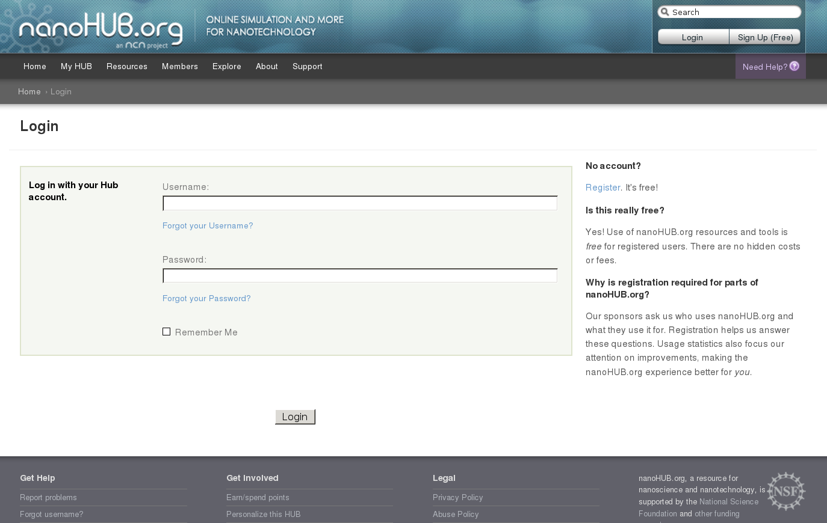
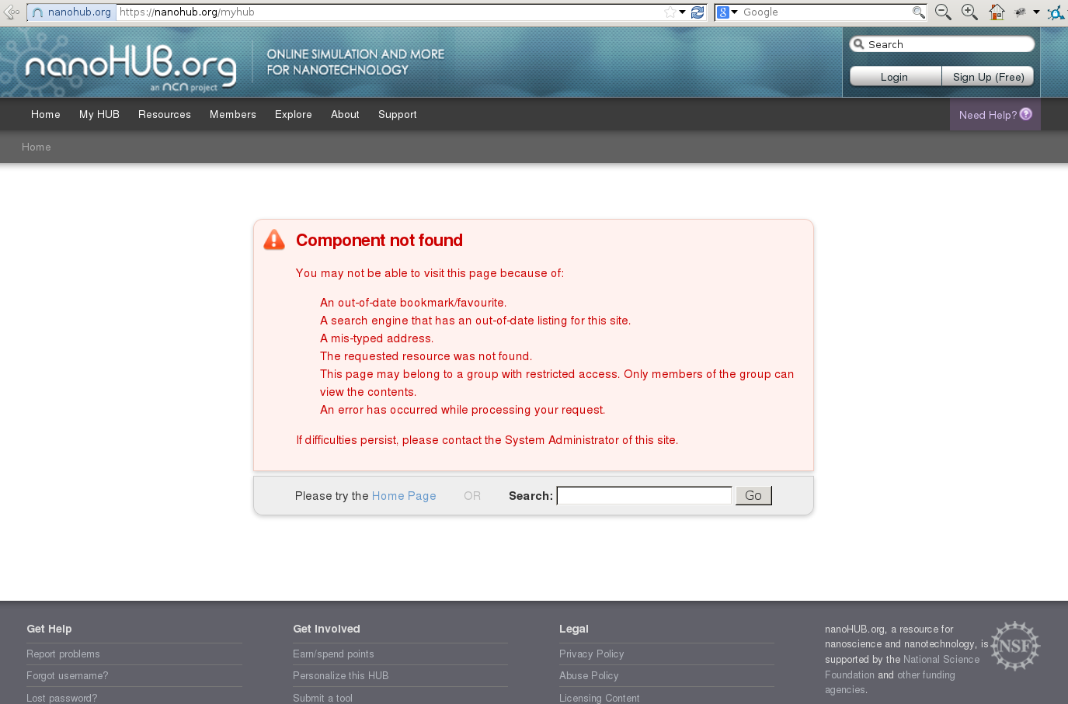
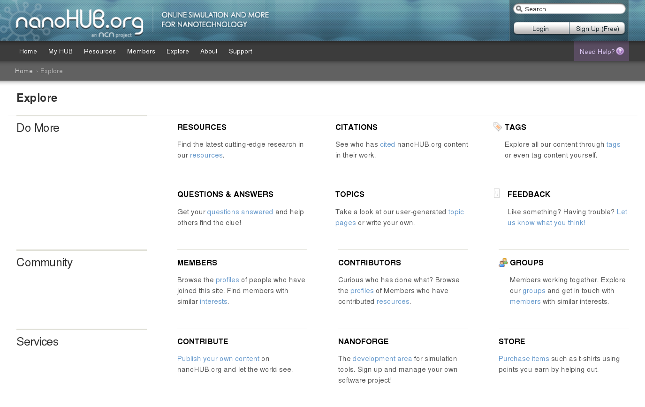
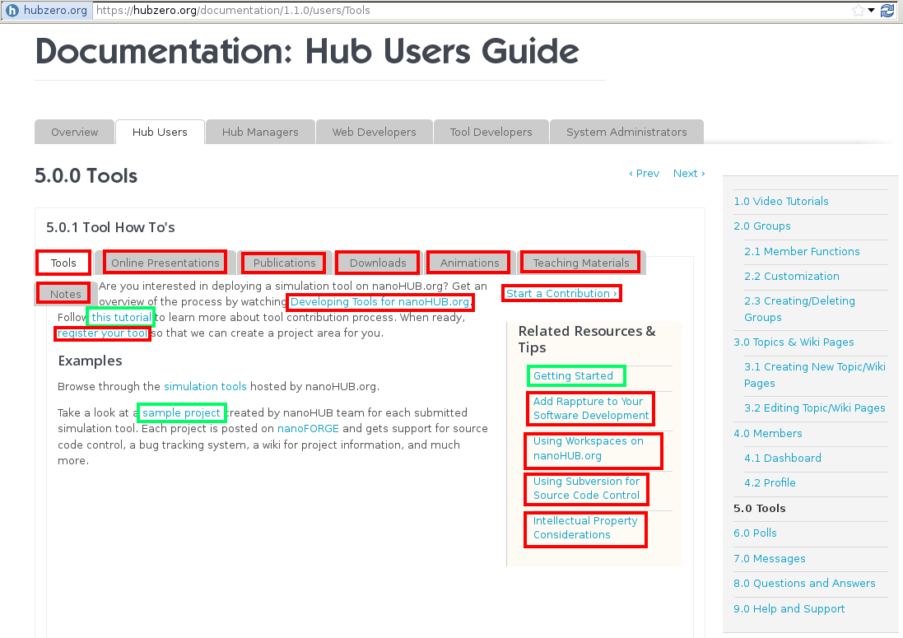
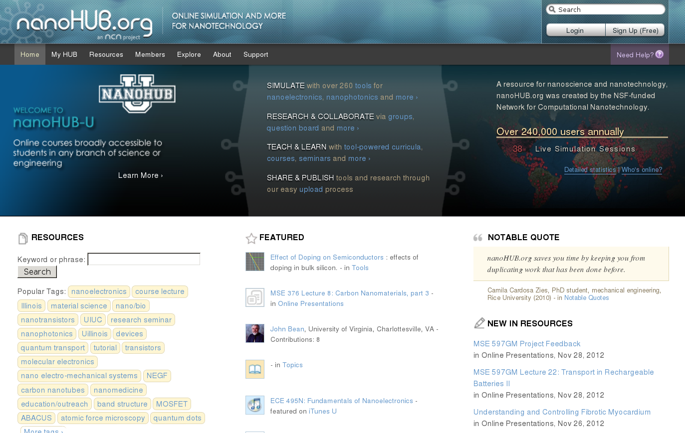
Linkcheck

Slide 2
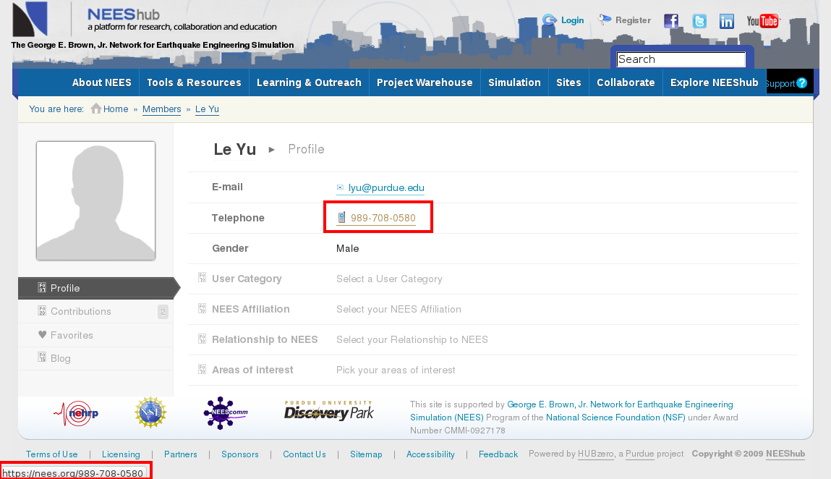
1. Phone Number Links

Slide 3
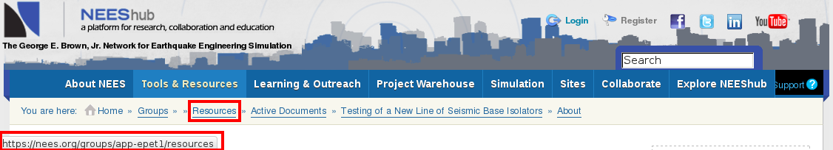
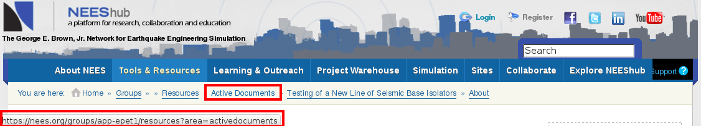
2. Bread Crumb Links
Example : https://nees.org/resources/770
link_text : Active Documents
target : https://nees.org/groups/app-epet1/resources?area=activedocuments

Slide 4

3. Hard Coded Links
Example : https://nees.org/simulation
link_text :
target : https://nees.org/resources/942/download/Deepsoilv3_7_setup.msi

Slide 5
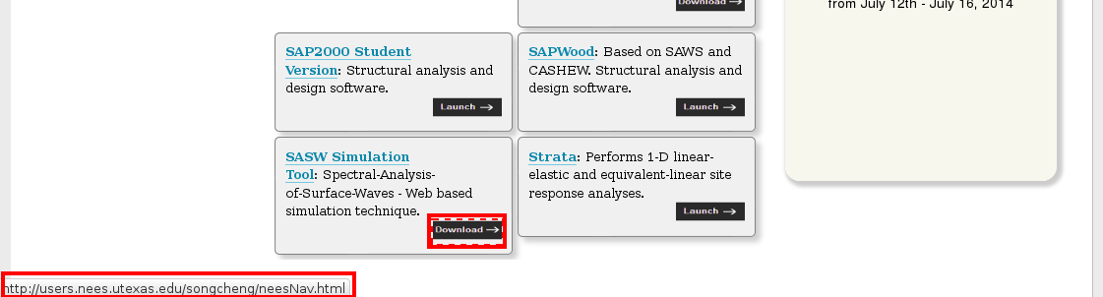
4. Referral Links
Example : https://nees.org/simulation
link_text :
target : https://nees.org/users.nees.utexas.edu/songcheng/

Slide 6
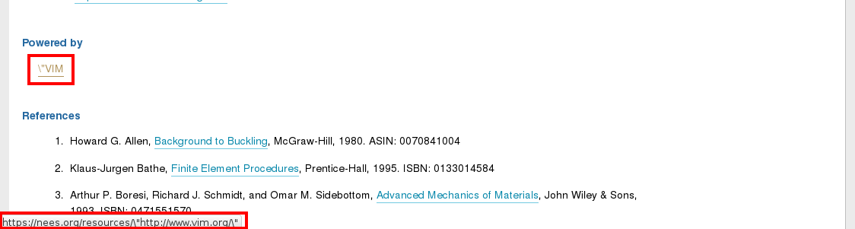
4. Referral Links
Example : https://nees.org/resources/frame3dd
link_text :
target : https://nees.org/resources/%5C%22http://www.vim.org/%5C%22

Slide 7
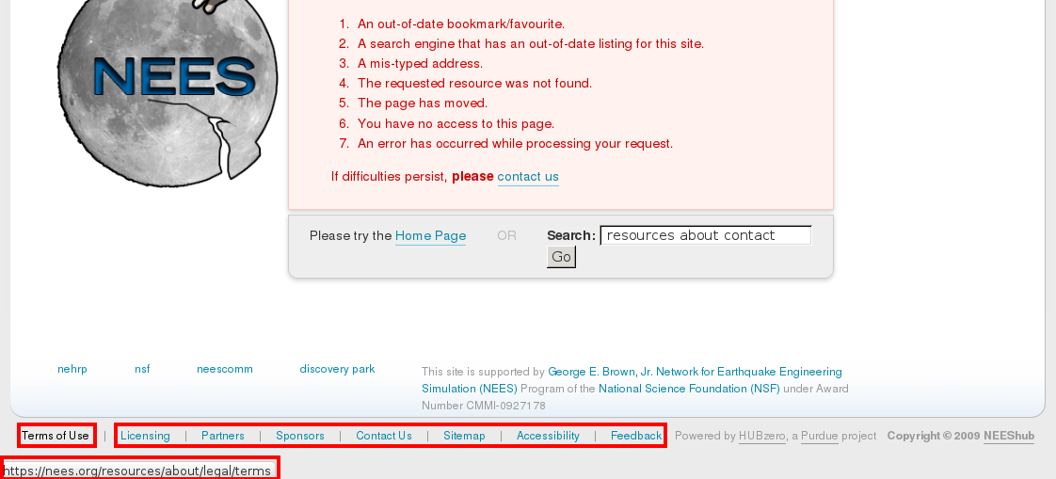
5. Errant Error Page Links
Example : https://nees.org/resources/about/contact
link_text : Terms of Use
target : https://nees.org/resources/legal/terms

Slide 8
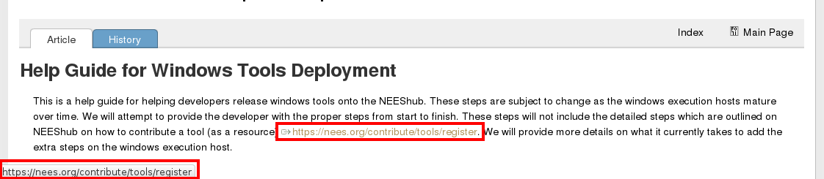
6. Bad Links from Website Reorganization
Example : https://nees.org/wiki/NEESWindowsToolDevelopmentHelpGuide
link_text : https://nees.org/contribute/tools/register
target : https://nees.org/contribute/tools/register

Slide 9
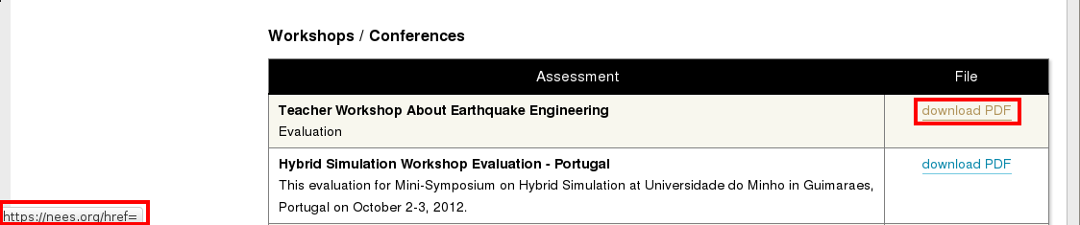
7. Other Bad Links
Example : https://nees.org/education/assessment-and-evaluation/surveys
link_text : download PDF
target : https://nees.org/href=

Slide 10
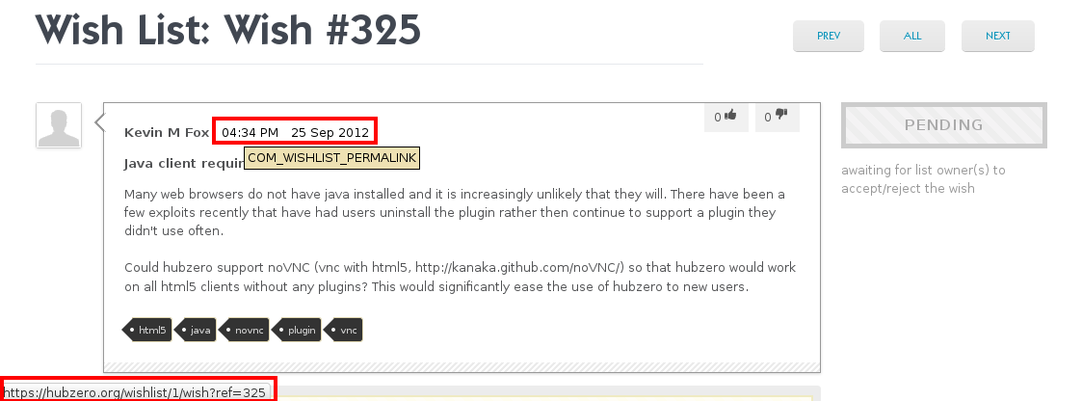
8. Permalinks
Example : https://hubzero.org/wishlist/general/1/wish/325
link_text : 04:34 PM 25 Sep 2012
target : https://hubzero.org/wishlist/1/wish?ref=325

Slide 11
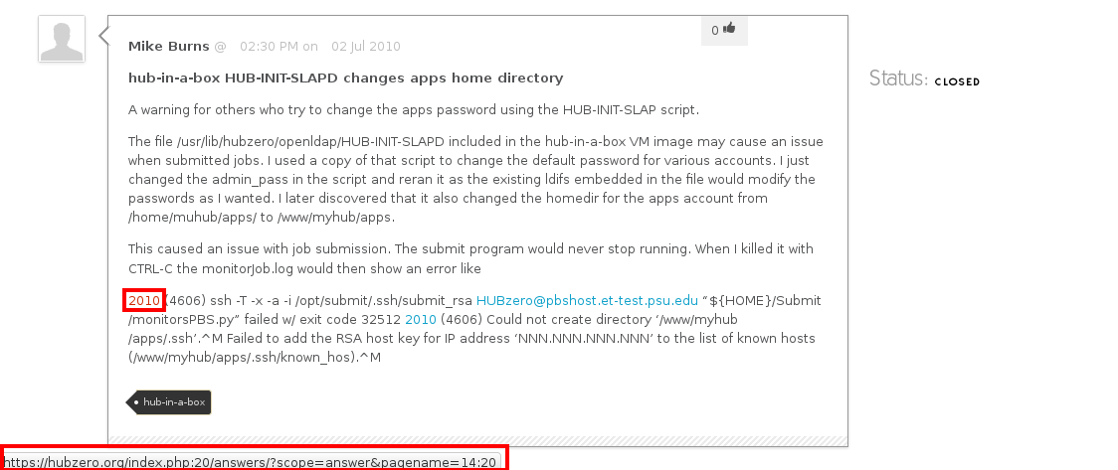
9. Forced Wiki Syntax
Example : https://hubzero.org/answers/question/17
link_text : 2010
target : https://hubzero.org/index.php:20/answers/?scope=answer&pagename=14%3A20

Slide 12
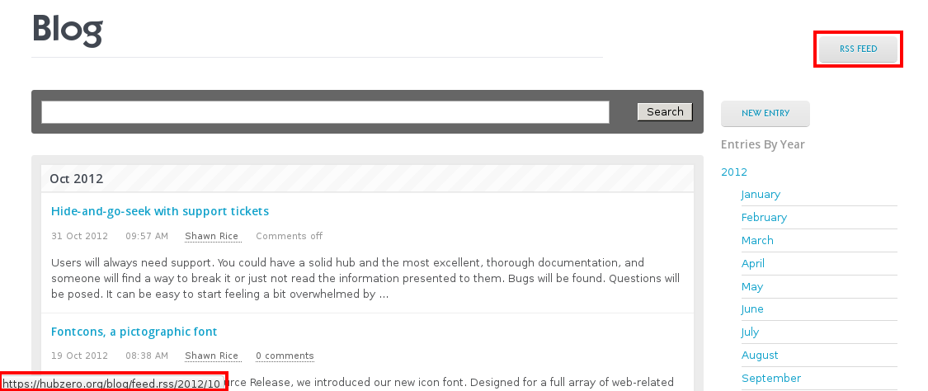
10. RSS Feed Links
Example : https://hubzero.org/blog/2012/10
link_text : RSS FEED
target : https://hubzero.org/blog/feed.rss/2012/10

Slide 13
Linkcheck results from other HUBs
HUB Name | # Pages Checked | # Urls Checked | # Error Urls | # Error Links
nees.org | 17697 | 19763 | 74 | 322
core.hubzero.org | 436 | 462 | 27 | 33
hubzero.org | 4133 | 4191 | 59 | 105
purduehub-u.purdue.edu | 444 | 459 | 16 | 32
geoshareproject.org | 955 | 969 | 15 | 20
cuahd.org | 926 | 937 | 12 | 44
pharmahub.org | 3662 | 3680 | 19 | 165
memshub.org | 1349 | 1352 | 4 | 4
nanohub.org* | 16558 | 38811 | 367 | 17640
trust-hub.org | 5060 | 5065 | 6 | 8526
* nanohub.org site was partially checked when results were collected. 21879 pages still to do.

