Slide 1
Design Patterns in Selenium
PurduePM Talks
August 19, 2014
Derrick Kearney

Slide 2
Page Object Design Pattern
Represent part of a web page as a class.
Two parts of the page object:
  Description of web elements
  Services provided
Goals:
  Separate specification and implementation.
  Take advantage of OOP features (encapsulation, inheritance, polymorphism).

Slide 3
Steps to create a Page Object
Identify the boundaries.
Locate the widgets.
Define the services.
Page Description
Page Services

Slide 4
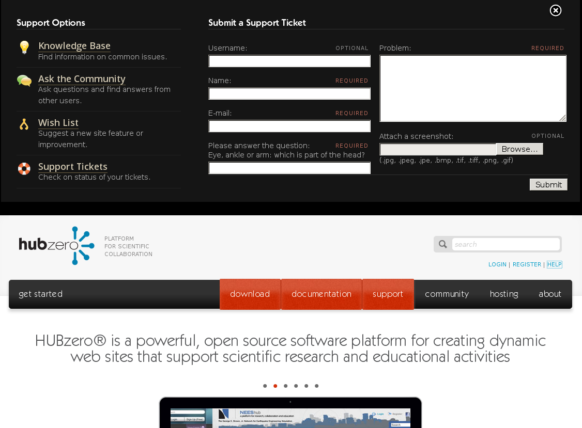

Slide 5
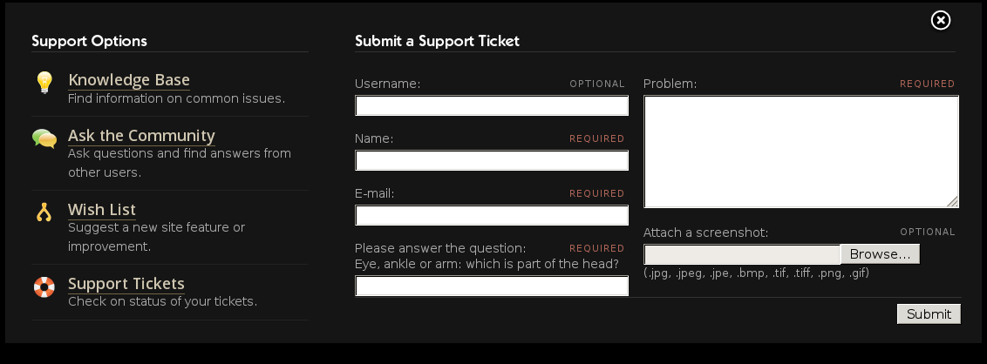
Widgets
Links

Slide 6
Widgets
Text Inputs

Slide 7
Widgets
Text Area

Slide 8
Widgets
File Upload

Slide 9
Widgets
Button

Slide 10
Services
Navigation:
  Knowledge Base
  Q&A
  Wishlist
  Support Tickets
Support Ticket:
  Populate Form
  Submit Form
Other:
  Close

Slide 11
Services
Navigation:
  Knowledge Base
  Q&A
  Wishlist
  Support Tickets
Support Ticket:
  Populate Form
  Submit Form
Other:
  Close

Slide 12
Services
Navigation:
  Knowledge Base
  Q&A
  Wishlist
  Support Tickets
Support Ticket:
  Populate Form
  Submit Form
Other:
  Close

Slide 13
class TroubleReportForm(BasePageWidget):
def __init__(self):
...
def goto_knowledge_base(self):
…
def goto_questions_answers(self):
…
def goto_wishlist(self):
…
def submit_ticket(self,data):
…
def open(self):
…
def close(self):
…
Page Description
Page Services

Slide 14
test problem
testuser
tu@hubzero.org
myscreenshot.png
class TroubleReportForm(BasePageWidget):
def __init__(self):
...
self.username = Text(self,'username')
self.captcha = Captcha(self,'captcha')
self.problem = TextArea(self,'problem')
self.upload = Upload(self,'upload')
self.submit = Button(self,'submit')
…
def submit_ticket(self,data):
…
def open(self):
…
def close(self):
…
# fill in the name, email, problem,
# upload a file, then submit the ticket
po = TroubleReportForm()
po.open()
po.name.value('testuser')
po.email.value('tu@hubzero.org')
po.problem.value('test problem')
po.upload.value('myscreenshot.png')
po.submit.click()

Slide 15
test problem
testuser
tu@hubzero.org
myscreenshot.png
class TroubleReportForm(BasePageWidget):
def __init__(self):
...
self.username = Text(self,'username')
self.captcha = Captcha(self,'captcha')
self.problem = TextArea(self,'problem')
self.upload = Upload(self,'upload')
self.submit = Button(self,'submit')
…
def submit_ticket(self,data):
…
def open(self):
…
def close(self):
…
# fill in the name, email, problem,
# upload a file, then submit the ticket
po = TroubleReportForm()
po.open()
data = {
'name' : 'testuser',
'email' : 'tu@hubzero.org',
'problem' : 'test problem',
'upload' : 'myscreenshot.png',
}
po.submit_ticket(data)

Slide 16
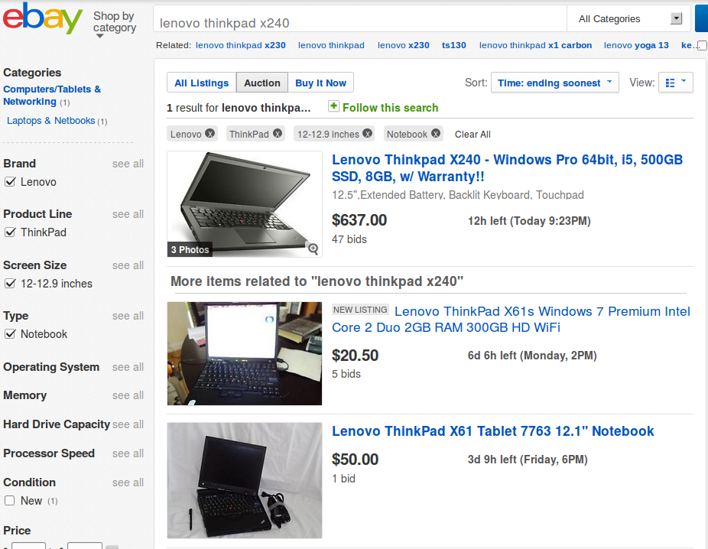
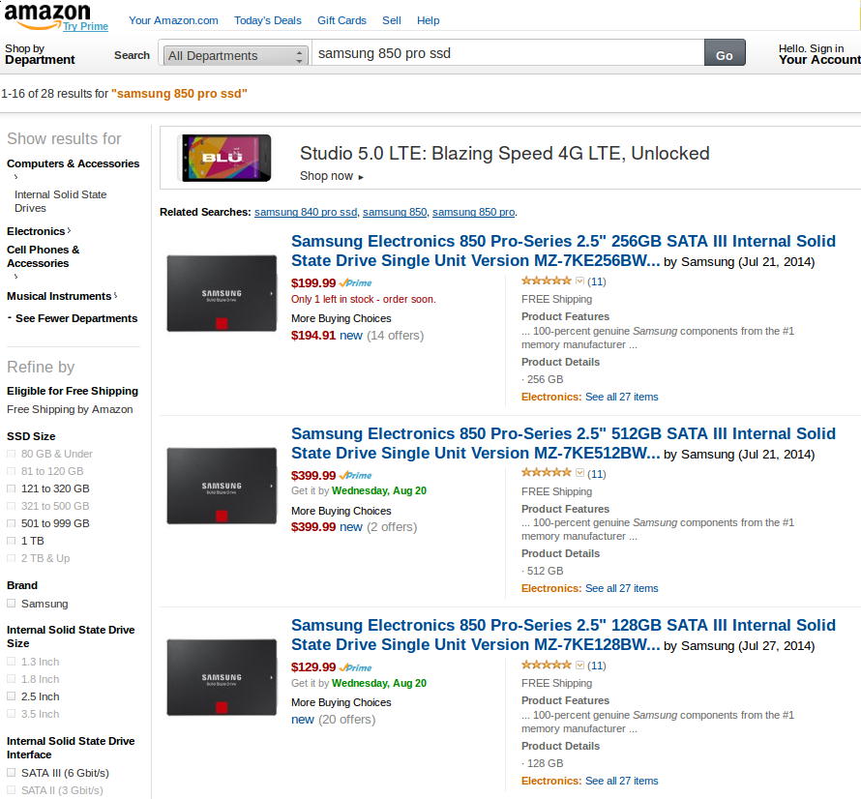
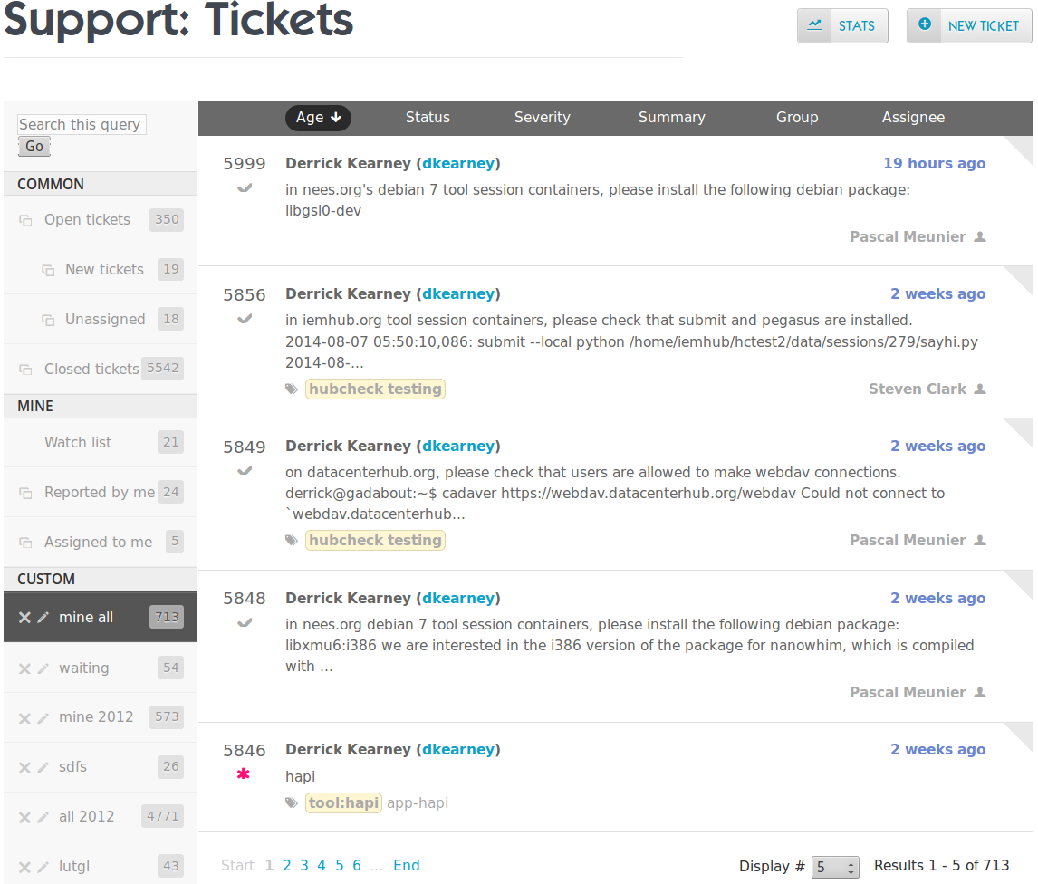
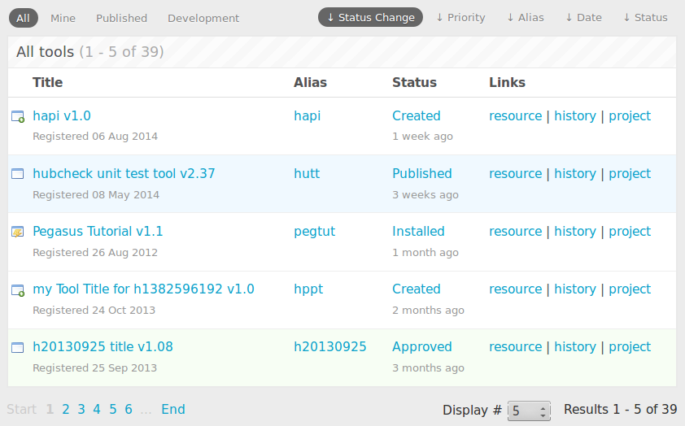
Interacting with lists of items
Notes:
We see lists everywhere
1. when we do a search on ebay, we are provided back a list of results
2. looking up items on amazon gives up back a list of matched items
3. Even on the hub, we find lists when reviewing support tickets
4. Or when interacting with Contribtool, the tool contribution process, we are presented with a list of items.
But how do you build page objects for lists. List pose a couple of problems.

Slide 17
How are lists used?
1. Interact with list meta-data
2. Present enumerable data
3. Query list item value
4. Interact with list item
Header counts
Column titles
Notes:
We can think about good ways to create page objects for lists by first investigating how we use lists.
Lists are a quick organized way to present a countable number of results back to the user.
Lists typically have some kind of meta-data to help the user interpret the data and give them hints about how many items are available to view.

Slide 18
How are lists used?
1. Interact with list meta-data
2. Present enumerable data
3. Query list item value
4. Interact with list item
Iterator
1
2
3
Notes:
Lists present similarly organized items back to the user. There is a countable number of items in the list. Sometimes we know ahead of time how many items will show up on the page, but often we don't.
Not knowing how many items to expect means we can't prebuild the page object. Even if we could, the number of objects we need to make could be unmanageable.
In order to find the item we are interested in, we probably have to evaluate each item until we find our target.

Slide 19
How are lists used?
1. Interact with list meta-data
2. Present enumerable data
3. Query list item values
4. Interact with list item
Readable item detail
Notes:
The items tend to be structured similarly with data that summarized the entry. In this sense, each item has a “value”.

Slide 20
How are lists used?
1. Interact with list meta-data
2. Present enumerable data
3. Query list item value
4. Interact with list item
Links to more detail
Notes:
Items may allow the user to interact with them. This is seen in situations where items summarize a result, and if the item is interesting, we can click links to access more detail about that result.
Ahead of time, we know the parts of the item we may want to interact with, but we don't know which item in the list we will be interested in.

Slide 21
Summary of problems.
How many items are there in the list?
  Can hard code locators...
Pre allocating doesn't scale
  Pre allocating object for large lists can waste system resources and make automation slow.

Slide 22
Proposed Interface
ItemList Pattern
  Two participants:
    Container class
    Item class
  Iterator Pattern to enumerate items
  Template Locators solve item count problem.
  Factory Method Pattern to create item objects on demand

Slide 23
ItemList Pattern Participants
Container Class:
Provides access to list meta-data
    num_items()
Can iterate through items
    next()
Search for list items
    get_item_by_position()
    get_item_by_property()
Item Class:
Represents single item in list
Can reference another item
    update_item_number()
Query value of item
    value()

Slide 24
ItemList Pattern Participants
Container Class:
Provides access to list meta-data
    num_items()
Can iterate through items
    next()
Search for list items
    get_item_by_position()
    get_item_by_property()
Item Class:
Represents single item in list
Can reference another item
    update_item_number()
Query value of item
    value()

Slide 25
Container Class Overview
class Container(object):
def __init__(self, locatordict, item_class, *args):
...
def num_items(self):
...
def __iter__(self):
...
def next(self):
...
def get_item_by_position(self,item_number):
...
def get_item_by_property(self,prop,val):
...

Slide 26
Container Class Overview
class Container(object):
def __init__(self, locatordict, item_class, *args):
...
def num_items(self):
...
def __iter__(self):
...
def next(self):
...
def get_item_by_position(self,item_number):
...
def get_item_by_property(self,prop,val):
...
Access list
meta-data

Slide 27
Container Class Overview
class Container(object):
def __init__(self, locatordict, item_class, *args):
...
def num_items(self):
...
def __iter__(self):
...
def next(self):
...
def get_item_by_position(self,item_number):
...
def get_item_by_property(self,prop,val):
...
Iterate over
items

Slide 28
Iterator Pattern

Slide 29
Container Class Overview
class Container(object):
def __init__(self, locatordict, item_class, *args):
...
def num_items(self):
...
def __iter__(self):
...
def next(self):
...
def get_item_by_position(self,item_number):
...
def get_item_by_property(self,prop,val):
...
Search for
list items
Notes:
The last thing we would like our container to be able to do is to retrieve an item from the list that matches some criteria

Slide 30
Searching for items: by position
def get_item_by_position(self,item_number):
…
return Item(...)
1
2
3
Notes:
Either retrieve the item by position, where we hand it a specific item number...

Slide 31
Searching for items: by property
def get_item_by_property(self,prop,val):
…
return Item(...)
Properties
Notes:
Or retrieve the item by matching a property. In this case we would tell the container object which property we would like to search against and give it a value match.
Our properties are associated with the “values” of our item object.
The thing to note about these two searching methods is that we are asking the container to create and return an object that represents an item in the list.
Our general container class doesn't know any thing about the items in the list. So far, we have only told it that there are these things called “Item”s but what the item object looks like depends on the list we are working with.

Slide 32
Container Defines Item Class
Notes:
The types of Item objects that should be returned are determined by the specific Container class.
So an Ebay search list container would return an ebay search list item.
An Amazon search list container would return an amazon search list item.
A HUB Support Ticket list container would return a HUB Support Ticket list item.
And a HUB Contribtool list container would return a HUB Contribtool list item.
The type of item returned is tied to the container returning it.

Slide 33
Factory Method Pattern
Define an interface for creating an object, but let subclasses define which class to instantiate.
  ADD UML IMAGE HERE
Notes:
This is a situation where we should be thinking about using the Factory Method Pattern.
The Factory Method Pattern is used when we want to define an interface for creating an object, but don't know which class to instantiate. Instead of always instantiating the same class, we delegate the responsibility to a subclass.

Slide 34
Search for list items
class Container(object):
def __init__(self, locatordict, item_class, *args):
...
Notes:
In our Container class, we can write out some of the boilerplate code for creating the class, and then leave it up to a subclass to decide which Item class to instantiate, and what arguments it needs.
Here, our Container class accepts an Item class and a list of arguments for the Item class.

Slide 35
Container Class as a Factory
class Container(object):
def __init__(self, locatordict, item_class, *args):
...
self.__item_class = item_class
self.__item_class_args = args
…
def get_item_by_position(self,item_number):
…
result = self.__item_class(
*self.__item_class_args,
item_number=item_number )
...
return result
Notes:
We store the Item class and its arguments inside of the container object, and use them in the get_item_by_position() and get_item_by_property() methods.

Slide 36
Container Class as a Factory
class Container(object):
def __init__(self, locatordict, item_class, *args):
...
self.__item_class = item_class
self.__item_class_args = args
…
def get_item_by_position(self,item_number):
...
result = self.__item_class(
*self.__item_class_args,
item_number=item_number )
...
return result
Factory Method Pattern
Notes:
The get_item_by_position() and get_item_by_property() methods are Factory Methods for Item objects.

Slide 37
ToolsList implements Container
class Container(object):
def __init__(self, locatordict, item_class, *args):
…
class ToolsList(Container):
def __init__(self, locatordict):
item_args = {…}
super(ToolsList,self).__init__(locatordict,ToolsItem,item_args)
class ToolsItem(Item):
def __init__(self, locator_templates):
...
Notes:
Next we can subclass Container and create a real container with a corresponding Item class. Our new container class is called ToolsList and it represents the List of tool items that we've been working with in earlier slides.
In the constructor for ToolsList, we call the constructor for the Container class, our base class, and pass it the ToolsItem class. ToolsItem is the Item class that represents a single item in the container.
Lets take a look at how the Item class works.

Slide 38
Item Class Overview
class Item (object):
def __init__ (self, locatordict, item_number):
…
def update_item_number (self, item_number):
…
def value (self):
…
Notes:
Real quickly, lets review the features we wanted from an object that represents an item in the list.
1. It should represent a single item in the list
2. We can update it to represent another item in the list
3. We can query it for the value of the item.
4. We can interact with it.
We can address the first two of these items in a base class for all Item objects. The last two are specific to the list and item being represented. They have to be addressed in subclasses of the Item class.

Slide 39
Items represent a single item
class Item (object):
def __init__ (self, locatordict, item_number):
self.locators = locatorsdict
self.__item_number = item_number
…
Notes:
We achieve the first feature by associating a numeric value with the item.

Slide 40
Items can be updated
class Item (object):
def __init__ (self, locatordict, item_number):
self.locators = locatorsdict
self.__item_number = item_number
…
def update_item_number (self, item_number):
…
locators = {
'title' : "css=tr:nth-of-type(1) .title",
'details' : "css=tr:nth-of-type(1) .details",
'alias' : "css=tr:nth-of-type(1) .alias",
'status' : "css=tr:nth-of-type(1) .status",
'time' : "css=tr:nth-of-type(1) .time",
'resource' : "css=tr:nth-of-type(1) .page",
'history' : "css=tr:nth-of-type(1) .history",
'wiki' : "css=tr:nth-of-type(1) .wiki",
}
Notes:
The second feature requires us to be able to update the item represented by the object.
This causes us a little trouble because in the past, we have hard coded our element locators, only updating them if the underlying web page changed.

Slide 41
Interacting with ItemLists
tr:nth-of-type(1) .title
tr:nth-of-type(1) .alias
tr:nth-of-type(1) .status
tr:nth-of-type(1) .page
tr:nth-of-type(1) .history
tr:nth-of-type(1) .wiki
Notes:
For example, if we wanted to create an object referencing the first row in a list of items, we would use a positional locator, with the '1' hard coded in the the locator.

Slide 42
Interacting with ItemLists
tr:nth-of-type(2) .title
tr:nth-of-type(2) .alias
tr:nth-of-type(2) .status
tr:nth-of-type(2) .page
tr:nth-of-type(2) .history
tr:nth-of-type(2) .wiki
Notes:
And if we wanted to reference the second row in a list of items, we would again use a positional locator, with the number '2' hard coded in the locator.
But this approach doesn't fit with our original goals. We didn't want to be forced into manually creating classes to represent all possible items that could show up in a list. It is wasteful of system resources and makes our automation scripts slow.

Slide 43
Interacting with ItemLists
tr:nth-of-type(n) .title
tr:nth-of-type(n) .alias
tr:nth-of-type(n) .status
tr:nth-of-type(n) .page
tr:nth-of-type(n) .history
tr:nth-of-type(n) .wiki
Notes:
What we need is a way to dynamically update the locators in our object. We could substitute the 'n' in our locators with a number that references which row we are interested in representing.
Well, we can do just that. This is the idea behind Template Locators.

Slide 44
Template Locators
>>> locator = "css=tr:nth-of-type({item_num}) .title"
>>>
>>> locator.format(item_num=3)
css=tr:nth-of-type(3) .title
Notes:
The Template Locator is an idea I first heard about from Adam Goucher of Element34 (@adamgoucher).
The idea is that you give your page object strings with templates in them. These are of course illegitimate locators. As part of the object instantiation process, the templates are substituted with legitimate values, making the locators valid.
In this example, we show how the substitution can be done in Python. Most programming languages allow for substituting values into strings.

Slide 45
Items can be updated
class Item (object):
def __init__ (self, locatordict, item_number):
self.locators = locatordict
self.__item_number = item_number
…
def update_item_number (self, item_number):
…
locators = {
'title' : "css=tr:nth-of-type(1) .title",
'details' : "css=tr:nth-of-type(1) .details",
'alias' : "css=tr:nth-of-type(1) .alias",
'status' : "css=tr:nth-of-type(1) .status",
'time' : "css=tr:nth-of-type(1) .time",
'resource' : "css=tr:nth-of-type(1) .page",
'history' : "css=tr:nth-of-type(1) .history",
'wiki' : "css=tr:nth-of-type(1) .wiki",
}
Notes:
Going back to our Item class, instead of accepting a locator dictionary from the caller...

Slide 46
Items can be updated
class Item (object):
def __init__ (self, locator_templates, item_number):
self.locators = {}
self.locator_templates = locator_templates
self.__item_number = item_number
self.update_item_number(item_number)
…
def update_item_number (self, item_number):
self.__item_number = item_number
for k,v in self.locators_templates.items():
self.locators[k] = v.format(item_num=self.__item_number)
…
locators = {
'title' : "css=tr:nth-of-type({item_num}) .title",
'details' : "css=tr:nth-of-type({item_num}) .details",
'alias' : "css=tr:nth-of-type({item_num}) .alias",
...
}
Notes:
We should accept a dictionary of locator templates. In our object initialization, or any time we want to update the item that our object represents, we can call the update_item_number() method and it will use the template locators to generate updated, valid locators.

Slide 47
Items have a value
class ToolsItem (Item):
def __init__ (self, locator_templates, item_number):
...
self.title = Link(...)
self.details = Text(...)
self.alias = Link(...)
...
def value(self):
properties = {
'title' : self.title.text(),
'details' : self.details.value,
'alias' : self.alias.text(),
...
}
return properties
...
value() method returns
a dictionary of properties
from the item.
Notes:
The last two features must be implemented in the subclasses of the Item class because they are specific to the types of items they represent.
Each item should be able to return a dictionary of properties that make up it's “value”. In the Item class and its subclasses this is done in the value() method.
The value method returns a dictionary of properties. These properties are usually the readable elements of the list item represented by the object.
The value() method is used by the Container class's get_item_by_property() method to retrieve an item from the list that has a matching property.

Slide 48
Items can be interacted with
class ToolsItem (object):
def __init__ (self, locator_templates, item_number):
...
self.title = Link(...)
self.details = Text(...)
self.alias = Link(...)
...
def goto_title(self):
self.title.click()
def get_details(self):
return self.details.value
def goto_alias(self):
self.alias.click()
...
Web page services are
implemented as methods
of the page object.
Notes:
The last feature of the item class is that it can be interacted with. This should be no surprise, as one of the main goals of a page object is to provide an interface to the services available on the page.
This too is specific to the item being represented so it must be done in the subclass, not the base class.

Slide 50
todo
Summary of the ItemList design pattern
Example usage of the subclasses
Color code examples
UML diagram for Factory Method Pattern
Description of Iterator Pattern

