Slide 1
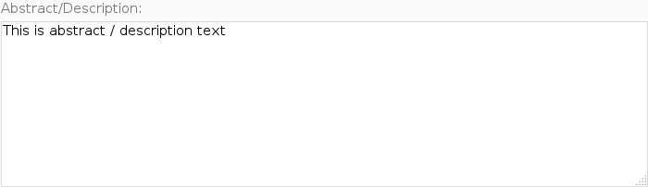
Interacting with Iframes
<label for="field-fulltxt">
Abstract/Description:
<textarea id="field-fulltxt">This is abstract / description text</textarea>
</label>
Notes:
Iframes are another area where we run into problems building page objects. When users upload resources to a HUBzero website, they are asked to describe the resource they are contributing.
The resource contribution form's description field used to be an HTML <textarea>. The field handled both plain text descriptions, but also allowed users to use a wiki-like markup language to include rich text descriptions. Building a page object with a textarea is pretty rudimentary.

Slide 2
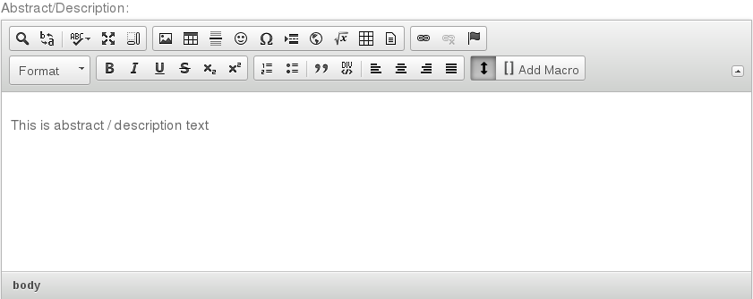
Interacting with Iframes
<iframe class="cke_wysiwg_frame">
<html>
<body class="ckeditor-body">
<p>This is abstract / description text </p>
</body>
</html>
</iframe>
Notes:
A few months ago, our web developers started incorporating a new editor for the description field. It looks like this and incorporates better functionality for handling rich text. So instead of writing out the wiki syntax to make words bold, for example, they would just press the “B” bold button in the editor and type the text they wanted to be bold. This is a great step forward for usability. And it meant we had to update our page objects. When I took a look at the new web page, I noticed the previously simple <textarea> field was replaced with an iframe and embedded web page.
Playing around with the iframe widget, I figured out that once I entered the Iframe, writing text to the <body> tag was just like writing text to the <textarea> tag.

Slide 3
Question:
Do I need to write a new page object for a widget embedded in an <iframe>, if I already have a class that works except for entering and exiting the <iframe>?
Notes:
So started asking myself, this question:
Do I need to write a whole new page object to deal with this widget that acts like a textarea page object that I already have, except that I have to enter a exit an iframe before and after I use it?

Slide 4
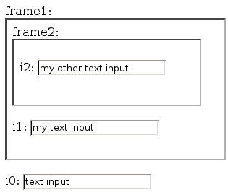
How do Iframes work
Notes:
Lets back up a little bit and start by explaining how iframes work.
Here is an example web page with some input fields embedded in different levels of iframes.

Slide 5
How do Iframes work
Default Context
i0 input in Default Context
<html>
<body>
<label for="frame1">frame1: </label>
<iframe id="frame1" src="inner_page.html"></iframe>
<br/><br/>
<label for="i0">i0: </label>
<input type="text" id="i0" value="text input"></input>
</body>
</html>
Notes:
The first input field, i0, is located in the default context. This is the level of the web page we generally work in when iframes are not involved.
Along with the input field i0, this web page also has an iframe, frame1.
In the HTML iframes just hold the location of another web page which will be embedded in the frame. In our example, frame1 is going to load up the web page inner_page.html.

Slide 6
How do Iframes work
Frame1 Context
i1 input in Frame1 Context
<html>
<body>
<label for="frame2">frame2: </label>
<iframe id="frame2" src="another_page.html"></iframe>
<br/><br/>
<label for="i1">i1: </label>
<input type="text" id="i1" value="my text input"></input>
</body>
</html>
Notes:
This is the HTML for inner_page.html. It makes up what we refer to as the Frame1 Context. The Frame1 context has an input field i1, and another iframe, frame2.
Again, the iframe frame2 holds the location of a web page, and in our case it points to another_page.html

Slide 7
How do Iframes work
i2 input in Frame2 Context
Frame2 Context
<html>
<body>
<label for="i2">i2: </label>
<input type="text" id="i2" value="my other text input"></input>
</body>
</html>
Notes:
And this is the HTML for the file another_page.html, that makes up the Frame2 Context. It contains an input field i2 that resides within the Frame2 context.

Slide 8
Page Object for i0
class Text(BasePageWidget):
def __init__(self, locator):
…
# getter
def value(self):
e = self.find_element(self.locator)
return e.get_attribute('value')
# setter
def value(self, text):
e = self.find_element(self.locator)
e.clear()
e.send_keys(text)
def append(self, text):
e = self.find_element(self.locator)
e.send_keys(text)
Default Context
Notes:
If we wanted to build a page object for the i0 input field, that resides in the Default Context, it would look something like this. There would probably be a getter method to retrieve the value of the input, a setter method to set the value of the input, and maybe an append method that just appended text to whatever was already in the field.
Since the i0 field resides in the default context, there is no need to do anything special, our methods will find the i0 input element in the HTML DOM, and perform actions on it.

Slide 9
Page Object for i1
class Text1Frame(BasePageWidget):
def __init__(self, locator):
…
# getter
def value(self):
…
# setter
def value(self, text):
frame = self.find_element('#frame1')
self._browser.switch_to_frame(frame)
e = self.find_element(self.locator)
e.clear()
e.send_keys(text)
self._browser.switch_to_default_content()
def append(self, text):
…
Frame1 Context
Notes:
If we wanted to build a page object for the i1 input field, we would have to do a little more work.
The page object is almost the same as the one for the i0 input field, but because i1 is located inside of the Frame1 context, we have to instruct the web browser to traverse the frame1 iframe to get to it.
So inside each of our methods we add a few lines of code to traverse the iframe, then we search for the element in the HTML DOM, perform our actions on the element, and lastly, we have to return back to the default context.

Slide 10
Page Object for i2
class Text2Frame(BasePageWidget):
def __init__(self, locator):
…
# getter
def value(self):
…
# setter
def value(self, text):
frame1 = self.find_element('#frame1')
self._browser.switch_to_frame(frame1)
frame2 = self.find_element('#frame2')
self._browser.switch_to_frame(frame2)
e = self.find_element(self.locator)
e.clear()
e.send_keys(text)
self._browser.switch_to_default_content()
def append(self, text):
…
Frame2 Context
Notes:
If we wanted to build a page object for the i2 input field, located inside of Frame2 context, which is located inside of the Frame1 context, we could start by using the Text or Text2Frame page objects, but we have to update our methods to traverse two iframe contexts.
We have to first go from the the Default context to the Frame1 context, then we have to go from the Frame1 context to the Frame2 context. Next, we can search for the i2 input field in the HTML DOM, perform our actions on the field, and finally, switch back to the default context.

Slide 11
Dealing with Iframes
Enter / Exit frames to interact with elements
Must update all methods of page object.
Create new page objects for Iframes?!?
Default Context
Frame1 Context
Frame2 Context
Notes:
So just to sum it up, when building page objects for the i0, i1 and i2 input fields, we have to be cognoscente of the frame level we are in.
All of the page objects started off with the same code, but for input i1, we had to update all methods to enter and exit the Frame1 context. And for input i2, we had to update all methods to enter and exit the Frame1 and Frame2 contexts.
Is there a way we can handle the entering and exiting of iframes outside of the page object so we could reuse our original page object that represents a Text field on a web page?

Slide 12
Page object's value: No Iframes
value()
Perform core actions
Notes:
Some way where we can write the methods of our page object once,

Slide 13
Page object's value: One Iframe
Enter Frame1
value()
Perform core actions
Exit Frame1
Notes:
And if we want to use that page object inside of an iframe, we can wrap the methods of the page object with code to enter and exit the iframe

Slide 14
Page object's value: Two Iframes
Enter Frame1
Enter Frame2
value()
Perform core actions
Exit Frame2
Exit Frame1
Notes:
And if we wanted to use the page object in two or more iframes, we could just keep wrapping the methods?

Slide 15
IframeWrap Design Pattern
Use Decorator Pattern to wrap attributes of a page object with Enter / Exit iframe calls.
value()
value()
value()
0 Iframes
1 Iframe
2 Iframes
Notes:
This is the idea behind the IframeWrap Design Pattern. It uses the Decorator Pattern to “decorate” or wrap the attributes of a page object with code to:
1. Enter an iframe context.
2. Call the original page object method.
3. Exit the iframe context.
It also supports the case where the original page object method could have been a previously wrapped method.

Slide 16

Decorator Pattern
Attach additional responsibilities to an object dynamically and transparently.
class A (object):
def f (self):
do_some_stuff()
a = A()
a
a
f
function
f
wrapper
function
Before Decoration
After Decoration
Notes:
Let's take a second to review how the decorator pattern works. The purpose of the decorator pattern is to extend functionality of an object without necessarily changing the interface. It is most notably seen used when you want to change a specific object at runtime, without changing all objects of a class. It does this by wrapping the original functionality of the object's attribute with code to do extra stuff.
For example, if we had an object 'a', which was an instance of class 'A', with a method 'f', we could add functionality to 'f' by first pointing a.f to our wrapper method, and then in our wrapper method, we would add the extra code to extend a.f, and call a.f

Slide 17
Applying the Decorator Pattern
class Text(BasePageWidget):
# setter
def value(self, text):
e = self.find_element(self.locator)
e.clear()
e.send_keys(text)
i1 = Text('#i1')
i1.value('new i1 text')
Frame1 Context
i1
i1
value
function
value
wrapper
function
Before Decoration
After Decoration
Notes:
We can apply this same idea to our Text page object. The page object has a method named value() that performs the core actions of adjusting the underlying HTML element.
In Python, the object's value attribute points to a function object, so we can represent it like this.
We would like to decorate this function object to add our enter and exit iframe commands.
After decorating the funtion object, the value attribute will point to our wrapper function, and our wrapper function will call our original function object.

Slide 18
Create decorated page objects
class FramedInputs(BasePageObject):
def __init__(self):
self.i0 = Text('#i0')
self.i1 = IframeWrap( Text('#i1'), ['#frame1'] )
self.i2 = IframeWrap( Text('#i2'), ['#frame2', '#frame1'] )
HTML element's
page object
List of frames
to traverse
Notes:
We can implement the IframeWrap pattern by first creating a page object we would like to wrap and passing it to a function like IframeWrap along with the locators for frames that need to be traversed to interact with the page object's HTML elements.
In this example, we create a Text page objects for all three of our inputs. For the inputs i1 and i2, we call the IframeWrap function along and give it the page object and a list of frames.

Slide 19
Find callable attributes
class IframeTracker(object):
...
def wrap_callable_attributes(self,o):
for attr, item in o.__class__.__dict__.items():
if callable(item):
item = getattr(o,attr)
setattr(o,attr,self.wrap_attribute(item))
i1
i1
value
function
value
wrapper
function
Before Decoration
After Decoration
Notes:
Internally, my implementation of the IframeWrap method creates an object I call IframeTracker. It is used to keep track of and assist with navigation between iframes.
The most interesting part of the IframeTracker object is when the page object gets decorated, so we'll skip to the fun stuff.
First the IframeWrap method calls the wrap_callable_attributes method, which identifies callable attributes from the class object.
Next we call the wrap_attributes method on the callable attributes.

Slide 20
Wrap attributes with iframe calls
class IframeTracker(object):
...
def wrap_callable_attributes(self,o):
for attr, item in o.__class__.__dict__.items():
if callable(item):
item = getattr(o,attr)
setattr(o,attr,self.wrap_attribute(item))
def wrap_attribute(self,item):
def wrapper(*args, **kwargs):
...
switched = self._switch_to_iframe_context(final_framelevel)
result = item(*args, **kwargs)
self._switch_to_iframe_context(initial_framelevel)
return result
return wrapper
frame = self.find_element('#frame1')
self._browser.switch_to_frame(frame)
e = self.find_element(self.locator)
e.clear()
e.send_keys(text)
self._browser.switch_to_default_content()
Notes:
The wrap_attribute() method wraps the callable attributes with calls to enter an iframe context, and exit an iframe context. The method returns a reference to the new wrapper function.
For the i1 input, you can already see the similarity between what we used to have to do manually, and what the IframeWrap pattern provides.

Slide 21
Store the wrapped attribute
class IframeTracker(object):
...
def wrap_callable_attributes(self,o):
for attr, item in o.__class__.__dict__.items():
if callable(item):
item = getattr(o,attr)
setattr(o,attr,self.wrap_attribute(item))
i1
i1
value
function
value
wrapper
function
Before Decoration
After Decoration
Notes:
Lastly, we set the name of our old callable attribute to reference the new wrapper function in the object we are trying to wrap.
With that, the attribute wrapping process is complete and we are ready to use our new IframeWrap'd page object.

Slide 22
Using an IframeWrap'd page object
class FramedInputs(BasePageObject):
def __init__(self):
self.i0 = Text('#i0')
self.i1 = IframeWrap( Text('#i1'), ['#frame1'] )
self.i2 = IframeWrap( Text('#i2'), ['#frame2', '#frame1'] )
po = FramedInputs()
# print out the current text in the widgets
print "i0.value = %s" % (po.i0.value)
print "i1.value = %s" % (po.i1.value)
print "i2.value = %s" % (po.i2.value)
# update the text in the widgets
po.i0.value = 'i0 text'
po.i1.value = 'new i1 text'
po.i2.value = 'new i2 text too'
Notes:
When we use the new IframeWrap'd page object, we don't see any difference in the interface. Page objects that traverse iframes work the same as elements that don't. The difference is mainly see in how we declare our page objects that need to traverse iframes.

Slide 23
IframeWrap Pattern Summary
Use IframeWrap Pattern when you have page objects for HTML elements that work the same inside or outside of an iframe
Uses Decorator Pattern to wrap page object attributes with calls to enter and exit iframe
value()
value()
value()

Slide 24
IframeWrap Pattern Gotchas
Not all page object attributes need to be wrapped.
  Keep a list of specific methods not to wrap.
Wrapping Python properties can be tricky
  Create a new class object from old class.
  Decorate the property functions of new class.
  Associate new class with page object.

