Slide 1
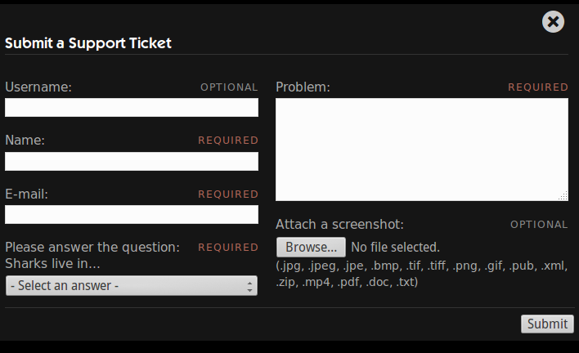
Working with Web Forms
Notes:
Part of the way HUBzero based websites grow is by encouraging users to upload new material from their research onto the website.
To automate the process of uploading and posting new resources, many of the website components use web forms to gather information from the user and generate web pages for the resouces.
Web forms are probably the most common way, that I know of, to ask the user a question and retrieve the response. On websites across the internet, you see them being used, most notably, for website registration, login, or on contact us pages.
I never realized just how prevelent web forms were until I started writing automation scripts for them. On my journey of building automation scripts that interacted with web forms, I accumulated a few best practices that have helped make building page objects for web forms a breeze for me. These best practices make up the WebForm Pattern.

Slide 2
WebForm Pattern
Standardize the interface for filling out a web form.
Usual Interface
Proposed Interface
po = TroubleReportForm()
po.set_name('testuser')
po.set_email('tu@hubzero.org')
po.set_problem('test problem')
po.set_upload('myscreen.png')
po.submit.click()
po = TroubleReportForm()
data = {
'name' : 'testuser',
'email' : 'tu@hubzero.org',
'problem' : 'test problem',
'upload' : 'myscreenshot.png',
}
po.populate_form(data)
po.submit_form()
Notes:
Purpose of the web form pattern is to help standardize the interface for filling out web forms.
The usual interface makes the script writer work hard to remember all of the accessor methods for the various inputs on the form.
The proposed interface encourages the user to simply list out what values they want in which widgets and send that information to a standard page service, the populate_form() method. Later the user can submit the form using the submit_form() method. These two services are are standard for all forms. We'll see how we can we can build an abstract base class that form based page objects can be derived from.

Slide 3

1. Give page objects a 'value'
test problem
testuser
tu@hubzero.org
myscreenshot.png
...
e = browser.find_element_by_id('trName')
e.clear()
e.send_keys(“testuser”)
...
…
name = Text('#trName')
name.value = 'testuser'
...
Notes:
The WebForm Pattern relies on page objects knowing how to retrieve and set the value of the HTML element it represents.
The Page Object design pattern teaches us to avoid directly interacting with HTML elements from within our automation scripts. We should push that type of interaction down a level into our page objects. A lot of people end up putting it in their member functions that are providing an interface to the web page's services. I've found it more helpful to push it down even further into a set of page objects that represent a few of the popular HTML elements like text inputs, buttons, checkboxes, radio buttons, and textareas.

Slide 4
Setting the value of a Checkbox
Usual Interface
Proposed Interface
# get the value
e = browser.find_element_by_id('ckbox')
e.is_selected()
# set the value
e = browser.find_element_by_id('ckbox')
If e.is_selected() is not val:
e.click()
# get the value
e = Checkbox('#ckbox')
x = e.value
# set the value
e = Checkbox('#ckbox')
e.value = True
Notes:
Value methods gives page objects a standard interface for accessors.
We just want to get or set the value in scripts, usually not concerned with the details of the type of widget it is, and certainly don't want to have to repeat or update the code in scripts.
In a way, our value methods are creating a facade for interacting with Selenium Webdriver.

Slide 5
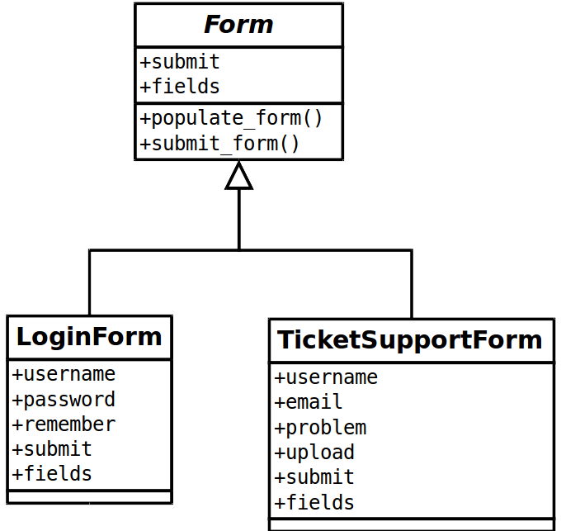
2. Use an abstract Form base class
Notes:
The second thing needed to implement the Web Form Pattern is to create a base class, named Form here, that all other web form page objects can be derived from.
The only notable thing about the Form base class is that it implements two method that sum up what you would be interested in doing on a web form:
Populating the form and submitting the form.

Slide 6

2. Use an abstract Form base class
class LoginForm(object):
def __init__(self):
…
def set_username(self,username):
…
def set_password(self,username):
…
def login_as(self,username,passwd):
…
Notes:
Some form interfaces create getter and setter methods for each individual fields on the form, but if we followed the suggestion from #1, we wouldn't need these.

Slide 7
2. Use an abstract Form base class
class TroubleReportForm(object):
def __init__(self):
…
def set_username(self,username):
…
def set_name(self,name):
…
def set_email(self,address):
…
def submit_ticket(self,username,name,...):
…
Notes:
Sometimes we also see methods that take one argument for each field in the form. These are ok, but on big forms, they can leave your code a little difficult to read, Trying to match positional arguments.

Slide 8
Proposed Interface: Form class
class Form(object):
…
def populate_form(self, data):
for (k,v) in data:
# find the widget in the object's
# dictionary and set its value
widget = getattr(self,k)
widget.value = v
def submit_form(self,data={}):
self.populate_form(data)
result = self.submit.click()
return result
Notes:
A different approach is to give all forms a common interface
with the populate_form() and submit_form() methods. These methods accept a dictionary of inputs that should be used to populate the form.
The populate_form() method iterates through the dictionary and matches keys with data members of the Form object. The values of the dictionary are then assigned to the data member's value accessor, setting the value of the underlying HTML element in the form.

Slide 9
LoginForm subclasses Form
class LoginForm(Form):
def __init__ (self):
self.username = Text('#userame')
self.password = Text('#password')
self.remember = Checkbox('#rmbr')
self.submit = Button('#submit')
Notes:
Now, when we come across a new page with a form on it, all we need to do is subclass the Form base class, and describe the fields in the form.
Here we do it for a HUBzero login page. The page contains username and password fields, a remember me checkbox and a form submission button.

Slide 10
TicketSupportForm subclasses Form
class TicketSupportForm(Form):
def __init__ (self):
self.name = Text('#trName')
self.email = Text('#trEmail')
self.problem = Text('#trProblem')
self.upload = Text('#trUpload')
self.submit = Button('#submit')
Notes:
Similarly, a page object for the HUBzero support ticket form would include data members for all of the fields on the form.
After describing the form in the constructor or initialization method, the page services are inherited from the Form base class, populate_form() and submit_form().

Slide 11
3. Organize form data into dictionaries
test problem
testuser
tu@hubzero.org
myscreenshot.png
po = TroubleReportForm()
po.submit_ticket(
'testuser',
'tu@hubzero.org',
'test problem',
'myscreenshot.png'
)
po = TroubleReportForm()
data = {
'name' : 'testuser',
'email' : 'tu@hubzero.org',
'problem' : 'test problem',
'upload' : 'myscreenshot.png',
}
po.populate_form(data)
po.submit_form()
Notes:
And in the automation script, the user would instantiate the page object as before, but instead of passing the arguments into a “submit_ticket” method, they would throw their arguments into a dictionary and pass the dictionary of arguments to the populate_form() method.

Slide 12
3. Organize form data into dictionaries
test problem
testuser
myscreenshot.png
po = TroubleReportForm()
po.submit_ticket(
'testuser',
'tu@hubzero.org',
'test problem',
'myscreenshot.png'
)
po = TroubleReportForm()
data = {
'name' : 'testuser',
'problem' : 'test problem',
'upload' : 'myscreenshot.png',
}
po.populate_form(data)
po.submit_form()
Notes:
This method makes it super easy to not populate one or more of the inputs as well, by just leaving them out of the dictionary.

Slide 13
3. Organize form data into dictionaries
test problem
testuser
po = TroubleReportForm()
po.submit_ticket(
'testuser',
'tu@hubzero.org',
'test problem',
'myscreenshot.png'
)
po = TroubleReportForm()
data = {
'name' : 'testuser',
'problem' : 'test problem',
}
po.populate_form(data)
po.submit_form()

Slide 14
Extending the Web Form Pattern
Many types of Forms can extend the base class
  Simple Forms : fill-in order is ambiguous
  Ordered Forms : fill-in order matters
  Multi-Button Forms: forms with cancel, back, previous button
  Preview Forms : forms with a preview button
Notes:
Wait, you're probably saying to yourself, “Hey Derrick, you solved the simple case, but not all web forms have just a submit button, or fill-in order doesn't matter”
This is true, but the Form base class can be extended to cover these cases as well. Some forms include a cancel or back button. Additional buttons and methods can be added to derived classes.
Some forms need to be filled out in a specific order. These forms can'[t use a dictionary. I'd had using a populate_form() method that parsed lists of tuples instead of dictionaries. You might also be able to get away with an ordered dictionary that provides list like access to its items.
Forms with preview buttons may take a little more work because the page loaded by the preview probably has an additional page object that needs to be created, that may reside in an iframe.

