Slide 1


Slide 2
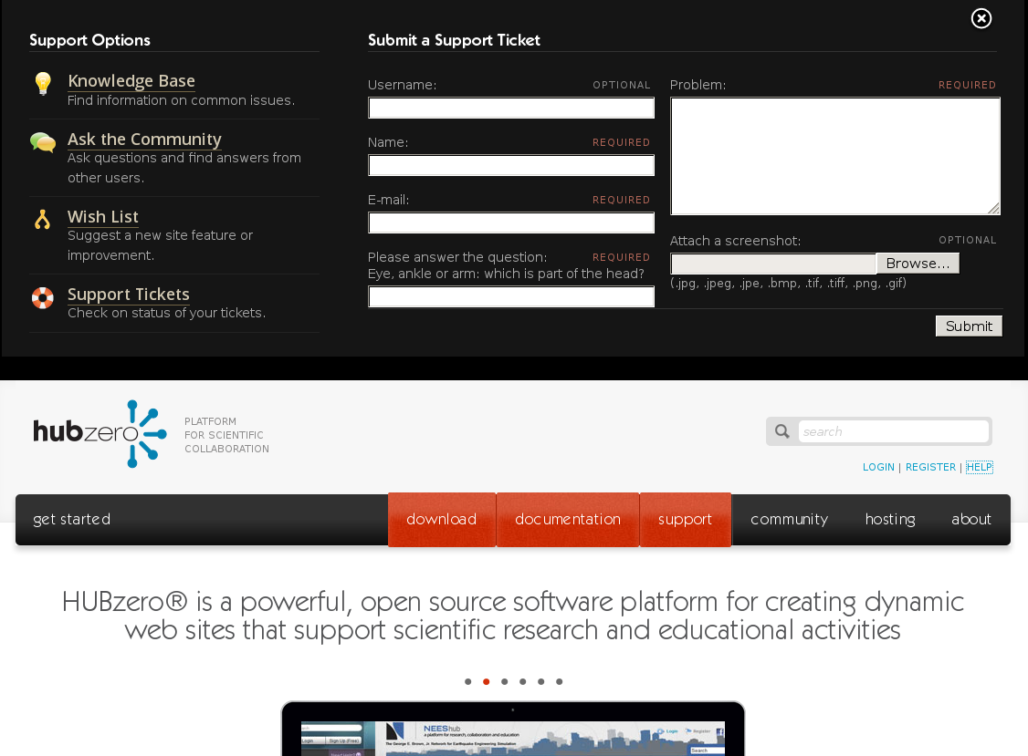

Slide 3

testuser
Writing to a Text Input:
1. Find the element
2. Clear the element
3. Send keys to the element
<label for=”trName”>
Name:
<span class=”required”>required</span>
<input id=”trName” type=”text” value=””
name=”reporter[name]”>
</label>
...
e = browser.find_element(by=BY.CSS, value=”input[id='trName']”)
e.clear()
e.send_keys(“testuser”)
...

Slide 4
testuser
tu@hubzero.org
Writing to a Text Input:
1. Find the element
2. Clear the element
3. Send keys to the element
<label for=”trEmail”>
E-mail:
<span class=”required”>required</span>
<input id=”trEmail” type=”text” value=””
name=”reporter[email]”>
</label>
...
e = browser.find_element(by=BY.CSS, value=”input[id='trEmail']”)
e.clear()
e.send_keys(“tu@hubzero.org”)
...

Slide 5
test problem
testuser
tu@hubzero.org
Writing to a Text Input:
1. Find the element
2. Clear the element
3. Send keys to the element
<label for=”trProblem”>
Problem:
<span class=”required”>required</span>
<textarea id=”trProblem”
name=”problem[long]”> </textarea>
</label>
...
e = browser.find_element(by=BY.CSS, value=”textarea[id='trProblem']”)
e.clear()
e.send_keys(“test problem”)
...

Slide 6
test problem
testuser
tu@hubzero.org
myscreenshot.png
Uploading a file:
1. Find the element
2. Send file path to element
<label for=”trUpload”>
Attach a screenshot:
<span class=”optional”>optional</span>
<input id=”trUpload” type=”file”
name=”upload”>
</label>
...
e = browser.find_element(by=BY.CSS,value=”input[id='trUpload']”)
e.send_keys(“$HOME/myscreenshot.png”)
...

Slide 7
test problem
testuser
tu@hubzero.org
myscreenshot.png
Pushing a button:
1. Find the element
2. Call the element's “click()” method
<div class=”submit”>
<input id=”send-forml” type=”submit”
value=”Submit”>
</div>
...
e = browser.find_element(by=BY.CSS,value=”input[id='send-form']”)
e.click()
...

Slide 8
…
# File a Support Ticket
# Populate the Name field
e = browser.find_element(by=BY.CSS, value=”input[id='trName']”)
e.clear()
e.send_keys(“testuser”)
# Populate the Email field
e = browser.find_element(by=BY.CSS, value=”input[id='trEmail']”)
e.clear()
e.send_keys(“tu@hubzero.org”)
# Populate the Problem field
e = browser.find_element(by=BY.CSS, value=”textarea[id='trProblem']”)
e.clear()
e.send_keys(“test problem”)
# Populate the Upload field
e = browser.find_element(by=BY.CSS,value=”input[id='trUpload']”)
e.send_keys(“$HOME/myscreenshot.png”)
# Click the Submit button
e = browser.find_element(by=BY.CSS,value=”input[id='send-form']”)
e.click()
...

Slide 9
…
# File a Support Ticket
# Populate the Name field
e = browser.find_element(by=BY.CSS, value=”input[id='trName']”)
e.clear()
e.send_keys(“testuser”)
# Populate the Email field
e = browser.find_element(by=BY.CSS, value=”input[id='trEmail']”)
e.clear()
e.send_keys(“tu@hubzero.org”)
# Populate the Problem field
e = browser.find_element(by=BY.CSS, value=”textarea[id='trProblem']”)
e.clear()
e.send_keys(“test problem”)
# Populate the Upload field
e = browser.find_element(by=BY.CSS,value=”input[id='trUpload']”)
e.send_keys(“$HOME/myscreenshot.png”)
# Click the Submit button
e = browser.find_element(by=BY.CSS,value=”input[id='send-form']”)
e.click()
...
Text Input
Text Input
Text Input
Text Input
Button

Slide 10
test problem
testuser
tu@hubzero.org
myscreenshot.png
class Text(BasePageWidget):
def __init__(self, locator):
…
def value(self, text):
e = self.find_element(self.locator)
e.clear()
e.send_keys(text)
<label for=”trName”>
Name:
<span class=”required”>required</span>
<input id=”trName” type=”text” value=””
name=”reporter[name]”>
</label>
...
e = browser.find_element( by=BY.CSS,
value=”input[id='trName']”)
e.clear()
e.send_keys(“testuser”)
...
…
name = Text(“input[id='trName']”)
name.value('testuser')
...

Slide 11
test problem
testuser
tu@hubzero.org
myscreenshot.png
class Button(BasePageWidget):
def __init__(self, locator):
…
def click(self):
e = self.find_element(self.locator)
e.click()
<div class=”submit”>
<input id=”send-form” type=”submit”
value=”Submit”>
</div>
...
e = browser.find_element( by=BY.CSS,
value=”input[id='send-form']”)
e.click()
...
…
submit = Text(“input[id='send-form']”)
submit.click()
...

Slide 12
…
# File a Support Ticket
# Populate the Name field
name = Text(“input[id='trName']”)
name.value(“testuser”)
# Populate the Email field
email = Text(“input[id='trEmail']”)
email.value(“tu@hubzero.org”)
# Populate the Problem field
problem = Text(“textarea[id='trProblem']”)
problem.value(“test problem”)
# Populate the Upload field
upload = Text(“input[id='trUpload']”)
upload.value(“$HOME/myscreenshot.png”)
# Click the Submit button
submit = Button(“input[id='send-form']”)
submit.click()
...
Text Input
Text Input
Text Input
Text Input
Button

Slide 13
test problem
testuser
tu@hubzero.org
myscreenshot.png
class Text(BasePageWidget):
def __init__(self, locator):
…
def value(self):
e = self.find_element(self.locator)
return e.get_attribute('value')
<label for=”trName”>
Name:
<span class=”required”>required</span>
<input id=”trName” type=”text” value=””
name=”reporter[name]”>
</label>
...
e = browser.find_element( by=BY.CSS,
value=”input[id='trName']”)
e.get_attribute('value')
...
…
name = Text(“input[id='trName']”)
x = name.value()
...

Slide 14
test problem
testuser
tu@hubzero.org
myscreenshot.png
class Text(BasePageWidget):
def __init__(self, locator):
…
def value(self):
e = self.find_element(self.locator)
return e.get_attribute('value')
<label for=”trProblem”>
Problem:
<span class=”required”>required</span>
<textarea id=”trProblem”
name=”problem[long]”> </textarea>
</label>
...
e = browser.find_element( by=BY.CSS,
value=”input[id='trProblem']”)
e.text
...
…
problem = Text(“input[id='trProblem']”)
x = problem.value()
...

Slide 15
test problem
testuser
tu@hubzero.org
myscreenshot.png
class TextArea(BasePageWidget):
def __init__(self, locator):
…
def value(self):
e = self.find_element(self.locator)
return e.text
<label for=”trProblem”>
Problem:
<span class=”required”>required</span>
<textarea id=”trProblem”
name=”problem[long]”> </textarea>
</label>
...
e = browser.find_element( by=BY.CSS,
value=”input[id='trProblem']”)
e.text
...
…
problem = Text(“input[id='trProblem']”)
x = problem.value()
...

Slide 16
test problem
testuser
tu@hubzero.org
myscreenshot.png
class Upload(BasePageWidget):
def __init__(self, text_loc,browse_loc):
…
def value(self,value):
e = self.find_element(self.browse_loc)
e.get_attribute('value')
<label for=”trUpload”>
Attach a screenshot:
<span class=”optional”>optional</span>
<input id=”trUpload” type=”file”
name=”upload”>
</label>
...
e = browser.find_element( by=BY.CSS,
value=”input[id='trUpload']”)
e.send_keys('$HOME/myscreenshot.png')
...
…
problem = Upload(“input[id='trProblem']”)
problem.value('$HOME/myscreenshot.png')
...

Slide 17
…
# File a Support Ticket
# Populate the Name field
name = Text(“input[id='trName']”)
name.value(“testuser”)
# Populate the Email field
email = Text(“input[id='trEmail']”)
email.value(“tu@hubzero.org”)
# Populate the Problem field
problem = TextArea(“textarea[id='trProblem']”)
problem.value(“test problem”)
# Populate the Upload field
upload = Upload(“input[id='trUpload']”)
upload.value(“$HOME/myscreenshot.png”)
# Click the Submit button
submit = Button(“input[id='send-form']”)
submit.click()
...
Text Input
Text Input
TextArea
Upload
Button

Slide 18
Go to Support Webpages
* Knowledge Base
* Questions/Answers
* Wish List
* Support Tickets

Slide 19
Submit New Ticket
* Name, Email, Problem

Slide 20
Submit New Ticket
* Name, Email, Problem,
Captcha

Slide 21
Submit New Ticket
* Name, Email, Problem,
Captcha, Upload

Slide 22
…
# File a Support Ticket
# Populate the Name field
e = browser.find_element(by=BY.CSS, value=”input[id='trName']”)
e.clear()
e.send_keys(“testuser”)
# Populate the Email field
e = browser.find_element(by=BY.CSS, value=”input[id='trEmail']”)
e.clear()
e.send_keys(“tu@hubzero.org”)
# Populate the Problem field
e = browser.find_element(by=BY.CSS, value=”textarea[id='trProblem']”)
e.clear()
e.send_keys(“test problem”)
# Populate the Upload field
e = browser.find_element(by=BY.CSS,value=”input[id='trUpload']”)
e.send_keys(“$HOME/myscreenshot.png”)
# Click the Submit button
e = browser.find_element(by=BY.CSS,value=”input[id='send-form']”)
e.click()
...

Slide 23
…
# File a Support Ticket
# Populate the Name field
name = Text(“input[id='trName']”)
name.value(“testuser”)
# Populate the Email field
email = Text(“input[id='trEmail']”)
email.value(“tu@hubzero.org”)
# Populate the Problem field
problem = TextArea(“textarea[id='trProblem']”)
problem.value(“test problem”)
# Populate the Upload field
upload = Upload(“input[id='trUpload']”)
upload.value(“$HOME/myscreenshot.png”)
# Click the Submit button
submit = Button(“input[id='send-form']”)
submit.click()
...

Slide 24
…
# File a Support Ticket
# Populate the Support Ticket
po = TroubleReportForm(“#troublereport”)
data = {
'username' : 'hctest1',
'name' : 'hctest1 hctest1',
'email' : 'hctest1@hubzero.org',
'problem' : 'test problem text',
'captcha' : True,
'upload' : '/home/hctest1/myscreenshot.png',
}
po.submit_ticket(data)
...

Slide 25
…
# File a Support Ticket
# Populate the Support Ticket
po = TroubleReportForm(“#troublereport”)
data = {
'name' : 'hctest1 hctest1',
'email' : 'hctest1@hubzero.org',
'problem' : 'test problem text',
}
po.submit_ticket(data)
...

Slide 26
class TroubleReportForm(BasePageWidget):
def __init__(self):
...
self.username = Text(self,'username')
self.captcha = Captcha(self,'captcha')
self.problem = Text(self,'problem')
self.upload = Upload(self,'upload')
self.submit = Button(self,'submit')
…
def submit_ticket(self,data):
…
def open(self):
…
def close(self):
…
Page Description
Page Services

Slide 27
class TroubleReportForm(BasePageWidget):
def __init__(self):
...
self.username = Text(self,'username')
self.captcha = Captcha(self,'captcha')
self.problem = Text(self,'problem')
self.upload = Upload(self,'upload')
self.submit = Button(self,'submit')
…
def submit_ticket(self,data):
…
def open(self):
…
def close(self):
…
# open and close the need help pane
po = TroubleReportForm()
po.open()
po.close()

Slide 28
class TroubleReportForm(BasePageWidget):
def __init__(self):
...
self.username = Text(self,'username')
self.captcha = Captcha(self,'captcha')
self.problem = Text(self,'problem')
self.upload = Upload(self,'upload')
self.submit = Button(self,'submit')
…
def submit_ticket(self,data):
…
def open(self):
…
def close(self):
…
# submit a blank ticket
po = TroubleReportForm()
po.open()
data = {}
po.submit_ticket(data)

Slide 29
test problem
testuser
tu@hubzero.org
myscreenshot.png
class TroubleReportForm(BasePageWidget):
def __init__(self):
...
self.username = Text(self,'username')
self.captcha = Captcha(self,'captcha')
self.problem = Text(self,'problem')
self.upload = Upload(self,'upload')
self.submit = Button(self,'submit')
…
def submit_ticket(self,data):
…
def open(self):
…
def close(self):
…
# fill in the name, email, problem,
# upload a file, then submit the ticket
po = TroubleReportForm()
po.open()
data = {
'name' : 'testuser',
'email' : 'tu@hubzero.org',
'problem' : 'test problem',
'upload' : 'myscreenshot.png',
}
po.submit_ticket(data)

Slide 30
test problem
testuser
tu@hubzero.org
myscreenshot.png
class TroubleReportForm(BasePageWidget):
def __init__(self):
...
self.username = Text(self,'username')
self.captcha = Captcha(self,'captcha')
self.problem = Text(self,'problem')
self.upload = Upload(self,'upload')
self.submit = Button(self,'submit')
…
def submit_ticket(self,data):
…
def open(self):
…
def close(self):
…
# login to the website,
# fill in problem, upload file,
# then submit ticket
po = Login()
po.login_as('testuser','tupass')
po = TroubleReportForm()
po.open()
data = {
'problem' : 'test problem',
'upload' : 'myscreenshot.png',
}
po.submit_ticket(data)

Slide 31
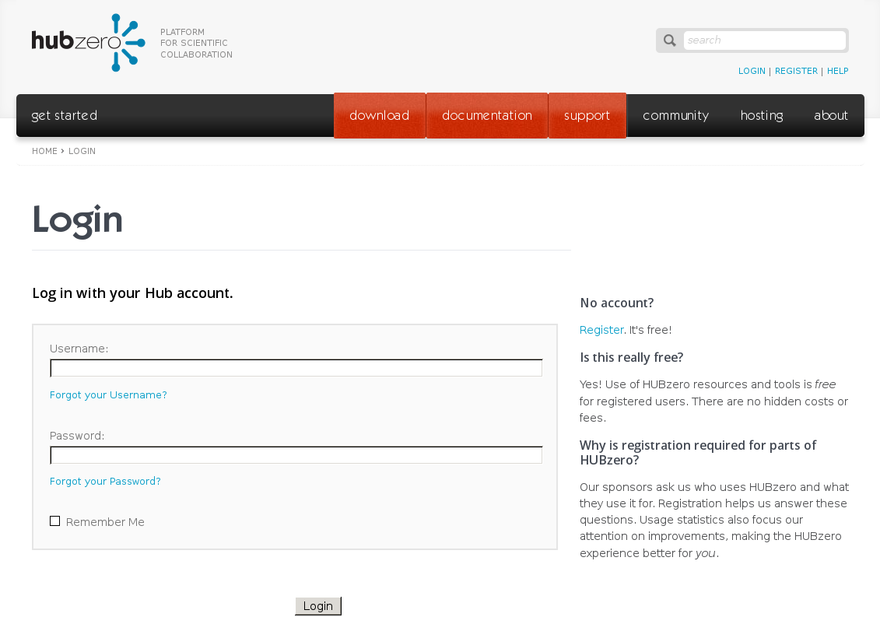

Slide 32
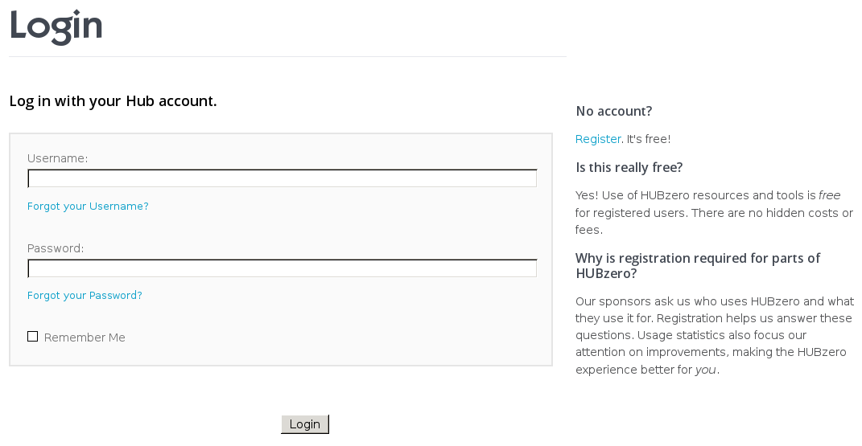

Slide 33
Links

Slide 34
Text Inputs

Slide 35
Checkbox

Slide 36
Button

Slide 37
class Login(BasePageWidget):
def __init__(self, locator):
...
self.username = Text(self,'username')
self.password = Text(self,'password')
self.remember = Checkbox(self,'remember')
self.remind = Link(self,'remind')
self.reset = Link(self,'reset')
self.register = Link(self,'register')
self.submit = Button(self,'submit')
def login_as(self,username,password):
self.username.value = username
self.password.value = password
self.submit.click()
Page Description
Page Services

Slide 38
class Login(BasePageWidget):
def __init__(self, locator):
...
self.username = Text(self,'username')
self.password = Text(self,'password')
self.remember = Checkbox(self,'remember')
self.remind = Link(self,'remind')
self.reset = Link(self,'reset')
self.register = Link(self,'register')
self.submit = Button(self,'submit')
def login_as(self,username,password):
self.username.value = username
self.password.value = password
self.submit.click()
po = Login('#hubForm')
po.login_as('testuser','testpassword')
po = Login('#hubForm')
po.remember.value = True
po.login_as('testuser','testpassword')
po = Login('#hubForm')
po.remind.click()
po = Login('#hubForm')
po.username.value = 'testuser'
po.submit.click()

Slide 40
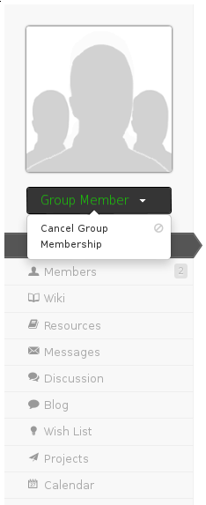
class GroupMember(User):
def __init__(self, group):
...
def cancel_group_membership(self,group):
po = GroupOverviewPage(group)
po.goto_page()
po.cancel.click()
po.confirm.click()

Slide 41
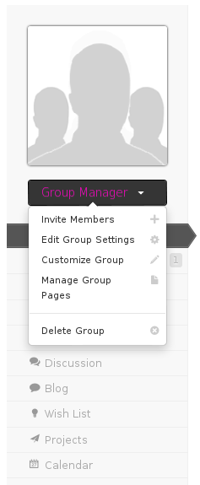
class GroupManager(User):
def __init__(self, group):
...
def invite_member(self,member):
…
def edit_group_settings(self,settings):
…
def customize_group(self,customizations):
…
def manage_group_pages(self,customizations):
…
def delete_group(self,groupid):
...

Slide 43
Links

Slide 44
Checkbox
Button

