Slide 1
Selenium Webdriver
Introduction to Page Objects

Slide 2
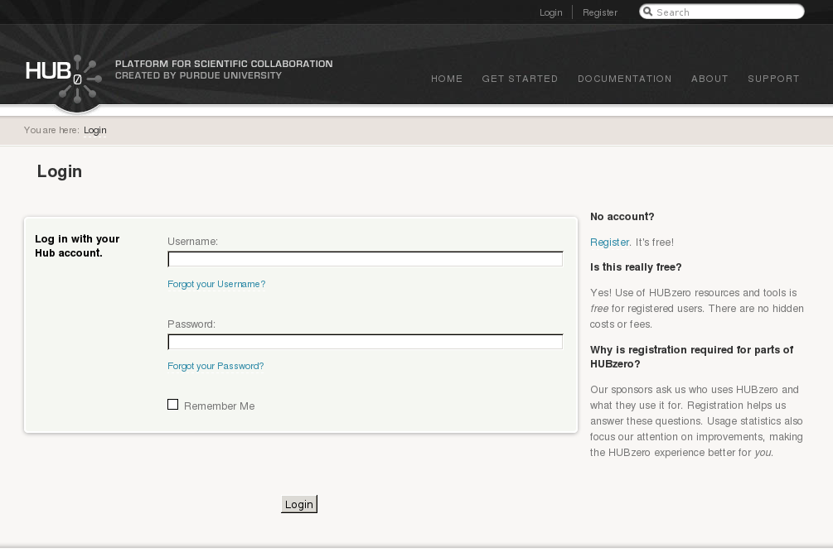

Slide 3

<label>
Username:
<input id=”username” class=”inputbox”
type=”text” name=”username”>
</label>

Slide 4
css=”input[id='username']”
css=”input[class='inputbox']”
css=”input[type='text']”
css=”input[name='username']”
<label>
Username:
<input id=”username” class=”inputbox”
type=”text” name=”username”>
</label>

Slide 5
...
e = browser.find_element_by_css_selector(“input[id='username']”)
e.clear()
e.send_keys(“hctest”)
...

Slide 6
<label>
Username:
<input id=”username” class=”inputbox”
type=”text” name=”username”>
</label>
...
e = browser.find_element_by_css_selector(“input[id='username']”)
e.clear()
e.send_keys(“hctest”)
...

Slide 7
...
e = browser.find_element_by_css_selector(“input[id='username']”)
e.clear()
e.send_keys(“hctest”)
...

Slide 8
hctest
...
e = browser.find_element_by_css_selector(“input[id='username']”)
e.clear()
e.send_keys(“hctest”)
...

Slide 9
<label>
Password:
<input id=”passwd” type=”password”
name=”passwd”>
</label>
hctest
*******
...
e = browser.find_element_by_css_selector(“input[id='passwd']”)
e.clear()
e.send_keys(“pass123”)
...

Slide 10
<p class=”submit”>
<input class=”button” type=”submit”
value=”Login” name=”Submit”>
</p>
hctest
*******
...
e = browser.find_element_by_css_selector(“input[name='Submit']”)
e.click()
...

Slide 11

...
e = browser.find_element_by_css_selector(“input[id='username']”)
e.clear()
e.send_keys(“hctest”)
e = browser.find_element_by_css_selector(“input[id='passwd']”)
e.clear()
e.send_keys(“pass123”)
e = browser.find_element_by_css_selector(“input[name='Submit']”)
e.click()
...

Slide 12
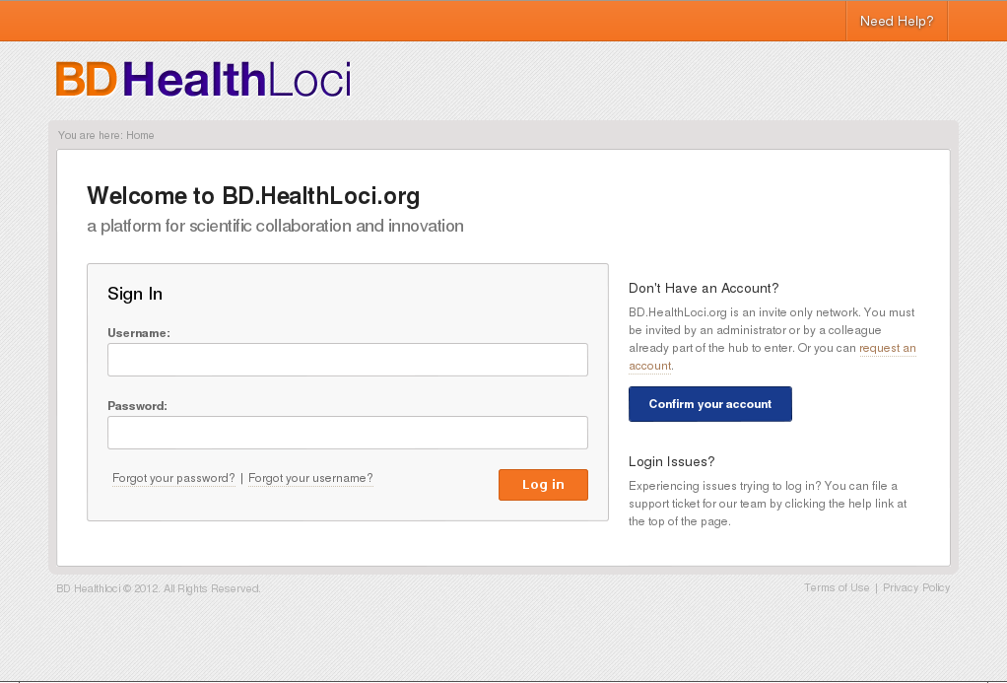

Slide 13
<input id=”login-submit” type=”submit”
value=”Login” name=”Submit”>
hctest
*******
...
e = browser.find_element_by_css_selector(“input[id='login-submit']”)
e.click()
...

Slide 14
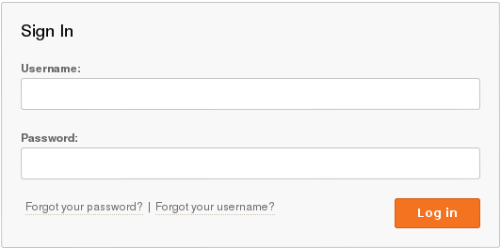
<label>
Username:
<input id=”username” class=”inputbox”
type=”text” name=”username”>
</label>
<label>
Username:
<input id=”username”
type=”text” name=”username”>
</label>
<label>
Password:
<input id=”passwd” type=”password”
name=”passwd”>
</label>
<label>
Password:
<input id=”passwd” type=”password”
name=”password”>
</label>
<p class=”submit”>
<input class=”button” type=”submit”
value=”Login” name=”Submit”>
</p>
<input id=”login-submit” type=”submit”
value=”Login” name=”Submit”>

Slide 15
...
e = browser.find_element_by_css_selector(“input[id='username']”)
e.clear()
e.send_keys(“hctest”)
e = browser.find_element_by_css_selector(“input[id='passwd']”)
e.clear()
e.send_keys(“pass123”)
e = browser.find_element_by_css_selector(“??????????????”)
e.click()
...

Slide 16
...
e = browser.find_element_by_css_selector(“input[id='username']”)
e.clear()
e.send_keys(“hctest”)
e = browser.find_element_by_css_selector(“input[id='passwd']”)
e.clear()
e.send_keys(“pass123”)
e = browser.find_element_by_css_selector(“??????????????”)
e.click()
...
Write “hctest” to username input
Write “pass123” to password input
Click the “Login” button

Slide 17
po = Login()
po.username.value = “hctest”
po.password.value = “pass123”
po.submit()

Slide 18
hctest
hctest
po = Login()
po.username.value = “hctest”
po.password.value = “pass123”
po.submit()

Slide 19
hctest
*******
hctest
*******
po = Login()
po.username.value = “hctest”
po.password.value = “pass123”
po.submit()

Slide 20
hctest
*******
hctest
*******
po = Login()
po.username.value = “hctest”
po.password.value = “pass123”
po.submit()

Slide 21
locators = {
'2011': {
'username': "css=input[id='username']",
'password': "css=input[id='passwd']",
'remember': "css=input[id='remember']",
'submit' : "css=input[name='Submit']",
},
'bd': {
'username': "css=input[id='username']",
'password': "css=input[id='passwd']",
'remember': "css=input[id='remember']",
'submit' : "css=input[id='login-submit']",
}
}
class Login(BasePageObject):
"""navigate to the login page,
fill in the form,
press the submit button"""
def __init__(self):
super(Login,self).__init__()
self.path = '/login'
self.locators = locators[self.locatorKey]
self.username = Text(self,self.locators['username'])
self.password = Text(self,self.locators['password'])
self.submit = Button(self,self.locators['submit'])
def login_as(self, username, password):
self.goto_page()
self.username.value = username
self.password.value = password
self.submit.click()

