Slide 1
Selenium Webdriver Primer
(in Python)
((with code))

Slide 2
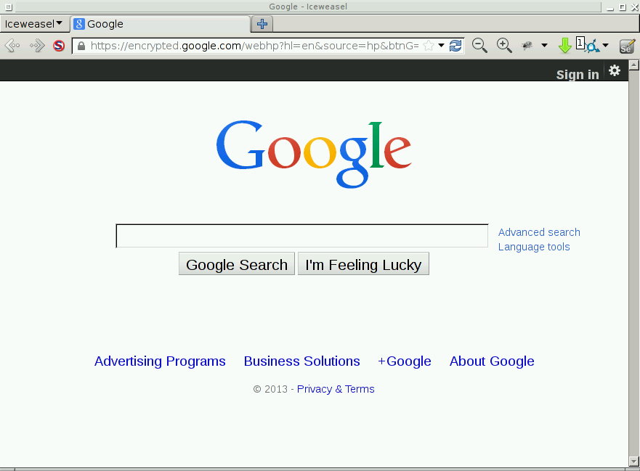


How Selenium Works
script.py

Slide 3

How Selenium Works
script.py

Slide 4
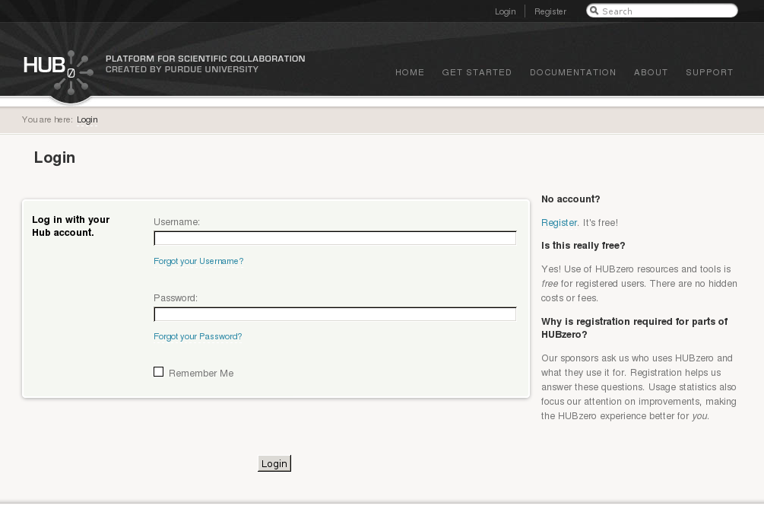

Slide 5
hctest

Slide 6
hctest
*******

Slide 7
hctest
*******

Slide 8
Loading the Selenium Webdriver module:
from selenium import webdriver

Slide 9
Start a web browser:
from selenium import webdriver
url = 'http://hubzero.org'
browser = webdriver.Firefox()

Slide 10
Navigating to a web page:
from selenium import webdriver
url = 'http://hubzero.org'
browser = webdriver.Firefox()
browser.get(url)

Slide 11
Closing a web browser:
from selenium import webdriver
url = 'http://hubzero.org'
browser = webdriver.Firefox()
browser.get(url)
...
browser.quit()

Slide 12
Finding elements on a web page:
from selenium import webdriver
url = 'http://hubzero.org'
browser = webdriver.Firefox()
browser.get(url)
browser.find_element(...)
browser.find_element_by_*(...)
browser.quit()

Slide 14

Locator Types:
Id
Name
Link
Xpath
CSS
<label>
Username:
<input id=”username” class=”inputbox”
type=”text” name=”username”>
</label>

Slide 15
Locator Types:
Id
Name
Link
Xpath
CSS
Locator Type: Id
Examples:
id='username'
<label>
Username:
<input id=”username” class=”inputbox”
type=”text” name=”username”>
</label>
e = browser.find_element_by_id(id)

Slide 16
Locator Types:
Id
Name
Link
Xpath
CSS
Locator Type: Name
Examples:
name='username'
<label>
Username:
<input id=”username” class=”inputbox”
type=”text” name=”username”>
</label>
e = browser.find_element_by_name(name)

Slide 17
Locator Types:
Id
Name
Link
Xpath
CSS
Locator Type: Name
Examples:
loc = ”//input[@id='username']”
loc = “//input[contains(@class,'inputbox')]”
<label>
Username:
<input id=”username” class=”inputbox”
type=”text” name=”username”>
</label>
e = browser.find_element_by_xpath(loc)

Slide 18
Locator Types:
Id
Name
Link
Xpath
CSS
Locator Type: Name
Examples:
loc = ”input[id='username']”
loc = “#username”
loc = “.inputbox”
<label>
Username:
<input id=”username” class=”inputbox”
type=”text” name=”username”>
</label>
e = browser.find_element_by_css_selector(loc)

Slide 19
Locator Types:
Id
Name
Link
Xpath
CSS
Locator Type: Link
Examples:
text = 'Register'
<p>
<a href=”/register”> Register </a>
. It's free!
</p>
e = browser.find_element_by_link_text(text)

Slide 20
<li id=”register”>
<a title=”Sign up for a free account” href=”/register”>Register</a>
</li>
Locator Type: Link
Examples:
link=Register
<p>
<a href=”/register”> Register </a>
. It's free!
</p>

Slide 21
<li id=”register”>
<a title=”Sign up for a free account” href=”/register”>Register</a>
</li>
css=”li[id='register'] > a”
css=”a[title='Sign up for a free account']”
<p>
<a href=”/register”> Register </a>
. It's free!
</p>

Slide 22
Locator Types:
Id
Name
Link
Xpath
CSS
...
e = browser.find_element(by='locator_type',value='locator')
e.clear()
e.send_keys(“hctest”)
...

Slide 23
...
e = browser.find_element_by_css_selector(“input[id='username']”)
e.clear()
e.send_keys(“hctest”)
...

Slide 24
<label>
Username:
<input id=”username” class=”inputbox”
type=”text” name=”username”>
</label>
...
e = browser.find_element_by_css_selector(“input[id='username']”)
e.clear()
e.send_keys(“hctest”)
...

Slide 25
...
e = browser.find_element_by_css_selector(“input[id='username']”)
e.clear()
e.send_keys(“hctest”)
...

Slide 26
hctest
...
e = browser.find_element_by_css_selector(“input[id='username']”)
e.clear()
e.send_keys(“hctest”)
...

Slide 27
<label>
Password:
<input id=”passwd” type=”password”
name=”passwd”>
</label>
hctest
*******
...
e = browser.find_element_by_css_selector(“input[id='passwd']”)
e.clear()
e.send_keys(“pass123”)
...

Slide 28
<p class=”submit”>
<input class=”button” type=”submit”
value=”Login” name=”Submit”>
</p>
hctest
*******
...
e = browser.find_element_by_css_selector(“input[name='Submit']”)
e.click()
...

Slide 29

...
e = browser.find_element_by_css_selector(“input[id='username']”)
e.clear()
e.send_keys(“hctest”)
e = browser.find_element_by_css_selector(“input[id='passwd']”)
e.clear()
e.send_keys(“pass123”)
e = browser.find_element_by_css_selector(“input[name='Submit']”)
e.click()
...

Slide 30
Traversing tables and lists:

Slide 31
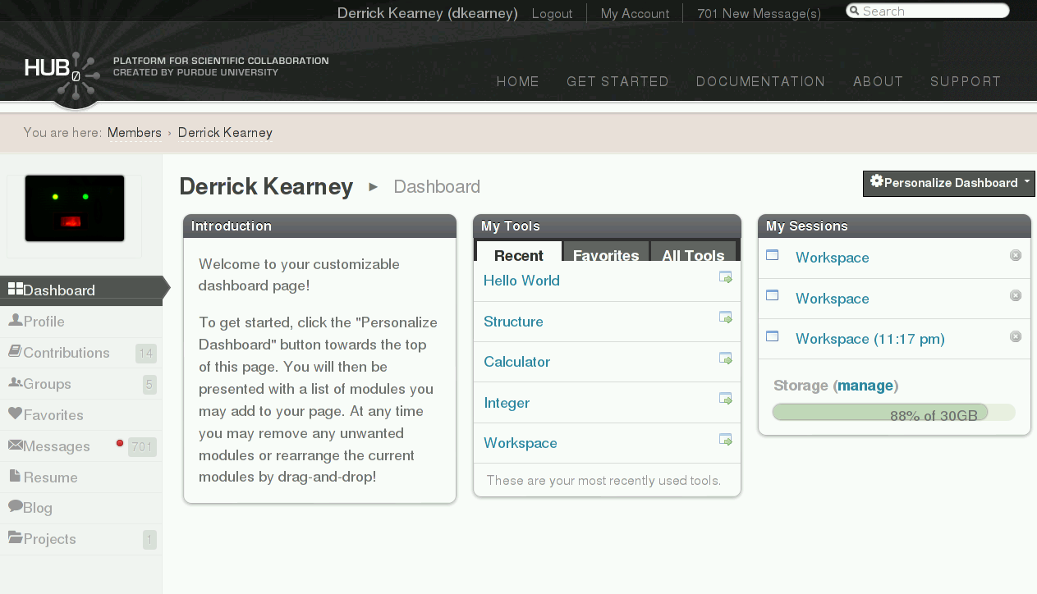

Slide 32
<ul id="page_menu">
<li class="active">
<a class="dashboard"
href="/members/1000/dashboard"
title="My Dashboard"> Dashboard </a>
</li>
…
<li class="">
<a class="groups"
href="/members/1000/groups"
title="My Groups"> Groups </a>
</li>
…
</ul>
css=”ul[id='page_menu'] > li:nth-child(4) > a”
css=”ul[id='page_menu'] a[class='groups']”
css=”#page_menu .groups”

Slide 33
Traversing tables and lists:
# Printing the text of the first link, from all list items:
...
elist = browser.find_elements_by_css_selector('#page_menu li')
for e in elist:
link = e.find_element_by_css_selector('a')
print 'link text = %s' % (link.text())
...
<ul id="page_menu">
<li class="active">
<a class="dashboard"
href="/members/1000/dashboard"
title="My Dashboard"> Dashboard </a>
</li>
…
<li class="">
<a class="groups"
href="/members/1000/groups"
title="My Groups"> Groups </a>
</li>
…
</ul>

Slide 34
Traversing tables and lists:
# Printing the title attribute of the first link, from all list items:
...
elist = browser.find_elements_by_css_selector('#page_menu li')
for e in elist:
link = e.find_element_by_css_selector('a')
print 'link text = %s' % (link.get_attribute('title'))
...
<ul id="page_menu">
<li class="active">
<a class="dashboard"
href="/members/1000/dashboard"
title="My Dashboard"> Dashboard </a>
</li>
…
<li class="">
<a class="groups"
href="/members/1000/groups"
title="My Groups"> Groups </a>
</li>
…
</ul>

Slide 35
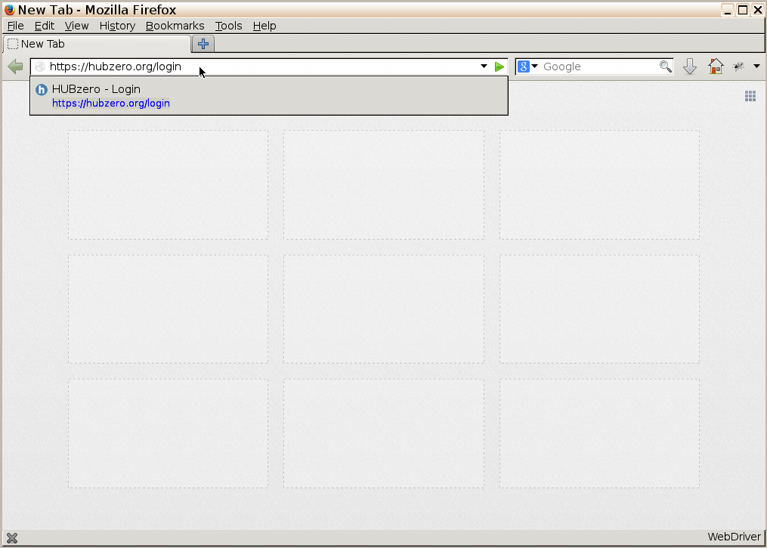
Implicit waits:
from selenium import webdriver
url = 'https://hubzero.org/login'
browser = webdriver.Firefox()
browser.get(url)
e = browser.find_element_by_css_selector(“input[id='username']”)
e.clear()
e.send_keys('hctest')
browser.quit()

Slide 36
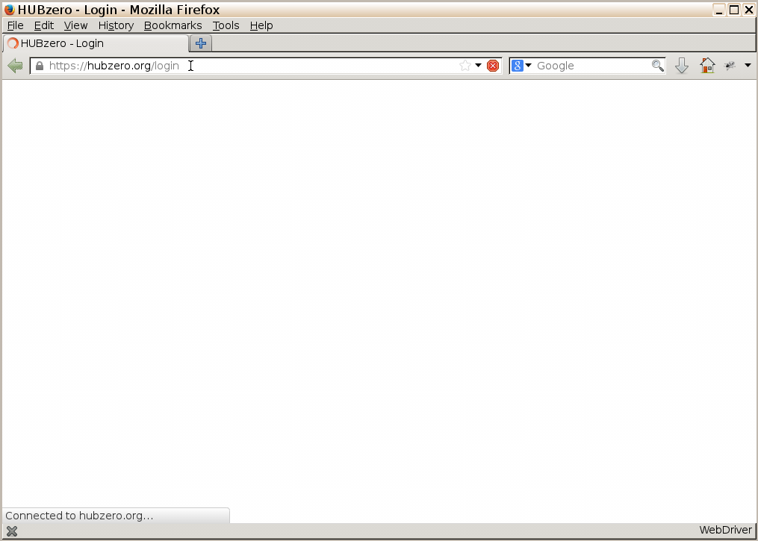
Implicit waits:
from selenium import webdriver
url = 'https://hubzero.org/login'
browser = webdriver.Firefox()
browser.get(url)
e = browser.find_element_by_css_selector(“input[id='username']”)
e.clear()
e.send_keys('hctest')
browser.quit()

Slide 37
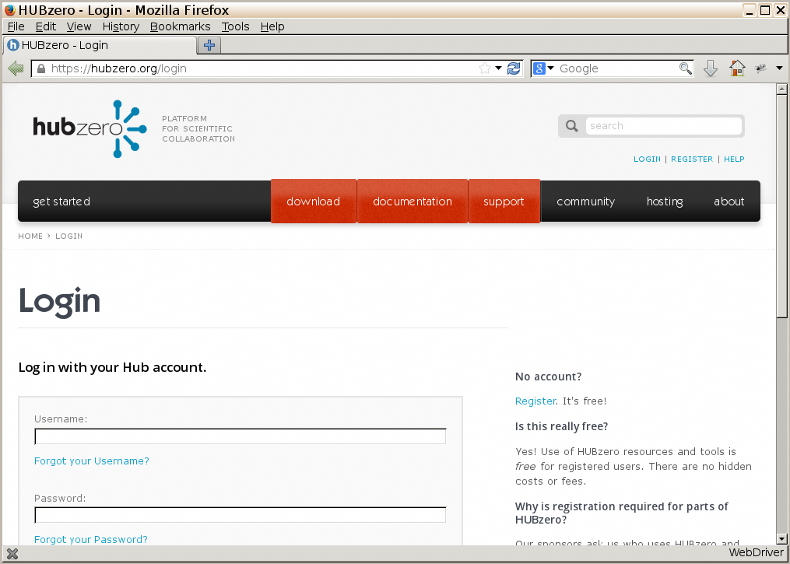
Implicit waits:
from selenium import webdriver
url = 'https://hubzero.org/login'
browser = webdriver.Firefox()
browser.get(url)
e = browser.find_element_by_css_selector(“input[id='username']”)
e.clear()
e.send_keys('hctest')
browser.quit()

Slide 38
Implicit waits:
from selenium import webdriver
url = 'https://hubzero.org/login'
browser = webdriver.Firefox()
browser.implicitly_wait(30)
browser.get(url)
e = browser.find_element_by_css_selector(“input[id='username']”)
e.clear()
e.send_keys('hctest')
browser.quit()

Slide 39
Explicit waits:
from selenium import webdriver
from selenium.webdriver.common.by import By
from selenium.webdriver.support.ui import WebDriverWait
from selenium.webdriver.support import expected_conditions as EC
url = 'https://hubzero.org/login'
browser = webdriver.Firefox()
browser.get(url)
wait = WebDriverWait(browser, 10)
wait.until(CONDITION)
e = browser.find_element_by_css_selector(“input[id='username']”)
e.clear()
e.send_keys('hctest')
browser.quit()

Slide 40
Explicit waits:
from selenium import webdriver
from selenium.webdriver.common.by import By
from selenium.webdriver.support.ui import WebDriverWait
from selenium.webdriver.support import expected_conditions as EC
url = 'https://hubzero.org/login'
browser = webdriver.Firefox()
browser.get(url)
wait = WebDriverWait(browser, 10)
wait.until(EC.visibility_of_element_located(
(By.CSS_SELECTOR,'#username')))
e = browser.find_element_by_css_selector(“input[id='username']”)
e.clear()
e.send_keys('hctest')
browser.quit()

Slide 41
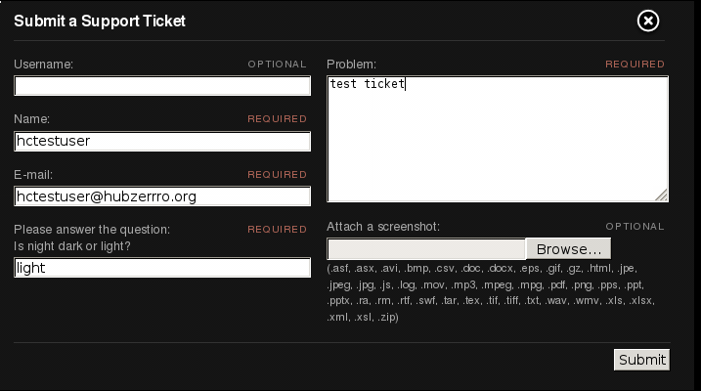
Dealing with AJAX:

Slide 42
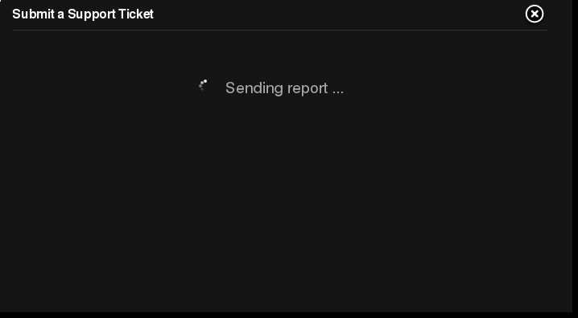
Dealing with AJAX:

Slide 43
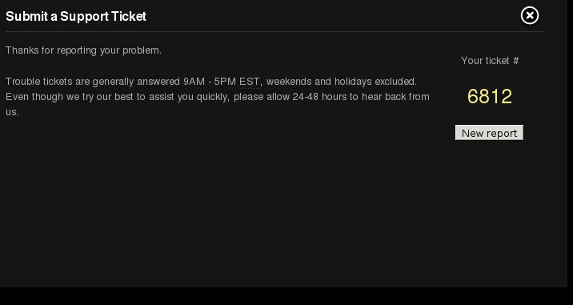
Dealing with AJAX:
<div id="trSuccess">
<div>
<p>Your ticket #
<span>
<a title=”View ticket” href="/support/ticket/6812">6812</a>
</span>
</p>
</div>
</div>

Slide 44
Dealing with AJAX:
…
submit_ticket()
# wait for the page to refresh
wait = WebDriverWait(browser, 60)
e = wait.until(lambda browser :
browser.find_element_by_id("trSuccess").is_displayed())
ticket_number = e.find_element_by_css_selector('a').text()
...
<div id="trSuccess">
<div>
<p>Your ticket #
<span>
<a title=”View ticket” href="/support/ticket/6812">6812</a>
</span>
</p>
</div>
</div>

