Slide 1
Automating Workspace Testing

Slide 2
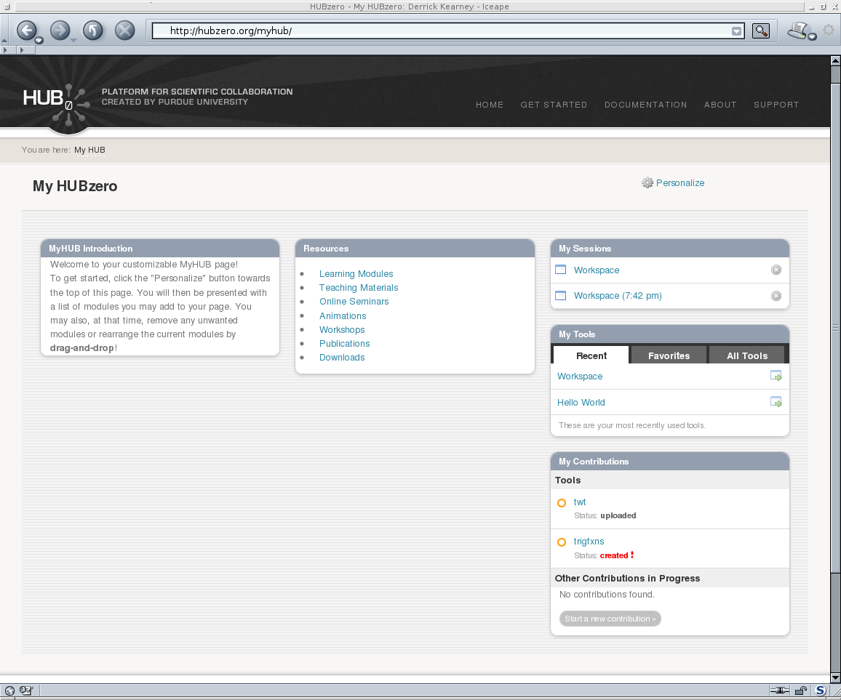
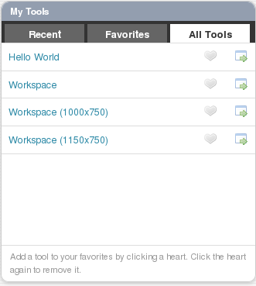



Accessing a Workspace
User's Web Browser
HUBzero Infrastructure
Web Server
Middleware
Grid
Submit
Proxy
Tool Session
Containers
Visualization

Slide 3
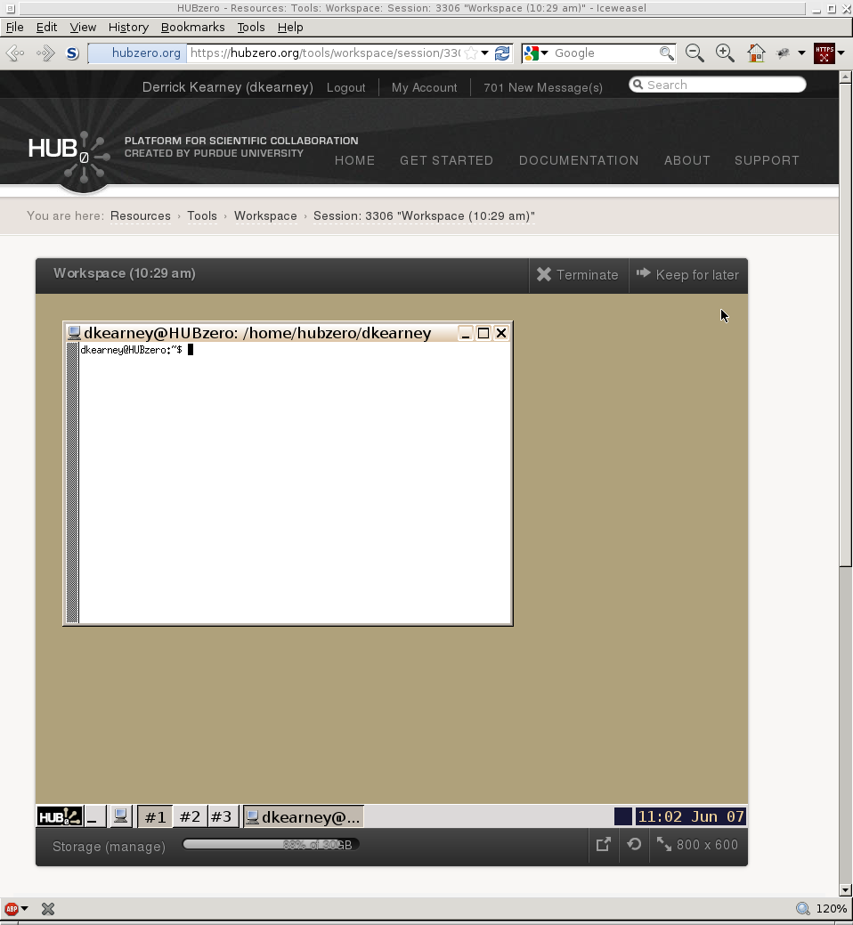
Workspace via Website
User's Web Browser
HUBzero Infrastructure
Web Server
Middleware
Grid
Submit
Proxy
Tool Session
Containers
Visualization

Slide 4
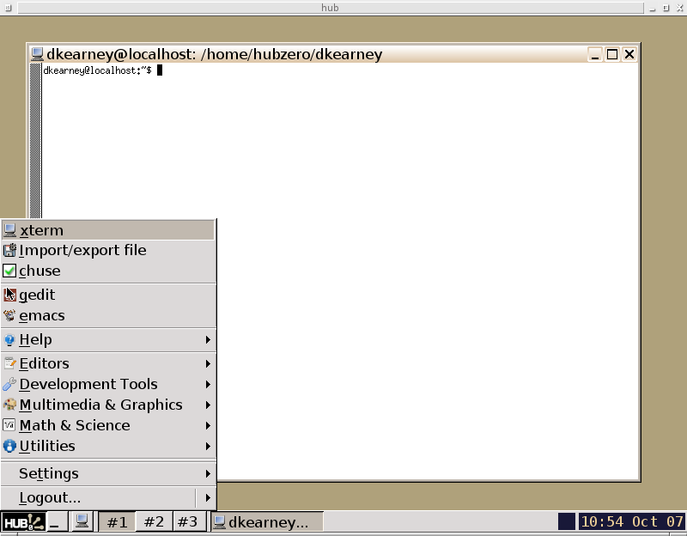
Using a Workspace
Development Tools Available
In Workspace:
* Editors: geany, emacs, vim
* Debuggers: gdb, ddd, valgrind
* Compilers: gcc, g++, gfortran
* Interpreters: wish, python, R,
octave, irb, perl,

Slide 5
Workspace via VirtualSSH
User's Terminal
HUBzero Infrastructure
$ ssh username@hub session
Entering session 1234
hub $
Web Server
Middleware
Grid
Submit
Proxy
Tool Session
Containers
Visualization

Slide 6
Workspace via VirtualSSH
User's Terminal
HUBzero Infrastructure
$ ssh username@hub session
Entering session 1234
hub $
Web Server
Middleware
Grid
Submit
Proxy
Tool Session
Containers
Visualization

Slide 7
Workspace via HUBcheck
Python Script
HUBzero Infrastructure
from hubcheck import ToolSession
ts = ToolSession(host,user,passwd)
shell = ts.access()
out,status = shell.execute(' echo hi')
Web Server
Middleware
Grid
Expect-like interface
for running commands
Submit
Proxy
Tool Session
Containers
Visualization

Slide 8
Testing in the Workspace
HUBzero Infrastructure
Web Server
Debian Squeeze Packages
Container Setup
Network Firewall
Rappture Toolkit
Filexfer
Submit
Middleware
Grid
Submit
Proxy
Tool Session
Containers
Visualization

Slide 9
Testing in the Workspace
HUBzero Infrastructure
Web Server
Debian Squeeze Packages
Container Setup
Network Firewall
Rappture Toolkit
Filexfer
Submit
Middleware
Grid
Submit
Proxy
Tool Session
Containers
Visualization

Slide 10
Testing Packages
HUBzero Infrastructure
Web Server
119 Debian Squeeze Packages
Compilers (gcc, g++, javac, gfortran)
Debuggers (gdb, valgrind)
Interpreters (python, perl, tcl, ruby)
Build tools (make, autoconf)
Editors (gedit, vim, emacs)
Utilities (zip, tar, ssh, rsync)
Window Managers (icewm, ratpoison)
Development tools
Middleware
Grid
Submit
Proxy
Tool Session
Containers
Visualization

Slide 11
Testing in the Workspace
HUBzero Infrastructure
Web Server
Debian Squeeze Packages
Container Setup
Network Firewall
Rappture Toolkit
Filexfer
Submit
Middleware
Grid
Submit
Proxy
Tool Session
Containers
Visualization

Slide 12
Testing Container Setup
HUBzero Infrastructure
Web Server
Check file locations and permissions
filexfer, importfile, exportfile
clientaction
pixelflip
mergeauth
startxvnc
xsetroot
icewm, icewm-captive, ratpoison
invoke_app
Testing for old installations
Middleware
Grid
Submit
Proxy
Tool Session
Containers
Visualization

Slide 13
Testing in the Workspace
HUBzero Infrastructure
Web Server
Debian Squeeze Packages
Container Setup
Network Firewall
Rappture Toolkit
Filexfer
Submit
Middleware
Grid
Submit
Proxy
Tool Session
Containers
Visualization

Slide 14
Testing Container Network Firewall
HUBzero Infrastructure
Web Server
3 User Configurations, 30 locations
Hub's website port 80 and 443
Rappture website
Google
Campus ssh ports
Hub nameservers
OpenDNS nameservers
Google nameservers
License servers
Visualization servers
Middleware
Grid
Submit
Proxy
Tool Session
Containers
Visualization

Slide 15
Testing in the Workspace
HUBzero Infrastructure
Web Server
Debian Squeeze Packages
Container Setup
Network Firewall
Rappture Toolkit
Filexfer
Submit
Middleware
Grid
Submit
Proxy
Tool Session
Containers
Visualization

Slide 16
Testing Rappture Toolkit
HUBzero Infrastructure
Web Server
Rappture Toolkit
Rappture Installation
Examples Run
Visualization Servers
Middleware
Grid
Submit
Proxy
Tool Session
Containers
Visualization

Slide 17
Testing in the Workspace
HUBzero Infrastructure
Web Server
Debian Squeeze Packages
Container Setup
Network Firewall
Rappture Toolkit
Filexfer
Submit
Middleware
Grid
Submit
Proxy
Tool Session
Containers
Visualization

Slide 18
Testing Filexfer
HUBzero Infrastructure
Web Server
Transfer file between hub and desktop
Filexfer Installation
Filexfer GUI
exportfile: hub to desktop
importfile: desktop to hub
Requires Selenium and Expect
Middleware
Grid
Submit
Proxy
Tool Session
Containers
Visualization

Slide 19
Testing in the Workspace
HUBzero Infrastructure
Web Server
Debian Squeeze Packages
Container Setup
Network Firewall
Rappture Toolkit
Filexfer
Submit
Middleware
Grid
Submit
Proxy
Tool Session
Containers
Visualization

Slide 20
Testing Submit
HUBzero Infrastructure
Web Server
Job submission to the Grid
Submit Installation
Submit job as registered user
Submit job as submit enabled user
Submit locally vs to the Grid
Collecting metrics from Submit
Middleware
Grid
Submit
Proxy
Tool Session
Containers
Visualization

Slide 21
Writing Tests for the Workspace
# we would like to run a command like this in the workspace to test Submit
$ submit -p @@vth=0:0.2:5 -p @@cap=10pf,100pf,1uf sim.exe @:indeck
About the command:
Submits 78 jobs.
Substitutes values for @@vth and @@cap into @:indeck file
  @@vth goes from 0 to 5 in steps of 0.2 (26 values).
  @@cap takes on 3 values, 10pf, 100pf, 1uf.
  26 x 3 = 78 jobs total.
indeck is treated as a template
  values are substituted in place of @@vth and @@cap in that file.
Example indeck:
[inputs]
C = @@cap
Vin = @@vth

Slide 22
Converting VirtualSSH to HUBcheck
ssh [flags] [user@]hostname [command]
Virtual SSH related flags
-t Force pseudo-tty allocation
Virtual SSH Commands
session create [session_title]
session start
session [session_number] [command]
session list
session stop session_number
session help
create a new session
start and enter a new session
access session
list user's existing sessions
stop the specified session
print session help message

Slide 23
VirtualSSH → ToolSession
Using VirtualSSH you would type... In HUBcheck you would type...
ssh [flags] [user@]hostname [command]
Virtual SSH related flags
-t Force pseudo-tty allocation
ts = ToolSession(...)
Virtual SSH Commands
session create [session_title]
session start
session [session_number] [command]
session list
session stop session_number
session help
ToolSession Object Methods
create(title=None)
start()
access(snum=None,command=None)
list()
stop(session_number)
help()

Slide 24
VirtualSSH - Create Session
Using VirtualSSH you would type... In HUBcheck you would type...
ssh -t user@hostname session create
ssh -t user@hostname session create mytitle
ts = ToolSession(hostname,
username = username,
password = password)
(stdin,stdout,stderr) = ts.create()
(stdin,stdout,stderr) = ts.create('mytitle')

Slide 25
VirtualSSH - Start Session
Using VirtualSSH you would type... In HUBcheck you would type...
ssh -t user@hostname session start
ts = ToolSession(hostname,
username = username,
password = password)
shell = ts.start()

Slide 26
VirtualSSH - Access Session
Using VirtualSSH you would type... In HUBcheck you would type...
ssh -t user@hostname session
ssh -t user@hostname session 40032
ssh -t user@hostname session “echo hi”
ssh -t user@hostname session 40032 “echo hi”
ts = ToolSession(hostname,
username = username,
password = password)
shell = ts.access()
shell = ts.access(session_number=40032)
(in,out,err) = ts.access(command='echo hi')
(in,out,err) = ts.access(40032,'echo hi')

Slide 27
VirtualSSH - List Session
Using VirtualSSH you would type... In HUBcheck you would type...
ssh -t user@hostname session list
ts = ToolSession(hostname,
username = username,
password = password)
(stdin,stdout,stderr) = ts.list()
print stdout.read(1024)

Slide 28
VirtualSSH - Stop Session
Using VirtualSSH you would type... In HUBcheck you would type...
ssh -t user@hostname session stop 40032
ts = ToolSession(hostname,
username = username,
password = password)
(stdin,stdout,stderr) = ts.stop(40032)
print stdout.read(1024)

Slide 29
VirtualSSH – Session Help
Using VirtualSSH you would type... In HUBcheck you would type...
ssh -t user@hostname session help
ts = ToolSession(hostname,
username = username,
password = password)
(stdin,stdout,stderr) = ts.help()
print stdout.read(1024)

Slide 30
ToolSession → ToolSessionShell
ts = ToolSession(hostname, username = username, password = password)
shell = ts.access()
Provides an Expect-like interface for running shell commands
ToolSessionShell Methods
shell.send(command)
shell.expect(patterns=[],flags=0)
shell.execute(commands)
Examples
shell.send('echo hi')

Slide 31
ToolSession → ToolSessionShell
ts = ToolSession(hostname, username = username, password = password)
shell = ts.access()
Provides an Expect-like interface for running shell commands
ToolSessionShell Methods
shell.send(command)
shell.expect(patterns=[],flags=0)
shell.execute(commands)
Examples
shell.send('echo hi')
shell.expect(['(\w+)'])
output = shell.match.groups()[0]

Slide 32
Expect Basics
Written by Don Libes in early 1990's
Core is written in C
Language bindings for Tcl
Ported to Python, Perl, other languages
Expect Scripts Typically Have 3 Parts:
Spawn the interactive program
Expect phrase
Send response

Slide 33
Expect Example
Written by Don Libes in early 1990's
Core is written in C
Language bindings for Tcl
Ported to Python, Perl, other languages
Expect Scripts Typically Have 3 Parts:
Spawn the interactive program
Expect phrase
Send response
User's Terminal
Expect Script
$ passwd libes
Changing password for libes on thunder
New password:
Retype new password:
spawn passwd [lindex $argv 0]
set password [lindex $argv 1]
expect “password:”
send “$password\r”
expect “password:”
send “$password\r”
expect eof

Slide 34
Expect Example
Written by Don Libes in early 1990's
Core is written in C
Language bindings for Tcl
Ported to Python, Perl, other languages
Expect Scripts Typically Have 3 Parts:
Spawn the interactive program
Expect phrase
Send response
User's Terminal
Expect Script
$ passwd libes
Changing password for libes on thunder
New password:
Retype new password:
spawn passwd [lindex $argv 0]
set password [lindex $argv 1]
expect “password:”
send “$password\r”
expect “password:”
send “$password\r”
expect eof

Slide 35
Expect Example
Written by Don Libes in early 1990's
Core is written in C
Language bindings for Tcl
Ported to Python, Perl, other languages
Expect Scripts Typically Have 3 Parts:
Spawn the interactive program
Expect phrase
Send response
User's Terminal
Expect Script
$ passwd libes
Changing password for libes on thunder
New password:
Retype new password:
spawn passwd [lindex $argv 0]
set password [lindex $argv 1]
expect “password:”
send “$password\r”
expect “password:”
send “$password\r”
expect eof

Slide 36
Expect Example
Written by Don Libes in early 1990's
Core is written in C
Language bindings for Tcl
Ported to Python, Perl, other languages
Expect Scripts Typically Have 3 Parts:
Spawn the interactive program
Expect phrase
Send response
User's Terminal
Expect Script
$ passwd libes
Changing password for libes on thunder
New password:
Retype new password:
spawn passwd [lindex $argv 0]
set password [lindex $argv 1]
expect “password:”
send “$password\r”
expect “password:”
send “$password\r”
expect eof

Slide 37
Expect Example
Written by Don Libes in early 1990's
Core is written in C
Language bindings for Tcl
Ported to Python, Perl, other languages
Expect Scripts Typically Have 3 Parts:
Spawn the interactive program
Expect phrase
Send response
User's Terminal
Expect Script
$ passwd libes
Changing password for libes on thunder
New password:
Retype new password:
spawn passwd [lindex $argv 0]
set password [lindex $argv 1]
expect “password:”
send “$password\r”
expect “password:”
send “$password\r”
expect eof

Slide 38
Examples – Execute Command
ts = ToolSession(hostname, username = username, password = password)
shell = ts.access()
command = 'submit --local echo hi'
output, error_code = shell.execute(command)
print output # hi
print error_code # 0
Expect-like interface simplified
using the Execute Pattern:
Send text
Expect sent text
Wait for command to complete
Capture command output
Capture command exit status

Slide 39
Examples – Transferring Files
from hubcheck import SFTPClient, ToolSession
ts = ToolSession(hostname, username = username, password = password)
shell = ts.access()
shell.execute('cd $SESSIONDIR')
sessiondir,error_code = shell.execute('pwd')
shell.importfile('./sim1.py', '../examples/sim1.py', mode=0o700)

Slide 40
Examples – Transferring Files
from hubcheck import SFTPClient, ToolSession
ts = ToolSession(hostname, username = username, password = password)
sftp = SFTPClient(hostname, username = username, password = password)
shell = ts.access()
shell.execute('cd $SESSIONDIR')
sessiondir,error_code = shell.execute('pwd')
sftp.chdir(sessiondir)
sftp.put('../examples/sim1.py', './sim1.py')
sftp.chmod('./sim1.py', 0700)

Slide 41
Examples – Writing Files
from hubcheck import SFTPClient, ToolSession
ts = ToolSession(hostname, username = username, password = password)
shell = ts.access()
shell.execute('cd $SESSIONDIR')
sessiondir,error_code = shell.execute('pwd')
exe_path = './sim1.py'
indeckfn = 'indeck.template'
indeck_template = '[inputs]\nC = @@C\n'
shell.importfile(indeck_template,indeckfn,mode=0o600,is_data=True)
command = 'submit --local -p @@C=10e-12,100e-12 %s --inputdeck @:%s' \
% (exe_path,indeckfn)
command += ' 0</dev/null'
output,error_code = self.ws.execute(command)

Slide 42
Examples – Writing Files
from hubcheck import SFTPClient, ToolSession
ts = ToolSession(hostname, username = username, password = password)
sftp = SFTPClient(hostname, username = username, password = password)
shell = ts.access()
shell.execute('cd $SESSIONDIR')
sessiondir,error_code = shell.execute('pwd')
sftp.chdir(sessiondir)
exe_path = './sim1.py'
indeckfn = 'indeck.template'
indeck_template = '[inputs]\nC = @@C\n'
f = sftp.open(indeckfn,mode='w')
f.write(indeck_template)
f.close()
command = 'submit --local -p @@C=10e-12,100e-12 %s --inputdeck @:%s' \
% (exe_path,indeckfn)
command += ' 0</dev/null'
output,error_code = self.ws.execute(command)

Slide 43
Using HUBcheck to Write Tests
import hubcheck
import os
class container_firewall_registered_user(hubcheck.TestCase):
def setUp():
…
def test_basic_connections():
…
def tearDown():
…

Slide 44
Writing Tests – setUp Fixture
def setUp(self):
self.remove_files = []
self.ws = None
# get user account info
hubname = self.testdata.find_url_for('https')
self.username,self.userpass = self.testdata.find_account_for('registeredworkspace')
cm = hubcheck.ContainerManager()
self.ws = cm.access(hubname, self.username, self.userpass)
# copy the checknet executable to the session directory
self.ws.execute('cd $SESSIONDIR')
sessiondir,es = self.ws.execute('pwd')
self.exe_fn = 'checknet.py'
local_exe_path = os.path.join(hubcheck.config.macros_dir,self.exe_fn)
self.exe_path = os.path.join(sessiondir,self.exe_fn)
self.remove_files.append(self.exe_path)
self.ws.importfile(local_exe_path,self.exe_path,mode=0o700)

Slide 45
Writing Tests – Test Method
def test_basic_connections(self):
"""
login to a tool session container and check basic network firewall
settings for a registered user in no network affecting groups.
"""
conns = [
# (desc, uri, port, expected_result)
('rappture', 'rappture.org', 80, True),
('ecn_systems', 'shay.ecn.purdue.edu', 22, False),
('google_https', 'google.com', 443, False),
('octave_ftp', 'ftp.octave.org', 21, False),
('localhost', 'localhost', 80, False),
('ecn_matlab', 'matlab-license.ecn.purdue.edu', 1703, False),
]
results = ''
for (desc,uri,port,eresult) in conns:
results += self._run_checknet(desc,uri,port,eresult)
self.assertTrue(results == '', results.strip())

Slide 46
Writing Tests – Test Method
def _run_checknet(self,desc,uri,port,eresult):
command = '%s --protocol tcp4 %s %s' % (self.exe_path,uri,port)
self.logger.debug('command = "%s"' % (command))
aresult,es = self.ws.execute(command)
if aresult == 'True':
aresult = True
else:
aresult = False
results = ''
if eresult != aresult:
results = '\n%s connection %s:%s received %s, expected %s' \
% (desc,uri,port,aresult,eresult)
return results

Slide 47
Writing Tests – tearDown Fixture
def tearDown(self):
# remove the executable from the workspace
for fname in self.remove_files:
self.ws.execute('rm -f %s' % (fname))
# get out of the workspace
# shut down the ssh connection
if self.ws is not None:
self.ws.close()

