Slide 1

An Important Idea
Communicating important ideas can be effective when text and diagrams are combined.

Slide 2
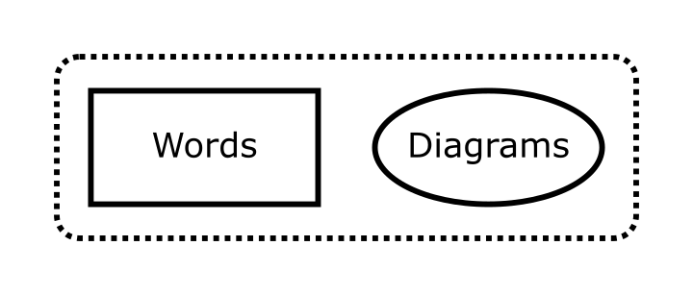

Slide 3
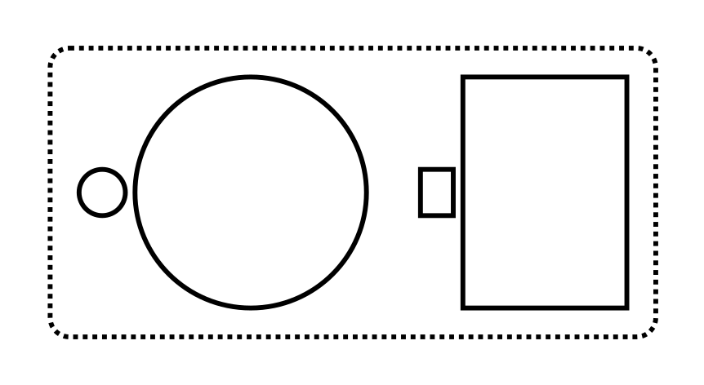
This may increase both understanding and retention.

Slide 4
Maybe try this in your next document!
def fn(): pass
def ident(x): return x
Fin.

