Slide 1

Priority Inversion: Pathfinder Case Study
BCSE303L
Operating Systems
Digital Assignment – 2
Batch 2021
Arnab Kumar (21BLC1387)
Sneha Baby Mathew (21BLC1236)
Rohan Raj (21BLC1073)

Slide 2
Priority Inversion Problem
High-priority processes can be blocked by low-priority processes.
Medium-priority processes preempt low-priority processes, causing further delays.
This situation leads to significant delays in critical tasks.
BCSE303L – Operating systems

Slide 3
Real-Time Operating System (RTOS) and Bus Communication
VxWorks RTOS:
Uses preemptive fixed-priority scheduling.
1553 Bus:
Transmits data from the lander to the radio.
Routes command signals from the CPU to the cruise and lander.
Critical Tasks:
bc_sched: Decides transmission and sets schedules.
bc_dist: Determines data recipients.
BCSE303L – Operating systems

Slide 4
Pathfinder’s Watchdog Timer Issue
Problem:
Watchdog timer checks if bc_dist completed execution.
Violated on Pathfinder’s VxWorks RTOS.
Consequence:
Resets during weather data collection.
Solution:
Priority inheritance: Higher-priority bc_dist unblocked by lower-priority ASI/MET task.
BCSE303L – Operating systems

Slide 5
Solution: Priority Inheritance
When a low-priority process holds a resource needed by a high-priority process:
It temporarily inherits the high priority.
Prevents medium-priority processes from preempting the low-priority process.
Priority inheritance solves the priority inversion problem.
BCSE303L – Operating systems

Slide 6
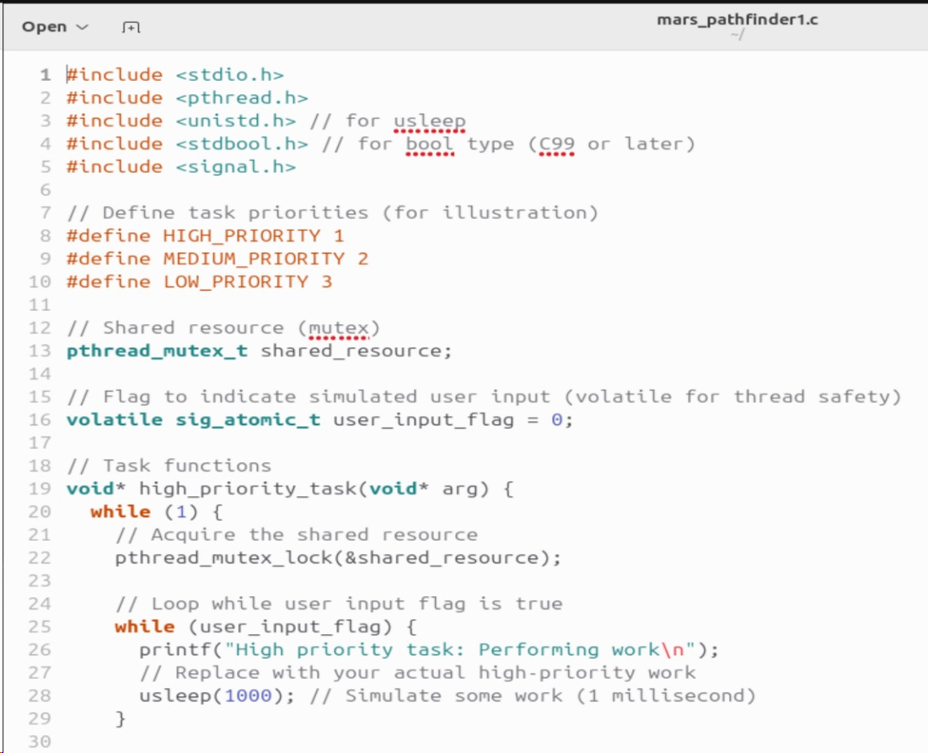
Code Snippet
BCSE303L – Operating systems

Slide 7
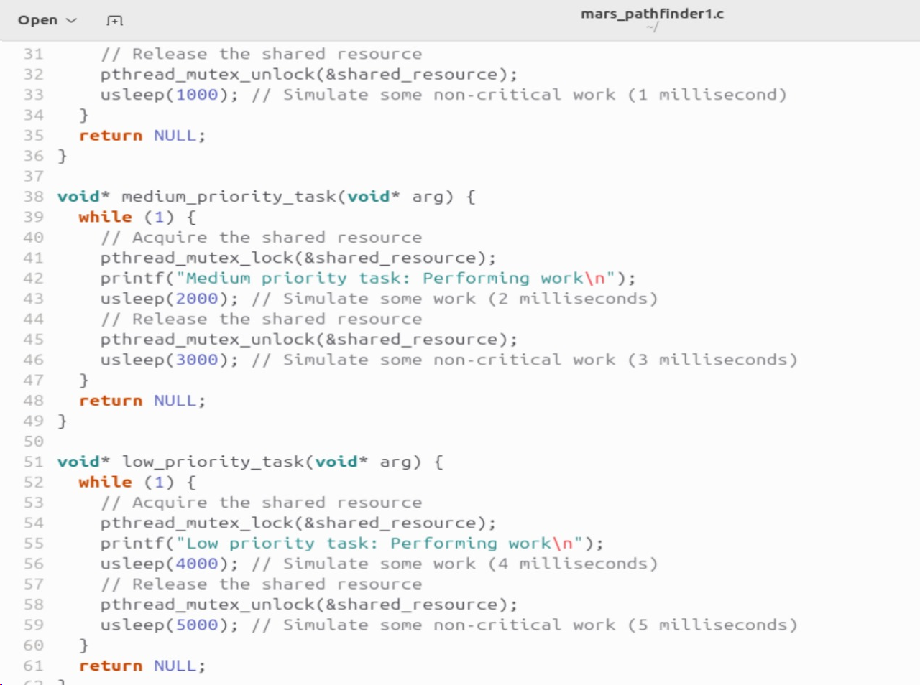
Code Snippet
BCSE303L – Operating systems

Slide 8
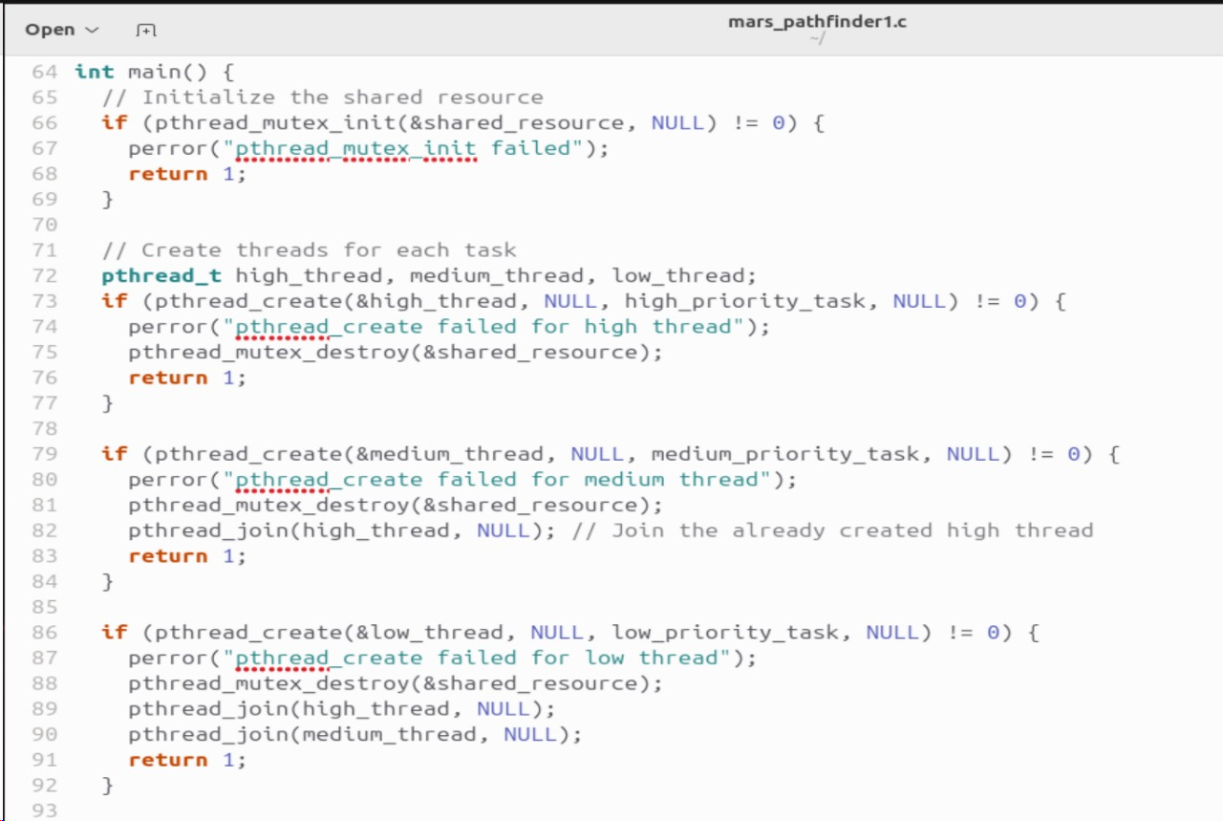
Code Snippet
BCSE303L – Operating systems

Slide 9
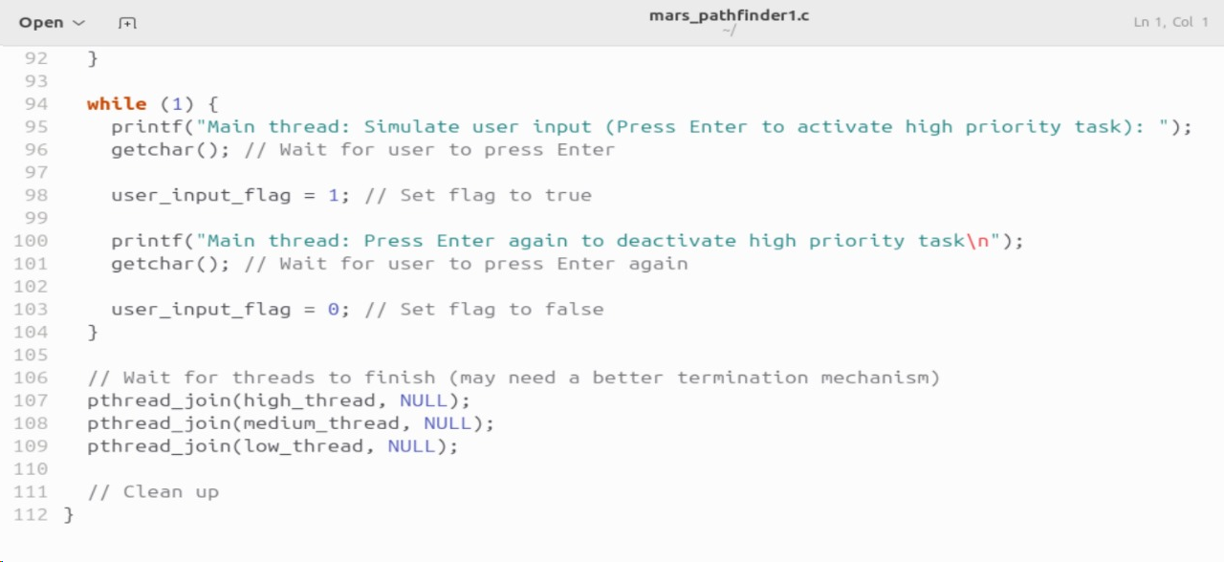
Code Snippet
BCSE303L – Operating systems

Slide 10
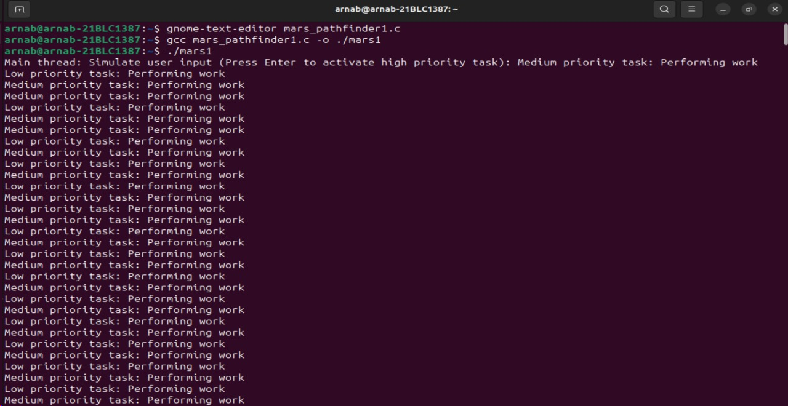
Simulation
BCSE303L – Operating systems

Slide 11
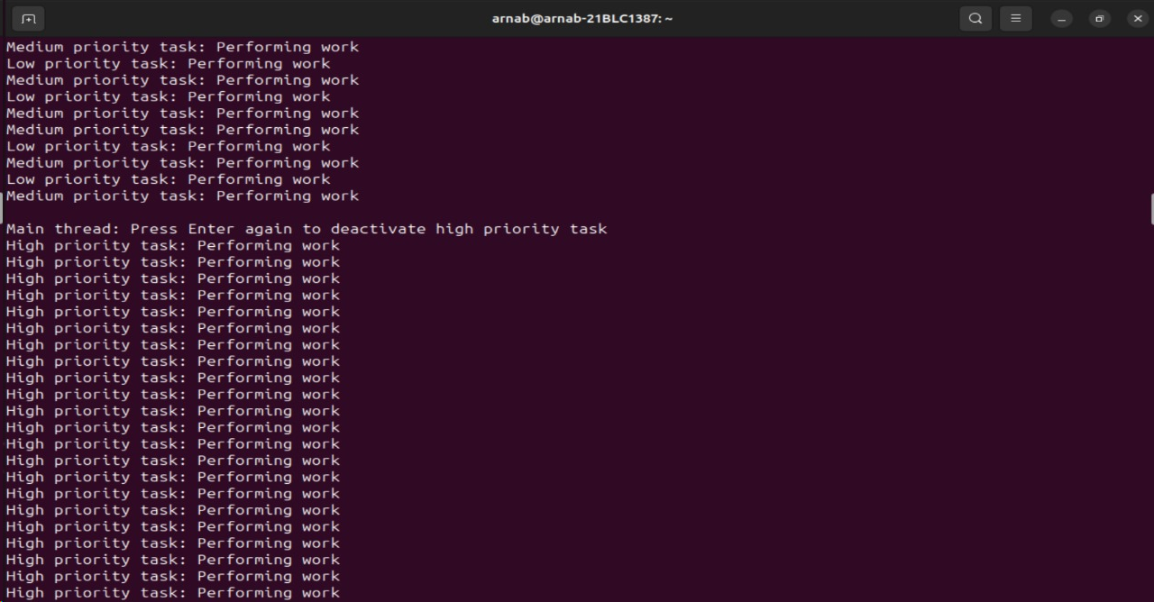
Simulation
BCSE303L – Operating systems

Slide 12
Solution Explanation
Thread Creation:
Three threads are created: high-priority, medium-priority, and low-priority.
These threads represent different tasks in a concurrent system.
Mutex (Shared Resource):
The shared_resource is a mutex (pthread mutex) used for synchronization.
It ensures that only one thread can access the shared resource (critical section) at a time.
User Input Simulation:
The user_input_flag is a volatile flag simulating user input.
When set (value = 1), the high-priority task performs its work.
BCSE303L – Operating systems

Slide 13
Solution Explanation
Task Execution:
Each thread runs an infinite loop.
Within the loop:
The high-priority task:
Checks the user_input_flag.
If set, it locks the mutex, performs its task (data transmission simulation), and unlocks the mutex.
The medium-priority task:
Simulates its task (e.g., computation) by sleeping.
The low-priority task:
Locks the mutex, simulates its task (e.g., sensor reading), and unlocks the mutex.
BCSE303L – Operating systems

Slide 14
Solution Explanation
Priority Inheritance Mechanism:
When the high-priority task waits for the shared resource held by the low-priority task:
The low-priority task temporarily inherits the high priority.
This prevents medium-priority tasks from preempting the low-priority task.
Priority inheritance ensures that the high-priority task is not blocked indefinitely.
Application to Mars Bug Problem:
Imagine these tasks as critical operations in the Mars Pathfinder mission.
Priority inversion could occur if data transmission (high-priority) is blocked by sensor readings (low-priority).
By using priority inheritance, the low-priority sensor task temporarily inherits the high priority, avoiding delays.
BCSE303L – Operating systems

Slide 15
References (Links, Books, Journals, Conference Papers)
The First Bug on Mars: OS Scheduling, Priority Inversion, and the Mars Pathfinder | by Wahome | Medium
Report_MarsPathFinder.pdf (chalmers.se)
What really happened on Mars Rover Pathfinder (cornell.edu)
BCSE303L – Operating systems

