Slide 1
Coordinated game-playing robots
Presented by:
Anuj Gautam(069-BEX-404)
Dilip Paneru(069-BEX-413)
Ramesh Neupane(069-BEX-433)
Yesh Kumar Adhikari(069-BEX-447)

Slide 2
Coordinated robots
Two or more robots cooperating with each other and working towards fulfilling some common objectives.
Multiple robots coordinating with each other can be employed in wide range of scenarios.
Co-ordination among various autonomous entities are present virtually in every industrial scenarios involving multiple robots

Slide 3
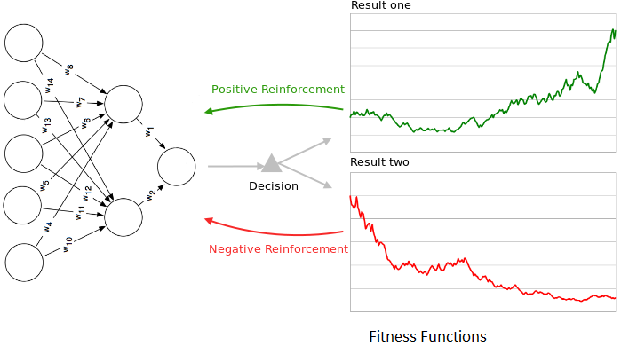
Learning
Agents learn from the result of previous actions.

Slide 4
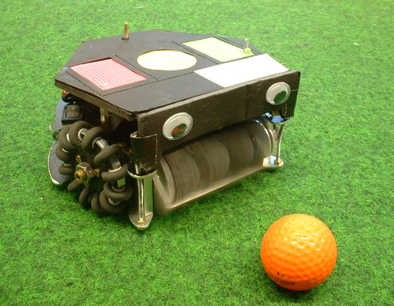
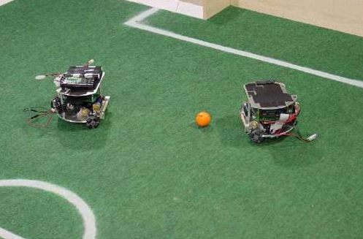
Introduction of our project
Our project is concerned with the coordination of multiple robots while performing certain tasks in an environment
In our case playing a simple game of football.

Slide 5
Why game-playing?
Publicly appealing while also offering significant challenges.
Although, our project is about playing simple game of football, it can easily be adapted and extended to various other problems.
The basic ideas and algorithms are the same.
The problems of coordinated movement, localization, communication ,the task of guiding an object(ball) towards the goal are generic to most multi-robot systems.

Slide 6
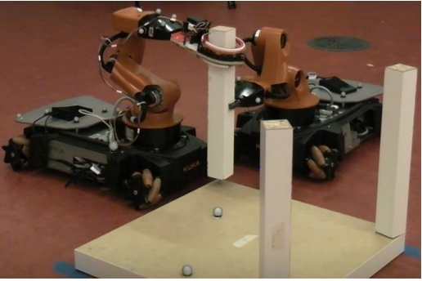
Application of Coordinated Multirobots
Two robots collaborating in assembling a table

Slide 7
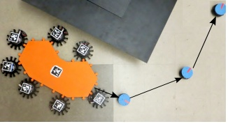
Examples(contd.)
Multiple robots( in black) transporting a large object(in orange ) along the shown path.

Slide 8
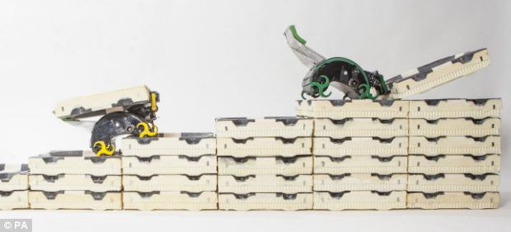
Examples(contd.)
TERMES robots building simple structures

Slide 9
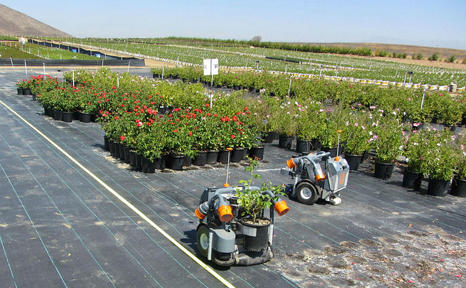
Agriculture
Two robots watering plants.

Slide 10
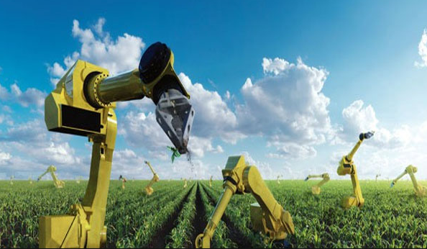
Farming

Slide 11
Other applications
Search and rescue operations in the case of disasters.
Live broadcasting of sports events from multiple scenes.

Slide 12
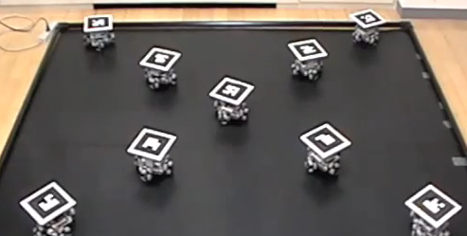
In Conclusion
What a single robot can do two or more robots can do with much more efficiency.

Slide 13
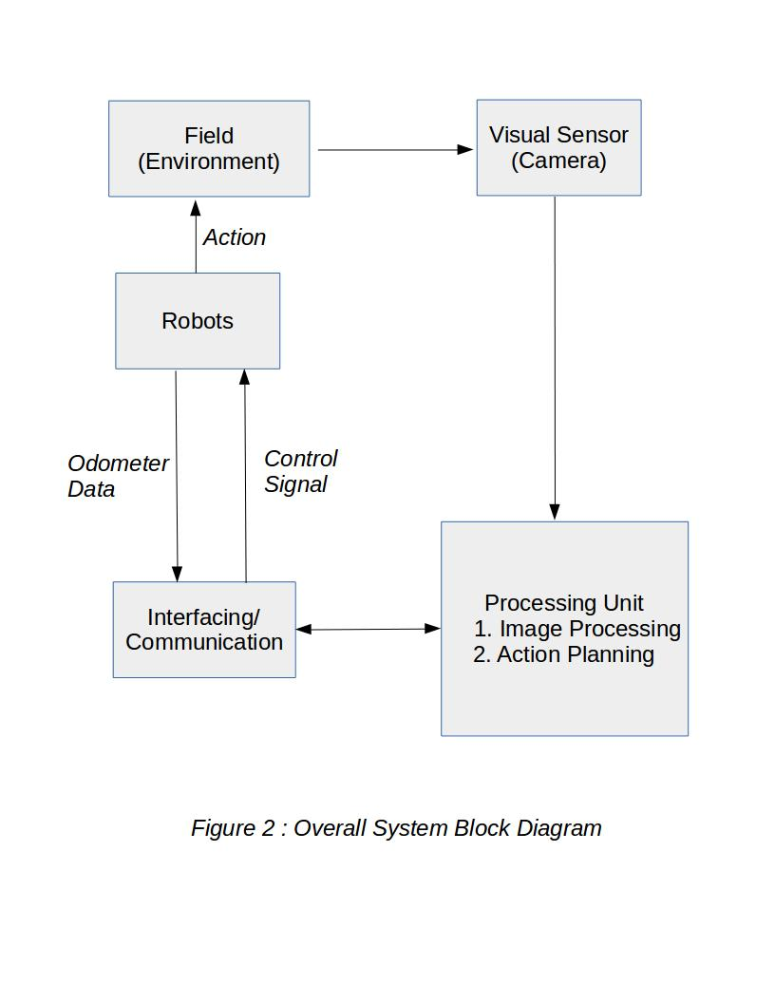
METHODOLOGY

Slide 14
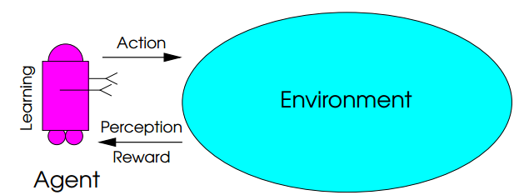
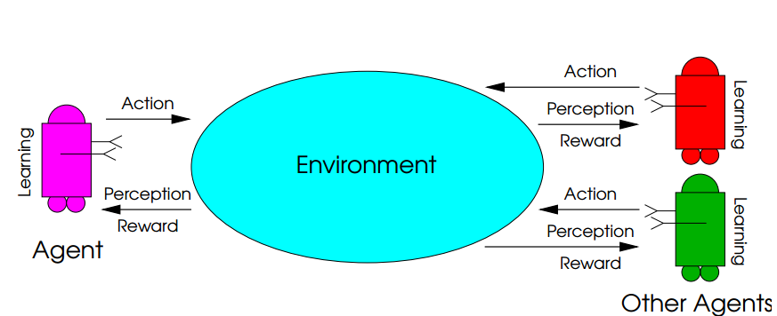
Methodology
Single Agent Model
Multiagent Model

Slide 15
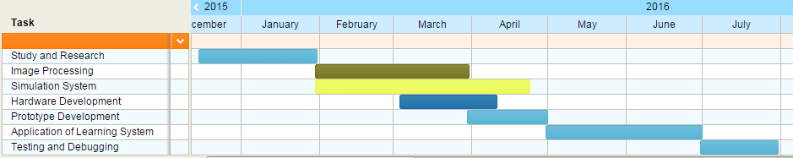
Time Schedule

Slide 16
Cost Estimation
S.No. | Component | Qty. | Rate(NRs.)
1. | Arduino | 2 | 3000
2. | IMU | 2 | 3000
3. | Communication Module | 2 | 3000
4. | Motor Driver | 4 | 4000
5. | DC Motor | 6 | 6000
6. | Robot body and wheel | 2 | 9000
7. | Camera | 1 | 6000
8. | Battery(Li-Po) | 2 | 6000
9. | Misc. |  | 4000
Total |  |  | 43000

Slide 17
Expectation
Total Project Cost(Rs.) = 43000
Expected Financial Help(Rs.) = 33% of the total cost
= 14333.33 = 14500
Remaining Costs(Rs.) = 28500

Slide 18
Discussion and Questions

Slide 19
Thank You!

