Slide 1
Medical Staff Demand Predictor
Group SAE

Slide 2
Problem Description
Nepal has a lot of health problems
Some of the sectors in medicine lack health personnels(mainly doctors)
The demand trend is not known

Slide 3
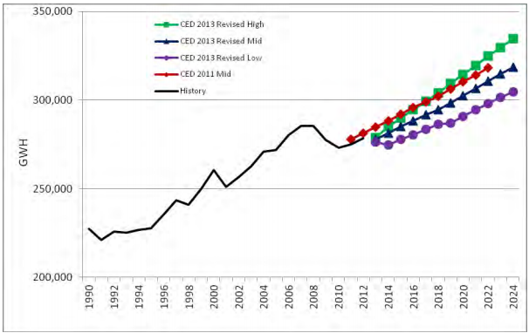
Proposed Solution
Stochastic Predictor
(Kalman Filter)

Slide 4
Methodology
Patient data
Patients/day
Required doctors
predictors
This years need
Current availability
Required number

Slide 5
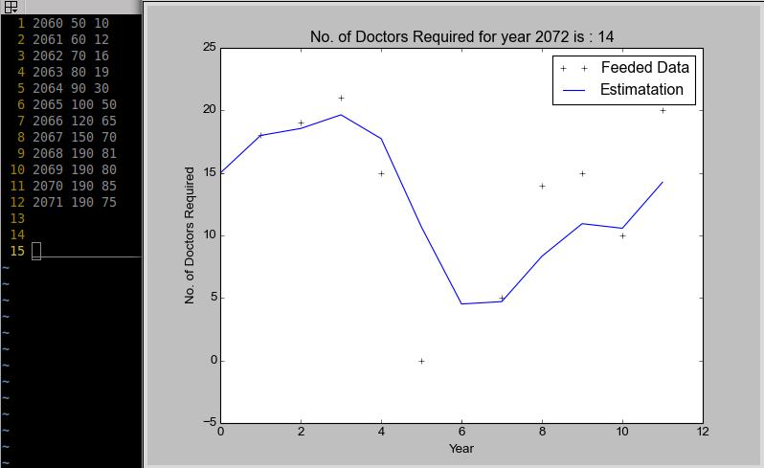
Visualization

Slide 6
Inference
Trend of medical problem
Immediate need of personnel for the specific field

Slide 7
Further Extension
For engineering demand prediction
Calculation of Unemployment

Slide 8
Thank You

