Slide 1

Team 7
Project A – Course Landing Page
Created by: Aleksandra, Bettina, Faris, Julia, Martin (Team Lead)

Slide 2
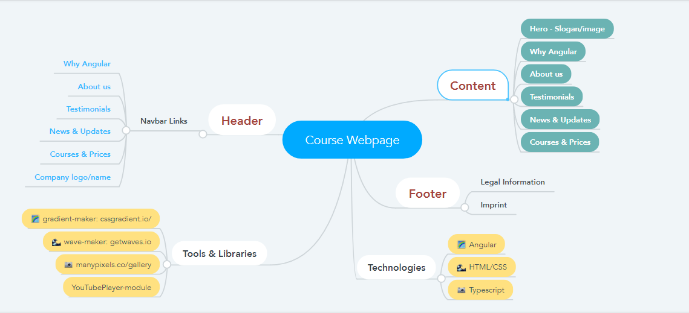
Mind Map

Slide 3
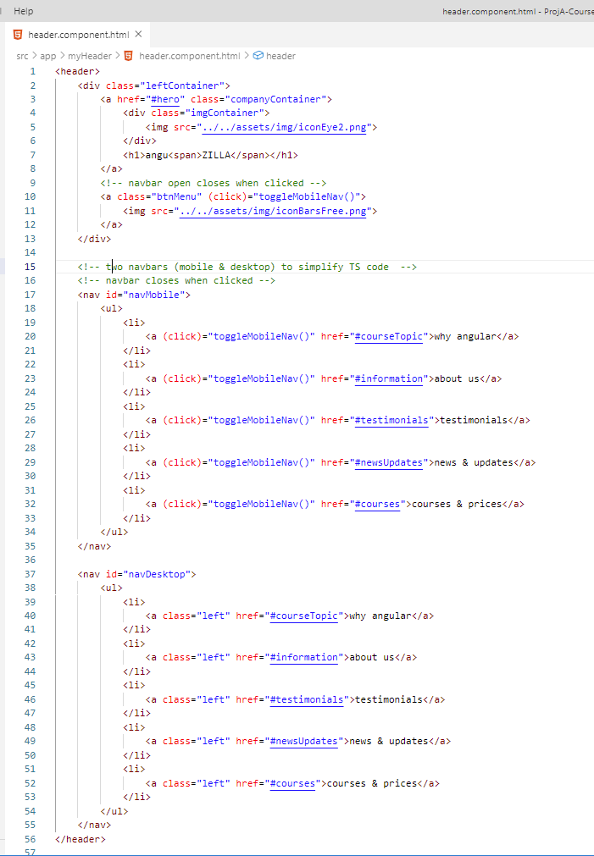
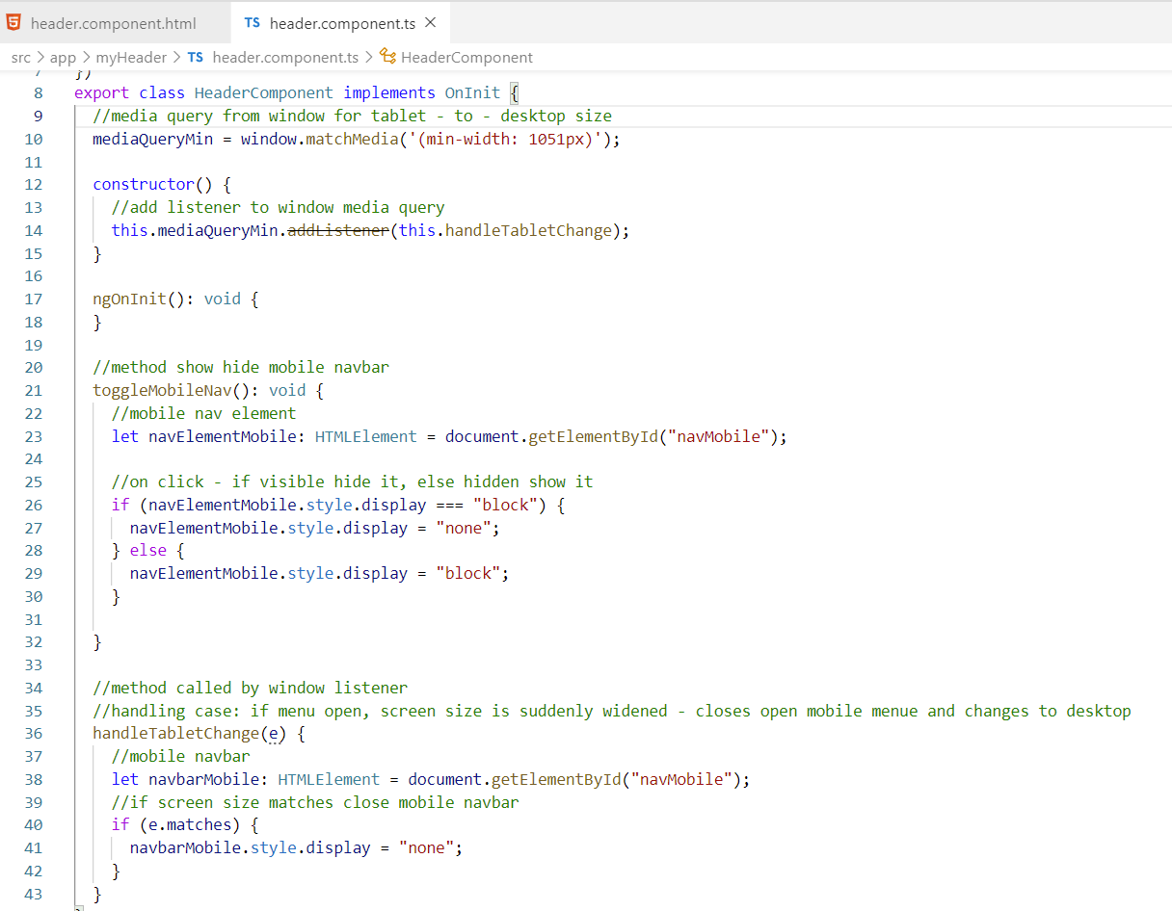
Code Snippets

Slide 4
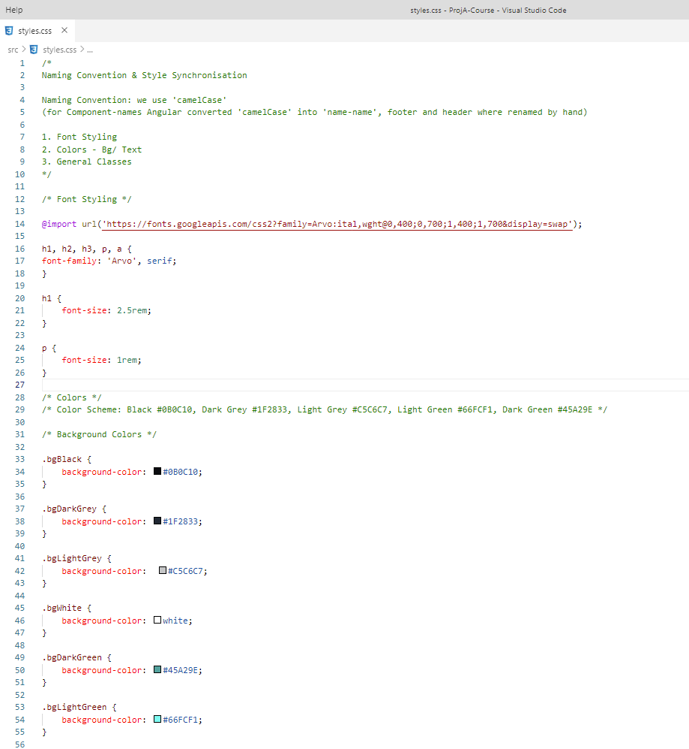
Naming Convention

Slide 5
Summary
Technology
Angular, CSS, Youtube-Player
Tools
MindMeister, Trello, Texteditor for Meeting Minutes, Slack
Team
5 People, workload divided as good as possible
Meetings
2 per day (morning & afternoon) – always longer than expected
Challenges
Different working speed
Trello/Kanban Task List not really necessary because of good communication during meetings
Communication worked well – Slack comment push when pushing done.

Slide 6
What we really think about it …
Aleksandra
…
Bettina
…
Faris
…
Julia
Martin
Good for improving team working skills ;-)
Organizing yourself in the beginning of a project is a bit like peeling an onion. Its tedious at the beginning -to find the start, but after you manage to grab the edge of the first layer, you can just start tearing away.

