Slide 1

Team 7
Project A – Course Landing Page
Created by: Aleksandra, Bettina, Faris, Julia, Martin (Team Lead)

Slide 2
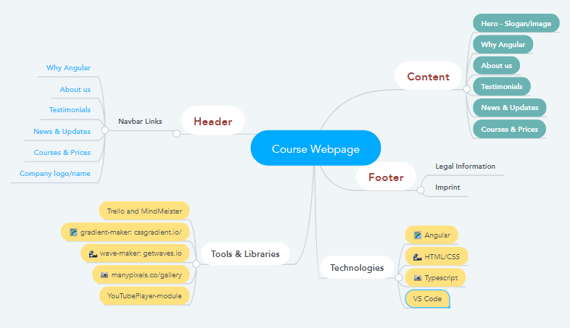
Mind Map

Slide 3
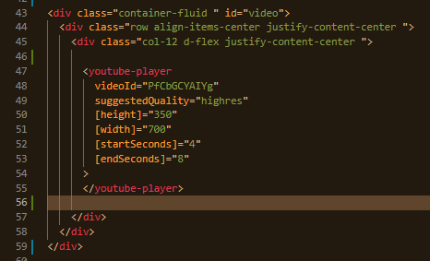
Code Snippets

Slide 4
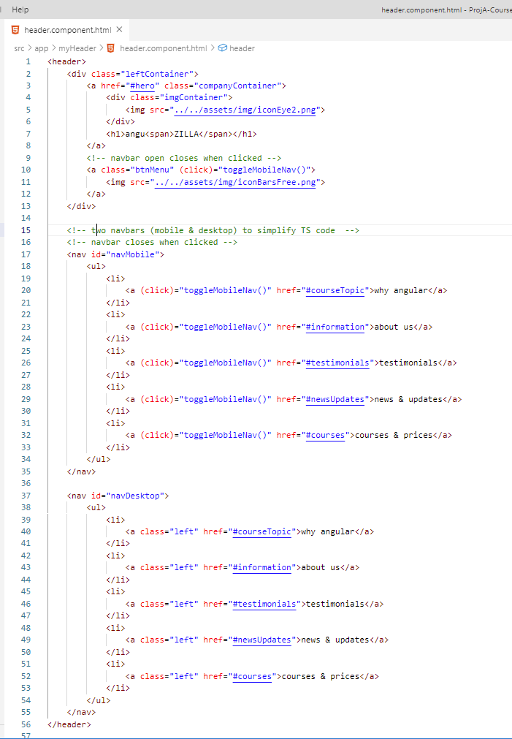
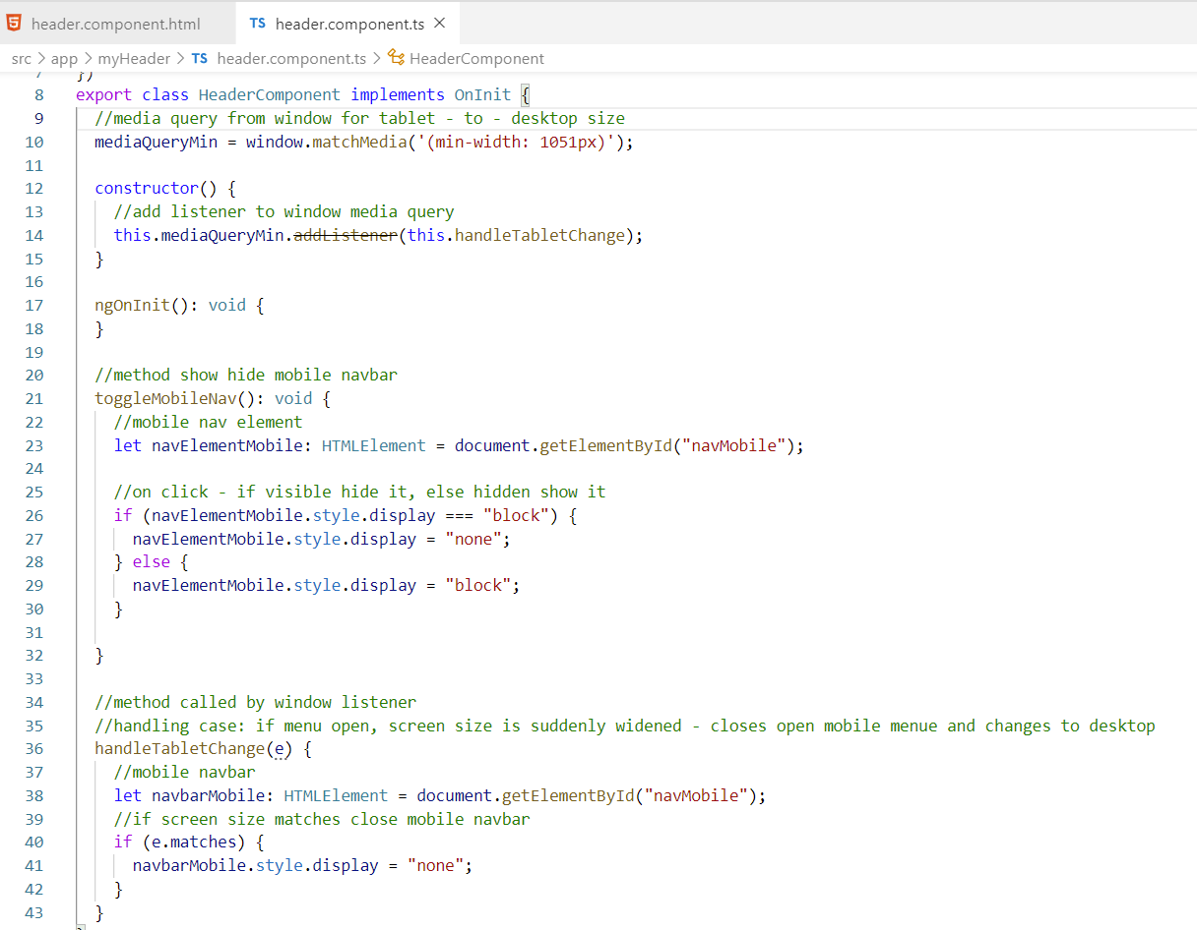
Code Snippets

Slide 5
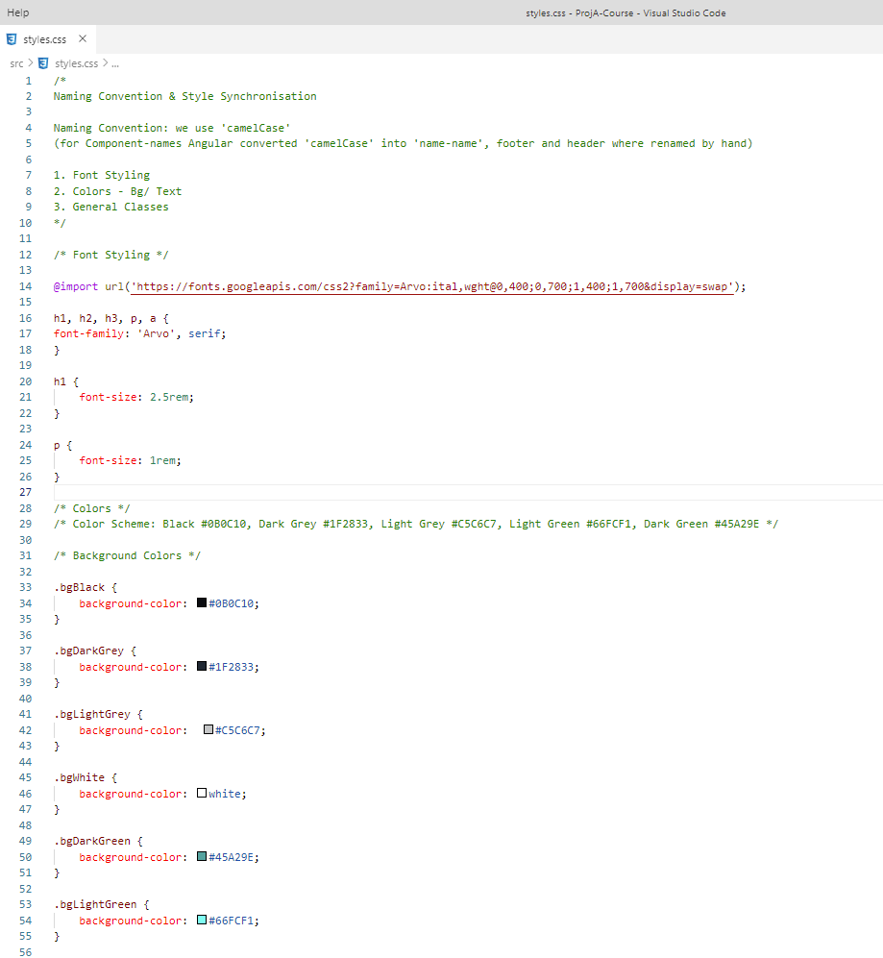
Naming Convention

Slide 6
Summary
Technology
Angular, CSS, Youtube-Player
Tools
MindMeister, Trello, Texteditor for Meeting Minutes, Slack
Team
5 People, workload divided as good as possible
Meetings
2 per day (morning & afternoon) – always longer than expected
Challenges
Different working speed
Trello/Kanban Task List not really necessary because of good communication during meetings
Communication worked well – Slack comment push when pushing done.

Slide 7
What we really think about it …
Aleksandra
Learning from others, gaining new perspective, understanding and patience for different personality types, overall great experience
Bettina
…
Faris
Go to the team meeting with ego.min file
Julia
Martin
Good for improving team working skills ;-)
Working on a project is like peeling through an onion: The first layer is always hard to grab.

