Slide 1
Groovy : Difference with Java

Slide 2
In one go ->
Default Imports
Multi-methods
Array initializers
Package scope visibility
ARM block – (Automatic Resource Management)
Inner Classes
Lambdas
GStrings
String and character literals
Primitive and wrappers
==
Extra keywords – as, def, in, trait

Slide 3
Default imports
java.io.*
java.lang.*
java.math.BigDecimal
java.math.BigInteger
java.net.*
java.util.*
groovy.lang.*
groovy.util.*

Slide 4
Multi-methods
Methods to be invoked are chosen at runtime – runtime dispatch
In java it’s decided at compile time
That is because Java will use the static information type, whereas Groovy will choose at runtime, when the method is actually called

Slide 5
Array Initializers
In Groovy, the { …​ } block is reserved for closures. That means that you cannot create array literals with this syntax:
int[] array = { 1, 2, 3}
Instead you have to use:
int[] array = [1,2,3]

Slide 6
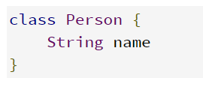
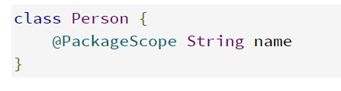
Package scope visibility
In Groovy, omitting a modifier on a field doesn’t result in a package-private field like in Java
Instead, it is used to create a property, that is to say a private field, an associated getter and an associated setter.
It is possible to create a package-private field by annotating it with @PackageScope

Slide 7
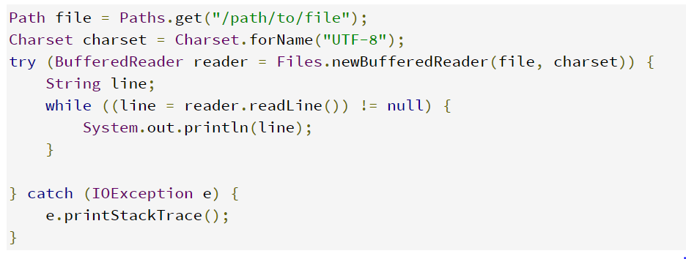
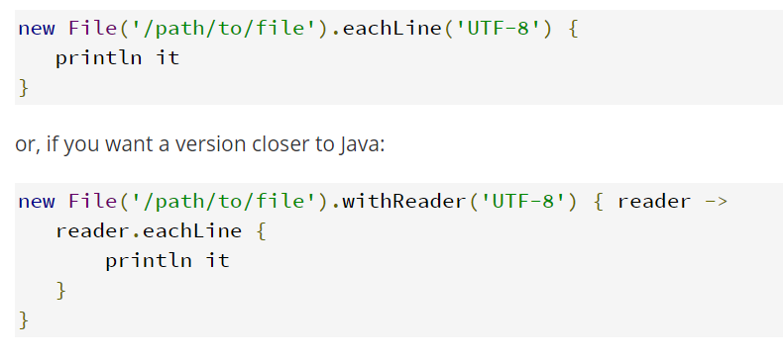
ARM Blocks
ARM (Automatic Resource Management) block from Java 7 are not supported in Groovy. Instead, Groovy provides various methods relying on closures, which have the same effect while being more idiomatic.
The same can be rewritten like-

Slide 8

Lambdas
Java 8 supports lambdas and method references
Java 8 lambdas can be more or less considered as anonymous inner classes. Groovy doesn’t support that syntax, but has closures instead

Slide 9
GStrings

