Slide 1

Jdk-13 Introduction
-- #greenlearner --

Slide 2
Released Data (GA)
17th Sept 2019

Slide 3
Major updates
New Features
Removed Features and Options
Deprecated Features and Options

Slide 4
New Features
Added FileSystems.newFileSystem(Path, Map<String, ?>) Method
Support for Unicode 12.1
Added -XX:SoftMaxHeapSize Flag
Uncommit Unused Memory
Maximum Heap Size Increased to 16TB
New keytool -showinfo -tls Command for Displaying TLS Configuration Information
Switch Expressions (Preview)

Slide 5
Removed Features and Options
Removal of awt.toolkit System Property
Removal of Runtime Trace Methods
Removal of Old Features from javadoc Tool

Slide 6
Deprecated
Deprecated rmic Tool for Removal
Deprecated and Unsupported Swing Motif Look and Feel on macOS
Deprecated Java Options -Xverify:none and -noverify

Slide 7
Jdk-13 installation & environment setup
Arvind
-- #greenlearner --

Slide 8
Jdk-13 String text block (preview)
Arvind
-- #greenlearner --

Slide 9
Jdk-13 Switch expression (preview)
Arvind
-- #greenlearner --

Slide 10
Jdk-13 Reimplement the Legacy Socket API (NioSocketImpl)
Arvind
-- #greenlearner --

Slide 11
Jdk-13 Uncommit Unused Memory (ZGC)
Arvind
-- #greenlearner --

Slide 12
Jdk-13 Dynamic CDS Archives (application class-data sharing)
Arvind
-- #greenlearner --

Slide 13
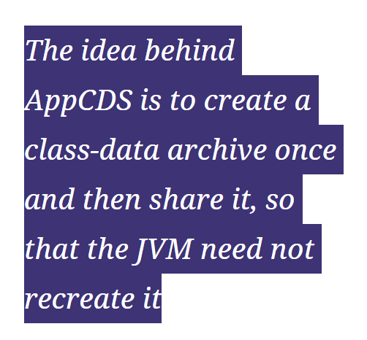
AppCDS
This feature evolved over several Java releases (10, 12, and 13).
To execute a class’ bytecode, the JVM needs to perform a few preparatory steps.
Loading
Verification of bytecode
Pulling the classes into and internal data structure
This is gonna take time. Right?
Point here is – As long as the application’s JARs do not change, this class-data is always the same

Slide 14
Jdk-13 JDK13 support in IntelliJ Idea
Arvind
-- #greenlearner --

