Slide 1


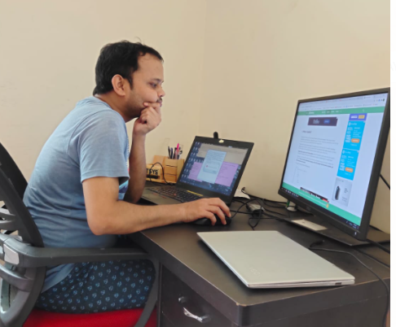




Distributed Tracing In Microservices
#codefarm #observability #tracing #logging #metrics

