Slide 1
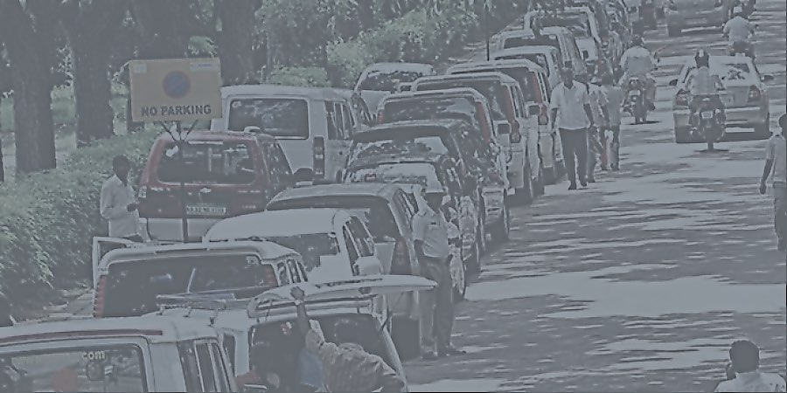
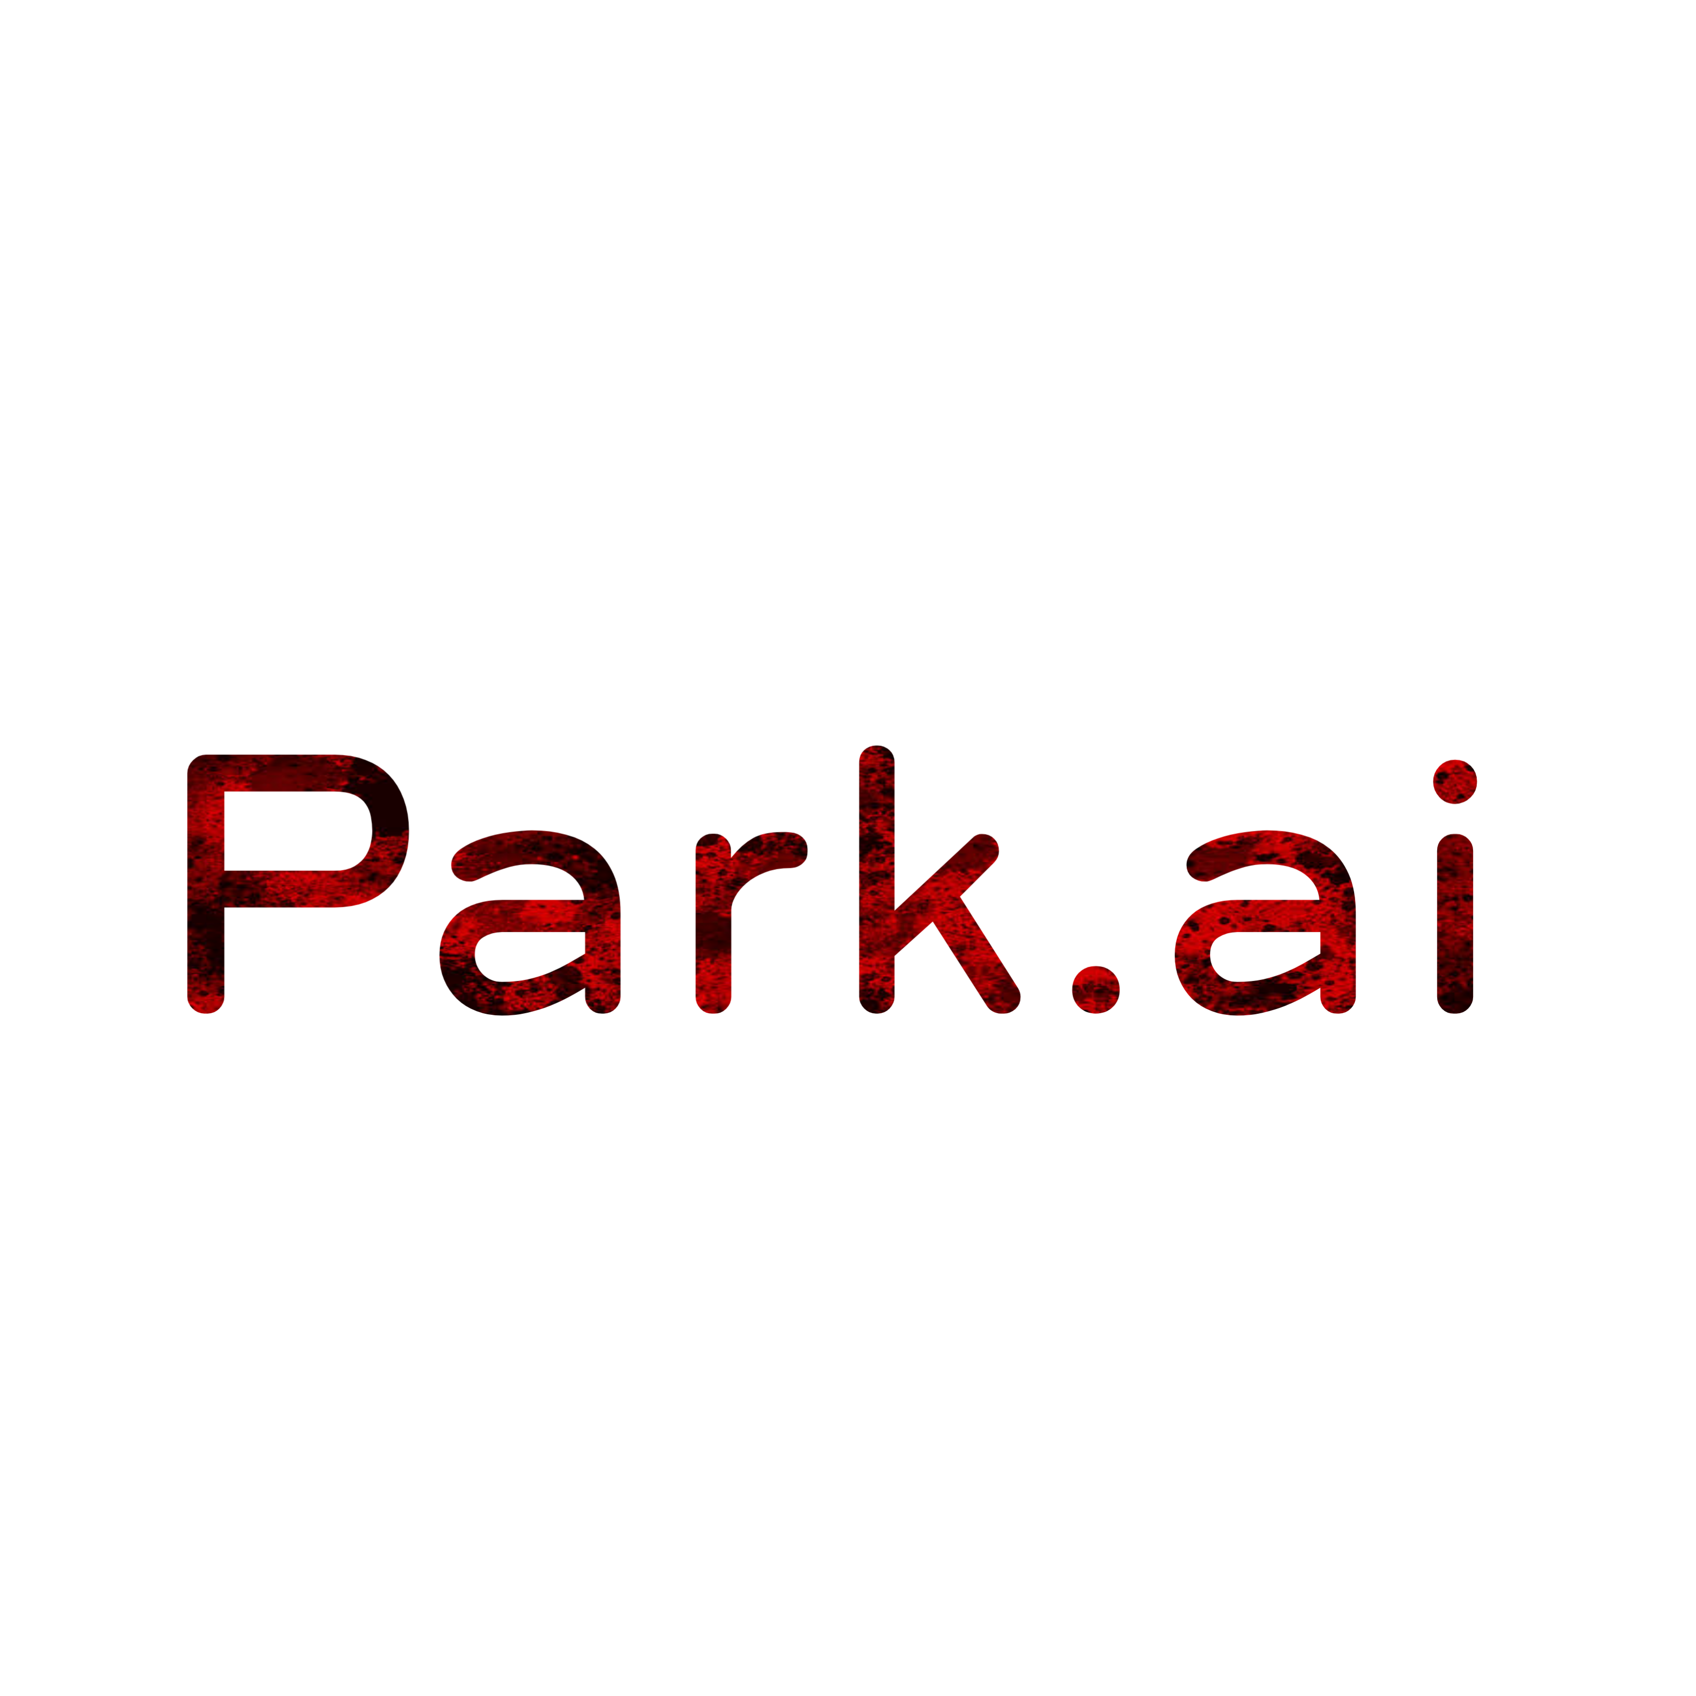

Park.ai
park anywhere and everywhere, legally!

Slide 2

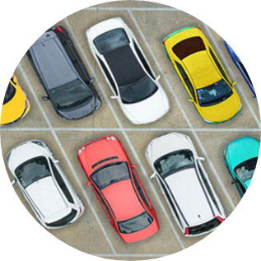
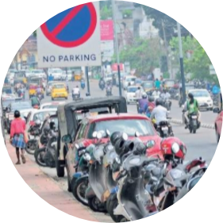
PARK.ai march 26th, 2021
Introduction
In metropolitan areas, most vehicle drivers have the daily concern of finding a vacant parking space especially during the rush hours.
So many parking management systems have been deployed in order to reduce such traffic congestion and improve the convenience for vehicle drivers.
Current systems cannot guide the drivers to their desired parking destinations.
US
India

Slide 3


PARK.ai march 26th, 2021
🤔
HOW CAN WE FIND EFFECTIVE PARKING SPACES???

Slide 4

INTRODUCTION

Slide 5

PARK.ai march 26th, 2021
Introduction :
park.ai is a cross-platform application which allows people to host and park their vehicles at private parking spaces.
People can now host their own private parking spaces on a rental basis.
It also allows the user to find available parking spaces near them using the app.

Slide 6
Why park.ai?
On any given working day approximately 40% of the roads in urban India are taken up for just parking the cars.
Tremendous pressure on parking spaces have led to serious concerns like traffic congestion, accidents, disproportionate demand and supply ratio, environmental hazards etc.
Pollutants like oil and grease are washed off from the parking lots into the water bodies during the rains. The pollutants contaminate the water table and are also responsible for urban heat island effect. The pollutants it emits causes health hazards and may cause respiratory and cardiovascular damages.

Slide 7
PARK.ai march 26th, 2021
We're done!
Thanks for giving this opportunities to present our ideas

