Slide 1
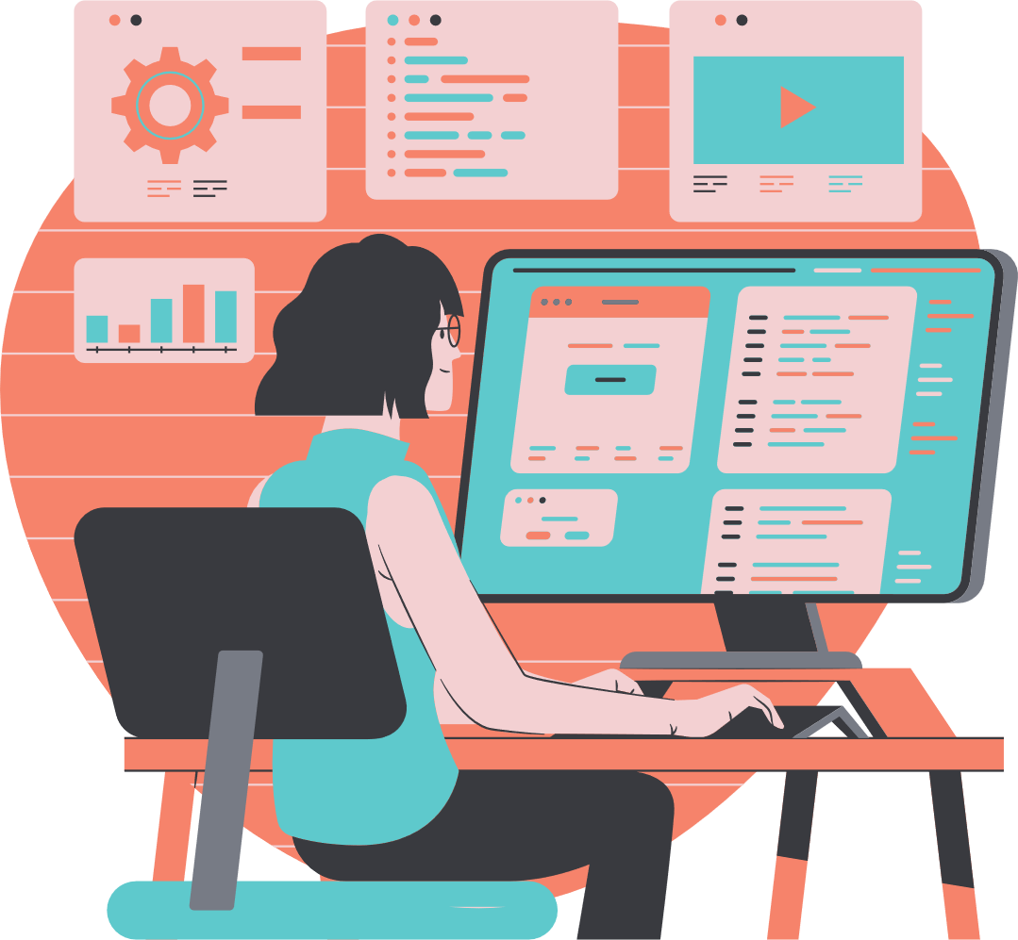

SPRING BOOT
PROJECT
SIMRAN TATKARE-207014
18-11-2024

Slide 2
TABLE OF CONTENTS
01
03
CODE & OUTPUT
INTRODUCTION
02
TECHNOLOGY USED

Slide 3
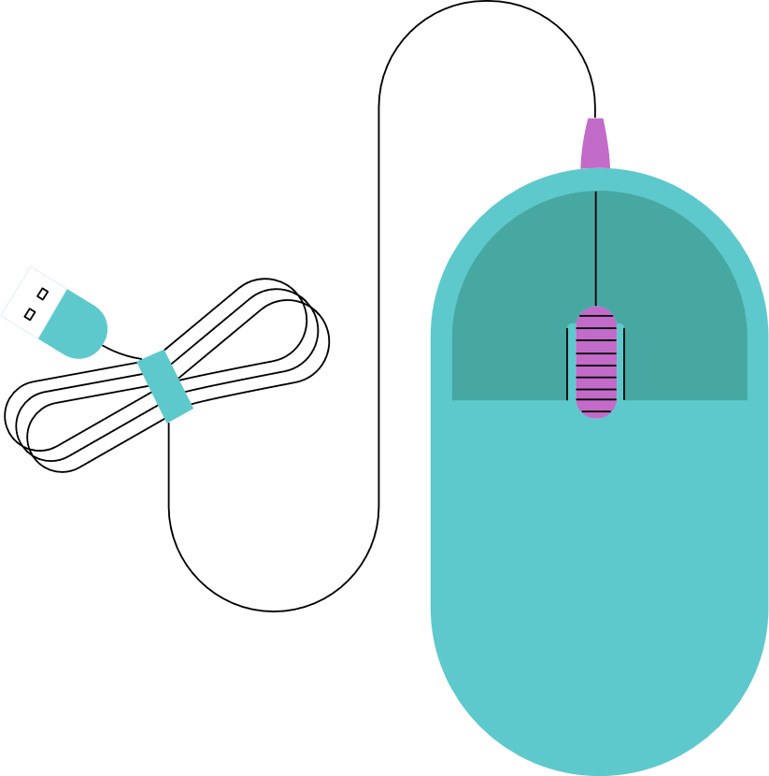
01
INTRODUCTION
This project showcases a web application built using HTML for the front-end and Spring Boot for the back-end.
It highlights the integration of modern web technologies to deliver a seamless, scalable, and user-friendly application.

Slide 4




02
TECHNOLOGIES USED ARE:
JAVA
JENKINS
SPRING
BOOT
DOCKER

Slide 5

A.
Java is a high-level, object-oriented programming language developed by Sun Microsystems (now Oracle).
It follows the "Write Once, Run Anywhere" (WORA) principle via the Java Virtual Machine (JVM).
Secure, robust, multi-threaded, and supports automatic memory management
Widely used for web applications,mobile apps,enterprise software,and IoT devices.

Slide 6
B.
Jenkins is an open-source automation tool written in Java, primarily used for Continuous Integration (CI) and Continuous Delivery (CD).
It helps automate building, testing, and deploying software, streamlining the development lifecycle.
Widely adopted for DevOps practices to improve software delivery efficiency and quality.

Slide 7
c.
Spring Boot is an open-source Java framework built on top of the Spring Framework, designed to simplify the development of production-ready applications.
It reduces configuration effort by providing pre-configured setups, allowing developers to focus on writing code rather than setup.
Auto-configuration, embedded servers (like Tomcat), minimal XML configuration, and Spring Boot Starter dependencies for quick setup.
Ideal for building microservices, web applications, and REST APIs with reduced complexity and faster development.

Slide 8
D.
Docker is an open-source platform that enables developers to build, package, and run applications in lightweight containers.
It ensures consistent environments across development, testing, and production by isolating applications and their dependencies.
Portable containers, fast deployment, efficient resource utilization, and integration with CI/CD tools.

Slide 9
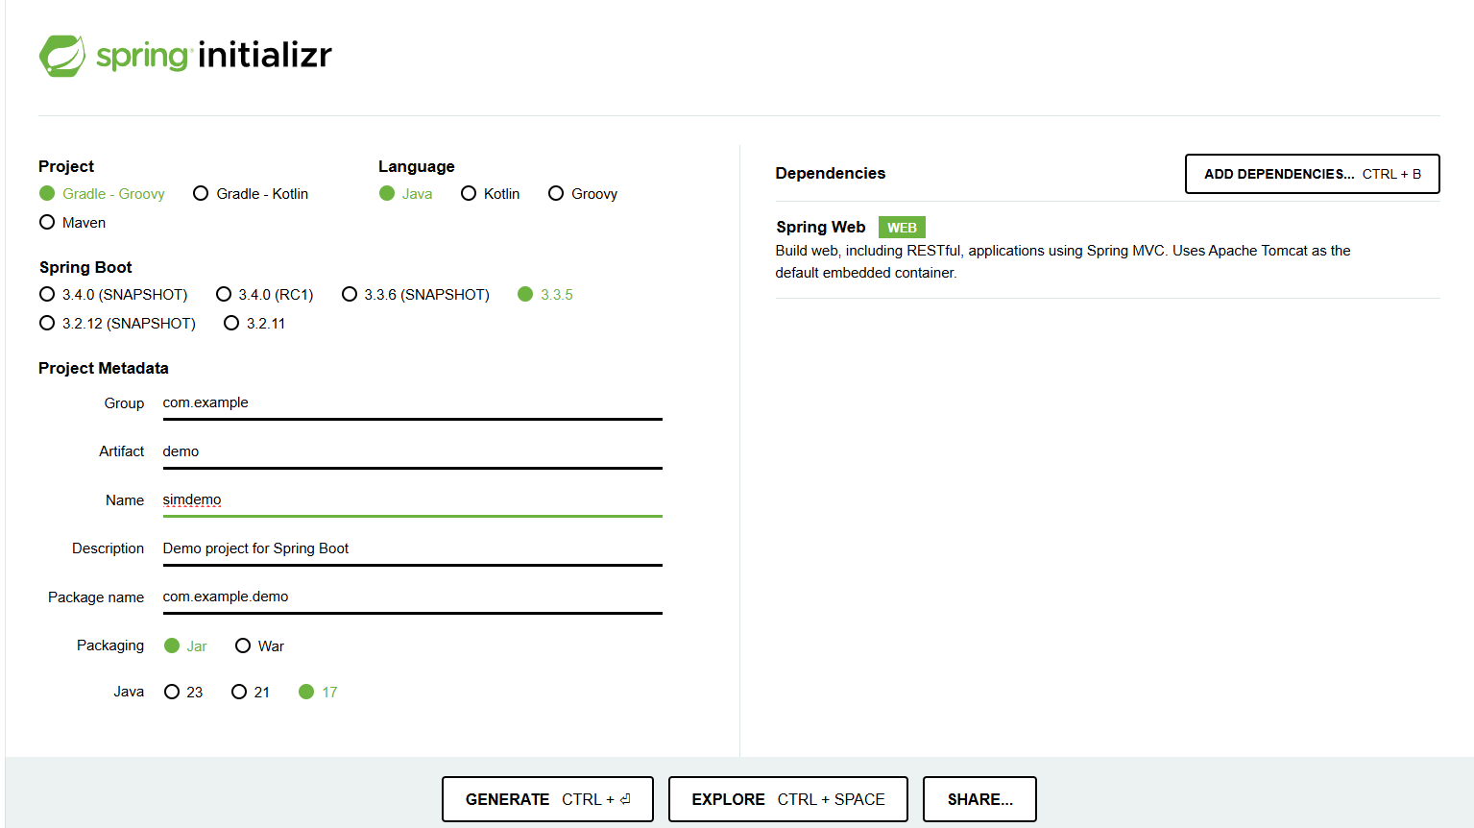
03

Slide 10
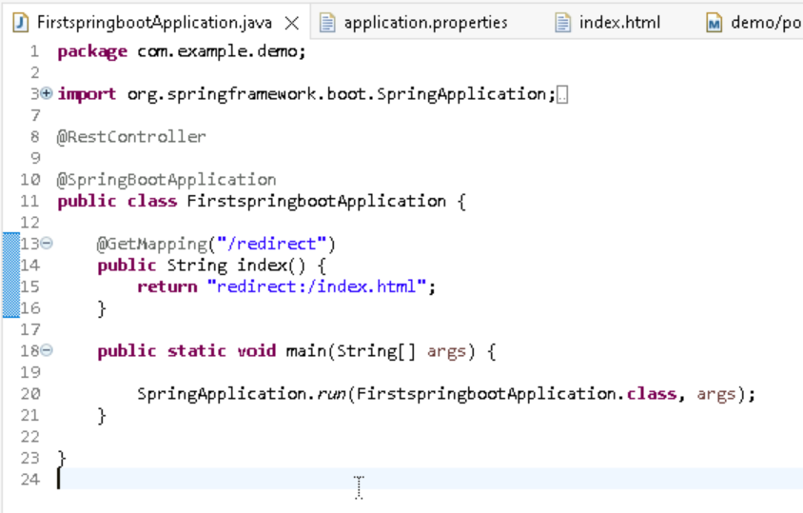
03

Slide 11
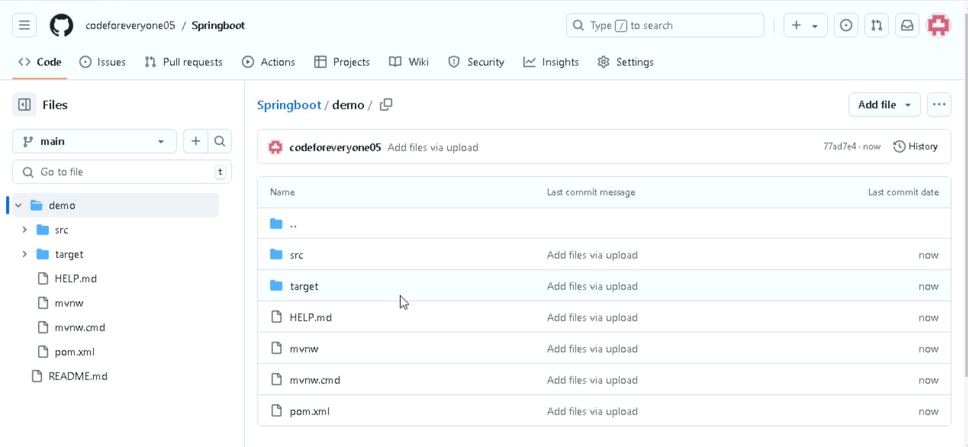
03

Slide 12
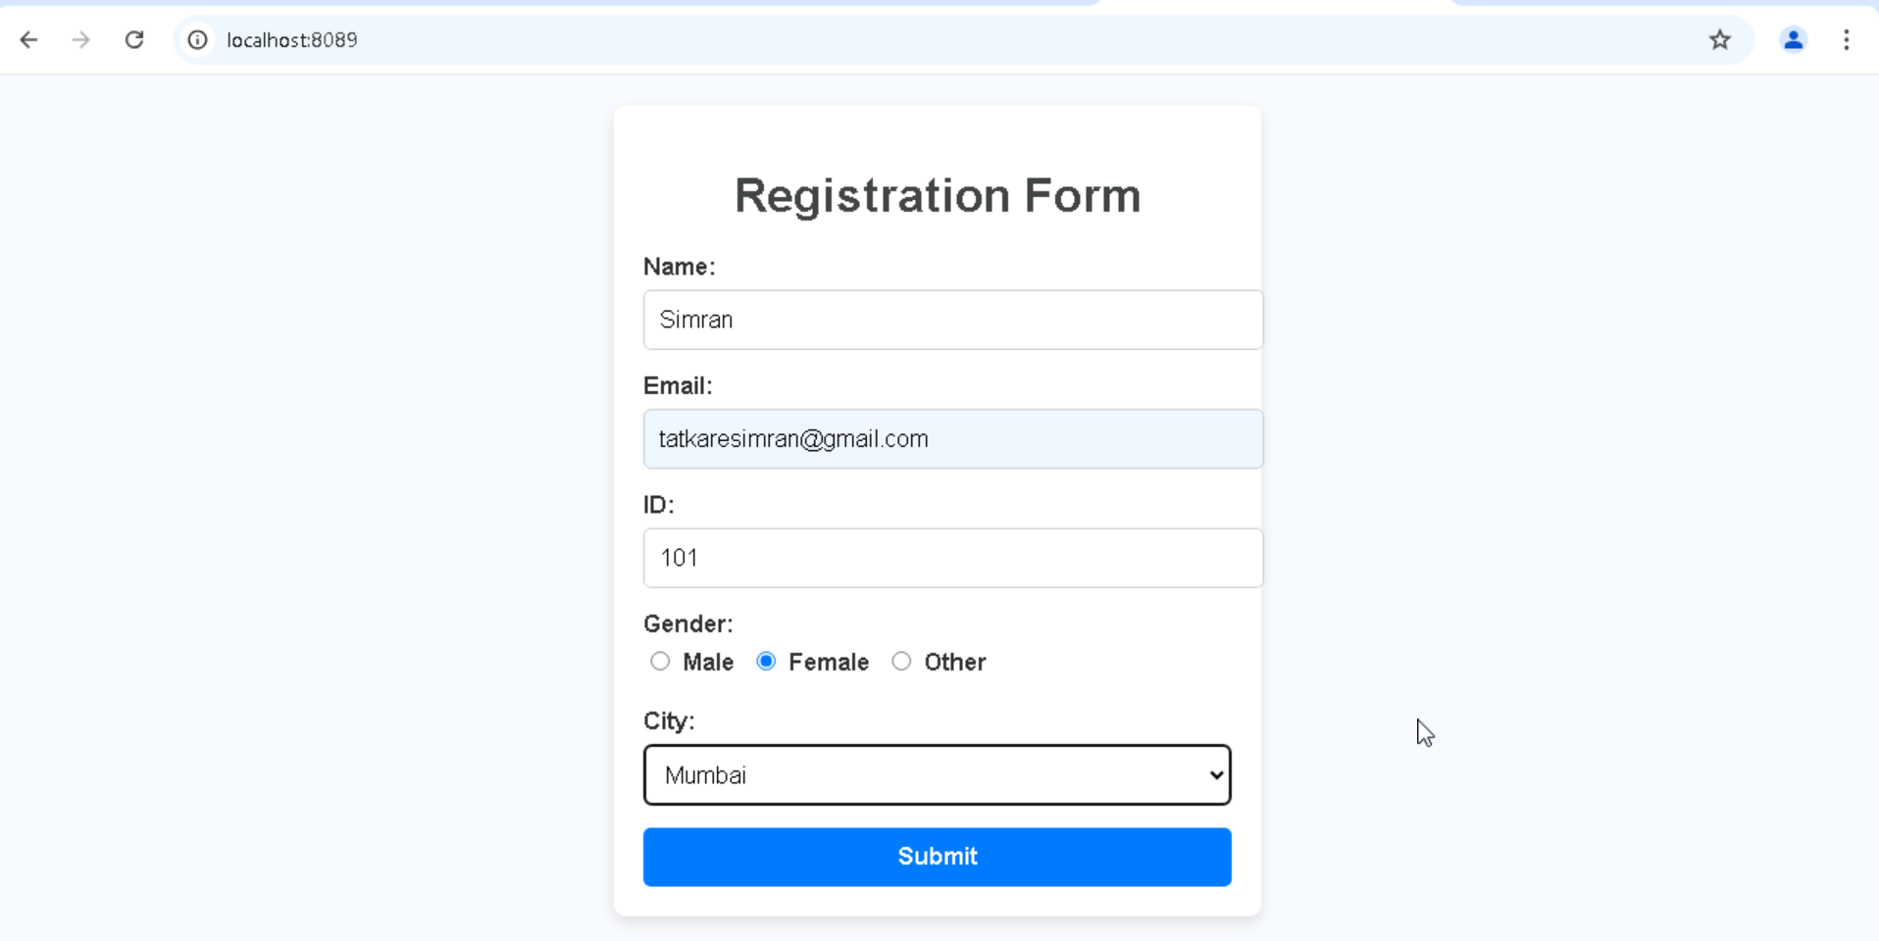
03

Slide 13
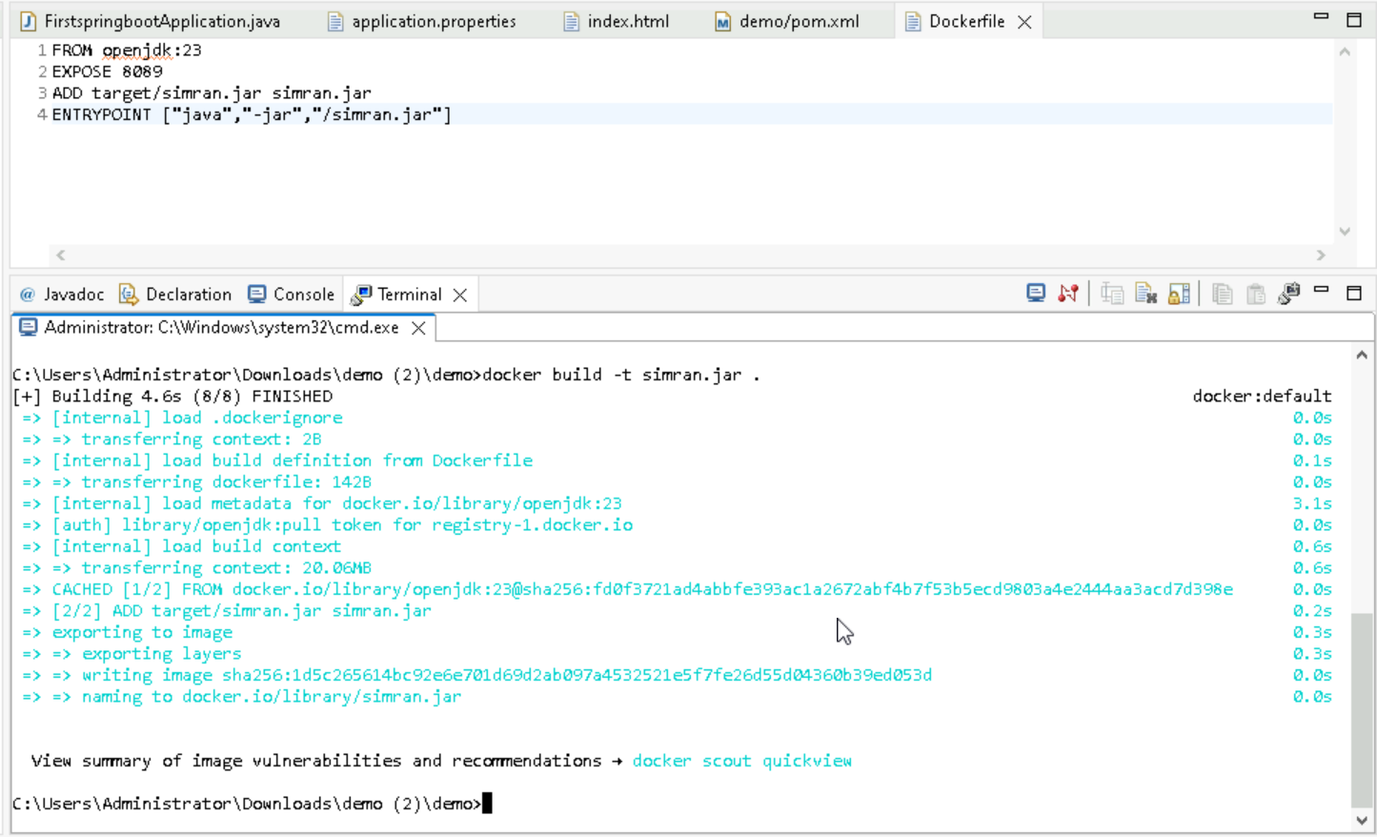
03

Slide 14
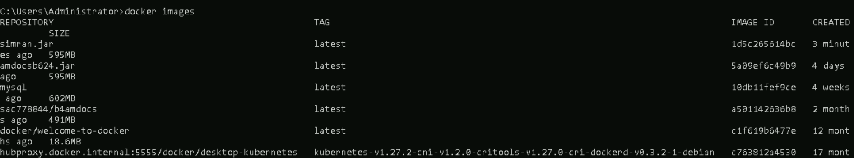
03

Slide 15
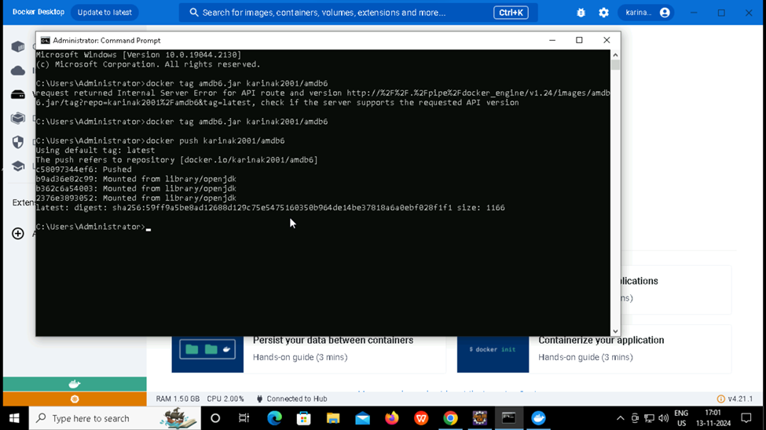

Slide 16
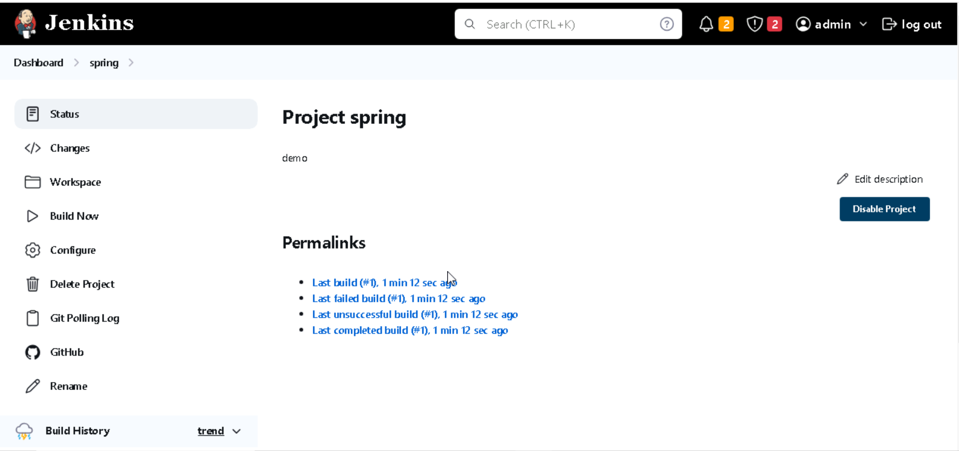

Slide 17
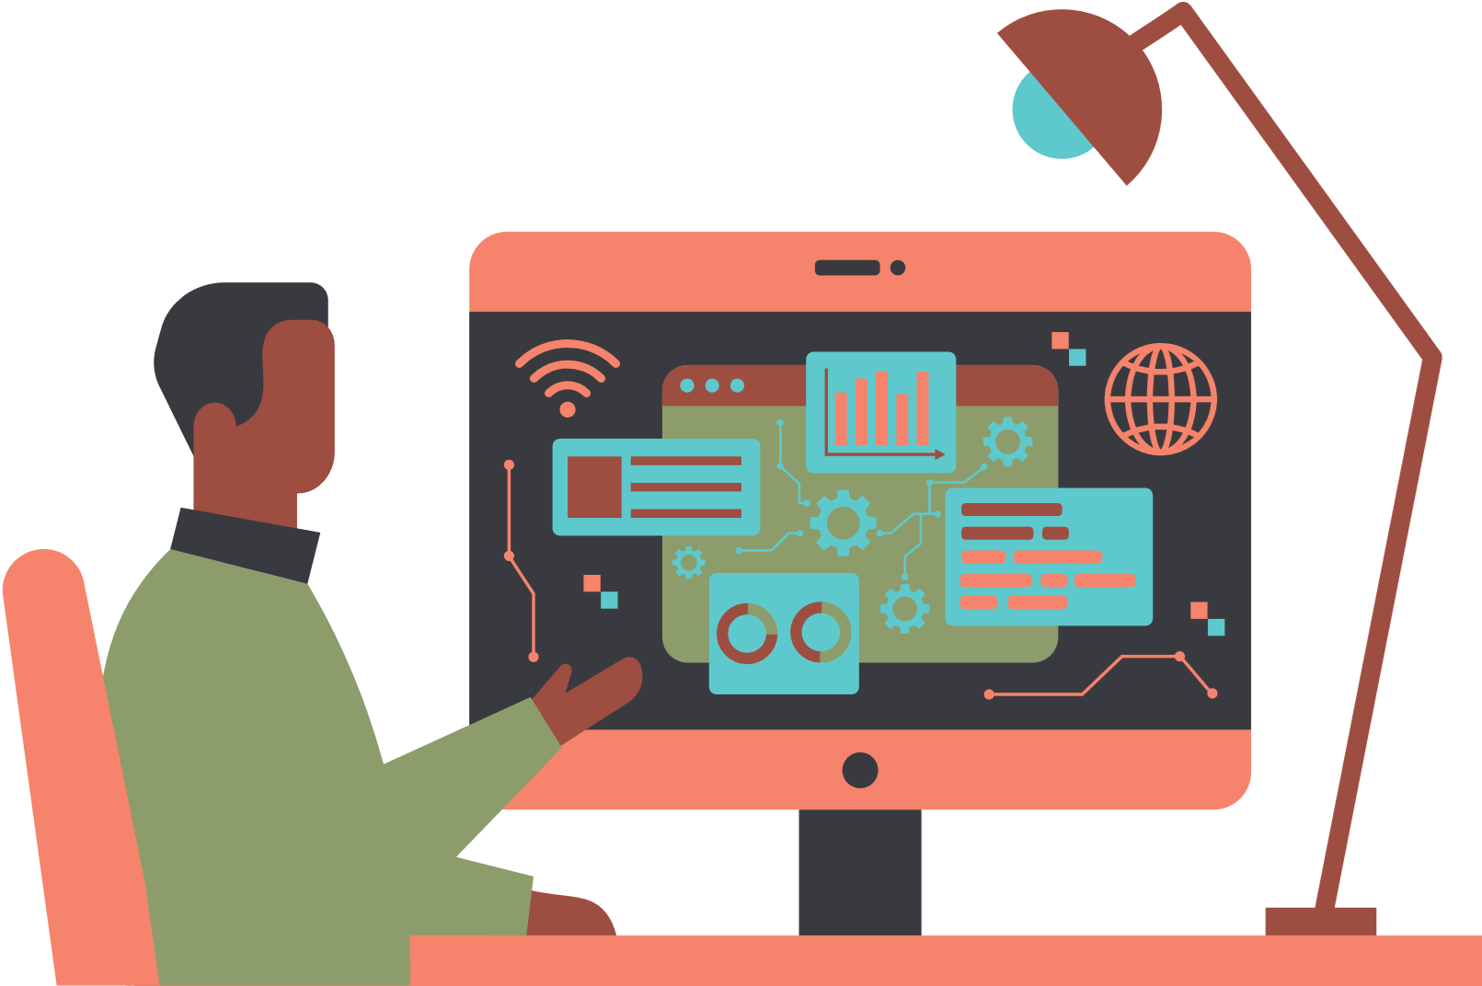
THANK YOU!

