Slide 1

राष्ट्रीय प्रौद्योगिकी संस्थान, रायपुर (छ.ग.), भारत
National Institute of Technology, Raipur (Chhattisgarh), India
Department of Information Technology
Minor Project Final Presentation — November 2026
Spatial-Guided Spectral-Channel Fusion Network
for Hyperspectral Remote Sensing Image Analysis
Under the Guidance of
Presented By
Dr. R.R. Janghel
Tejas Surya
Roll No. 23118098
Associate Professor (Supervisor)
Dept. of Information Technology,
National Institute of Technology, Raipur
B. Vyshnavi
Roll No. 23118021
Valluri Lahitha
Roll No. 23118106
B.Tech Seventh Semester, Nov 2026
National Institute of Technology, Raipur
Notes:
Welcome everyone. This is the final Minor Project presentation for SGSCF-Net.

Slide 2
Outline
» Recap: Problem Statement & Research Objectives
» SGSCF-Net Architecture Overview
» Module Design: SBAM, CBSA, SCFG
» Hybrid Loss Function
» Experimental Setup & Benchmark Datasets
» Results: Indian Pines, Pavia University, Salinas Valley
» Classification Maps Comparison
» Computational Efficiency & Parameter Analysis
» Ablation Study & Depth Sensitivity
» Hyperparameter Grid Search (60 Runs)
» Data Scarcity Stress Testing (1%–10%)
» Cross-Dataset Summary & Key Achievements
» Future Work & Research Directions
Minor Project Report Presentation Nov. 2026
Dept. of IT, NIT Raipur
2 / 20
Notes:
Here is the outline of today's presentation.

Slide 3
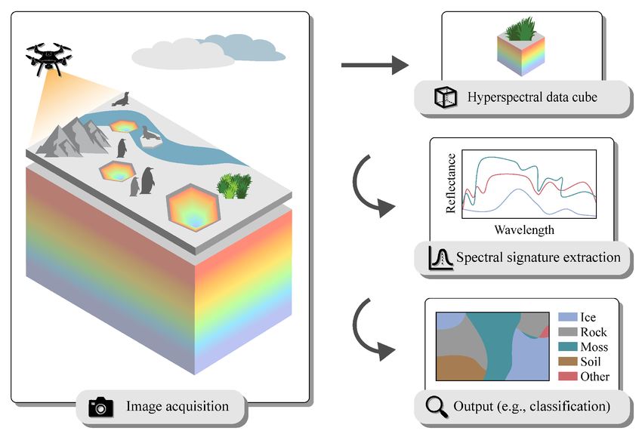
Recap: Problem Statement & Research Objectives
Problems Identified (Mid-Semester)
• Hughes Phenomenon: High bands + low samples = overfitting
• Memory Explosion: 3D-CNNs & Transformers exceed 85M+ parameters
• Feature Entanglement: Spatial + spectral mixing blurs class signatures
• Class Imbalance: Minority classes (Oats: 20 samples) collapse to 0%
• Unfiltered Noise: Atmospheric absorption corrupts raw band features
What We Delivered (This Presentation)
• Fully implemented & trained SGSCF-Net across 3 benchmark HSI datasets (Indian Pines, Pavia University, Salinas Valley)
• 120+ GPU training runs: 60-run patch/batch grid search + 12 data scarcity stress tests + 24 baseline benchmark runs
• Competitive or superior accuracy vs. 8 SOTA baselines while using only 308K parameters (vs. 6.4M for SSAN, ~610K for ViT)
• Complete 31-page ACM-format research paper with per-class breakdowns, classification maps, ablation studies, convergence analysis
Minor Project Report Presentation Nov. 2026
Dept. of IT, NIT Raipur
3 / 20
Notes:
Recall from our mid-semester report, we identified 5 core problems in hyperspectral classification.

Slide 4
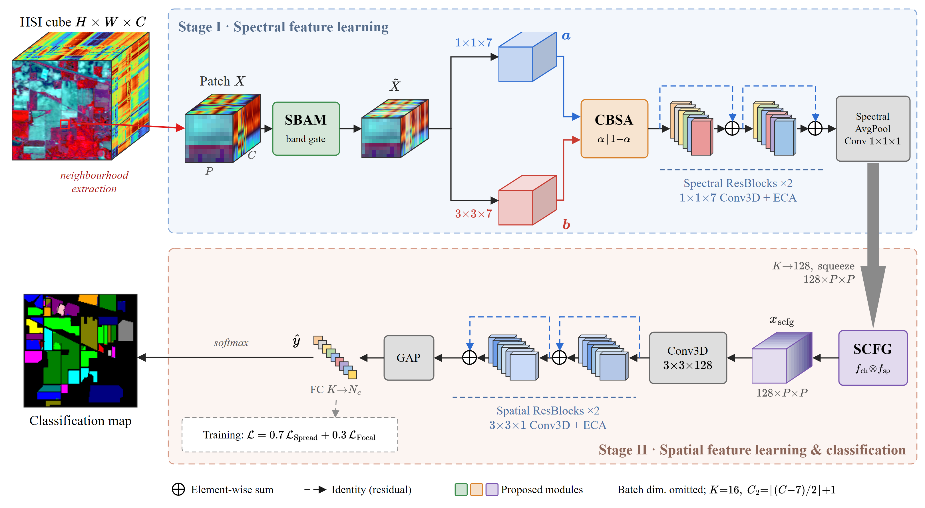
SGSCF-Net: End-to-End Architecture Overview
Input: X ∈ ℝ^(B×1×P×P×C) → SBAM recalibration → Dual-branch CBSA → Spectral deepening → SCFG covariance gating → Spatial refinement → ŷ ∈ ℝ^(B×C_cls)
Stage I: SBAM band gate → Stage II: Dual 3D entry + CBSA complementary gating → Spectral ResBlocks ×2 + ECA → Stage III: SCFG covariance transition → Stage IV: Spatial ResBlocks → GAP + FC | Loss: 0.7×Spread + 0.3×Focal
Minor Project Report Presentation Nov. 2026
Dept. of IT, NIT Raipur
4 / 20
Notes:
This is the full architecture diagram from our paper.

Slide 5
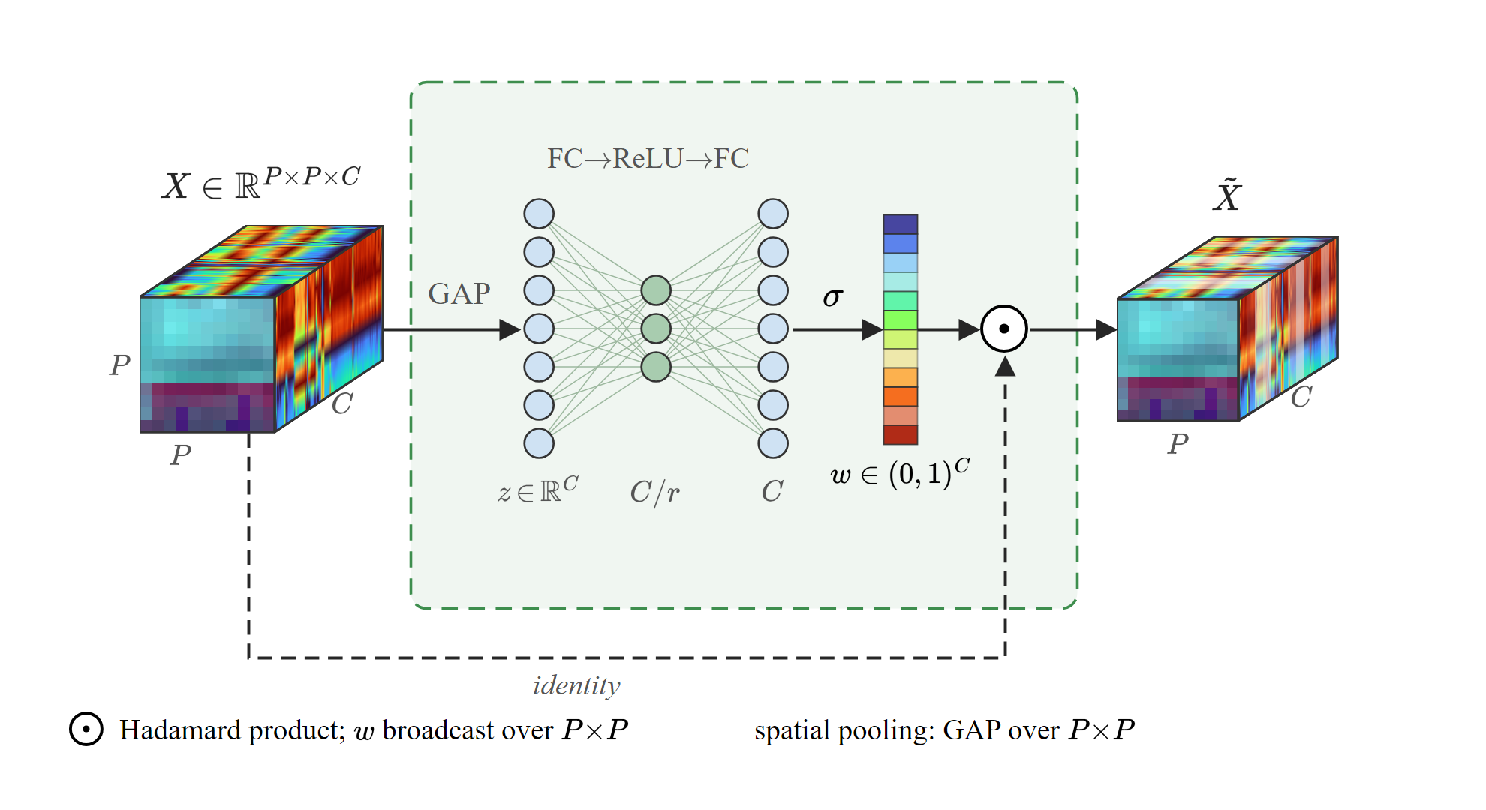
Module 1: Spectral Band Attention Module (SBAM)
What SBAM Does
• Operates on RAW spectral bands BEFORE any convolution
• Adaptive 3D average pooling compresses P×P spatial grid
• Squeeze MLP bottleneck (reduction r=8) learns band weights
• Sigmoid gate w ∈ (0,1)^C suppresses noisy atmospheric bands
• Hadamard product: X̃ = X ⊙ w (channel-wise reweighting)
Key Equations & Design Insight
• z_c = (1/P²) ∑ X(b,1,u,v,c) [spatial pooling]
• w = σ(W₂ · δ(W₁z + b₁) + b₂) [MLP bottleneck]
• X̃ = X ⊙ E(w) [band filtering]
•
• Recalibrates BEFORE convolution (unlike SENet/CBAM)
• Only 10,225 params (3.32% of total network)
Minor Project Report Presentation Nov. 2026
Dept. of IT, NIT Raipur
5 / 20
Notes:
SBAM is our first novel module.

Slide 6
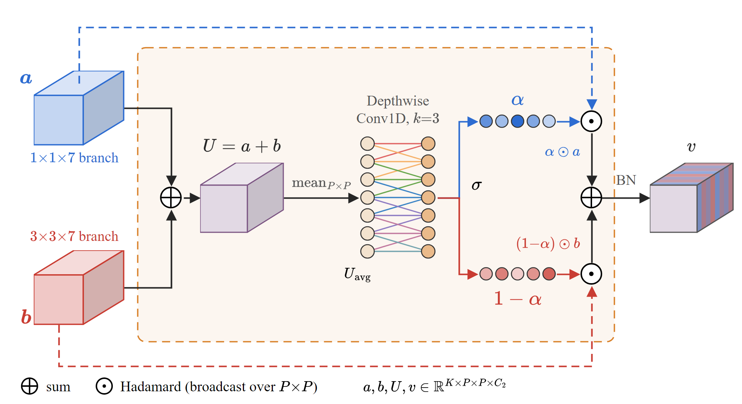
Module 2: Complementary Branch Spectral Attention (CBSA)
Dual-Branch Design
• Branch a: 1×1×7 Conv3D → pure spectral inter-band transitions
• Branch b: 3×3×7 Conv3D → joint spatial-spectral context
• Both: K=16 filters, spectral stride=2, BN + ReLU
•
• Complementary Gating:
• α = σ(Conv1D_k(MeanPool(a + b))) [k=3]
• v = BN(α ⊙ a + (1-α) ⊙ b)
Key Insight & Efficiency
• α + (1-α) ≡ 1 → ZERO redundancy between branches
• When α → 1: spectral fidelity dominates
• When α → 0: spatial context dominates
• Forces non-overlapping orthogonal representations
• Only 80 parameters (0.03%) for the gating layer
• Followed by 2 Spectral ResBlocks + ECA-3D (7,364 params)
Minor Project Report Presentation Nov. 2026
Dept. of IT, NIT Raipur
6 / 20
Notes:
CBSA is our second novel module.

Slide 7
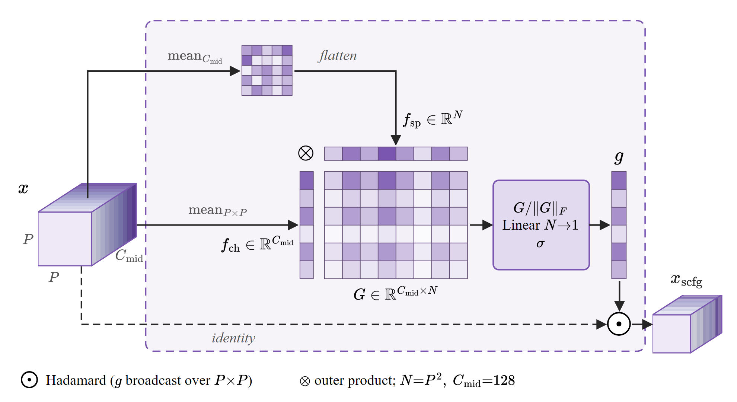
Module 3: Second-Order Covariance Fusion Gate (SCFG)
Covariance-Based Channel Calibration
• Transitions from spectral → spatial processing stage
• Adaptive 3D pool collapses spectral dim: C₂ → 1
• 1×1×1 Conv3D expands: K=16 → C_mid=128
•
• Second-Order Statistics:
• f_ch ∈ ℝ^(B×C): channel descriptor (mean over spatial)
• f_sp ∈ ℝ^(B×N): spatial descriptor (mean over channels)
• G = f_ch ⊗ f_sp ∈ ℝ^(B×C×N) [outer product]
Frobenius Normalization & Gating
• G̃ = G / (||G||_F + ε) [Frobenius norm stabilization]
• g = σ(W_G · G̃) ∈ ℝ^(B×C_mid) [linear projection]
• x_scfg = x ⊙ g [spatial modulation]
•
• Only 82 parameters (0.03% of network)
• Captures bilinear correlations missed by first-order GAP
Minor Project Report Presentation Nov. 2026
Dept. of IT, NIT Raipur
7 / 20
Notes:
SCFG is our third novel module.

Slide 8
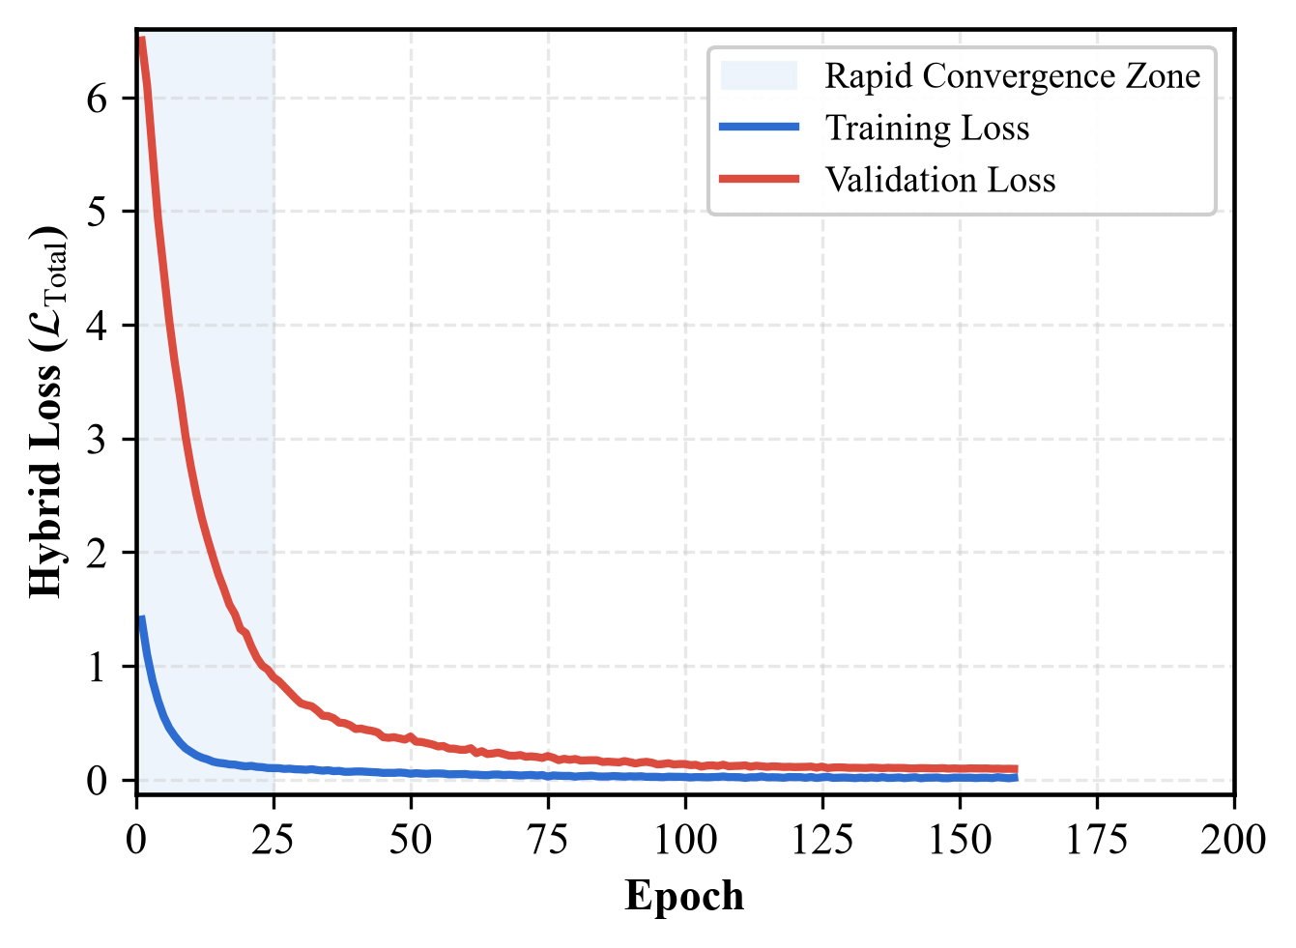
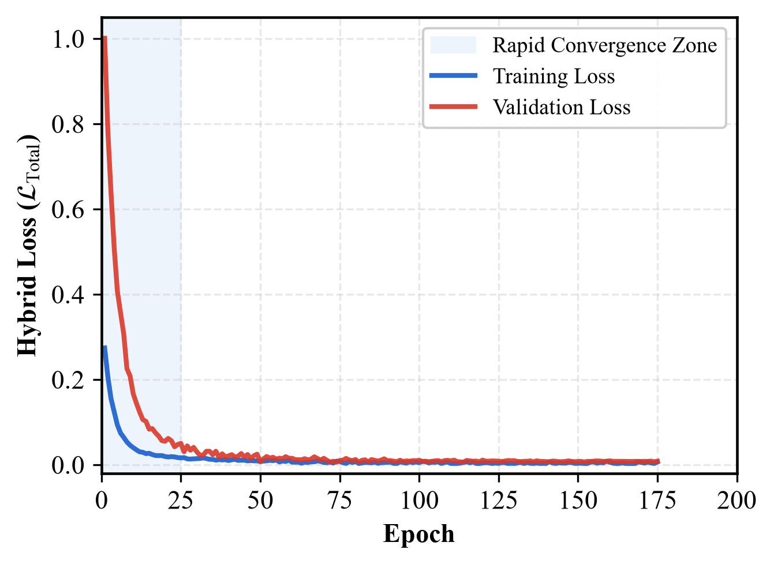
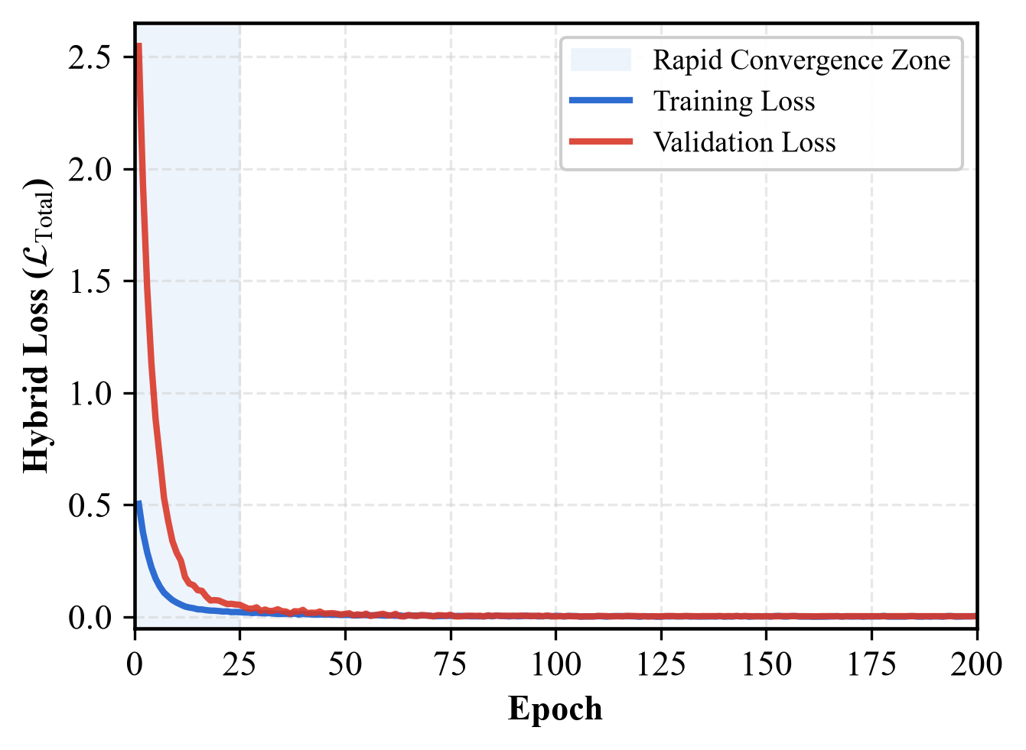
Minority-Aware Hybrid Loss Function
Spread Loss (weight = 0.7)
• Dynamic margin m(r) = 0.2 + 0.7·r, scheduled over training
• Early epochs: relaxed margin (m=0.2) prevents over-penalization
• Late epochs: strict margin (m=0.9) enforces wide class boundaries
Focal Loss (weight = 0.3)
• Inverse-frequency class weights: w_c = 1/(N_c + ε)
• Focusing parameter γ=2.0 down-weights easy-to-classify samples
• Prevents majority classes from dominating gradients over minorities
Training & Validation Loss Convergence (200 Epochs)
Indian Pines
Pavia University
Salinas Valley
Minor Project Report Presentation Nov. 2026
Dept. of IT, NIT Raipur
8 / 20
Notes:
Our hybrid loss combines Spread Loss with Focal Loss.

Slide 9
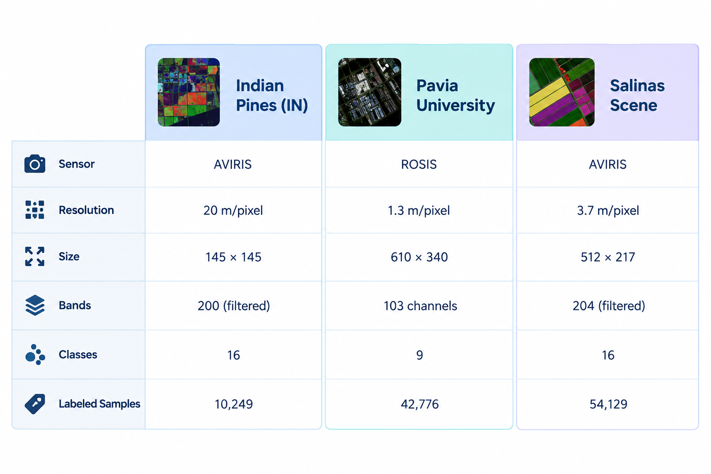
Experimental Setup & Benchmark Datasets
Standardized Evaluation Protocol
• Split: 10% Train / 10% Validation / 80% Test
• Stratified per class (preserved proportions)
• Patch size: 11×11 spatial neighborhood
• Batch size: 32, Epochs: 200
• Optimizer: Adam, LR: 5×10⁻⁴ → 10⁻⁶
• Cosine Annealing LR schedule
• Hardware: NVIDIA Tesla T4 GPU (Kaggle)
8 Baseline Models Benchmarked
• 3D CNNs: SSRN, A2S2K-ResNet
• Transformers: ViT, HSI-SSFTT, HyperRoPE-HiT
• Attention Networks: SSAN
• Capsule / Hybrid: DMC, CRV-MHDL
• All trained from scratch, identical protocol
• 24 total baseline runs (8 models × 3 datasets)
Minor Project Report Presentation Nov. 2026
Dept. of IT, NIT Raipur
9 / 20
Notes:
We evaluated on three standard HSI benchmarks.

Slide 10
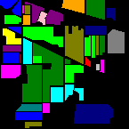

Results: Indian Pines — Per-Model Comparison
Model | OA (%) | AA (%) | κ | Time (min)
SSRN | 98.52 | 79.99 | 0.9831 | 6.29
A2S2K-ResNet | 98.11 | 94.41 | 0.9785 | 14.89
HyperRoPE-HiT | 94.07 | 89.37 | 0.9324 | 1.43
HSI-SSFTT | 98.45 | 94.29 | 0.9823 | 1.05
DMC | 82.55 | 64.11 | 0.7989 | 17.73
ViT | 90.33 | 89.12 | 0.8895 | 1.68
CRV-MHDL | 67.20 | 51.71 | 0.6222 | 1.33
SSAN | 64.19 | 72.77 | 0.5979 | 14.00
SGSCF-Net (Ours) | 98.05 | 94.82 | 0.9778 | 8.80
Classification Maps
Ground Truth
SGSCF-Net
Key Finding
• SSRN tops OA (98.52%) but 0% on
• Alfalfa, Grass-mowed, Oats
• SGSCF-Net: BEST AA (94.82%)
• Alfalfa: 95.00%, Oats: 54.17%
• vs. SSRN: 0%, 0%, 0% on those
Minor Project Report Presentation Nov. 2026
Dept. of IT, NIT Raipur
10 / 20
Notes:
On Indian Pines, SGSCF-Net achieves 98.05% OA and the BEST Average Accuracy of 94.82%.

Slide 11
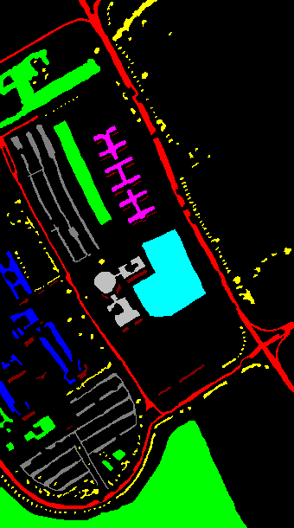

Results: Pavia University — Urban Material Classification
99.82%
99.71%
99.76
12.9 min
Overall Accuracy
Average Accuracy
Kappa (κ × 100)
Training Time
Per-Class Highlights
• 4 classes at 100.00%: Asphalt, Painted Metal, Bare Soil, Bitumen
• Meadows: 100.00% (14,919 test pixels classified perfectly)
• Gravel: 99.76% — historically confused with Asphalt
• Shadows (947 px): 99.34% via SCFG covariance operator
Baseline Context
• SSRN: 99.87% OA (marginally higher, 11.36 min)
• A2S2K-ResNet: 99.83% OA, 41.12 min (3.2× slower)
• SSAN: 76.82% OA — Gravel drops to 17.96%
Ground Truth
SGSCF-Net
Minor Project Report Presentation Nov. 2026
Dept. of IT, NIT Raipur
11 / 20
Notes:
On Pavia University, SGSCF-Net achieves 99.82% OA.

Slide 12
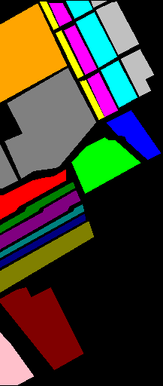

Results: Salinas Valley — Fine-Grained Agriculture
99.92%
99.92%
99.91
57.7 min
Overall Accuracy
Average Accuracy
Kappa (κ × 100)
Training Time
Per-Class Highlights
• 11 of 16 classes reach 100.00% accuracy
• All 4 Romaine lettuce growth stages (4-7 wk): 99.65-100%
• Vineyard untrained: 99.73% vs. Vineyard trellis: 100.00%
• SCFG captures chlorophyll absorption band-ratio shifts
Baseline Context
• A2S2K-ResNet: 100.00% OA (10.34 min, similar speed)
• SSAN: 88.20% OA — Grapes untrained 57.89%, collapse
• OA trend: 98.05% (IP) → 99.82% (PU) → 99.92% (SV)
Ground Truth
SGSCF-Net
Minor Project Report Presentation Nov. 2026
Dept. of IT, NIT Raipur
12 / 20
Notes:
On Salinas Valley, SGSCF-Net reaches 99.92% OA.

Slide 13
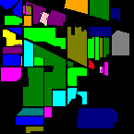
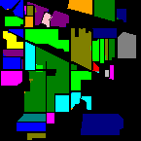


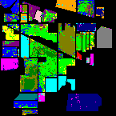
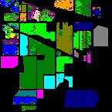
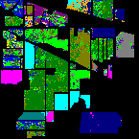
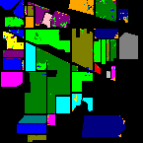




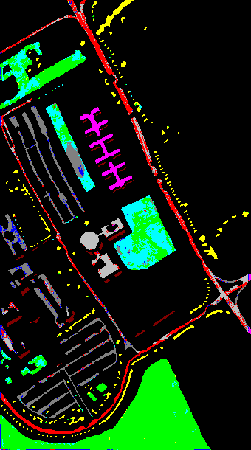







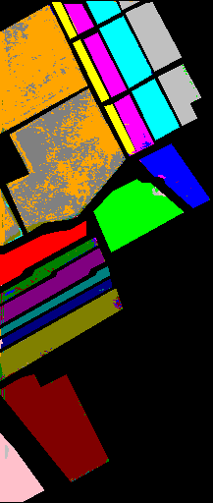

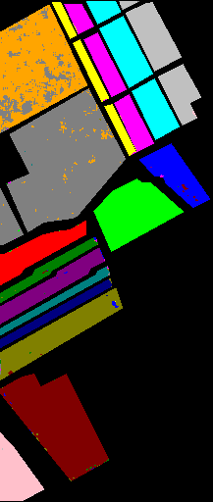

Visual Comparison: Classification Maps Across Models
Indian
Pines
GT
Ours
SSRN
SSFTT
A2S2K
ViT
SSAN
DMC
CRV
HiT
Pavia
Univ.
GT
Ours
SSRN
SSFTT
A2S2K
ViT
SSAN
DMC
CRV
HiT
Salinas
GT
Ours
SSRN
SSFTT
A2S2K
ViT
SSAN
DMC
CRV
HiT
Minor Project Report Presentation Nov. 2026
Dept. of IT, NIT Raipur
13 / 20
Notes:
Classification maps across all 9 models plus ground truth.

Slide 14
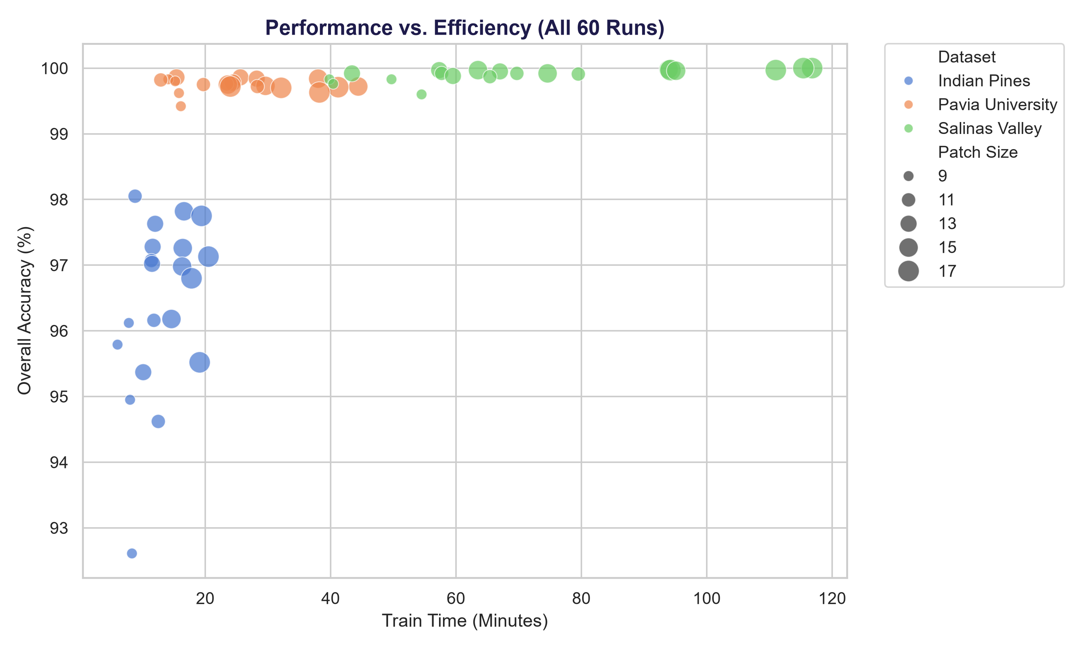
Computational Efficiency & Parameter Analysis
Model | Params | Checkpoint | IP Time | OA (%)
ViT | ~610K | 2.4 MB | 1.68 min | 90.33
HSI-SSFTT | ~156K | 625 KB | 1.05 min | 98.45
A2S2K-ResNet | ~380K | 1.5 MB | 14.89 min | 98.11
SSAN | 6.40M | — | 14.00 min | 64.19
DMC | ~480K | — | 17.73 min | 82.55
SGSCF-Net (Ours) | 308,097 | 1.2 MB | 8.80 min | 98.05
Module-Level Parameter Breakdown (Indian Pines)
• SBAM: 10,225 (3.32%) | CBSA: 80 (0.03%) | SCFG: 82 (0.03%) → 3 novel modules = only 10,387 params (3.37% of total)
• Primary volume: Spatial 3D entry (11.98%) + Spatial ResBlocks (81.00%) — standard Conv3D backbone
• Classifier head: 272 params (0.09%) — single linear layer, no deep FC stacks
Minor Project Report Presentation Nov. 2026
Dept. of IT, NIT Raipur
14 / 20
Notes:
SGSCF-Net uses only 308K parameters.

Slide 15
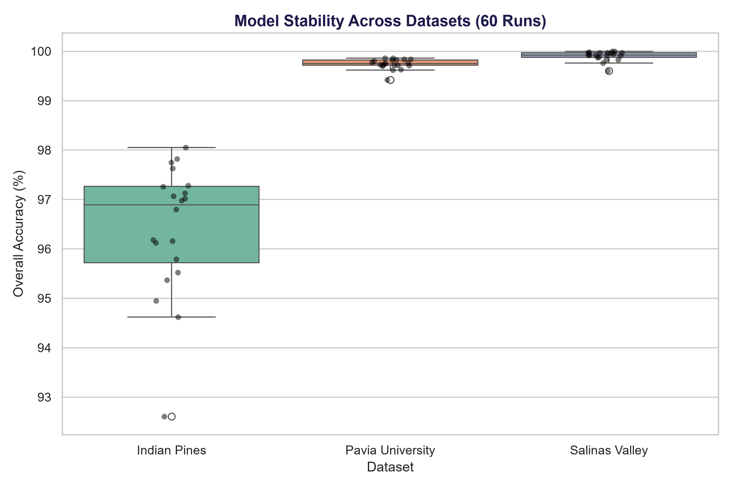
Ablation Study & Block Depth Sensitivity
# | SBAM | CBSA | SCFG | H.Loss | OA (%) | AA (%)
1 | ✓ | × | × | × | 93.65 | 89.24
2 | ✓ | ✓ | × | × | 95.18 | 91.80
3 | ✓ | ✓ | ✓ | × | 96.44 | 93.05
4 | ✓ | ✓ | ✓ | CE | 97.26 | 93.78
5 | ✓ | ✓ | ✓ | ✓ | 98.05 | 94.82
Ablation Insights
• SBAM alone lifts baseline from ~90% to 93.65% OA
• Replacing shared SE gate with CBSA: +1.53% OA
• SCFG adds +1.26% via second-order correlations
• Hybrid loss: +0.79% OA, +1.04% AA (minority protection)
• Oats class: 0% (CE-only) → 54.17% (hybrid loss)
Block Depth Sensitivity (D)
• D=1: 179K params, 95.82% OA (underfits)
• D=2: 308K params, 98.05% OA (optimal ✔)
• D=3: 437K params, 97.88% OA (diminishing returns)
• D=4: 566K params, 97.40% OA (overfitting onset)
• D=2 yields best accuracy-efficiency trade-off
Minor Project Report Presentation Nov. 2026
Dept. of IT, NIT Raipur
15 / 20
Notes:
Our ablation study shows each component contributes measurably.

Slide 16
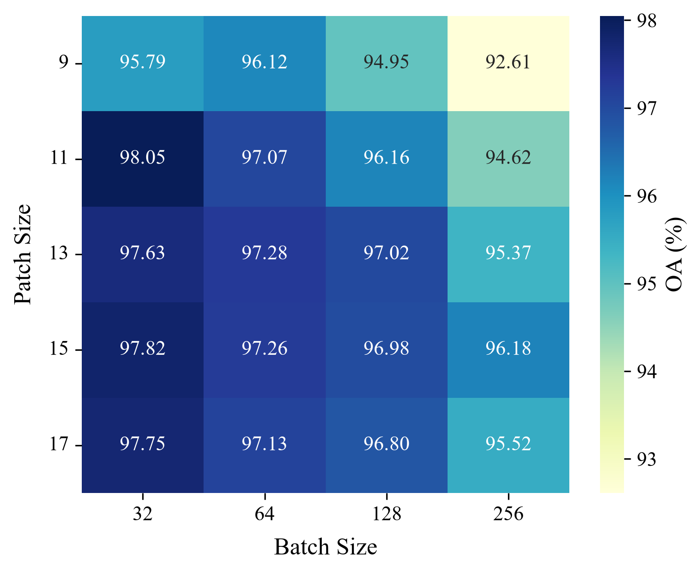
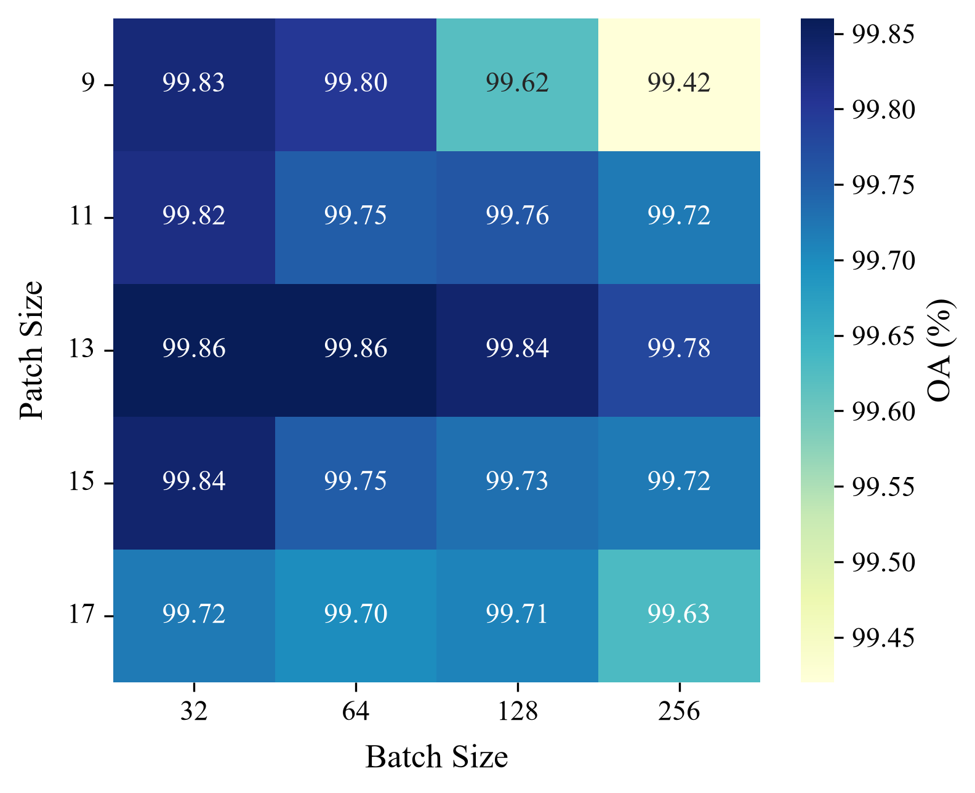
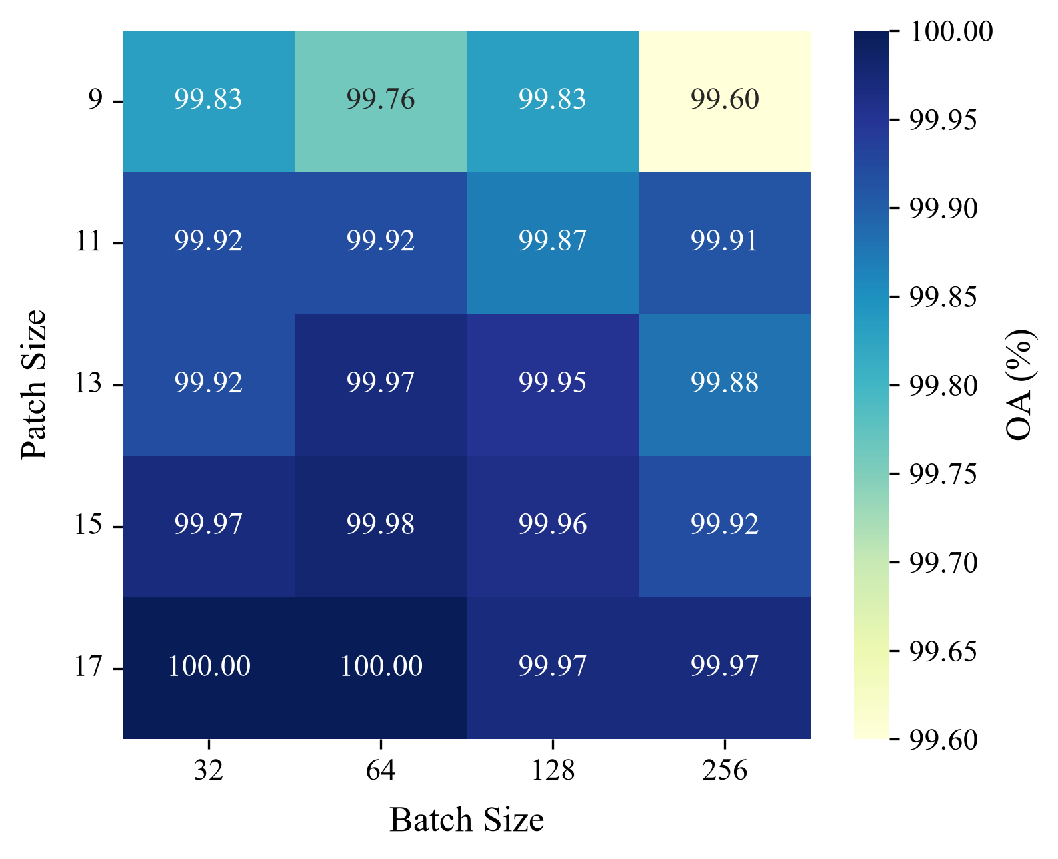
60-Run Hyperparameter Grid Search
5 Patch Sizes (9×9, 11×11, 13×13, 15×15, 17×17) × 4 Batch Sizes (32, 64, 128, 256) = 20 runs/dataset × 3 datasets = 60 total
Indian Pines OA Heatmap
Pavia University OA Heatmap
Salinas Valley OA Heatmap
Optimal Configuration
• Patch 11×11, Batch 32
• OA: 98.05% (IP), 99.82% (PU), 99.92% (SV)
• Consistent Rank 1 or within 0.08%
Spatial Window Trade-off
• 9×9: underfits (misses texture boundaries)
• 15×15, 17×17: overfits (cross-field contamination)
• 11×11 at 20m/pixel = 220m ground distance
Batch Size Dynamics
• B=32 beats B=256 by 3.43% on Indian Pines
• Small batches: higher gradient variance
• Preserves minority class decision boundaries
Minor Project Report Presentation Nov. 2026
Dept. of IT, NIT Raipur
16 / 20
Notes:
We ran a 60-run grid search across 5 patch sizes and 4 batch sizes.

Slide 17
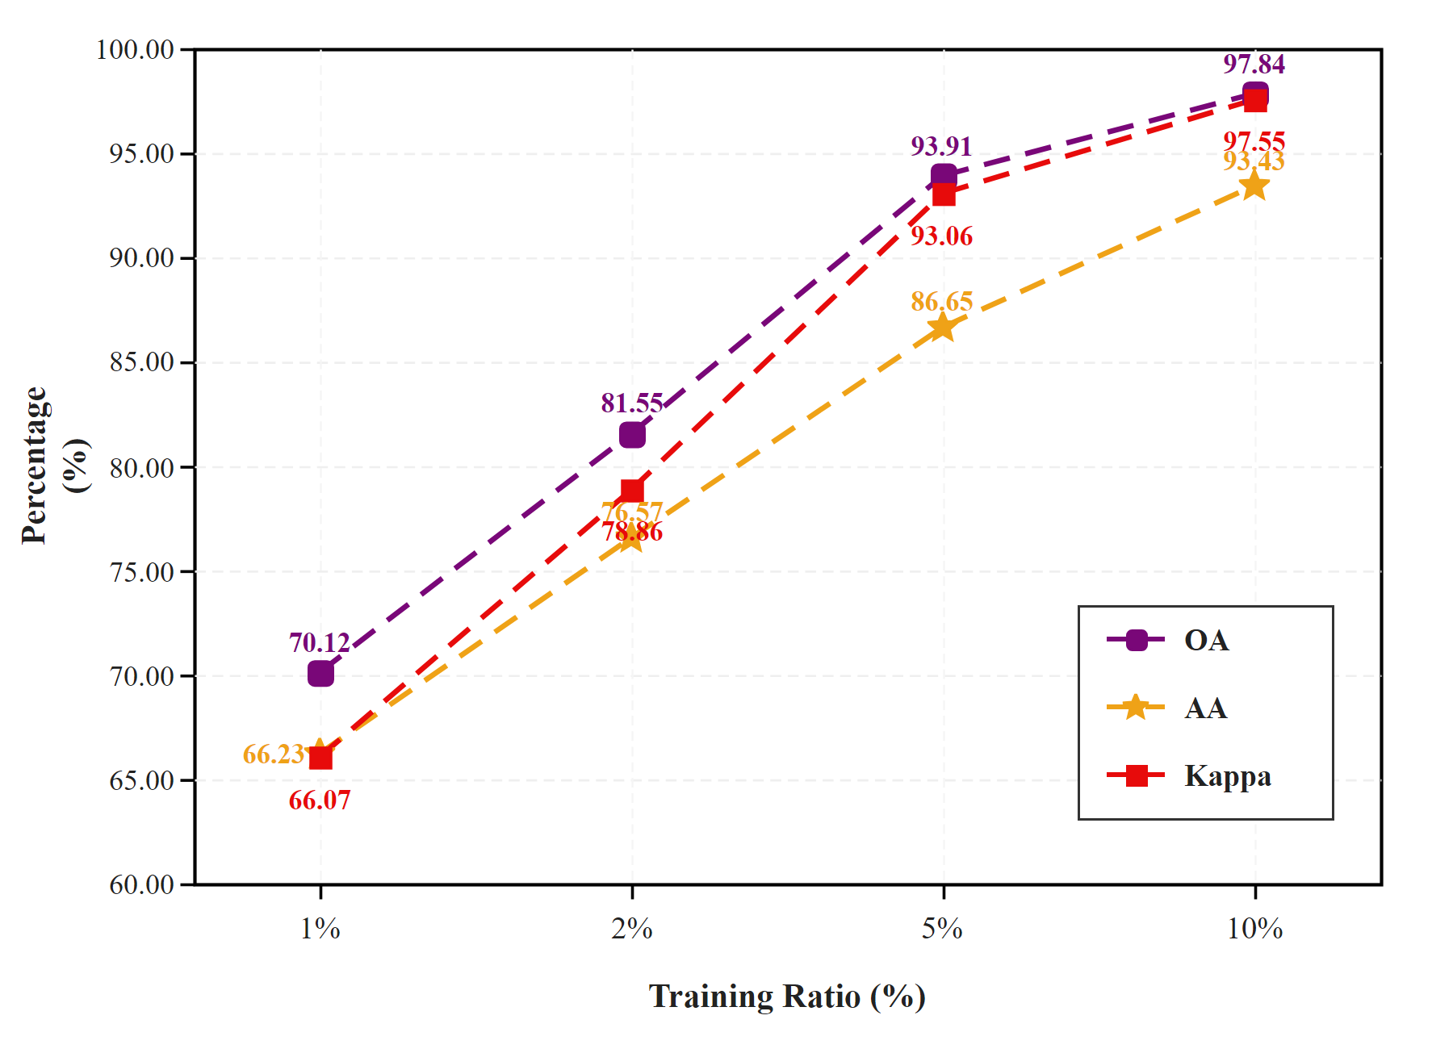
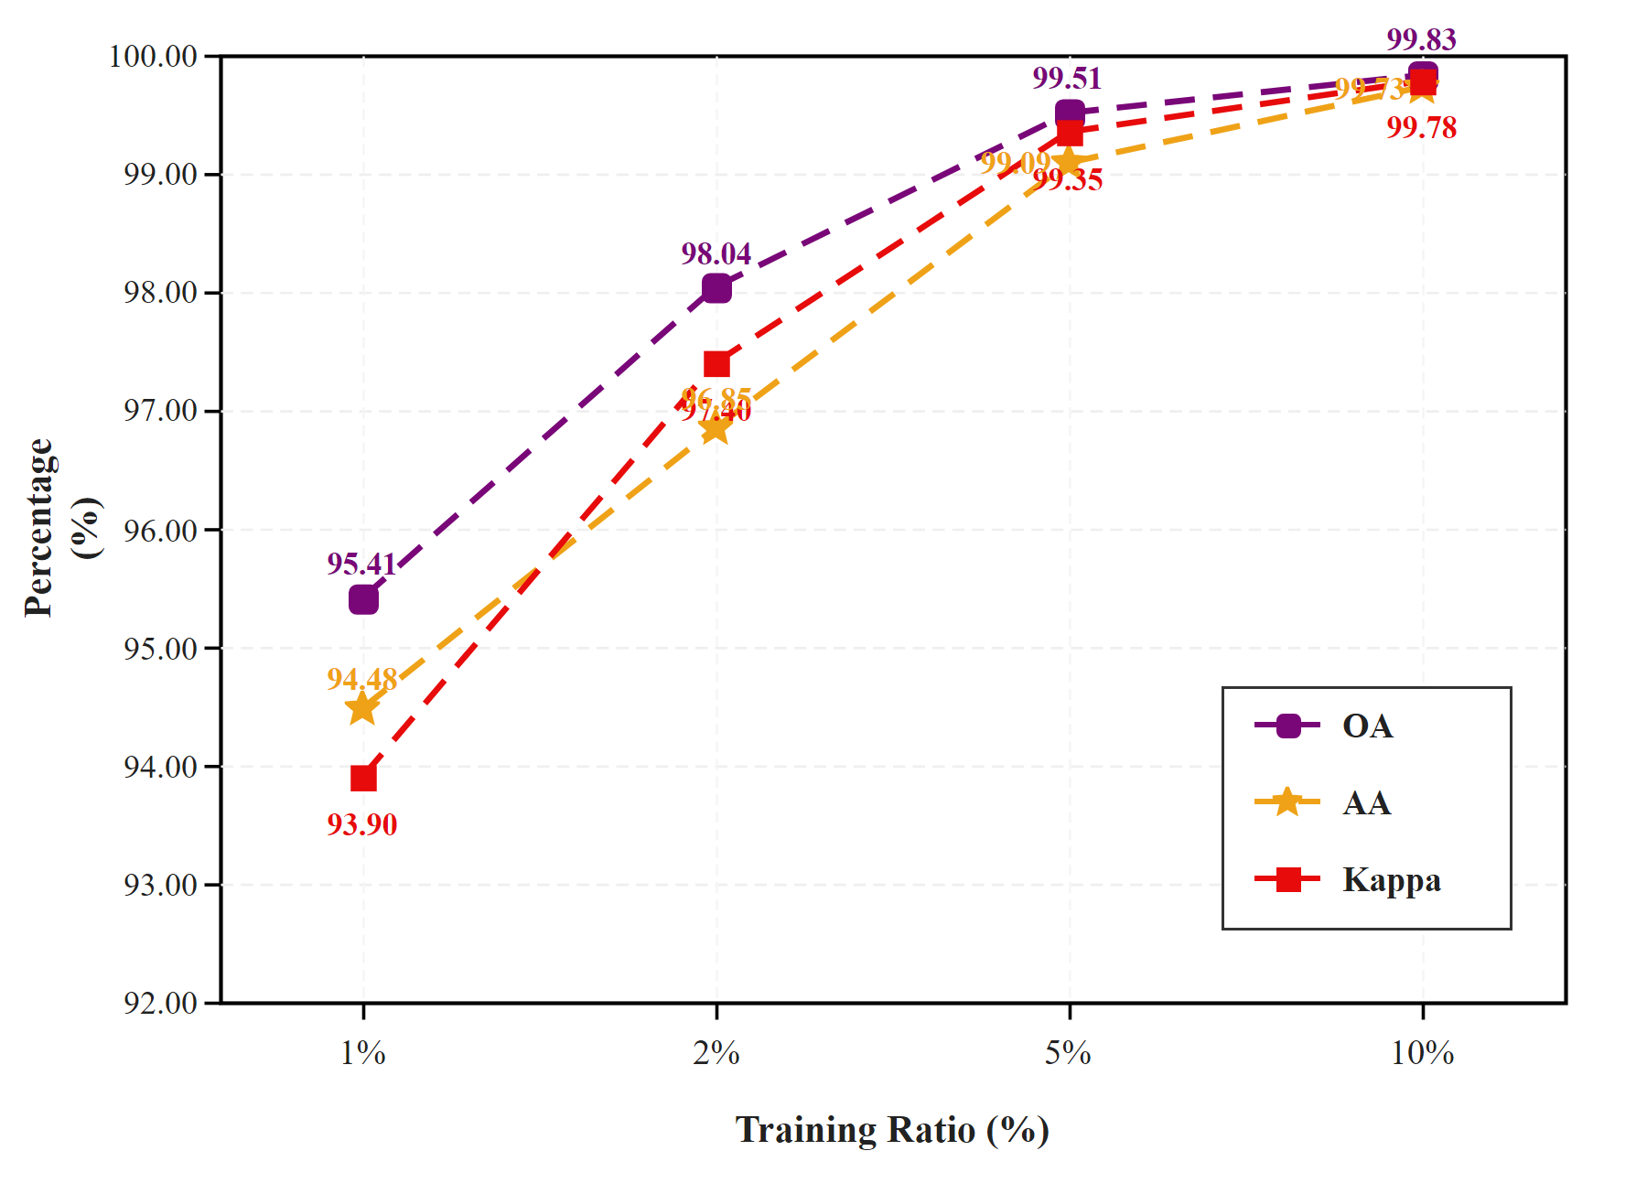
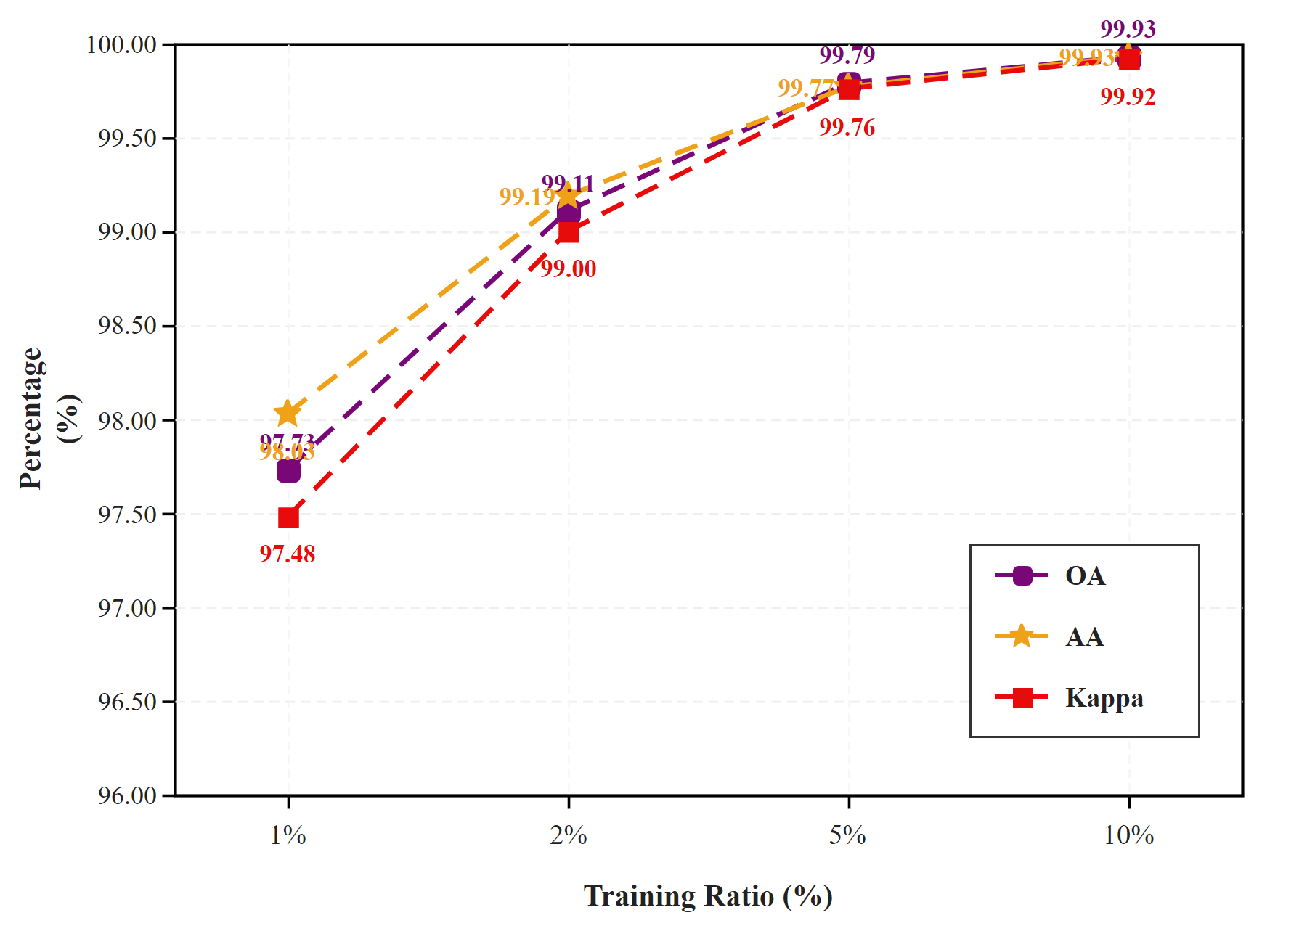
Data Scarcity Stress Testing: 1% – 10% Training Ratios
Dataset | 1% Train | 2% Train | 5% Train | 10% Train | Drop
Indian Pines | 70.12% | 81.55% | 93.91% | 97.84% | -27.73%
Pavia University | 95.41% | 98.04% | 99.51% | 99.83% | -4.43%
Salinas Valley | 97.73% | 99.11% | 99.79% | 99.93% | -2.20%
Indian Pines Degradation
Pavia University Degradation
Salinas Valley Degradation
Salinas: most resilient (−2.20%, 97.73% at 1%) | Pavia: moderate (−4.43%, 95.41% at 1%) | Indian Pines: steepest drop (−27.73%, 70.12% at 1% — Oats has 1–2 patches)
Minor Project Report Presentation Nov. 2026
Dept. of IT, NIT Raipur
17 / 20
Notes:
We stress-tested from 10% down to 1% training data.

Slide 18
Cross-Dataset Summary & Key Achievements
98.05%
99.82%
99.92%
308K
Indian Pines OA
Pavia Univ. OA
Salinas Valley OA
Total Parameters
Project Achievements
• Designed & implemented 3 novel modules (SBAM, CBSA, SCFG)
• Best Average Accuracy on Indian Pines (94.82%) across all 9 models
• 99.82% OA on Pavia, 99.92% OA on Salinas (near-perfect)
• 120+ GPU runs: 60 grid search + 12 scarcity + 24 baseline + proposed
• O(N) linear complexity — no quadratic self-attention overhead
• 1.18s test inference on Indian Pines (vs. 135.74s SSAN)
• Complete 31-page ACM-format research manuscript drafted
Why SGSCF-Net Matters
• Lightweight: 308K params vs. 6.4M SSAN, ~610K ViT, ~480K DMC
• Balanced: Protects minority classes where SSRN/SSAN collapse to 0%
• Generalizable: Consistent top-tier across 3 diverse HSI scenes
• Efficient: 8.80 min training vs. 17.73 (DMC), 41.12 (A2S2K)
• Modular: SBAM/CBSA/SCFG are plug-and-play for any 3D CNN
• Reproducible: Fixed 10/10/80 split, 200 epochs, public datasets
• Edge-deployable: 1.2 MB checkpoint, suitable for UAV/satellite
Minor Project Report Presentation Nov. 2026
Dept. of IT, NIT Raipur
18 / 20
Notes:
Summary: best AA on Indian Pines, near-perfect on Pavia and Salinas.

Slide 19
Future Work & Research Directions
1
Hardware-Aware Quantization
2
Self-Supervised Pretraining
INT8/FP8 tensor quantization + structured pruning for real-time inference on edge NPUs and FPGAs aboard UAVs and satellite platforms
Masked spectral pre-training on large uncurated HSI cubes to learn transferable representations and reduce label dependency below 1%
3
Multi-Modal Fusion
4
Journal Publication
Extend SCFG covariance mechanism to joint HSI + LiDAR classification for multi-sensor Earth observation pipelines
Target IEEE Transactions on Geoscience and Remote Sensing (TGRS) or similar Q1 journal for peer-reviewed publication of this work
Minor Project Report Presentation Nov. 2026
Dept. of IT, NIT Raipur
19 / 20
Notes:
Four directions for future work.

Slide 20
Thank You
Questions & Discussion
SGSCF-Net: Spectral-Guided Spatial Cross-Attention Fusion Network
for Hyperspectral Image Classification
Presented By
Guided By
Tejas Surya — Roll No. 23118098
Dr. R.R. Janghel
B. Vyshnavi — Roll No. 23118021
Associate Professor, Dept. of IT
National Institute of Technology, Raipur
Valluri Lahitha — Roll No. 23118106
National Institute of Technology, Raipur • Department of Information Technology • November 2026
Minor Project Report Presentation Nov. 2026
Dept. of IT, NIT Raipur
20 / 20
Notes:
Thank you for your attention. We are happy to take any questions.

