Slide 1
Components Based Software Engineering

Slide 2

Recap Lecture
1- What’s NPM?
2- Why we use NPM?
3- Difference between MAP,FILTER

Slide 3
INSTALLING NPM
›Node.js is an open-source, cross-platform JavaScript run-time environment that executes JavaScript code outside of a browser.
Step1- Go to https://nodejs.org/en/
Step2- Install Nodejs Server
Step3- Test it
> Node -–version
> Npm – version

Slide 4

CBSE-Example

Slide 5
Properties of Component
› Independent
› Standardized
› Deployable
› Feature Based

Slide 6
Benfits of Components
› Re-usability
› Extendable
› Easy to Maintain
› Easy to Replace
› Lot of more

Slide 7


Slide 8
What is REACT
› React is a JavaScript library for building user interfaces. It is maintained by Facebook
› Declarative React makes it painless to create interactive UIs. Design simple views for each state in your application.
› Component-Based Build encapsulated components that manage their own state, then compose them to make complex UIs.
›Learn Once, Write Anywhere React can also render on the server using Node and power mobile apps using React Native.
›Single Page Application (SPA).

Slide 9
INSTALLING REACT [SPA]
›Create React App is the best way to starting building a new React single page application. It sets up your development environment so that you can use the latest JavaScript features, provides a nice developer experience, and optimizes your app for production.
>npm install -g create-react-app
>create-react-app hello-world
>cd hello-world
>npm start

Slide 10
What's a component?
›A component is a small, reusable chunk of code that is responsible for one job. That job is often to render some HTML. The terms "component," "React component," and "component instance" all refer to the same thing.

Slide 11
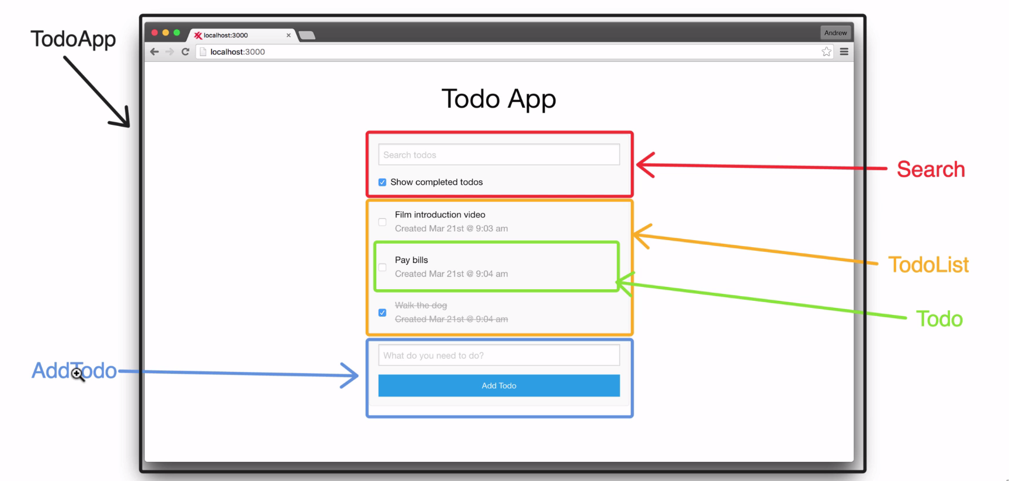
Is everything component?

Slide 12
INSTRUCTIONS FOR CONVERTING HTML + CSS TO REACT
Step1- Decide Reasonable Components
Step2- Add custom Css, Bootstrap css to app.js.
Step3- Change class= to className
Step4- Close every self tag, e.g <img src={} />

Slide 13
Props,State Reactjs

Slide 14
Props
›Props because you don’t want to have a component rendering static data, but pass dynamic data to your component instead. That’s where React’s props come into play. You can pass data in React by defining custom HTML attributes to which you assign your data with JSX syntax. So don’t forget the curly braces.

Slide 15
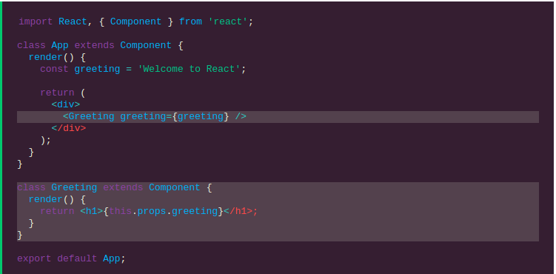
Props

Slide 16
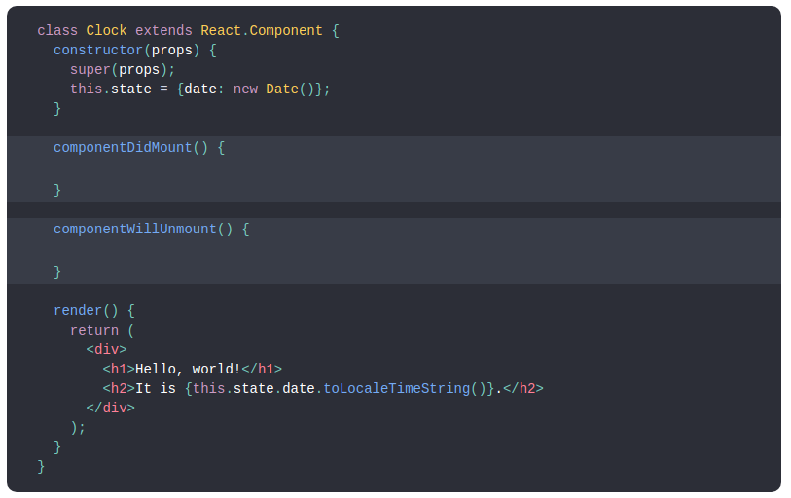
State
Component state, also known as local state, allows you to save, modify and delete properties
that are stored in your component. The ES6 class component can use a constructor to initialize
internal component state later on.

Slide 17


