Slide 1

Data Wrangling of Texas 2013 Motor Vehicle Data
DSO104 Final

Slide 2
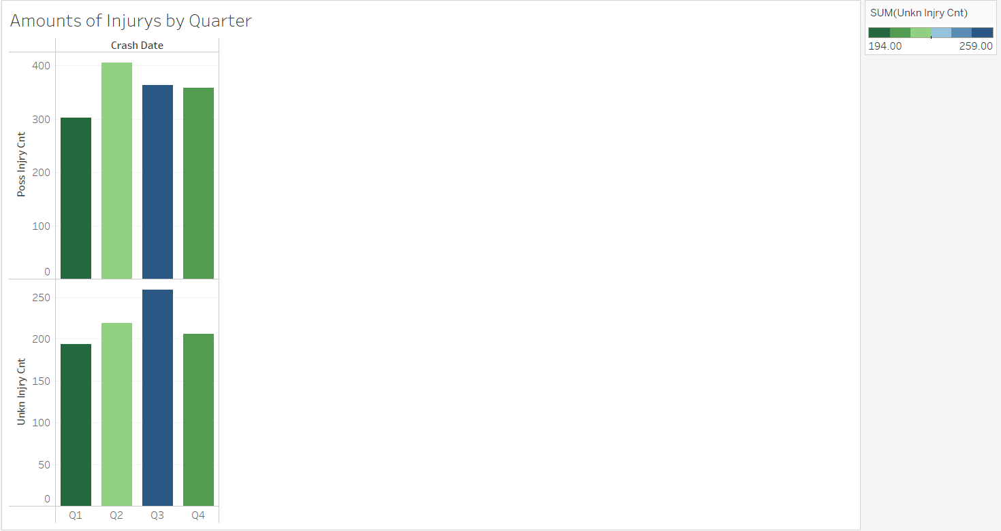
Looks as though there were more crashes the resulted in injury during Quarter 2 of 2013

Slide 3
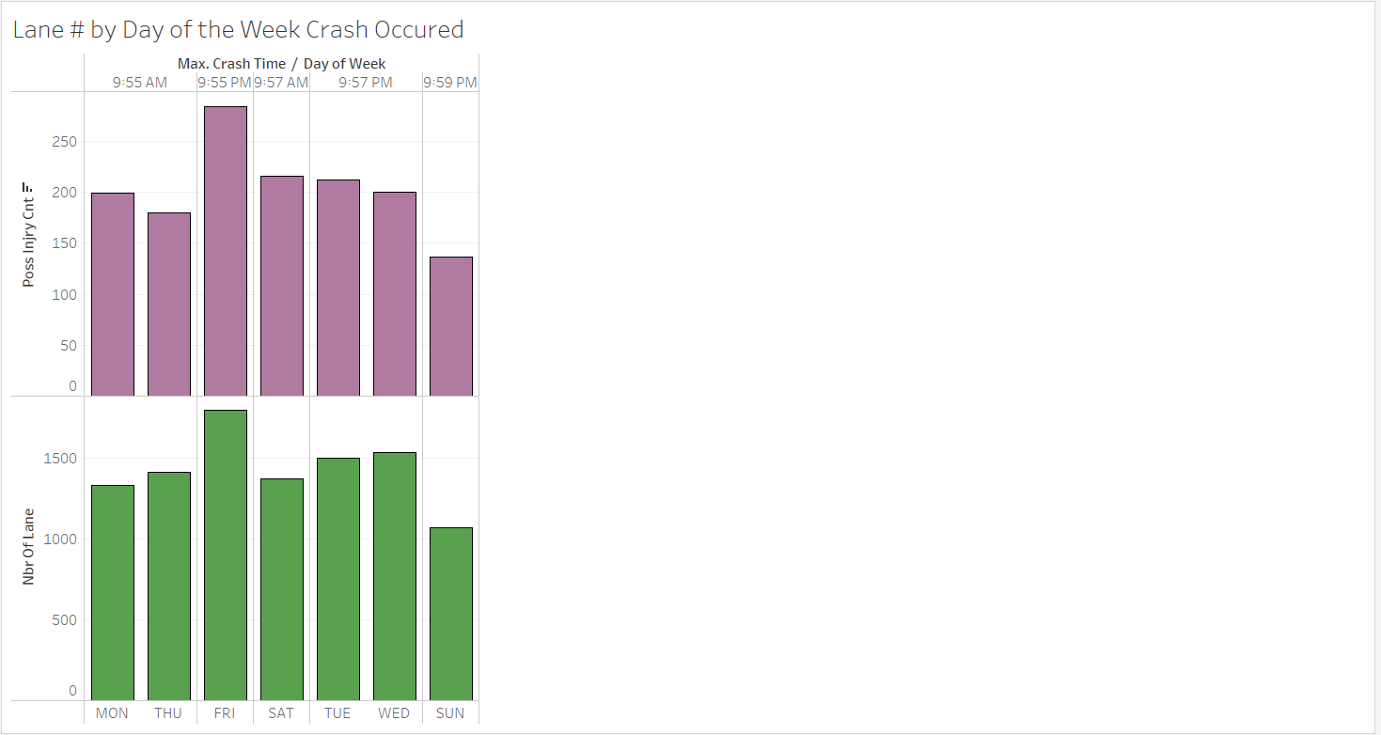
The number of the lanes seems to go inline with the day of the week ; the number of lanes affects the number of crashes. Larger numbers of lanes results in more crashes.

Slide 4
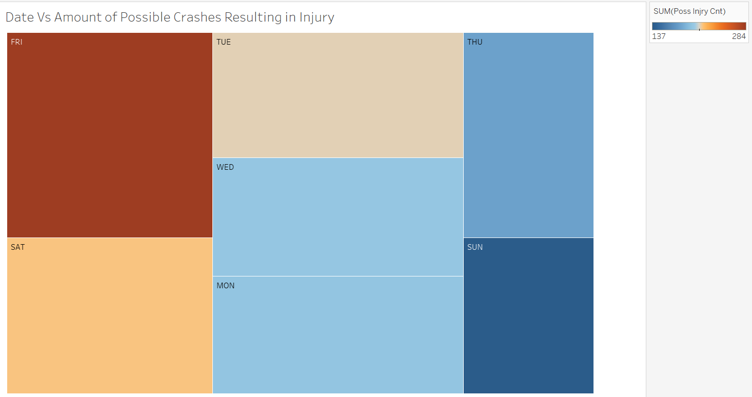
Friday appears to have the most crashes that result in injury. This may be due to drivers rushing home to start their weekend, or more drivers are on the road Fridays.

Slide 5
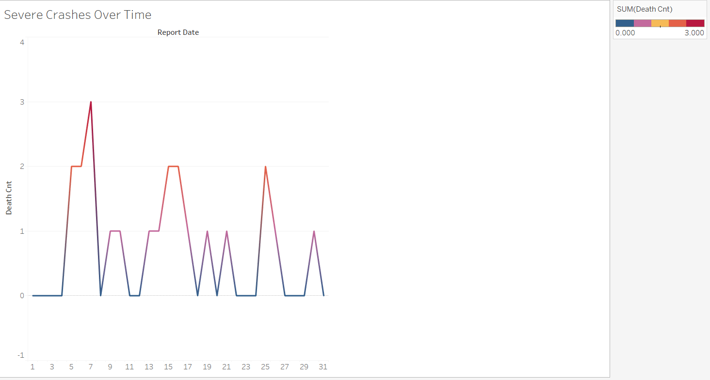
Crashes that resulted in death appear to mostly between the 4th and 5th of the month and again rising halfway through the month as well as towards the end. More people could perhaps be out running errands or on outtings likely due to most people receiving paychecks at the beginning, middle and end of the month.

Slide 6
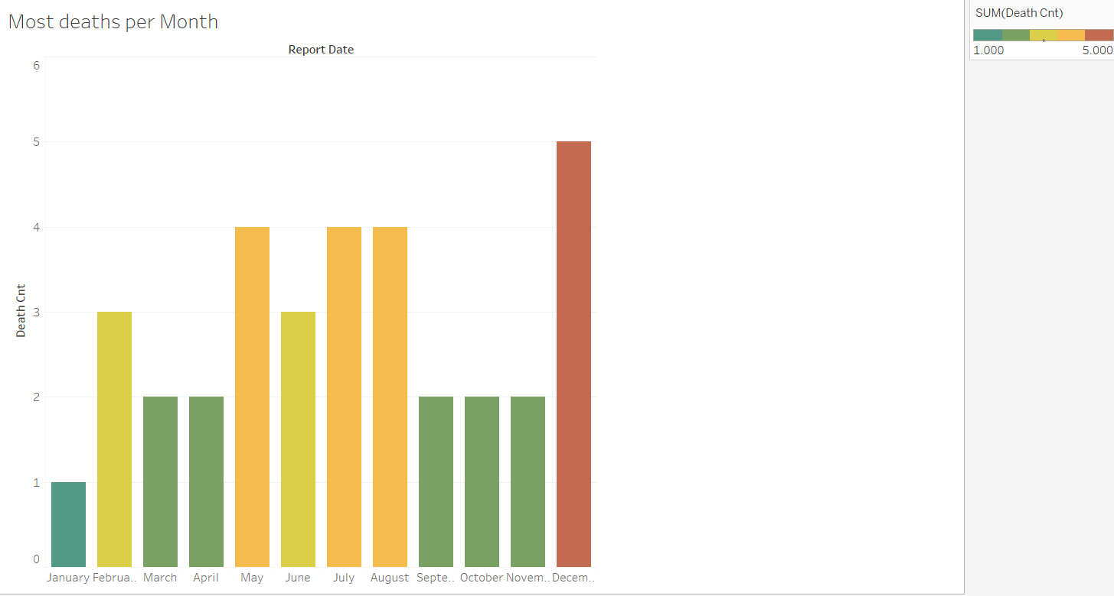
Holiday travels and outings may be the reason why most deaths caused by crashes occurred mostly in December as well as winter weather dangers

