Slide 1
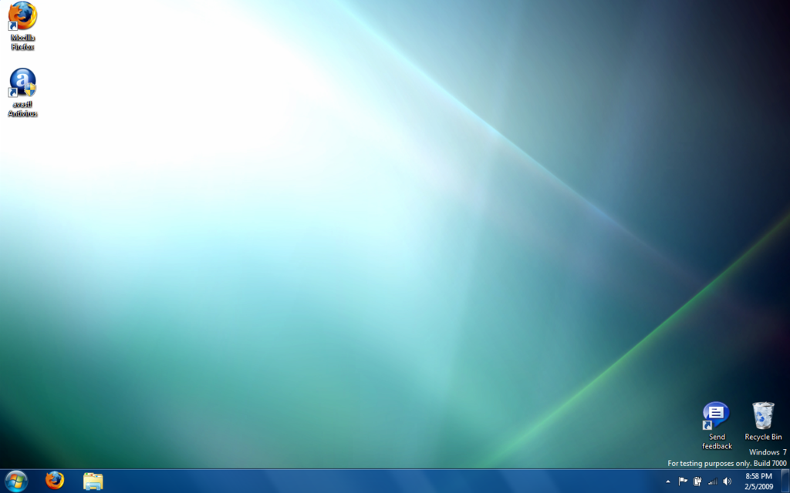
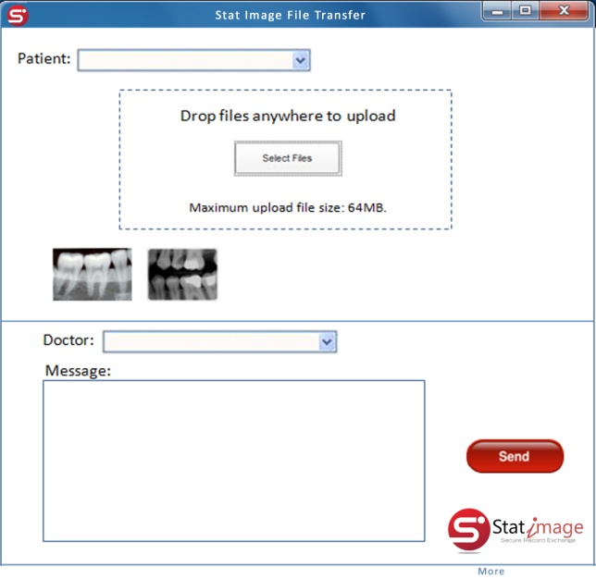
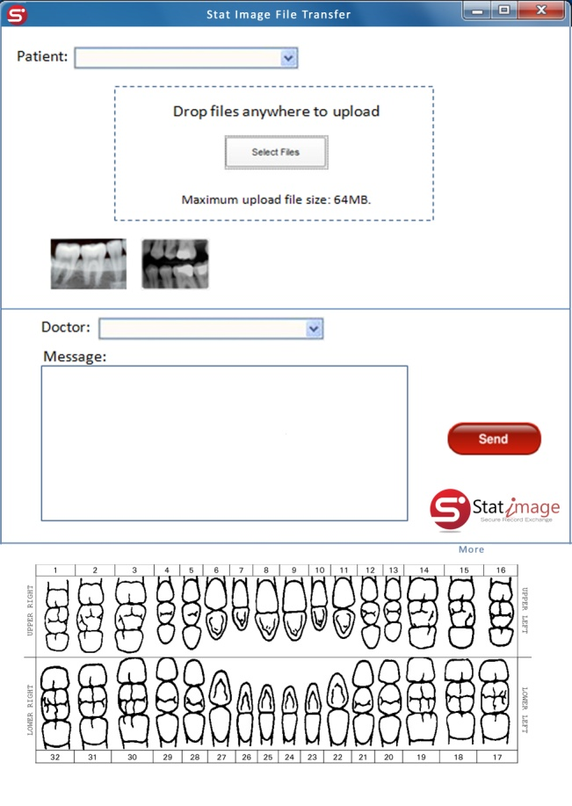

Point2Point

Slide 2
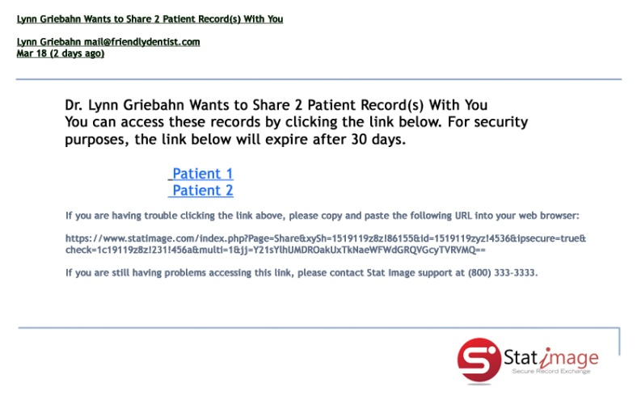
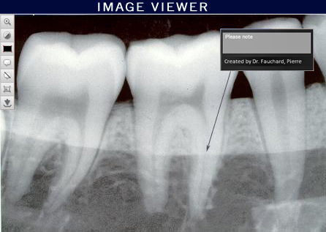
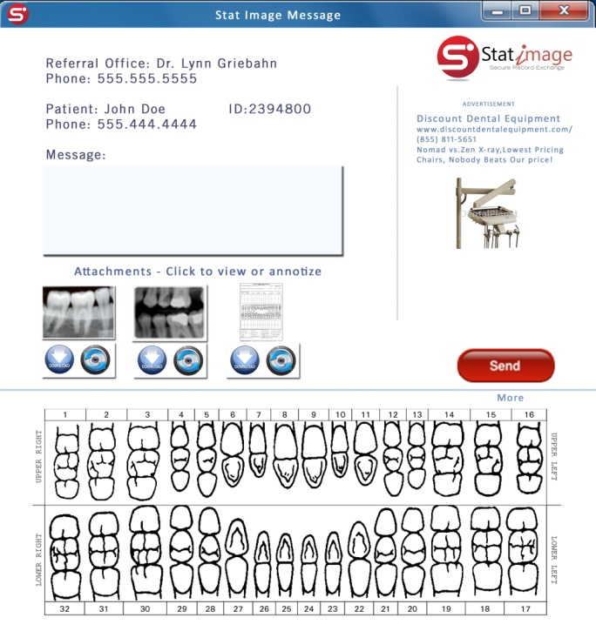
Recipient
Step 1 – Open Email
Step 2 – Select Link
Sender
Step 1 – Choose recipient from pull-down list
Step 2 – Choose patient from pull-down list
Step 3 – Drag and drop files to be sent
Step 4 – Optional – add comments, annotations
Step 5 – Hit send button
Background Activity
Populate dropdowns with patient and recipient info from database
Attach pertinent patient information to message
Assign and acknowledge recipient
Certify attachment
Generate encryption key with expiry date
Encrypt attached files
Encrypt protected healthcare information
Log transaction and assign transaction ID

