Slide 1
ANALYTCITY Presentation
Team Name: “THE ANALYST”
Team Members:
Shreyas Tripathi: Technex ID:TX12762 (ECE,IIT-BHU)
Aman Shreshtha: Technex ID:TX11556 (ECE,IIT-BHU)

Slide 2
CONTENTS
TRAINING DATA ANALYSIS
PROCEDURE
INSIGHTS
RESULTS

Slide 3
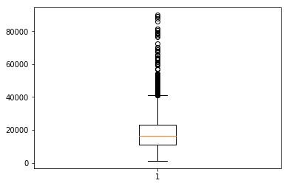
TRAINING DATA ANALYSIS
We analysed the given training data using different plots , so as to get a better understanding of which model will work well and what features can be engineered for better results.
1. This box plot is plotted for AMOUNT column of the data.
2. This tells us that the data has large variation so if we directly use this data, the model will not be able to generalize well.
3. To counter this, we have used log transformations.

Slide 4
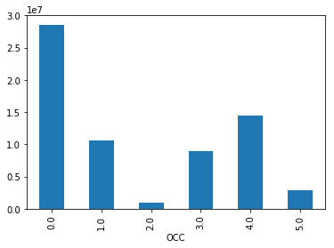
1. This is a plot of total AMOUNT vs Occupational Categories.
2. This plot is telling us that there are large number of rows having OCC = 0.
3. So during data imputation it is safe to impute the missing rows with 0.
4. The plot also tells there is a stong relation between Occupational Category and the amount value.
5. Hence this feature will be useful in deciding whether the person is defaulter or not.

Slide 5
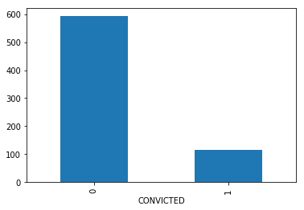
1. This is a plot of number of defaulters vs whether they were convicted for some crime or not.
2. As we can clearly see people with no criminal record are more likely to repay their loans.

Slide 6
APPROACH
As was stated in Problem Statement, we had to predict the probability of a person being a defaulter so we used Classifier models.
So firstly, we tried training the given training data set via logistic regression model from Sci-kit learn library.
Accuracy scored in this model was:
Then we tried using training via SVM model from Sci-kit learn library.
Accuracy scored in this model was:
Finally, we used Multi-layered Perceptron(nueral Network)which gave us the maximum accuracy and AUC_ROC.
Accuracy scored in this model was:

Slide 7
PROCEDURE
Firstly, we imported all the necessary packages. Then we imported models from the scikit learn library.
Then we read the data from the given train.csv file using pandas pd.read_csv().
Then we check the number of null values in each column using apply().
Then after seeing that RATIO field has the highest number of null values, then we store all those rows with not null values in RATIO field in a data frame .
Then we fill the missing values in above data frame by imputation by median or in some cases imputation by one or zero.
Then we train a linear regression model to learn the values of the RATIO field by training on the not null data frame.
Then we use this model to predict the missing values of VALUE and put it into the original data.

Slide 8
PROCEDURE (contd..)
Then we train the calculated training data set in different models which are discussed in the INSIGHTS section of this presentation.
Finally, we decide to use MLP(Multilayer perceptron) model with 5 layers of 100,100,50,30,10 neurons to predict probability of DEFAULTERS on the test data set.
For this model, we get an accuracy of 88.07% and AUC_ROC value 77.296% on the train-test split of Training data set.
Then we put the predicted values of DEFAULTER into the Test file and convert it into an excel file using pd.ExcelWriter() function.

Slide 9
INSIGHTS ON DATA PREPROCESSING
As we had to predict the probability of a person being a defaulter, we used Classifier models.
It was also noticed that the some values were missing in the training data set. So we had two paths available: either use regressors or use imputation to fill those missing values.
Our decision regarding the above problem was also influenced by the factor of number of missing values in each fields. We considered the field which had the maximum number of missing values which was “RATIO”.
For this field “RATIO”, we trained the prediction model in two ways i.e with regressors and with imputation by median.
We got better accuracy and AUC_ROC for the model where missing values were filled by imputation. So we decided to fill the all the missing values by imputation by median. In case of fields with values 0/1, we filled them according to the most occurring element.

Slide 10
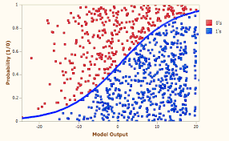
INSIGHTS REGARDING MODEL SELECTION: Logistic Regression
Firstly, we started with Logistic Regression model.
As we know, Logistic regression is a statistical method for analyzing a dataset in which there are one or more independent variables that determine an outcome. The outcome is measured with a dichotomous variable (in which there are only two possible outcomes).

Slide 11
For testing the model, we divided the training data set and calculated the accuracy on the split of the training data set.
Here also, we trained the data set on two variations of Logistic Regression: One with given values of data set and other with taking log values of the Fields : AMOUNT, DUE_MORTGAGE, VALUE.
Accuracy on first model was 83.597%, whereas the accuracy of the model with log values of fields was 83.877%.
Hence we can see that the model where we took log of the fields has slightly higher accuracy. This can be apparently explained by the fact by taking log of the fields, we decreased the variation among the values of the fields

Slide 12
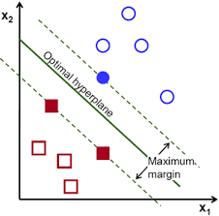
SVM(Support Vector Machine)
Next, we tried using the SVM models.
A Support Vector Machine (SVM) is a discriminative classifier formally defined by a separating hyperplane. In other words, given labeled training data (supervised learning), the algorithm outputs an optimal hyperplane which categorizes new examples.

Slide 13
Here also, we tried two different variations of SVM:one with linear kernel and other one with RBF(Radial basis function) kernel.
We got a lower accuracy for the RBF kernel as compared to the linear kernel.
This can be explained by the fact that, as we have seen from the graphs of the training data set, that the training data is not uniformly distributed, rather it is biased towards on eside which can better be approximated by a line hence linear kernel has slightly higher accuracy.
Accuracy for linear kernel SVM is 84.411%, which is slightly lesser than the logistic regression model

Slide 14
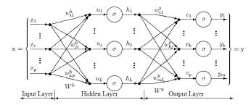
MLP( Multi-layered Perceptron) model
Next, we tried MLP(multi-Layered Perceptron) model.
A multilayer perceptron (MLP) is a class of feedforward artificial neural network. An MLP consists of at least three layers of nodes. Except for the input nodes, each node is a neuron that uses a nonlinear activation function. MLP utilizes a supervised learning technique called backpropagation for training

Slide 15
Here also, we used two variations of MLP: one with three layers of 30 neurons each and other one with 5 layers with 100,100,50,30,10 neurons.
Accuracy for first model(with three layers) was 78.9% and for the other model (with 5 layers) was 88.07%.
As the accuracy of the second model was highest, we have used this for predicting on the test data.

Slide 16
RESULTS
We used MLP(multilayer perceptron) model to predict the test file.
WE scored an accuracy of 88.07% on the train/test split of training data set given to us .
The predictions on test file are attached with the zip folder in excel format.

Slide 17
THANK YOU

