Slide 1

InsuranceSuite 10 Integration
InsuranceSuite 10 Fundamentals
BATCH PROCESSESS

Slide 2
Batch processes overview
Running batch processes
Custom batch processes

Slide 3
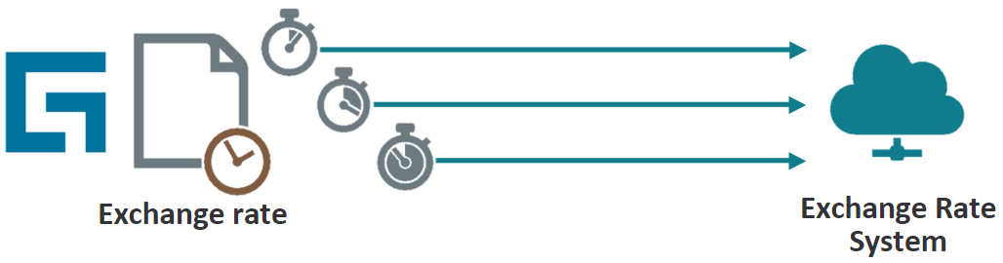
Batch processes
A batch process is a background process that performs tasks independent of a user
Typically, a batch process runs on a periodic schedule
Two type of batch process
Predefined
Custom
Notes:
By default, batch processes do all their work on the batch server within a single process. If the Guidewire application is installed as a cluster, then you can distribute the work of process-intensive tasks across multiple servers. The mechanism that manages the distribution of work is called a work queue (or sometimes a distributed work queue). In a Guidewire cluster, worker processes can run in parallel on multiple servers. Worker processes are not restricted to running on the batch server. The batch process that supports workers is a writer. A writer is a schedulable batch process that runs only on the batch server. A writer loads a queue with work items to be completed by one or more workers. Together, the arrangement of workers, a writer, and a queue make up a distributed work queue. Distributed work queues have an advantage because multiple servers in a cluster can share processing. Each work queue concerns itself with a specific task. For more information on distributed work queues, refer to the application's System Administration Guide. Batch processes are documented in each application's System Administration Guide.

Slide 4
Predefined batch processes
A predefined batch process is a batch process that is configured in the base application
Examples:
Contact Manager: Duplicate Contacts Finder
ClaimCenter: Claim exception
PolicyCenter: Policy renewal start
BillingCenter: Account inactivity
Developers can schedule or manually run each process but cannot directly configure what each does
Some processes can be indirectly configured because they trigger configurable elements
Notes:
The predefined batch processes perform "core functionality". They can act on a single entity such as the activity escalation batch process, which executes against instances of the Activity entity or perform global actions such as the database statistics batch processes, which executes against the entire system.
The activity escalation batch process executes against every activity. When it finds an activity with a non-null due date that is open past its escalation date and has not yet been escalated, it runs the activity escalation rule set for that activity. Developers cannot directly configure the batch process itself. For example, they cannot modify the batch process to execute against only high priority activities. However, developers can indirectly configure the batch process by configuring the activity escalation rule set. For example, they can add a rule condition that prevented other rules from being run if the activity was not high priority.

Slide 5
Custom batch processes
A custom batch process is a batch process created by an integration developer
Allows for periodic scheduling of work beyond what the base application provides
Is fully configurable
Can include triggers to integration points
Notes:
Custom batch processes can be created as of the applications released on the Carbon platform:
ClaimCenter 6.0 (and later)
PolicyCenter 4.0 (and later)
BillingCenter 3.0 (and later)

Slide 6
Executing batch processes
Common ways to execute a batch processes
Periodically based on a schedule (the most common use)
Immediately from the Internal Tools UI
From an API call such as a web service or command line
Every execution option is not necessarily configured for every process
Duplicate Contacts Finder batch process:
Can be run from the UI and scheduled
Not configured to be executed from an API
Notes:
Running a batch process immediately is also known as "run on demand".
By default, a given batch process can only be run using a specific set of options. However, this is controlled by the BatchProcessType typelist, which is modifiable. So you can theoretically configure the system to allow a given batch process to run in ways other than its initial configuration.

Slide 7
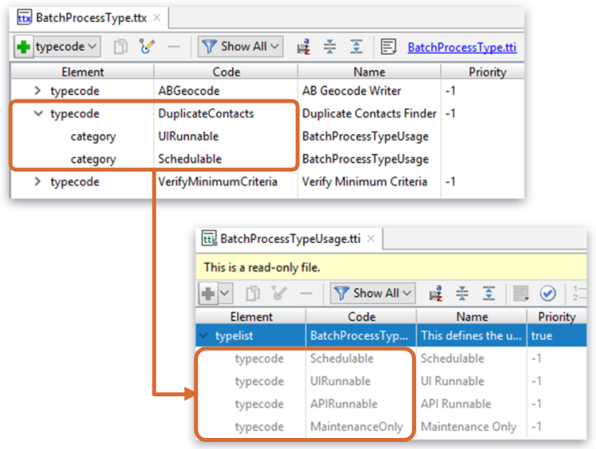
Batch process execution options
Every batch process that is UI runnable is inherently API runnable
Notes:
Every batch process is listed in the BatchProcessType typelist. For predefined batch processes, the Internal property is true.
Every batch process has one or more typecode categories from the BatchProcessTypeUsage typelist. This defines the circumstances under which the batch process can be executed. For example, ActivityEsc is the activity escalation batch process. It has two categories: Schedulable and UIRunnable. This means the batch process can be scheduled or run from the batch process UI. It can also be run from an API, as every batch process that is UI runnable is inherently API runnable. However, it is not limited to being run only in maintenance mode.
You can add additional typecodes to the BatchProcessType typelist. This is one step in creating custom batch processes. However, you cannot add typecodes to the BatchProcessTypeUsage typelist.

Slide 8
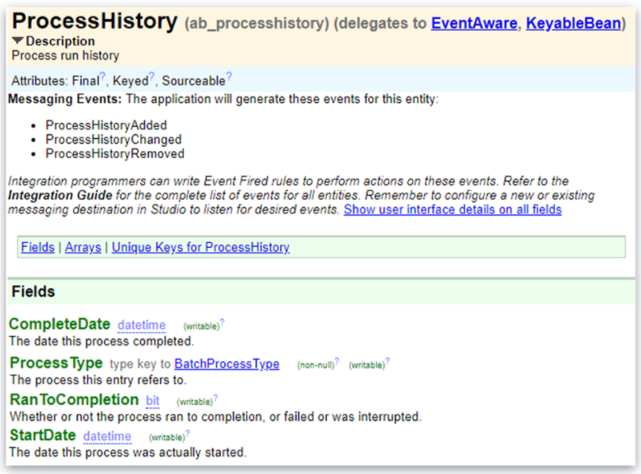
Batch processes and messaging
You can use Guidewire messaging to launch external processes during a batch process
As a batch process starts, the application fires a ProcessHistoryAdded event
As the status of the batch process changes, the application fires a ProcessHistoryChanged event
The CompleteDate property contains the datestamp in a datetime object
Events can be used to trigger additional processing
Notes:
You can use Guidewire messaging to launch external processes upon completion of a batch process. For example, you could write records to a file or database table as the batch process handles each transaction. After the batch process has handled all transactions, the data can be submitted to a downstream system.
To coordinate this activity, use the ProcessHistory entity. As a batch process starts, the Guidewire application fires a ProcessHistoryAdded event. As the status of the process changes, the application fires a ProcessHistoryChanged event. When the application catches a ProcessHistoryChanged event, the processHistory.CompletionTime property contains the datestamp in a datetime object.

Slide 9
Batch processes overview
Running batch processes
Custom batch processes

Slide 10
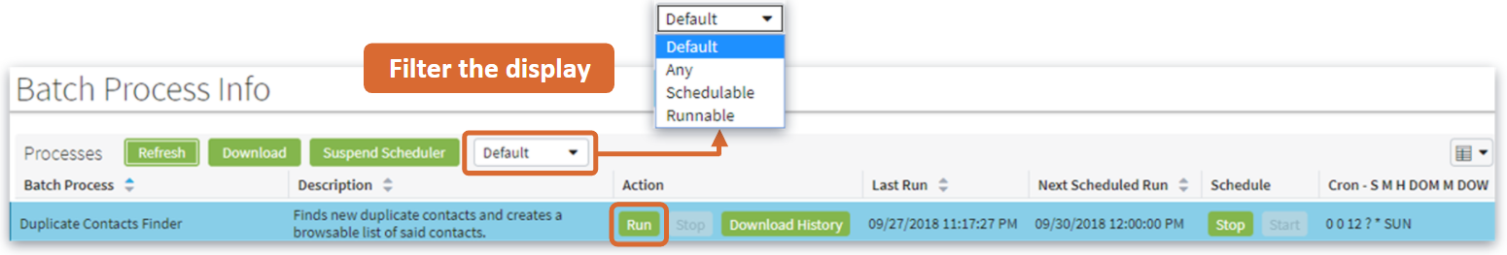
Batch Process Info UI Screen
UI screen used to run batch processes on demand and view additional status information
To view Server Tools, press ALT+SHIFT+T
To run a batch process manually, click Run
Batch process execution begins immediately
While batch process is running, the Last Run Status column lists the process as Running
Notes:
The Batch Process Info list is part of the Internal Tools provided with the Guidewire application. To access Internal Tools, the EnableInternalTools parameter in config.xml must be set to true. If it is, then you can view Internal Tools by pressing ALT+SHIFT+T.
By default, the Batch Process Info list displays only the batch processes that can be run on demand or scheduled. However, you can change the batch processes listed by selecting the appropriate value in the dropdown beneath the Processes label.
"Default" lists all batch processes that are either schedulable and/or runnable.
"Any" lists all batch processes including those that can be run only from the API.
"Schedulable" lists only batch processes that can be scheduled.
"Runnable" lists only batch processes that can be run from the Batch Process Info list.
The Refresh button refreshes the information on the page. The Download button gives you the option of downloading a separate HTML file containing a sortable list of batch processes.

Slide 11
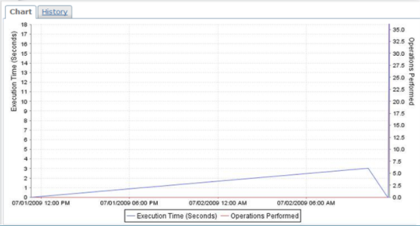
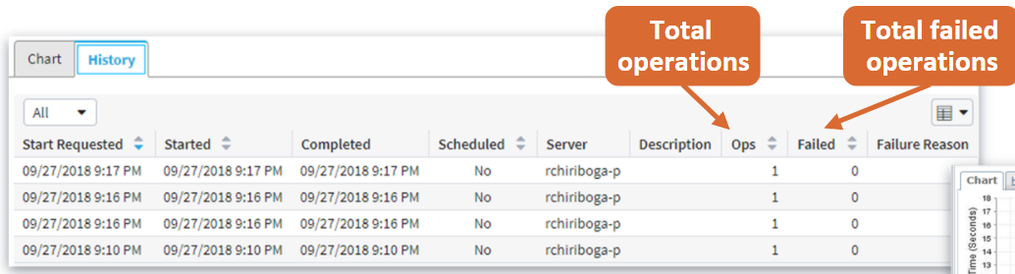
Chart and History cards
Detail information about selected batch process appear below list of batch processes
Chart and History
Notes:
The History card lists instances of the selected batch process. It defaults to listing only failed instances, but you can change the dropdown at the top of the card to show all instances. For each instance, the start and complete times are listed, as well as the number of operations in the batch process (the Ops column), the number of failed operations (the Failed column), and the reason for batch process failure, if the instance failed. An operation is an arbitrary measurement of the work the batch process has to do.

Slide 12
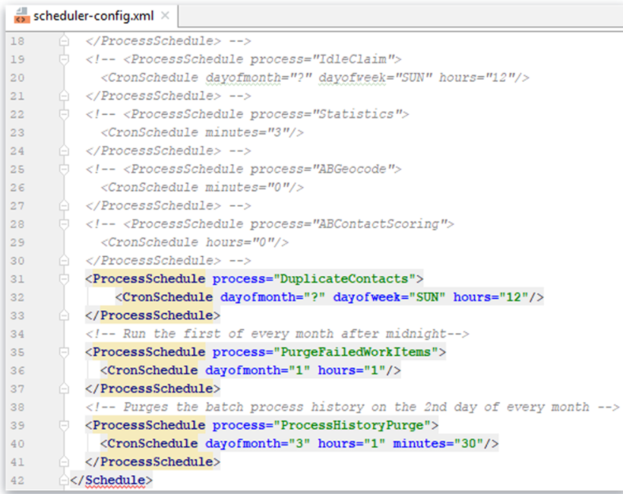
Scheduling a batch process
Defines batch process schedules
configuration.config.scheduler
<ProcessSchedule/> element describes which batch process to execute and when
<CronSchedule/> child element describes when process runs
Define schedule attributes
Restart server to deploy your changes
Notes:
Generally, schedule the amount of time between batch process runs in hours instead of minutes. This is because some batch processes require a lot of resources on a server. Schedule such processes to wake infrequently or at times that the server is less taxed, such as late at night or very early in the morning. The Guidewire application scheduler uses the application server time for reference.
The CronSchedule element describes when the process is run. It contains schedule_attributes that specify the timing, such as one time per hour or every night. The schedule_attributes is a combination of one or more of the following attributes:
Attribute | Value Range | Default | Example
seconds | 0-590 | 0 | seconds="0"
minutes | 0-590 | 0 | minutes="15"
hours | 0-23| * | hours="12"
dayofmonth | 1-31 | * | dayofmonth="1"
month | 1-12 or JAN-DEC | * | month="2"
dayofweek | 1-7 or SUN-SAT | ? | dayofweek="1"
(continued)

Slide 13
Notes:
(continued)
Examples of <CronSchedule /> element and attributes:
<CronSchedule hours="10" />
Run every day at 10 a.m.
<CronSchedule hours="0" />
Run every night at midnight.
<CronSchedule minutes="15,45" />
Run at 15 and 45 minutes after every hour.
<CronSchedule minutes="0/5" />
Run every five minutes.
<CronSchedule hours="0" dayofmonth="1" />
Run at midnight on the first day of the month.
<CronSchedule hours="12" dayofweek="MON-FRI" dayofmonth="?" />
Run at noon every weekday (without regard to the day of the month).
<CronSchedule hours="22" dayofmonth="L" /> Run at 10 p.m. on the last day of every month.
<CronSchedule minutes="3" hours="8-18/2" dayofweek="1-5" dayofmonth="?"/>
Run 3 minutes after every other hour, 8:03 a.m. to 6:03 p.m., Monday through Friday.
<CronSchedule minutes="*/15" hours="0-8,18-23"/>
Run every 15 minutes after the hour, 12:15 a.m. to 8:45 a.m. and 6:15 p.m. to 11:45 p.m.

Slide 14
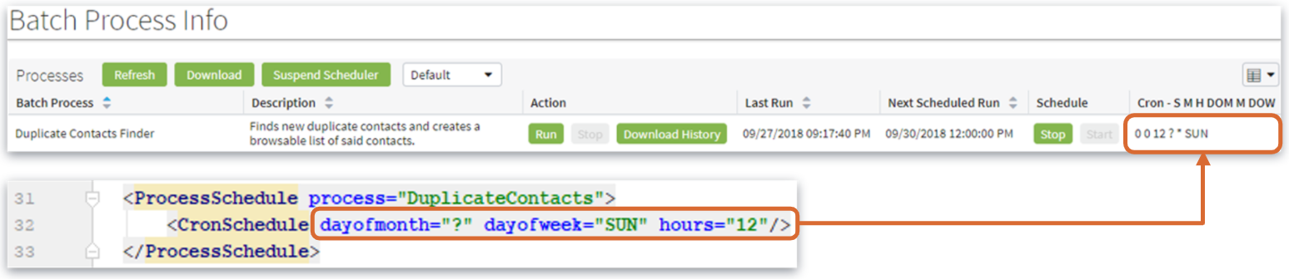
Scheduled batch processes
Once scheduled, the batch process UI screen shows
Cron schedule criteria
Next scheduled Run time
S (seconds) = 0
M (minutes) = 0
H (hours) = 12
DOM (dayofmonth) = ?
M (month) = *
DOW (dayofweek) = SUN
Notes:
Along with the standard values listed, there are special characters that give you more flexible options.
"*" means "all values". For example, dayofmonth="*" means run the process every day.
"?" is used only for dayofmonth and dayofweek attribute and means "without regard to this value" For example, hours="12" dayofweek="MON-FRI" dayofmonth="?" means "Run at noon every weekday (without regard to the day of the month)".
"," separates multiple values. For example, dayofweek="MON,FRI" means every Monday and Friday. Do not includes spaces after the comma.
"/" specifies increments. For example, minutes="0/15" means start at minute 0 and run every 15 minutes.
"L" is used only for dayofmonth and dayofweek and means "the last day of the month/week".
Once a batch process has been scheduled, its cron schedule criteria and next run time are listed on the Batch Process Info screen.

Slide 15
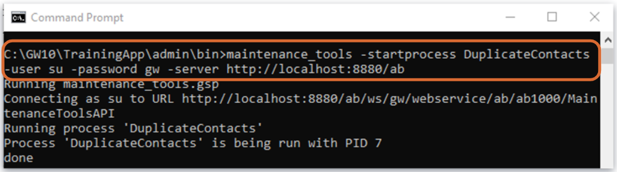
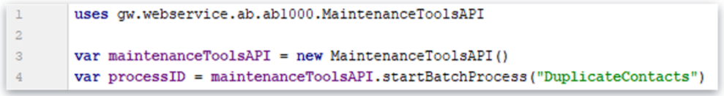
Running a batch process from an API
Command line syntax
maintenance_tools -startprocess <processName> -user <user> -password <password> –server <server>
Web service syntax
processID = maintenanceToolsAPI.startBatchProcess(“processName”)
Notes:
If a batch process is API runnable, you can run the process from either the command line or a web service/

Slide 16
Batch processes overview
Running batch processes
Custom batch processes

Slide 17
Custom batch process architecture (1)
IProcesses Plugin
switch (type):
FlagOverdue LegalReportsBatch.gs
ActivityEsc
Archive DataDistribution FlagOverdueLegalReports ...
Processes Plugin
A custom batch process is implemented by a Gosu class called by the ProcessesPlugin
Notes:
Custom batch processes are instantiated by the ProcessesPlugin plugin.
The ProcessesPlugin contains a switch statement that specifies, for each custom batch process type, the class to execute when the batch process runs.
PolicyCenter 10.0, ClaimCenter 10.0 and Training app 10.0 all implement IProcessPlugin in base application; BillingCenter 10 and ContactManager 10.0 do not implement that

Slide 18
Custom batch process classes
ProcessesPlugin implements the IProcessesPlugin
ProcessesPlugin overrides createBatchProcess()
createBatchProcess()
evaluates BatchProcessType
instantiates a custom batch process object from a Gosu or Java class
returns a batchProcess object
Gosu class must extend the BatchProcessBase and override the doWork() function
Notes:
The ProcessesPlugin contains a switch statement that specifies, for each custom batch process type, the class to execute when the batch process runs. The class to execute can be either a Gosu class or Java class. The class must extend the BatchProcessBase class, which takes care of the overhead for the batch process. The only method the class needs to implement is the doWork() method, which specifies the work unique to the batch process.
Both predefined and custom batch processes are executed by the same framework.

Slide 19
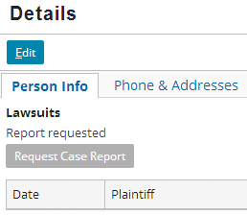
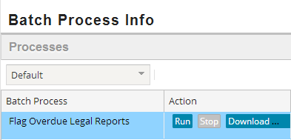
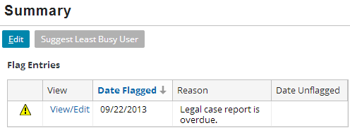
Use case: Batch process flags ABDoctors
with overdue legal reports
Report NOT received in the allotted time
Notes:
In TrainingApp, a user can request a legal case report for an ABDoctor by clicking the "Request Case Report" button on the Details screen Person Info card. The response from the legal case report system should occur within a given timeframe. If a response has not been received in a timely fashion, then the legal report is considered overdue. A custom batch process periodically checks to see if there are any contacts with overdue legal report requests, and flags any contacts it finds.
In TrainingApp, you can request a legal case report that receives no response by requesting the report when ExternalApp is not running.

Slide 20
Steps to implement custom batch process
Add a batch process typecode to the BatchProcessType typelist
Define typecode categories to specify the batch process execution options
Create a new custom batch process class
Extends BatchProcessBase, implements a specific constructor syntax, and overrides doWork()
Implement and modify the ProcessesPlugin class to instantiate and return the custom batch process object
Configure scheduler-config.xml
Deploy your changes

Slide 21
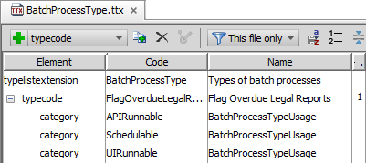
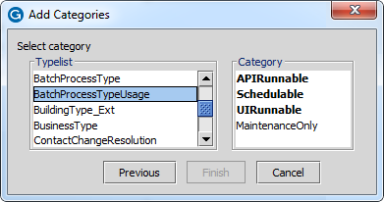
Step 1: Add BatchProcessType typecode
Each typecode represents a batch process
Guidewire does NOT support modification of internal batch processes
Add Typecode then add Category of BatchProcessTypeUsage
Notes:
All batch processes listed in BatchProcessType are visible from the BatchProcessInfo page.
Although a batch process can have multiple usage types, every batch process must support at least one of the following usage types :
Schedulable - Batch Process can be run on a regular schedule defined in scheduler-config.xml
APIRunnable - Process can be started and stopped via the API
UIRunnable - Process can be started and stopped via Batch Process Info page (and via the API)
MaintenanceOnly - Process can be started only when the server is at maintenance run level (regardless of manner used to start it)
In the slide example, the FlagOverdueLegalReports typekey is associated with the APIRunnable, Schedulable, and UIRunnable typecodes.
This means the batch process can be run from the API and the UI, and is also schedulable. It lacks the MaintenanceOnly code, which means it can be run regardless of the server level. If it had the MaintenanceOnly code, then the batch process could only be run while the server was at the maintenance run level.

Slide 22
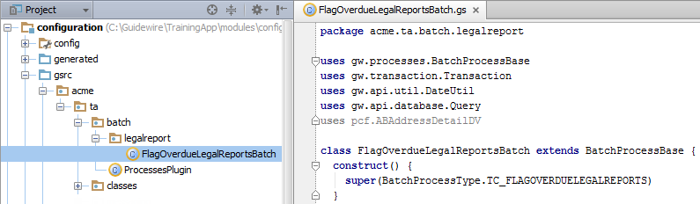
Step 2: Create a batch process class
Type Code value
Recommended naming convention:
Package: <company>.<app_code>.batch.<functional_area>
Class: <meaningfulName>Batch
Custom batch process class (Gosu or Java) must:
Extend BatchProcessBase
Have a construct() method that must call super(), passing appropriate typecode value
Override the doWork() method
Notes:
Custom batch process classes must extend BatchProcessBase and have a construct() method that must call super(), passing appropriate typecode value. In addition, the custom batch process class must override a single function, doWork(), which does the work of the batch process.

Slide 23
Example: Commit data in a batch process
13 override function doWork() {
…16 Transaction.runWithNewBundle(\bundle -> {
…24 var messageQuery = Query.make(Message)
…27 var resultsObj = messageQuery.select()
28 for (currentMessage in resultsObj) {
29 var relatedContact = (currentMessage.MessageRoot as ABContact)
…31 if (!relatedContact.FlagEntries.hasMatch(\currentEntry ->
32 currentEntry.Reason == FlagEntryReason.TC_OVERDUE_LEGAL_REPORT)) {
…35 relatedContact = bundle.add(relatedContact)
36 var newEntry = new FlagEntry()
37 newEntry.FlagDate = gw.api.util.DateUtil.currentDate()
38 newEntry.Reason = FlagEntryReason.TC_OVERDUE_LEGAL_REPORT
39 relatedContact.addToFlagEntries(newEntry)
…41 }
42 }
…47 }, "su")
…54 }
Notes:
Batch processes do not have a "current" bundle. If a batch process needs to commit data, then you must create a bundle manually using the runWithNewBundle() method.
The runWithNewBundle() method takes a block as an input parameter. The block must name a bundle and then identify the code to execute (as shown in line 16 above).
If you query for any objects, those objects initially belong to a read-only bundle. To modify the objects, you must copy them into your new bundle (as shown in line 35 above).
You do not need to manually commit the bundle. The runWithNewBundle() method executes an implicit commit() when it is done executing the block passed to it.
When a batch process is run via the scheduler, there is no inherent user. However, a user is needed whenever data is committed to the database. Therefore, if a batch process is schedulable and commits data, then it must use the following syntax:
runWithNewBundle ( \ bundle -> { blockToExecute }, userToUseWhenCommittingData )
If a batch process is likely to have many items to process each time it is run, then the items to process should be broken down into smaller chunks, and each chunk should be executed in its own transaction. This prevents problems that can arise from reading and then attempting to commit large amounts of data in a single transaction.

Slide 24
Step 3a: Create the ProcessesPlugin class
BillingCenter and ContactManager
1 package acme.ta.batch
2
3 uses gw.plugin.processing.IProcessesPlugin
4 uses gw.processes.BatchProcess
5 uses acme.ta.batch.legalreport.FlagOverdueLegalReportsBatch
6
7 class ProcessesPlugin implements IProcessesPlugin {
8 construct() {
9 }
10 override function createBatchProcess(type:BatchProcessType, arguments : Object[]) : BatchProcess { 11 switch(type) { 12 case BatchProcessType.TC_FLAGOVERDUELEGALREPORTS: 13 var myBatchProcess = new FlagOverdueLegalReportsBatch() 14 return myBatchProcess 15 default: 16 return null 17 }
18 }
19 }
Notes:
In all applications except ClaimCenter, the ProcessesPlugin is not implemented. To implement the plugin, implement the IProcessesPlugin interface and override the createBatchProcess function as shown in the code below.
package acme.ta.batch
uses gw.plugin.processing.IProcessesPlugin
uses gw.processes.BatchProcess
uses acme.ta.batch.FlagUnverifiedBankAccountsBatch
class ProcessesPlugin implements IProcessesPlugin {
construct() {
}
override function createBatchProcess(type : BatchProcessType, arguments : Object[]) : BatchProcess {
switch(type) {
case BatchProcessType.TC_FLAGUNVERIFIEDBANKACCOUNTS:
return new FlagUnverifiedBankAccountsBatch()
default:
return null
}
}
}

Slide 25
Step 3a: Modify ProcessesPlugin class
ClaimCenter and PolicyCenter
… 4 uses gw.processes.BatchProcess
… 8 uses acme.ta.batch.legalreport.FlagOverdueLegalReportsBatch
10 class ProcessesPlugin implements IProcessesPlugin {
…13 override function createBatchProcess(type:BatchProcessType, arguments : Object[]) : BatchProcess { 14 switch(type) { …21 case BatchProcessType.TC_FLAGOVERDUELEGALREPORTS: 22 var myBatchProcess = new FlagOverdueLegalReportsBatch() 23 return myBatchProcess …24 default: 25 return null 26 }
27 }
28 }
Add a reference to the full qualified class
Add a case statement for the given typecode
Return an instantiated custom batch process object

Slide 26
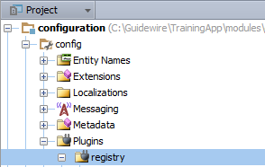
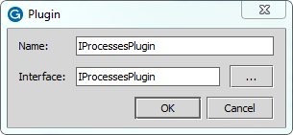


Step 3b: Create the IProcessesPlugin.gwp
BillingCenter and ContactManager
Create the plugin
/config/plugin/ registry/
Specify the Plugin
IProcessesPlugin name
IProcessesPlugin interface
Notes:
ClaimCenter ,PolicyCenter and Training app, implement processplugin.gwp. Billing Center 10 and ContactManager 10 donot implement this.

Slide 27
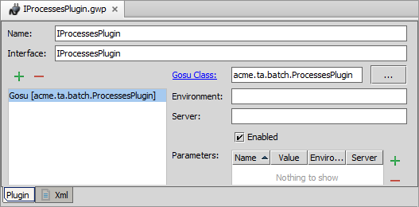
Step 3c: Implement the IProcessesPlugin
/config/plugin/registry/IProcessesPlugin.gwp
Check Enabled
Select the custom batch process class
Specific parameter name/value pairs if required

Slide 28
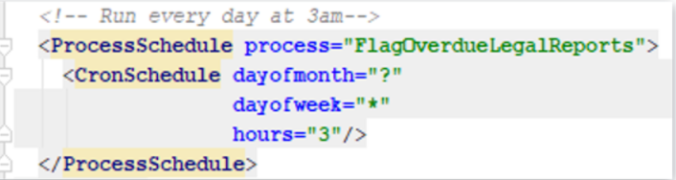
Step 4: Configure scheduler-config.xml
The scheduler-config.xml is found under configuration.config.scheduler
dayofmonth=“?”, Indicates no specific value. Used only for dayofmonth and dayofweek attributes.
dayofweek=“*”, Indicates all values i.e all days of the week
hours = “3” means 3 am using 24 hours clock

Slide 29
Step 5: Deploy the implementation
Restart Server
Reload Changed classes
Typelist Extensions
Plugin registry file
Gosu Class
Typelist Extension
Plugin File
Gosu Class

Slide 30
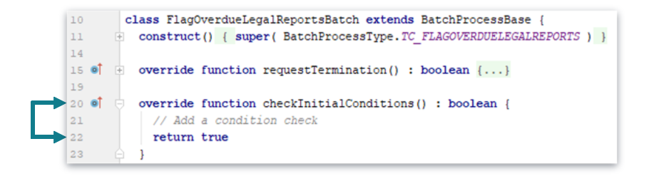
checkInitialConditions method
checkInitialConditions()
Used to determine if conditions are met to begin processing
Return true: doWork() will be called
Return false: only a history event will be written
Default : true
Notes:
checkInitialConditions() : The base class implementation of checkInitialConditions() returns true. You can override this function and return false under situations where it doesn't make sense to execute the batch process. The purpose of this method is to check environmental condition like server run level. Avoid running long running logic here, If you want to check for some database condition do it in the dowork() method.
Guidewire recommends that you do not return false from this method unless the condition which triggers this is temporary.
When false is returned
GW freezes any work in that batchprocess
Sets last run status for that batchprocess to running
Runs the checkInitialConditions() method every one minute until it returns true or till it stopped from the UI
After 10 minutes the batchprocess is stopped and it logs error message.

Slide 31
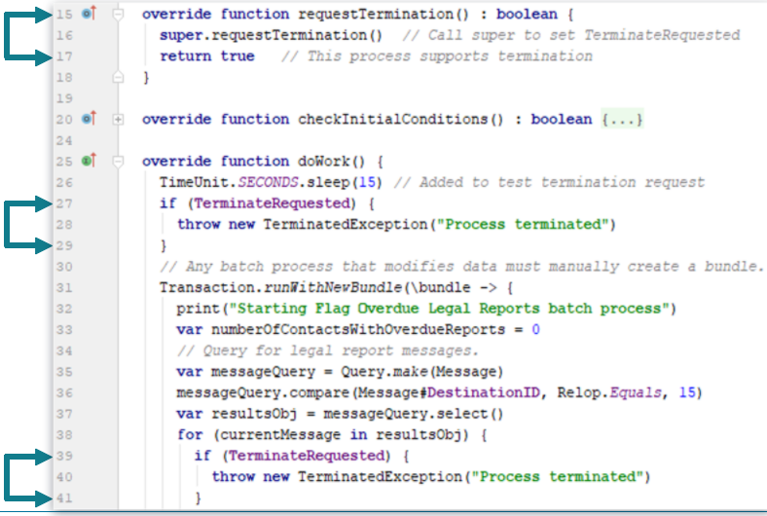
requestTermination method
requestTermination() method
Called by Guidewire to request that process self-terminate
Return true if request will be honored
Return false if request will not be honored
Handled by setting monitor flag in code and exiting any loops
Notes:
requestTermination(): In some cases, the application wants to terminate a batch process, such as when...
The process is run from the UI and the user clicks "Stop".
The process is run from the API and the stop process command is received.
The application is shutting down.
When termination is requested, the application executes the requestTermination() method, which returns a boolean. The base class implementation returns True, which means "the batch process is able to terminate itself". False means "the batch process is not able to terminate itself". Although you can return false from requestTermination(), Guidewire strongly recommends you design your batch process so that you actually can terminate the action. It is critical to understand that returning false does not prevent the application from shutting down or reducing the run level. The application delays shutdown or change in run level for a period of time. However, eventually the application continues to shut down or reduce run level independent of this batch process setting. Avoid this situation by designing your code to check and respect the TerminateRequested property.

Slide 32
Other helpful methods and properties
OperationsExpected property
Set this once after determining number of items to be processed
Used to provide feedback in the UI for UI Runnable Processes
incrementOperationsCompleted()
Call after processing an item, regardless of success or failure
incrementOperationsFailed()
Call in addition to incrementOperationsCompleted() for failed items
Exclusive property
Can another instance of this batch process start while this process is running?
Notes:
An operation is an arbitrary measure of batch process progress as defined by the developer. The Batch Process Info page automatically reports information on operations completed and fails. Custom batch processes can report operations completed and failed.
If an exception is thrown in a batch process, the batch process is considered "failed". The exception message is listed as the reason.
In addition to the properties and methods shown in the slide, the following are also available from BatchProcessBase:
getDescription(), which returns the batch process type’s description. The base class gets this string from the batch's typekey description. You can override this method to change the description.
getDetailStatus(), which returns the batch process type’s detailed status. The base class defines a default simple implementation. You can override this method to provide more useful detail information about the status of your batch process for the Admin user interface, particularly if your class experiences any error conditions.
.Progress, which dynamically returns the progress of the batch process. The base class returns text in the form "x of y" where x is the amount of operations completed and y is the total operations. If y is unknown, then just "x" is returned. These values are determined from the OperationsCompleted and OperationsExpected properties. You can override the Progress getter to change this behavior.
Exclusive: The Exclusive property determines whether another instance of this batch process can start while this process is running. The base class implementation always returns true. Set this property to false if you want to prevent multiple instances of this property from running.

Slide 33
Best practices

Slide 34
Updating database
No Current bundle for batchprocess
Use Transaciton.runwithNewBundle(/bundle->{},”user”} or Transaction.newBundle()
If you expect to update a large number of rows
Consider using paging with regular commit
Keep bundle size small
Be careful with assessors
Use Query best practices-
Do filtration in database rather than in application

Slide 35
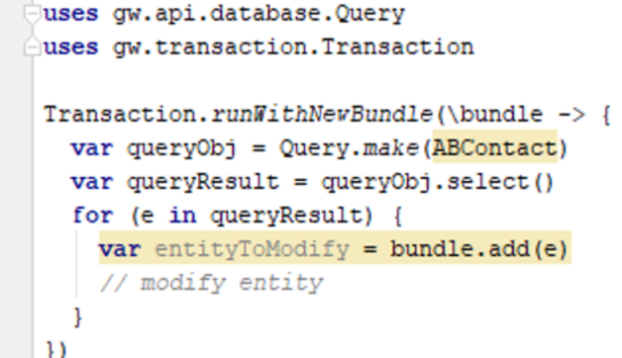
Best practices- Updating database
Problematic approach
Above approach has below problems
Memory : The result set is possibly large
Bundle performance
All rows from query added to bundle
If assessors are used for these entities those will also be added to the bundle.

Slide 36
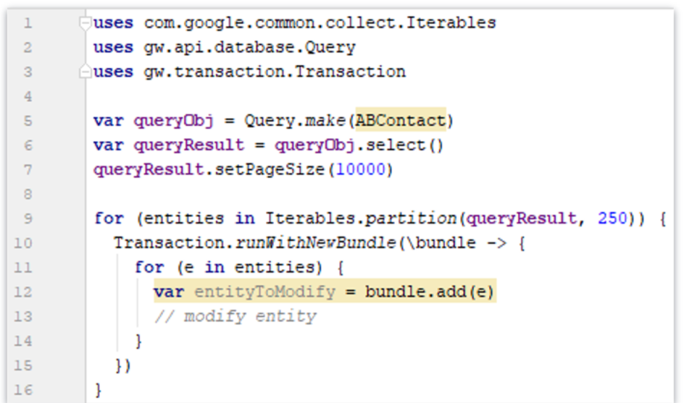
Better approach- paging with regular commits
Notes:
The above approach is a better approach compared to the previous approach as it keeps a limit on the query result and the bundle size.
Optimal page and bundle size are dependent on DB, table and environment. Performance testing can help arrive at the right number.
The above approach might still be slow for very large queries.
Query with paging is not ideal when the query result is modified such that it repositions the cursor, more details on this and alternate approach given in the next slide

Slide 37
Paging with modifications
In the below case assume that the query is retrieving records whose flag is true, and the page size is two. In the first iteration(page) query will return records 1 and 3. In the second iteration query should ideally return records 4 and 5 , but after the first iteration if the batch process changes the value of ‘flag’ in record 3 to false, only record 5 will be returned and record 4 will be skipped in the second page’s result
This can be overcome by id chunking (explained in notes)
BatchBatBatchProcessBase.setChunkingByIdchProcessBase.setChunkingById
Row Number | Flag
1 | True
2 | False
3 | True
4 | True
5 | True
6 | false
Notes:
The BatchProcessBase.setChunkingById method has the following signature. setChunkingById(IQueryResult queryResult, int chunkingSize).The setChunkingById method returns nothing. Use the setChunkingById method method to set the query retrieve chunk size. After setting the chunking factor, the batch process iterates the Gosu query as usual. Beneath the surface, the query retrieves the data in chunks, using a series of separate SQL queries, rather than retrieving the data all at once in one massive block. The effect is very similar to the existing setPageSize method on the query API. However, the differences between the two methods include the following:
Method Query.select().setPageSize uses ROWNUM (or its equivalent) to do the chunking.
Method BatchProcessBase.setChunkingById orders the results by ID and uses WHERE ID > lastChunkMaxId to do the chunking.
Using ID chunking is much more robust than using the setPageSize method if your process alters the input to the original query, as batch processes often do. For example, suppose that your batch process looks for all unprocessed items of type X and then processes them. If you use ROWNUM chunking then the query for the first chunk functions correctly: WHERE ROWNUM < chunksize
After processing the returned items, the Gosu query will issue another SQL query: WHERE ROWNUM >= chunksize AND ROWNUM < chunksize * 2
Unfortunately, this query skips chunksize unprocessed items because processing the first chunk of data alters the input to the subsequent query.

Slide 38
Describe the role batch processes play in Guidewire applications
Schedule batch processes
Implement custom batch processes

Slide 39
DEMO

Slide 40
This demonstration will create a batch process that checks if an ABPerson has either a phone number or email. If they don’t, flag the contact.
Requires
Training App
GW Studio
Supported web browser

Slide 41
LAB

Slide 42
Complete the exercises listed in “Batch Processes” chapter in the “InsuranceSuite 10 Integration: Kickstart “ work book

Slide 43
What are the three ways a batch process can be run? Which of the three is the most common?
When you add a new batch process typecode to BatchProcessType, why must you add one or more categories to the typecode?
When creating a custom batch process, do you need to implement the ProcessesPlugin or just modify it?
For a custom batch process, what method or methods are required?
How does a batch process commit changes to the database?
Notes:
Answers
1) Scheduled, run from the UI, run from the web service API. Scheduled is the most common way.
2) The categories of a BatchProcessType typecode determines how the batch process can be run (from the UI, scheduled, from the API, or/or in maintenance level).
3) It depends on the application. For ClaimCenter, the plugin is already implemented and you only need to modify it. For all other applications, you must implement the plugin.
4) Only the doWork() method is required.
5) The code must create a new bundle using runWithNewBundle() and add the entities to be changes and committed to that bundle.

