Slide 1

InsuranceSuite 10 Integration
RESTful Web Services

Slide 2
Lesson Objectives
By the end of this lesson, you should be able to :
Create a swagger schema to define an API
Reference an existing integration view in the API
Create an API handler class
Publish an API
Use swagger-ui to test an API

Slide 3
Introduction to REST API

Slide 4
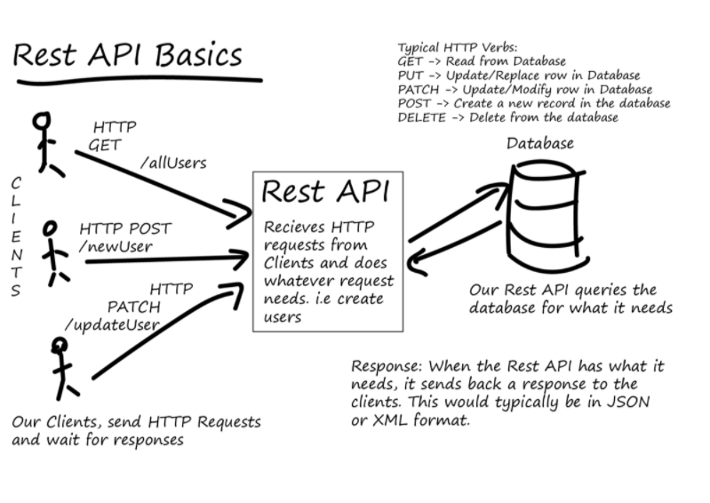
What is the InsuranceSuite REST framework?
A framework for defining
defining RESTful webservices
Publishing only
No client toolkit for invoking APIs
Design approach is schema-first
rather than code-first
Based on Swagger schemas
Not based on JAX-RS

Slide 5
REST API Basics
Typical HTTP verbs :
GET-> Read from database
PUT->Update replace row
in database
PATCH->Update modify
row in database
Post->create a new record in database
Delete->Delete from the database
CLIENTS
HTTP GET/all users
Rest API
Receives HTTP request from client and does whatever request needs. i.e create users
Database
HTTP POST/new users
Our Rest API queries the
database for what it needs
HTTP PATCH/update users
Our Client send HTTP requests and wait for the responses
Response : When the rest API has what it needs, it sends back a response to the clients, this would typically be in JSON or XML format
Notes:
A RESTful API is an application program interface(API) that uses HTTP request to GET,PUT,PATCH,POST and DELETE data. A RESTful API-also refereed to as a RESTful web service-is based on representational state transfer(REST) technology.
RSEST is the idea of using the hypertext transport protocol(HTTP) to view and manipulate resources. Following this protocol, the primary allowable actions are GET,PUT,PATCH,POST,DELETE. Unique resource locators(URLs) are the means for referencing exposed entities, and the HTTP response codes are used to understand the state of the interaction in its full form, REST employs media types that define the available resources and allowable payloads, and links are provided to facilitate auto-discovery of resources and actions.
PATCH vs PUT
PATCH requests that a set of changes described in the request entitybe applied to the resource identified by the request-URI.(Preferred verb for an update).
PUT requests that the encosed entity be stored under the supplied Request-URI. If the request-URI refers to an already existing resource. The enclosed entity should be considered as a modified version of the one residing on the origin server-the entire entity will be replaced. If the reuest-URI does not point to an existing resource, and that URI is capable of being defined as a new resource by the requesting user agent, the origin server can create the resource with that URI.
Why not use JAX-RS?
Code-first APIs don’t compose or extend cleanly-becomes difficult-to-impossible to ship OOTB APIs that you can extend without just modifying all the classes in place and “owning” everything
JAX-RS does not work consistently across our supported application servers
Lots of other work needed on top of the basic dispatch and (de)serialization layers anyway-authentication, logging, standard error formats,localization,etc.
What is swagger?
Swagger is a specification for documenting REST APIs that has become the closest thing to an industry standard that you will find, with a growing ecosystem of tools that can understand swagger schemas. The InsuranceSuite REST framework uses Swagger version 2.0 schemas to define the API’s themselves, including the available resource(i.e. the paths), the verbs that can be used with those resources, what paramters each operation accepts, and the schema for any payload or response if those are specified in JSON. Swagger is designed for schema-first development of APIs, meaning that you can develop the API specification before starting implementation, and as such is intended to be a file format that humans can read and write directly with minimal editor support. The official swagger 2.0 spec is available at https://github.com/OAI/OpenAPI-Specification/blob/master/versions/2.0.md.

Slide 6
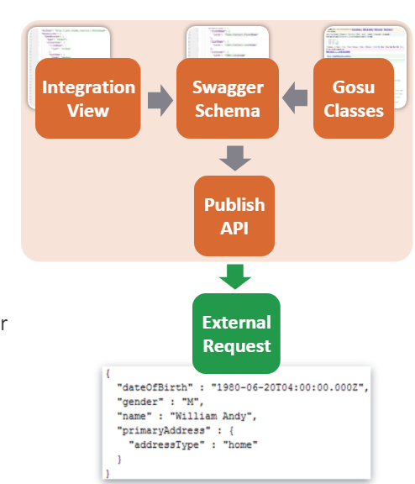
RESTful framework components
Swagger schema
Swagger 2.0 schema definitions to define
APIs
Integration Views
JSON schema draft 4 to define the input/output schemas
Can use the same schemas for integration views and/or
REST APIs
Schema files drive request routing, validation
and (de)serialization
Framework also handles standardized error codes and error formats,
localization, pluggable authentication, pluggable logging, content negotiation etc
Gosu classes
Implement the API itself
Notes:
RESTful framework components
The InsuranceSuite REST PAI framework uses swagger 2.0 schema files to define the structure of a given API, and JSON schema files to define the schema for API inputs and outputs. Integration Mapping files and integration filters can optionally be used to implement GET methods within the API. Together, the swagger schema and JSON schema pieces are used to determine :
The set of resources exposed by the API; each resource is called a “path” or “path item” in swagger, and can have variables interposed for things like resource ids. For example, /contact/{contacted}/addresses might define a resource for the addresses associated with a specific contact.
The set of HTTP verbs that can be used to operate on a particular resource. Swagger calls these the “operations.: For example, the /contact/{contacted}/addresses resource might define a GET operation that returns the addresses for the specified contactr and a POST operation for adding a new address to the contact. Updates and deletions of addresses might be done via PATCH and DELETE operations on /contact/{contacted}/addresses/{addressed}
The set of path parameters, query parameters, and custom headers applicable to each operation. In the above example,”contacted” and “addressed” are path parameters. At runtime, the framework will match the request URL against the defined path and extract out those path parameters for use by implementation code. Query parameters are the bits after the? In the URL and are often used for additional parameters to an operation.
The schema for the payload passed to an operation, if any. In the above example, a POST to /contact/{contacted}/addresses might specify a JSON schema definition that defines the format for the body of the POST request.
The schema for the response returned by an operation, if any, as well as possible HTTP codes that will be returned. A GET request to /contact/{contacted}/addresses might specify a json schema for the list of addreses,a nd that the default success code is 200.
Validation and serialization/deserialization for those parameters, inputs and outputs. A paramters might be declared as required, or with a specified min and max value, or as an integer versus a string; the framework can then use that information to automatically validate the inputs and return an appropriate HTTP response if the input is invalid, and can deserialize the data into appropriate POJOs for use by the implementation code.
Every operation defined within the swagger schema is then bound to a specific handler class and method, which will be invoked to process the request whenever a request is made against the appropriate URL and HTTP request method. A single configuration file, published-apis.yaml, is used to control which swagger schemas are actually exposed via the REST servlet.
WHY not DTOs?(Data transfer Object)
Wrappers allow for clean extension-no need to subclass, overwrite OOTB classes, create runtime proxies, etc.
Wrappers allow code re-use across API versions
Wrappers allow for “late-binding” of code to the schema, which helps modularity
I.e. base application code can execute without knowing if its being called by an customer extension API
Wrappers can be optional
Don’t like them? Too slow to compile? Your code is mostly reflective/meta anyway? Then don’t generate them.
Wrappers are module-specific
Since extension schemas are in a different namespace, so are the wrappers
Wrappers are a module-specific implementation detail.

Slide 7
Use case
Requirements
Create an API that will allow external resources to:
View a contact
View a list of contact notes
Update a contact
Add a note to a contact
Design approach
Define the API schema
Create the Swagger schema for the API paths and operations
Define the API Integration view
Create an integration view for any inputs and outputs
Define the API handler class
Implement the API by creating a handler class and its methods
Publish and test the API
Add it to published-apis.yaml file
Notes:
Use case
Some simple convention to keep in mind.
Try to structure things as operations on resources rather than as RPC calls, i.e. instead of calling addContact you are POSTing to /contacts
GET should never mutate a resource
Use PUT to replace an existing resource, PATCH to partially update it (i.e. only updating specified fields), DELETE to remove objects, and POST to create new resources under an existing container
Use plurals for resource paths where there are multiple sub-resources, i.e. /contacts/{contacted} rather than /contact/{contacted}

Slide 8
Define API Schema

Slide 9
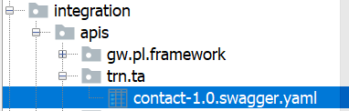
Create a new yaml file
Swagger schemas are written as yaml file
Placed in subdirectories of the config/integration/apis folder
Swagger schemas can be defined in their own namespace within the apis folder and can be nested in arbitrary folders.
As a best practice, customer-specific swagger schemas should be put into a customer-specific namespace
Apis/<company_code>/<product_code>
Swagger schemas must always have a version attached to their name, separated by a ‘-’ character
The names should be formed as
<name>-<version>.swagger.yaml
For example, for training :
config/integratin/apis/trn/contact-1.0.swagger.yaml
Swagger schema named trn.ta.contact-1.0 within the application
Notes:
YAML(YAML Ain’t Markup language) is a human readable data serialization standard for all programming languages. It is used for configuration files and in many application where data is being stored in the next page you can see an example.

Slide 10
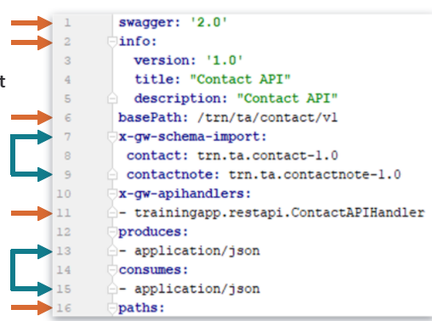
Define header information
Base path
Determines where the resources are rooted on rest servlet
REST servlet define in web.xml file with the default path rest
Becomes a prefix to each of the paths
The runtime path to the resources will
<schema>://<server>:<port>/<webapp>/<servlet>/
<basepath>/<resource>
http://localhost:8880/ab/rest/trn/ta/contact/v1/<resource>
(Resource are defined in paths)
InsuranceSuite extensions
Any declaration that starts with x-gw are custom InsuranceSuite extensions to the schema, for example:
x-gw-schema-import
X-gw-apihandlers
Notes:
Define header information
Line 1 : Must always specify swagger : ‘2.0’ in the file.
Line 2 : Basic information about the schema.
Line 6 : Determines where the resources are rooted on the rest servlet. It becomes prefix to each of the paths: http://localhost:8880/ab/rest/trn/ta/contact/v1/<resource>
Line 7-9 : Schemas alias and import path are defined. Reference to the imported schema are prefix with the alias before the ‘#’ symbol.
Line 11 : Specifies the default handler class that will be instantiated for the operations.
Line 13,15 : Specifies the default input/output file format for operations unless explicitly declared.
Line 16 : Resource/Operations are defined under path.
Header Template
Swagger : ‘2.0’ info :
Description : “My API”
version :’1.0’
title : “My API”
Base path : <basepath> # the base path is prepended to every path in this API, generally in the form <grouping>/<version> line claims/v1
X-gw-schema-import :
<alias> : <json schema name> # can include any numbers of import.
Produces:# used as the default for operations that don’t explicitly declare it -application/json.
Consumes : # used as the default for operations that don’t explicitly declare it -application/json

Slide 11
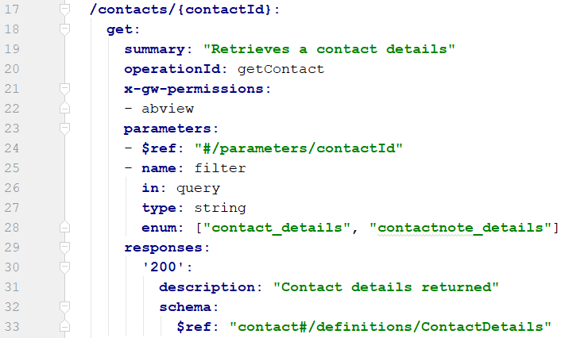
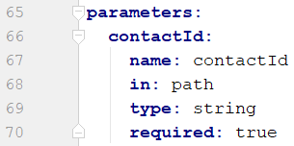
Define get operation to view a contact and its notes
HTTP GET requests are used to retrieve resource information only
Notes:
Define get operation to view a contact and its notes
Line 17 : Defines the resource path.
Line 18 : HTTP verb to read from the database.
Line 20 : Unique method name the framework will call at runtime.
Line 21 : InsuranceSuite extension that defines required permission(s) to execute the operations.
Line 24,65 : Required parameter is defined and passed in the URL path.
Line 25 : Filter parameter is defined. It is optionally used by the mapper query operation to obtain the TransformResult object. Two filters will be available for the external resource.
Line 30 : Standard response code for successful request.
Line 33 : Reference to the json schema definition used for the response returned by the operation, if any.
HTTP response status are divided in five category.
1xx : Informational - Communicates transfer protocol level information
2xx : Success – Indicates that the client request was accepted successfully.
3xx : Redirection – Indicates that the client must take some additional action in order to complete their request.
4xx : Client Error – This category of error status codes points the finger at the client.
5xx : Server Error – The server takes responsibility for these error status codes.
HTTP response code example
200(OK) – standard response for successful HTTP request. The actual response will depend on the request method used. In a GET request, the response will contain an entity corresponding to the requested resource. In a POST request, the response will contain an entity describing or containing the result of the action.
201(Created) – the request has been fullfilled, resulting in the creation of a new resource. The origin server MUST create the resource before returning the 201 status code.
202(Accepted) – the request has been accepted for processing, but the processing has not been completed. The request might or might not be eventually acted upon, and may be disallowed when processing others.
Path Template
Paths :
/<path>:
<method>: # methods are in lower-case, i.e. get, post, patch, put, delete, options, or head
summary:<summary># Any text you like
description:
<description># Any text you like
operationid :
<operationid> # Becomes the handler method name, must be ubique within this schema
parameters : # you can omit this if the method has no parameters. Parameters is a list, so each element is prefixed with ‘-’ to indicate it’s a list item
-name:<foo>
in:
<query/path/body/header>
# either query,path,body, or header
required : <true/false> # defaults to false, must be set to true for path parameters
type : <string/integer/number/Boolean?# only for query, path or header parameters
schema : # only included for the body parameter
$ref: <alias>#/definitions/<name>
responses:
‘<code>’ : # Make sure its in single or double quotes. 200 is generic, 201 for “created”, 204 for responses without a body
description: <description>
schema : # Only include for a 201 or 204
$ref: <alias>#/definitions/<name>
Permissions
Generally, permissions should be enforced in the handler, rather than using the x-gw-permissions property in the schema. System permission can be used in the schema if there is no special application-level logic on that permission.
Referencing the system permission directly is often not very safe, because you may be bypassing the logic on the associated application permission key, i.e. if you used abview, you’d bypass all the Tag permission logic for ABContact.

Slide 12
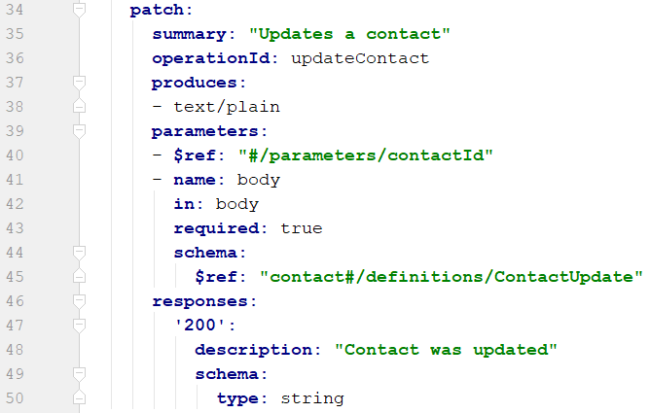
Define patch operations to update a contact
HTTP PATCH requests are used to make partial update on a resource
HTTP PUT requests are used to replace a resource in its entirely
Notes:
Define patch operations to update a contact
Line 34 : HTTP verb to update a database record.
Line 36 : Unique method name the framework will call at runtime.
Line 37 : Explicitly defines what the operation will produce, if any. Overrides default setting of application/json.
Line 40 : Required parameter is defined and passed in the URL path.
Line 41-45 : Defines the parameter for the json object sent in from the external resource. Json object parameter are defined by referenced schema.
Line 47 : Standard response code for successful update.
Line 50 : Schema definition used for the response returned by the operation, if any.

Slide 13
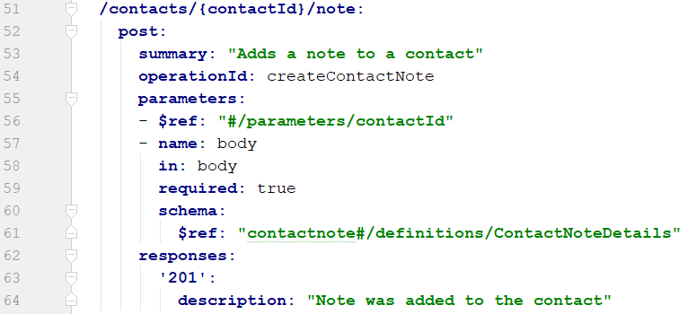
Define post operation to add a note to a contact
HTTP POST requests are used to create new resources.
Notes:
Define post operation to add a note to a contact
Line 51 : Defines the resource path
Line 52 : HTTP verb to add a database record
Line 54 : Unique method name the framework will call at runtime
Line 56 : Required parameter is defined and passed in the URL path.
Line 57-61 : Defines the parameter for the JSON object sent in from the external resource. JSON object parameter are defined by the reference schema.
Line 63 : Standard response code for successful update

Slide 14
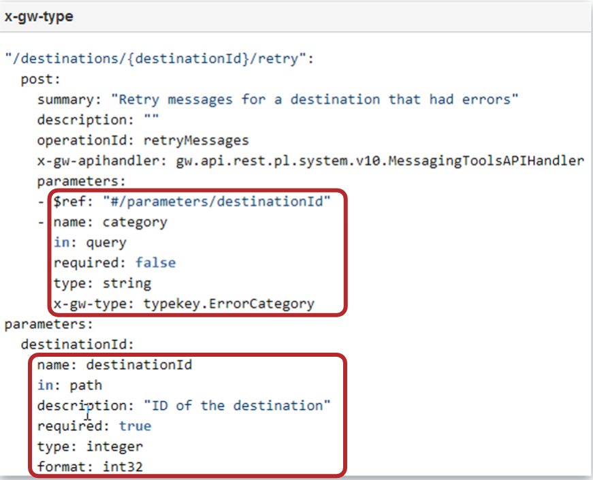
Parameter validation constraints
A resource may have a parameter in their
path, body, header and query
Depending on the type of parameter,
constraints can be specific to ensure
the request confirms to expected schema
definition.
Apart form standard swagger schema 2.0
spec parameter option we also support :
x-gw-type for path, query and header parameters
The value of x-gw-type is an InsuranceSuite typekey
Notes:
Parameter validation constraints
Walking through above example:
There are couple of parameter specified for the above resource namely the path parameter destinationId and the query parameter category
The path parameter destinationId is required and must be an 32 bit integer value
The query parameter category is not required but if specified it must be string and it must correspond to a code from one of the typekeys in the ErrorCategory typelist.

Slide 15
Define API Integration View

Slide 16
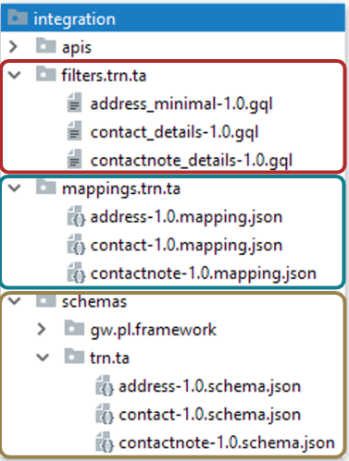
Define API Integration view
API Inputs and outputs can be associated with a JSON schema definition and its corresponding mapper file
The JSON schema and mapping files in InsuranceSuite are shared between the integration views framework and the REST API framework
Both make use of the same files, with the same rules, and the same subset of json schema
Notes:
JSON schema and mapping configuration in covered in detail in the integration view lesson

Slide 17
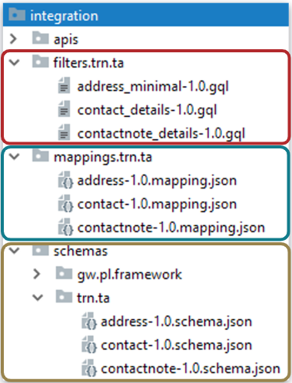
Integration View files used to view a contact and it’s notes
Schema file
contact-1.0.schema.json which imports the address and contactnote schemas
ContactDetails definition contains the properties needed for the response object
Mapper file
contact-1.0-mapping.json which imports the address and contactnotes mappings
ContactDetails mapper defines the paths to the data needed for the response object properties
Filter files
contact_details-1.0.gql
contactnote_details-1.0.gql
Used to return either contact or notes information

Slide 18
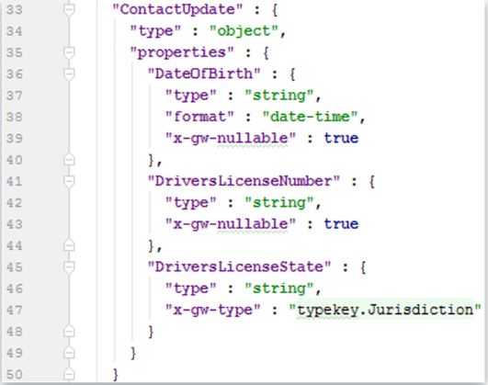
Integration View files used to update a contact
Schema file
ContactUpdate definition is added to the contact-1.0.schema.json file
X-gw-nullable = true added to properties to allow for null values
By default, on input, explicitly-null properties are not allowed
Mapper file
Not required since mapping of the input properties and domain properties will be handled in API handler class
Notes:
Code example lines 39, 43
By default, on input, explicitly-null properties are not allowed
To allow this, nulls have to be explicitly defined on the property.
The only use case for explicit nulls on inputs is PATCH requests, where you need to explicitly null out a field.
Note that required fields cannot have null values. Reference the data dictionary before allowing a null field.

Slide 19
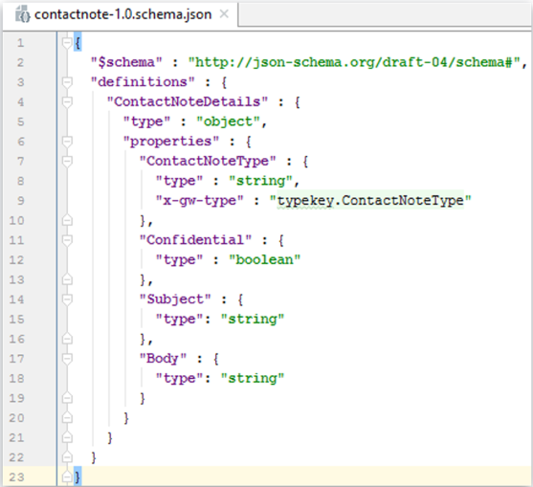
Integration View files used to add a contact note
Schema file
contacnotet-1.0.schema.json file
Mapper file
Not required since mapping of the input properties and domain properties will be handled in API handler class
Notes:
Note that required fields cannot have null values. Reference the data dictionary prior to allowing a null field.

Slide 20
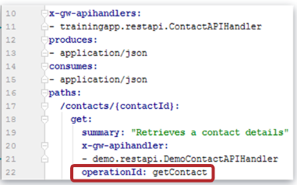

API handler class
Handler classes can be specified at the root level of the document and overridden at the operation level
The root document can provide a list of classes rather than just one; they’ll be considered in order
Handler classes need to have no arguments, public constructor
Every operation defined for published API must have an associated handler method
For each operation
The framework will look for a public method with a name that matches the opertaionId, for each candidate handler class
Declared methods are considered first, then all methods
There must be exactly one match
Method names cannot be overloaded
Notes:
Lifecycle:
The handler class itself is created for every single request, so it’s important that the handler class’s have a no argument public constructor. The handler method is invoked after the request has been authenticated and all inputs have been validated and deserialized; if the input is invalid, the handler method will never be invoked.
Handler method requirements:
The handler method for a given operation need to meet the following criteria:
The method’s name must match the operationId; if the operationId is not a valid identifier, for the purposes of determining the expected method name, a leading ‘_’ will be prepended if the first character is not a valid start identifier start, and all other illegal characters will be replaced with ‘_’
The method must be public
The method must be non-static
The method’s parameter must either be of type RequestContext, or must have a name and type that matches a parameter declared on the operation’s configuration
The method’s return type must be either be void, gw.api.rest.Response, or some type that the framework can serizlise out
The class containing the method must have a non-arg constructor
It is not technically a requirement that the handler class be implemented in Gosu rather than Java, but the parameter binding algorithm relies on method parameter names, and those parameter names are not currently preserved in Java, so as a practical matter API handler classes must currently be implemented in Gosu. If you wish to implement the handler class in Java, you can create a Gosu class that simply serves to bind method parameters and then delegates all actual logic to a Java helper class.
Handler Binding Algorithm:
The set of possible handler classes can either be specified directly on the operation, via x-gw-apihandlers property on the root object. (Note that x-gw-apihandlers is not inherited across files via combination: the defaults there only apply to operations defined in that file.) x-gw-apihandler defined at the operation level will override the value of x-gw-handlers on the document root.
Methods are bound to operations when the REST servlet is initialized, and for each operation the search operation looks like this:
Each API handler class is considered individually, in order
First, only the explicitly declared methods on that class are considered (i.e. methods inherited from supertypes are ignored)
If a method is public, non-static, and has the same name as the opertionId, consider it as a possible handler method
Note: there’s a bug in 10.0.0 where static methods are also considered
If there were two or more possible methods, report a configuration error
If exactly one method matched, assume that’s the handler method to use
If no methods matched, proceed to looking at all methods on the handler class, not just declared methods
The same logic applies: two or more possibilities is an error, a single matching method means we use that method
If all handler classes have been considered and no matches were found, report a configuration error
If a handler method was found, validate it’s type and arguments according to the requirements mentioned above

Slide 21
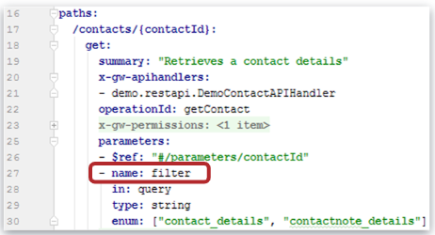

Parameter binding
Each method parameter must match the name and type of parameter declared on the Swagger schema
Order doesn’t matter
Don’t have to include all possible paramters
Each parameter to the API handler must either be:
A parameter declared on Swagger schema for the associated operation, or
Of type gw.api.rest.RequestContext
Runtime operation parameter values can always retrieved by name from the RequestContext if they’re not explicit arguments to the handler method
Notes:
Query, Header and Path parameters:
Query parameters, Header parameters and Path parameters are all handled similarly. All such parameters declared in the schema will be processed as follows:
If the parameter is required, but is not present on the request, an error message will be generated
If the input parameter does not match defined data type, an error message will be generated
If the input parameter does not conform to the declared constraints such as minLength or maximum, an error message will be generated
Parameters:
Parameters type should match the deserialized type of the parameter
String, BigDecimal, Date, etc. for scalar values
List for array values
JsonObject a JsonWrapper Subclass, String or byte[] for the body parameter
RequestContext object:
The RequestContext interface represents information about the current request being processed. Any API handler method can be passed the current RequestContext for the request by having a parameter of type RequestContext. RequestContext is also used as input to the IRestDispatchPlugin. The requestContext object serves a number of different methods at runtime. It can be used to:
Access the original HttpServletRequest to obtain raw request information that might not be surfaced in other ways.
Access headers, query parameters and path parameters by name, in either deserialized (if they’re explicitly listed in the schema) or “raw” form. This can be helpful when writing common infrastructure shared across multiple API endpoints; for example if you have several API’s that use a query parameter named “sort” that works in predictable way, you can build common infrastructure that can take the RequestContext extract “sort” query parameter from it by name, rather than passing the parameter values down directly.
Access metadata about the request being served such as the SwaggerOperation object, path template, or API fully-qualified name.
Access other information about the request being handled, such as the negotiated response type.

Slide 22
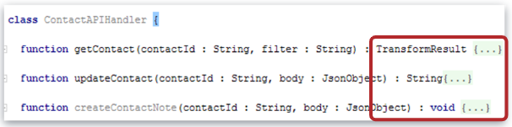
Return values
The API handler method can return either gw.api.rest.Response, void, or any type that can be serialized out at runtime
Some common return types include:
Void
If the operation returns 204 response code (no content), the method need not return anything at all
TransformResult
An operation that produces JSON and/or XML and which uses an integration Mapping to produce that data can return a TransformResult directly
String or byte[]
Can return a String or byte[] that will be return out as-is
Response
Can return a response object that explicitly set the response code, response body, and/or custom headers
Notes:
The API handler method can return either gw.api.rest.Response, void, or any type that can be serialized out at runtime. If the Swagger operation defines multiple 2xx response codes, then the handler must return gw.api.rest.Response, so that handler method can set the desired status code. It is also legal for a handler method to return Object and have different possible return values at runtime, so long as those return values are all serializable at runtime by the framework.
Some common return type include:
void - If the operation returns 204 response code, the method handler can have no return value
JsonObject or JsonWrapper subtype – An operation that produces JSON and/or XML an return a JsonObject or any generated schema wrapper type.
TransformResult - An operation that produces JSON and/or XML and which uses an Integration mapping to produce that data can return a TransformResult directly.
Response: If the method handler needs more explicit control over the response’s status code, or wishes to add custom headers to the response the method handler can return a Response object that combines the desired status code, response body and headers.
String or byte[] – For something other than JSON or XML return data, the handler method can return a String or byte[] that will be written as-in.
Exceptions:
API handlers can throw exceptions that will then be translated appropriate HTTP status codes and error messages. Any exception that implements gw.api.exception.HasErrorInfo interface can be used, including custom exception subtypes, but in general the exception classes defined in the gw.api.rest.exceptions packages should be suitable for mapping common error cases. For example, a NotFoundException can be thrown if an entity ID referenced from path parameter can not be found in the database, or a BadInputException can be thrown if the input fails some additional validation performed by the method handler. Any exception thrown by the method handler that does not implement HasErrorInfo will automatically be mapped to a 500 (Internal Server Error) status code.

Slide 23
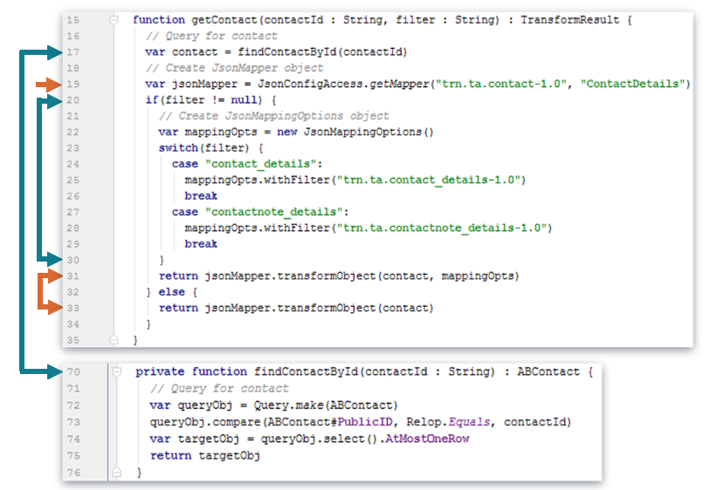
Handler method to view a contact and its notes
Notes:
Code example:
Line 17, 70
Use private method to retrieve contact and object by PublicID.
Line 19
Create the JsonMapper object.
Define the fully qualified path to the mapper file.
Define the mapper name.
Line 20-30
Create the JsonMappingOptions Object.
Based on the filter argument, set the mapping option.
Line 31, 33
Return the TransfoRmresult object.

Slide 24
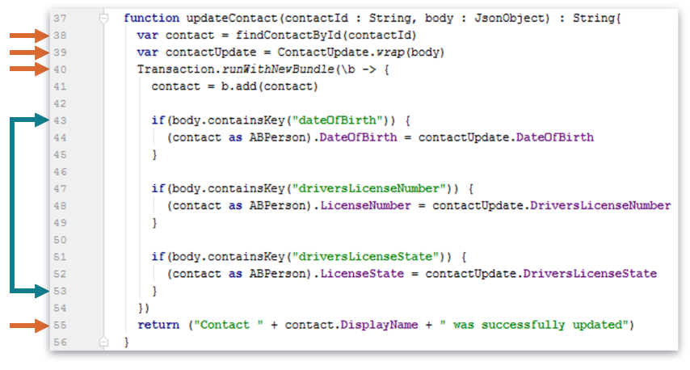
Handler method to updated a contact
Notes:
Code example:
Line 38
Reference private method to retrieve contact and object.
Line 39
Use ContactUpdate schema wrapper classes to wrap the JsonObject body argument.
Note that ContactUpdate schema wrapper classes need to be generated first.
Line 40
Create a new bundle to update the contact.
Credentials provided by the external sources are used to commit the bundle.
Line 43, 53
Update the contact if new information is sent.
Line 55
Return a String object.

Slide 25
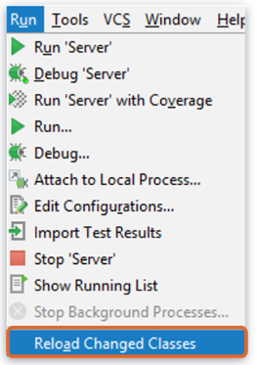
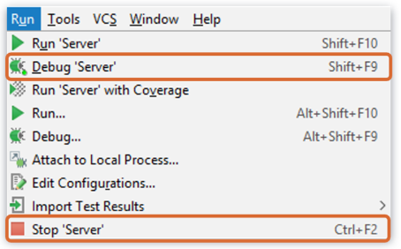
Deploy code changes
Restart Server
New Gosu Class
Reload changed classes
Modified Gosu Class
Notes:
You can restart the server from studio by stopping running server and after the server stops, then starting the server again in either Run or Debug mode (preferred for training).

Slide 26
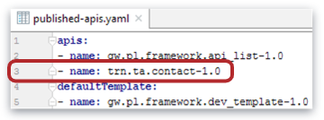
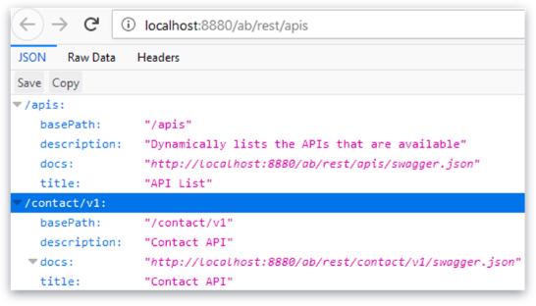
API publishing
Schema files do not turn into network endpoints by default
Must opt-in APIs to control what is exposed on the network
Files are added to config/integration/apis/published-apis.yaml
Extensions model
Customers extend the core API and publish their extended version, not the core one
Multiple live versions can be published, all based on core version
The default API URL returns a list of APIs that have been published
http://localhost:8080/ab/rest/apis
Notes:
Default URL’s
swagger-ui URL’s
https://localhost:8080/ab/resources/swagger-ui
apis URL’s
http://localhost:8080/ab/rest/apis
Verify that you can visit the published from the swagger-ui URL and that you can request the/apis enpoint from Postman (or any other tool you prefer).

Slide 27

swagger-ui
InsuranceSuite bundles a swagger-ui distribution
Default URL is <base-servlet-URL>/resources/swagger-ui
http://localhost:8080/ab/resources/swagger-ui
Every API automatically gets a /swagger.json endpoint
The servlet by default exists at /rest
Returns the default external view of the schema
In swagger-ui manually change the endpoint to reference the desired API
<basePath>/swagger.json
The basePath declared in the schema is prepended to every path in the schema
Notes:
Exposing Guidewire RESTful Web Services
How would we go about publishing one of our web services if we wanted to (for example) publish it through AWS? When I paste YAML file on my api, the swagger editor complains about the #ref as it does not know what that is. This works locally with the swagger-ui, but it fails in the online swagger editor.
Answer:
You wont be able to copy-and-paste directly from your configuration environment, since we have proprietary extensions added, including x-gw-import code to reference JSON schema files.
In order to use the swagger file with an external tool that understands Swagger, you need to fetch the “external” version of the Swagger schema, which will normalize things and inline all the JSON schema definitions into the file. If you have the server running, the easiest way to get that files is just to fetch the swagger.json from endpoint itself, by making a GET request against <api>/swagger.json, i.e. something like http://localhost:8080/cc/rest/eic/intg/claim/v1/swagger.json if you’re running ClaimCenter locally.
You can also run genExternalSchemas build task, which will generate the “external” versions of all of the JSON schema and Swagger files and persist them to disk.

Slide 28
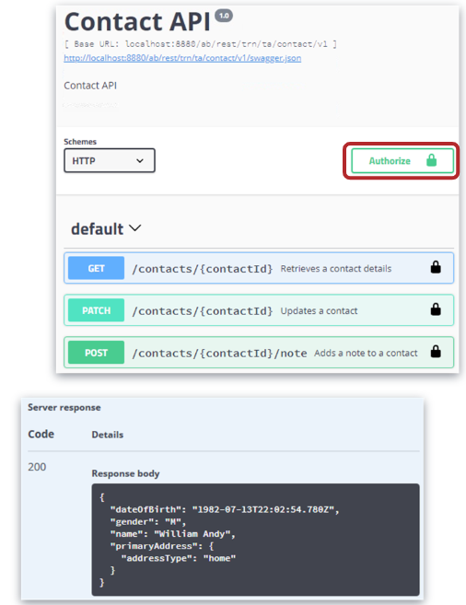
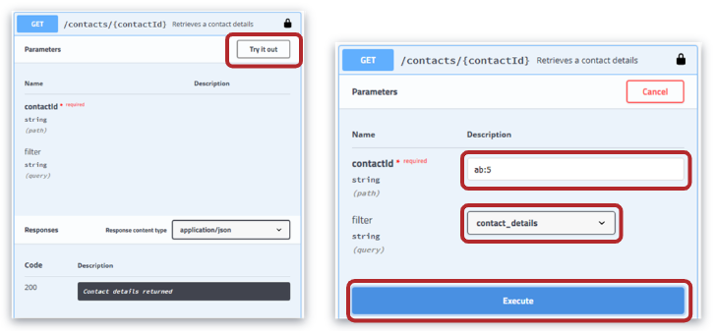
Contact API
Click Authorize to enter login credentials
Click HTTP verb to test each API
Click Try it out to test
Enter parameter(s)
Click Execute

Slide 29
DEMO

Slide 30
This video will demonstrate how to create a Rest API that will output the following user data in JSON format : First Name, Last Name, Job Title, User Name, Locked, Name of each assigned group.
Pre-Requisites
Training App Guidewire Studio
Supported web browser

Slide 31
LAB

Slide 32
Complete the exercises listed in “Restful Web Services” chapter in the “InsuranceSuite 10 Integration: Kickstart “ work book

Slide 33
Match the HTTP verbs with it’s description
Verb | Answer | Description
PUT |  | Delete from the database
RETRIEVE |  | Update/Replace row in the database
GET |  | Create a new record in the database
PATCH |  | Read from the database
INSERT |  | Update/Modify row in the database
REMOVE |  | Not an HTTP verb
POST |  | Not an HTTP verb
REPLACE |  | Not an HTTP verb
DELETE |  | Not an HTTP verb
Notes:
Answers
1) Typically, a message event gets triggered when an event-aware entity is created, changed, or removed. (There are also other application-specific message events.)
2) The primary purpose of the MessageContext entity is to create messages using information from the message event and the triggering entity.
3) Seven, which would occur if all seven destinations listen to EscalationAdded. Zero, which would occur if none of the destinations listen to EscalationAdded.
4) MessageTransport, which sends the message to the external system.
5) MessageContext.Root is of type Object, but message payloads typically need to work with the MessageContext.Root as the type of entity that triggered the message event. Therefore, the MessageContext.Root entity must be cast to be of that type.

Slide 34
Match the HTTP verbs with it’s description
Verb | Answer | Description
PUT | Update/Replace row in the database | Delete from the database
RETRIEVE | Not an HTTP verb | Update/Replace row in the database
GET | Read from the database | Create a new record in the database
PATCH | Update/Modify row in the database | Read from the database
INSERT | Not an HTTP verb | Update/Modify row in the database
REMOVE | Not an HTTP verb | Not an HTTP verb
POST | Create a new record in the database | Not an HTTP verb
REPLACE | Not an HTTP verb | Not an HTTP verb
DELETE | Delete from the database | Not an HTTP verb
Notes:
Answers
1) Typically, a message event gets triggered when an event-aware entity is created, changed, or removed. (There are also other application-specific message events.)
2) The primary purpose of the MessageContext entity is to create messages using information from the message event and the triggering entity.
3) Seven, which would occur if all seven destinations listen to EscalationAdded. Zero, which would occur if none of the destinations listen to EscalationAdded.
4) MessageTransport, which sends the message to the external system.
5) MessageContext.Root is of type Object, but message payloads typically need to work with the MessageContext.Root as the type of entity that triggered the message event. Therefore, the MessageContext.Root entity must be cast to be of that type.

Slide 35
When the files must be updated to publish an API schema?
swagger.yaml
published-schemas.yaml
codegen-schemas.yaml
published-apis.yaml
json-apis.yaml
Notes:
Answers
1) Typically, a message event gets triggered when an event-aware entity is created, changed, or removed. (There are also other application-specific message events.)
2) The primary purpose of the MessageContext entity is to create messages using information from the message event and the triggering entity.
3) Seven, which would occur if all seven destinations listen to EscalationAdded. Zero, which would occur if none of the destinations listen to EscalationAdded.
4) MessageTransport, which sends the message to the external system.
5) MessageContext.Root is of type Object, but message payloads typically need to work with the MessageContext.Root as the type of entity that triggered the message event. Therefore, the MessageContext.Root entity must be cast to be of that type.

Slide 36
When the files must be updated to publish an API schema?
swagger.yaml
published-schemas.yaml
codegen-schemas.yaml
published-apis.yaml
json-apis.yaml
published-apis.yaml
Notes:
Answers
1) Typically, a message event gets triggered when an event-aware entity is created, changed, or removed. (There are also other application-specific message events.)
2) The primary purpose of the MessageContext entity is to create messages using information from the message event and the triggering entity.
3) Seven, which would occur if all seven destinations listen to EscalationAdded. Zero, which would occur if none of the destinations listen to EscalationAdded.
4) MessageTransport, which sends the message to the external system.
5) MessageContext.Root is of type Object, but message payloads typically need to work with the MessageContext.Root as the type of entity that triggered the message event. Therefore, the MessageContext.Root entity must be cast to be of that type.

Slide 37
Create a swagger schema to define an API
Reference an existing integration view in the API
Create an API handler class
Publish an API
Use swagger-ui to test an API

