Slide 1
Claim History
9 December 2013
Notes:
Guidewire training materials contain Guidewire proprietary information that is subject to confidentiality and non-disclosure agreements. You agree to use the information in this manual solely for the purpose of training to implement Guidewire software solutions. You also agree not to disclose the information in this manual to third parties or copy this manual without prior written consent from Guidewire. Guidewire training may be given only by Guidewire employees or certified Guidewire partners under the appropriate agreement with Guidewire.

Slide 2
Lesson objectives
By the end of this lesson, you should be able to:
Explain claim history functionality
Create custom claim history types
Create custom claim history records
Track individual field changes in Gosu
This lesson uses the notes section for additional explanation and information. To view the notes in PowerPoint, choose View→Normal or View→Notes Page. If you choose to print the notes for the lesson, be sure to select “Print hidden slides.”

Slide 3
Lesson outline
Claim history basics
Writing custom history records
Tracking changes to fields

Slide 4
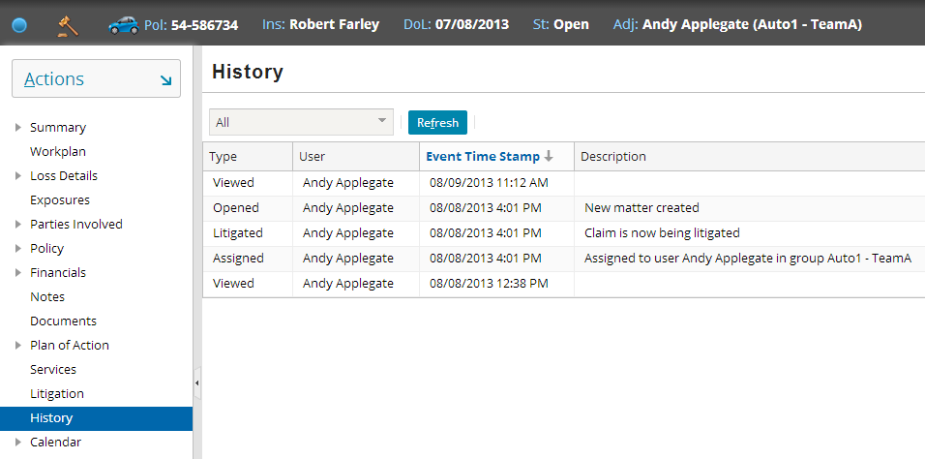
Claim history
A claim history is an uneditable record of important events and actions taken on the claim
Notes:
Note that the claim history includes obvious entries (such as significant edits) as well as more trivial events such as viewing the claim. The History screen can include, through configuration, any kind of event a carrier wants to track, such as when the value of the Loss Cause field changes (and what the old and new values are).

Slide 5
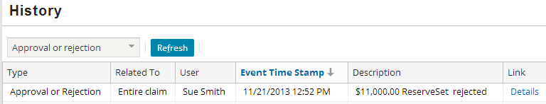
Claim history record
A claim history record is an entry in the claim history, documenting a single recordable claim event
Every history record has the following claim history fields:
Type
Related To
User
Event Time Stamp
Description
Link
Notes:
Claim history record fields
Type - The claim event causing the entry in the History table, such as an exposure being opened, closed or reopened, a stopped check, an activity’s due date changed, and so on.
Related To - Whether the event relates to the entire claim or one of its parts, like an exposure or reserve line.
User - Person who caused the event.
Event Time Stamp - Date and time the event occurred (in descending order, by default).
Description - A brief description of the event. This is provided for history entries written by ClaimCenter, and you may add your own when you write rules that create custom history events.
Link – If available, a link to the DV (Detail View) of the object’s details. In the base configuration, links are enabled for Transaction Approvals such as the one shown in the above screenshot (Approval or Rejection of a Reserve); anything that involves approval or rejection. That way, you can rapidly view the Approval information – if the Approval was actually approved or rejected, and why or why not? Note that the creation of the Reserve itself is not recorded in Claim history in the base application.

Slide 6
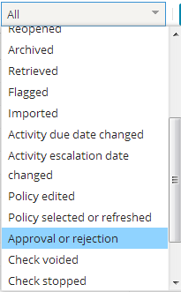
Claim history type
History type is the claim event causing the history record to be created
For example, the closing of a claim event produces a history record of type “closed”
ClaimCenter comes with standard history types that trigger automatically created claim history records
Standard events mostly include editing, assigning, viewing, approvals, etc…
Note that some events are not included in history in the base application (i.e. creating activities, creating reserves)
ClaimCenter may be configured to have custom history types, defining additional events to be added to the claim history
Filter History by type of event
Notes:
The base application claim history event types are defined in the HistoryType typelist. These history events will be generated by ClaimCenter by default regardless of configuration. More details on these event types can be found in the ClaimCenter Application Guide, under the Claim History section.

Slide 7
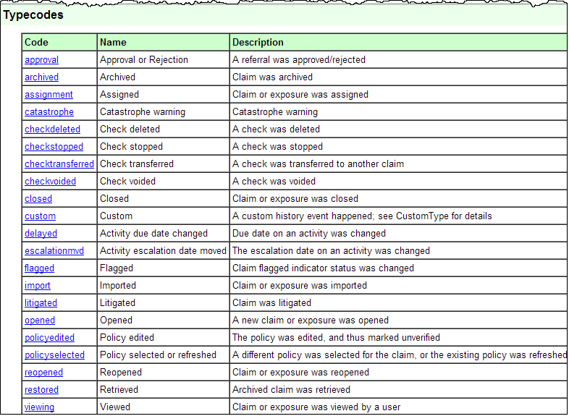
HistoryType Typelist in base application
Notes:
The ClaimCenter Data Dictionary provides a useful way to view all of the event types that are recorded in history. Note most involve some kind of edit to existing data, except for the “opening” (creation) of an exposure or matter. The opening of the claim itself is not recorded in history.

Slide 8
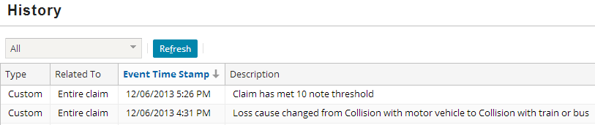
Common cases for custom history types
Tracking specific field changes
For example, record when loss cause changes
Tracking specific claim situations that occur
For example, record when a claim gets its tenth note
Notes:
Why does the application need custom history types rather than just one “general” type? They are needed for filtering by type on the claim history page.
Note that in base ClaimCenter, the type displayed will always be "Custom" unless you configure the ListView pcf to dynamically display your new type using the “value” property. The lab associated with this lesson has you perform that configuration.

Slide 9
Lesson outline
Claim history basics
Writing custom history records
Tracking changes to fields

Slide 10
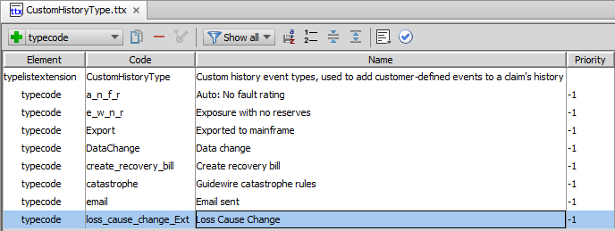
Custom claim history types
CustomHistoryType typelist defines history events that may be tracked by configured rules
Some “custom” history types are predefined in the base application
New custom history types can be added
Notes:
The name is what will appear in the history “type” column on the history screen.
The HistoryType.tix typelist is an internal typelist and cannot be modified or extended. CustomHistoryType.ttx is fully configurable.

Slide 11

How to configure custom history records
Syntax
Claim.createCustomHistoryEvent(CustomHistoryType, Text)
Claim is the claim to which you are adding a history record
CustomHistoryType is the history type
Text is the text to be displayed on the history record’s description column (in the screen)
Notes:
The above snippet is included inside the action of a ClaimPreUpdate rule, and will be discussed in greater detail in a few slides.

Slide 12
Lesson outline
Claim history basics
Writing custom history records
Tracking changes to fields

Slide 13

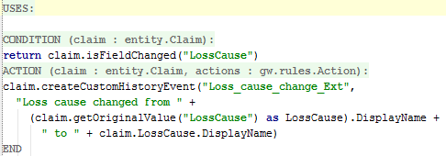
Checking for field changes
Syntax
entity.isFieldChanged(“field”)
Returns a boolean
Notes:
The parameter we send to isFieldChanged is a string. Ensure you are using the proper field name by checking the Data Dictionary.

Slide 14
Finding the original value
Syntax
entity.getOriginalValue(“field”)
Returns an ordinary object
Need to cast the result in order to get the display name
Notes:
The parameter we send to getOriginalValue is a string. Ensure you are using the proper field name by checking the Data Dictionary.

Slide 15
Lesson objectives review
You should now be able to:
Explain claim history functionality
Create custom claim history types
Create custom claim history records
Track individual field changes in Gosu

Slide 16
Review questions
What is a claim history?
Name three examples of claim history events.
Is it possible to define new types of history events?
Will any claim history records be recorded if no rules are written to configure it?
Notes:
Answers
A claim history is an uneditable record of important events and actions taken on the claim.
Possible answers: Assigned, Viewed, Closed.
Yes. You add them in the CustomHistoryType typelist.
Yes, ClaimCenter automatically tracks a collection of recordable events, such as viewing the claim, editing the policy, and flagging the claim.

Slide 17
Notices
Copyright © 2001-2014 Guidewire Software, Inc. All rights reserved.
Guidewire, Guidewire Software, Guidewire ClaimCenter, Guidewire PolicyCenter, Guidewire BillingCenter, Guidewire Reinsurance Management, Guidewire ContactManager, Guidewire Vendor Data Management, Guidewire Client Data Management, Guidewire Rating Management, Guidewire InsuranceSuite, Guidewire ContactCenter, Guidewire Studio, Guidewire Product Designer, Guidewire Live, Guidewire DataHub, Guidewire InfoCenter, Guidewire Standard Reporting, Guidewire ExampleCenter, Guidewire Account Manager Portal, Guidewire Claim Portal, Guidewire Policyholder Portal, ClaimCenter, BillingCenter, PolicyCenter, InsuranceSuite, Gosu, Deliver Insurance Your Way, and the Guidewire logo are trademarks, service marks, or registered trademarks of Guidewire Software, Inc. in the United States and/or other countries.
All other trademarks are the property of their respective owners.
This material is confidential and proprietary to Guidewire and subject to the confidentiality terms in the applicable license agreement and/or separate nondisclosure agreement.
This file and the contents herein are the property of Guidewire Software, Inc. Use of this course material is restricted to students officially registered in this specific Guidewire-instructed course, or for other use expressly authorized by Guidewire. Replication or distribution of this course material in electronic, paper, or other format is prohibited without express permission from Guidewire.
Guidewire products are protected by one or more United States patents.

