Slide 1
Designing Clean Data Model Graphs
11 February 2014
Notes:
Guidewire training materials contain Guidewire proprietary information that is subject to confidentiality and non-disclosure agreements. You agree to use the information in this manual solely for the purpose of training to implement Guidewire software solutions. You also agree not to disclose the information in this manual to third parties or copy this manual without prior written consent from Guidewire. Guidewire training may be given only by Guidewire employees or certified Guidewire partners under the appropriate agreement with Guidewire.

Slide 2
Lesson objectives
By the end of this lesson, you should be able to:
Describe how the claim graph defines the boundaries of information for a given claim
Add a new entity to the claim graph
Describe the common issues concerning overlap, ClaimInfo, and cross-claim entities
Identify errors in a malformed data model graph
This lesson uses the notes section for additional explanation and information. To view the notes in PowerPoint, choose View→Normal or View→Notes Page. If you choose to print the notes for the lesson, be sure to select “Print hidden slides.”

Slide 3
Lesson outline
Overview of data model graphs
Claim graph entities
Non-graph entities
Overlap entities
Claim Info entities
Data model graph tools

Slide 4
Claim information is spread across objects
For any given claim, the information about that claim is spread over of a number of objects, including:
The claim object itself
Objects uniquely "owned" by the claim
Objects that are potentially referenced by other claims in addition to this claim
claim 127
exposure 31
vehicle incident 8
activity 635
user 96
(owned by user 96)
Notes:
From a logic perspective, a claim "owns" an object if the object is referenced only by that claim (and the claim's sub-objects) and by no other claim (nor the sub-objects of any other claim).
From a technical perspective, a claim "owns" an object if the object has a foreign key field that references either the claim or one of its sub-objects.
Ownership cascades from the claim through all of its sub-objects. For example, if a claim owns an exposure and an exposure owns a reserve transaction, then the claim is also said to own the reserve transaction.

Slide 5
Who cares about "a claim and its objects"?
Several ClaimCenter features process a "claim and its objects" as a unit
Archiving
"The claim and its objects" are copied to the archive and then removed from the primary database
Objects referenced by that and other claims (such as users and groups) are not archived
Canceling out of the New Claim wizard / Purging
"The claim and its objects" are deleted from the database
Policy Refresh
These features make use of a "data model graph”
In ClaimCenter, this is known as the claim graph
All customers need to care because a clean claim graph is required to start the ClaimCenter server
Notes:
The data model graph feature exists to support two ClaimCenter features: archiving and purging.
Archiving is a feature that removes claims and their sub-objects from the ClaimCenter database and stores them in a file. The database stores claims that are "active" (such as open claims, recently closed claims, or claims recently restored from the archive). The archive stores "inactive" claims (closed claims for which there has been no recent activity). Regular archiving of inactive claims serves to reduce the size of the active database and improve efficiency. Searches within ClaimCenter return both active and archived claims.
Purging is a feature that permanently removes claims and their sub-objects from the database. Once purged, the claim cannot be searched for or restored. Claims can be purged for various reasons, including removal of claims mistakenly entered, and claims that have aged beyond the point of a carrier’s data retention policy. The purge is executed by the purge batch process. This batch process physically deletes all claims (and their sub-objects) that have been marked as retired. There are two ways a claim can be marked as retired:
Cancelling out of the New Claim Wizard
Administrators can retire a claim manually via the maintenance_tools command line (or the corresponding SOAP API)
There is no way for a user in ClaimCenter to manually retire a claim.
Policy Refresh is a feature that takes the current policy snapshot associated with a claim and replaces it with a new snapshot from the policy system. It is useful when the current policy snapshot is known to be inaccurate in some way, either because the policy was incorrect at time of claim creation or perhaps the policy system was down and the initial claim was created with an unverified policy.

Slide 6
The claim graph
The claim graph consists of the Claim entity and all other entities whose instances can be owned by a single claim
Claim
Exposure
Policy
Incident
Coverage
Notes:
Ownership can be direct or indirect. For example, every exposure, incident, and policy is directly owned by a single claim. (When a policy is brought over to ClaimCenter, it is brought over as a snapshot. Every claim has its own copy of the policy. So even if two or more claims are based on the same logical policy, each claim has its own snapshot and therefore uniquely owns that copy of the policy.) Every coverage is also owned by a single claim, but the ownership is indirect. Coverage does not have a foreign key to Claim, but rather to Policy, which in turn has a foreign key to Claim.
The claim graph consists of a single hierarchy with a single root entity (Claim). It must be complete enough such that when a claim is removed or moved to the archive, everything uniquely related to the claim gets moved with it. (All entities in the claim graph are connected directly or indirectly to Claim, and therefore directly or indirectly to one another.)

Slide 7
Claim graph instances
A claim graph instance is a set of objects consisting of one claim and all the objects uniquely owned by that claim
It does not include any data potentially referenced by multiple claims
Claim graph instance for claim 127
claim 127
exposure 31
vehicle incident 8
activity 635
user 96
(User 96 is referenced by many claims and therefore is not uniquely owned by claim 127)

Slide 8

Non-graph data
Non-graph data consists of any data not in the claim graph
Admin data
System data
Cross-claim entities
User
Group
ActivityPattern
ClaimAssn
BusinessWeek
Notes:
Unlike the claim graph, non-graph data is not necessarily related. It includes different kinds of data, including:
Admin data – entities whose instances can be referenced my multiple claim graph instances, but is owned by none of them. (Note that a given instance can be referenced by zero or only one claim.) This includes Users, Groups, ActivityPatterns, etc…
System data – data needed for basic application functionality that doesn’t have any direct relationship to claims processing, like the BusinessWeek entity.
Cross-claim entities – entities that link multiple claims together, but are not owned by any of the individual claims. One example of this is ClaimAssocation, which identifies two or more claims as being related to one another.

Slide 9
ClaimInfo data
If the claim is archived, how can we search for it?
The ClaimInfo entity has a one-to-one relationship with Claim
Each instance stores summary information about one claim
The ClaimInfo entity has special behaviors which exclude it from the Claim graph
When a claim is archived, its ClaimInfo object remains in the primary database
This allows for searches across active and archived claims
Other objects can be associated with the ClaimInfo entity
<onetoone>
1
Claim Info
Claim
<foreignkey>
Notes:
ClaimInfo has a one-to-one relationship with Claim. The purpose of the ClaimInfo entity is to maintain summary information about a claim for the point in time when the claim is archived. During archiving, the Claim instance is copied to the archive and then removed from the primary database. However, the ClaimInfo and associated instances remain. Claim searches are conducted against the ClaimInfo entity, which lets searches return results from both "active" and archived claims. When a claim is purged, however, the ClaimInfo object and any associated entities must be purged as well.
The ClaimInfo object is created when the corresponding claim is created, not when the claim is archived.

Slide 10
Every entity is one of four possible types
Claim graph
Exposure
claim graph entity
Non-graph data
Contact
overlap entity
Claim Info data
User
ClaimInfo
non-graph data entity
claim info data entity
Notes:
A "claim graph entity" is an entity that belongs only to the claim graph. Each of its instances belong to a single claim. One example is the Exposure entity.
A “non-graph data entity" is an entity that is not in the claim graph. It may be admin data referenced by multiple claims but not owned by any of them, or system data, or cross-claim entities. Examples include the User, the BusinessWeek, and the ClaimAssociation.
An "overlap entity" is an entity that might belong to either the claim graph or non-graph (admin) data. This occurs when some instances of the entity are owned by a single claim and other instances are referenced by multiple claims. An example of this is Contact. In some cases, a contact is associated to a single claim, such as a witness. In other cases, a contact is referenced by multiple claims, such as the account holder for a particular policy or the contact information for a user. For an overlap entity, every instance is either a "single claim instance" tied to a claim graph entity or a "multi-claim instance" and therefore admin data. There are only a small number of overlap entities and almost all of them are related to the Contact entity.
A “claim info" entity is an entity that is associated with a single claim, but is explicitly excluded from the claim graph. This is to ensure that this entity remains in the database even after the rest of the claim graph has been archived. All such data is associated with a ClaimInfo instance that is associated with a single claim.

Slide 11
Technical differences between each type
Claim graph instances are:
Copied to archive and removed from database during archiving
Removed from database during purging
Non-graph data is not removed from database as a result of archiving or purging
Overlap instances are treated as either claim graph or non-graph, depending on the individual instance
ClaimInfo data instances are:
Left in database and not copied to archive during archiving
Removed from database during purging
Claim graph
Exposure
claim graph entity
Contact
overlap entity
ClaimInfo
User
claim info data entity
non-graph data entity
non-graph data
Notes:
An overlap entity is an entity that has claim graph instances and admin data instances. So, for an overlap entity, some of its instances are copied to the archive and then removed from the database, and some of its instances are left in the database.

Slide 12

Adding new entities to ClaimCenter
When you create a new entity in ClaimCenter, you must decide whether it belongs to the claim graph and configure it appropriately
If an entity should be part of the claim graph but isn't, its instances will not be removed (archived or purged) when the claim is removed
If an entity is added to the claim graph incorrectly:
ClaimCenter may not start
The databases could be put into an inconsistent state
Notes:
The ClaimCenter server performs a series of checks during startup. These checks verify that the current data model has a well-formed claim graph that can support archiving and purging of claims. In some cases, a failed check will prevent the server from starting. (Other checks, when they fail, will allow the server to start but will log warnings. These warning identify potential problems with the graph that might not be an issue depending on business logic.)
ClaimCenter cannot always detect misconfigured entities at startup. If you misconfigure an entity and ClaimCenter does not detect this at start up, then the archive process can put the database in an inconsistent state. For example, if you've configured an entity so that it is in the claim graph when it's actually shared admin data, then archiving will probably fail at runtime, though possibly after appearing to successfully archive some claims. This leaves the databases in an inconsistent state. If you've configured an entity so that it is shared admin data when it's really uniquely owned by each claim, then it will be stranded in the database when the claim is archived.

Slide 13
Lesson outline
Overview of data model graphs
Claim graph entities
Non-graph entities
Overlap entities
Claim Info entities
Data model graph tools
Notes:
Designing Clean Data Model Graphs - 13

Slide 14
Relationship terminology
(A) Incident
(B) Claim
(C) Policy
<foreignkey>
<foreignkey owner=“true”>
Owns
Owns
Typical foreign key relationship is “owned by” in the direction of the foreign key
Possible to define foreign keys as “own” relationship by setting owner=“true” parameter in foreign key definition
If entity A has a foreign key to entity B, then entity A “owned by" entity B, and entity B "owns" entity A
If entity B has an owner=“true” foreign key to entity C, then entity B “owns” entity C
Notes:
In the example above:
Incident has normal “owned by” foreign key to Claim
Claim owns Incident
Claim has owner=“true” foreign key to Policy
Claim owns Policy
In he remainder of this lesson, red solid-line arrows are used to represent “owned by” relationships and blue solid-line arrows are used to represent owner’=“true” relationships, unless otherwise noted. When a foreign key is involved, these lines point from the entity with the foreign key to the entity the foreign key references.

Slide 15
Claim graph entities
A new entity should be added to the claim graph if every instance uniquely belongs to only one claim
Claim
Incident
TravelClaimDetails_Ext
(custom entity)
VehicleBodyDamage_Ext
(custom entity)
dent
Notes:
In the example above, a new VehicleBodyDamage_Ext entity is being added to ClaimCenter. Every instance of VehicleBodyDamage_Ext is a dent or scratch that references only one VehicleIncident, and therefore belongs uniquely to only one claim. Because of this, VehicleBodyDamage_Ext should be added to the claim graph with a regular foreign key (VehicleIncident is a subtype of Incident.) TravelClaimDetails_Ext is also being added to the ClaimCenter. It stores claim-level information for a single travel claim. It is added to the graph with an owner=“true” foreign key from the claim entity.

Slide 16
Creating claim graph entities
claim graph
Extr
To configure an entity as a claim graph entity, the entity must both:
Implement the Extractable delegate
Be owned by a claim graph entity, in one of these ways:
Have a foreign key from the new entity to an existing claim graph entity
Have an owner=“true” foreign key from an existing claim graph entity to the new entity
<fk>
(new)
Extr
<fk>
(new)
Notes:
From a technical perspective, ClaimCenter considers an entity to be part of the claim graph if it is owned by a claim graph entity. This happens with when the new entity has a foreign key pointing to a claim graph entity, or a claim graph entity has an owner=“true” foreign key pointing to the new entity.
If you create a new entity that is owned by a claim graph entity but does not implement the Extractable delegate, ClaimCenter will not start. It assumes the entity is part of the claim graph and the error message states you must implement the Extractable delegate.
If you create a new entity that is not owned by a claim graph entity but does implement the Extractable delegate, ClaimCenter will not start. It assumes the entity is not part of the claim graph and the error message states you must remove the line that implements the Extractable delegate.

Slide 17
The Extractable delegate
Extractable
VehicleBodyDamage
The Extractable delegate contains methods needed to cleanly remove (archive or purge) an object from the primary database
Every entity that belongs to the claim graph must implement this delegate
Entities that do not belong to the claim graph must not implement this delegate
Notes:
A delegate is a virtual entity consisting of database fields and/or methods that can be reused by multiple concrete entities. Delegates bundle together functionality that is needed by multiple unrelated entities.
The archiving process interacts with all entities that implement the Extractable delegate. Therefore, an entity whose instances are not to be archived cannot implement the Extractable delegate.
If an entity that is not part of the claim graph implements the Extractable delegate, ClaimCenter throws an error during start-up and does not start. The error message says "The following are not in the Domain graph but implement Extractable (remove <implementsEntity name="Extractable"/>) : EntityName.“

Slide 18
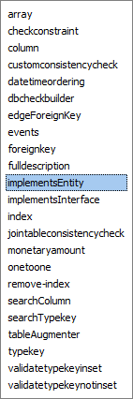
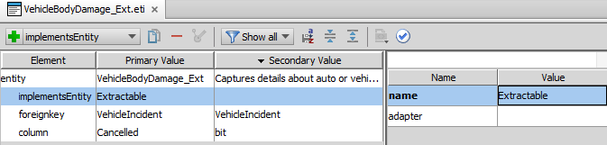
1. Implementing the Extractable delegate
Notes:
To implement the delegate, include the implementsEntity in the entity definition (or extension) file with a value of “Extractable”.
Creating entities is covered in the pre-requisite lesson “Creating Entities” in the “ClaimCenter 8.0 Configuration Fundamentals” course.

Slide 19
2. Creating a valid relationship
The new entity must also be owned by an entity in the claim graph, either:
Foreign key from new entity to owner entity
Owner can have no reference to new entity
Owner can have an array of the new entity
Owner can have a one-to-one or edge foreign key to the new entity
An “owner=“true” foreign key to the new entity
<foreignkey>
Owner Entity
New Entity
<foreignkey>
Owner Entity
New Entity
<array>
<foreignkey>
Owner Entity
New Entity
1
<onetoone>
<foreignkey>
Owner Entity
New Entity
Notes:
There is no restriction on the number of foreign keys a new entity can have that point to claim graph entities. To be in the claim graph, a new entity must point to at least one entity (such as Exposure). But it is acceptable to have multiple foreign keys to multiple claim graph entities (such as one to Exposure and another to Claim). Note that it is the developer’s responsibility to ensure that all the foreign keys point to entities belonging to the same claim.

Slide 20
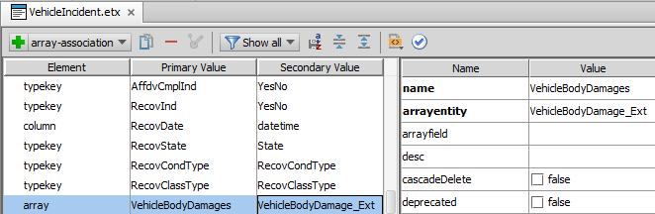
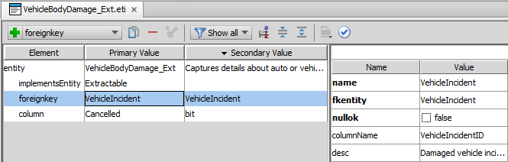
Foreign key example 1
<foreignkey>
Owner Entity
New Entity
<array>
Notes:
In the example above, the VehicleBodyDamage_Ext entity must be added to the claim graph. Therefore, in addition to implementing the Extractable delegate, it also has a foreign key to an entity that is already in the claim graph (VehicleIncident, which is a subtype of Incident). The VehicleIncident entity also has an array of VehicleBodyDamage that points to the VehicleBodyDamage_Ext entity, but this array is not required to create a legal claim graph.

Slide 21
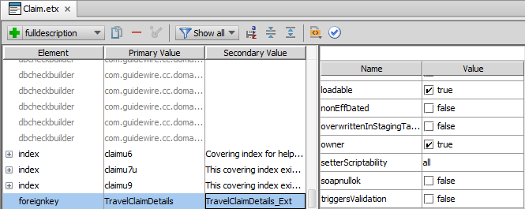
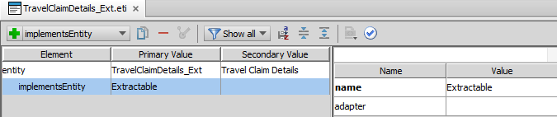
Foreign key example 2
<foreignkey>
Owner Entity
New Entity
Notes:
In the example above, the TravelClaimDetails_Ext entity must be added to the claim graph. It implements the Extractable delegate. For instructional purposes, this is the only property of this newly created entity, though in reality it would have several other properties. In addition, a foreign key has been added to Claim.etx to point to TravelClaimDetails_Ext with owner=true.

Slide 22
Lesson outline
Overview of data model graphs
Claim graph entities
Non-graph entities
Overlap entities
Claim Info entities
Data model graph tools
Notes:
Designing Clean Data Model Graphs - 22

Slide 23
Non-graph entities
Non-graph entities include admin data, system data, and cross-claim data
An entity is considered a non-graph entity if:
Its instances can be referenced by multiple claim graph instances, AND
There is no foreign key relationship from the new entity into the claim graph
Nothing special must be done to create admin or system data entities
Manufacturer Recall_Ext
ReliefFund_Ext
Notes:
Also, there cannot be an owner=“true” foreign key from a claim graph entity to the new non-graph entity.

Slide 24
Modeling cross-claim entities
Claim
MultiCar Accident_Ext
Cross-claim entities can be problematic to model, because they store claim-centric data owned by more than one claim
It is difficult to archive claim A and not archive claim B when claims A and B own the same cross-claim instance
Notes:
When a claim is archived, the claim and all of its sub-objects are copied to the archive and then removed from the primary database. If two claims own the same cross-claim entity, then there is a problem when one claim is archived and the other isn't.
If you archive the cross-claim instance, then foreign keys on the second claim will break because they reference the now non-existent cross-claim instance.

Slide 25
Implementing cross-claim entities
MultiCar Accident_Ext
Claim
<onetoone>
<foreignkey>
1
Claim Info
MultiCar Accident_Ext
Claim
<foreignkey>
You can implement a cross-claim entity by relating the entity to ClaimInfo
ClaimInfo is not part of the claim graph, and therefore is not removed when a claim is removed
This avoids the problem of having a cross-claim instance refer to a claim which is present and a claim which has been removed
Notes:
To solve the problem, cross-claim entities should reference the ClaimInfo entity. Although each ClaimInfo instance is owned by a single claim, the entity has special behaviors that exclude it from the claim graph. If a single cross-claim entity references multiple ClaimInfo instances, there are no problems if some of the corresponding claims have been removed from the database (archived) while others are still in the database, because the ClaimInfo entities persist.
There may be some circumstances where a new entity needs to reference multiple sub-objects across multiple-claims (such as multiple checks or multiple documents). If you need to model this type of an entity, consult with a Guidewire resource on your implementation project.
ClaimCenter has special internal handling for the ClaimInfo entity so that it can have a foreign key to Claim and yet not be extractable. This functionality is not available for customer entities. (In other words, you cannot create a custom "Info" entity, although you can create additional entities in the “ClaimInfo graph,” as discussed later in this presentation.)

Slide 26
Lesson outline
Overview of data model graphs
Claim graph entities
Non-graph entities
Overlap entities
Claim Info entities
Data model graph tools
Notes:
Designing Clean Data Model Graphs - 26

Slide 27
Overlap entities
Overlap = some instances associated with and owned by one claim, and some associated with many claims but owned by non-graph entity
Claim Graph
Claim
Contact
claimant
claim owner (CC user)
witness
Non-graph data
Notes:
Overlap entities are entities for which some instances need to be owned by a particular claim, and some instances do not. Those that do not may be referenced by multiple claims or only by other non-graph instances.
For example, Contact is an overlap entity. This is because Contact stores contact information for two kinds of contacts:
Contacts that are involved in a specific claim (claimants, witnesses, and so on) – these should be in the claim graph
Contacts that are used for cross-claim purposes (account holders) or contacts that are working on the claim (users) – these should not be in the claim graph.
In the example above, the first contact is a claimant that is referenced by only the first claim graph instance. Similarly, the third contact is a witness that is referenced only by the third claim graph instance. However, the second contact is a claim owner (a ClaimCenter user.) It is referenced by all three claim graph instances.

Slide 28
Overlap entities
Overlap entities typically store contact and address information
This is because ClaimCenter uses a single set of entities for both claim-specific contacts and carrier-related contacts
Customers typically need to add few or no overlap entities
Mostly contact-related entities
Overlap entities must implement two delegates:
Extractable
OverlapTable
Notes:
The following entities are most of the overlap entities in the ClaimCenter base application: Address, AddressCorrection, Contact, ContactAddress, ContactCategoryScore, ContactContact, EFTData, OfficialID.

Slide 29
Creating overlap entities
claim graph
To configure an entity as an overlap entity, the entity must both:
Implement the Extractable and Overlap delegates
Be owned by an overlap entity
Overlap
Extr
<fk>
(new)
<fk>
Overlap
Extr
(new)
non-graph data
Notes:
From a technical perspective, ClaimCenter considers an entity to be an overlap entity if it is owned by an overlap entity. This happens with when the new entity has a foreign key pointing to an overlap entity, or an overlap entity has an owner=“true” foreign key pointing to the new entity.
If you create a new entity that is owned by an overlap entity but does not implement the Extractable delegate, ClaimCenter will not start. It assumes some instances of the entity are part of the claim graph and the error message states you must implement the Extractable delegate.

Slide 30
Lesson outline
Overview of data model graphs
Claim graph entities
Non-graph entities
Overlap entities
Claim Info entities
Data model graph tools
Notes:
Designing Clean Data Model Graphs - 30

Slide 31
Creating Claim Info entities
ClaimInfo
(new)
(new)
<fk>
<fk>
To configure an entity as a Claim Info entity:
Either:
Create a foreign key from your new entity to a ClaimInfo entity, or
Create an owner=“true” foreign key from a ClaimInfo entity to your new entity
Edit PurgeClaimInfoMethodsImpl→ NonGraphBeansToPurge() to purge the new entity when the claim is purged
Notes:
ClaimInfo has a one-to-one relationship with Claim. The purpose of the ClaimInfo entity is to maintain summary information about a claim for the point in time when the claim is archived. During archiving, the Claim instance is copied to the archive and then removed from the primary database. However, the ClaimInfo instance remains. Claim searches are conducted against the ClaimInfo entity, which lets searches return results from both "active" and archived claims.
ClaimCenter has special internal handling for the ClaimInfo entity so that it can have a foreign key to Claim and yet not be extractable. This functionality is not available for customer entities. (In other words, you cannot create a custom "Info" entity.)
Editing the NonGraphBeansToPurge() function is relatively simple. You need to add one line to the function for each new ClaimInfo entity you add. The line is of the form
new Pair<IEntityType,List<Key>>(entity.NEWENTITY, {<list of newentity ID’s to be purged> })
See the code for explanation.

Slide 32
Lesson outline
Overview of data model graphs
Claim graph entities
Non-graph entities
Overlap entities
Claim Info entities
Data model graph tools
Notes:
Designing Clean Data Model Graphs - 32

Slide 33
Data model graph tools
ClaimCenter provides tools to prevent and correct data models with claim graph problems
Data model checks during start-up
DOT format descriptions of data model
Notes:
If a data model did not have clearly defined boundaries for the claim graph, then when a claim is removed, restored, or retired:
Sub-objects belonging to the claim would not be correctly removed, restored, or retired.
Sub-objects belonging to other claims (and/or other claims themselves) might inadvertently also be removed, restored, or retired.

Slide 34
Data model checks during start-up
During start-up, ClaimCenter verifies the data model meets the following requirements (and will not start if any are not met):
All entities in claim graph implement Extractable delegate
No entities outside claim graph implement Extractable delegate
Notes:
The ClaimCenter server performs a series of checks during startup. These checks verify that the current data model can support archiving, purging and export of claims. Some of these checks prevent the server from starting. Other checks are warnings and allow the server to start. These checks warn about potential problems with the graphs that might not be an issue depending on business logic.
The following checks are also performed during startup:
Overlap tables implement OverlapTable - The overlap entities must implement the OverlapTable delegate.
Exceptions to links from outside the domain graph are outside the domain graph - ClaimCenter has some built-in exceptions to the general rule of not having a foreign key from an entity outside the domain graph to one inside the domain graph. For these entities, ClaimCenter verifies that the outside entity is indeed outside the domain graph.
For more information on data model checks during start-up, refer to the ClaimCenter Configuration Guide.

Slide 35
Errors during data model check
If a claim graph check fails, ClaimCenter:
Reports only the first failed requirement it encounters
If the requirement is an issue for multiple entities, then it reports on all entities which did not meet that requirement
Prints information to the console and the log
Identifies the entity (or entities) and the problem

Slide 36
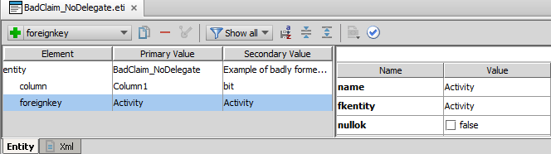
Data model flaw: Example 1 Claim graph entity with no delegate
hoades-w53 2014-02-11 12:06:00,379 ERROR An exception was thrown while starting a component. Setting runlevel to SHUTDOWN [Archiving graph validation failed. Error details:
The graph construction algorithm determined that the following are in the Domain graph. To confirm this, please change them to implement Extractable.
BadClaim_NoDelegate
]
hoades-w53 2014-02-11 12:06:00,380 INFO Stopping database
Notes:
In the example above, the new entity, BadClaim_NoDelegate, has a foreign key to the Activity entity (a claim graph entity). This means the new entity is part of the claim graph. However, the entity doesn't implement the Extractable delegate. An excerpt from the console ClaimCenter application log in Studio shows the error message when the server is restarted after this new entity is created.

Slide 37
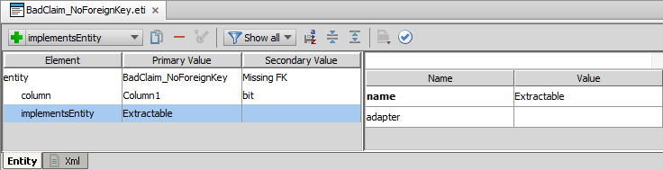
Data model flaw: Example 2 Implements extractable but not in claim graph
hoades-w53 2014-02-11 12:19:38,111 ERROR An exception was thrown while starting a component. Setting runlevel to SHUTDOWN [Archiving graph validation failed. Error details:
The graph construction algorithm determined that the following are not in the Domain graph. To confirm this, please change them so that they do not implement Extractable.
BadClaim_NoForeignKey
]
hoades-w53 2014-02-11 12:19:38,113 INFO Stopping database
Notes:
In the example above, the new entity, BadClaim_NoForeignKey, has no foreign keys to any claim graph entities. This means the new entity is not part of the claim graph. However, the entity implements the Extractable delegate. An excerpt from the console ClaimCenter application log in Studio shows the error message when the server is restarted after this new entity is created. (In this case, the suggestion in the error message may not be appropriate. The entity may be intended for the claim graph, in which case a foreign key to a claim graph entity must be added to fix the problem.)

Slide 38
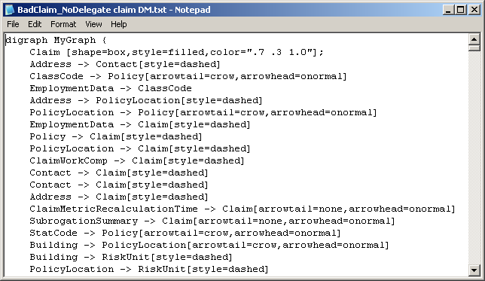
DOT format
DOT is a plain text graph description language
Generated by ClaimCenter to describe data model from a graph perspective
Can be converted into an image by a DOT viewer tool, such as Graphviz
Notes:
The DOT format described above should not be confused with Gosu's "dot notation", which is used to specify a field for a given object (such as aClaim.ValidationLevel).
To view a domain or admin data visually, you need to download and install additional software that can read .dot files and render an image from the DOT language. There are many viewers available (some open source or free) that you can use for this purpose. One such is Graphviz, which you can download from the following URL: http://www.graphviz.org/About.php

Slide 39
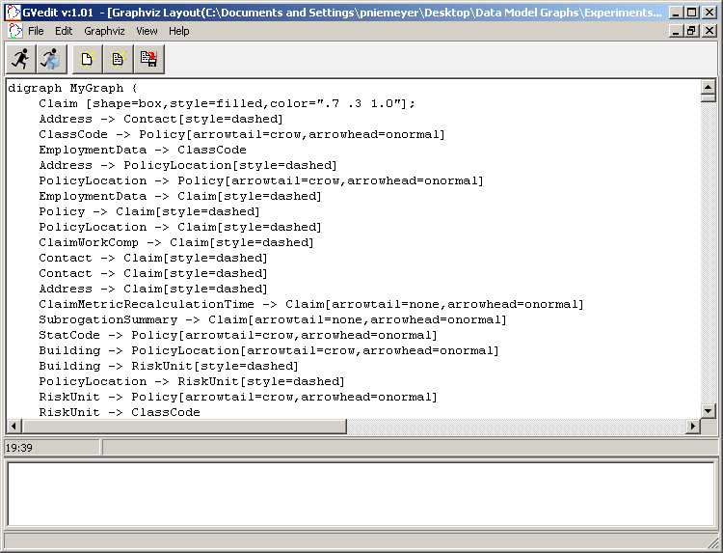
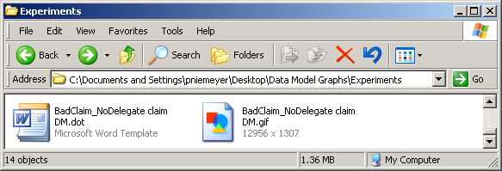
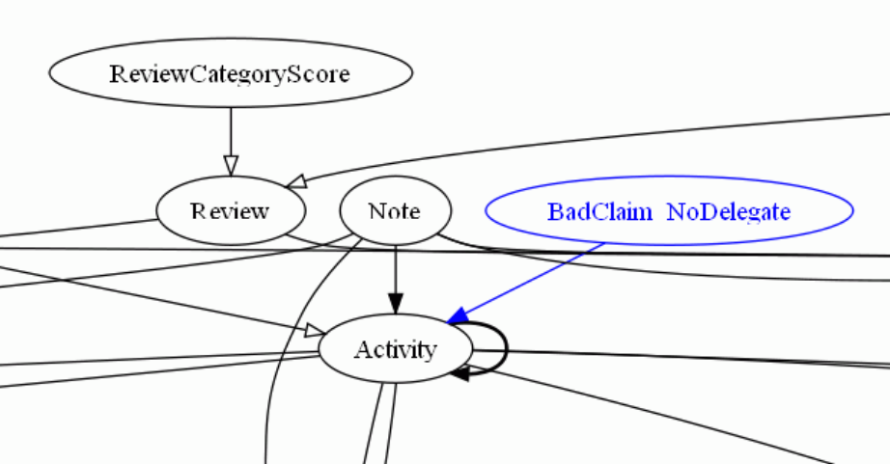
Sample DOT graph
Notes:
The DOT graph shown above was rendered using GVedit (version 1.01), which is a Graphviz tool that was downloaded from the following URL: http://www.graphviz.org/About.php
At a high level, the DOT graph notation was loaded into the tool. The tool then generated a GIF file. Finally, the GIF file was opened using Microsoft Paint. A snippet of the image is shown in the lower right corner. (The full image is significantly large as it visually depicts all entities in the given graph and their relationships.)
Within the graph, each notation has the following meaning:
Arrows point in the direction of foreign keys. The direction of the arrow is the is owned by relationship. (For example, Note is owned by Activity.)
A bold arrow from an entity to itself means an edge foreign key. (For example, Activity has an edge foreign key to itself.)
An open arrow from one entity to another entity represents either an array (multi-pronged tail) or a one-to-one relationship (single line tail). (For example, Review has an array of ReviewCategoryScores.)
Blue entities and links mean that these entities and links were defined through data model extensions. (For example, BadClaim_NoDelegate is a data model extension.)
A full discussion of DOT graphs and how to use them to diagnose data model problems is beyond the scope of this lesson. Consult the ClaimCenter Configuration Guide for further details.

Slide 40
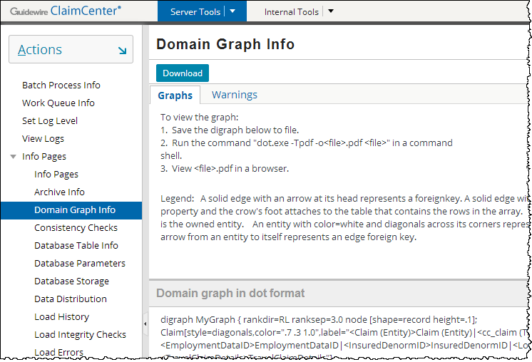
The Domain Graph Info page
Provides DOT format download for graphs (after successful server start-up)
Provides list of warnings
Notes:
The Archive Graph Info page provides information about both the claim graph (labeled above as the domain graph) and the Admin data. This information is relevant for clean data model design, whether a customer is implementing archiving or not.
The warnings tab warns of situations which could potentially lead to errors. ClaimCenter provides only warnings for these situations (rather than preventing the server from starting) because business logic may prevent the erroneous situation from becoming problematic. For a full list of warnings, consult the ClaimCenter Configuration Guide.

Slide 41
Lesson objectives review
You should now be able to:
Describe how the claim graph defines the boundaries of information for a given claim
Add a new entity to the claim graph
Describe the common issues concerning overlap, ClaimInfo, and cross-claim entities
Identify errors in a malformed data model graph
This lesson uses the notes section for additional explanation and information. To view the notes in PowerPoint, choose View→Normal or View→Notes Page. If you choose to print the notes for the lesson, be sure to select “Print hidden slides.”

Slide 42
Review questions
Replace each "__" with "only one claim" or "many claims":
A claim graph instance contains a set of objects that have information about ______.
Each instance of a claim graph entity (such as a document) references _____.
Each instance of an Admin data entity (such as a user) is referenced by _____.
What kind of foreign keys are used to add an entity to the claim graph?
What property (field) can be found in an eti file that defines a claim graph entity?
How can you tell when your data has a malformed claim graph?
Notes:
Answers
1. a) only one claim
b) only one claim
c) many claims
A foreign key to a claim graph entity from a new entity, or a foreign key (with owner=“true”) from a claim graph entity.
implementsEntity (with value of “Extractable”)
ClaimCenter does not start.

Slide 43
Notices
Copyright © 2001-2014 Guidewire Software, Inc. All rights reserved.
Guidewire, Guidewire Software, Guidewire ClaimCenter, Guidewire PolicyCenter, Guidewire BillingCenter, Guidewire Reinsurance Management, Guidewire ContactManager, Guidewire Vendor Data Management, Guidewire Client Data Management, Guidewire Rating Management, Guidewire InsuranceSuite, Guidewire ContactCenter, Guidewire Studio, Guidewire Product Designer, Guidewire Live, Guidewire DataHub, Guidewire InfoCenter, Guidewire Standard Reporting, Guidewire ExampleCenter, Guidewire Account Manager Portal, Guidewire Claim Portal, Guidewire Policyholder Portal, ClaimCenter, BillingCenter, PolicyCenter, InsuranceSuite, Gosu, Deliver Insurance Your Way, and the Guidewire logo are trademarks, service marks, or registered trademarks of Guidewire Software, Inc. in the United States and/or other countries.
All other trademarks are the property of their respective owners.
This material is confidential and proprietary to Guidewire and subject to the confidentiality terms in the applicable license agreement and/or separate nondisclosure agreement.
This file and the contents herein are the property of Guidewire Software, Inc. Use of this course material is restricted to students officially registered in this specific Guidewire-instructed course, or for other use expressly authorized by Guidewire. Replication or distribution of this course material in electronic, paper, or other format is prohibited without express permission from Guidewire.
Guidewire products are protected by one or more United States patents.

