Slide 1
Location Groups and Pages
22 October 2013
Notes:
Guidewire training materials contain Guidewire proprietary information that is subject to confidentiality and non-disclosure agreements. You agree to use the information in this manual solely for the purpose of training to implement Guidewire software solutions. You also agree not to disclose the information in this manual to third parties or copy this manual without prior written consent from Guidewire. Guidewire training may be given only by Guidewire employees or certified Guidewire partners under the appropriate agreement with Guidewire.

Slide 2
Lesson objectives
By the end of this lesson, you should be able to:
Describe the architecture of a location group
Configure existing location groups
Create and modify pages
This lesson uses the notes section for additional explanation and information. To view the notes in PowerPoint, choose View→Normal or View→Notes Page. If you choose to print the notes for the lesson, be sure to select “Print hidden slides.”

Slide 3
Lesson outline
Location group basics
Location group configuration
Page configuration

Slide 4
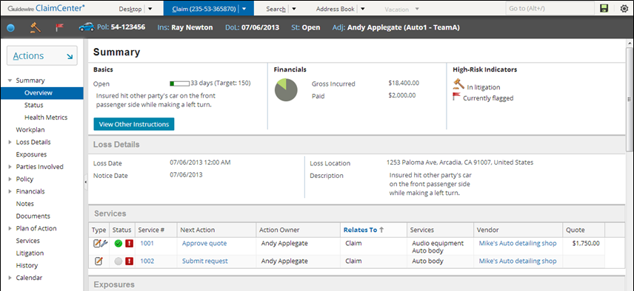
Location groups
A location group is a location tab that groups a set of menu links (and their associated locations), a set of menu actions, and an info bar
Tab Bar
Info Bar
Menu Actions
Menu Links
Notes:
In other words, each tab in the tab bar represents a location group. Everything on the example shown is centered around a claim.
When navigating between locations in a location group, the menu links, menu actions, and info bar remain the same.
The info bar is the set of widgets that appear below the tabs but above the screen area. (In other words, they're the icons and widgets in the horizontal dark gray strip just above the "Summary" label.) Some location groups do not have info bars, in which case the dark gray strip is not visible.
The menu links are the set of clickable labels in the side bar (such as "Summary" or "Workplan“ or “Loss Details”) that provide navigation to screens. Generally, all labels are known as menu links, however, when configuring, you may think of parent menu links and child menu links. In the example shown, Summary would be the parent menu link and Overview, Status, and Health Metrics child menu links). Therefore parent menu links do nothing other than organize a set of related business processes and open child menu links when clicked.
The menu actions are collapsed inside the Actions menu.

Slide 5
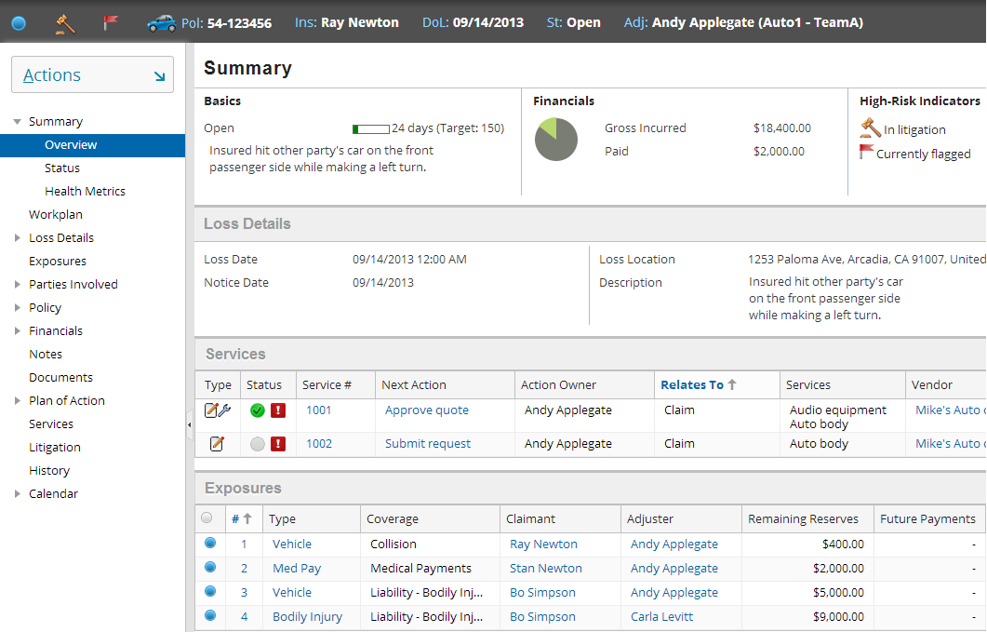
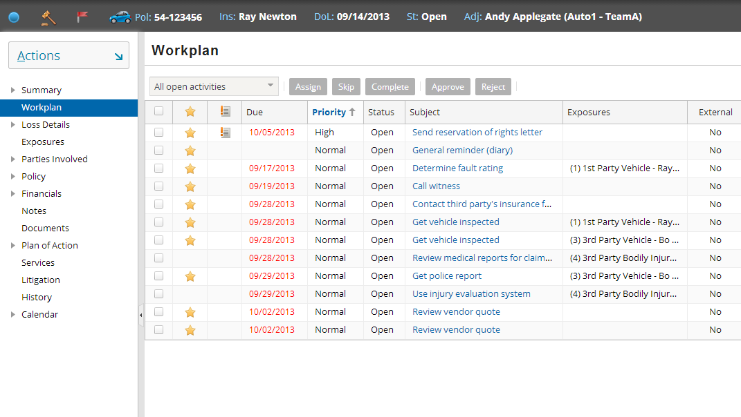
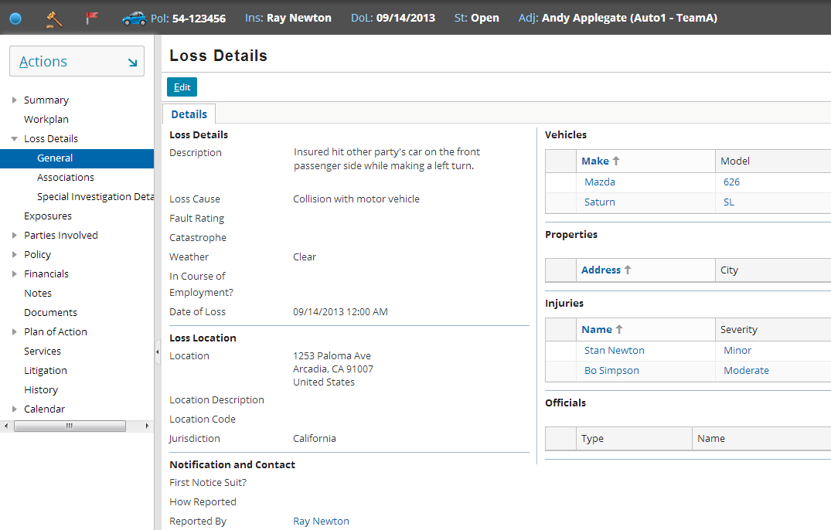
Navigating within the location group
Screen updates
Menu actions, menu links and info bar unchanged
Updates
Unchanged
Notes:
When you navigate from one location within the location group to another location within that same group, the contents of the screen area changes. However, note that the menu links, menu actions, and info bar remain the same.

Slide 6
Pages
A page is a location that contains a single screen in the main frame
Used exclusively within location groups
Notes:
Pages are the most common location.
Ultimately, the "groups" inside location groups are groups of pages. The contents of a location group is a series of pages.

Slide 7
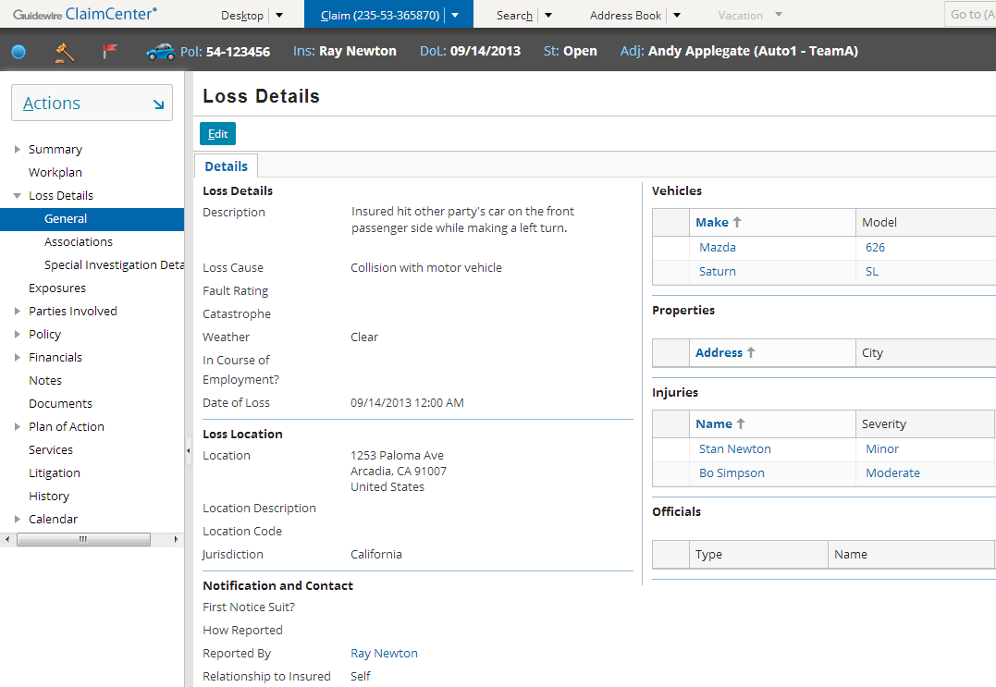
Two levels of navigation
1st level - tab bar
- "location ref"
2nd level - menu links
Notes:
Each tab in the tab bar points to a location group.
Each location group contains one or more "location refs". A location ref points to a page (which contains a screen which is rendered in the screen area). Each menu link directly navigates to a page, and “parent” menu links to the first menu link in the location group (i.e. General within “Loss Details”).

Slide 8
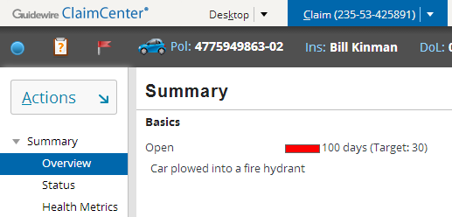
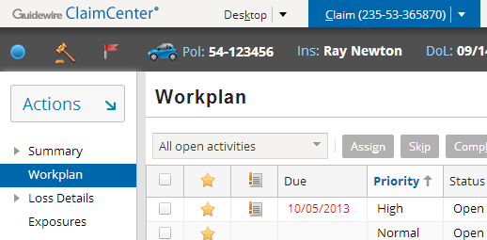
Location refs can point to location groups
Location ref points to a “parent” location group
Child menu links rendered
First page is rendered to fill screen area
Location ref points to a single location page
If the location group has only one page, no child menu links rendered
No location group needed
Notes:
A menu link location ref (a "second level navigation") can point to either another location group or a page. When it points to another location group, the child menu links are rendered.
When a location group points to a page, the screen contained by the page is rendered alone in the screen area.

Slide 9
Architecture of a location group
Tab
Location Group
Location Ref
Page
screen
Location Ref
Location Group
Page
screen
Location Ref
Page
Location Ref
screen
Notes:
In the base application, location groups consist of tabs (First-level navigations) and menu links (Second-level navigations).
A first-level navigation to a location group is a location group which a tab points to (either directly or through a forward). This type of location group is a "parent-level" group. If it has an info bar and menu actions, those elements are displayed. A first-level navigation location group can contain pages and other location groups.
A second-level navigation location group is a location group which some other location group contains. This type of location group is a "child-level" group. It typically does not have an info bar or menu actions. A second-level navigation location group typically contains only pages or child location groups.
A location group contains location refs. Each location ref points to either a page or another location group. When a location ref points to a page, clicking the label of the location ref (the menu link) renders the page, which renders the associated screen. When a location ref points to a location group, clicking the label of the location ref (the menu link) renders the location group as a set of menu links. The first location ref's page is also rendered.

Slide 10
Location groups in the base application
Desktop.pcf
Search.pcf
Claim.pcf
AddressBook.pcf
Team.pcf (if user can view team)
Admin.pcf (if user can view any admin screen)
Vacation.pcf (if user is backup for someone on vacation)
Notes:
Fortunately, the five primary location groups visible to adjuster end users (Desktop, Claim, Search, Address Book, and Vacation) are in PCF files with names identical to their English tab label (except for spaces).

Slide 11
Location group and page configuration
Two levels of configuration
Location-group-level
Entry point and navigation to location group
Permissions to visit
Location refs
Page-level
Screen that a page renders
Page logic (visibility, editability)
Page labels
Location Group
Location Ref
Location Group
Page
Location Ref
screen
Notes:
The next section of this lesson discusses location-group-level configuration. The section after that discusses page-level configuration.

Slide 12
Lesson outline
Location group basics
Location group configuration
Page configuration

Slide 13

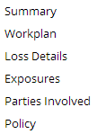
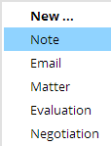
Information in location group PCF File
Claim.pcf
info bar
Entry Point
menu actions
Location group PCF file contains:
Entry point and required objects
"Location refs" which point to pages or child location groups
Attributes that point to separate files for info bar and menu actions

Slide 14
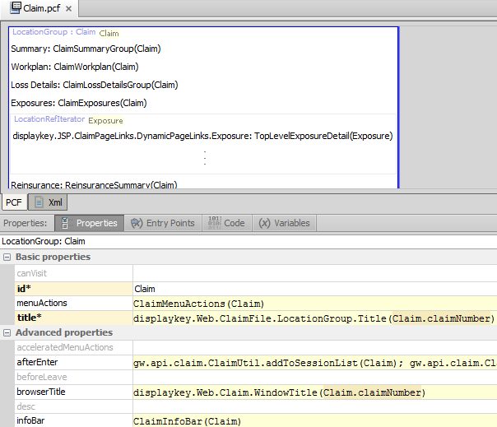
Example PCF file: Claim (LocationGroup)
Location Refs declared in top pane
Tabs, including: Properties (menu actions, info bar) Entry Point (entry points)
Notes:
The PCF file for a location group consists of location refs. Each location ref points to a page or child location group. The location group attributes are specified on the tabs at the bottom.

Slide 15
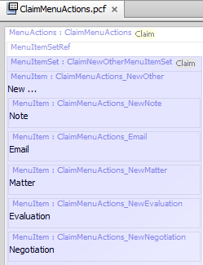
Location group menu actions
Notes:
The location group's menuActions property specifies the file to use for contents of the Actions menu.

Slide 16

Location group info bar
Notes:
The location group's infoBar property specifies the file to use for contents of the info bar.

Slide 17

canVisit property
true
false
Notes:
The canVisit attribute determines whether a user can visit the location group. If blank, the attribute evaluates to true. When the attribute evaluates to false, the tab is not rendered in the user interface. (For example, if perm.User.viewanyadmin returns false (which means the user does not have permissions to view any Admin screen), the Administration tab is not rendered for that user.
Location groups visibility can also be controlled by the visible attribute of the Tab whose action navigates to the Location group. When set to false, it will prevent the user from being able to access the location (unless another navigation link were available).
Single-screen locations and wizards also have a canEdit attribute. Location groups do not. Editablility for location groups is controlled at the level of each page.

Slide 18

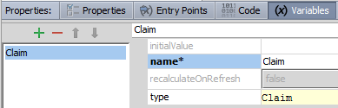
Entry points
Recall that entry point is name for location used by navigation widgets
Each object expected in each entry point must be declared on variable tab
entry point name
object name
object type
Notes:
In the example above, the Claim location group has an entry point name of "Claim". It expects a single object of type claim which is referred to within the PCF page as "Claim". For the purposes of instructional clarification, the location group could also have been declared as "ClaimLG(aClaim: Claim)". In this case, the entry point name is "ClaimLG" (which is how any widget navigating to this location would need to reference it). It would expect an object of type Claim which is referred to within the PCF file as "aClaim".
Important: If your variable name is something other than "Claim", you will need to add to the Page’s “parent” attribute the explicit reference to the parent location with the variable name as the argument. For example, if your page’s variable was “aClaim”, your parent attribute would be “Claim(aClaim)”.

Slide 19
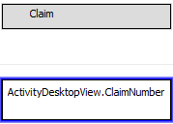

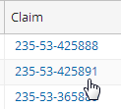
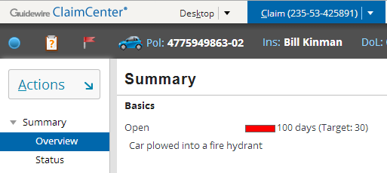
Navigating to location groups
Navigation uses "go()"
Syntax:
pcf.EntryPointOfLocation.go(objectsToPass)
Notes:
Most navigation widgets have an action attribute, which defines where to navigate to when the widget is clicked. The syntax for an action attribute which navigates to a location is:
pcf.LocationEntryPoint.method(objectList), where
LocationEntryPoint is (one of) the location entry point(s) defined on the destination location's Entry Points tab.
method is the method used to navigate to the location (which, for location groups, is almost always "go").
objectList is a comma-delimited list of zero to many objects. This list must match the number of objects and the type which are expected by the location entry point.
In the example above, the CaseID cell (which displays the claim number in a list of activities) has an action attribute of Claim.go(ActivityDesktopView.Claim). This means the widget navigates to the location with an entry point of "Claim" (which corresponds to the Claim location group) using the go method (which means the location is rendered in the screen area with no "Return to..." link) and the claim associated to the ActivityDesktopView object is passed to the location.

Slide 20
Lesson outline
Location group basics
Location group configuration
Page configuration

Slide 21
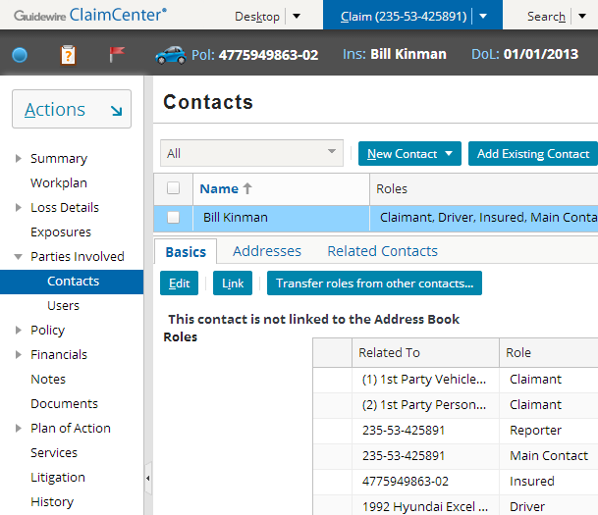
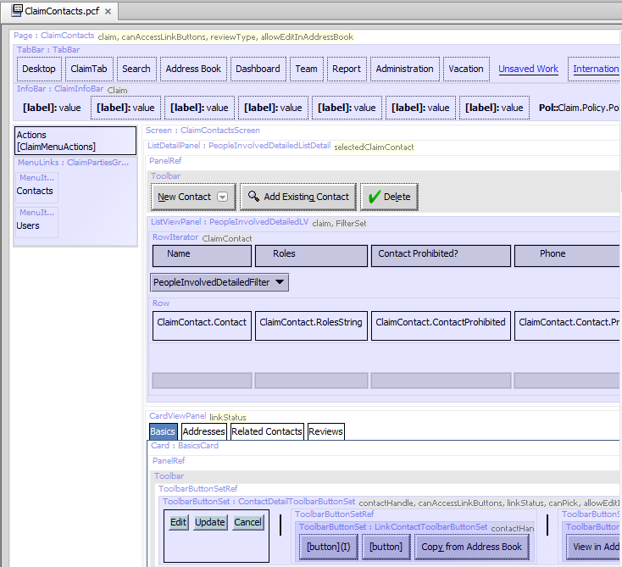
Page PCFs
Page PCF file contains references to all embedded content
Notes:
A page is actually very simple, as it typically contains just a screen with panel references to the views to embed within it. However, the rendering of the page in Studio can look somewhat complex, as all the embedded elements are visible in the page.
Recall you may use ALT+SHIFT+E from ClaimCenter in your browser to open the appropriate PCF in Studio.

Slide 22
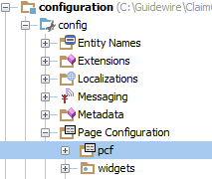
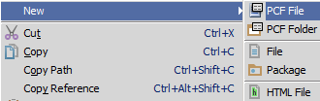
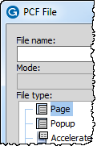
Creating a new page
Right-click on "Page Configuration (PCF)" folder or any subfolder
Select New>PCF File
Select "Page" file type
Note there is no file suffix enforcement for pages

Slide 23
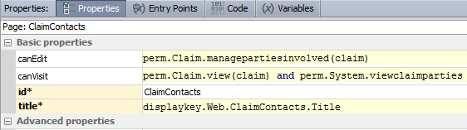
canVisit property
Notes:
Similar to a location group's canVisit attribute, a user can see links to (and therefore navigate to) a page only if canVisit evaluates to true.

Slide 24
Edit mode
A page is either in readonly or edit mode
If canEdit evaluates to true, the page has Edit/Update buttons
If startInEditMode is true, then page renders in Edit mode
Notes:
If a given page's canEdit mode evaluates to false, then the page appears only in readonly mode, even if startInEditMode is set to true.
The startInEditMode is found in the Page’s Advanced Properties section (scroll to bottom).

Slide 25
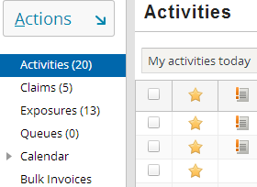
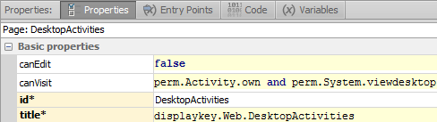
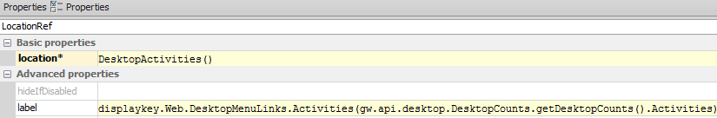
Page-related labels
Title bar label comes from page's title property
Menu link label comes from Location Ref label property
Notes:
The location ref's label attribute references the display key "Web.DesktopMenuLinks.Activities", which in the English locale is set to "Activities ({0})". The "{0}" is a placeholder for a value passed to the display key. In this case, the value that is passed is the return value of the function gw.api.desktop.DesktopCounts.getDesktopCounts().Activities, which returns the number of activities assigned to the given user.
The page's title attribute references the display key "Web.DesktopActivities", which in the English locale is set to "{JSP.TabBar.LinkButton.OpenActivities}“, which in turn references another display key {Term.Activites.Proper}. However this value can (and is in example shown in the slide) overridden by the contained Screen element’s special child TitleBar widget which itself has an attribute called appendListViewPaging set to true. This returns one of two strings, either "Activities (X - Y of Z)", where X and Y are equal to the "set numbers" of the first and last of activities displayed on the list view and Z is equal to the total number of activities, or "Activities (empty)" if there are no activities in the list.

Slide 26


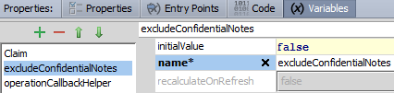
Multiple entry points
Locations can have multiple entry points with different signatures
Entry Points
Signature
Notes:
Locations can have multiple entry points. This is useful when a single location can be referenced from different places with different known or required pieces of information. In the example above, the Claim Summary location group has entry points for normal operations and for the case where ClaimCenter should not display confidential notes. The excludeConfidentialNotes variable defaults to "false" in the typical situation, but it can be passed to the location group with the value set to "true", in which case the confidential notes will be hidden from display.

Slide 27
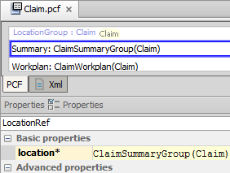
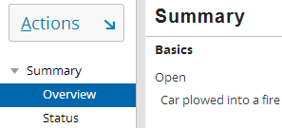
Navigate to pages or other location groups from location refs
Claim Location Group's Location Ref
When clicked, where do I navigate to?
Notes:
Each location ref has a location attribute. This specifies the entry point of the location which the location ref points to. The location is typically a child location group or a page. If the destination location group or page requires one or more objects, then the location attribute must specify which objects to pass.

Slide 28
Lesson objectives review
You should now be able to:
Describe the architecture of a location group
Configure existing location groups
Create and modify pages

Slide 29
Review questions
When you navigate between locations in a location group:
What changes?
What remains the same?
What two things can a location ref point to?
How does ClaimCenter visually render a location group within a location group?
What happens if a location group's canVisit attribute evaluates to false?
When viewing a location group PCF file in Studio, which Studio tab specifies how to navigate to it?
Notes:
Answers
1. a) The contents of the screen area changes. b) The menu links, menu actions, and info bar remain the same.
2. A child location group or a page.
3. It renders the child location group as a set of child menu links (i.e. Parties Involved contains Contacts and Users).
4. When a location group's canVisit attribute is false, the location group is not rendered in the user interface. For example, if the location group appears on a tab, the tab is not rendered at all.
5. The Entry Points tab. This identifies the "navigation name" of the location group as well as any objects needed when navigating to it.

Slide 30
Notices
Copyright © 2001-2014 Guidewire Software, Inc. All rights reserved.
Guidewire, Guidewire Software, Guidewire ClaimCenter, Guidewire PolicyCenter, Guidewire BillingCenter, Guidewire Reinsurance Management, Guidewire ContactManager, Guidewire Vendor Data Management, Guidewire Client Data Management, Guidewire Rating Management, Guidewire InsuranceSuite, Guidewire ContactCenter, Guidewire Studio, Guidewire Product Designer, Guidewire Live, Guidewire DataHub, Guidewire InfoCenter, Guidewire Standard Reporting, Guidewire ExampleCenter, Guidewire Account Manager Portal, Guidewire Claim Portal, Guidewire Policyholder Portal, ClaimCenter, BillingCenter, PolicyCenter, InsuranceSuite, Gosu, Deliver Insurance Your Way, and the Guidewire logo are trademarks, service marks, or registered trademarks of Guidewire Software, Inc. in the United States and/or other countries.
All other trademarks are the property of their respective owners.
This material is confidential and proprietary to Guidewire and subject to the confidentiality terms in the applicable license agreement and/or separate nondisclosure agreement.
This file and the contents herein are the property of Guidewire Software, Inc. Use of this course material is restricted to students officially registered in this specific Guidewire-instructed course, or for other use expressly authorized by Guidewire. Replication or distribution of this course material in electronic, paper, or other format is prohibited without express permission from Guidewire.
Guidewire products are protected by one or more United States patents.

