Slide 1
Line of Business: Typelists
24 February 2014
|EOS~001|
Notes:
|EON~001|
Guidewire training materials contain Guidewire proprietary information that is subject to confidentiality and non-disclosure agreements. You agree to use the information in this manual solely for the purpose of training to implement Guidewire software solutions. You also agree not to disclose the information in this manual to third parties or copy this manual without prior written consent from Guidewire. Guidewire training may be given only by Guidewire employees or certified Guidewire partners under the appropriate agreement with Guidewire.

Slide 2
Lesson objectives
By the end of this lesson, you should be able to:
Describe the purpose of the Line of Business model
Describe how the LOB typelists define the LOB model
Configure LOB typelists
This lesson uses the notes section for additional explanation and information. To view the notes in PowerPoint, choose View→Normal or View→Notes Page. If you choose to print the notes for the lesson, be sure to select “Print hidden slides.”
|EOS~002|
Notes:
|EON~002|

Slide 3
Lesson outline
Line of business model
The LOB typelists
LOB model configuration
|EOS~003|
Notes:
|EON~003|

Slide 4
What is line of business?
Carriers organize policies, coverages, covered losses within a hierarchy
This hierarchy impacts:
How reporting is done
Which coverages are displayed for claim associated to given type of policy
Which user interface elements are used to capture information for given exposure
This hierarchy is known as the "line of business" model (LOB model)
It has six levels
Property
Homeowners
Homeowners Med. Pay.
Medical Payments
|EOS~004|
Notes:
|EON~004|
ClaimCenter is delivered out of the box with several pre-configured business lines in the LOB model. You can see these when adding a new claim or exposure. Based on the line of business presented or selected, you will have different options.
The structure of the Line of Business is defined in six distinct typelists:
LossType
LOBCode
PolicyType
CoverageType
CoverageSubtype
ExposureType
Each typelist file is more complex than typelists seen so far.

Slide 5
Loss type
LossType
Auto
Property
Personal Auto
Commercial Auto
Commercial Property
Inland Marine
High-level category of loss
Ties together policies, coverages, and claims that deal with similar losses
Useful for dynamic generation of UI and reporting
|EOS~005|
Notes:
|EON~005|
A loss type is a broad general industry category for P&C insurance activity. For example:
Auto
Liability
Property
Travel
Workers' Compensation
In many cases, a claim's loss type determines the UI elements to use or display. For example, the New Claim Wizard could have a Vehicles step which should be displayed for personal auto and commercial auto claims. In this case, the step's visibility would be tied to the loss type being "Auto". (Theoretically, you could tie it to the policy type being "personal auto" or "commercial auto", but this approach can have long-term problems if a line of business has more than two policy types - which would mean increasingly complex conditions in the logic - or if new policy types are added in the future - which would require changes to the UI logic that would not have been needed if the condition had been tied to the loss level.)

Slide 6
LOB code
LossType
Auto
Property
LOBCode
Personal Auto Line
Comm Auto Line
Commercial Property Line
Inland Marine Line
Personal Auto
CommAuto
Commercial Property
Inland Marine
Additional layer below LossType
More granular level than loss type for reporting purposes
LOB code references a business categorization
Not as commonly used as determinant for claims handling
|EOS~006|
Notes:
|EON~006|
LossType to LOBCode is 1:M (one-to-many).
A loss type (general category of insurance) can have many lines of business (business units at a carrier).
Each line of business belongs to only one loss type.
Selected Examples (not an exhaustive list):
Auto (loss type) : Personal Auto Line (LOB)
Auto (loss type) : Commercial Auto Line (LOB)
Property (loss type) : Commercial Property Line (LOB)
Property (loss type) : Inland Marine Line (LOB)
Because LOB is a business categorization, it is less common to use the LOB code as a determinant for how to handle claims. It is more typical to handle claims based on the LossType (the broad categorization of what kind of loss is being insured against) and the more specific typelists discussed on the following slides.

Slide 7
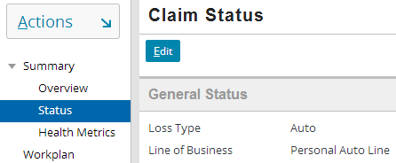
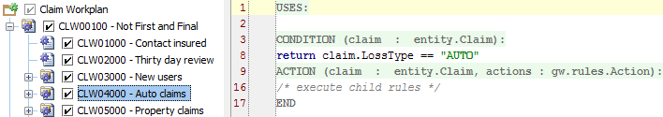
Loss type and LOB code in ClaimCenter
Claim Status
Workplan rules for auto claims
|EOS~007|
Notes:
|EON~007|
The screenshots above show two places where LossType and LOBCode appear and/or changes how the application behaves in the base application.
The first example is from the Summary (Claim Status menu link) for an auto claim. The claim's loss type and line of business are displayed at the top of the detail view. (Although the screenshot shows only the auto version of Claim Status, all versions of Claim Status in the base application display loss type and LOB code.)
The second example is a claim workplan rule. The rule states that the child rules (Scene inspection and New users) are executed only if the claim's loss type code is “AUTO”.

Slide 8
Policy type
LossType
Liability
Property
LOBCode
General Liability Line
Commercial Property Line
Inland Marine Line
Policy Type
Commercial Property
Commercial Package
Inland Marine
A product (type of policy) offered by carrier
Single policy type may be associated with multiple LOBs
|EOS~008|
Notes:
|EON~008|
A policy is a product of a line of business that is sold to customers and that promises to pay money when a specified type of loss occurs.
Examples for the Property loss type:
Commercial Property
Commercial Package
Inland Marine (e.g. Trucking Companies)
LOBCode to PolicyType is M:M (many-to-many)
A line of business (business units at a carrier) can sell many types of policies.
A type of policy can be sold by many lines of business units. In base ClaimCenter, only Commercial Package policies are sold under more than one LOB.
Examples:
Commercial Property Line (LOB) : Commercial Property (policy), Commercial Package (policy)
Inland Marine Line (LOB) : Inland Marine (policy), Commercial Package (policy)

Slide 9
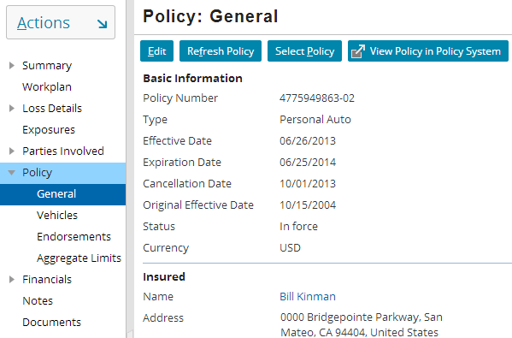

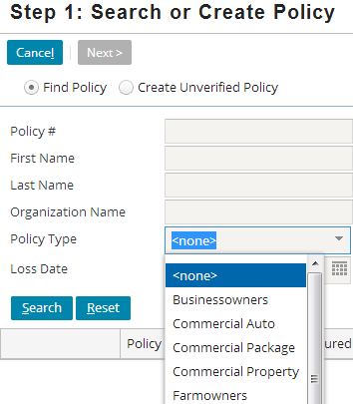
Policy type in ClaimCenter
Claim's policy's policy type
List of all policy types when searching for policy
|EOS~009|
Notes:
|EON~009|
The screenshots above show two places where PolicyType appears and/or changes how the application behaves.
The first example is from the Policy: General screen for an auto claim. The policy's type is listed.
The second example is the first step of the New Claim Wizard, where users search for the relevant policy. One of the search criteria is policy type.
NOTE: The link to “View Policy in Policy System” in the top screenshot is new as of ClaimCenter 8.0. It provides a link in a new browser popup window to Guidewire PolicyCenter (in the base application), however, this may be configured to link to PolicyCenter or another PAS (Policy Administration System).

Slide 10
Coverage type
LossType
Property
LOBCode
Commercial Property Line
Homeowners Line
Policy Type
Commercial Package
Commercial Property
Homeowners
Coverage Type
General Liability
Building Coverage
Extra Expense Coverage
Homeowners Med. pay.
A type of coverage offered on one or more types of policies
|EOS~010|
Notes:
|EON~010|
A coverage is a type of loss included in the policy for which the carrier will compensate the insured.
Examples for Commercial Package policy type: General Liability, Building Coverage, Extra Expense Coverage
Examples for Commercial Property policy type: Building Coverage, Extra Expense Coverage
Examples for Homeowners policy type: Homeowners Medical Payments
PolicyType to CoverageType is M:M (many-to-many).
A type of policy can include many coverages. For example, Commercial Package includes General Liability, Building Coverage, Extra Expense Coverage.
A coverage may be available on more than one policy type. For example, Building Coverage is offered on both Commercial Package and Commercial Property policy types.

Slide 11
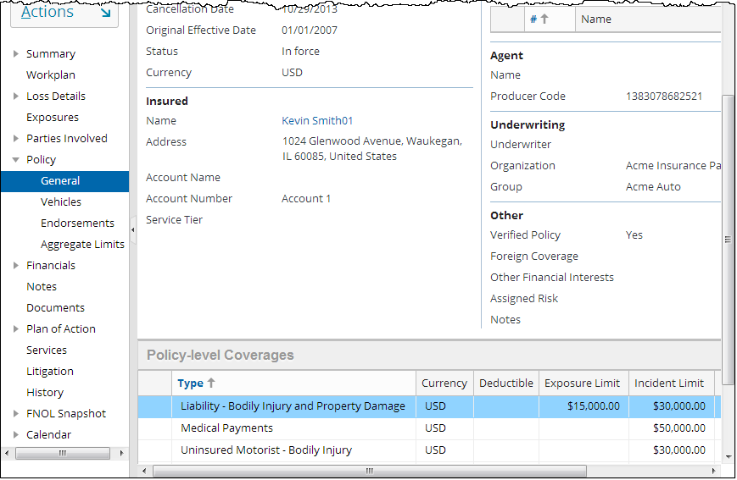
Coverage type in ClaimCenter (1 of 2)
Coverage types on claim's policy
|EOS~011|
Notes:
|EON~011|
The screenshot above shows one important place where CoverageType appears and changes how the application behaves.
The first example is from the Policy > General screen for an auto claim, at the bottom of the screen. The Policy-level Coverages list lists the coverages on the policy. The first column identifies the type of each coverage.

Slide 12
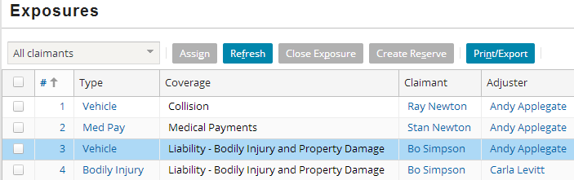
Coverage type in ClaimCenter (2 of 2)
Coverage type for each exposure
|EOS~012|
Notes:
|EON~012|
The second example is the list of Exposures on a claim (Exposures screen). Recall that an exposure is used to track the money "from" one coverage to one claimant. The Exposures list view lists the coverage type (and claimant) for each exposure. The “Type” column on this screen is explained in the next slide.

Slide 13
Exposure type
LossType
Auto
A set of information to gather for an exposure
Map to coverage type as many-to-many
LOBCode
Personal Auto Line
Policy Type
Personal Auto
Commercial Property
Coverage Type
Liability - Bodily Injury and Property Damage
Building Coverage
Collision
Exposure Type
Bodily Injury
Vehicle
Property
|EOS~013|
Notes:
|EON~013|
During the claims process, an adjuster must gather information about the loss as it pertains to the relevant coverage. Theoretically, ClaimCenter could have a separate detail view for every coverage offered by the carrier. This would be unwieldy, as it is not unusual for a carrier to offer hundreds of coverages across all lines of business.
To simplify the gathering of information, ClaimCenter has the concept of an "exposure type". It is a set of information needed during claims processing that relates to one or more similar type of coverages. For example, “Collision” and “Liability – Bodily Injury and Property Damage” both cover damage to a vehicle. (Collision covers damage to the insured vehicle from collision with another object. “Liability – Bodily Injury and Property Damage” covers damage to a third-party vehicle.) When a vehicle is damaged, the same sort of information needs to be gathered (What is the extent of damage?, Was the vehicle towed?, Is the vehicle a total loss?), regardless of which coverage is involved. Therefore, the two coverages are mapped to a single exposure type (vehicle damage), and it is this exposure type which is used to govern the information to gather during the claims process.
CoverageType to ExposureType is M:M (many-to-many).
A coverage type can map to multiple exposure types. (“Liability – Bodily Injury and Property Damage” maps to Vehicle Damage (how was vehicle damaged?), Property Damage (how was non-vehicle property damaged?), and Bodily Injury Damage (how was the person injured?)
An exposure type can map to multiple coverage types. (Vehicle damage maps to Collision and “Liability – Bodily Injury and Property Damage”.)
However, the CoverageType-to-ExposureType relationship is implemented technically unlike all the other relationships. This will be explained in a few slides.

Slide 14



Exposure type in ClaimCenter
Exposure type during new exposure creation
|EOS~014|
Notes:
|EON~014|
The screenshots above show several places where ExposureType appears and/or changes how the application behaves.
The screenshot at the top is the list of Exposures on a claim. The Exposures list view lists the exposure type for each exposure. Note that Vehicle appears twice – as an exposure type related to Collision as well as Liability Bodily Injury and Property Damage.
The screenshots at bottom example are examples of new exposure detail views visible when exposures are created. The exposure type appears in the title bar.

Slide 15
Coverage-to-exposure-type mapping
Some coverages map to a single exposure type in a simple manner
Some coverages map to multiple exposure types
In some cases, a coverage maps to a single exposure type, but the mapping must capture information about the circumstance of the loss
Vehicle (damage)
Collision
Bodily Injury (damage)
Liability -Bodily Injury and Property Damage
Vehicle (damage)
Property (damage)
Premise/Ops - Gen Damage (limit: $100,000)
General Liability
General (damage)
Products/Completed Ops - Gen Damage (limit: $50,000)
|EOS~015|
Notes:
|EON~015|
In the first example, Collision coverage (from an auto policy) maps to the Vehicle (damage) exposure type. Whenever a loss is covered by the collision coverage, the adjuster must gather information about the damage done to the vehicle. No other information will ever be relevant to that coverage.
In the second example, “Liability – Bodily Injury and Property damage" (for an auto policy) coverage maps to the all of BI (Bodily Injury)(damage), Vehicle (damage), and Property (damage) exposure types. Whenever a loss is covered by this coverage, the adjuster must gather information either about an injury, a damaged vehicle, or a damaged piece of property. The relevant exposure type depends on what was damaged.
In the third example, General Liability coverage (for a Commercial Package policy) maps only to the General (damage) exposure. However, the policy outlines two limits for the coverage: a $100,000 limit on Premises/Operations, and a $50,000 limit on Products/Completed Operations. In both cases, the adjuster must gather similar information about the damage, but the financial exposure is different based on the circumstance of the loss.

Slide 16
Coverage subtype maps coverage to exposure
ClaimCenter uses an additional typelist to represent this mapping from coverage type to exposure type, called CoverageSubtype
Each coverage subtype is a single mapping between one coverage type and one exposure type
Vehicle (damage)
Collision
Collision
Liability - BI
Bodily Injury (damage)
Liability -Bodily Injury and Property Damage
Liability - VD
Vehicle (damage)
Liability - PD
Property (damage)
Premise/Ops -Gen Damage
General Liability
General (damage)
Products/Completed Ops - Gen Damage
|EOS~016|
Notes:
|EON~016|

Slide 17
Coverage subtype
LossType
Auto
Property
LOBCode
Personal Auto Line
Commercial Property Line
Homeowners Line
Policy Type
Personal Auto
Commercial Property
Homeowners
Coverage Type
Liability - Bodily Injury and Property Damage
Building Coverage
Homeowners Med. pay.
Coverage Subtype
Exposure Type
Bodily Injury
Vehicle
Property
Medical Payments
|EOS~017|
Notes:
|EON~017|
A coverage subtype is a pair consisting of one coverage type and one exposure type. It breaks down the M:M (many-to-many) relationship between CoverageType and ExposureType into two 1:M (one-to-many) relationships. Because it is establishing a valid coverage/exposure pair, a coverage subtype must have exactly one parent (one coverage) and one child (one exposure).
Why Is This Level Needed?
The coverage subtype level is needed for coverages which are "complex". A coverage is complex when the exposure created from the coverage needs to specify not only what information to gather (the exposure type) but also the circumstance of the loss (coverage subtype). For example, General Liability coverage (for a Commercial Package policy) could have two limits for the coverage: a $100,000 limit on Premises/Operations, and a $50,000 limit on Products/Completed Operations. The exposure type is used to specify that information must be gathered about damaged property. The coverage subtype is used to determine which limit is relevant. Note that there is nothing on the coverage subtype itself that provides this functionality – Gosu functions can check the exposure.CoverageSubType field before taking actions.

Slide 18




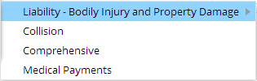
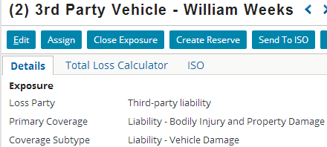
Coverage subtype in ClaimCenter
Coverage type during exposure creation
Coverage subtypes during exposure creation
Coverage subtype for existing exposure
|EOS~018|
Notes:
|EON~018|
The screenshots above show two places where CoverageSubtype appears and/or changes how the application behaves.
The first example is from the New Exposure menu. It is used during exposure creation. In the series of cascading menus (with extraneous information from the screen removed), we can see that the user has decided to choose an exposure "by coverage," which means that they are selecting from a list of coverages that are on the current policy. The current policy has two vehicles on it, a 1996 Toyota Corolla and a 1997 Saturn SL. The current claim involves the Corolla, so the user has selected that vehicle. There appear to be four coverages on the vehicle. Only one of the coverages (Liability – Bodily Injury and Property Damage) has more than one coverage subtype, which is why that coverage has an additional menu.
The second example is the detail view for an existing exposure. The (primary) coverage and coverage subtype are listed.
NOTE: If creating exposures by the "Choose by Coverage Type" option (which is not shown in the screenshots), ClaimCenter lists all coverages for the claim's type of policy. These coverages may or may not actually be on the policy selected at the start of the claim wizard. In some cases, users need this option because the policy system may be unavailable or because the policy is not up-to-date and the adjuster wanted to allow for adding coverages that the customer believes her or she has. Coverages are defined in the LOB (Line of Business) model, which is a way to identify and categorize all the possible types of coverages provided by a carrier.

Slide 19

System which "determines" each level
LossType
Property
LOBCode
Commercial Property Line
Homeowners Line
Policy Type
Commercial Property
Homeowners
Policy Admin System
Coverage Type
Building Coverage
Homeowners Med. pay.
Coverage Subtype
Exposure Type
Medical Payments
Property
|EOS~019|
Notes:
|EON~019|
Information about the LossType, LOBCode, PolicyType, CoverageType and CoverageSubtype is ultimately determined by the policy administration system (PAS). ClaimCenter has information local to itself about the structure of a policy, but this information is designed to map to what is stored in the PAS so that when policies are retrieved from the PAS, ClaimCenter knows how to interpret them.
Information about ExposureType is unique to ClaimCenter. ExposureType is a mechanism used to streamline the gathering of information about a loss. Therefore, there is no analog to exposure type in the PAS.

Slide 20
Line of business levels: Review
LossType
Auto
Property
LOBCode
Personal Auto Line
Commercial Property Line
Homeowners Line
Policy Type
Personal Auto
Commercial Property
Homeowners
Coverage Type
Compre-hensive
Colli- sion
Building Coverage
Homeowners Med. pay.
Coverage Subtype
Exposure Type
Medical Payments
Vehicle
Property
|EOS~020|
Notes:
|EON~020|

Slide 21
Lesson outline
Line of business model
The LOB typelists
LOB model configuration
|EOS~021|
Notes:
|EON~021|

Slide 22
The LOB model typelists
Typelists:
Typecodes:
ClaimCenter manages LOB model through series of six interconnected typelists
Typecodes in each typelist reference typecodes in the typelists above and below it
For example, “PersonalAuto" policy typecode references one parent LOB code (“PersonalAutoLine") and thirty-six child coverage typecodes (such as “PACollisionCov“ and “PARentalCov”)
LossType
LOBCode
PersonalAutoLine
PolicyType
PersonalAuto
CoverageType
PACollisionCov PAComprehensiveCov …
CoverageSubtype
ExposureType
|EOS~022|
Notes:
|EON~022|
All other typelists in Studio with parent/child relationships have the relationship specified in one direction. In other words, the child list references the parent list, but the parent list does not reference the child list.
The six LOB typelists behave differently. Within the LOB model, whenever a parent typecode refers to a child typecode, the child typecode must also refer to the parent typecode. Fortunately, the LOB typelists as they appear in Studio automatically ensure that a given parent/child relationship is identified in both lists in the underlying XML files. This relationship is almost transparent to the developer.

Slide 23
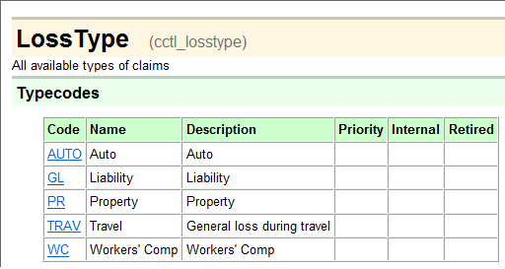
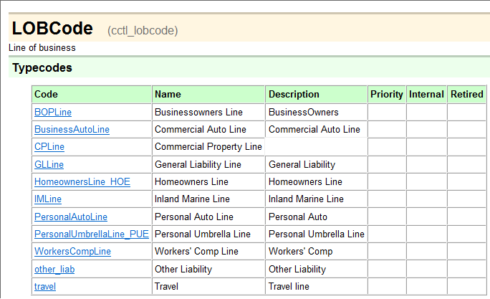
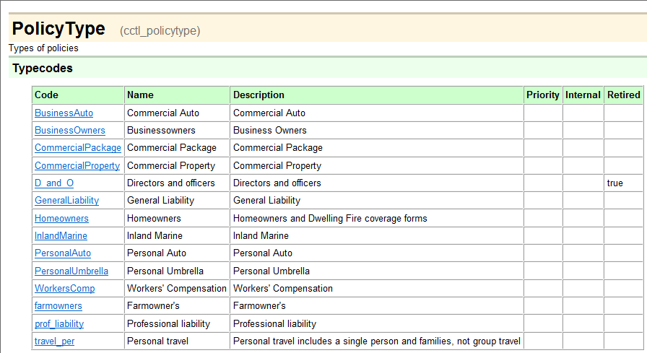
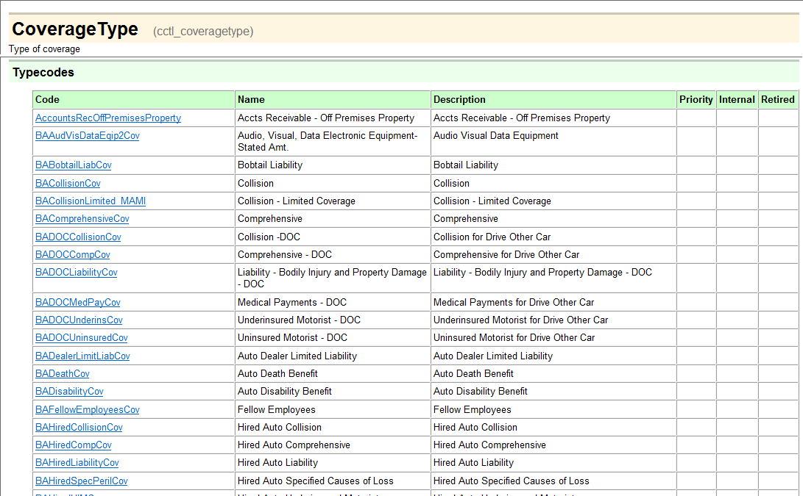
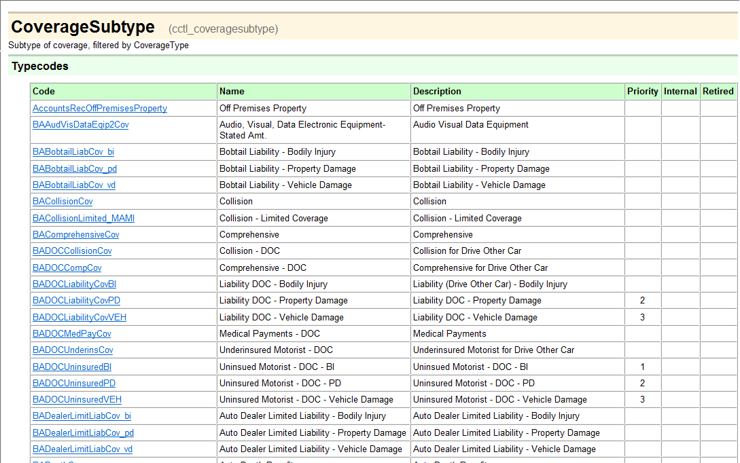
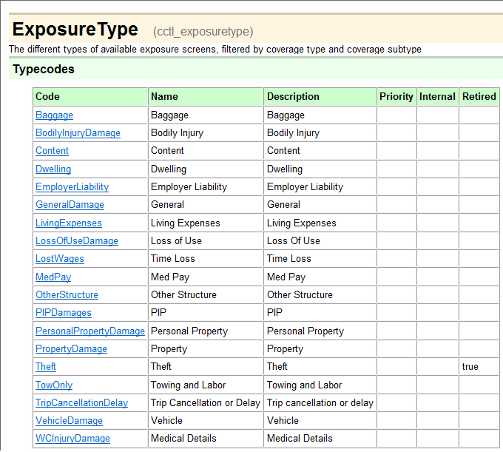
LOB typelists
|EOS~023|
Notes:
|EON~023|
The six LOB typelists from the data dictionary are shown above. If you view the typelists in the data dictionary, you will notice that each one of them makes heavy use of the Categories column. This is because each typecode is relevant only in a limited number of circumstances.
Recall that the Data Dictionary is located in: C:/Guidewire/ClaimCenter/build/dictionary/data/index.html

Slide 24
Common Typelists external to LOB model
ClaimantType LossCause MetroReportType OfficialType PriContributingFactors* QuickClaimDefault ResolutionType SeverityType
LossType
LOBCode
InsuranceLine* ClaimTier ExposureTier
PolicyType
InternalPolicyType PolicyTab
CostCategory CovTermPattern LineCategory
CoverageType
SourceSystem
CoverageSubtype
LossPartyType*
ExposureType
Incident
|EOS~024|
Notes:
|EON~024|
The six typelists that comprise the LOB model are not isolated from the ClaimCenter data model. Typecodes in other typelists reference typecodes in the six LOB typelists, and in some cases typecodes in the LOB typelists reference typecodes in non-LOB typelists. For example, the InsuranceLine typelist is used for stat reporting. It has typecodes (such as "glass") which reference typecodes in the PolicyType typelist (such as “BusinessAuto" and “PersonalAuto"). Similarly, typecodes in PolicyType (such as “PersonalAuto") reference typecodes in InternalPolicyType (such as "personal"). Typecodes in four of the typelists reference typecodes in the SourceSystem typelist. Note: The external typelists shown are not exhaustive, and instead show common external typelists you need to be aware of. For example, ClaimSegment is an external incoming typelist to LossType but is not listed above in red.
Consequently, when you make changes to typelists within the LOB model, you may also need to add, remove, or modify typecodes in typelists outside of the LOB model.
*Be aware that there are some instances of cascading references across three or more typelists. For example:
LossType is referenced by PriContributingFactors, which is referenced by SecContributingFactors, which is referenced by ResContributingFactors
PolicyType is referenced by InsuranceLine, which is referenced by both InsuranceSubline and MajorPerils
CoverageSubtype is referenced by LossPartyType, which is referenced by VehicleType
In these cases, a change to one LOB typelists could require changes to a non-LOB typelist, which in turn requires changes to another non-LOB typelist.
Configuration steps involving external typelists are aided by the use of the “Incoming Categories” and “Outgoing Categories” tabs in the LOB Typelists. This will be discussed later in this lesson, in the LOB Model Configuration section. These tabs display all incoming and outgoing external typelists.

Slide 25
Common LOB model configurations
Adding new entries
Example: Adding "umbrella" policy
Retiring existing entries
Example: Obsolescing "pollution" coverage
Connecting two entries
Example: Associating "spoilage" coverage with the "homeowner's" policy
Disconnecting two entries
Example: Disassociating “electronic equipment" coverage from parent "personal auto" policy
|EOS~025|
Notes:
|EON~025|
Removing a line of business from the base application's LOB model is a daunting task that is not recommended. Retirement of the line achieves the same objective AND allows for access of any existing data in that line.

Slide 26
Lesson outline
Line of business model
The LOB typelists
LOB model configuration
|EOS~026|
Notes:
|EON~026|

Slide 27

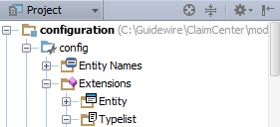
Identifying LOB Typelists
LossType.ttx
LOBCode.ttx
PolicyType.ttx
CoverageType.ttx
CoverageSubtype.ttx
ExposureType.ttx
|EOS~027|
Notes:
|EON~027|
Like all other typelists in Studio, LOB typelists are found alongside all other base application typelists by navigating in the Project window as shown in the screenshot. It is imperative to know the name of each of the six typelists, and where your typelist extension files are edited.
LOB typelists have unique configuration properties:
1. The parent/child relationships previously described, as well as the 1:M, M:M and M:1 relationships that exist are supported by “Children”, “Parents” and “Other Categories” folder node icons inside the LOB typelists only. No other typelists in ClaimCenter have these nodes.
2. You may add new LOB typecodes, and perform other configurations using a right-click context menu that is not found in other typelists. More on this will be discussed later in this lesson.

Slide 28
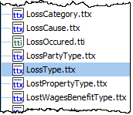
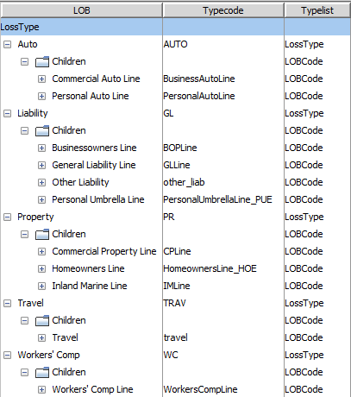
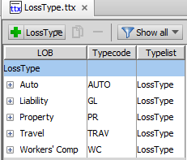
Selecting a LOB typelist
Loss type typecodes expanded to show child LOB codes
Double-click to open
Loss types (with no children showing)
When you select a LOB typelist, its typecodes are displayed and parent/child node navigation is available
|EOS~028|
Notes:
|EON~028|
For more on the basics of working with typelists in Studio in the new typelist editor of Guidewire Studio 8.0, consult the “Typelists” lesson in the Configuration Fundamentals training course (a prerequisite to this course).
LOB typelist extensions are physically stored here: C:\Guidewire\ClaimCenter\modules\configuration\config\extensions\typelist

Slide 29
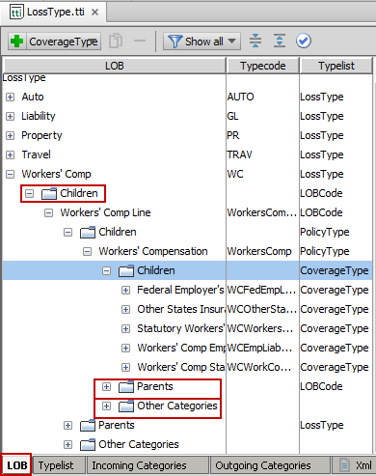
Example parent/child LOB typelist structure
WC LossType has one child LOBCode
LossType
Children, Parents, Other Categories unique to LOB typelists
LOBCode
PolicyType
Work only in this tab when configuring LOB
CoverageType
|EOS~029|
Notes:
|EON~029|
In the above example, the WC LossType has one LOBCode (Workers’ Comp Line), and this LOBCode has one PolicyType (Workers’ Compensation). The Workers’ Compensation Policy Type has five child Coverage Types.
NOTE: When performing configuration work on a LOB typelist, ensure the “LOB” tab is selected. Only LOB typelists have the “Children”, “Parents” and “Other Categories” folder nodes to display the LOB hierarchy. Generally, it is easier to navigate down the hierarchy, starting with LossType. Work on LOB typelists can be done in any one of the six LOB typelist files in Studio, however, it may be more straightforward, to, for example, edit child CoverageType typecodes from the PolicyType typelist.

Slide 30
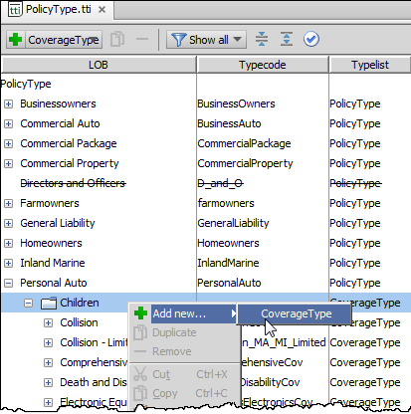

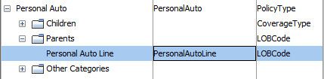
Children and parent codes
For given code, you can:
View and edit associations to child codes
View associations to parent codes
…
|EOS~030|
Notes:
|EON~030|
In the example above, if you were to add a new CoverageType, the right-click context menu on the folder node provides the option to add a new child CoverageType under the parent “PersonalAuto” PolicyType code. Likewise, you may view the parent (the single typecode PersonalAutoLine), but not add an additional parent. Adding parents is not an available or recommended configuration. Instead, you always add child typecodes.

Slide 31
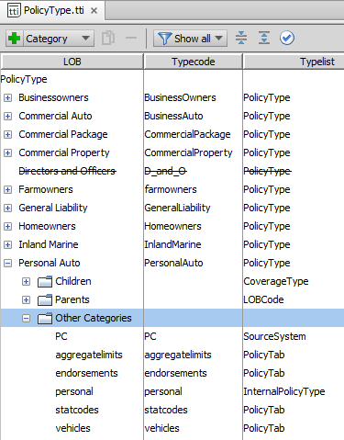
Category
Each code has an additional folder node for configuring other categories (associations to non-LOB typelists)
InternalPolicyType PolicyTab SourceSystem
PolicyType
|EOS~031|
Notes:
|EON~031|
This information is also visible in the “Incoming” and “Outgoing” Categories tabs in the LOB typelist, which will be discussed later in this lesson. The difference is “Other Categories” displays external typecodes and typelists for an individual typecode only.

Slide 32
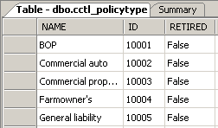
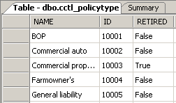
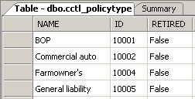
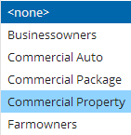
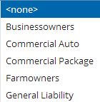
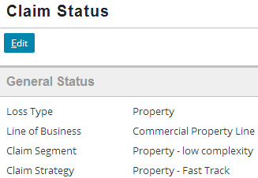
Removing codes from LOB model
Active
Retired
Deleted (Removed)
Database
New Objects
Existing Objects
|EOS~032|
Notes:
|EON~032|
There are only two ways to remove a code from the LOB Model: retiring and deleting.
When a code is retired, it cannot be chosen in any dropdowns for new objects or for existing objects that are being edited. However, the value does display for any existing record which uses the object. (In the example above, Commercial property (the PolicyType) has been retired. It cannot be selected from any dropdown in the NCW, but it still appears as the policy type for any policy which was of type Commercial Property at the time the code was retired.)
When a code is deleted, it is physically removed from the database. In this example, an error will occur, as the underlying tables will have a foreign key reference to a row which no longer exists, and instances where the typecode is used as a category elsewhere are now gone. This example is a serious enough error that causes the server to be unable to start. Note that deleting an entry in one of the LOB model typelists requires finding any references to that typecode in the referencing typelists as well. Therefore, it is never advised to delete any LOB typecodes.

Slide 33
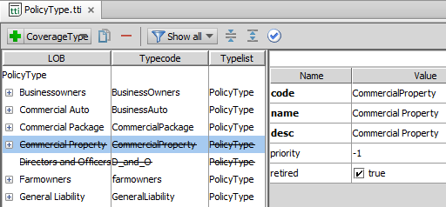
Retiring typecodes
You must retire typecodes as the preferred way to cleanly remove entire policy types, coverages, coverage subtypes, etc.
Deleting typecodes is not advised and can only perhaps be used if no existing object references other typelists or code
Retired typecodes appear with strikethrough font (across all of ClaimCenter) whenever they appear in the hierarchy
|EOS~033|
Notes:
|EON~033|
The recommendation around retiring typecodes (as opposed to deleting them) is not unique to the LOB model. This is a good practice for any typecode that is referenced by existing records across all of ClaimCenter.

Slide 34
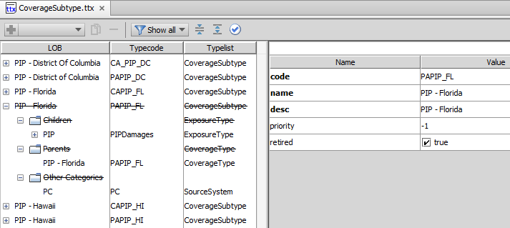
Retiring CoverageSubtype typecodes
CoverageSubtype typelist serves as a “mapping” between CoverageType and ExposureType
A coverage subtype must have exactly one parent (one coverage) and one child (one exposure).
CoverageType
CoverageSubtype
ExposureType
If a particular pairing of coverage and exposure is no longer needed, retire the typecode
Be careful not to retire the ExposureType as it is used by other parents
|EOS~034|
Notes:
|EON~034|
In the example shown, the CoverageSubtype linking the (Personal Auto) PIP – Florida CoverageType and the PIPDamages is removed from the UI so no new exposures can be created from it, however any existing claims with exposures created from this coverage still appear. As of October 2007, the state of Florida no longer allows PIP coverage (which is similar to Med Pay).
Removing a CoverageSubtype from parent (Remove typecode from parent) is not recommended because it would orphan the CoverageSubtype. In essence, the removal would remove a linkage, and the CoverageSubtype’s purpose is to create a linkage. Retire a CoverageSubtype when existing data references the subtype. If no existing data uses a particular CoverageSubtype (such as in a new implementation), it is safe to Delete (Remove) the CoverageSubtype.

Slide 35
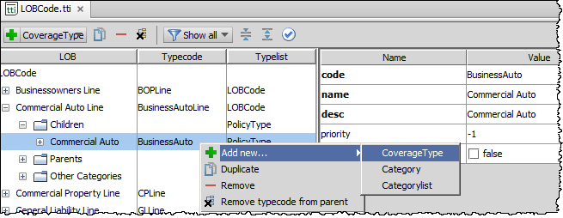
Creating and removing codes and code associations
Commercial Auto
“Toolbar” in Studio to replicate context menu
new typecode
existing typecode
Commercial Auto Line
merci
...
Com
Commercial auto
|EOS~035|
Notes:
|EON~035|
Most typecodes and folder nodes in the navigation panel have an appropriate right-click context menu used to modify that node. To display the context menu, right-click the given node, or use the “toolbar” buttons at the top of the typelist in Studio.
Add new…>CoverageType allows you to create a new CoverageType typecode and make it a child of the given typecode, or allows you to add an existing typecode as a child to the given PolicyType typecode. This is the most common configuration.
Duplicate creates an exact copy of the selected typecode except for appending “1” to the end of the newly created typecode.
Remove entirely deletes the typecode from the LOB Model. Any child typecodes will no longer have the given typecode as a parent. Any child typecodes which had only the given typecode as a parent become orphan typecodes and orphaned typecodes will prevent the server from starting. Therefore codes should be deleted with extreme caution, as problems will arise if any existing object references the code. Consider retiring codes instead as a best practice, or remove typecode from parent.
Remove typecode from parent deletes the association between the given typecode and its parent, but the given typecode is not deleted. This option is available only when you select a non-folder child node within the given tree structure. For example, in the screenshot shown, “Remove typecode from parent” is available because the selected PolicyType code (BusinessAuto) has a parent LOBCode typecode. You have navigated to a child, which has a parent from which you can remove the association. Studio is able to infer the exact association to remove. So, generally, you are only able to use “Remove typecode from parent” by expanding the “Children” folder node and selecting the child.

Slide 36
Remove typecode from parent
When using Remove typecode from parent, the association is deleted only.
PolicyType
CoverageType
CoverageSubtype
|EOS~036|
Notes:
|EON~036|
Generally, you would not remove a CoverageSubtype itself from a parent (instead retire the typecode). CoverageSubtype is a “M:M” relationship between a single CoverageType and a single ExposureType. You would use remove from parent for other configurations, such as the one shown above (CoverageType to PolicyType).

Slide 37
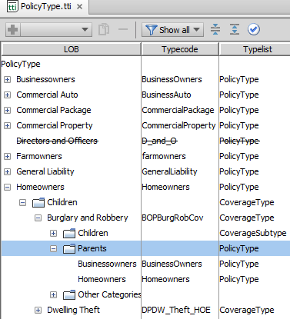

Referential integrity within the LOB model
Whenever you add a LOB association at one level, Studio automatically makes reciprocal association
LossType
developer makes Burglary and Robbery a child of Homeowners...
LOBCode
PolicyType
...and Studio makes Homeowners a parent of Burglary and Robbery
CoverageType
CoverageSubtype
ExposureType
|EOS~037|
Notes:
|EON~037|

Slide 38
Referential integrity beyond LOB model
Associations between LOB typelists and non-LOB typelists must be maintained manually
LossType
LOBCode
InsuranceLine
PolicyType
InternalPolicyType PolicyTab
CoverageType
...and modifies references in InsuranceLine, adds references to InternalPolicyType and PolicyTab
Developer adds International_ BOP_Ext policy type...
CoverageSubtype
ExposureType
|EOS~038|
Notes:
|EON~038|

Slide 39
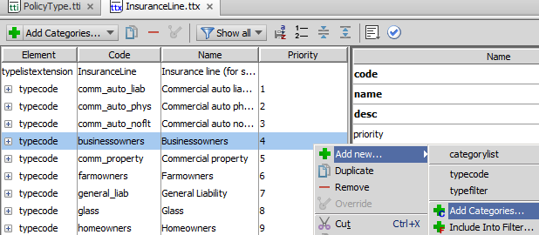
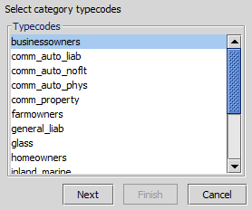
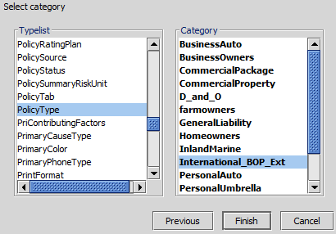

Referential integrity beyond LOB model: example
v
u
u
w
|EOS~039|
Notes:
|EON~039|
The scenario shown in the previous slide is one in which the developer has added a new policy type (International_BOP_Ext). He or she must manually manage references to it in typelists external to the LOB typelists.
The screenshot above shows the InsuranceLine typelist extension, a typelist used for stat coding. Because a new policy type has been added, each InsuranceLine stat code which must reference it must be modified. The screenshot shows the InsuranceLine value of "businessowners" being associated to the new “International_BOP" policy type thru the use of a wizard.

Slide 40
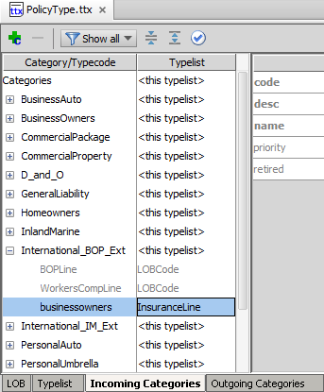
Viewing External Typelists in LOB Typelists
Incoming Categories are all external references to typekeys in this typelist.
Outgoing Categories are references from typekeys in this typelist.
Incoming and Outgoing External Typelists
External typecode and Typelist referenced and configured is visible
|EOS~040|
Notes:
|EON~040|
LOB Typelists, in addition to possessing a “LOB” tab to work with parent/child relationships, also have Incoming Categories and Outgoing Categories tabs to view and manage external typelist references. This provides useful visibility into all of the external related typelists that are involved w/ LOB typecodes.
In the example shown, the configuration performed on the previous slide is now not only visible in the InsuranceLine typelist, but also in the PolicyType typelist extension.

Slide 41
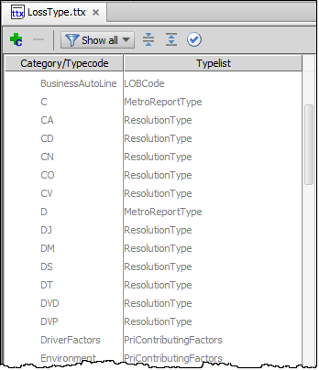
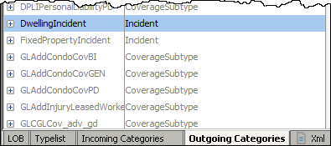
Examples: Incoming and Outgoing Categories to External Typelists
ClaimantType LossCause MetroReportType OfficialType PriContributingFactors* QuickClaimDefault ResolutionType SeverityType
LossType
ExposureType
Incident
…
|EOS~041|
Notes:
|EON~041|
Recall there are several “Incoming” external typelists related to LossType, a few of which are shown in the above. The only “Outgoing” external typelist related to ExposureType is “Incident”.
*Be aware that there are some instances of cascading references across three or more typelists. For example:
LossType is referenced by PriContributingFactors, which is referenced by SecContributingFactors, which is referenced by ResContributingFactors
Technically, “Incoming” and “Outgoing” are analogous to “Parent” and “Child”, the only difference being Incoming/Outgoing includes typelists external to the LOB model, and the fact that dependencies in the LOB model are often bi-directional (i.e. LOBCode is a parent of PolicyType, and PolicyType is a child of LOBCode).

Slide 42
Non-LOB dependent typelists
PriContributingFactors
LossType
SecContributingFactors
LOBCode
ResContributingFactors
PolicyType
CoverageType
Use the Incoming/Outgoing categories typelist cards to trace cascading references outside of the LOB typelists
CoverageSubtype
ExposureType
|EOS~042|
Notes:
|EON~042|
*Be aware that there are some instances of cascading references across three or more typelists. For example:
LossType is referenced by PriContributingFactors, which is referenced by SecContributingFactors, which is referenced by ResContributingFactors
PolicyType is referenced by InsuranceLine, which is referenced by both InsuranceSubline and MajorPerils
CoverageSubtype is referenced by LossPartyType, which is referenced by VehicleType
In these cases, a change to one LOB typelists could require changes to a non-LOB typelist, which in turn requires changes to another non-LOB typelist.

Slide 43
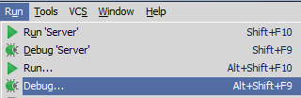
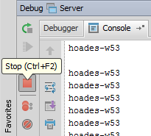
Deploying line of business changes
Recall that LOB model is stored in typelists
Whenever you modify typelist information, you must stop and restart the server to deploy the information
|EOS~043|
Notes:
|EON~043|
Stopping and starting the server can be done from commands as shown at the top or from within Studio (run in debug process).

Slide 44
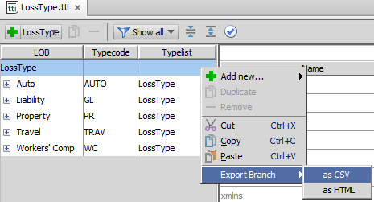
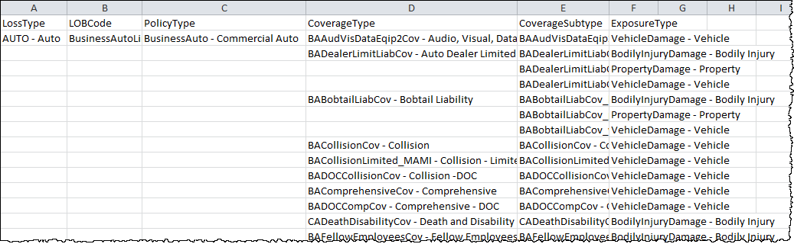
Exporting LOB model data
You can export the entire LOB model (or any portion of it) into an HTML or CSV file
LOB tree.csv (opened in MS Excel)
|EOS~044|
Notes:
|EON~044|

Slide 45

The PolicyCenter typecode generator
typecode generator
PolicyCenter provides a typecode generator that automatically creates typecodes in ClaimCenter for policies and coverages declared in PolicyCenter
Useful for customers that implement both PolicyCenter and ClaimCenter
Configured in and executed from PolicyCenter
The typecode generator is additive
It adds or modifies typecodes for policies and coverages for which PolicyCenter is the "source system"
It does not modify typecodes for policies and coverages for which PolicyCenter is not the "source system"
|EOS~045|
Notes:
|EON~045|
The policy and coverage structure in PolicyCenter's Product Model must be duplicated in ClaimCenter's line of business model. Theoretically, one could build every policy type and coverage type manually in both applications. But, it is far more convenient to build them once in PolicyCenter and then simply export the policy types and coverage types to ClaimCenter via the typecode generator.
Keep in mind that the typecode generator exports policy types and coverage types to ClaimCenter, but it does not keep the PC Product Model "synchronized" with the ClaimCenter LOB model. ClaimCenter is capable of interacting with multiple policy administration systems (PASs). Therefore, ClaimCenter may contain policy types and coverage types for policies that exist in other PASs. The typecode generator adds and modifies typecodes for which PolicyCenter is the source system, but it does not modify typecodes needed for interaction with other PASs.

Slide 46
Lesson objectives review
You should now be able to:
Describe the purpose of the Line of Business model
Describe how the LOB typelists define the LOB model
Configure LOB typelists
|EOS~046|
Notes:
|EON~046|

Slide 47
Review questions
What is the difference between the LossType and LOBCode typelists?
What is the primary purpose of an ExposureType? Name an exposure type which could map to multiple coverages.
Typecodes at one LOB level can have only one parent and only one child. Which level is it? Why is this true?
Where would you go in the LOBCode typelist to associate an existing Policy Type of "BusinessOwners” to an existing coverage of "Directors and Officers"?
When you retire or delete a typecode:
Can new objects use the value?
Can existing objects that use the value be displayed?
|EOS~047|
Notes:
|EON~047|
Answers
1. LossType broadly groups claims that will have similar losses. LOBCode is a business categorization.
2. An ExposureType is a set of information used to create an exposure. For example, a "vehicle" exposure type could be used for exposures which are tied to a "collision" coverage or a "liability - vehicle damage" coverage, because both coverages require information about the way in which a given vehicle was damaged. It could also be used for exposures which are tied to a “comprehensive” coverage, an “Electronic Equipment” coverage, and so on.
3. CoverageSubtype. This is because CoverageSubtype's purpose is to break down the many-to-many relationship between CoverageType and ExposureType into two many-to-one relationships.
4. You would expand the BOPLine LOBCode (at the very top), select the “BusinessOwners” PolicyType, use the right-click context menu to select “Add new… CoverageType” and select the "Directors and Officers" coverage (code DandO) (Use View > Notes Page in PowerPoint to view the screenshot of selecting an existing coverage type):
5. a) In both cases, no.
b) If the code is retired, yes. If the code is deleted, no, you will get an error if you attempt to display the object or start the server.

Slide 48
Notices
Copyright © 2001-2014 Guidewire Software, Inc. All rights reserved.
Guidewire, Guidewire Software, Guidewire ClaimCenter, Guidewire PolicyCenter, Guidewire BillingCenter, Guidewire Reinsurance Management, Guidewire ContactManager, Guidewire Vendor Data Management, Guidewire Client Data Management, Guidewire Rating Management, Guidewire InsuranceSuite, Guidewire ContactCenter, Guidewire Studio, Guidewire Product Designer, Guidewire Live, Guidewire DataHub, Guidewire InfoCenter, Guidewire Standard Reporting, Guidewire ExampleCenter, Guidewire Account Manager Portal, Guidewire Claim Portal, Guidewire Policyholder Portal, ClaimCenter, BillingCenter, PolicyCenter, InsuranceSuite, Gosu, Deliver Insurance Your Way, and the Guidewire logo are trademarks, service marks, or registered trademarks of Guidewire Software, Inc. in the United States and/or other countries.
All other trademarks are the property of their respective owners.
This material is confidential and proprietary to Guidewire and subject to the confidentiality terms in the applicable license agreement and/or separate nondisclosure agreement.
This file and the contents herein are the property of Guidewire Software, Inc. Use of this course material is restricted to students officially registered in this specific Guidewire-instructed course, or for other use expressly authorized by Guidewire. Replication or distribution of this course material in electronic, paper, or other format is prohibited without express permission from Guidewire.
Guidewire products are protected by one or more United States patents.
|EOS~048|
Notes:
|EON~048|

