Slide 1
ClaimCenter Overview
22 April 2015
|EOS~001|
Notes:
|EON~001|
Guidewire training materials contain Guidewire proprietary information that is subject to confidentiality and non-disclosure agreements. You agree to use the information in this manual solely for the purpose of training to implement Guidewire software solutions. You also agree not to disclose the information in this manual to third parties or copy this manual without prior written consent from Guidewire. Guidewire training may be given only by Guidewire employees or certified Guidewire partners under the appropriate agreement with Guidewire.

Slide 2
Lesson objectives
By the end of this lesson, you should be able to:
Describe the role of ClaimCenter in the Guidewire InsuranceSuite products
Describe the process of logging on to ClaimCenter
Describe the structure and functionality of the user interface
Describe the typical implementation team members and tools that they use
This lesson uses the notes section for additional explanation and information. To view the notes in PowerPoint, choose View→Normal or View→Notes Page. If you choose to print the notes for the lesson, be sure to select “Print hidden slides.”
|EOS~002|
Notes:
|EON~002|

Slide 3
Lesson outline
ClaimCenter overview
Logging in
User interface
ClaimCenter implementations
|EOS~003|
Notes:
|EON~003|

Slide 4
Guidewire product landscape
Guidewire provides core systems used by carriers as operational systems of record
Core Operations Support
External Access
Data Management and BI Products
Monitoring & Guidance
Operational Systems of Record
|EOS~004|
Notes:
|EON~004|
Guidewire builds software products that help property and casualty (P&C) insurers replace their legacy core systems and transform their business. Guidewire provides core systems and data management/business intelligence tools used by insurers as operational systems of record. Additional products provide support for anytime/anywhere access and guidance and monitoring.
Who uses Guidewire products?
Everything in the blue circle is targeted at internal users at insurance companies—claims adjusters, underwriters, supervisors, risk managers, customer service representatives, billing clerks, and so on.
External Access includes two types of external users:
Third-party users such as policyholders and vendors, who can't log in to the core systems but need to access some of the data that lives in those systems.
Authorized users of the core systems who have special requirements, such as an adjuster who is currently mobile after a catastrophe and has no internet access but needs to take pictures and take notes to upload later.
Monitoring and Guidance describes a variety of hosted services that enable carriers to use cloud-based applications in their day-to-day workflow. Hosted services include geographic visualization, catastrophe capture, and comparison of peer insurer benchmarks, among others.

Slide 5







Guidewire products
Mobile & Portals
Guidewire Live
InfoCenter
DataHub
|EOS~005|
Notes:
|EON~005|
Operational Systems of Record
In the area of Core Operations Support, Guidewire InsuranceSuite provides a complete set of applications to support a carrier's core operations—underwriting, policy administration, billing, and claim management. The slide provides a high-level view of the core Guidewire products. It is not an exhaustive list of all applications and licensed features. Therefore, some features and products, such as ContactManager, Client Data Management, PolicyCenter Rating, PolicyCenter Reinsurance, and the ISO Standards-Based templates, are not shown.
In the area of Data Management and Business Intelligence Products, Guidewire DataHub is an operational data store that unifies, standardizes, and stores data from a carrier's own systems as well as external sources. Guidewire InfoCenter is a business intelligence warehouse that is purpose-built for P&C insurance. It provides easy-to-use reporting formats for business intelligence, analysis, and enhanced decision making. Using InfoCenter, carriers gain operational insight across the enterprise.
Monitoring and Guidance
Guidewire Live is a network that connects peer insurers, core systems data, external sources of information (such as weather services), and expert tools. Users access Guidewire Live through applications hosted by Guidewire and designed for specific challenges faced by P&C insurance professionals.
External Access
Mobile & Portals is a new set of applications that feature add-on products to the Guidewire core suite, providing self-service transactions through various mobile channels.

Slide 6
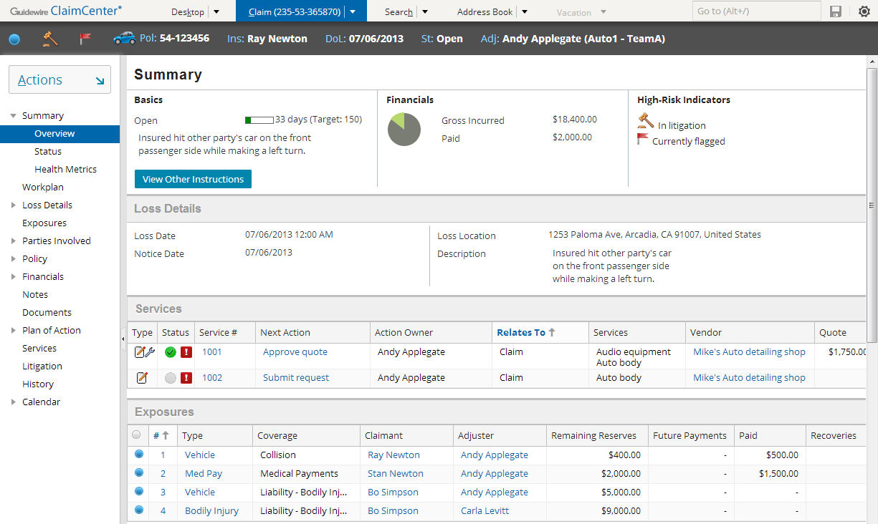
ClaimCenter Internal Users
customer service rep
adjuster
supervisor
Browser-based application
Supports the most common types of internal users:
Customer Service Representatives (who create claims) (CSRs)
Adjusters (who act on claims)
Supervisors (who supervise users and approve work)
|EOS~006|
Notes:
|EON~006|
ClaimCenter (CC) is a browser-based application that enables users to participate in claims processing. The most common internal users of ClaimCenter at a carrier are shown in this slide and these are the primary users that will be discussed in this course.

Slide 7
The value proposition of ClaimCenter
ClaimCenter makes the claims process:
policy
activities
financials
Claim
parties
notes
documents
litigation
Claim-centric
Collaborative
Controlled
|EOS~007|
Notes:
|EON~007|
ClaimCenter Overview - 7
ClaimCenter is a claim-centric solution. All of the data pertaining to a claim is centralized in the claim file. This includes information on policies, financials, diaries, documents, parties involved, and litigation. All users have an integrated and holistic view of the claim.
ClaimCenter facilitates collaboration among claims workers by providing one centralized location where all information needed to adjudicate the claim can be uniformly worked on and shared concurrently.
ClaimCenter provides a wide span of control for supervisors by providing them with real-time team statistics and the ability to not only manage the team but to also control and direct team activities.

Slide 8


Guidewire applications architecture
Users
Operational Database
Guidewire Application
Policy Admin.
Authen- tication
Document Storage
Address Book
Check Printing
|EOS~008|
Notes:
|EON~008|
ClaimCenter Overview - 8
Three-tier architecture is a client-server architecture in which the operational data, application logic, and user interface are developed and maintained as independent modules on separate platforms. Three-tier architecture is one of the industry-standard software architectures.
The data tier contains the business and operational database. It is hosted in an Oracle or SQL Server database or cluster of databases.
The application tier contains the functional process logic. It is hosted in an application server such as WebLogic, WebSphere, Apache Tomcat, or JBoss EAP.
The presentation tier contains the user interface. The Guidewire user interface is supported in these web browsers: Google Chrome, Mozilla Firefox, and Microsoft Internet Explorer.
Refer to the "Guidewire Platform Support Matrix" for the latest and most complete information about the software Guidewire supports. You can access it from the customer portal by navigating to http://guidewire.hivelive.com/pages/home"Resources -> Documentation", and clicking "Platform Matrix".
Each application is typically integrated with a number of external systems.

Slide 9
Typical integration points
External System
Overview
Authentication
Claim Intake
Policy administration
First Notice application
Claim Objects
Address book
Vendor portal
Geocoding service
Document production
Document storage
Processing Claims
ISO ClaimSearch
Metro Reporting Bureau
General Ledger
Check Processing
Financial Institutions
Medical bill review
Reinsurance administration
Management & Configuration
Reporting
|EOS~009|
Notes:
|EON~009|
The integration points are listed above in the order in which they are discussed in the course. A definition for each system appears below:
Authentication - This system takes a user name and either a token or a password and verifies if the two match.
Policy administration - This application stores information about policies issued by the carrier, the coverages on each policy, and the people or assets covered by those coverages.
First Notice application - This application stores First Notice of Loss reports in a standard XML-based file format called ACORD XML.
Address book - This is an integration point to an external address book application for managing contacts used across multiple claims.
Vendor portal – This is an integration point to an external portal that a vendor uses for managing incoming requests for service related to claims (such as vehicle repair, vehicle inspection, or property inspection).
Geocoding service - This service provides longitude and latitude coordinates for a street address (or exchanges zip code for city/state and vice versa).
Document production - This is an integration point to an external system used to store document templates and create documents.
Document storage - This is an integration point to an external document storage system which is used for document storage and retrieval.
ISO ClaimSearch - This system is a database of claims filed by carriers across the United States and is used to detect duplicate and fraudulent insurance claims.
(continued)

Slide 10
(Notes only slide)
|EOS~010|
Notes:
|EON~010|
Metropolitan Reporting Bureau - This system provides a nationwide police accident and incident reports service in the United States used by carriers to improve recordkeeping and to reduce fraud.
General ledger - This system tracks finances for the carrier, and the integration point exists so that the ledger system can stay abreast of the payments ClaimCenter is making.
Check processing - This system prints paper checks and/or manages electronic funds transfers.
Financial institutions - The integration point exists so that ClaimCenter can track when checks have been paid by banks.
Medical bill review - This system provides information about the standard amount of money being charged within the industry for a given medical service.
Reinsurance administration – This system stores information about reinsurance agreements the carrier has with reinsurers, and the specific agreements on each policy.
Reporting - This system provides reports on ClaimCenter business and user data.

Slide 11
Lesson outline
ClaimCenter overview
Logging in
User interface
ClaimCenter implementations
|EOS~011|
Notes:
|EON~011|

Slide 12
Accessing ClaimCenter
Users must have:
A web browser (Google Chrome, Mozilla Firefox, or Microsoft Internet Explorer)
The ClaimCenter URL
A user name and password
|EOS~012|
Notes:
|EON~012|
To access ClaimCenter, a user must have:
A web browser (Chrome, Firefox or IE)
The URL for connecting to ClaimCenter
A valid user name and password

Slide 13
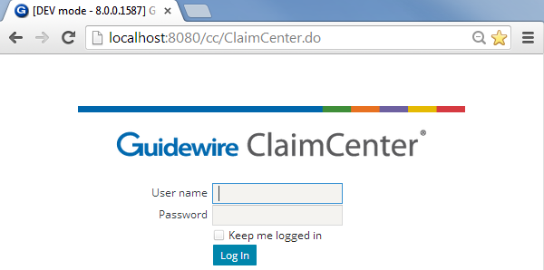
The login page
Because the pages are generated dynamically:
Back is not supported
You typically cannot bookmark or create favorites to pages (other than the login page)
|EOS~013|
Notes:
|EON~013|
To log in to an application, end users must open an instance of their web browser and access the system through the appropriate URL (Universal Resource Locator, also more commonly known as a "web address"). The URL is:
http://machine:port#/instanceName/ClaimCenter.do, where:
machine is the name of the host machine, and
port# is the port which the browser should use to access the application, and
instanceName is the name of the instance of ClaimCenter (typically "cc").
Connections to ClaimCenter are usually initiated using one of the following methods:
Providing users with a “Favorite” or “Bookmark” or “Shortcut” that links to the URL
Providing users with a shortcut on the computer desktop that invokes a browser with the URL
Creating a web link on a readily accessible web page that links to the URL
Even though the Back button and favorites to non-login pages are not supported, navigation within ClaimCenter is rarely if ever cumbersome. ClaimCenter contains a number of navigation features to make it easy for users to view commonly referenced information and recently viewed information. These features are discussed through this section.
With regard to bookmarks/favorites, it is technically possible to have favorites to pages other than the login page, but it requires the help of a ClaimCenter developer to enable a particular page for that purpose (through the use of technology known as an entry point.) For the typical user experience, the login page is the only one that should be saved as a favorite.

Slide 14

Authentication and authorization
username and password
Desktop: Activities
authenticated? what permissions? which start page?
Yes! View claim, ... Desktop: Activities
cc data
|EOS~014|
Notes:
|EON~014|
Authentication is the process of verifying a user is who he or she claims to be. Authorization is the process of determining which objects a user is allowed to view and edit and what actions a user is allowed to take.
When an end user attempts to log on to an application, the following occurs:
The user supplies their user name and password to ClaimCenter via the login page.
ClaimCenter queries the authentication system (which could be a separate system accessed through an integration point or the ClaimCenter database itself) to authenticate the user.
ClaimCenter queries the ClaimCenter database to determine which permissions are assigned to the user and what the user's start page is. Permissions determine which screens the user can navigate to and which actions the user can perform. The startup view is the first page rendered after log in.
ClaimCenter renders the appropriate startup view with permissions appropriate for that user.
Out-of-box, authentication is managed through the ClaimCenter database. There is a table in the database which stores user names and password. (The system can also be configured to authenticate against an existing user domain structure, as discussed on the next slide.)
ClaimCenter can be configured to lock an account after a user attempts to log in a certain number of times without providing the correct password. (This feature is designed to prevent someone circumventing the authentication process to illegally log on to the application.) When an account is locked, it must be unlocked by a manager. In the base application, the number of attempts before locking the account is 3, but this number can be configured.

Slide 15
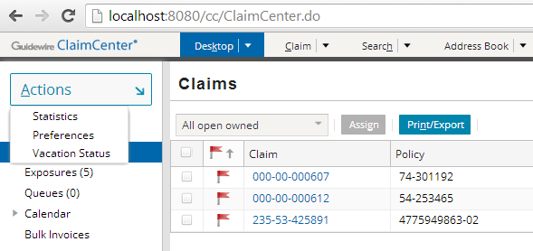
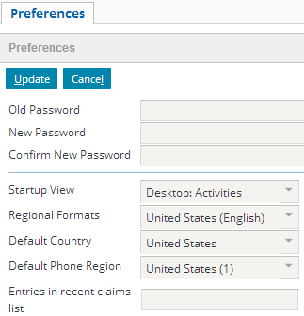
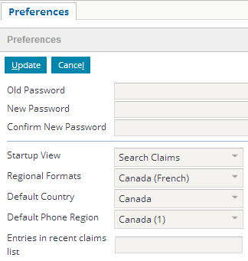
The startup view
|EOS~015|
Notes:
|EON~015|
Each user has a startup view, which is what is first displayed when the user logs in. This is sometimes referred to as the user's "landing page".
In the base application, a new user's startup view is set to "Desktop: Activities". This page lists all open activities that have been assigned to that user.
Users can change their startup view by clicking the Preferences menu action accessible from the Desktop. This opens a worksheet in the workspace frame. In this worksheet, they can select a different view as their startup view. (The workspace frame displays information that is "stand-alone" from a navigation perspective. The information could be user preferences (which has no impact on business data), or it could be a new note or new activity (which, once created, does not require any change to the data displayed in the screen area). The workspace frame is visible only when a worksheet is rendered. Most of the time, it is collapsed.)
The "look and feel" of ClaimCenter is controlled by a series of cascading style sheets (CSS). These can be configured if a given instance requires the use of different fonts and/or colors.
There are a total of eight regional formats (will be discussed later in this lesson):
Australia (English)
Canada (English)
Canada (French)
France (French)
Germany (German)
Great Britain (UK)(English)
Japan (Japanese)
United States (English)

Slide 16
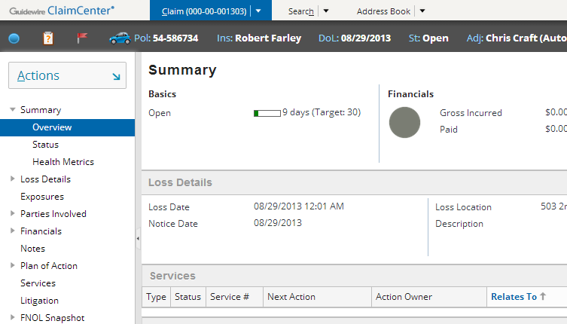
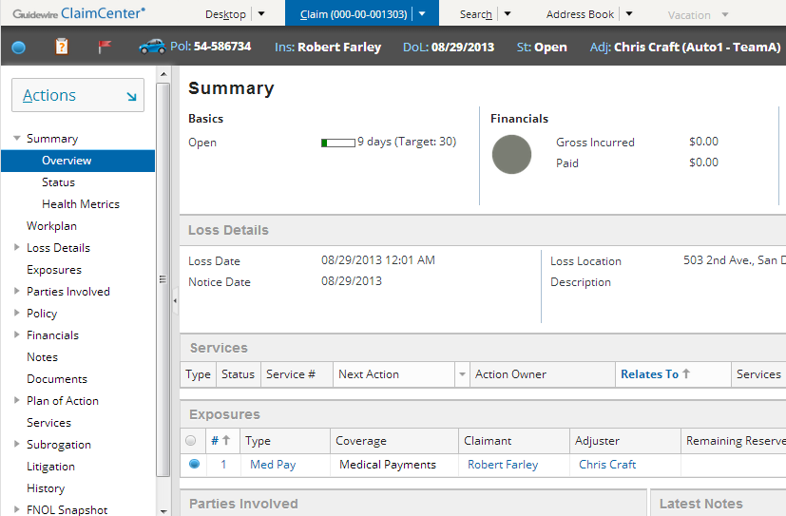
User permissions
Ida Belt (Customer Service Representative)
Dana Evans (Adjuster)
|EOS~016|
Notes:
|EON~016|
A permission is a granular ability to see or do something within ClaimCenter, such as "create activities" or "close exposures".
A role is a named collection of permissions. Typically, a role maps to a job function or job title. For example, the "adjuster" role would contain the set of permissions appropriate to someone who was an adjuster. (This role might, for example, have the "create activities" or "close exposures" permissions, but it would not have the "create users" permission. Similarly, a "customer service representative" role might have only "create activities" and not "close exposures".)
Administrators can assign roles to users. They can also create new roles and modify existing roles (to add or remove permissions to them).
When embedded in the web browser, the name of the user you are logged on as appears as a mouse-over text on the browser’s tab. You may also view the user by clicking the “gear” icon (Options menu).
In the example above, Ida Belt (who is a CSR and is shown in the left screenshot) does not have a Desktop tab. When viewing a claim, she does not have access to the Workplan, Policy, Documents, or History screens. Dana Evans (who is an adjuster and is shown in the right screenshot) has access to all of the things just listed.
User permissions is discussed in detail in the "Permissions" lesson.

Slide 17
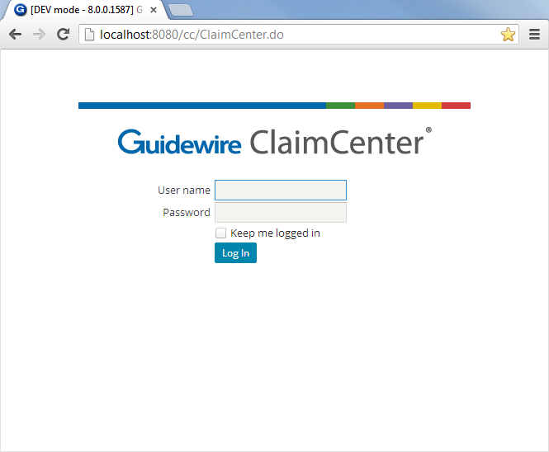
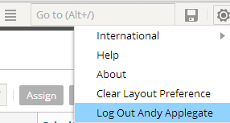
Logging out
After the configured period of inactivity, OR when you click...
|EOS~017|
Notes:
|EON~017|
When a user is finished interacting with ClaimCenter, he or she can log out using the Logout link.
The timeout period can be configured in the config.xml file. The default value is 10800 seconds (3 hours).

Slide 18
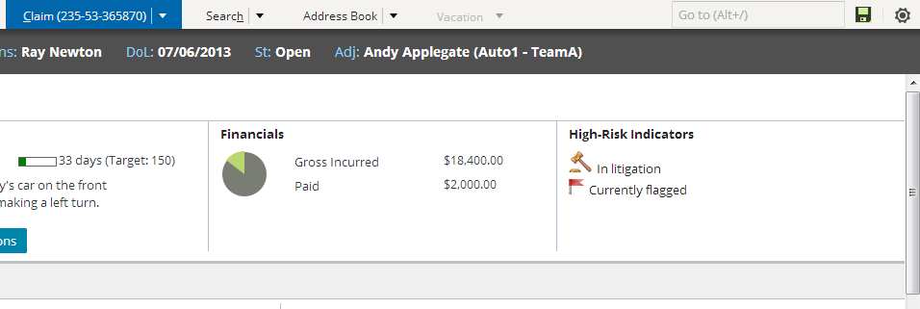
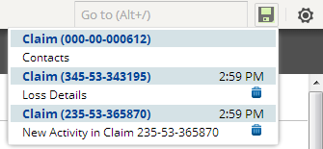
The unsaved work list
unsaved work exists (icon is green)
unsaved on current claim
unsaved on previously visited claims
discard unsaved work
|EOS~018|
Notes:
|EON~018|
"Unsaved work" refers to either work in a screen for a new object which you created but did not save or work in a screen for an existing object which you put into edit mode without updating or cancelling. In other words, unsaved work refers to any work which you navigated away from without clicking the Update or Cancel button. When the unsaved work list icon turns from gray to green, “unsaved work” exists.
All of your unsaved work is automatically listed in the unsaved work list. Work for the claim currently in focus is listed at the top, and work for previously visited claims is listed underneath.
From the unsaved work list, you can either navigate to the screen where the unsaved work is (by clicking the link) or discard the work (by clicking the corresponding trash icon).
If you attempt to log off with unsaved work, you are warned that all unsaved work will be discarded. If you click Ok, then all unsaved work is discarded.
The unsaved work list is available only when you have unsaved work. If the menu is unavailable (grayed out), then you have updated / saved all changes you have made so far. Lastly, you may discard data in the unsaved work list using the small “trash” icon.

Slide 19
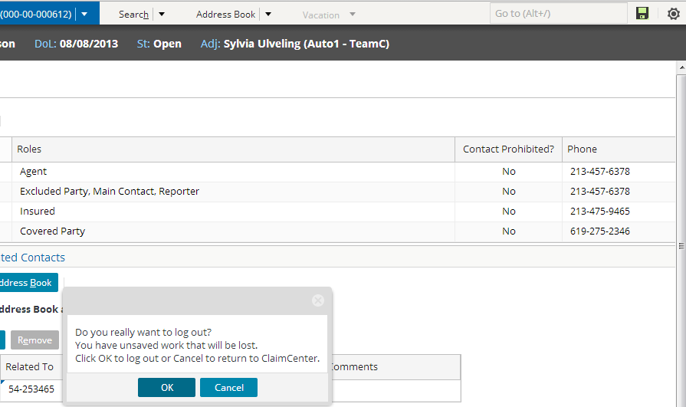
Logging off with unsaved work
If the user attempts to log out and there is unsaved work...
... the user must verify that it is okay to discard the unsaved work.
|EOS~019|
Notes:
|EON~019|
If the user inadvertently closes the web browser (without formally logging off), all unsaved work is likely to be discarded.

Slide 20
Lesson outline
ClaimCenter overview
Logging in
User interface
ClaimCenter implementations
|EOS~020|
Notes:
|EON~020|

Slide 21
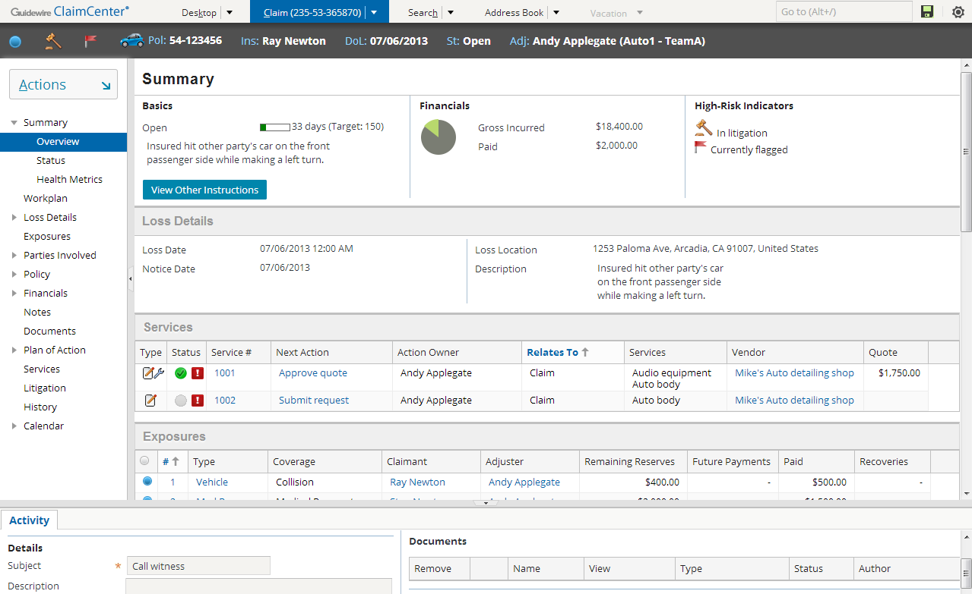
Main areas of the user interface
Tab Bar
Info Bar
Screen Area
Side Bar
Workspace
|EOS~021|
Notes:
|EON~021|
The ClaimCenter user interface can be broken down into the following main areas:
The Tab Bar is the top portion of the screen. It contains the Guidewire ClaimCenter logo, main tabs, the Unsaved Work List (save button icon) and the Options Menu (gear icon). Use the Options menu to set regional/international settings, layouts, link to help, about and log out.
The Info Bar is the horizontal dark gray strip between the tab bar and the screen area. It is not always visible. (In the base application, it is visible only on the Claim tab.) When it is visible, it either contains summary information about the primary object displayed in the screen area as well as a series of icons to identify or signal activities, claim status and other information.
The Side Bar is the vertical bar running down the left side of the user interface. The side bar contains menu actions and menu links that navigate the user to different parts of the application and let the user create new objects and initiate new jobs.
The Screen Area is the rectangular area to the right of the side bar. When the Workspace is collapsed, the screen area occupies the lower right corner of the user interface. This is where the majority of the business data is displayed and acted upon.
The Workspace displays information that is "stand-alone" from a navigation perspective. The information could be user preferences (which has no impact on business data), or it could be a new note or new activity (which, once created, does not require any change to the data displayed in the screen area). The Workspace is visible only when a worksheet is rendered. Most of the time, it is collapsed.

Slide 22
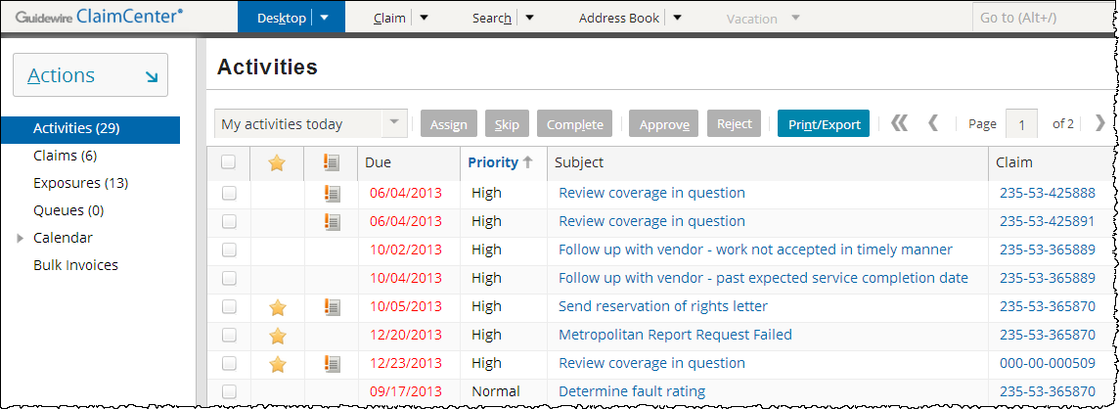
The desktop tab
User-centric, listing work you as the user are responsible for (regardless of which claim it pertains to)
|EOS~022|
Notes:
|EON~022|
The Desktop tab is a series of lists of objects for which the user has some responsibility, including:
Activities assigned to the user.
Claims assigned to the user
Exposures assigned to the user
Queues the user has access to (which contain activities that no user has taken ownership of yet)
Customer service representatives do not have access to the Desktop tab in the base application.

Slide 23
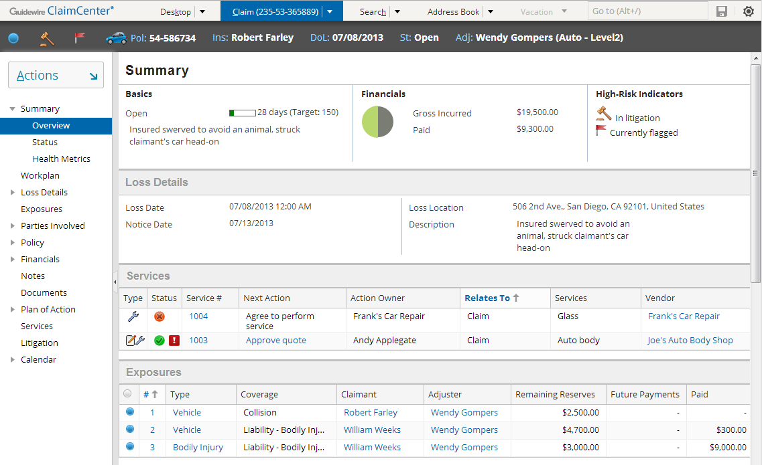
The claim tab
Claim-centric, listing work for this claim (regardless of who is doing the work)
|EOS~023|
Notes:
|EON~023|
The Claim tab contains the "claim file", which is a series of screens detailing information about the claim and its exposures.

Slide 24
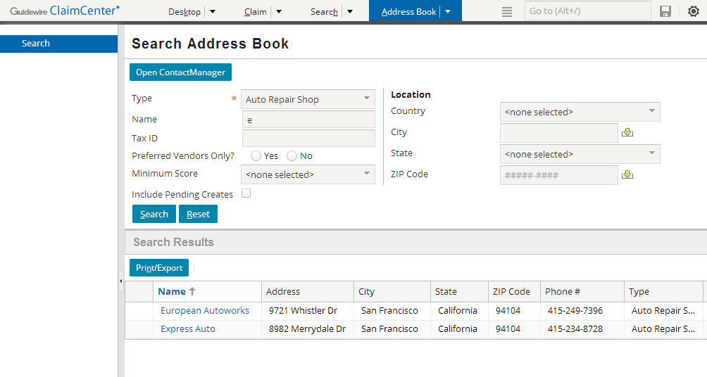
The address book tab
Used to search for contacts listed in an external address book application
|EOS~024|
Notes:
|EON~024|
The Address Book tab is used for searching for contacts listed in an external address book application. This could be Guidewire's ContactManager application or another customer contact management system.

Slide 25
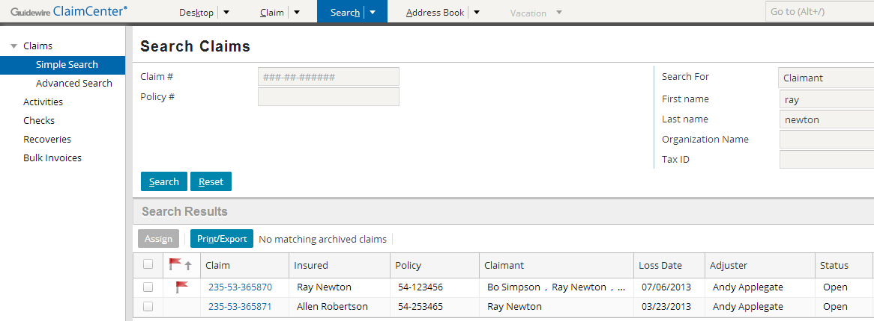
The search tab
Text fields are treated as "starts with" conditions
Can have multiple screens with different number of fields
|EOS~025|
Notes:
|EON~025|
The Search tab gives users the ability to search for different types of objects, specifically:
Claims
Activities
Checks
Recoveries
Bulk invoices
Some fields on search screens are text fields. Whenever you enter text into one of these fields, ClaimCenter treats the field as a "starts with" criteria. For example, if you entered "Smith" into the last name field, then the search will return any user whose last name starts with 'Smith', which includes "Smith", "Smithers", and "Smith-Collins".
In the base application, there are two claim search screens, a "simple" one (shown above) and an advanced one with a larger number of search fields. Claim search is the only search which has two screens in the base application, but any entity can have additional search screens created for it.

Slide 26

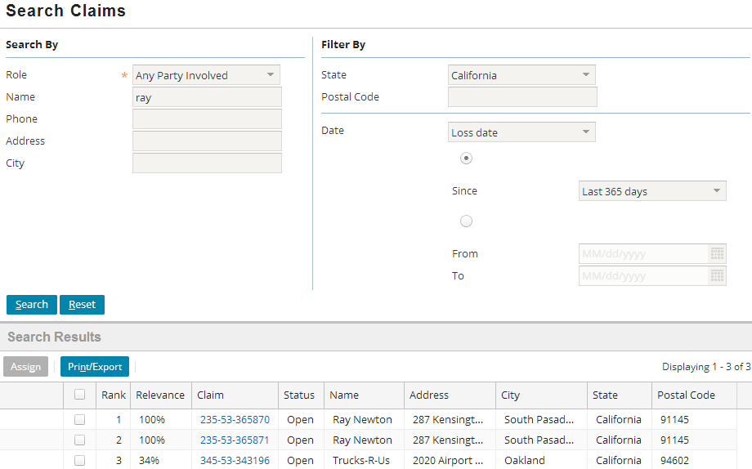
Search by Contact (Free-Text)
Filter term (exact match) to constrain search results
Query term (inexact match) sent to search engine as criteria
Results include claims with matching claim contacts
|EOS~026|
Notes:
|EON~026|
Search by Contact specifically searches the active ClaimCenter database of Claim Contacts. This means the fields are used to retrieve claims containing contacts with the matching criteria.
Search by Contact is not enabled in the base application. It requires Solr installation and configuration on server, usually on a standalone application server such as Tomcat.
In the example, the criteria is for claims with a contact named “Ray” (matching on the first name 100%), and limited to only claim contacts with addresses in California (exact match on State field). It is important to know that address fields (Address, City, State Postal Code) match against Contact addresses, not loss location. This search shown in the example cannot be performed using “Simple Search” in the base application.
NOTE: You may wish to adjust the column widths of the “Search Results” to your liking, and/or rearrange or remove columns. Your changes will persist with each subsequent search you do during your web browsing session. The base application set of columns may contain more columns that you need.

Slide 27
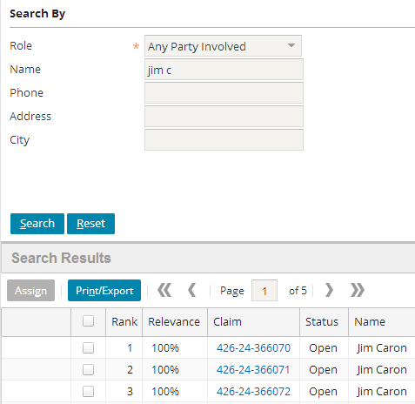
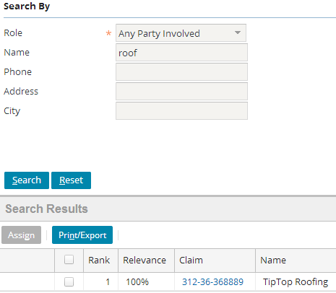
Searching by Names
First and/or Last OR Company name
|EOS~027|
Notes:
|EON~027|
Name is one of the most flexible fields in free-text search. In the example you may search by both first and last name and because a whitespace separates the two terms, it is interpreted as a first and last name combination and claims involving “Jim Caron” are listed in the results.
The purpose of using free-text search capabilities with an engine such as the Guidewire Solr Extension is to provide inexact and partial matches, similar to modern search engines where people can enter part of a name, a whole name, a last name, or a first name or even a company name and expect to see a set of results that include synonyms, names “containing” a phrase or word, or names that “sound” alike. Typos and alternate spellings are acceptable, and free-text search provides a large set of potential results that can be constrained by the use of exact match “Filter By” fields if possible.
Search by Contact and Free-Text Search capabilities are discussed in the ClaimCenter 7.0-8.0 New Configuration Features training course (Free-Text Search lesson).

Slide 28
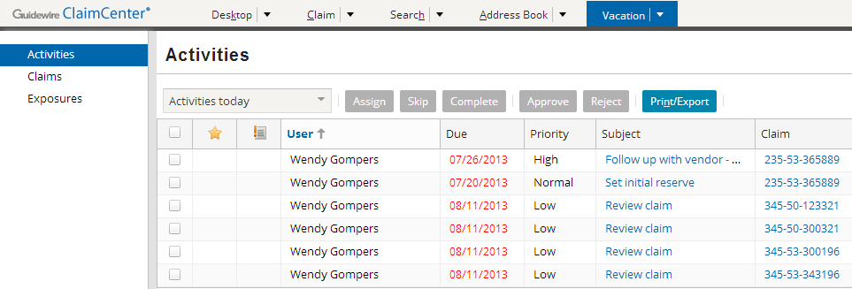

The vacation tab
Access to assigned work for user marked as “On vacation”
Visible only if specified as backup user to another user
Otherwise grayed out
|EOS~028|
Notes:
|EON~028|
Adjusters have a Vacation tab. The Vacation tab shows the objects that belong to users who are currently on vacation and for whom you are the designated backup handler. You can manage these objects as if they were your own. If you are not the backup handler for any users currently on vacation, this tab is unavailable (as shown in previous slides).

Slide 29
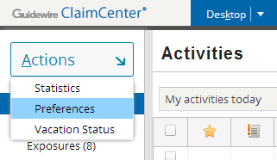
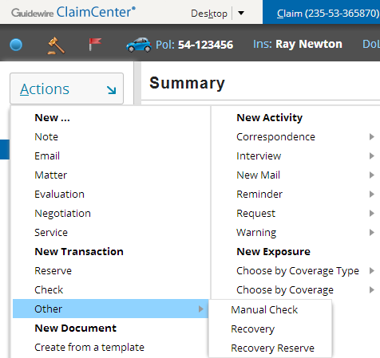
Actions menu
Actions menu displays a set of cascading menu actions based on the current tab
Menu actions execute actions (which often display screens in the screen area or workspace frame where a new object can be created)
menu actions
|EOS~029|
Notes:
|EON~029|
The side bar contains the Actions menu, which has embedded menu actions that navigate the user to different parts of the application and let the user create new objects and initiate new jobs.
The behavior described above is true for base application menu links and menu actions. However, any clickable item can be configured to behave in any manner.

Slide 30
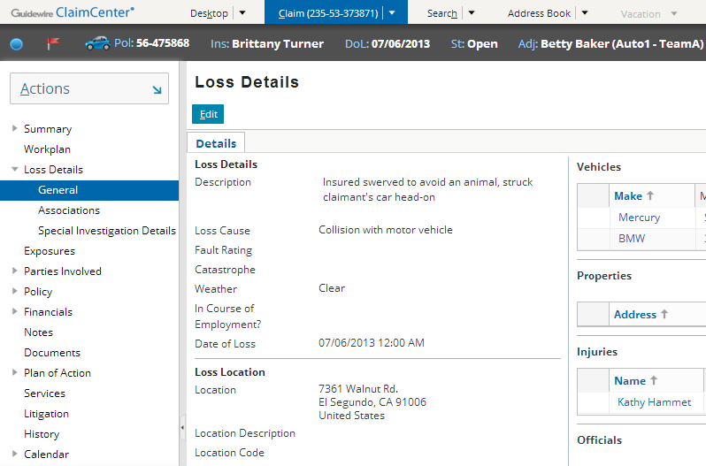
The screen area
Menu links
|EOS~030|
Notes:
|EON~030|
The screen area is the rectangular area to the right of the side bar. When the workspace frame is collapsed, the screen area occupies the lower right corner of the user interface. This is where the majority of the business data is displayed and acted upon.
End users typically navigate to a given screen (that is, they cause a screen to be rendered in the screen area) by clicking the appropriate tab and then clicking the appropriate menu link. Screens may open directly from solitary menu links (i.e. Workplan, Exposures, Notes) or from “child” menu links (i.e. Loss Details, Parties Involved, Financials). To summarize, menu links consist of any links in the sidebar that, when clicked, may navigate you to a screen. They can be configured in a parent-child hierarchy as shown above, but all are still menu links.

Slide 31
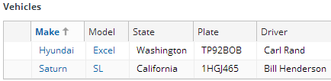
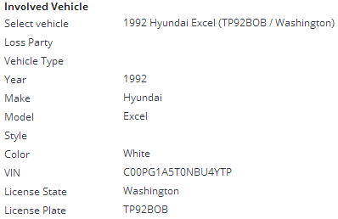
Primary views
List View
Detail View
Organize atomic widgets that display information about one object or one set of objects
Two types of primary views
|EOS~031|
Notes:
|EON~031|

Slide 32
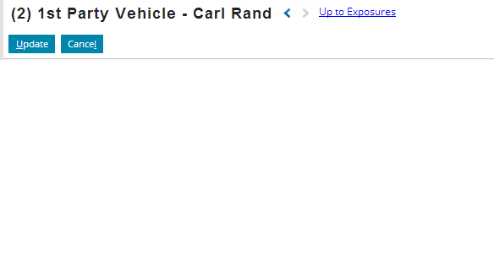
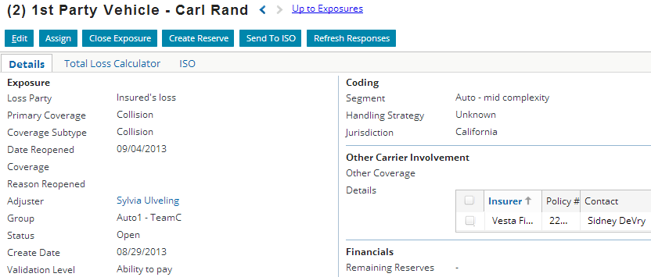
Secondary views: card view
A card view is a collection of cards
Each card can contain a detail view, list view, card view, or listdetail view
First card
|EOS~032|
Notes:
|EON~032|
In the example above, the card view is a collection of three detail views. The first one is “Details”, second is “Total Loss Calculator”, and the third “ISO”. Each card in this example contains a detail view with one inline list view (except for “Total Loss Calculator”).

Slide 33
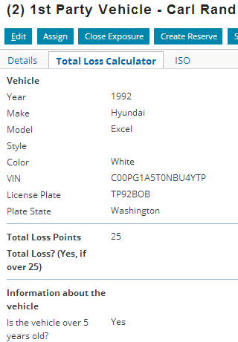
Secondary views: card view
Card view behaves as one screen
You may make edits in multiple cards and commit (update) the changes for all cards at once
Updates all cards
Second card
|EOS~033|
Notes:
|EON~033|
If you were to make changes in the “Details” as well as the “Total Loss Calculator” cards, when you click “Update”, all changes across all cards are saved.

Slide 34
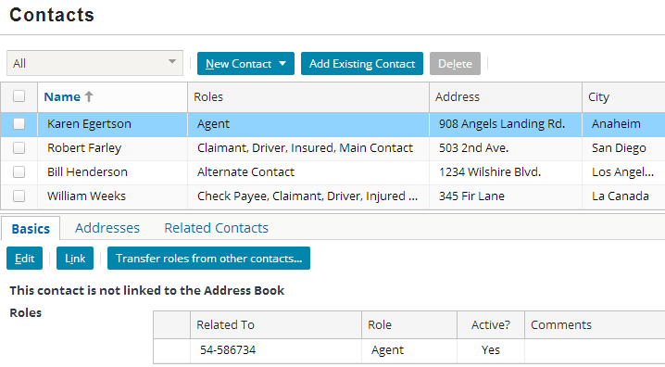
Secondary views: listdetail view
Listdetail view
List on top
"Details" of selected row on bottom
Contains a list on top with one object selected and "details" about that object on the bottom
The "details" could be a detail view, list view, card view, or embedded listdetail view
|EOS~034|
Notes:
|EON~034|
In the example above, the listdetail view is a collection of two views:
A list view (the list of contacts on top)
A card view (a set of three additional lists, each on their own card, on the bottom)

Slide 35
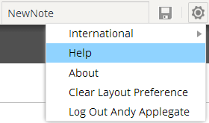
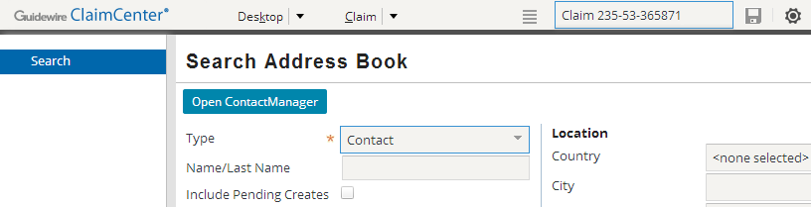
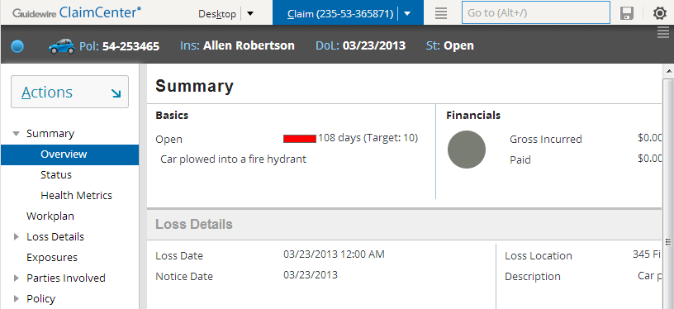
The "QuickJump" field
ALT+/, and then "Claim 235-53-365871" and then Enter
Help menu shows all ALT shortcuts
|EOS~035|
Notes:
|EON~035|
The QuickJump field is located in the upper-right corner of the user interface, though it can be accessed using a keyboard shortcut as well. The QuickJump field is designed to let users navigate to virtually any place in ClaimCenter without having to use their mouse or pointer.
For example, to navigate to claim 235-53-356871, a user could press ALT+/ (to activate the QuickJump field) and then enter "Claim 235-53-365871" and then press the Enter key. This navigates the user to that claim solely using the keyboard.
The valid set of character strings that can be entered in the base application's QuickJump field depends on which tab the user is on.
The largest set of options is tied to the Claim tab. This is because there are a number of places the user can navigate to once a given claim has been selected. The user can:
Navigate to a different tab (for example, "AddressBook" takes the user to the Address Book tab)
Navigate to a screen relevant to the claim in focus (for example, "LossDetails" takes the user to the Loss Details screen for the active claim)
Navigate to a screen where a new object can be created (for example, "NewNote" takes the user to the New Note screen for the active claim)
If there is no claim in focus (which is the case when the Desktop, Search, or Address Book tabs are active), then the user can only go to a given tab or start a new claim.
The QuickJump box is configurable. Developers can remove existing QuickJump strings, modify the spelling for existing strings, and create new ones.
Use the Help option in the Options menu (“gear icon”) to access a listing and description of all available ALT keyboard shortcuts. Keep in mind underlined letters in menus and menu items represent the key used (i.e. press ALT+k to go to the Desktop tab).

Slide 36
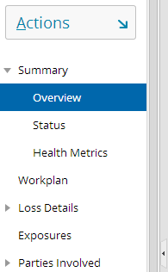
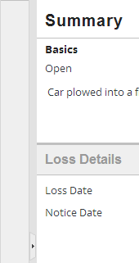
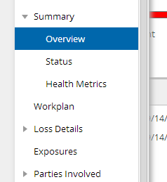
Side bar modes
Fixed mode
Collapsed mode
Floating mode
Click collapsed panel to trigger
Panel floats over center
Click panel button to revert to Fixed mode
Adjustable borders
Right and bottom scrollbars supported
Panel collapses
Center moves left and creates screen real estate
|EOS~036|
Notes:
|EON~036|
In the sidebar, the left navigation menu features second level navigation menu links.

Slide 37
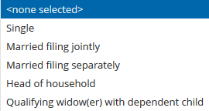

Drop-down list behavior
Tax Filing Status
As you type, the list filters to the matching pattern
When editing, the longest option value determines width of the drop-down values
Filters as you type
|EOS~037|
Notes:
|EON~037|
Drop-down lists support filtering the list as you type and sizing based on the values in the list. When editing the specific field, the drop-down grows to the longest size.

Slide 38
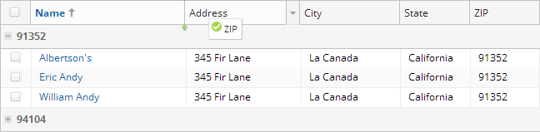
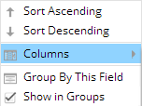
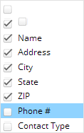
User configurable lists
1
5
3
2
Ascending and descending sort
Group by this field
By column data value
Collapse and expand
Re-arrange horizontally
Show and hide columns
Resize columns
4
User-configuration persists in browser local storage
|EOS~038|
Notes:
|EON~038|
When working with lists, the user can control several user-configurable interactive columns. The end user can re-arrange, show and hide, resize, sort and group data by a column data value. Configurators no longer need to limit the data views contained in a List View for end users.
User configurations are saved in the browser local data store.

Slide 39
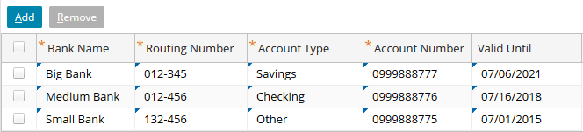

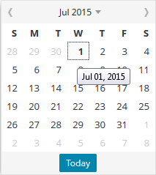
Editing in List Views
Watermark
Editable cell indicator
Top left triangle:
Standard user interface controls in primary and secondary views support:
Watermark
Validation
Drop-down lists
Calendar
|EOS~039|
Notes:
|EON~039|
Standard user interface controls such as watermark, validation, drop-down lists and Calendar date pickers are supported in List Views and all other primary and secondary views. The Watermark is tied to what is known as an “input mask”, which allows data to be entered according to a set number of characters or numbers. All input masks and field validators are configurable.

Slide 40
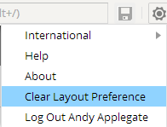
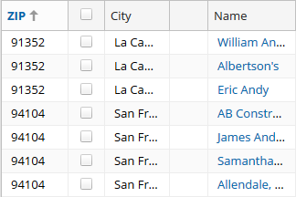
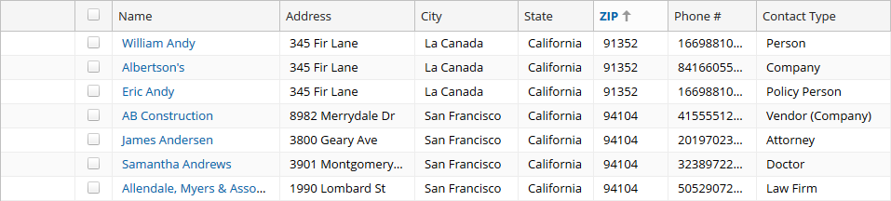
Clear layout preference
User configuration stored in browser Local Data store
Reset layout default with Settings → Clear Layout Preference
User configuration
Default configuration
|EOS~040|
Notes:
|EON~040|

Slide 41
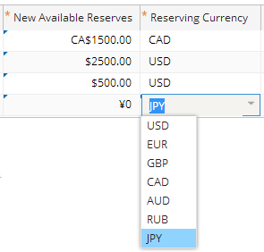
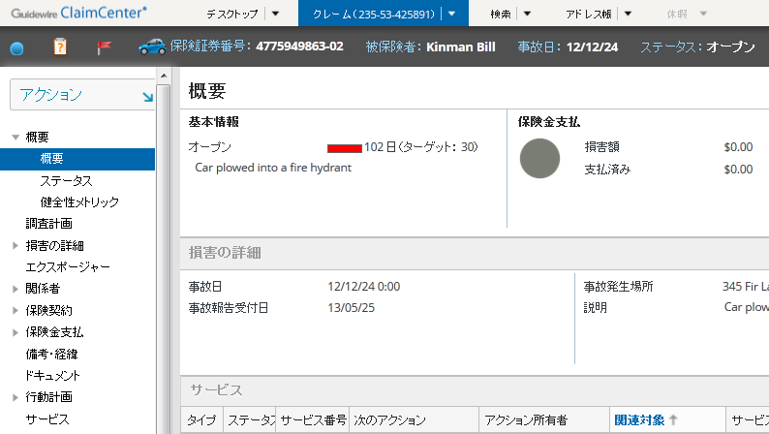
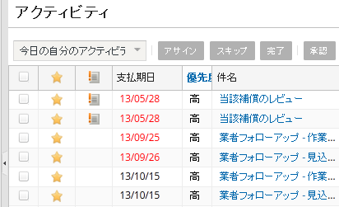
Localization: Language Packs
A locale can define how elements of the UI are presented, including:
Global Currencies
Date/time formats
Text labels
|EOS~041|
Notes:
|EON~041|
The two screenshots in Japanese are from our Japanese language pack for ClaimCenter. The English language screenshot is from the default EN_US (English – USA) application, but has the ability to switch between currencies.

Slide 42
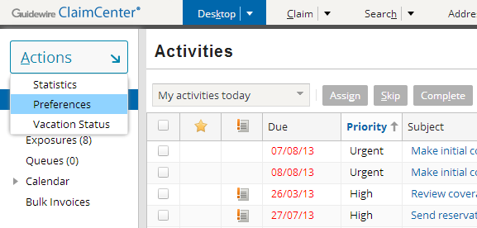
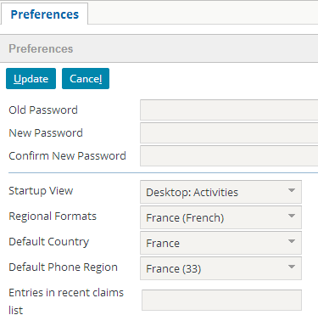


Setting Regional Format
Regional format can be set per user:
At logon (default)
By the user via preferences, or via the options menu
|EOS~042|
Notes:
|EON~042|
The eight regional formats shown in the screenshot above are included with the base application. For more information about Language packs and regional formats, consult the “Internationalization Features” lesson in the “ClaimCenter 7.0-8.0 New Configuration Features” course.

Slide 43
Lesson outline
ClaimCenter overview
Logging in
User interface
ClaimCenter implementations
|EOS~043|
Notes:
|EON~043|

Slide 44
Guidewire implementation team
Business architect
Writes business requirements documents
Configuration developer
Configure product data model, user interface, and business logic
Integration developer
Create integration points to external systems to share data with Guidewire application
Reporting developer
Develops data warehouses and reports
Data migration developer
Migrates data from legacy system to Guidewire application
|EOS~044|
Notes:
|EON~044|
A Guidewire implementation team consists of several people acting in several roles.
The following roles are relevant to every implementation:
Business architects are responsible for writing business requirements documents. They learn the functionality of the base application and then identify how the base application must be configured to meet the needs of a particular carrier.
Configuration developers configure the behavior of the application. This includes extending the application data model, modifying the application user interface, and writing business logic to enforce requirements.
Integration developers create integration points so that the Guidewire application can share data with external systems.
The following roles are relevant to an implementation only if the associated feature or functionality is to be implemented:
Reporting developers configure reporting functionality for the Guidewire application, such as creating data warehouses and creating reports to meet the business needs. This role is relevant only for carriers who are planning to implement one of the Guidewire Data Management reporting solutions.
Data migration developers migrate data from legacy systems to the Guidewire application. This could include either administration data (such as users and groups) and/or business data (such as policies that are still in force, unpaid invoices, and/or open claims.) This role is relevant only for carriers who are planning to do a data migration.

Slide 45

Configure ClaimCenter using Studio
Configure product behavior, user interface, integration points and business logic
|EOS~045|
Notes:
|EON~045|
Guidewire ClaimCenter Studio is a development environment for the technical members of the implementation team. It lets you configure product behavior, write integration points, and complete other technical tasks. Studio provides graphical editors for most of the configuration files.
There are two modes of environment – Development environment and Production environment.
Development environment is used to build and test application customization before deploying your changes to a production server.
The Production environment is after your changes are deployed to a running application server. It generates web pages for browser-based client access to ClaimCenter.
Guidewire applications define their business logic through the following Gosu constructs:
Gosu business rules define actions to take based on conditional logic (if this is true, then do the following). Users write each one as a Condition and an Action. Each condition block must evaluate to either true or false. Within an action block, users can use the full range of the Gosu language to perform further condition evaluations, to create, manage, and manipulate business objects and entities.
Gosu classes behave in a similar fashion to Java classes in that they become objects when instantiated, contain data constructions to store data, and contain methods to manipulate that data.
Gosu enhancements are a feature of the Gosu language that users can use to augment classes and other types with additional concrete methods and properties.

Slide 46


Example: Editing fields in the user interface
Use PCF Visual Editor to:
Add or remove widgets from UI
Rearrange widgets or modify label text
Create and modify detail views, list views, card views and listdetail views
|EOS~046|
Notes:
|EON~046|
To modify the user interface, developers interact with a visual editor to modify PCF files and the screen elements they contain. PCF (Page Configuration File) is a proprietary version of XML used to define how the user interface behaves. The Studio PCF editor provides a visual way of adding or modifying the XML-defined screen elements.

Slide 47

ClaimCenter documentation
C:\Guidewire\ClaimCenter\doc\index.html
Table of contents
Documentation set
Publication date in footer
|EOS~047|
Notes:
|EON~047|
ClaimCenter Overview - 47
There are two types of ClaimCenter documentation that you can access from the ClaimCenter Welcome page:
Books that are immediately available in both HTML and PDF format
Dynamic documents that need to be generated
When you mouse-over the name of a document, a tooltip that describes the resource is displayed. For dynamic documents, the tooltip also provides instructions for generating the document.
Two tabs are provided for searching and navigating the documentation:
The Contents tab displays the table of contents for all books.
The Search tab allows you to perform a simple word search within the HTML documents. You can select a specific book or choose “All Available Books” to include in your search.
The following buttons are available:
“Find in TOC” displays the table of contents with the current topic highlighted.
“Previous Page” and “Next Page” help you navigate sequentially through a document. Note the difference in behavior between “Previous Page” and the back button in your browser: “Previous Page” takes you to the page that immediately precedes the current page whereas the back button redisplays the most recent page you visited.
E-mail opens a new email that includes a link to the current topic.
Print allows you to print the current page.
“Link to This Page” provides a URL for you to copy or bookmark in your browser.

Slide 48

Location of documentation
Available from <ClaimCenter home>\doc directory
API references are also available but must be generated
Documentation set in PDF
Always open this file to access full documentation set
|EOS~048|
Notes:
|EON~048|
ClaimCenter is shipped with a full set of documentation in both HTML and PDF formats. The recommended way to access the full documentation set is to open the main index.html. You can then bookmark the URL in your browser.
In addition, there are multiple references that describe the current state of your implementation, but they must be generated. These references are discussed in the “ClaimCenter Application Configuration" and “ClaimCenter Application Integration" courses. The three references are:
Gosu API reference
Java API reference
SOAP API reference

Slide 49
Lesson objectives review
You should now be able to:
Describe the role of ClaimCenter in the Guidewire InsuranceSuite products
Describe the process of logging on to ClaimCenter
Describe the structure and functionality of the user interface
Describe the typical implementation team members and tools that they use
|EOS~049|
Notes:
|EON~049|

Slide 50
Review questions
Name three external systems that are typically integrated with ClaimCenter.
What does an end user need to access a Guidewire application?
When a user attempts to log into ClaimCenter, what three pieces of information does the application attempt to determine?
Name two ways a user could identify if they have any unsaved work.
What is Guidewire Studio?
|EOS~050|
Notes:
|EON~050|
1. Possible answers: Policy administration system, Address book, vendor portal, authentication system, check printing system, reporting system.
2. A supported web browser and a valid user name and password.
3. Whether or not the user can be authenticated, what are the user's roles (permissions), and what is the user's startup page.
4. The unsaved work list is available. (It is available only when there is unsaved work.) If a user attempts to log off ClaimCenter and there is unsaved work, a dialog box alerts them to this fact.
5. Guidewire Studio is a development environment for the technical members of the implementation team. It lets the configure product behavior, write integration points, and complete other technical tasks.

Slide 51
Notices
Copyright © 2001-2014 Guidewire Software, Inc. All rights reserved.
Guidewire, Guidewire Software, Guidewire ClaimCenter, Guidewire PolicyCenter, Guidewire BillingCenter, Guidewire Reinsurance Management, Guidewire ContactManager, Guidewire Vendor Data Management, Guidewire Client Data Management, Guidewire Rating Management, Guidewire InsuranceSuite, Guidewire ContactCenter, Guidewire Studio, Guidewire Product Designer, Guidewire Live, Guidewire DataHub, Guidewire InfoCenter, Guidewire Standard Reporting, Guidewire ExampleCenter, Guidewire Account Manager Portal, Guidewire Claim Portal, Guidewire Policyholder Portal, ClaimCenter, BillingCenter, PolicyCenter, InsuranceSuite, Gosu, Deliver Insurance Your Way, and the Guidewire logo are trademarks, service marks, or registered trademarks of Guidewire Software, Inc. in the United States and/or other countries.
All other trademarks are the property of their respective owners.
This material is confidential and proprietary to Guidewire and subject to the confidentiality terms in the applicable license agreement and/or separate nondisclosure agreement.
This file and the contents herein are the property of Guidewire Software, Inc. Use of this course material is restricted to students officially registered in this specific Guidewire-instructed course, or for other use expressly authorized by Guidewire. Replication or distribution of this course material in electronic, paper, or other format is prohibited without express permission from Guidewire.
Guidewire products are protected by one or more United States patents.
|EOS~051|
Notes:
|EON~051|

