Slide 1
The Claims Process
5 January 2015
|EOS~001|
Notes:
|EON~001|
Guidewire training materials contain Guidewire proprietary information that is subject to confidentiality and non-disclosure agreements. You agree to use the information in this manual solely for the purpose of training to implement Guidewire software solutions. You also agree not to disclose the information in this manual to third parties or copy this manual without prior written consent from Guidewire. Guidewire training may be given only by Guidewire employees or certified Guidewire partners under the appropriate agreement with Guidewire.

Slide 2
Lesson objectives
By the end of this lesson, you should be able to:
Describe the stages of claims processing from a business perspective
Describe the stages of claims processing from a functional perspective
This lesson uses the notes section for additional explanation and information. To view the notes in PowerPoint, choose View→Normal or View→Notes Page. If you choose to print the notes for the lesson, be sure to select “Print hidden slides.”
|EOS~002|
Notes:
|EON~002|

Slide 3
Lesson outline
The business perspective
The functional perspective
|EOS~003|
Notes:
|EON~003|

Slide 4
The claims process: two perspectives
Two ways to describe the claims process:
“Business perspective”
Focusing on how the carrier as a whole views claim processing
“Functional perspective”
Focusing on how claims are processed within ClaimCenter
|EOS~004|
Notes:
|EON~004|

Slide 5

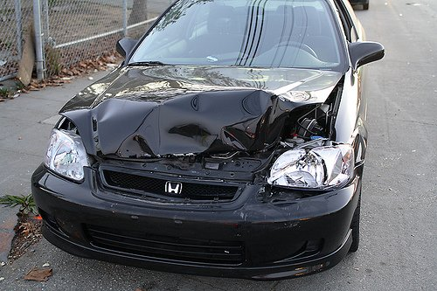
Phase 1: Intake
Intake
|EOS~005|
Notes:
|EON~005|
During intake, the carrier is informed of a potentially covered loss. For auto and property claims, this is often referred to as First Notice of Loss (FNOL). For workers' comp claims, this is also known as First Report of Injury (FROI).
The intake event is significant because:
It is the point in time at which the claim is created and assigned to an adjuster.
It is the point in time which determines when other events must occur. (For example, the business process may require that all coverages in question be verified within 30 days of the FNOL.)
It is the first major opportunity to control costs with regards to reducing leakage. (For example, if the intake process is sufficiently robust, then an auto claim which is a total loss can be assessed rapidly, and costs associated to storing the car can be reduced or eliminated.)
It is the first major opportunity to reduce the time needed to process a claim. (For example, common intake steps can be automated, such as creating activities or service requests for work that always need to be done for a given type of claim rather than waiting for a user to manually create them.)
It is the first major opportunity to control costs with regards to business efficiency. (For example, if the intake process is sufficiently robust, then general information can be collected by first-tier CSRs, which frees the more expert-level adjusters to spend their time focusing exclusively on the aspects of claim processing that require their expertise.)
It can set the tone for the entire claim process. If the insured feels that the carrier is concerned, it can expedite processing and minimize the chance of later legal action.
Information about incidents such as bodily injuries, damages to property and/or vehicles can be recorded in detail, therefore speeding up the information-gathering process.

Slide 6
Phase 2: Adjudication
Intake
?
Discovery/ Investigation
Adjudication
Loss Assessment
|EOS~006|
Notes:
|EON~006|
Adjudication is the process of determining if you are going to pay a claim, and if so, how much you are going to pay.
Within the insurance industry, adjudication is often further sub-divided into two phases: discovery/investigation and loss assessment.
During discovery (which is also often referred to as investigation), the carrier gathers whatever information is needed to process the claim. In some cases, all of the data may have been acquired during intake. In other cases, the carrier may need to do additional work, such as:
Verify whether the loss is covered
Obtain statements from witnesses
Obtain information from third-party systems, such as metropolitan police reports
Obtain estimates from the claimant or approved vendors
During loss assessment, the carrier determines how much the claim is going to cost. This involves both payments made to claimants as well as expenses incurred in processing the claim. This could also involve recovery, which involves situations where money can be acquired from other parties to help recoup the carrier's expenditures.
In general, assessments and estimates done by parties not working directly for the carrier fall into the realm of discovery/investigation. Assessments and estimates done by parties working directly for the carrier fall into the realm of loss assessment.
The discovery/investigation phase and loss assessment phase are not discrete. It is not unusual for a claim to bounce back and forth between these two phases as information is gathered and loss is assessed. Therefore, from the standpoint of the course, it is easier to address the two of them together at the adjudication level.

Slide 7
Phase 3: Payment
Intake
Adjudication
Payment
|EOS~007|
Notes:
|EON~007|
Once the loss has been assessed and the payment has been approved, the carrier can provide the payments to the claimants. The payment phase involves creating, approving, and issuing the checks.
One major concern of all insurance carriers is "leakage". Leakage is defined as "claims payments beyond those necessary to satisfy a typical claimant". Leakage could occur in many ways, including but not limited to:
Paying for a loss that occurred at a time when the policy was not in effect, or for a loss which was not covered on the policy.
Paying an amount in excess of the responsibility of the carrier (such as paying $1100 for a coverage with a $1000 limit).
Paying an amount in excess of what the claimant needs to be indemnified (such as paying $600 for a repair that most reputable mechanics would estimate at $400).
In order to identify and control leakage, a carrier must closely track what payments are being made for. Consequently, the payment phase involves a somewhat rigorous categorization of claim costs (money paid to indemnify claimants) and expenses (expenses incurred as a result of processing the claim, such as an inspection fee and mileage reimbursement for a property inspector who inspects damage done to a factory).
The term “indemnify” (or “indemnification”) in a high-level, LOB-agnostic sense means to make whole or reimburse a claimant for their loss. For WC, the term has a specific meaning, because “indemnity” payments are specific payments of lost wages due to a work injury. Therefore, the term “claim cost” will often be used for WC claims to mean both lost wage payments as well as medical payments, but for auto or property claims, you can think of “claim cost” payments as being synonymous with “indemnity” or “indemnification” payments (payments for auto repair, auto parts, property damage, or medical bills).

Slide 8
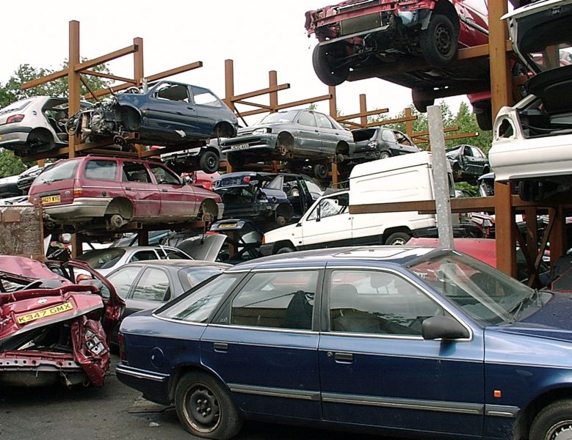
Phase 4: Recovery
Intake
Adjudication
Payment
Recovery
|EOS~008|
Notes:
|EON~008|
In some cases, the carrier may also attempt to recover funds paid to the claimant by obtaining money from a third party's carrier if the third party was at fault (which is known as "subrogation") or by taking possession of a significantly damaged property and selling all or parts of it to a third party (which is known as "salvage").
Technically speaking, recovery does not need to start after payment. Recovery can begin as early as first notice of loss if enough information is known at this time. (For example, early in the claims process, the carrier could determine that the car is a total loss and immediately take possession of it and sell it to a salvage yard.)
The image shown above is meant to represent a salvage opportunity. The damaged car is considered a total loss, so the carrier (Acme) takes possession of the car from the insured. Acme then sells the car to a salvage yard for parts (the exchange of the damaged car for some amount of money).

Slide 9
Litigation
Litigation
Intake
Adjudication
Payment
matter
Recovery
|EOS~009|
Notes:
|EON~009|
Litigation is an umbrella term for several activities which involve the resolution of disputes. It includes
Evaluation (an assessment of the liabilities and damages involved in the plan of action to settle, that is the expected costs)
Negotiation (the back-and-forth discussion of how much loss occurred and how much indemnification is required)
Mediation and arbitration (which involves the resolution of a dispute with the assistance of a third party without actually filing a lawsuit)
Actual litigation (law suits)
Litigation can occur during any or all of the other phases. For example, there may already be pending litigation at the time that the loss is reported to the carrier. A claim of this nature can be flagged as a "first notice suit" claim. However, when litigation is an issue, it is typically relevant only to certain phases of claims processing. (For example, the litigation may involve tasks in the adjudication phase, but have no relevant activity during the payment phase.)
Litigation and matters are discussed in the “Workers’ Comp: Specialized Claim Processes” lesson.

Slide 10
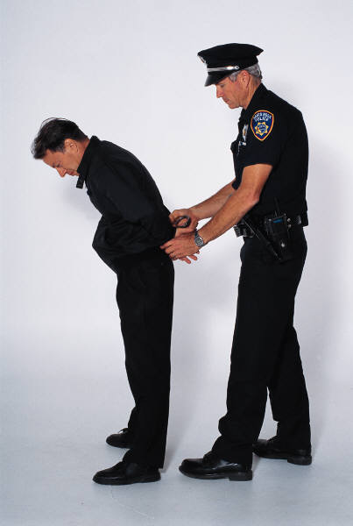
Fraud detection and special investigations
Litigation
Fraud Detection
Intake
Special Investigations
Adjudication
Payment
Recovery
|EOS~010|
Notes:
|EON~010|
Fraud detection refers to the activities around detecting claim activity that is indicative of fraud and could warrant further investigation. This is typically a process which is ongoing throughout every phase of the claims process.
If a claim is considered to be suspicious, then it is referred to the special investigations unit. They will investigate the activity and determine the validity of the claim. Their investigation runs parallel to the normal claim processing.

Slide 11
Fundamental and specialized processes
Litigation
Fraud Detection
Intake
Special Investigations
Adjudication
Payment
Recovery
|EOS~011|
Notes:
|EON~011|
It can be helpful to think of the different phases in two categories: fundamental (those that happen with most if not all claims) (in green) and specialized (those that happen with only some claims) (in blue).
Intake, adjudication, and payment can be thought of as fundamental. For a claim which has one payment and goes through the normal claims process, all three of these phases will occur. Similarly, fraud detection is an ongoing process throughout the entire claims process for all claims.
Recovery is a specialized process which is relevant only for claims where there is a recovery opportunity. Claims without property that is considered a total loss and/or without third parties who are at fault (or do not have insurance) may have no recovery opportunities.
Litigation is a specialized process which is relevant only for claims where there is a dispute between parties which needs to be resolved.
Special investigations is a specialized process which is relevant only for claims which are considered potentially fraudulent.

Slide 12
Lesson outline
The business perspective
The functional perspective
|EOS~012|
Notes:
|EON~012|

Slide 13
The claims process: two perspectives
Two ways to describe the claims process:
“Business perspective”
Focusing on how the carrier as a whole views claim processing
“Functional perspective”
Focusing on how claims are processed within ClaimCenter
|EOS~013|
Notes:
|EON~013|

Slide 14
Managing claim and exposure maturity
(draft)
New Loss Completion
"Intermediate Levels of Maturity"
Ability to Pay
ClaimCenter uses "validation levels" to measure how mature a claim and its exposures are
Every level has a series of conditions that a claim or exposure must meet in order to reach that level
|EOS~014|
Notes:
|EON~014|
There are two validation levels common to nearly every carrier ("new loss completion" and "ability to pay”). The intermediate levels vary from carrier to carrier.
In the base application, there are five levels of maturity:
Load save - This is the level a claim must be at in order to be imported from an external system or temporarily saved in a claim portal system. A claim at this stage has not yet been touched by a user via ClaimCenter. (This level is relevant only for imported FNOLs or claims in a portal.)
New loss completion - This is the level a claim must be at to be saved (or modified by a user if the claim is imported).
Valid for ISO - This level is used to signify that the claim has the minimal information needed for filing with ISO.
Send to external (systems) - This level is used to signify that the claim has the minimal information needed to send information about it to external systems within the carrier, such as a policy administration system which is trying to assess policy renewal rates.
Ability to pay - This is the level a claim must be at in order to have payments written against it.
The Valid for ISO and Send to external (systems) levels are configurable. The other three levels are internal levels required by ClaimCenter and cannot be modified. You can also add additional levels not found in the base application.

Slide 15
New loss completion
(draft)
New Loss Completion
"Intermediate Levels of Maturity"
Ability to Pay
To be saved as a new claim or exposure, the object must meet all conditions at "new loss completion"
If a draft claim or exposure does not meet all conditions at this level, the save fails and the user is told which condition(s) the object does not yet meet
|EOS~015|
Notes:
|EON~015|
The icons used in the next few slides do technically represent an auto claim and auto exposure, however, they are also used in a generic sense to represent a claim and exposure on any LOB (Line of Business).

Slide 16
The maturing claim/exposure
(draft)
New Loss Completion
"Intermediate Levels of Maturity"
Ability to Pay
As claims processing continues, object satisfies more conditions
Whenever possible, ClaimCenter automatically promotes it to the highest level it satisfies
ClaimCenter prevents changes that would force an object to slip backwards
|EOS~016|
Notes:
|EON~016|
A claim or exposure becomes more mature because it meets requirements defined by the carrier's business practice. For example, an auto policy carrier may not require metropolitan police reports when a claim is initially created. But, it may require them before the claim can be paid against. Whenever an object is modified, ClaimCenter automatically checks to see if the modifications allow it to be promoted to a higher validation level.

Slide 17
Ability to pay
(draft)
New Loss Completion
"Intermediate Levels of Maturity"
Ability to Pay
Eventually, objects reach "ability to pay"
Checks cannot be issued if claim is not at this level
Exposure reserve lines cannot be used if exposure is not at this level
|EOS~017|
Notes:
|EON~017|
Claim and exposure maturity and validation levels are discussed throughout the course. The most complete discussion is in the "Adjudicating Claims" lesson (both Workers’ Comp and Personal Auto versions). However, some discussion of the issue also appears in the following lessons (both Workers’ Comp and Personal Auto versions):
"The New Claim Wizard"
"Exposures"
"Payments"

Slide 18
Stage 1: User creates claim
policy
insured
3rd-party claimant
injury incident
injury incident
vehicle incident
|EOS~018|
Notes:
|EON~018|
The claim is created during the intake process by a CSR or adjuster through the new claim wizard, or thru a policyholder portal. The user who creates the claim must specify the relevant policy and the claimants. They also typically detail as much information about the incidents as possible, as well as any other loss detail information available at that time. For policyholders submitting a claim in a portal, a certain minimum set of information is required in order to save the claim for later, and a greater amount of information is required to submit the claim. The next lesson (Intro to Claim Intake) covers this process.
In the example above, the claim is an auto claim in which the insured hit a third party. The insured is at fault, has incurred vehicle damage, and has suffered an injury. The third party's car was not damaged, but the third party suffered a minor concussion.

Slide 19
Stage 2: Rules "set up" the claim
segment: normal
Dana Evans
workplan
|EOS~019|
Notes:
|EON~019|
Once the claim is created, ClaimCenter business rules segment the claim, which is the act of classifying the claim (for example as a "fast track", "normal" or "complex" claim) so that the right strategies can be used to process the claim. The business rules also assign an owner to the claim and create a series of activities known as the workplan which identify work that must be done to process the claim. All of this is referred to as "claim set-up".
In the example above, the claim is considered to be normal (it is more complex than just a broken windshield, but not so complex that it involved a death). It is assigned to Dana Evans and activities are created for the workplan.

Slide 20
Stage 3: Rules/adjuster creates exposures
Dana Evans
claimants
collision
insured
med pay
liability
3rd-party claimant
|EOS~020|
Notes:
|EON~020|
Once the decision to pay on the claim has been made, exposures are created. Each exposure tracks a potential payment from a single coverage to a single claimant.
Exposures can be created automatically by business rules. (This is often done for workers' comp claims, and when it is done, it usually occurs along with claim setup.) Exposures can also be created manually by adjusters.
In the example above, three exposures are required: one to indemnify the insured for damage done to his car, one to indemnify the insured for the medical bills related to his injury, and one to indemnify the third party for her concussion.
(continued)

Slide 21
(Notes only slide)
|EOS~021|
Notes:
|EON~021|
A brief glossary for common auto and workers’ comp policy coverages:
AUTO
Coverages for vehicles
Collision - This covers damage to the insured's car that is the result of a collision with another object.
Liability - vehicle damage - This covers damage to a third party's car that is the result of a collision with another object where the insured is at fault.
Comprehensive - This covers damage to the insured's car that results from anything other than a collision with another object (such as theft, vandalism, or weather).
Coverages for injuries
Bodily injury - This is a liability coverage that covers injuries to a third party and any legal defense when an injured third party sues the insured.
Medical payments - This covers injuries to the insured and any passengers regardless of who is at fault. Some people opt out of this coverage because they have existing health coverage which meets their needs. This is available in most states in the United States.
Personal injury protection (PIP) - This coverage is largely identical to medical payments. It often covers injuries to the insured and any passengers regardless of who is at fault. However, it is available in only 16 states in the United States. Many of the states with PIP coverage do not have medical payment coverage. In these cases, PIP coverage "replaces" medical payment coverage. A small number of states offer both medical payments and PIP. These states have laws that identify which coverage comes into effect first and how much coverage it provides before it is exhausted and the other coverage comes into play. However, these laws vary from state to state, so there is no universal answer as to how PIP and medical payments work when they are on the same auto policy.
WORKERS’ COMPENSATION
Medical
Medical covers essentially all medical expenses (with certain limits)
Disability
Covers lost time (also known as “income replacement” or “indemnity”). Coverage varies by state/jurisdiction, but for many states the coverage is 67% of a worker’s wages (up to a maximum of anywhere from $800 to $1200/week). Disability is generally categorized under two broad categories - 1. TD (Temporary Disability) and 2. PD (Permanent Disability), the difference being TD handles partial wages for a worker that suffers a temporary disability they can recover from (such as a broken leg), while PD handles partial wages for a worker that suffers a permanent disability they cannot recover from (such as the loss of a leg). A discussion of additional disability coverages and indemnity payments is discussed in the “Workers’ Comp: Time Loss” lesson.
Death
The deceased injured worker’s spouse/dependents are paid a fixed amount (depending on # of dependents. There is also a burial allowance (probably a lump sum).
All WC coverages vary from state to state or jurisdiction, so the above is a generalization only and does not represent each state’s complete coverages or laws.

Slide 22
Stage 4: Rules/adjuster creates reserves
Dana Evans
claimants
collision
insured
med pay
liability
3rd-party claimant
|EOS~022|
Notes:
|EON~022|
A reserve line is an amount of money set aside for expected payments related to a given exposure.
In the example above, each exposure has a single reserve line associated with it. However, an exposure can have multiple reserve lines, which occurs if there will be two or more payments from the exposure and the carrier wants to track the money separately. For example, a collision coverage exposure could require an indemnification payment to the insured (to fix the damage done to the car) as well as an expense payment to the auto inspector vendor (for the auto inspection).
Reserve lines can be created automatically by business rules. (This is often done for all exposures, and when it is done, it usually occurs when the exposure is set up.) Reserve lines can also be created manually by adjusters.

Slide 23
Stage 5: Users complete activities
Dana Evans
claimants
collision
insured
med pay
liability
3rd-party claimant
|EOS~023|
Notes:
|EON~023|
Most or all of the work to be done on the claim is detailed in the workplan activities. Once reserves have been created, those activities are completed.

Slide 24
Stage 6: Claim & exposures become payable
payable!
Dana Evans
claimants
collision
insured
payable!
med pay
payable!
liability
payable!
3rd-party claimant
|EOS~024|
Notes:
|EON~024|
The claim and each of its exposure have a maturity level, often referred to as a validation level. Typically, the final level is "ability to pay". When a claim is at ability to pay, checks can be written for it. When an exposure is at ability to pay, the money in its reserve line(s) can be used for checks. Gaining the ability to write checks against a claim and use the reserve lines of its exposures is a prerequisite to making payments.
In some cases, the claim and its exposures may become payable as a natural result of the completion of all of the activities. However, the two are not required to be functionally connected. Furthermore, activities typically focus on tasks that must be done by a given time and/or must be done by people other than the adjuster. Therefore, it is not unusual for a claim to have all activities complete and yet the claim itself or one or more of its exposures is not payable. (It is also possible that a claim and all of its exposures are payable, but there are still open activities.)

Slide 25
Stage 7: Checks are issued
payable!
Dana Evans
claimants
collision
insured
payable!
med pay
pay to: insured
payable!
liability
payable!
pay to: 3rd-party claimant
3rd-party claimant
|EOS~025|
Notes:
|EON~025|
Once the claim and its exposures are payable, payments can be created.
Money is transferred from the carrier to the payees through checks. Each check gets its money from one or more reserve lines.
In the example above, there are two checks. The first check is payable to the insured. It is for his collision loss and medical payments. Consequently, the check gets its money from two reserve lines from two different exposures. The second check is payable to the third party. The money comes from the third exposure's reserve line.

Slide 26
Stage 8: Exposures and claim are closed
payable!
CLOSED
Dana Evans
claimants
collision
insured
CLOSED
payable!
med pay
CLOSED
pay to: insured
payable!
liability
CLOSED
payable!
pay to: 3rd-party claimant
3rd-party claimant
|EOS~026|
Notes:
|EON~026|
When the financial obligation associated to an exposure has been satisfied, the exposure can be closed. If an exposure results in one payment, then the exposure is typically closed when that one payment is made. If an exposure results in multiple payments (which could occur if there is a recurring payment, possibly for ongoing medical treatment), then the exposure is typically closed when the final payment is made.
When all of the activities are complete, all the payments have been made, and all the exposures are closed, the claim can be closed. In some cases, a claim may be closed as soon as the payment is made (and the last indemnification exposure is closed). In other cases, the claim may remain open beyond the last payment (possibly because the claim involves recovery which is taking place after the last payment, or possibly because there is lingering activity work to complete, such as verification that legal documents have been filed with the appropriate government agency).
The diagrams in the preceding set of slides have not made reference to documents, notes, and matters. Documents and notes are typically used for every claim, but they typically record things that have occurred. They do not represent work that needs to be done, and in most cases their existence does not move the claim forward in the claim process. Consequently, they have been omitted from the discussion. Matters are relevant to moving a claim forward in the claims process, but only for claims involving potential litigation. Since these types of claims are not the most fundamental type of claims, matters have also been omitted from the discussion.

Slide 27
No one-to-one correspondence of steps
Business Process
Functional Process
Create and setup claim
Intake
Create exposures
Create reserves
Adjudication
Complete activities
Make claim and exposures payable
Payment
Make payments/ Issue checks
Close exposures and claim
|EOS~027|
Notes:
|EON~027|
The business process steps and functional process steps (stages) do not have a one-to-one correspondence. In particular:
During intake, the claim is created. Exposures and reserves could also be created at this time, depending on the LOB. For WC claims, exposures are most often created automatically when the claim is first created. For auto claims, exposures could be created during intake phase manually and explicitly by the adjuster or CSR, but usually are not created at this time.
During adjudication, ClaimCenter exposures could be created, reserves could be created, activities could be completed, and the claim and its exposures could become payable.
At payment, payments are made. But, reserves could be created at this time, activities could be completed, and the claim and its exposures could become payable. Payment may also cause exposures and the claim to be closed.

Slide 28
Lesson objectives review
You should now be able to:
Describe the stages of claims processing from a business perspective
Describe the stages of claims processing from a functional perspective
|EOS~028|
Notes:
|EON~028|

Slide 29
Review questions
State if the following are true or false.
Every claim goes through the intake phase.
Every claim goes through the payment phase.
Every claim goes through the recovery phase.
Special investigations is a process that runs parallel to the regular claims process and is ongoing at all times for all claims.
The carrier typically decides if they are going to pay on a claim (and how much) during the adjudication phase.
When is a claim or exposure at the "new loss completion" level?
What level do you want to get the claim and each exposure to and why?
|EOS~029|
Notes:
|EON~029|
Answers
1. a) True. (If it doesn't go through intake, it is not a claim.)
b) False. (Many claims result in payments, but some claims do not.)
c) False. (Recovery is appropriate only if there is a salvageable item or if there is a third party at fault.)
d) False. (The statement is a true statement about fraud detection. Special investigations occurs only if some suspicious and possibly fraudulent activity is detected.)
e) True.
2. A claim or exposure is at the "new loss completion" level when it is initially created.
3. You want the claim and its exposures to get to the "ability to pay" level because you can write checks only against claims at ability to pay from exposures at ability to pay.

Slide 30
Notices
Copyright © 2001-2014 Guidewire Software, Inc. All rights reserved.
Guidewire, Guidewire Software, Guidewire ClaimCenter, Guidewire PolicyCenter, Guidewire BillingCenter, Guidewire Reinsurance Management, Guidewire ContactManager, Guidewire Vendor Data Management, Guidewire Client Data Management, Guidewire Rating Management, Guidewire InsuranceSuite, Guidewire ContactCenter, Guidewire Studio, Guidewire Product Designer, Guidewire Live, Guidewire DataHub, Guidewire InfoCenter, Guidewire Standard Reporting, Guidewire ExampleCenter, Guidewire Account Manager Portal, Guidewire Claim Portal, Guidewire Policyholder Portal, ClaimCenter, BillingCenter, PolicyCenter, InsuranceSuite, Gosu, Deliver Insurance Your Way, and the Guidewire logo are trademarks, service marks, or registered trademarks of Guidewire Software, Inc. in the United States and/or other countries.
All other trademarks are the property of their respective owners.
This material is confidential and proprietary to Guidewire and subject to the confidentiality terms in the applicable license agreement and/or separate nondisclosure agreement.
This file and the contents herein are the property of Guidewire Software, Inc. Use of this course material is restricted to students officially registered in this specific Guidewire-instructed course, or for other use expressly authorized by Guidewire. Replication or distribution of this course material in electronic, paper, or other format is prohibited without express permission from Guidewire.
Guidewire products are protected by one or more United States patents.
|EOS~030|
Notes:
|EON~030|

