Slide 1
Introduction to Claim Intake
6 January 2015
|EOS~001|
Notes:
|EON~001|
Guidewire training materials contain Guidewire proprietary information that is subject to confidentiality and non-disclosure agreements. You agree to use the information in this manual solely for the purpose of training to implement Guidewire software solutions. You also agree not to disclose the information in this manual to third parties or copy this manual without prior written consent from Guidewire. Guidewire training may be given only by Guidewire employees or certified Guidewire partners under the appropriate agreement with Guidewire.

Slide 2
Lesson objectives
By the end of this lesson, you should be able to:
Define the steps of the claim intake process
Identify the steps of automated claim setup
Describe how validation is performed for new claims
This lesson uses the notes section for additional explanation and information. To view the notes in PowerPoint, choose View→Normal or View→Notes Page. If you choose to print the notes for the lesson, be sure to select “Print hidden slides.”
|EOS~002|
Notes:
|EON~002|

Slide 3
Lesson outline
The claim intake process
Automated claim setup
New claim validation
|EOS~003|
Notes:
|EON~003|

Slide 4
First Notice of Loss (FNOL)
First Notice of Loss is the event in which the carrier is informed of a potentially covered loss
For workers' comp claims this is known as First Report of Injury (FROI)
For personal lines a policyholder portal option may be used for online submission instead of the traditional method of reporting a claim over the phone
|EOS~004|
Notes:
|EON~004|
The FNOL event is significant because:
It is the point in time at which the claim is created and assigned to an adjuster.
It is the point in time which determines when other events must occur. (For example, the business process may require that all coverages in question be verified within 30 days of the FNOL.)
It is the first major opportunity to control costs with regards to reducing leakage. (For example, if the FNOL process is sufficiently robust, then an auto claim which is a total loss can be assessed rapidly, and costs associated to storing the car can be reduced or eliminated.)
It is the first major opportunity to control costs with regards to business efficiency. (For example, if the FNOL process is sufficiently robust, then general information can be collected by first-tier CSRs, which frees the more expert-level adjusters to spend their time focusing exclusively on the aspects of claim processing that require their expertise.)
It can set the tone for the entire claim process. If the insured feels that the carrier is concerned about the loss, it can expedite processing of the claim and minimize the chance of later legal action.
(continued)

Slide 5
(Notes only slide)
|EOS~005|
Notes:
|EON~005|
Across the industry, the term "FNOL" has more than one use. It can be used to mean:
The event during which the carrier is first notified of a loss
The form used to capture information about the loss
The set of information imported into a claims processing system from which a claim is initially generated
This course uses the term "FNOL" to refer to the event for most lines of business (other than Workers’ Compensation).
For simplicity, this course uses the term FNOL to refer to the first notice of loss for all types of claims, except Workers’ Compensation (where the acronym FROI (First Report of Injury) is used).

Slide 6

The claim intake process
Claim is entered in Portal
Claim is entered in New Claim Wizard
Automated Claim Setup
Create and assign activities
Segment claim
Assign claim
Validate claim
import
Claim is entered in external FNOL application
|EOS~006|
Notes:
|EON~006|
The claim intake process is represented above with seven broad steps. Keep in mind that this is a high-level summary. Some steps may occur in a manner different than what the diagram suggests. There may be additional steps depending on the specific line of business, whether the claim is entered by a customer service representative or an adjuster, and/or whether special issues such as fraud or recovery are relevant.
There are three ways that a claim can come into existence in ClaimCenter: 1. A claim can be created manually when a "reporter" contacts the carrier (usually by phone) and reports the loss. This could be across a number of channels, including in-person, telephone, or fax. A ClaimCenter user takes the information and creates a claim from it using the new claim wizard.
2. A personal auto or homeowners claim can be created using a customer portal such as Guidewire Claim Portal for Policyholders. The difference is the claim is submitted into ClaimCenter by the policyholder directly from a mobile app or web portal, and no user intervention is needed in ClaimCenter to initially create the claim.
3. Alternately, the claim could be created in an external FNOL application and then imported into ClaimCenter. This is different than the portal because import is a “two step” process – first the claim is saved in a FNOL application, then the claim is imported in to ClaimCenter.
Once the claim has been created or imported, it enters the automated claim setup process. There are three primary things that occur during claim setup. First, the claim is segmented. Segmentation is the process of determining the strategy for how the claim should be processed. (For example, is the claim straight-forward or is it complex and will it require adjusters with special expertise.) Then, the claim is assigned. Assignment is the act if determining who is responsible for the claim. The user creating the claim can specify who it should be assigned to, or the assignment could be determined using automated rules. Finally, a series of activities known as the "workplan" are created and assigned. These activities identify the work that must be done to process the claim and who must do it.
(continued)

Slide 7
(Notes only slide)
|EOS~007|
Notes:
|EON~007|
After claim setup has been completed, validation rules are executed to verify that the claim meets the minimum set of requirements to exist in the system as a claim other users can view and modify. If any of the validation rules fail, then:
If the claim was created in the new claim wizard or portal, the user must either cancel the claim or fix the errors and re-save the claim.
If the claim was imported, then the import of that claim fails. An error might be returned to the FNOL application and/or logged so that a system administrator could investigate the issue as needed.
When validation occurs successfully, the claim intake process is done.

Slide 8
Who manages the intake process at carriers?
For larger carriers, intake is typically managed by a customer service representative (CSR)
For smaller carriers, intake is more typically managed by an adjuster
|EOS~008|
Notes:
|EON~008|
The two scenarios described assume the carrier will control the intake process. The portal intake process for personal lines is described on the next slide to account for policyholder submission of personal auto or homeowners claims.
When the intake process is managed by a CSR, the following are typically true:
Exposures are either created automatically during the claim setup process, or manually by adjusters after the intake process. They are not created by the CSR while the claim is initially being created.
When the intake process is managed by an adjuster, the following are typically true:
Exposures may be created manually by the adjuster during initial claim creation. This could cause initial reserves to be set during claim setup. It also may mean that the assignment strategy for the claim has the claim assigned to one user and the exposures to other users.

Slide 9


Portal Intake Process
If a claim is submitted using a portal application, the submission is handled initially by the policyholder
Portal submission process may occur in stages:
Policyholder saves claim for later or leaves claim in an incomplete state. The draft claim is saved in ClaimCenter.
The saved claim is able to be retrieved using the New Claim Wizard if the policyholder calls in and completes the claim over the phone
Policyholder may include a “note” to the adjuster during claim submission. This “note” appears as an activity on the claim in ClaimCenter.
|EOS~009|
Notes:
|EON~009|
In addition to the traditional method of a CSR or adjuster handling the claim submission process from a phone conversation with the policyholder, a carrier may deploy a portal application to allow policyholders to submit claims on their own from their mobile devices, phones or personal computers.
When the intake process is via a policyholder submitting a claim on a portal application:
Exposures are either created automatically during the claim setup process, or manually by adjusters after the intake process. They are not created by the policyholder in the portal application while the claim is initially being created. In fact, many integrations with portal systems do not save any data in the portal app but in the claim system itself.
The process around handling of an incomplete “draft” claim that a policyholder starts on the portal but abandons ensures that if the policyholder calls in or the carrier wishes to retrieve this “draft” claim, the information can be retrieved. More on this is described later in this lesson.

Slide 10
Required data: the policy
Determines claim type (such as auto for an auto policy)
Provides information about insured and what is covered
Used to verify that loss is covered and whether any deductibles or limits restrict extent of coverage
|EOS~010|
Notes:
|EON~010|
Each claim in ClaimCenter (no matter if submitted in the NCW, online via a portal, or imported) must eventually have four required pieces of data: 1) policy 2) parties involved (reporter and/or claimant) 3) loss event information (the “when, where and cause”) 4) incident (what was lost/damaged/injured?) In the base application, the claim may be linked to an "unverified policy". This is a policy which is not imported from an external policy administration system, but rather is created at the moment by the user entering the claim. In practice, most implementations of ClaimCenter require the user to retrieve a "verified" policy from an external system.

Slide 11
Required data: parties involved
During intake, certain parties must be specified, such as:
The insured
The reporter (who may or may not be the insured and may or may not be a claimant)
|EOS~011|
Notes:
|EON~011|
Recall the following definitions:
The insured is the person covered by the policy.
A claimant is a person requesting compensation for a loss.
A reporter is a person who identifies that a loss has occurred.

Slide 12
Required data: loss event
Typically some minimal amount of information about how the loss occurred, such as:
Date and time of loss
Location of loss
Cause of loss (such as theft, vandalism, collision with another car)
|EOS~012|
Notes:
|EON~012|
The loss details are the most line-of-business-dependent set of information. For example, an auto claim potentially requires information about the vehicles involved, the road conditions, the visibility, and any associated police reports. A workers' comp claim potentially requires information about the date the injury was reported to the employer, the nature of the injury, the diagnosis of the physician, and the work location where the injury occurred.

Slide 13
Required data: incident(s)
Recall that an incident entity is a collection of information about damage. It typically represents an item that was lost or damaged.
Typically, incidents are identified during intake, such as:
A damaged or stolen auto
A damaged building
An injured person
|EOS~013|
Notes:
|EON~013|
For property coverages, the incidents are typically listed on the claim. Information about these items can be copied over from the policy, though the user may still have to specify which items are relevant to the claim. For liability coverages, the incidents must typically be entered entirely by the user.
Other examples of incidents are baggage, a trip, and living expenses. In these cases, it isn't as clear that the incident actually represents the damaged item, but it is still a collection of information about damage.

Slide 14
The intake process: manually entered claims
Claim is entered in Portal
Claim is entered in New Claim Wizard
Automated Claim Setup
Create and assign activities
Segment claim
Assign claim
Validate claim
import
Claim is entered in external FNOL application
|EOS~014|
Notes:
|EON~014|

Slide 15
The new claim wizard (NCW)
new auto claim
1
2
new WC claim
3
new property claim
A series of screens that guide users through manual creation of new claims
Incorporates multiple lines of business
Screens and flow are completely configurable
|EOS~015|
Notes:
|EON~015|
All wizards in ClaimCenter are completely configurable. The configuration options include:
Modifying existing screens so that information is captured in a different way
Deleting screens that gather information irrelevant to a given carrier’s business
Adding screens that gather information relevant to a given carrier's business that are not present in the base application
Modifying the order in which the steps appear
Modifying the availability of steps
Modifying the validation requirements to go from one step to the next
The new claim wizard itself is discussed in detail in the "New Claim Wizard" lesson.

Slide 16
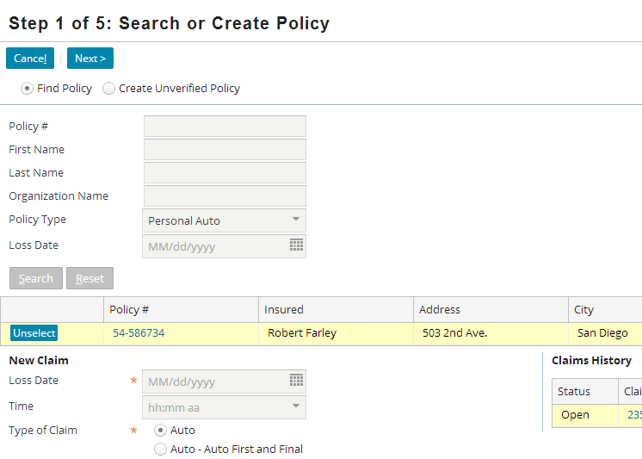
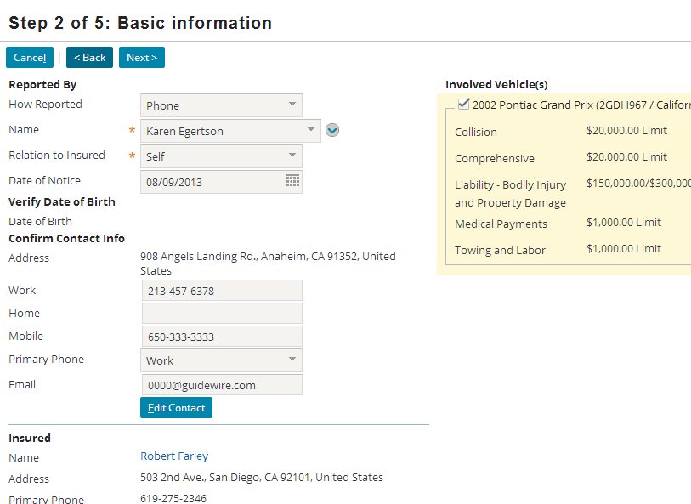
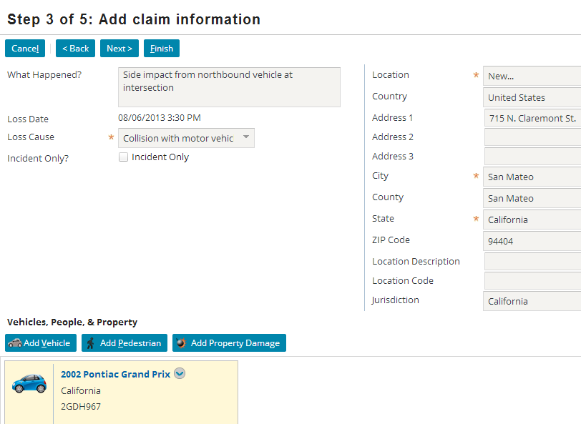
The new claim wizard: sample screens
|EOS~016|
Notes:
|EON~016|
The sample screens shown are for a personal auto claim. The wizard differs greatly for other lines of business (Workers’ Compensation, Commercial Auto, Homeowners, Commercial Property, Travel, etc.)

Slide 17
The intake process: imported claims
Claim is entered in Portal
Claim is entered in New Claim Wizard
Automated Claim Setup
Create and assign activities
Segment claim
Assign claim
Validate claim
import
Claim is entered in external FNOL application
|EOS~017|
Notes:
|EON~017|
A claim could be created in an external FNOL application and then imported into ClaimCenter.

Slide 18

First notice application integration
First Notice Application
FNOL reports
Nearly every instance of ClaimCenter has an integration point to a first notice application
This application stores First Notice of Loss reports in a standard XML-based file format called ACORD XML
It could be hosted by the carrier or by a FNOL service provider
|EOS~018|
Notes:
|EON~018|
Information exchange:
ClaimCenter does not send any information
ClaimCenter receives FNOL Reports
The effort around planning and configuring this integration point is typically minimal. The integration occurs in one direction and the information itself is relatively uncomplicated, inherently structured, and tends to follow at least some accepted industry practices.
A given instance of ClaimCenter may be integrated with one or more first notice applications.
A given FNOL application could be hosted by the carrier. There are also FNOL application providers used by small carriers who cannot afford the infrastructure (such as customer-facing portal) or the round-the-clock access on their own.
FNOL applications are generally specific to auto, property, and personal or selected commercial lines. For WC (Workers’ Compensation), FNOL applications are not used. Instead, FROI (First Report of Injury) forms are filled out on paper or electronically submitted (but not via the mechanism described above). So the concept of an application for “first notice” does not apply to WC.

Slide 19
The intake process: portal claims
Claim is entered in Portal
Claim is entered in New Claim Wizard
Automated Claim Setup
Create and assign activities
Segment claim
Assign claim
Validate claim
import
Claim is entered in external FNOL application
|EOS~019|
Notes:
|EON~019|
A claim could be created and submitted directly in ClaimCenter by a policyholder (the consumer) in a portal such as Guidewire Claim Portal for Policyholders. This is most common for the personal auto or homeowners lines of business.

Slide 20
Portal integration
Claim Portal Application
Claim info
Some instances of ClaimCenter have integration points to policyholder portals
This could be Guidewire Claim Portal for Policyholders or another portal provider
The primary purpose is to provide a policyholder portal for auto and homeowners customers to submit claims, inquiries, documents, and change contact information.
Provides customers a more personalized, direct communication channel with their carrier
Portal applications can also include vendor portal and agent/broker applications
|EOS~020|
Notes:
|EON~020|
The portal submission of a claim is actually functionally very similar to using the New Claim Wizard, except that it must conform to a variety of web and other form factors such as mobile devices and tablets. In addition, the user of a portal may be able to:
Upload pictures of a damaged vehicle or piece of property during the portal submission
Save their work and submit the claim over a period of time rather than in a single “sitting” over the phone
Receive more personalized information and/or updates regarding the claim after it has been submitted
As stated previously, portal applications are most common for personal lines of business (such as personal auto or homeowners).

Slide 21
Lesson outline
The claim intake process
Automated claim setup
New claim validation
|EOS~021|
Notes:
|EON~021|

Slide 22
The intake process: automated claim setup
Claim is entered in Portal
Claim is entered in New Claim Wizard
Automated Claim Setup
Create and assign activities
Segment claim
Assign claim
Validate claim
import
Rules triggered by claim import, portal entry or completion of new claim wizard
Prepare claim for adjudication
Claim is entered in external FNOL application
|EOS~022|
Notes:
|EON~022|
Once the claim has been created in the NCW, thru the portal or imported, it enters the automated claim setup process. There are three primary things that occur during claim setup. First, the claim is segmented. Segmentation is the process of determining the strategy for how the claim should be processed. (For example, is the claim straight-forward or is it complex and will it require adjusters with special expertise.) Then, the claim is assigned. Assignment is the act of determining who is responsible for the claim. The user creating the claim can specify who it should be assigned to, or the assignment could be determined using automated rules. Finally, a series of activities known as the "workplan" are created and assigned. These activities identify the work that must be done to process the claim and who must do it.
Claim setup is run only when the NCW completes, or when you call the addFNOL() method from the web services API, or when using the “Edge” API for the Guidewire Claim Portal. You cannot invoke setup from rules.

Slide 23
Automated claim setup
Automated Claim Setup
Create and assign activities
Segment claim
Assign claim
A series of rules designed to:
Execute any work required for the claim that can be done automatically (such as generating a list of activities to complete)
Ensure that the claim is ready for adjudication
Sometimes referred to as “SAW”
Segment
Assign
Workplan
|EOS~023|
Notes:
|EON~023|

Slide 24
Presetup
Automated Claim Setup
Create and assign activities
Segment claim
Assign claim
WC claim
Medical Details
Presetup executes rules needed to run before segmentation, such as the automatic creation of exposures
|EOS~024|
Notes:
|EON~024|
For claims associated to an auto policy, there are situations where one or more exposures can be anticipated. For example, if the loss cause is collision, a collision exposure could be created. If a rental car was required, then a rental reimbursement exposure could be created.
For claims associated to workers' comp policies, there is a relatively narrow range of possible exposure scenarios. Therefore, workers' comp exposures are often created automatically during the presetup portion of claim setup. The example in the slide above is from a workers' comp policy. A “Medical Details” exposure is created to handle medical costs associated with the worker’s injury.
Theoretically, any sort of work can be done during presetup.
Exposures are discussed in detail in the "Exposures" lesson (Personal/Commercial lines), “Medical Details Exposures” and “Time Loss Exposures” lessons (Workers’ Compensation).

Slide 25

Segmentation rules
Segmentation Rules
Claim 100-00-000027
medium
Segment Types
Assign a segment type value to claim
Segment type denotes strategy to be used for claim processing, such as:
"low complexity" for an auto claim involving only windshield damage
"high complexity" for an auto claim involving a death
easy
medium
hard
|EOS~025|
Notes:
|EON~025|
A claim's segment can be thought of as a label which classifies the general strategy for processing the claim. This strategy could include how the claim is assigned, how reserves are created, and/or the types of activities that are created. Segmentation rules are analogous to a person who looks at a claim and simply affixes a color-coded sticker to it where each color denotes the strategy (as in green means low complexity, blue means normal complexity, and red means high complexity).
A claim involving windshield damage alone is “low complexity” due to the often rapid processing and small dollar amounts involved in paying out the claim (these claims can be closed in a matter of hours).
A claim involving a fatality is “high complexity” due to the multiple coverages involved with fatalities (death benefits, burial, etc.), and potential for settlements and/or litigation as well as additional paperwork (death certificates, metro reports, etc.).
Both of these business scenarios are included and enabled in the base application’s segmentation rules.
(continued)

Slide 26
(Notes only slide)
|EOS~026|
Notes:
|EON~026|
In the base application, the available values for segment are:
Auto - glass
Auto - high complexity
Auto - low complexity
Auto - mid complexity
Contents - high complexity
Contents - low complexity
Injury - high complexity
Injury - low complexity
Injury - mid complexity
Liability - high complexity
Liability - low complexity
Liability - mid complexity
Property - high complexity
Property - low complexity
Property - mid complexity
Travel - high complexity
Travel - low complexity
Travel - mid complexity
Unknown
Workers' Comp - employer's liability
Workers' Comp - lost time
Workers' Comp - med only

Slide 27
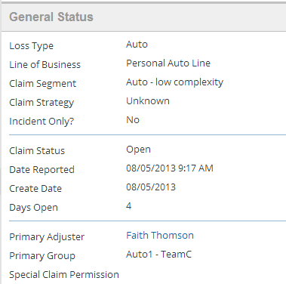
Segmentation rules: example
if loss type is auto AND number of vehicles = 1 AND injuryOccurred = false
then set segment to "Auto - low complexity"
|EOS~027|
Notes:
|EON~027|
The slide shows an example of a claim a claim segmentation rule. The rule states "for claims where the loss type is auto, there is only one vehicle involved, and there were no injuries, then the claim segment should be set to "Auto - low complexity".

Slide 28
Assignment rules
Betty Baker
Dana Evans
Western Auto Adjusters
Claim 100-00-000027
Hank Pym
Janet Van Dyne
medium
Western Complex Auto Adjusters
location: California
Bruce Banner
Tony Stark
Eastern Auto Adjusters
|EOS~028|
Notes:
|EON~028|
Assignment rules are used to determine the group and user to which a claim is assigned. Assignment rules can make use of the object's segment or strategy value, either by itself or in conjunction with other information (such as the insured's location). Assignment rules can also be written without any reference to the claim's segment. Rules can also use the complexity of the claim and the current workload of the group's users to select the best user.

Slide 29
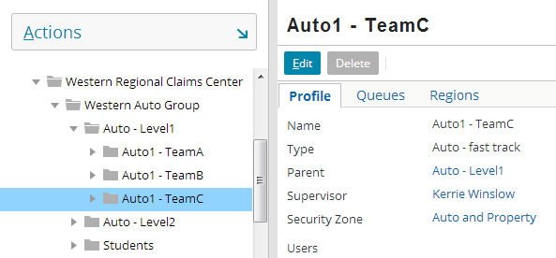
Assignment rules: example
if segment is “Auto – low complexity”
then assign to an auto group in relevant region AND assign by round robin to adjuster in that group
|EOS~029|
Notes:
|EON~029|
The slide shows an example of a claim assignment rule. The rule states "If the claim segment is Auto – low complexity, then assign the claim to a group which is in the same region, and then select a user from that group using round robin assignment." The associated policy has a primary insured who lives in the western region. Therefore, the claim has been assigned to the “Auto1 - TeamC" group, which is a group that exists in the Western Region and which is made up of auto adjusters who handle normal auto claims. The type of group can be seen on the Administration tab Group Detail Page (if logging in using “Super User” (su)).
Round robin assignment assigns objects to users within a group in a cyclical fashion. The first object goes to the first user, the second object to the second user, and so on. When every user has been assigned an object, the cycle repeats again with the first user. In the example above, Faith Thomson is a user in the AutoC - TeamA group. She is the next user in the round robin cycle when the assignment rules run for this claim. Therefore, the claim is assigned to her.

Slide 30
Contrasting segmentation and assignment
easy
medium
hard
Segmentation:
Determines the strategy for processing the object
Is done only for claims and exposures
Sets a single field on the object to a value from a predefined list
Is only done once for a given object
Assignment:
Determines the group and owner of the object
Is done for claims, exposures, activities, and matters
Associates object to group and user (chosen from existing groups and users)
Could occur many times for a given object
|EOS~030|
Notes:
|EON~030|
The primary purpose of segmentation is to categorize a claim or exposure with regards to the strategy for processing the claim. This categorization is a simple field value. It may or may not be used by assignment rules, and it may or may not be used in other aspects of claim processing. (For example, certain line items might be written to the claim's history based on its segment, such as details to changes in the parties involved if and only if the claim has a segment of "complex").
The primary purpose of assignment is to determine the owner of an assignable object, which includes activities and matters. The assignment is two foreign keys, one pointing to an existing group and one pointing to an existing user. Assignment may or may not be based on segment.

Slide 31
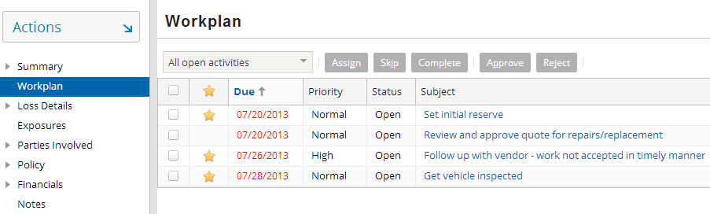
Workplan rules
The workplan is the list of activities associated to a claim
Workplan rules create activities
Activity assignment rules assign activities
|EOS~031|
Notes:
|EON~031|
The workplan itself is simply the set of activities associated to a claim and its exposures. It specifies the work that must be done to process the claim and who must do it.
Activities are assigned using a set of assignment rules. These rules contain logic that identify an owner based on attributes of the activity. For example, a "Contact insured" activity might always get assigned to the owner of the claim. An "Inspect property for mudslide damage" might be assigned to a property inspector who is in the same region as the property which suffered the loss.
Activity creation is not unique to the claim setup process. Activities can also be created automatically when certain events occur. (For example, when the fault rating changes from "no fault" to "other driver at fault", business rules could automatically create an activity to determine if subrogation is appropriate. Subrogation is the act of getting money from the third party or the third party's carrier when the third party is at fault.) Activities can also be created manually by a user. (For example, a user may have a question about the extent of a seldom-encountered coverage, and he or she could create an activity asking a more experienced adjuster to review the policy and the claim.)

Slide 32
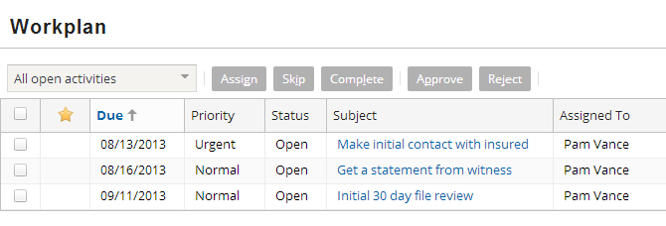
Claim workplan rules: example
if (always)
then create initial contact activity AND create 30 day review activity
|EOS~032|
Notes:
|EON~032|
The slide shows an example of a claim workplan rule. The rule states "Always create two activities - an initial contact activity, and a 30 day review activity." The two activities are automatically associated to the claim. Note that the rule only creates the activities. It does not assign them.

Slide 33
Activity assignment rules: example
if activity is initial contact activity OR activity is 30 day review activity
then assign activity to claim owner
|EOS~033|
Notes:
|EON~033|
Similar to claim assignment rules, activity assignment rules assign activities. The slide shows an example of an activity assignment rule. The rule states "Assign all initial contact activities and 30 day diary activities to the user who owns the claim."

Slide 34
Summary: automated claim setup
Segment claim
easy
Assign claim
Create and assign activities
|EOS~034|
Notes:
|EON~034|
To summarize:
Segmentation rules segment, or determine the strategy for, the claim. The result of these rules is a segment value being assigned to the claim.
Claim assignment rules assign the claim to a group and a user in that group.
Workplan rules create a series of activities for the claim known as the workplan, and assign those activities to appropriate users.

Slide 35
Lesson outline
The claim intake process
Automated claim setup
New claim validation
|EOS~035|
Notes:
|EON~035|

Slide 36
The intake process: claim validation
Claim is entered in Portal
Claim is entered in New Claim Wizard
Automated Claim Setup
Create and assign activities
Segment claim
Assign claim
Validate claim
import
Claim is entered in external FNOL application
|EOS~036|
Notes:
|EON~036|
After claim setup has been completed, validation rules are executed to verify that the claim meets the minimum set of requirements to exist in the system as a claim other users can view and modify. If any of the validation rules fail, then:
If the claim was created in the new claim wizard or portal, the user must either cancel the claim or fix the errors and re-save the claim.
If the claim was imported, then the import of that claim fails. An error might be returned to the FNOL application and/or logged so that a system administrator could investigate the issue as needed.
When validation occurs successfully, the claim intake process is done.

Slide 37
Ensuring completeness of new claim
ClaimCenter validation levels measure claim maturity
Also used at end of intake to ensure claim is complete enough to begin adjudication
Requirements shown here are examples and are configurable
New Loss Completion
Intermediate Levels of Maturity
Load Save
Policy number is valid
Driver of vehicle is specified
Loss date is specified
If insured at fault, fault rating specified
|EOS~037|
Notes:
|EON~037|
There are three validation levels common to nearly every carrier ("load save", "new loss completion" and "ability to pay"). The intermediate levels vary from carrier to carrier. The pieces of information required at each level shown here are for illustrative purposes only and may not represent what ClaimCenter requires on each new claim. In addition, the validation logic at each level is configurable.
In the base application, there are five levels of maturity:
Load save - This is the level a claim must be at in order to be imported from an external system or partially entered thru a portal. A claim at this stage has not yet been touched by a user via ClaimCenter. (New claims created within ClaimCenter must also meet all conditions set at this level.)
New loss completion - This is the level a claim must be at to be saved (or modified by a user if the claim is imported).
Valid for ISO - This level is used to signify that the claim has the minimal information needed for filing with ISO.
Send to external (systems) - This level is used to signify that the claim has the minimal information needed to send information about it to external systems within the carrier, such as a policy administration system which is trying to assess policy renewal rates.
Ability to pay - This is the level a claim must be at in order to have payments written against it.
The Valid for ISO and Send to external (systems) levels are configurable. The other three levels are internal levels required by ClaimCenter and cannot be modified. You can also add additional levels not found in the base application.

Slide 38
New claim wizard claims
New Loss Completion
Intermediate Levels of Maturity
Load Save
New claim wizard claims must meet all conditions at and below "new loss completion"
Policy number is valid
Driver of vehicle is specified
Loss date is specified
If insured at fault, fault rating specified
|EOS~038|
Notes:
|EON~038|
Claims created through the new claim wizard must meet all conditions at the "new loss completion" level and any level below it. In the base application, the only level below it is "load save".

Slide 39
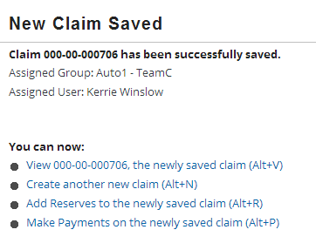
Wizard claim passing new claim validation
|EOS~039|
Notes:
|EON~039|
When a claim created through the new claim wizard meets all conditions at and below the "new loss completion" level, then the "New Claim Saved" screen is displayed to the user. The information on this screen can be configured, but in the base application it displayed the claim number, the user and group to whom the claim was assigned, and links for likely next steps.

Slide 40
Imported FNOL or Portal claims
Claims imported from an external application must meet all "load save" conditions
Those that do not also meet "new loss" typically need user review
The same process applies to incomplete claims from a portal
New Loss Completion
Intermediate Levels of Maturity
Load Save
Policy number is valid
Driver of vehicle is specified
Loss date is specified
If insured at fault, fault rating specified
Review imported FNOL
FNOL Queue
|EOS~040|
Notes:
|EON~040|
The Edge API handles the integration between ClaimCenter and the portal. When a claim is “saved for later” by the policyholder, the claim is actually saved in ClaimCenter at “load save” validation level.
If an imported claim satisfies all conditions at the "load save" level and does not satisfy all conditions at the "new loss completion" level, then an activity is typically generated to review the imported FNOL. This activity is assigned to an "FNOL queue". Users can retrieve the activity from the queue, review the FNOL, and make the changes needed to get it to meet the "new loss completion" level.
This process is available for portal claims that are not at “new loss completion”. Keep in mind that if a claim saved on a portal application is incomplete and not submitted, it’s information can be retrieved. That way an adjuster or CSR may find the claim if a policyholder begins filing a claim on a portal and continues if they call in to a call center, or another party calls in to complete the claim. However, a portal claim is only saved at “load save” and cannot be saved lower than this level.

Slide 41
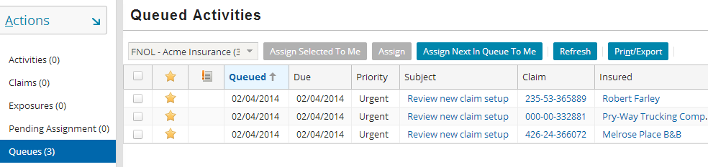
Incomplete imported FNOLs
Imported FNOLs do not necessarily contain sufficient data to be considered done with intake
For incomplete FNOLs, an activity is created and placed in an FNOL queue
From the activity, a user can view the FNOL and modify it as needed
|EOS~041|
Notes:
|EON~041|
Some carriers use FNOL applications that are robust enough such that all imported FNOLs can be considered complete. These carriers do not need to use FNOL queues.
Other carriers use FNOL applications that cannot, on their own, ensure that an imported FNOL is complete. These carriers must use a business process where an activity indicates an FNOL needs review and a user reviews the FNOL and provides the information required to bring to a level of completeness with regards to the intake process. FNOL review is not always assigned to a given user. Instead, the FNOL activities are put into a queue where multiple users can access them and take ownership of them.
This process is used for incomplete portal claims that may come in to ClaimCenter as well.
If a user has access to an FNOL queue, then he or she can view it by:
Clicking the Queues page link on the Desktop.
Selecting the FNOL queue from the dropdown at the top of the list.
The base application does not contain any logic to create and assign FNOL activities. However, once the logic for processing imported FNOLs has been determined (such as who is responsible for them), this is a relatively simple configuration to make to the application.

Slide 42
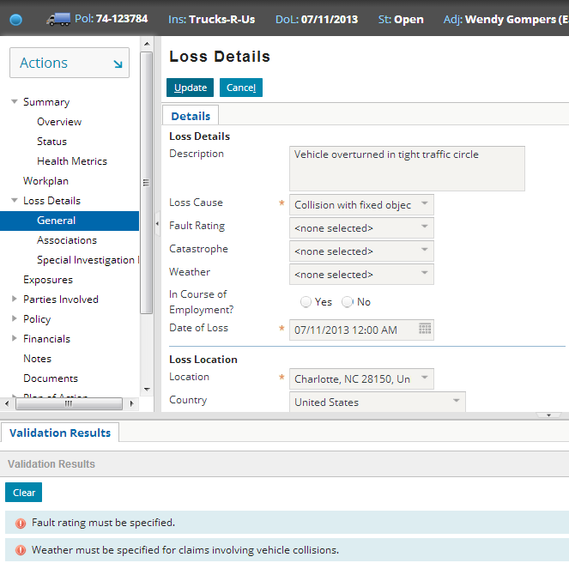
Completing incomplete imported FNOLs
To complete the incomplete FNOL, a user must ensure all required information is present
|EOS~042|
Notes:
|EON~042|
During its life cycle, a claim moves through several validation levels. A claim at the "load save” level has been imported into ClaimCenter but does not have the minimal information required for the claim to have the setup rules run against it. A claim at the “New loss completion” level does have the minimal information required for claim setup. Consequently, a user who is responsible for an imported FNOL must determine what changes (if any) are required to move the claim to "new loss completion".
A user can use one of the menu items in the Claim Actions menu to determine this. If the user selects Actions > Validate Claim Only > New loss completion, then ClaimCenter will run the validation rules for a claim at the new loss completion level. This is shown in the screenshot below (which is visible if you view PowerPoint in Notes view (View > Notes Page)). If the claim is at or beyond that level, then ClaimCenter will report that validation was successful (no validation errors) and the Review FNOL activity can be closed. If the claim is not at the new loss completion level, ClaimCenter will identify the ways in which the claim must be modified to advance it to the new loss completion level.

Slide 43
Failing new claim validation
For imported FNOLs, claim is not saved
For wizard claims, user must fix errors or cancel claim
New Loss Completion
Intermediate Levels of Maturity
Load Save
Policy number is valid
Driver of vehicle is specified
Loss date is specified
If insured at fault, fault rating specified
import
wizard
|EOS~043|
Notes:
|EON~043|
An imported claim fails validation if it does not meet all conditions at the "load save" level. In the example above, if the claim is imported but does not have a valid policy number, it will fail validation.
By default, “saved but not submitted” claims from a portal are at load save. That way, a claim must meet certain minimum validation in the portal in order to be saved by a policyholder (i.e. a valid policy number and loss date).
A new claim wizard claim fails validation if it does not meet all conditions at and below the "new loss completion" level. In the example above, if the claim is created in the new claim wizard but does not have a valid policy number and specifies the insured is at fault without a fault rating, then it will fail validation.

Slide 44
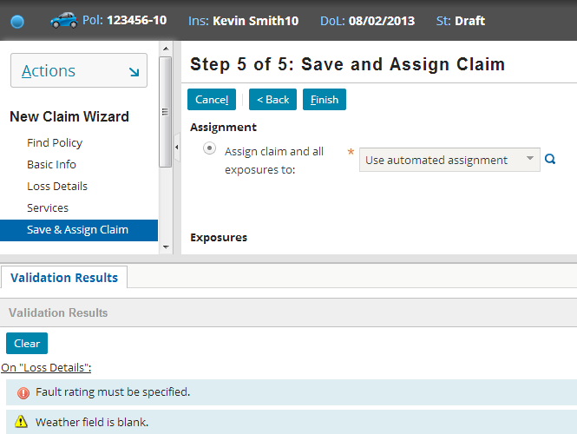
Wizard claim failing new claim validation
display screen where error exists
|EOS~044|
Notes:
|EON~044|
ClaimCenter contains a set of rules that define the data that must be present within a claim in order for it to be considered a valid "load save" or "new loss" claim. These rules are run at the end of the import process and the end of the new claim wizard. Each rule can produce one of two possible results:
The rule could warn the user of a certain situation. The situation does not need to be attended to immediately, but at some point in the future it will prevent the claim from moving forward within its life cycle. Validation warnings appear in the Validation Results screen with a yellow yield sign icon.
The rule could throw an error. If an error is thrown, the claim cannot be saved until the error is fixed. Validation errors appear in the Validation Results screen with a red arrow icon.
If a claim has no warnings or errors, then the claim is immediately saved and the Validation Results screen is not displayed.
If a claim has only warnings, then the user only needs to click the Finish button a second time. Upon the second click, the claim is saved. The Validation Results screen remains visible until the user clicks the Clear button. (You do not need to clear the validation results to save the claim or vice versa.)
If a claim has errors (or warnings and errors), then the claim cannot be saved. The issues causing the errors must be attended to, or the new claim must be canceled.
In some cases, the "Error on..." label in the validation results is a link. Clicking the link displays the page with the error.

Slide 45
Lesson objectives review
You should now be able to:
Define the steps of the claim intake process
Identify the steps of automated claim setup
Describe how validation is performed for new claims
|EOS~045|
Notes:
|EON~045|

Slide 46
Review questions
What type of user (at a carrier) manages the intake process?
What four things are required on every claim?
What information is typically passed to and from ClaimCenter and an FNOL application?
What three things are done during the claim setup process?
During validation, what happens to a wizard claim that:
Does not meet all "load save" conditions?
Does not meet all "new loss" conditions?
During validation, what happens to an imported claim that:
Does not meet all "load save" conditions?
Does not meet all "new loss" conditions?
|EOS~046|
Notes:
|EON~046|
Answers
1. This typically depends on the size of the carrier. For larger carriers, the intake process may be managed by a CSR, who is responsible for identifying the minimal amount of information for a claim and seeing that it is assigned to an adjuster. For smaller carriers, the intake process may be managed by an adjuster.
2. The policy, the parties involved, loss event, and incidents. Loss event information would be details such as where, when (loss date), who was at fault, etc.
3. ClaimCenter receives the claim data from the FNOL application but does not typically send any information to the FNOL application.
4. The claim is segmented and assigned and the claim's workplan activities are created and assigned.
5. For both a) and b), validation fails and the user must fix the errors or cancel the new claim.
6. a) The import fails. b) The import succeeds, but an activity is typically generated so that a user will review the claim and bring it up to the new loss level.

Slide 47
Notices
Copyright © 2001-2014 Guidewire Software, Inc. All rights reserved.
Guidewire, Guidewire Software, Guidewire ClaimCenter, Guidewire PolicyCenter, Guidewire BillingCenter, Guidewire Reinsurance Management, Guidewire ContactManager, Guidewire Vendor Data Management, Guidewire Client Data Management, Guidewire Rating Management, Guidewire InsuranceSuite, Guidewire ContactCenter, Guidewire Studio, Guidewire Product Designer, Guidewire Live, Guidewire DataHub, Guidewire InfoCenter, Guidewire Standard Reporting, Guidewire ExampleCenter, Guidewire Account Manager Portal, Guidewire Claim Portal, Guidewire Policyholder Portal, ClaimCenter, BillingCenter, PolicyCenter, InsuranceSuite, Gosu, Deliver Insurance Your Way, and the Guidewire logo are trademarks, service marks, or registered trademarks of Guidewire Software, Inc. in the United States and/or other countries.
All other trademarks are the property of their respective owners.
This material is confidential and proprietary to Guidewire and subject to the confidentiality terms in the applicable license agreement and/or separate nondisclosure agreement.
This file and the contents herein are the property of Guidewire Software, Inc. Use of this course material is restricted to students officially registered in this specific Guidewire-instructed course, or for other use expressly authorized by Guidewire. Replication or distribution of this course material in electronic, paper, or other format is prohibited without express permission from Guidewire.
Guidewire products are protected by one or more United States patents.
|EOS~047|
Notes:
|EON~047|

