Slide 1
Contacts
17 March 2015
|EOS~001|
Notes:
|EON~001|
Guidewire training materials contain Guidewire proprietary information that is subject to confidentiality and non-disclosure agreements. You agree to use the information in this manual solely for the purpose of training to implement Guidewire software solutions. You also agree not to disclose the information in this manual to third parties or copy this manual without prior written consent from Guidewire. Guidewire training may be given only by Guidewire employees or certified Guidewire partners under the appropriate agreement with Guidewire.

Slide 2
Lesson objectives
By the end of this lesson, you should be able to:
Describe the functionality of contacts
Describe the functionality of ContactManager
Create contacts in ClaimCenter
Work with contacts in ClaimCenter
Describe approaches to searching for contacts
This lesson uses the notes section for additional explanation and information. To view the notes in PowerPoint, choose View→Normal or View→Notes Page. If you choose to print the notes for the lesson, be sure to select “Print hidden slides.”
|EOS~002|
Notes:
|EON~002|

Slide 3
Lesson outline
Contact basics
ContactManager
Creating ClaimCenter contacts
Searching for contacts
|EOS~003|
Notes:
|EON~003|

Slide 4


Review: Entities in the claim file
claim
contact
incident
service
exposure
activity
document
note
matter
reserve line
check
|EOS~004|
Notes:
|EON~004|
A claim is an event in which one or more (potentially) covered losses occurred.
A contact is a person or organization who has a relationship to a claim, such as:
A claimant requesting compensation for a loss.
The reporter of the claim.
A doctor treating an injury.
A vendor providing services to claimants.
An incident is an item that was lost or damaged, such as a vehicle, a property, or a person suffering one or more injuries.
An exposure is a set of data used to track a potential payment from one coverage to one claimant.
A reserve line is an amount of money set aside for expected payments related to a given exposure.
A check is a single transfer of money tracked by an exposure to one or more individuals or organizations.
An activity is a task required to process a claim. The set of activities associated to a given claim is often referred to as the claim's "workplan".
A document is an electronic file or physical piece of paper which contains information relevant to the claim.
A note is a text entry which details the events, courses of actions, and/or thinking of a user during the processing of a claim.
A matter is a set of data pertaining to a single (potential) lawsuit.
A service request is a mechanism to track vendor progress, receive quotes from vendors, and provide a list of services and vendors that provide those services.

Slide 5
Review: The claims process
Litigation
Fraud Detection
Intake
Special Investigations
Adjudication
Payment
Recovery
|EOS~005|
Notes:
|EON~005|
During intake, the carrier is informed of a potentially covered loss. For auto and property claims, this is often referred to as First Notice of Loss (FNOL). For workers' comp claims, this is known as First Report or Injury (FROI).
Adjudication is the process of determining if the carrier is going to pay a claim, and if so, how much.
Once the loss has been assessed and the payment has been approved, the carrier can provide the payments to the claimants. The payment phase involves creating, approving, and issuing the checks.
In some cases, the carrier may also attempt to recover funds paid to the claimant by obtaining money from a third party's carrier if the third party was at fault (which is known as "subrogation") or by taking possession of a significantly damaged property and selling all or parts of it to a third party (which is known as "salvage").
Litigation is an umbrella term for several activities which involve the resolution of disputes.
Fraud detection refers to the activities around detecting claim activity that is indicative of fraud and could warrant further investigation. This is typically a process which is ongoing throughout every phase of the claims process.
If a claim is considered to be suspicious, then it is referred to the special investigations unit. They will investigate the activity and determine the validity of claim. Their investigation runs parallel to the normal claim processing.

Slide 6


Mapping entities to the claims process
Litigation
Intake
Adjudication
Used heavily throughout entire process
Payment
Recovery
|EOS~006|
Notes:
|EON~006|
Theoretically speaking, a given entity type can be used or could be relevant in nearly every part of the claims process. However, some entities tend to be worked on heavily in one part of the process and less so in other parts of the process.
Incidents are created and often fully detailed during Intake. Services may be added and associated with those incidents, or related to the claim itself.
Exposures and reserve lines are usually established during Adjudication.
Checks are exclusive to Payment.
Matters are exclusive to Litigation.
There are four primary entities of the claim file which span all phases of claims processing: contacts, activities, documents, and notes.

Slide 7
Contacts
Contact
Claimant
Reporter
Auto Repair Shop
Hospital
Doctor
Court
A contact is a person, organization, or venue which is related to the claim, such as...
Someone who suffered a loss
Some company or vendor which repaired a damaged asset or treated an injured person
Some place where disputes were resolved
|EOS~007|
Notes:
|EON~007|
A venue is a location for a scheduled event relevant to claims processing. Typically, venues are places where dispute resolution occurs, such as a courthouse or a conference room used for arbitration.

Slide 8

The contact subtype hierarchy
Contact
the primary subtypes
Person
Company
Place
Person Vendor
Adjudi- cator
Company Vendor
Legal Venue
searches at this level return doctors and attorneys
Law Firm
Attorney
Medical Care Org
searches at this level return only doctors
Doctor
Auto Towing
Auto Repair
|EOS~008|
Notes:
|EON~008|
Contacts within ClaimCenter are organized into a specific subtype hierarchy. The organization of the hierarchy helps to specify and enable certain types of functionality. For example:
The hierarchy helps to define the sorts of searches users can do. You can easily configure search screens for any node in the hierarchy. The search results will include matching contacts at or below that node. In the example above, a user could do a search for attorneys (which will return just attorneys), or for doctors (which will return just doctors), or for person vendors (which will return both attorneys and doctors, but not law firms or medical care organizations because they are not underneath the "Person Vendor" node of the hierarchy).
The hierarchy helps to define the criteria for identifying two objects as possible matches. For example, if the matching logic for law firms, medical care organizations, auto towing and auto repair shops is identical (the tax ID for the two objects must match), then this logic can be specified at the Company Vendor level.
There are three primary subtypes in the contact subtype hierarchy: person, company, and place. Below these three primary subtypes are several “child” subtypes. It is recommended that no new subtypes should be created. However, customization such as adding properties/fields is acceptable. Instead of creating new subtypes, use other configuration capabilities in ClaimCenter such as adding new contact roles, configuring contact tags (in ContactManager), or configuring the list of vendor services provided (for example, adding services under a category of “Landscaping” (lawn repair, tree repair, gardening, etc.)). That way, a new subtype of vendor such as “Landscaping Vendor” is not needed. Both of these configurations and more are explained in the ClaimCenter 8.0 Application Configuration and ContactManager 8.0 Configuration for ClaimCenter 8.0 training courses, and on the next slide.
An adjudicator is not a claims adjuster. An adjudicator is a judge or arbitrator as a type of Person. An adjudicator may have a specific adjudicative domain.

Slide 9

The ABContact entity
ContactManager
ABContact
primary subtypes
ABPerson
ABCompany
ABPlace
ABAdjud- icator
ABPerson Vendor
ABPolicy Person
ABCompany Vendor
ABPolicy Company
ABLegal Venue
AB Attorney
AB Doctor
AB LawFirm
ABMedical CareOrg
ABAuto TowingAgcy
ABAuto RepairShop
|EOS~009|
Notes:
|EON~009|
The ABContact entity is a subtyped entity in ContactManager. In other words, it is broken down into categories (such as ABPerson, ABCompany, and ABPlace), and those categories can be further broken down into categories (such as ABPerson consisting of ABAdjudicator, ABPersonVendor, and ABPolicyPerson). This hierarchical organization helps to model information about contacts. Information common to all contacts can be established at the ABContact level (such as Name and Tax ID). This information is automatically inherited by all of its subtypes. Information specific to an ABPerson (such as First Name, Gender, and Date of Birth) can be put at the ABPerson level. It will be inherited by all of its subtypes, but information on the ABPerson subtype is not available to ABCompany or ABPlace.
You can create a contact at any level in the hierarchy except for the top level. (This is represented in the diagram above by a lock.) Thus, a contact could be an ABPerson, or an ABPersonVendor, or an ABAttorney. But it cannot be "just" an ABContact.
In the ABContact hierarchy, an ABPolicyPerson is a person who owns a policy issued by the carrier (such as an individual with a personal auto policy). An ABPolicyCompany is a company that owns a policy issued by the carrier (such as a construction company with a workers' compensation policy).
There is one entity that participates in the hierarchy that does not appear in the diagram above: ABUserContact. This type of contact represents a ContactManager user and is used to store his or her contact information (such as home phone numbers). Likewise, on the diagram shown on the previous slide, UserContact is not shown. This type of contact represents a ClaimCenter user and is used to store similar contact information.

Slide 10
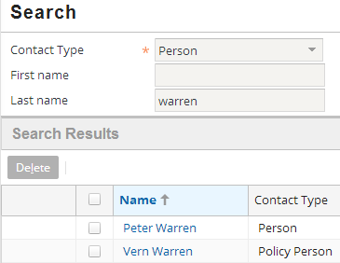
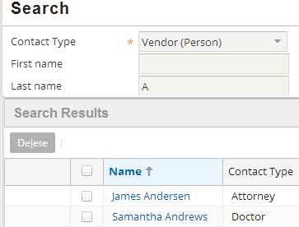
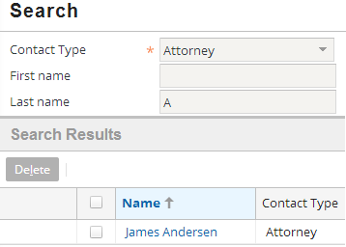
Search results within subtypes
ContactManager
ABPerson
ABPerson Vendor
ABAttorney
ABDoctor
|EOS~010|
Notes:
|EON~010|
Any search conducted at a given level returns contacts whose subtype is at or below that level. For example:
A search for ABPersons returns ABPersons, ABPersonVendors, ABAttorneys, and ABDoctors.
A search for ABPersonVendors returns ABPersonVendors, ABAttorneys, and ABDoctors.
A search for ABAttorneys returns only ABAttorneys.

Slide 11
Contact tags
client
vendor
claim party
claim party
claim party
Jon Wu (auto policy holder, involved in accident)
Adam Pohl (driver of other car)
Kay Ashton (doctor who treated Jon Wu)
Contact tags are tags that identify one or more broad relationships that a contact has with the carrier
Contact tags have greater flexibility than subtypes because, unlike subtypes, a contact can have any number of tags
The base application includes three tags
Client (a policy holder)
Claim party (a contact involved in a claim)
Vendor (a contact that provides service for a claim)
|EOS~011|
Notes:
|EON~011|
Contact tags provide more flexibility for categorizing contacts than subtypes do. Subtypes are limited in several ways:
A contact can only be of one subtype. Therefore, it is hard to reflect that a given contact may have multiple roles with the company (such as a doctor who is both a claim party and a vendor, and could also possibly be a client).
Once created, a contact's subtype is fixed.

Slide 12
Two applications store contacts
Address Book
ContactManager
contacts relevant to a single claim
contacts relevant to multiple claims
Two applications store contacts
ClaimCenter stores contact information as it pertains to a given claim
Address Book stores contacts that are (potentially) relevant to multiple claims
Contacts can be shared across both applications
|EOS~012|
Notes:
|EON~012|
Most carriers with claims processing systems have a contact management application, which is often referred to in the industry as the "address book".
ClaimCenter comes with a separate contact management application called ContactManager. ClaimCenter and ContactManager are integrated, and most of the functionality belonging to ContactManager appears seamlessly in ClaimCenter. The ContactManager application functionality is typically referenced within ClaimCenter using the term "Address Book".
This course uses the term "Address Book" to reference functionality found in ContactManager.
The topic of how vendor contacts are shared, managed and edited is discussed in detail in the Shared Contacts lesson that follows this lesson.
PC-CM (PolicyCenter – ContactManager) integration is not covered in this training course. This course only covers CC-CM integration. PC-CM integration is covered in the ContactManager Configuration course.

Slide 13
“Local” contacts
Address Book
Claim 000-00-002001
ContactManager
Stanley Poole (witness)
Typically a non-vendor, non-venue contact, such as a passenger, claimant, or a witness
|EOS~013|
Notes:
|EON~013|
A ClaimCenter contact may exist only in ClaimCenter (and not in Address Book). This is typical when the contact is not expected to be used for any other claim (such as a witness or a third-party claimant), which is typically true for a contact which is not a vendor or a venue. There is no need for contact information to be shared across multiple claims, so the contact is not stored in the address book. This is also known as a “local” contact (local to ClaimCenter).

Slide 14
“Shared” contacts
Address Book
Claim 000-00-002006
ContactManager
Dr. Matt Sawyer (1)
Claim 036-22-934712
Dr. Matt Sawyer (AB)
Dr. Matt Sawyer (2)
Claim 908-00-230166
Typically a vendor (or venue)
Dr. Matt Sawyer (3)
|EOS~014|
Notes:
|EON~014|
A ClaimCenter contact may also exist in the address book. This is typical when the contact is used or is expected to be used for multiple claims. This is typically true for person vendors such as doctors, company vendors such as hospitals, or venues such as courts. Theoretically, it could also include a policy holder with a large number of potential claims, such as a large business with a workers' comp policy. Because there is a need for contact information to be shared across multiple claims, the contact is stored in the address book. (In the diagram above, the "AB" after the Address Book Matt Sawyer stands for "address book".)
ContactManager is often referred to by the two-letter abbreviation AB, which stands for Address Book.

Slide 15
(Notes only slide)
|EOS~015|
Notes:
|EON~015|
When two objects (contacts) are linked, modifications to one of the objects are generally replicated to the other linked objects. For example, a change made to the contact in ClaimCenter is copied to the address book (and may require approval). A change made to the contact in the address book is immediately copied to all instances of the contact in ClaimCenter.
These behaviors depend on user permissions. Contact changes or additions made in ClaimCenter by an adjuster user are not immediately replicated because they are placed in a “pending approval” state. But the object is still linked and awaiting approval.

Slide 16

Types of users that work with contacts
Address Book
ContactManager
CSRs, Adjusters, and Supervisors...
Work in ClaimCenter
Create “local" contacts
Create “shared" contacts from AB contacts or in ClaimCenter
Vendor managers...
Work in Address Book (“AB”)
Create and edit reusable address book contacts (mostly vendors)
|EOS~016|
Notes:
|EON~016|
Adjusters execute their work within ClaimCenter. They typically create contacts in ClaimCenter (which are either local contacts or shared contacts that are created from existing Address Book contacts). Adjusters can also link a ClaimCenter contact to an Address Book contact if a ClaimCenter contact is unlinked but identical to an existing Address Book contact, or if they supply the required information for a new contact to exist in the Address Book, such as Tax IDs, Addresses, Phone Numbers and other information. More on this will be discussed later.
Vendor managers execute their work within Address Book. They create contacts in Address Book which can be used across multiple ClaimCenter claims. Their changes and edits to contacts are automatically synced to ClaimCenter users.

Slide 17
Adding a contact within ClaimCenter
Adding a New Contact (non-vendor)
Address Book
Claim 000-00-002001
Stanley Poole (witness)
ContactManager
Dr. Matt Sawyer (AB)
Adding an Existing Contact
Claim 908-00-230166
Dr. Matt Sawyer
|EOS~017|
Notes:
|EON~017|
Within ClaimCenter, contacts only exist when associated to a claim (i.e. a passenger, injured party or vendor). Consequently, you can only create a contact from a claim, and not independently of a claim in ClaimCenter. There are two approaches for adding a contact to a claim:
You can add a non-vendor “New Contact” in “Parties Involved”. In this case, the contact is a local contact who exists only in ClaimCenter. The minimal information for a contact must be specified at the time you add the contact to the claim.
You can add an “Existing Contact” in “Parties Involved”. This will “pull” a vendor contact from the Address Book into ClaimCenter. In this case, you search for and identify an Address Book contact to add to the claim. A new object is still created in ClaimCenter, but the information for that object is copied from Address Book. The objects are automatically linked.
NOTE: Contacts may also be added to a claim by adding a new vendor on a Service Request, or by choosing an existing vendor on a Service Request. This process is discussed in the subsequent “Shared Contacts” lesson.

Slide 18
AB Contacts are automatically synced
Address Book
ContactManager
in sync
out of sync
Dr. Matt Sawyer (AB) phone: 453-2331
Dr. Matt Sawyer (1) phone: 453-2331
phone: 324-6600
phone: 324-6600
324-6600
|EOS~018|
Notes:
|EON~018|
Changes made in Address Book are automatically synced to the ClaimCenter object. In the example, the phone number is changed in ContactManager and synced immediately to contacts on claims: 1. Both contacts have same phone number 2. Change is applied to AB copy of Dr. Matt Sawyer so both contacts now out of sync (temporarily) 3. Changes are pushed immediately from AB and now both copies are in sync again The details of synced and shared contacts are explained further in the “Shared Contacts” lesson.

Slide 19
Adding a contact within Address Book
Address Book
ContactManager
Adding a Contact
Quake City Explosives Inc. (AB)
|EOS~019|
Notes:
|EON~019|
Within Guidewire ContactManager (which is also sometimes referred to as Address Book), contacts can exist without a relationship to anything else. The typical approach for adding a contact within ContactManager is to open ContactManager directly and create a new contact. This functionality is typically reserved for a small number of individuals who are responsible for maintaining the contact information for shared contacts.
There is one other situation in which a contact can be created in Address Book. If you attempt to link a ClaimCenter contact to Address Book, ClaimCenter searches for a matching object. If it cannot find one and if the user executing the linking has sufficient permissions, then an object is created in Address Book and linked to the ClaimCenter. If a user does not have permission (typically true for vendor contact addition) then ContactManager has additional checks / approval before adding the new contact. The “Shared Contacts” lesson discusses the behavior in more detail.

Slide 20
Address Book integration
search criteria
Address Book Application
general contact data
ContactManager
Every instance of ClaimCenter has an integration point to an address book application
Nearly every implementation uses Guidewire ContactManager as the address book application
|EOS~020|
Notes:
|EON~020|
Information exchange
ClaimCenter typically sends search criteria
ClaimCenter receives information about contacts, which could be the objects matching search criteria, but it could also be data about a linked contact which needs to be synced
Although ContactManager is used for nearly every implementation of ClaimCenter, this is not a requirement. ClaimCenter can be integrated to any external address book application.
ClaimCenter can also send information about new contacts to be created or edited in the address book, and an example of this (for an auto claim) includes vendors created during creation of service requests. For adjusters, these additions and changes are usually pending approval by a vendor manager in the address book. Likewise, contacts and vendors can be managed and edited in ContactManager. While service requests are likely not to be used on other kinds of claims (such as workers’ compensation), contact creation can occur within ClaimCenter on other types of claims by adding vendors from the “Parties Involved” screen.
The data models for contacts do not have to be identical in both systems. But the fields shared across the two systems (such as first and last name, phone number, and so on) do need to be identical.
The effort around planning and configuring this integration point is typically minimal. ContactManager was designed for easy integration with ClaimCenter.
A given instance of ClaimCenter is typically integrated with a single address book application.

Slide 21
Contact roles in ClaimCenter
Auto Claim 036-22-934712
Workers' Comp Claim 772-12-900000
OmniTech Inc. - Insured (policy)
Ellen Lopez - Insured (policy) - Reporter (entire claim) - Claimant (exposure 1)
Tommy Duke - Claimant (exposure 1)
Matt Sawyer - Doctor (entire claim)
Matt Sawyer - Doctor (entire claim)
|EOS~021|
Notes:
|EON~021|
Whenever a contact is associated to a claim, the contact must have one or more roles on the claim. Each role identifies a relationship between the contact and the claim. Each role can be “related to” the claim or one of its parts. This relationship designates if the contact has this role for the entire claim, for the policy, for a specific exposure, for a service, or for a specific incident.
Keep in mind that every contact object in ClaimCenter is unique. It is possible for a single person or vendor to be a contact on multiple claims. (In the example above, Matt Sawyer is a doctor (vendor) for the auto claim and the workers' comp claim.) In this case, there are two unique objects corresponding to the same person. Fields within one object may have the same values as or different values than the corresponding fields in the other object. For example, Matt Sawyer's address may be the same in both contact objects, but his "okay to contact" field may be different. (It could be okay to contact him for the workers' comp claim but not okay to contact him for the auto claim.)
Note that the “insured” on the WC (Workers’ Comp) claim is a business (OmniTech). WC insurance is commercial insurance, meaning the policyholder is an employer that is often (depending on the law) required to hold a WC policy to indemnify workers for lost wages and/or medical bills resulting from injuries sustained during the course of employment. This is different than personal auto insurance, in which the “insured” is an individual.

Slide 22
Lesson outline
Contact basics
ContactManager
Creating ClaimCenter contacts
Searching for contacts
|EOS~022|
Notes:
|EON~022|

Slide 23

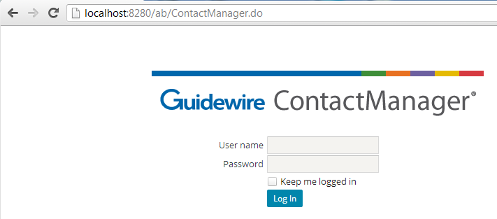
Accessing ContactManager
ContactManager
|EOS~023|
Notes:
|EON~023|
As already stated, ClaimCenter comes with a separate contact management application called ContactManager.
The process of logging on to ContactManager is identical to that of ClaimCenter. To log in to an application, end users must open their web browser and access the system through the appropriate URL (Universal Resource Locator, also more commonly known as a "web address"). The URL is:
http://machine:port#/instanceName/ContactManager.do, where:
machine is the name of the host machine, and
port# is the port which the browser should use to access the application, and
instanceName is the name of the instance of ContactManager (typically "ab", for address book).
Typically, the only types of business users who have access directly to the ContactManager application are vendor managers.

Slide 24
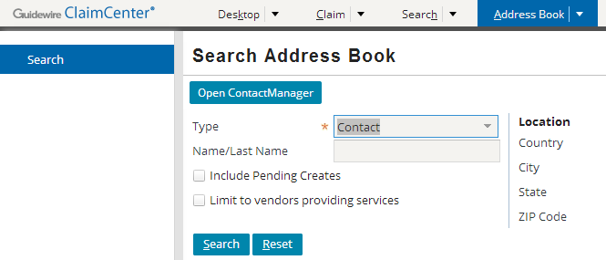

Accessing ContactManager from ClaimCenter
ContactManager
|EOS~024|
Notes:
|EON~024|
You can access ContactManager from a link in ClaimCenter, which by default provides a URL to the ContactManager application in a new browser popup window. This is available in the base application in the Address Book tab in ClaimCenter, or when searching for a Contact to add in the “Parties Involved” screen.
Non-claim related Contacts are wholly edited and managed in ContactManager, not ClaimCenter. Any editing of contacts without a claim context must be done in the Address Book. Hence the easy link to ContactManager.

Slide 25
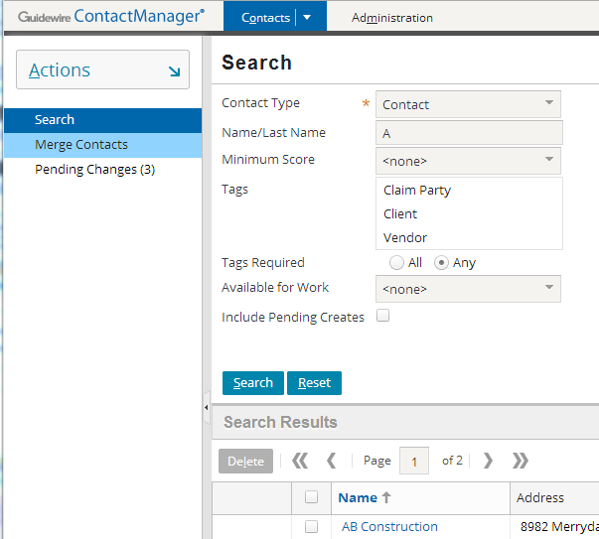
The ContactManager interface
Tab bar
Sidebar
ContactManager
Screen Area
|EOS~025|
Notes:
|EON~025|
The ContactManager user interface is relatively simple compared to ClaimCenter. The three components are illustrated in the figure.
ContactManager is used to create contacts, searching for contacts, view contacts, and modify contacts.
You may also use the “Merge Contacts” menu link to identify two potentially duplicate contacts. If duplicates, you may merge the two Contacts’ data together into one correct contact.
Adjusters, CSRs, and other users without permissions may create or edit vendor contacts in ClaimCenter pending approval. Note the “Pending Changes” menu link which is used to approve these changes.

Slide 26
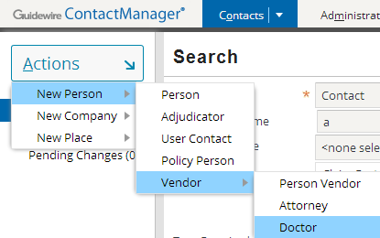
Creating new contacts in ContactManager
ContactManager
|EOS~026|
Notes:
|EON~026|
New contacts in ContactManager are created using the appropriate menu action from the Contacts tab's navigation bar. The menus and fields are self-explanatory, and all of the functionality used to create contacts (such as required fields, dropdowns, validation, and so on) are also used in ClaimCenter and have already been discussed in this course.
Recall that there are three primary subtypes in the contact subtype hierarchy: person, place, and company. They correspond to the three page actions on the Contacts tab.
In both ContactManager and ClaimCenter, there is a Related Contacts tab (which is visible if you view PowerPoint in Notes view (View > Notes Page)).
This tab is used to specify that this contact has a relationship to some other contact (such as Bruce Banner is an employee of Victory Memorial Hospital). The other contact automatically gets the inverse relationship. (In other words, Victory Memorial Hospital becomes linked to Bruce Banner with the relationship of employer.) This is a structured way of establishing when someone is to be contacted through someone else.

Slide 27
Lesson outline
Contact Basics
ContactManager
Creating ClaimCenter contacts
Searching for contacts
|EOS~027|
Notes:
|EON~027|

Slide 28
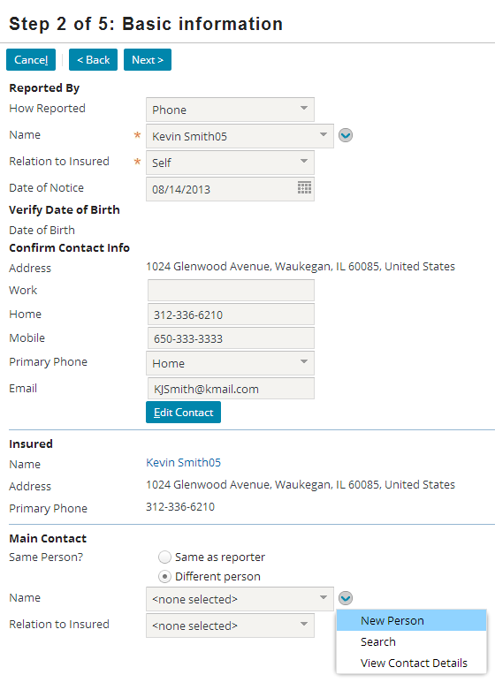

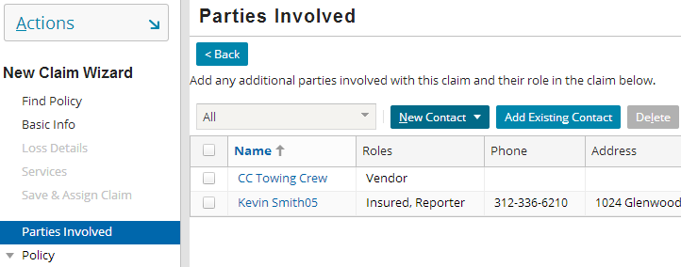
Creating contacts from the new claim wizard
Contacts added on the Basic Information step have a pre-defined role
Contacts added on the Parties involved step can have any role
|EOS~028|
Notes:
|EON~028|
During the New Claim wizard, you can add contacts to a claim at multiple points, including the Basic Information step and the Parties Involved step.
In some places, such as the Basic Information step, a given contact has a pre-defined role. For example, the contact specified in the Reported By section has the role "reporter". The contact specified in the Main Contact section has the role "main contact".
In some places, such as the (optional) Parties Involved step, a given contact can have any role. For example, a contact added here could be "insured", "witness", "doctor" and so on.
You may also create contacts in the New Claim Wizard when adding service requests to a claim. This topic is covered in the “Vendor Service Requests” lesson.

Slide 29
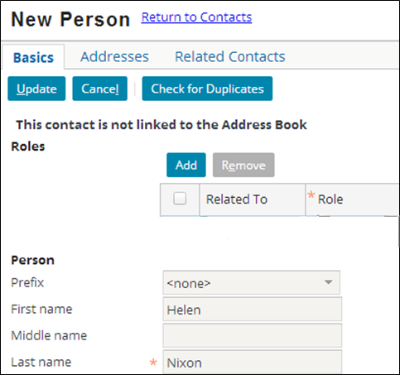
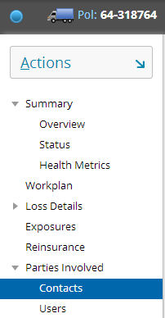
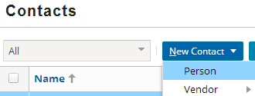
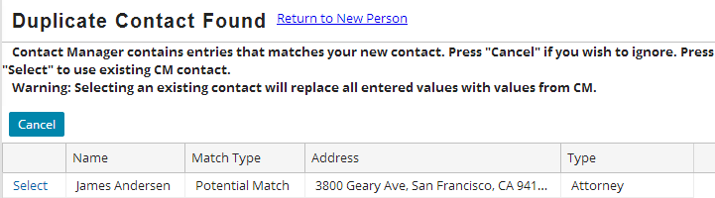
Adding a new local contact
ContactManager
4 (optional)
3
2
1
|EOS~029|
Notes:
|EON~029|
To create a new local contact in ClaimCenter (as opposed to using a contact from Address Book):
Navigate to the Parties Involved > Contacts screen.
Click New Contact and choose the appropriate choice from the sub-menus (Person, Vendor, Company, Legal).
On the Basics card, enter the contact information.
You may wish to check the Address Book (ContactManager) for matches before creating new Contacts using the “Check for Duplicates” button. While the Address Book primarily stores vendor Contacts, you may check for duplicates of any kind (Persons, Vendors, Companies, Legal) that may exist. Checking for duplicates is only available upon Contact creation. In ContactManager, you may find existing duplicates using the “Merge Contacts” tool previously mentioned. This “Check for Duplicates” mechanism is a separate tool, and is in ClaimCenter only. The purpose is to identify existing contacts in ContactManager and copy the full and complete contact details into ClaimCenter instead of someone entering duplicate data.
Person contact duplicates are matched using a combination of: Last name and one of address, phone, Tax ID (Social Security Number), Date of Birth or Driver’s License information.
Company or vendor contact duplicates are matched using a combination of: Name and Tax ID.
The duplicate finding/matching is very similar to the behavior involved in linking a ClaimCenter local contact to CM. This is discussed in the next lesson (Shared Contacts).

Slide 30
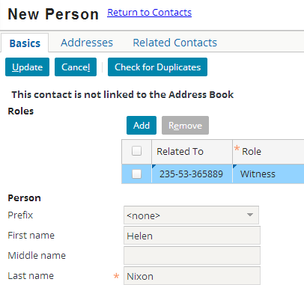
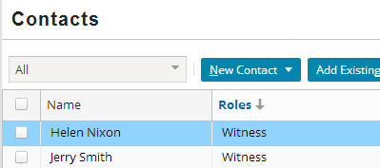
(cont.) Adding a new local contact
6
4
5
Resulting screen after Update – the new contact appears in the Contacts list
|EOS~030|
Notes:
|EON~030|
4. You must add at least one role to the contact. To add a role, click the Add button in the Roles list view. Complete the information in the new row.
5. When the information about the contact is complete, click Update. This returns you to the Contacts list.
6. In the base application user interface, the statement "not linked to the Address Book" is used to denote a local ClaimCenter contact.
In this case, there is no need to link this particular contact (a Witness) to the AddressBook.

Slide 31
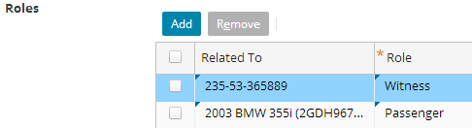
Roles in the User Interface
Claim 235-53-365889
witness
Helen Nixon
passenger
Incident 2003 BMW 355i
Role holds for entire claim
Role holds for BMW incident
|EOS~031|
Notes:
|EON~031|
Recall that a contact may have more than one role and that each role is held in relation to the entire claim or to a specific exposure, incident, or policy.
The default relationship for each role is the entire claim, which appears in the Related To dropdown as the claim number.
In the example above, Helen Nixon:
Has the role of witness for the entire claim.
Has the role of passenger only for the 2003 BMW 355i incident.

Slide 32
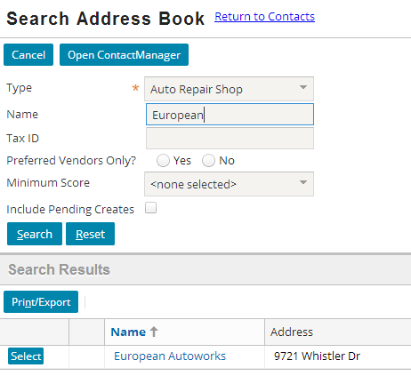
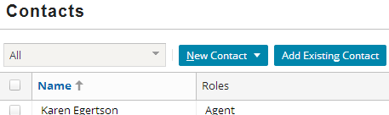
Adding shared (existing) contacts
Enter contact name
2
3
1
|EOS~032|
Notes:
|EON~032|
Navigate to the Contacts screen, which appears in the Parties Involved screen.
Click Add Existing Contact and specify search criteria.
Click Search

Slide 33
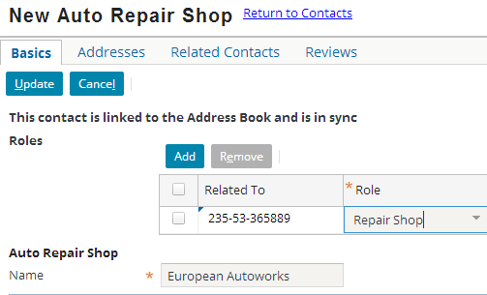
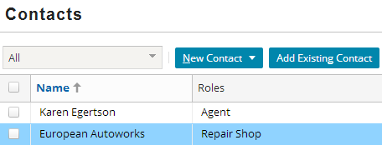
Adding shared (existing) contacts
5
Select role
4
After Update, the contact appears in the Contacts list
|EOS~033|
Notes:
|EON~033|
Continued:
4. Click the Select button corresponding to the desired contact, which creates a copy of the contact in ClaimCenter.
5. Add a role for the selected contact – in this example, the role is a Repair Shop
6. Click Update. This returns you to the Contacts list, and the new contact appears in the list of contacts.
NOTE: If you were to add a “local” vendor or company in ClaimCenter, it will become shared with the AB because the vendor addition will be pushed to ContactManager pending approval. Addition of a vendor requires including the name of the vendor and a Tax ID.

Slide 34
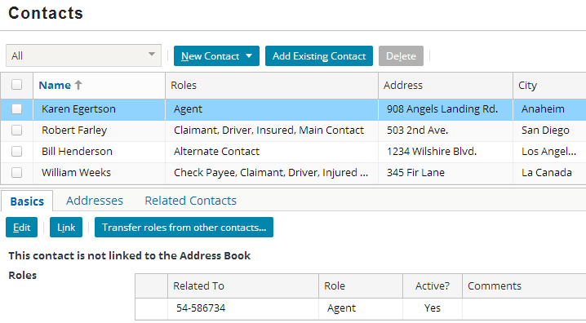
Transferring roles on a claim
Transfer roles from other contacts… button initiates process to move roles from multiple contacts into one (surviving) contact
Contacts whose roles are transferred (chosen on next screen) will be removed
|EOS~034|
Notes:
|EON~034|
When you select a contact, you can find the Transfer roles from other contacts… button on the Basics card for that contact.
This button takes you to a popup where you can decide what other contact(s)’ roles to transfer to this contact.
This contact remains on the claim and inherits all roles of the other selected contacts. The other selected contacts are then removed from the claim.

Slide 35
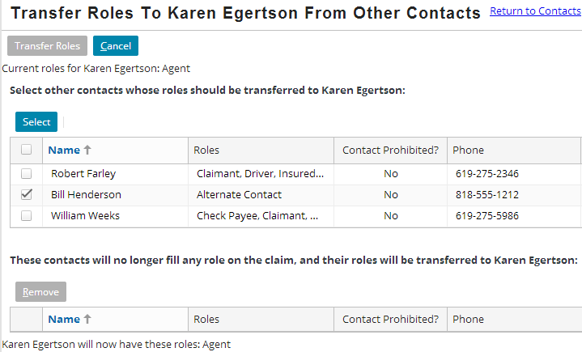
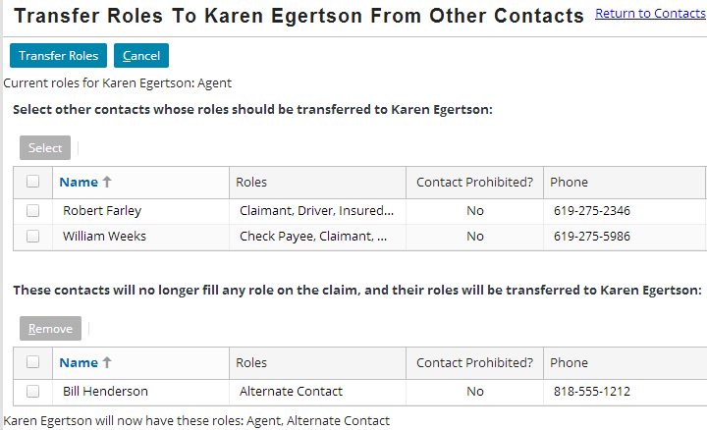
Transferring roles screen
Select contacts to merge into survivor
Selected contacts moved to “to be removed” list view
List of roles for survivor updated
|EOS~035|
Notes:
|EON~035|
Select the checkboxes for one or more other contacts by checking the checkboxes. These contacts will be removed from the claim, and their roles added to the surviving contact.
Click Select. The contacts selected in step 1 are moves to a “to be removed” list view, and all roles from these contacts are added to the new list of roles for the surviving contact.
Note that the title of this screen highlights the name of the surviving contact.

Slide 36

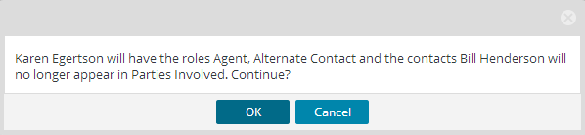
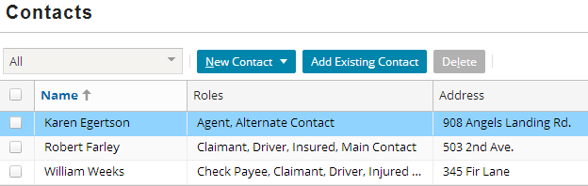
Transfer the roles
Click Transfer Roles to perform transfer
ClaimCenter displays final message detailing roles survivor will have, and contacts to be removed from claim
Can only transfer if survivor allowed to have all selected roles
|EOS~036|
Notes:
|EON~036|

Slide 37
Lesson outline
Contact Basics
ContactManager
Creating ClaimCenter contacts
Searching for contacts
|EOS~037|
Notes:
|EON~037|

Slide 38
Approaches to Searching for Contacts
Searching for contacts in the Address Book can be done using four different approaches (or combinations thereof) to reduce time and improve quality of service. This includes searching:
By Name, Type or Services Provided
For example, an Auto Repair Shop named “Express Auto” providing auto body services
By Location
For example, all contacts in 94404 (Zip Code), or a city and state (Memphis, TN)
By Proximity to a Location (using the Geocoding service)
For example, any Auto Repair Shop within 40 miles of the loss location
By Preferred Status and/or by Performance Score
For example, an Auto Repair Shop who is a Preferred Vendor and whose Average Review Score is at least 80
|EOS~038|
Notes:
|EON~038|
A combination of the approaches described may be employed. You may wish to perform a narrow search to locate only auto repair shops starting with the name “Mighty Auto”, in San Mateo, California, 94403, with a minimum score of 20, that provide auto glass services.
This section pertains to searching the Address Book in either ClaimCenter or ContactManager. Searching for claims is a separate process and you may search for claims using “Search by Contact” but the scope of that search is all Claim Contacts, not the Address Book. Searching using “Search by Contact” is a free-text search on all claims using the capabilities of Apache Solr for inexact matching on names of parties involved in a claim. For more information on this, consult the “Free-Text Search” lesson in the “ClaimCenter 7.0-8.0 New Configuration Features” training course.
At the very minimum, all searches require either a name OR a city and state OR zip (postal) code. An error will warn the user of the minimum search requirements.

Slide 39
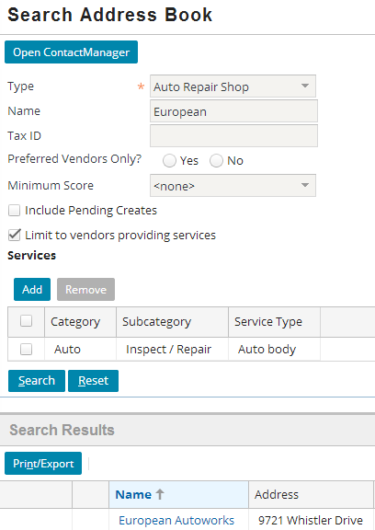
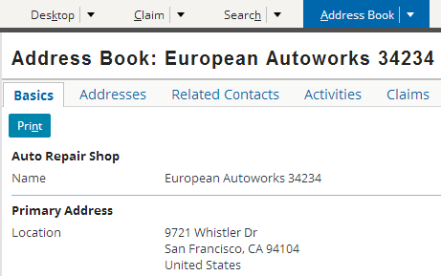
Searching by Name, Type or Services Provided
List of associated claims
Search result, not associated claim
|EOS~039|
Notes:
|EON~039|
Note that you are searching the Address Book for contacts without being within the context of a claim. For example, you may want to know the mailing address for an auto repair shop or doctor’s office even though you are not currently working on any claim associated to that contact. Address Book searches are conducted from the Address Book tab in ClaimCenter. All information about the contact is available including any claims the contact is associated with (Claims card).
In the example, the search criteria is a fragment of the name, type of contact, and limited to specific services provided. Name uses a "starts with" query to identify contacts matching the entered values. This is most common when the adjuster or claimant have already identified the service provider.
You are not required to perform such a specific search. Simplistic searches using a fragment of a name are allowed (i.e. just entering “Miller” in the “Name/Last Name” field). However, you cannot just search for a “type” alone. If you only specify a contact type, you will not be able to perform the search (example visible if you view PowerPoint in Notes view (View > Notes Page)):

Slide 40
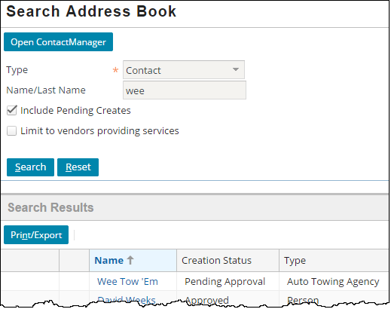
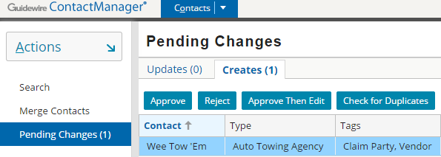
Searching Vendors: “Pending Creates”
Vendor Contacts may be added to a Claim by any ClaimCenter user
When users without “abcreate” permissions add a vendor, those vendors will be in a “pending” state
“Pending” contacts may be approved or rejected by a vendor manager user in the Address Book
These pending Contacts are immediately linked and in sync and are searchable in the Address Book just like any other AB Contact
Search all types of newly created “pending” vendors
Notes:
Any search of the Address Book in ClaimCenter may also “Include Pending Creates”. Generally, adjusters and CSRs (who do not have abedit/abcreate permissions) can create vendor contacts in ClaimCenter, but these contacts are automatically set to “pending approval”. When these users do this, their changes are sent to ContactManager for approval and review by a user with the proper permissions.
Note that you may search for any type of contact. While only vendors may be in a “pending” state, you do not have to limit your search to “Doctor”, “Auto Repair Shop”, “Medical Care Organization” or any specific type of vendor contact when using “Include Pending Creates”. This gives the user the flexibility in search if the user is not sure if the vendor is new, or what specific type the vendor is.
The process of approving or rejecting vendor contacts is discussed in the “Shared Contacts” lesson of this course.
The Searching “Pending Creates” flag is also available in ContactManager.

Slide 41
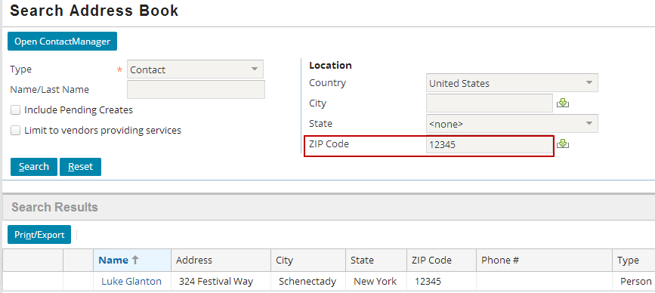
Searching by Location
You may search by:
A city and state (i.e. “Arlington, TX”) (or city and province)
A zip code (or postal code) (i.e “02258”)
|EOS~040|
Notes:
|EON~040|
It is also possible to search by the first few digits of a zip code. Entering 123 will find contacts in 12345, 12344, 12343, 12342 and so on. Likewise, searching on the first three (English) characters of postal codes (in other countries) may be performed as well. Entering M2N (a Canadian FSA in North York, Ontario) will find contacts in M2N 7K1, M2N 9C3, M2N 3H3, and so on. A FSA is known as a “Forward Sortation Area” in Canada.

Slide 42
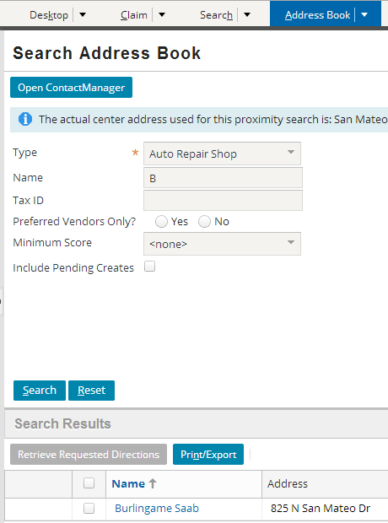
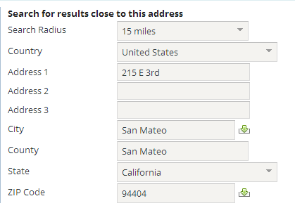
Searching by proximity to a location
Using the Geocoding service, you can search either ClaimCenter or Address Book for contacts that meet a given proximity criteria
Result is within 15 miles of the address or zip code entered.
|EOS~041|
Notes:
|EON~041|
There are two common proximity criteria:
Find all contacts within a given distance of a given location (such as find all auto shops within 15 miles of the loss location)
Find the top X closest contacts to a given location (such as find the five auto shops closest to the loss location)
Proximity searches are accomplished using geocoding. Geocoding assigns geographic coordinates to locations and uses them to find contacts within a given proximity. Geocoding requires integration with a geocoding system, which is typically provided by a vendor. Proximity searches can also be performed in Kilometers (such as in Canada) as a search radius unit (which is visible if you view PowerPoint in Notes view (View > Notes Page)).

Slide 43
Geocoding integration
address
Geocoding Service
map coordinates, zip code data
Many instances of ClaimCenter have an integration point to a geocoding service, such as Microsoft's Bing
This service provides longitude and latitude coordinates for a street address (or exchanges zip code for city/state and vice versa)
|EOS~042|
Notes:
|EON~042|
Information exchange
ClaimCenter sends the address
ClaimCenter receives coordinates, which it can use to do proximity calculations, or exchange city/state and zip code information
Geocoding services can be used to provide a list of valid zip codes for a given city and state, or a list of valid cities for a given zip code.
The amount and nature of the information provided from the geocoding service varies from provider to provider, and as a result there can be other uses for geocoding. For example:
Geocoding can be used with some services to provide the zip code for a given city and state, or to provide the city and state for a given zip code.
Geocoding can retrieve proximate distances (the direct distance between two points) and/or driving distances (which are typically longer as this does not connect two points directly but rather through a route of streets).
Geocoding can retrieve driving directions.
The effort around planning and configuring this integration point is typically minimal. Geocoding services exist to provide this type of service, and therefore they typically expend effort to make the integration straight-forward.
A given instance of ClaimCenter is typically integrated with a single geocoding service.

Slide 44

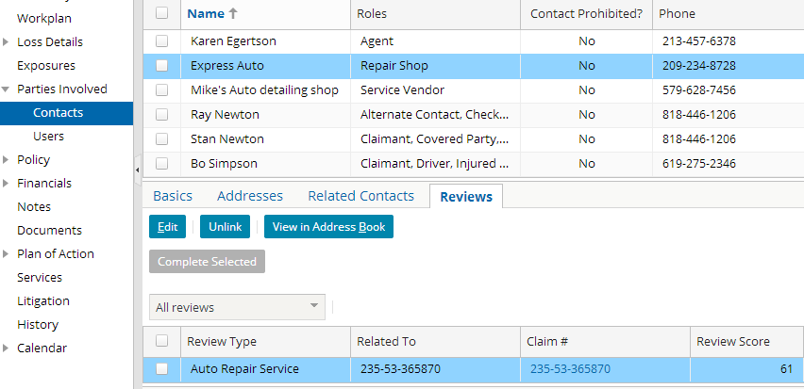
Service provider reviews
You can review and track the performance of a service provider at the claim level for different categories of service
|EOS~043|
Notes:
|EON~043|
Service Providers are contacts such as Auto Repair Shops, Lawyers or Doctors. Reviews are edited and managed in ClaimCenter, not ContactManager.
NOTE: Service provider reviews are not the same as service metrics. Metrics are measurements of the time it takes (in days) for a vendor to respond to a service request, or the time it takes for a vendor to complete work on a service. This lesson discusses service provider reviews, and the “Vendor Service Requests” lesson discusses metrics.

Slide 45
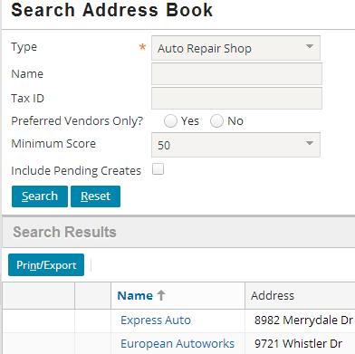
Search by preferred status and/or review scores
Adjusters can search by preferred providers that have a good track record
Choose a vendor type and preferred vendors and/or minimum score (10 – 90)
1st
|EOS~044|
Notes:
|EON~044|
During Service Request creation, the CSR or Adjuster may search for vendors to provide particular services (and use the same search shown here), and then filter or limit the results by scores or by preferred vendors. Service Requests are discussed in the “Vendor Service Requests” lesson.
Not shown is the requirement to search on a zip code or combination of city and state. Therefore you would need to supply this (like any search of the address book). However this does provide a way to combine a geographic search with preferred status and/or review scores.

Slide 46
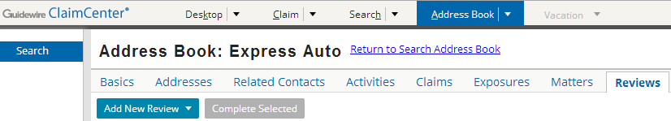
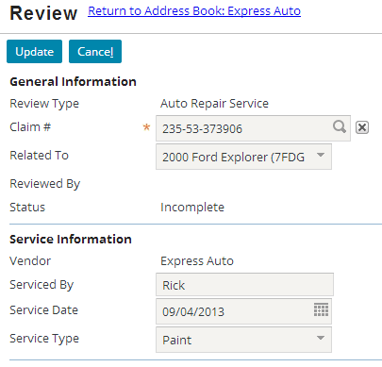

Creating new performance reviews
After locating the Service Provider, you can create/manage reviews
A drop down allows selection of the available service provider review types, in this case, “Auto Repair Service”
|EOS~045|
Notes:
|EON~045|
In the base application, a single review type is provided for Auto Repair Shop. It is possible to configure other review types for Doctors or Lawyers. These review types could re-use some of the same categories and questions, or could be entirely different.

Slide 47
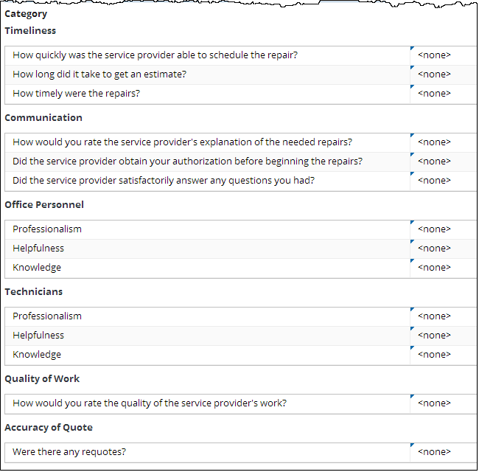
Review question sets
|EOS~046|
Notes:
|EON~046|
Each Review Type contains one or more Categories.
Categories are used for grouping sets of similar questions.
Each answer is associated with a score.
The score for each question answered is used to compute the Category Scores.
In the base application, if a question is not answered, it’s not used in the calculation.

Slide 48
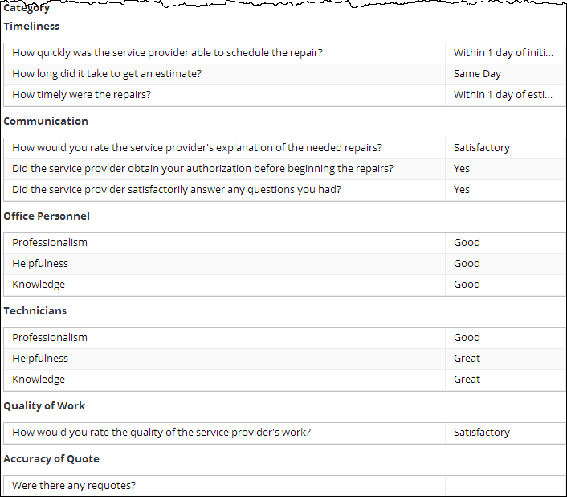
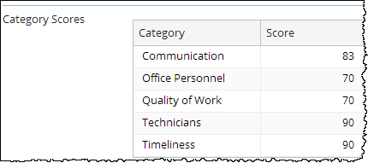
Completed provider review and scores
Review Score: 82
|EOS~047|
Notes:
|EON~047|
Notice that the Accuracy of Quote section was not answered and thus not included in the final score.

Slide 49
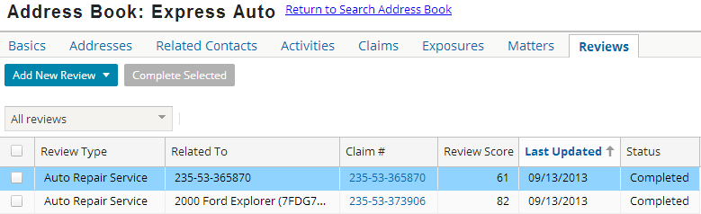
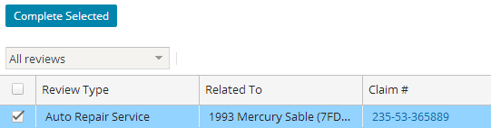
Viewing all provider performance reviews
After completing question set, complete review
|EOS~048|
Notes:
|EON~048|
All reviews for a particular service provider are available when locating the provider in the Address Book Search. Once a review is marked complete, it is read-only.
For more on the functionality of service provider reviews, and configuring service provider reviews, consult the “ContactManager Configuration for ClaimCenter” training course.

Slide 50
Lesson objectives review
You should now be able to:
Describe the functionality of contacts
Describe the functionality of ContactManager
Create contacts in ClaimCenter
Work with contacts in ClaimCenter
Describe approaches to searching for contacts
|EOS~049|
Notes:
|EON~049|

Slide 51
Review questions
If “Tire Town” is in the Address Book and is associated to three claims, how many contacts have the name “Tire Town"?
Is it common or uncommon to have a contact that exists only in ClaimCenter? Only in Address Book?
What is the purpose of a contact role? A contact role "owner"?
How can you tell if a contact is linked and/or in sync?
How could you identify all the claims that a given contact is associated to?
|EOS~050|
Notes:
|EON~050|
Answers
1. Four. There would be one contact in Address Book and three in ClaimCenter. Every contact, whether it is linked or not, is a unique and separate object.
2. It is common to have a contact that exists only in ClaimCenter. This is true for contacts that are relevant to only one claim (such as a witness or passenger). It is uncommon to have a contact exist only in Address Book. The primary purpose for creating a contact in Address Book is to have it associated to multiple claims, and if it is associated to even one claim, then the contact will also exist in ClaimCenter.
3. A contact role identifies the relationship that the contact has with the claim (such as insured, witness, doctor, and so on). The contact role owner identifies if the contact has that role for the entire claim or for just the policy, a given exposure, or a given incident.
4. You can tell that a contact is linked and/or in sync by selecting the contact from the Parties Involved - Contacts screen. A label on the Basics card identifies the contact's state.
5. Assuming that the contact is a shared contact that has linked instances in both ClaimCenter and Address Book, you could view the contact in Address Book (either by finding the contact from a Parties Involved - Contacts screen and clicking the "View in Address Book" button or by searching for it via the Address Book tab), and then view the Claims card, which lists all claims the contact is linked to.

Slide 52
Notices
Copyright © 2001-2014 Guidewire Software, Inc. All rights reserved.
Guidewire, Guidewire Software, Guidewire ClaimCenter, Guidewire PolicyCenter, Guidewire BillingCenter, Guidewire Reinsurance Management, Guidewire ContactManager, Guidewire Vendor Data Management, Guidewire Client Data Management, Guidewire Rating Management, Guidewire InsuranceSuite, Guidewire ContactCenter, Guidewire Studio, Guidewire Product Designer, Guidewire Live, Guidewire DataHub, Guidewire InfoCenter, Guidewire Standard Reporting, Guidewire ExampleCenter, Guidewire Account Manager Portal, Guidewire Claim Portal, Guidewire Policyholder Portal, ClaimCenter, BillingCenter, PolicyCenter, InsuranceSuite, Gosu, Deliver Insurance Your Way, and the Guidewire logo are trademarks, service marks, or registered trademarks of Guidewire Software, Inc. in the United States and/or other countries.
All other trademarks are the property of their respective owners.
This material is confidential and proprietary to Guidewire and subject to the confidentiality terms in the applicable license agreement and/or separate nondisclosure agreement.
This file and the contents herein are the property of Guidewire Software, Inc. Use of this course material is restricted to students officially registered in this specific Guidewire-instructed course, or for other use expressly authorized by Guidewire. Replication or distribution of this course material in electronic, paper, or other format is prohibited without express permission from Guidewire.
Guidewire products are protected by one or more United States patents.
|EOS~051|
Notes:
|EON~051|

