Slide 1
Activities
30 July 2014
|EOS~001|
Notes:
|EON~001|
Guidewire training materials contain Guidewire proprietary information that is subject to confidentiality and non-disclosure agreements. You agree to use the information in this manual solely for the purpose of training to implement Guidewire software solutions. You also agree not to disclose the information in this manual to third parties or copy this manual without prior written consent from Guidewire. Guidewire training may be given only by Guidewire employees or certified Guidewire partners under the appropriate agreement with Guidewire.

Slide 2
Lesson objectives
By the end of this lesson, you should be able to:
Describe the functionality of activities
Create activity patterns
Create activities
Review activities associated to a claim
Take ownership of queued activities
Edit and complete activities assigned to you
This lesson uses the notes section for additional explanation and information. To view the notes in PowerPoint, choose View→Normal or View→Notes Page. If you choose to print the notes for the lesson, be sure to select “Print hidden slides.”
|EOS~002|
Notes:
|EON~002|

Slide 3
Lesson outline
Activity basics
Working with activity patterns
Creating activities
Working with claim activities
Working with queued activities
Working with your activities
|EOS~003|
Notes:
|EON~003|

Slide 4
Review: Activities
Contact insured
Dana Evans
An activity is a task required to process a claim
Ultimately assigned to a user responsible for completing the task
Identifies:
When the task is to be completed
Whether it has been done or not
|EOS~004|
Notes:
|EON~004|
Activities can be created manually or automatically at almost any time, including during the claim setup process.

Slide 5

Who creates activities and why?
Business rules create activities to implement common business practices
Users create activities and assign them to themselves as a reminder of work to do
Users create activities and assign them to others to request assistance with a claim
Reservation of rights letter
Verify coverage
Vehicle salvage opportunity
|EOS~005|
Notes:
|EON~005|
ClaimCenter creates activities to implement common business practices. For example, whenever a claim is created, three activities are created and associated to the claim: "Claim Acknowledgement letter", "Contact insured", and "30-day reminder".
Users create activities and assign them to themselves as a reminder of work to do. For example, while working on a claim, if an issue comes up which causes the adjuster to question coverage, he or she could create a "Verify coverage" activity and assign it to himself or herself.
Users create activities and assign them to others to request assistance with a claim. For example, if an auto claim has a salvage opportunity but the adjuster working the claim doesn't deal with auto salvage, he or she could create a "Vehicle salvage opportunity" activity which gets assigned to someone in the auto salvage group.

Slide 6
Workplans and desktops
adjuster
supervisor
legal prof.
Desktop
Desktop
Desktop
work
plan
Initial contact
Approve reserve
Contact plaintiff
work
plan
Initial contact
Approve reserve
Contact plaintiff
work
plan
Initial contact
Approve reserve
Contact plaintiff
|EOS~006|
Notes:
|EON~006|
Every activity is associated to a claim and assigned to an owner
For a given claim, all activities associated to it are listed in its workplan.
For a given user, all activities assigned to him or her are listed on his or her desktop.
This functionality gives a user the ability to easily see the work that he or she is responsible for, as well as seeing all of the work needed to be done for a given claim.
Note in the example above that every claim has the same workplan (an activity to make initial contact with the insured, an activity to approve an initial reserve, and an activity to contact a plaintiff who is suing the insured). All initial contact activities are assigned to a single adjuster. All approval activities are assigned to a supervisor. All legal activities are assigned to a legal professional.

Slide 7


What claim objects are activities associated with?
Every activity is associated with a claim
Optional additional association with an exposure, service request, contact, or matter on that claim
|EOS~007|
Notes:
|EON~007|
Activities can also be associated with documents and notes. Documents are discussed in the "Documents" lesson and notes are discussed in the "Notes" lesson.

Slide 8
How are activities created?
Verify Coverage Activity Pattern priority: medium due days: 5
Verify Coverage Activity priority: medium due: Oct. 12, 2009
Created from an "activity pattern"
An activity pattern is a template which specifies details about the activity (subject, priority, number of days until due, and so on)
|EOS~008|
Notes:
|EON~008|
Managers have the ability to create and modify activity patterns on the Administration tab. You can configure the data model to add fields to the activity pattern entity. When a field is added to the activity pattern entity, it is available on all activity patterns. For example, a given carrier might want to add a "Required Role" field which is used to identify the role a person must have in order to have this type of activity assigned to them.

Slide 9
When are activities created?
Automatically during workplan step of claim setup
Automatically in response to a specific business event
Manually by a user at any time
|EOS~009|
Notes:
|EON~009|
Rules can create activities automatically either during claim setup (as suggested in the first scenario above) or in reaction to any event, such as the adding of a witness to a claim (as suggested in the second scenario above).

Slide 10
Activity assignment
Claim 10-0027
Peter Beebe
Assignment Rules
Assign "Contact Claimant" activities to claim owner
Contact Claimant
Assigned to a user and group, which is selected either by:
Assignment rules, or
User creating or reassigning activity
|EOS~010|
Notes:
|EON~010|
Activity assignment rules are often affected by the type of activity and the owner of the parent object.

Slide 11
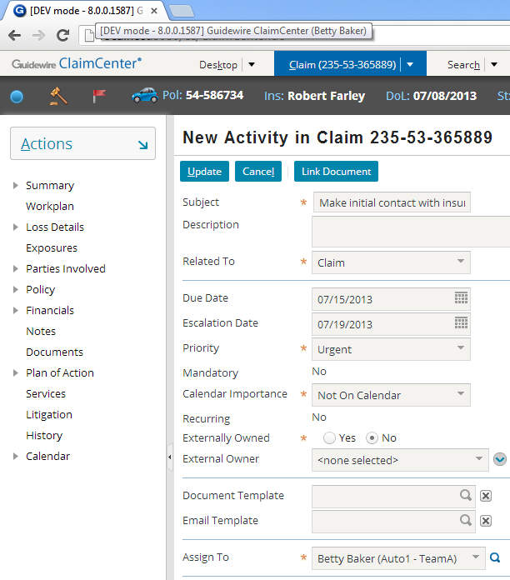
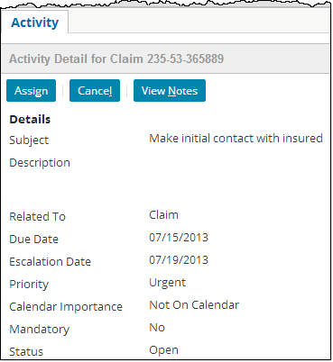
Activity ownership
activity can be reassigned but not edited by other users
Betty Baker
activity assigned to Betty Baker
Cathy Clark
|EOS~011|
Notes:
|EON~011|
When an activity is assigned to a user:
It appears in that user's Activities desktop list.
It can be edited only by that user (or other users with appropriate permissions, such as the owner's supervisor).
In some cases, a user who does not own an activity can reassign an activity. For example, permissions could establish that any user in a given group can reassign activities assigned to that group. Alternately, permissions could establish that the owner of a claim can reassign any activity on that claim.

Slide 12





The life cycle of an activity
In progress (new/updated)
In progress (normal)
Overdue
Escalated
Closed (complete or skipped)
|EOS~012|
Notes:
|EON~012|
Once an activity is created, it goes through as many as five stages.
Initially, the activity is in progress and it is "new or updated". Any activity which has been newly assigned to you (or which has been modified by another user since the last time you viewed it) has a star icon in the first column.
Once you view an activity assigned to you, it is in progress as any normal activity. Viewing a "new or updated" activity causes the star to disappear. An activity which is in progress (and is "normal") has no special visual designation.
Every activity has a due date and an escalation date. When the due date has passed, the activity is overdue. The due date now appears in red.
When the escalation date has passed, the activity is escalated. An escalated activity appears with the escalation icon (an activity with an exclamation point) in the second column.
At any point, an activity can be closed. There are two ways you can close an activity. You can complete it (which means the work is done), or you can skip it (which means the work has not been done but is now irrelevant). When an activity is closed, it no longer appears in any activities list unless the filtering criteria specifically includes closed activities.

Slide 13

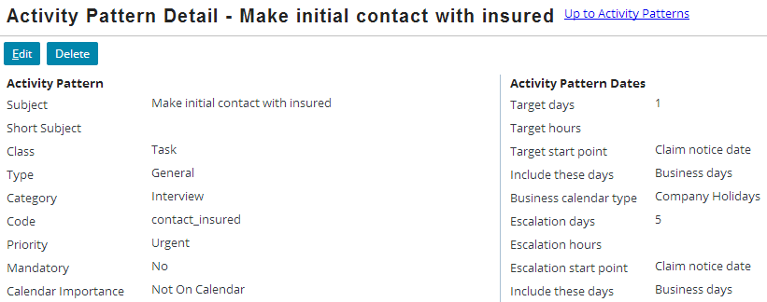
Overdue and escalated activities
Activity patterns can specify how long before an activity is overdue or escalated
|EOS~013|
Notes:
|EON~013|
In the base application, the only behavior assigned to overdue or escalated activities is the way in which they appear in activity lists. The base application can be configured to add special functionality for overdue or escalated activities. For example, ClaimCenter could be configured to automatically reassign escalated activities to the user's supervisor.

Slide 14
Review: Queues
Midwest Normal Auto Adjusters
Vehicle salvage opportunity
Lucas Fleming
Vehicle salvage opportunity
MW Salvage
A repository associated to a group which contains activities assigned to the group but not to any user in that group
Users in group can take ownership of activities in queue
|EOS~014|
Notes:
|EON~014|
Unlike groups and users, which can own any type of assignable object, queues can contain only activities.

Slide 15
Lesson outline
Activity basics
Working with activity patterns
Creating activities
Working with claim activities
Working with queued activities
Working with your activities
|EOS~015|
Notes:
|EON~015|

Slide 16
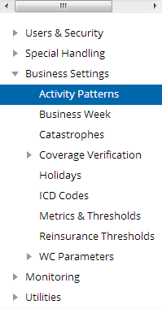
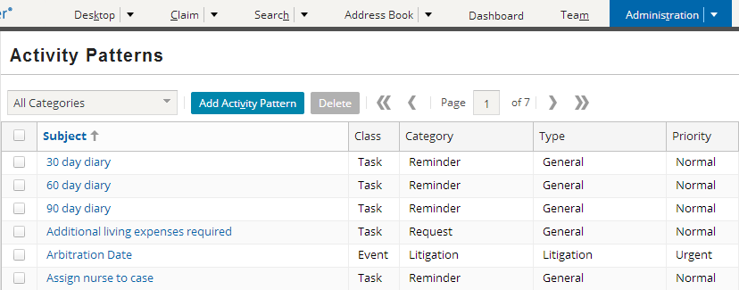
Activity patterns
administrator
|EOS~016|
Notes:
|EON~016|
Activity patterns are typically created and modified by administrators. A user with sufficient permissions to view and edit activity patterns can navigate to the Activity Patterns menu link by going to the Administration tab and clicking the Activity Patterns menu link (Business Settings > Activity Patterns).

Slide 17
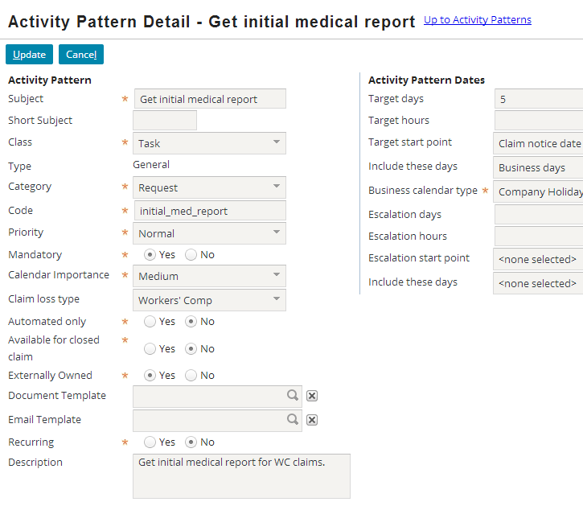
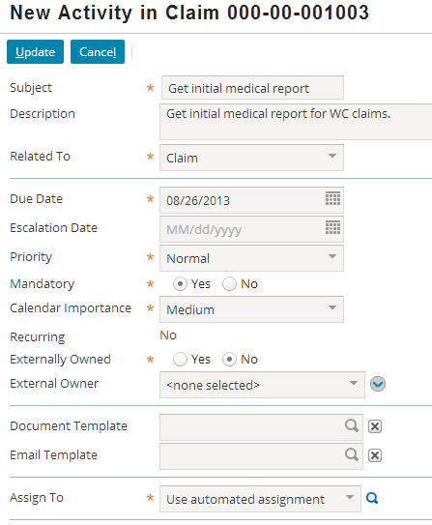
Attributes of an activity pattern
|EOS~017|
Notes:
|EON~017|
The attributes of an activity pattern determine the behavior and default values of the activities created from it.
Many of the attributes listed above are self-explanatory. Those that are not are defined below.
Short Subject - This is a brief description of the activity used on small areas of the UI such as a calendar event entry.
Class - If the activity is a task or event. A task can have a due date whereas an event cannot.
Type – Defaults to “General”. A general activity is closed by being completed or skipped. ClaimCenter has other activity types such as “Approval” activities (which are closed by being approved or denied). In the base application, activity patterns may only be created for general activities. Approval activities are internal and may be configured such that activity patterns may be created for approval or other types of activities.
Category - The category of the activity, which determines where in the "New Activity" page action menu the activity pattern appears.
Code - The internal name for the pattern, which is used by business rules when creating activities or checking to see which pattern an activity was created from.
Mandatory - Whether a user can skip this activity.
Claim Loss Type - The line of business for which this activity is available. (If no value is specified, it is available for claims on any line of business.)
Automated Only - Whether this pattern is hidden from manual activity creation and used only by business rules
Available for closed claim - Whether the activity can be added to a closed claim, meaning the activity could be performed on a closed claim. Also whether the activity can be open on a closed claim. If “Yes” the claim can be closed if the activity is still open. If “No” the activity must be skipped or closed before closing the claim.
(continued)

Slide 18
(Notes only slide)
|EOS~018|
Notes:
|EON~018|
Externally Owned - Whether the activity can be owned by an external user
Document Template - If the user should be able to create a document from a template while completing this activity, this specifies the document template to use.
Recurring - Whether the activity is likely to recur on a regular schedule. (For example, a 30 day reminder activity means that the user should check the object every 30 days.)
Description - This describes what is expected in the completion of this activity. It is visible to users only when looking at the details of the activity.
Target days/hours – The number of days/hours from the start point for the target date for activity completion
Target start point – The starting point from which the target date should be calculated. Options are activity creation date, claim loss date, and claim notice date.
Include these days – Include all calendar days or just business days.
Escalation days/hours – The number of days/hours from the start point for the escalation date for activity completion
Escalation start point – The starting point from which the escalation date should be calculated. Options are activity creation date, claim loss date, and claim notice date.
Include these days – Include all calendar days or just business days.

Slide 19
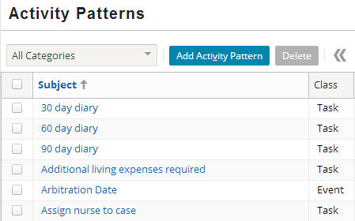
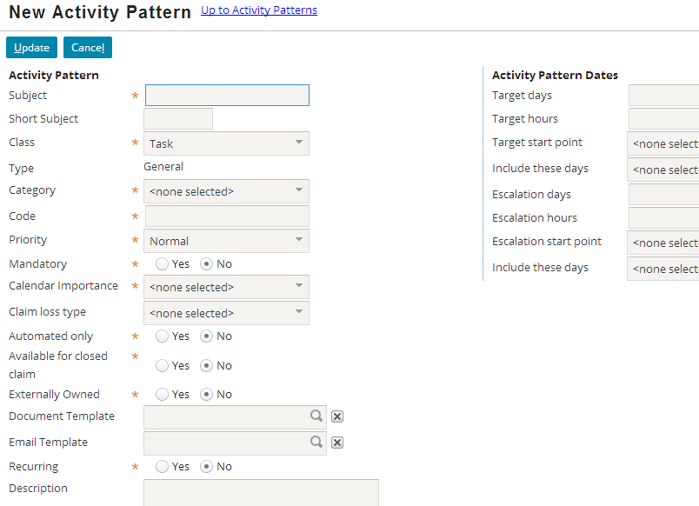
Creating new activity patterns
|EOS~019|
Notes:
|EON~019|
To create a new activity pattern, click the Add Activity Pattern button, specify the attributes for the activity pattern, and click Update.
To edit an existing activity pattern, click the name of the activity pattern in the list. Modify the attributes as appropriate and click Update. Changes to an activity pattern affect only activities from that point forward. No changes are made to activities that have already been created from that pattern.

Slide 20
Lesson outline
Activity basics
Working with activity patterns
Creating activities
Working with claim activities
Working with queued activities
Working with your activities
|EOS~020|
Notes:
|EON~020|

Slide 21
Creating activities
2
Navigate to parent claim
Select appropriate activity pattern
Identify associated exposure, claimant, service request, or matter, if necessary
Specify additional information as needed (including assignment method)
1
3
|EOS~021|
Notes:
|EON~021|
"Additional information" could include the activity's due date, escalation date, or priority.

Slide 22
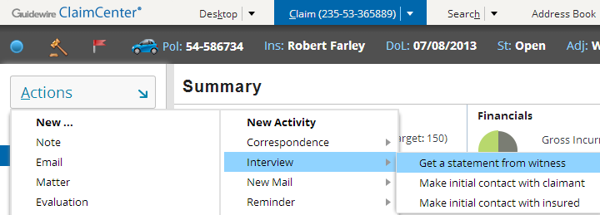
Creating new activities 1 and 2: Navigate to the claim and specify the activity pattern
Categories
Activity patterns are grouped into related categories
|EOS~022|
Notes:
|EON~022|
To create a new activity, you must first specify the activity pattern. In the example above, the "Get a statement from witness" pattern is being specified.

Slide 23
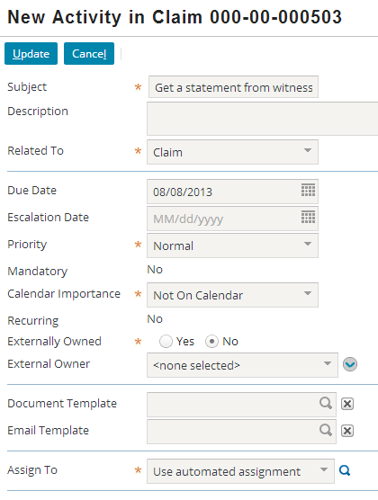
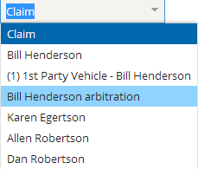
Creating new activities 3: Related to object
|EOS~023|
Notes:
|EON~023|
The "Related To" field is used to specify the parent object or objects of the activity. An activity is always associated to the claim. You can:
Have the activity associated only to the claim by retaining the default value of “Claim”
Associate the activity to an exposure (such as the “1st Party Vehicle – Bill Henderson" exposure)
Associate the activity to a claim contact (such as “Allen Robertson“, “Dan Robertson”, “Bill Henderson” or “Karen Egertson")
Associate the activity to a matter (such as “Bill Henderson arbitration")

Slide 24
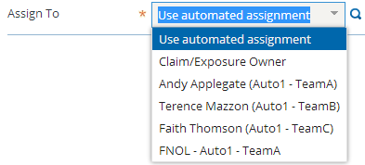
Creating new activities 4: Assign To
|EOS~024|
Notes:
|EON~024|
Note that some of the fields have initial values (such as Subject, Description, Due Date, Escalation Date, Priority, and so on.) These initial values either come from the activity pattern or are calculated from the activity pattern. For example, the Due Date is specified in the activity pattern as 3 days after the day the activity is created. So if an activity is created on October 8, its due date is set to October 11. Depending on the activity pattern, the Due Date could be specified from a different “Target start point” such as 3 days after the claim was filed.
The Assign To dropdown gives you the choice of assigning the activity to:
Selected users (typically those within your group)
Select groups and their queues
The "Use automated assignment" option, which uses the assignment business rules to determine the owner
When the activity has been detailed, you can create the activity by clicking the Update button.

Slide 25
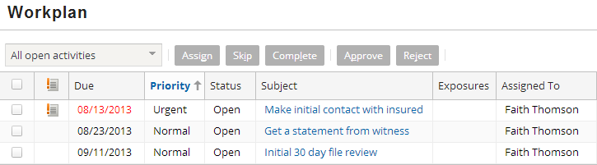
Creating new activities: The new activity
|EOS~025|
Notes:
|EON~025|
Once completed, the activity is assigned based on the criteria specified by the activity creator. This criteria could be:
Assigning the activity to a specific user.
Assigning the activity to a specific group (and letting automated rules select a user in the group)
Letting automated assignment rules do the entire assignment.
From a business standpoint, the most common logic used for activity assignment is to assign the activity to the claim owner, although this is a generalization and not an absolute rule.
Once assigned, the activity also appears in the list of activities associated to the claim (assuming it falls into the criteria specified in the toolbar filter).

Slide 26
What can you do with activities?
For activities associated to a claim, you can:
View them (and filter them)
Search for them
For activities in a queue, you can:
View them
Take ownership of them
For activities you own, you can:
View them
Modify them
Reassign them
Complete or skip them
|EOS~026|
Notes:
|EON~026|
Activities can be skipped only if they are not mandatory.

Slide 27
Lesson outline
Activity basics
Working with activity patterns
Creating activities
Working with claim activities
Working with queued activities
Working with your activities
|EOS~027|
Notes:
|EON~027|

Slide 28
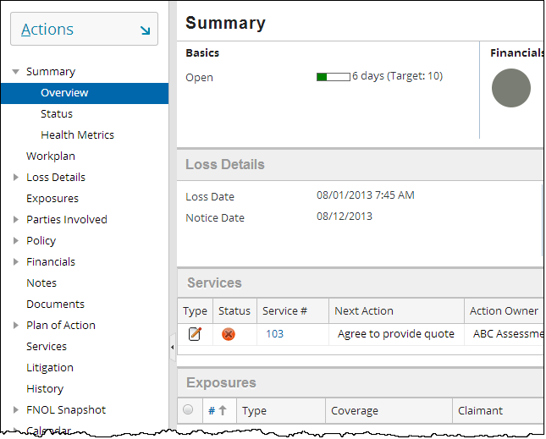
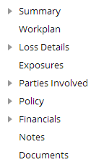
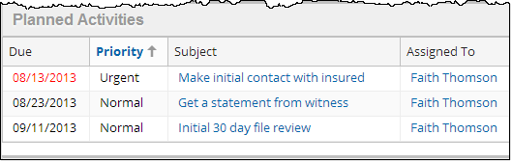
Viewing the list of claim activities
|EOS~028|
Notes:
|EON~028|
In the base application, the activities associated to a given claim appear in two places:
From the Summary screen (Overview menu link), you can scroll down to see a list labeled "Planned Activities". From this list, the only thing you can do is view an activity in detail.
From the Workplan screen, you can see a list labeled Workplan. From this list, you can filter out and act on activities, as well as view an activity in detail.

Slide 29
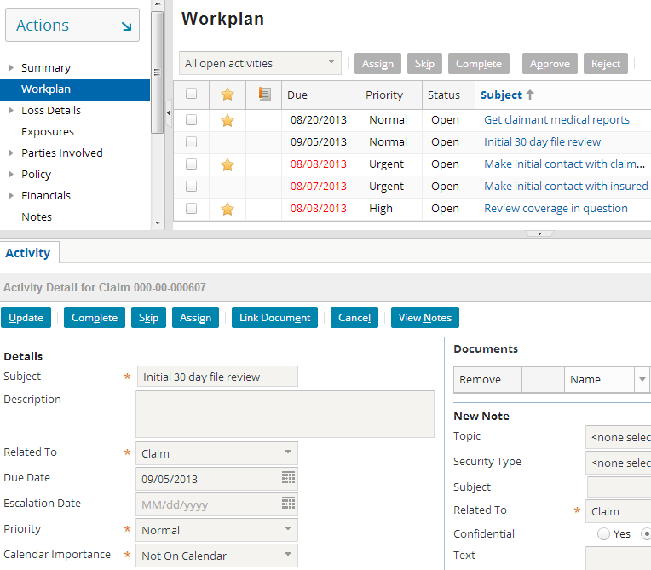
Viewing an activity in detail
|EOS~029|
Notes:
|EON~029|
In general, the Subject column in a list of activities contains clickable links. When you click a Subject, the corresponding activity is opened in the workspace frame. From here, you can view the activity in detail. If you are the owner of the activity (or otherwise have permissions to edit activities you do not own), you can also modify the activity.

Slide 30
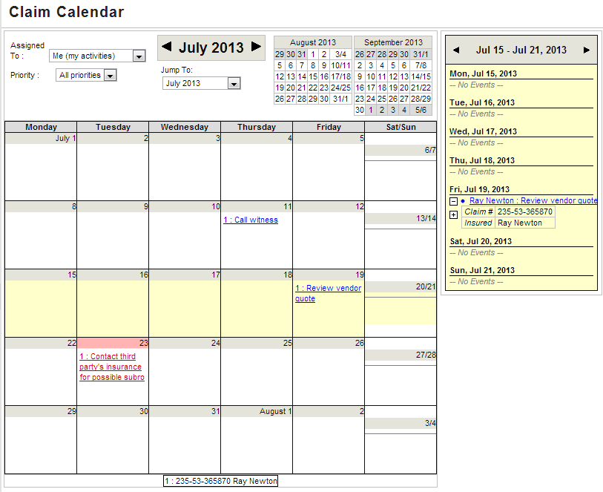
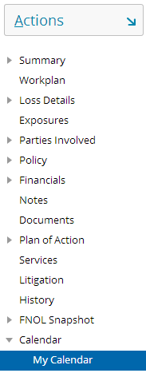


Viewing claim activities via the calendar
|EOS~030|
Notes:
|EON~030|
Activities associated to a claim and with a Calendar Importance value can also be viewed via the Claim Calendar. A drop down allows the user to view just her claim activities or all activities on the claim (workplan) assigned to all users. The color (red/blue) does not signify ownership, rather whether it is marked as “Top” calendar importance. Workplan items of “Top” importance are red, all others are blue.
On any given date in which an activity is due, the subject of the activity appears in the calendar on that date. This is a clickable link that navigates to the activity.
There is also a weekly summary on the right of the calendar. This lists activities due that week. Once again, each of the activities is a clickable link that navigates to the activity.
A box at the bottom of the calendar identifies the claim numbers for all the activities appearing in the calendar (as shown in the zoom-in on the bottom). This calendar shows activities for just one claim (235-53-365870) but it could show multiple claims if the user were viewing the Desktop Calendar, which contains all activities owned by the logged-in user. Lastly, Ray Newton is shown in this example because he has a role of “Main Contact” on the claim (defined in the “Parties Involved”.

Slide 31
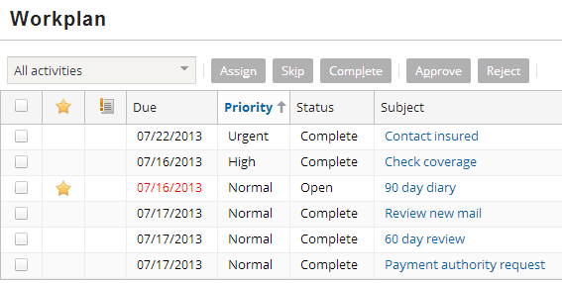
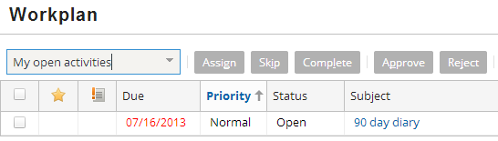
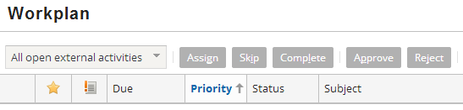
Filtering activities in an activity list
|EOS~031|
Notes:
|EON~031|
Activity lists typically include a toolbar filter that lets you filter out activities you are not interested in viewing. In the example above:
The top screenshot shows "All activities" (no filtering at all).
The middle screenshot shows "My open activities". All of the activities that are visible in the first screenshot do not show in this view except for one because they are Complete. Keep in mind if an activity is “Skipped” it will also not show up in the middle screenshot.
The bottom screenshot shows "All open external activities". None of the activities are external. Therefore, the list is empty.
In the base application, the following criteria are available in the activity lists' toolbar filter:
All open activities
My open activities
All activities
My activities
My open due next 7 days
My open due next 14 days
My open due next 30 days
All open external activities
My open external activities

Slide 32
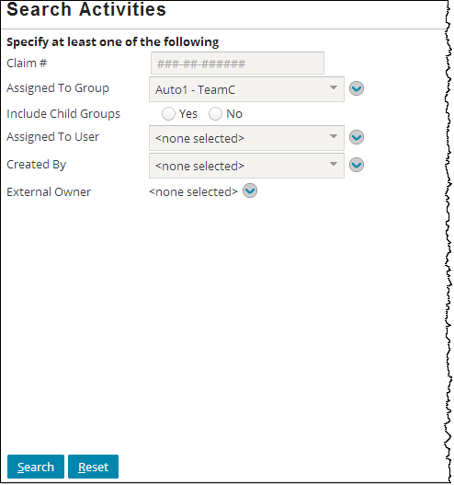
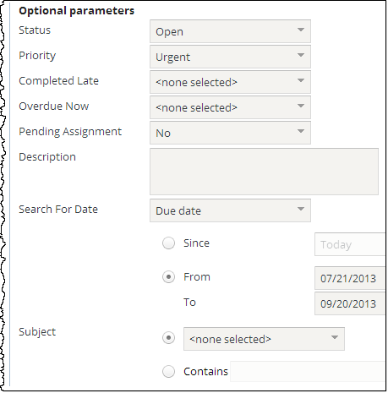
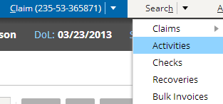
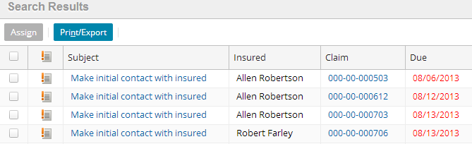
Searching for activities
|EOS~032|
Notes:
|EON~032|
You can search for activities using the Search Activities screen on the Search tab. At least one criterion on the left column must be entered. Additional criteria may be used to narrow the search results, as can be seen in the slide which narrows the activities to a status of “Open” and priority of “Urgent”, and limited to a particular date range.

Slide 33
Lesson outline
Activity basics
Working with activity patterns
Creating activities
Working with claim activities
Working with queued activities
Working with your activities
|EOS~033|
Notes:
|EON~033|

Slide 34
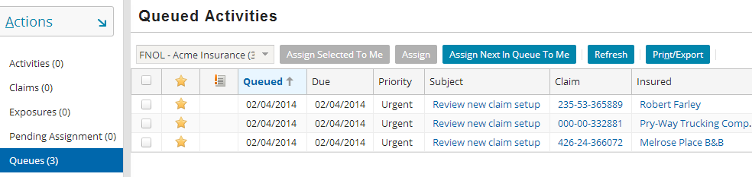
Viewing queued activities
Activities assigned to queues that you have access to can be viewed by clicking the Queues page link on the Desktop tab
|EOS~034|
Notes:
|EON~034|
Recall that a queue is associated to a group. Typically, members of a group can view any activity assigned to any of the group's queues. If you have access to multiple queues (either because your group has multiple queues or you are a member of multiple groups each with at least one queue), then you can use the toolbar filter to select which queue you wish to view.

Slide 35
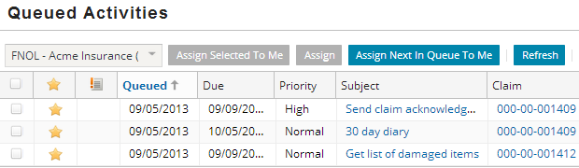
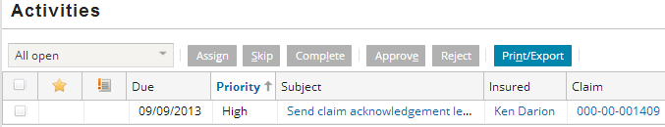
Taking ownership of a queued activity
|EOS~035|
Notes:
|EON~035|
To take ownership of a queued activity, click the Assign Next In Queue To Me button on the toolbar. The top activity in the queue is assigned to you.
Some users have sufficient permission to take ownership of any activity in a queue (as opposed to simply the first activity). For these users, there is a column of checkboxes on the left of the list and an "Assign Selected To Me" button in the toolbar. To take ownership of a given object, the user selects the appropriate checkbox and clicks the "Assign Selected To Me" button.

Slide 36
Lesson outline
Activity basics
Working with activity patterns
Creating activities
Working with claim activities
Working with queued activities
Working with your activities
|EOS~036|
Notes:
|EON~036|

Slide 37
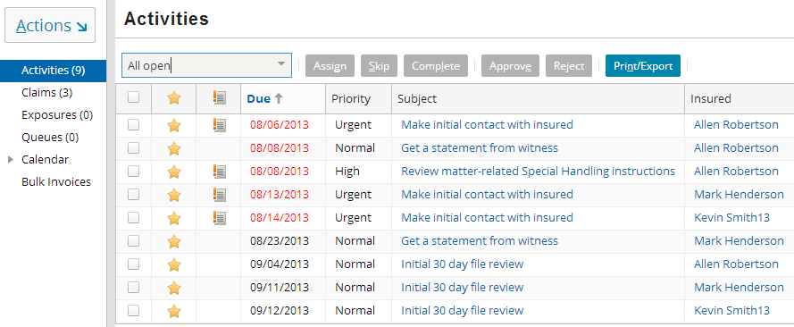
Viewing your activities via desktop list
navigate to claim and activity
Clicking activity subject:
Displays associated claim in screen area
Opens activity in workspace frame
|EOS~037|
Notes:
|EON~037|
The desktop list provides all activities, across all claims, assigned to you (the logged in user)

Slide 38
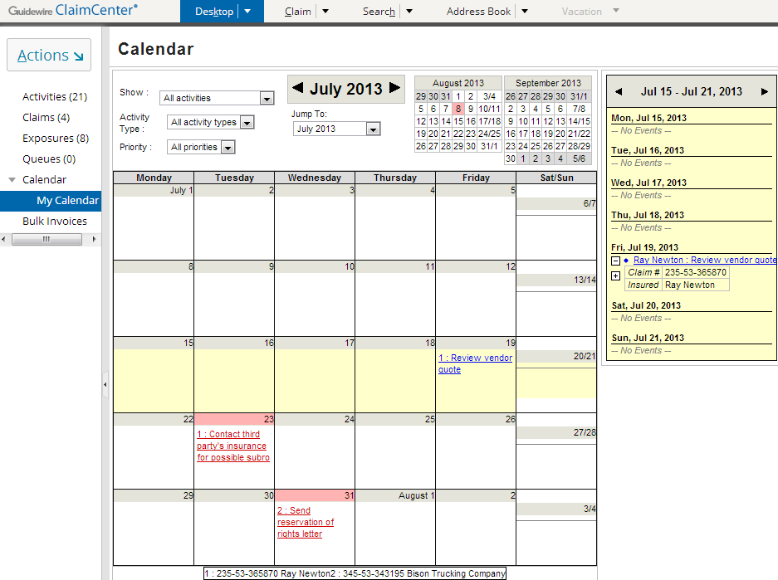

View your activities via desktop calendar
|EOS~038|
Notes:
|EON~038|
Similar to the Claim Calendar, activities assigned to you can also be viewed via your Desktop Calendar (My Calendar menu link). On any given date in which an activity is due, the subject of the activity appears in the calendar on that date. This is a clickable link that navigates to the activity. If the activity’s Calendar Importance is marked “Top”, the subject will display in red, as is the case for the “Send reservation of rights letter” activity.
There is also a weekly summary on the right of the calendar. This lists activities due that week. Once again, each of the activities is a clickable link that navigates to the activity.
A box at the bottom of the calendar identifies the claim numbers for all the activities appearing in the month’s calendar (as shown in the zoom-in on the bottom). This is useful as the activities assigned to you often span multiple claims. In this example, the logged-in user is assigned activities spanning two claims:
235-53-365870 (Ray Newton)
345-53-343195 (Bison Trucking Company)

Slide 39
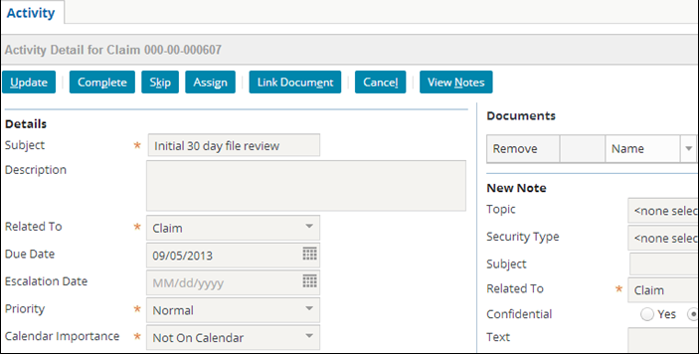
Editing your activities
|EOS~039|
Notes:
|EON~039|
You can make edits to an activity that you own. When you are done editing the activity, click the Update button.

Slide 40

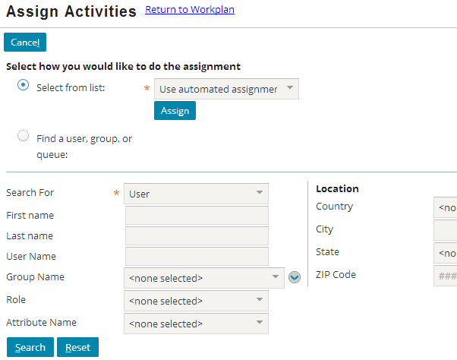
Reassigning your activities
|EOS~040|
Notes:
|EON~040|
You can reassign an activity that you own or activities owned by others (provided you have the correct permissions). To do this, either:
Navigate to the activity and click the Assign button, or
Navigate to a list containing the activity, select the check box to the left of the activity, and click the Assign button.
Either method displays the Assign Activity screen (shown above). From this screen, you can assign the activity via assignment rules or specify a user, group, or queue.

Slide 41
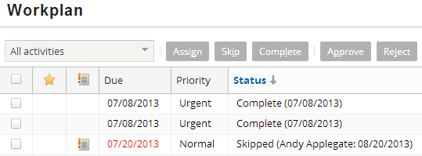
Closing your activities
|EOS~041|
Notes:
|EON~041|
There are two ways you can close a general activity:
Complete - This indicates the work for the activity has been done.
Skip - This indicates that the work for the activity is not done but no longer needs to be done. (For example, if a car was initially believed to be stolen, an "Affidavit of vehicle theft" activity might get created. If it later becomes apparent that the car was towed, the affidavit activity could be skipped.) Skipping is analogous to "logically deleting" the activity. It is still listed inside the database and can still be seen in ClaimCenter, but it has also been flagged as an activity which was ultimately irrelevant to the processing of the claim.
An activity can be flagged as mandatory. A mandatory activity cannot be skipped. It can only be completed.
There is a special type of activity called an approval activity which is closed by approving or rejecting the approval (hence the “dimmed out” buttons labeled “Approve” and “Reject”). This type of activity is discussed in the "Supervisors" lesson and is used to approve transactions such as reserves and payments.

Slide 42
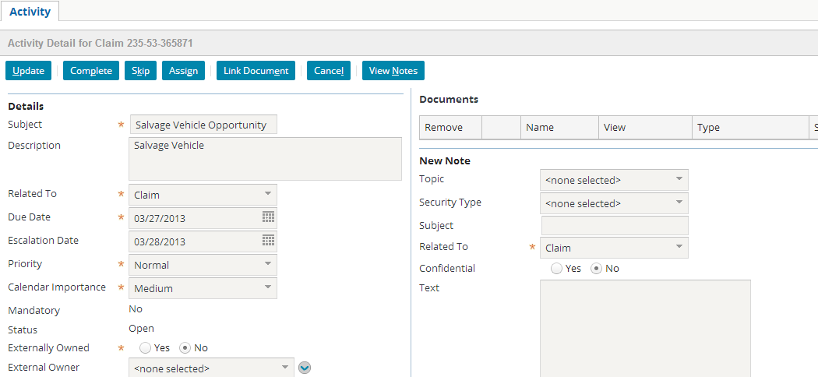
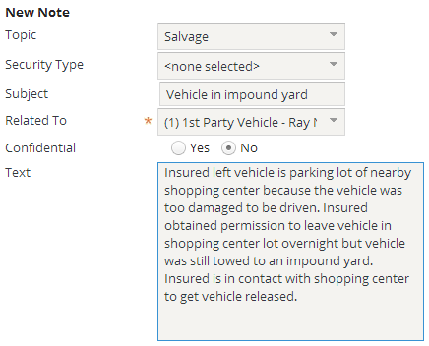
Creating an activity note
|EOS~042|
Notes:
|EON~042|
You can create one or more notes that are associated with a specific activity. These notes can record the actions or thinking behind the processing of a activity.
To create a note related to an activity:
Navigate to the activity.
In the New Note section, complete the fields as appropriate.
Click Update.
An activity can also be linked to a document. Documents are discussed in the "Documents" lesson.

Slide 43
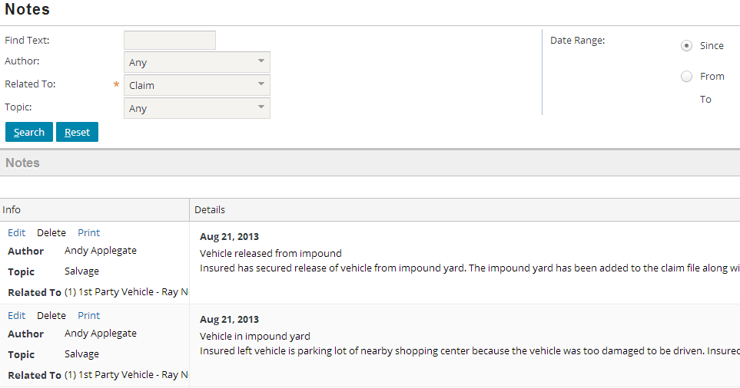

Viewing the notes for a given activity
|EOS~043|
Notes:
|EON~043|
Notes that pertain to a specific activity are listed on the Notes screen, along with all the other notes created for the claim.
To see a list of just the notes for a given activity:
Navigate to the activity.
Click the View Notes button.
Activities that are not related to that activity do not appear in the Activity Notes list. Notes are discussed in the “Notes” lesson.

Slide 44
Lesson objectives review
You should now be able to:
Describe the functionality of activities
Create activity patterns
Create activities
Review activities associated to a claim
Take ownership of queued activities
Edit and complete activities assigned to you
|EOS~044|
Notes:
|EON~044|

Slide 45
Review questions
Every activity is associated to a claim. What are the four sub-objects that an activity could optionally be associated to?
What is an activity pattern?
What do the following mean?
An activity in a list has a “star” icon in the first column.
An activity in a list has an “activity with exclamation point” icon in the second column.
An activity in a list has a due date in red.
Name one similarity and one difference between the Desktop Activities list and a claim's Workplan list.
What are the two ways an activity can be closed? What is the difference between the two?
|EOS~045|
Notes:
|EON~045|
Answers
1. Exposure, contact, matter, service request.
2. An activity pattern is a template used to create activities.
3. a) The activity is new or has been modified by another user since you viewed it.
b) The activity is escalated. (It is open past its escalation date.)
c) The activity is overdue. (It is open past its due date.)
4. Possible answers (similarities):
Both lists list activities.
Both lists have filtering criteria to modify which activities appear.
Both lists have an analogous calendar which lists the activities in calendar format.
Possible answers (differences):
Desktop Activities lists activities assigned to you (regardless of the claim involved). Claim Workplan lists activities associated to a claim (whether they're assigned to you or not).
5. An activity can be completed or skipped. A completed activity's work has been done. A skipped activity's work has not been done but is no longer relevant and does not need to be done.

Slide 46
Notices
Copyright © 2001-2014 Guidewire Software, Inc. All rights reserved.
Guidewire, Guidewire Software, Guidewire ClaimCenter, Guidewire PolicyCenter, Guidewire BillingCenter, Guidewire Reinsurance Management, Guidewire ContactManager, Guidewire Vendor Data Management, Guidewire Client Data Management, Guidewire Rating Management, Guidewire InsuranceSuite, Guidewire ContactCenter, Guidewire Studio, Guidewire Product Designer, Guidewire Live, Guidewire DataHub, Guidewire InfoCenter, Guidewire Standard Reporting, Guidewire ExampleCenter, Guidewire Account Manager Portal, Guidewire Claim Portal, Guidewire Policyholder Portal, ClaimCenter, BillingCenter, PolicyCenter, InsuranceSuite, Gosu, Deliver Insurance Your Way, and the Guidewire logo are trademarks, service marks, or registered trademarks of Guidewire Software, Inc. in the United States and/or other countries.
All other trademarks are the property of their respective owners.
This material is confidential and proprietary to Guidewire and subject to the confidentiality terms in the applicable license agreement and/or separate nondisclosure agreement.
This file and the contents herein are the property of Guidewire Software, Inc. Use of this course material is restricted to students officially registered in this specific Guidewire-instructed course, or for other use expressly authorized by Guidewire. Replication or distribution of this course material in electronic, paper, or other format is prohibited without express permission from Guidewire.
Guidewire products are protected by one or more United States patents.
|EOS~046|
Notes:
|EON~046|

