Slide 1
Documents
26 October 2015
|EOS~001|
Notes:
|EON~001|
Guidewire training materials contain Guidewire proprietary information that is subject to confidentiality and non-disclosure agreements. You agree to use the information in this manual solely for the purpose of training to implement Guidewire software solutions. You also agree not to disclose the information in this manual to third parties or copy this manual without prior written consent from Guidewire. Guidewire training may be given only by Guidewire employees or certified Guidewire partners under the appropriate agreement with Guidewire.

Slide 2
Lesson objectives
By the end of this lesson, you should be able to:
Describe the functionality of documents
Create documents
Create emails
Work with documents
This lesson uses the notes section for additional explanation and information. To view the notes in PowerPoint, choose View→Normal or View→Notes Page. If you choose to print the notes for the lesson, be sure to select “Print hidden slides.”
|EOS~002|
Notes:
|EON~002|

Slide 3
Lesson outline
Document basics
Creating documents
Creating emails
Working with documents
|EOS~003|
Notes:
|EON~003|

Slide 4

Documents
PSA
We received notice of an accident involving an automobile owned or operated by you on October 04, 2012.
A ClaimCenter document is a document which contains information relevant to the claim
Documents are either:
Physical pieces of paper (such as a photograph of damaged property), or
Electronic files (such as a PDF, Word or Email document)
|EOS~004|
Notes:
|EON~004|
Documents can be used to:
Track information on physical pieces of paper that document the loss (such as photographs of a damaged car)
Track information on physical pieces of paper that are used to process the claim (such as repair quotes from auto mechanics)
Record all correspondences with claimants, including emails

Slide 5
Documents
WCS
Please evaluate and treat Ms. Arlington for TBI resulting from workplace injury on 8/4/2014.
A ClaimCenter document is a document which contains information relevant to the claim
Documents are either:
Physical pieces of paper (such as a claim form from an employee or a doctor’s prescription), or
Electronic files (such as a PDF, Word or Email document)
|EOS~005|
Notes:
|EON~005|
Documents can be used to:
Track information on physical pieces of paper that document the loss (such as diagrams of the floor plan for a workplace)
Track information on physical pieces of paper that are used to process the claim (such as diagnoses from a doctor)
Record all correspondences with claimants, including emails

Slide 6


Document management architecture
Document Production
User Machine
Document Storage
browser
Physical Location
Five places where document information can exist
|EOS~006|
Notes:
|EON~006|
There are five "systems" where information about documents can exist:
The user's machine
ClaimCenter
A document production system, which stores templates used to generate documents
A document storage system, which stores electronic documents
A physical location, which stores physical documents
The specific information about what is stored on each system is discussed on the next slides.

Slide 7
Document management architecture: Physical documents
Document Production
User Machine
Document Storage
browser
Physical Location
|EOS~007|
Notes:
|EON~007|
For physical documents:
ClaimCenter tracks information about the document (such as the name, status, and where it is located)
A physical location (such as a filing cabinet) contains the document itself.
Also, a user can view the information that ClaimCenter has stored about the document (such as the name, status, and where it is located).
Because the document is not electronic, ClaimCenter cannot do much more than track its existence.

Slide 8


Electronic document production
template
Dear <claimant.name>, On <lossdate>...
Dear Jim Means, On May 3...
+
Letter to Insured MS Word Draft
Claim 100-00-100001
Document production is the act of creating a draft document by merging:
A template
A set of business data values
|EOS~008|
Notes:
|EON~008|
A document template is a ClaimCenter template used to generate commonly needed documents. Document templates often include information drawn from the claim and its related records.
The document template can retrieve any information available to the claim, including:
Information on the claim itself (such as the claim file number)
Information from the claimants (such as the claimant's name and address)
Information from users assigned to the claim (such as the name of an inspector who will view the property or construction site)
The document which results from the merge is typically considered a draft document because the adjuster has the opportunity to modify it before it becomes final and/or gets sent to the relevant party.
Document metadata is stored apart from the document itself.

Slide 9
Document management architecture: Electronic doc. production (1)
Document Production
+ field values
User Machine
Document Storage
Physical Location
|EOS~009|
Notes:
|EON~009|
It is difficult to make general statements about document production because there are many possibilities that can be combined in various ways.
In some cases, document templates are stored on a separate document production system. When a document needs to be produced, the field values and the name of the template are passed to the document production system. The document production system merges the information and returns a draft, which in turn is made available to the user.

Slide 10
Document management architecture: Electronic doc. production (2)
Document Production
User Machine
Document Storage
+ field values
Physical Location
|EOS~010|
Notes:
|EON~010|
In some cases, document templates are stored on the application server that hosts ClaimCenter. ClaimCenter merges the document itself and makes the resulting draft available to the user. (This approach may be less typical for documents authored in a Microsoft product like Word and may be more typical for open-source formats such as PDF.)

Slide 11

Document management architecture: Electronic document production (3)
Document Production
User Machine
Document Storage
+ field values
Physical Location
|EOS~011|
Notes:
|EON~011|
In some cases, document production takes places on the user's machine. In this case, the template and the field values are passed to the user's machine, and the user's local copy of the application merges the information and creates the draft.
The three approaches are not mutually exclusive. It is possible for some documents to be produced on a document production system, some to be produced by the ClaimCenter application server, and some to be produced on the user's machine. In these circumstances, it is typically the type of document that determines where the document is created. (For example, reservation of rights letters may exist in a legacy content management system and be produced on a separate machine, whereas basic "make contact with claimant" letters are done on the user's machine.)

Slide 12
Document production integration
template name, data to merge
Document Production System
draft of document
Regardless of where the document production occurs, every instance of ClaimCenter has an integration point to a document production application somewhere in the ClaimCenter architecture
This application merges templates and data, and it may also store the document templates
Nearly every implementation has at least some documents created using applications on each user's machine (such as Microsoft Word)
|EOS~012|
Notes:
|EON~012|
Information exchange:
ClaimCenter sends the name of the template and any information to be merged into the template.
ClaimCenter receives a draft of the document based on the template with the relevant data merged into it.
Information to merge into a document could include things like:
The current date
The recipient's name and address
The relevant claim number
This integration point is typically not the one requiring the greatest amount of effort to plan and configure, but the effort involved is significant enough that it also cannot usually be considered minimal.
A given instance of ClaimCenter may be integrated with one or more document production applications. For example, some documents may be created using applications on the user's machine whereas other documents are produced by an application elsewhere in the carrier's network. This can occur if the carrier has a legacy document production application which is used for specific types of documents, but it makes more sense for general or newer documents to be produced from the user machines.

Slide 13
Document management architecture: Electronic document storage
Document Production
User Machine
Document Storage
browser
(master copy)
(local copy)
Physical Location
|EOS~013|
Notes:
|EON~013|
Each electronic document has a MIME type. This is used by the user's local machine to determine what application to use to view a document (such as using Adobe Acrobat for PDF files).
For each electronic document, the document management system stores two sets of information. One set of information is the document itself (which is represented above with the Microsoft Word icon). The other set of information is a meta-file which stores information about the document (such as who the author is).

Slide 14
Document storage integration
document to store
Document Storage System
document to view and/or edit
Every instance of ClaimCenter has an integration point to a document storage application, such as ImageRight
This application stores "master" copies of documents
|EOS~014|
Notes:
|EON~014|
Information exchange:
ClaimCenter can send new document to be stored as well as edited versions of documents.
ClaimCenter receives the "master" version of stored documents upon request.
The ImageRight document management system was written by Advanced Solutions, Inc. specifically for the insurance industry. According to Advanced Solutions, "each feature was developed at the request of a business or IT executive, an adjuster, a claims manager, or an underwriter."
This integration point is typically not the one requiring the greatest amount of effort to plan and configure, but the effort involved is significant enough that it also cannot usually be considered minimal.
A given instance of ClaimCenter is typically integrated with a single document storage application.

Slide 15
Document mailing
Document Production
User Machine
Document Storage
browser
(master copy)
(local copy)
Physical Location
|EOS~015|
Notes:
|EON~015|
Typically, when a new document gets created, the carrier wants to send a physical copy of the document to the relevant party. (There may be some electronic communication with relevant parties via email, but because of the legal issues surrounding insurance and claims processing, most if not all important documents are delivered to the relevant party via postal mail.)
There are typically two ways in which the document gets mailed:
A ClaimCenter user prints the document and mails it to the recipient. This could be the claims adjuster or a customer service representative, and it typically means the user prints the copy using a printer on the office network and then inserts the document into an envelope himself/herself.
The document storage system takes responsibility for mailing the document. This typically involves some sort of flag that can be set on the document (such as a checkbox labeled "Mail copy to recipient") and an integration between the document storage system and a printing and mailing system.

Slide 16
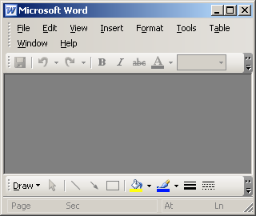
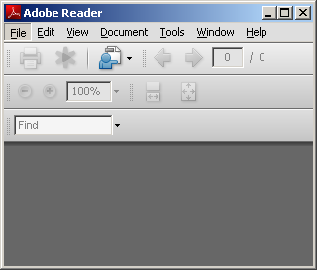
Important document attributes
???
Each document has a MIME type
This is used by the user's local machine to determine what application to use to view a document (such as using Adobe Acrobat for PDF files)
Each document has a security type
Sensitive documents are visible only to you, your supervisors, and people with permission to view sensitive documents
|EOS~016|
Notes:
|EON~016|
Documents in the base application have additional attributes, but there is no significant functionality tied to these attributes. These attributes can be configured and additional attributes could be added.

Slide 17
Three ways to create a document
Identify that a paper document exists
User Machine
ClaimCenter
Doc Storage
Link (upload) an existing electronic file
User Machine
ClaimCenter
Doc Storage
Create a doc from a ClaimCenter document template
User Machine
ClaimCenter
Doc Storage
|EOS~017|
Notes:
|EON~017|
There are three ways to create a document. You can:
Create a simple record that identifies that a paper document exists (and that there is no electronic copy of it to be stored in the document management system).
Upload an existing electronic file from your machine to the document management system.
Create a new document using a ClaimCenter document template, which creates a local copy on your machine which is ultimately uploaded to the document management system.

Slide 18
Lesson outline
Document basics
Creating documents
Creating emails
Working with documents
|EOS~018|
Notes:
|EON~018|

Slide 19
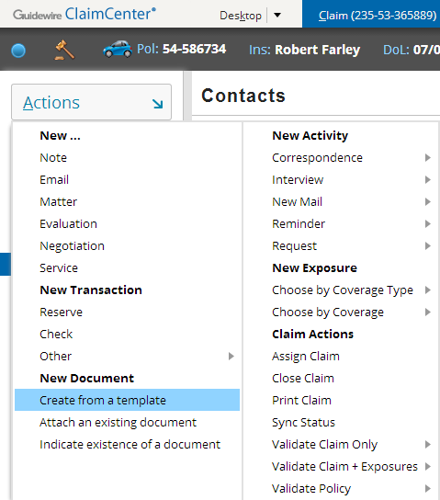
The New Document menu
To create a new document, navigate to the appropriate claim and select the appropriate New document menu item
|EOS~019|
Notes:
|EON~019|
You can also create a document from an activity. This is discussed later in this lesson.

Slide 20
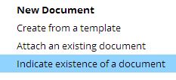
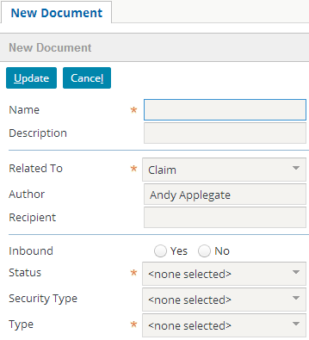
Adding records of paper documents
|EOS~020|
Notes:
|EON~020|
To add a document which is "known to exist" (but is not stored in the document management system):
Select the "Indicate the existence of a particular document" menu item.
Specify the information about the document.
Click Update.

Slide 21

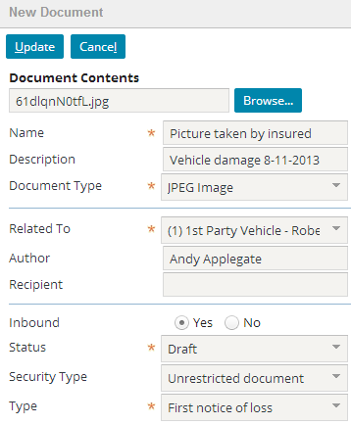
Adding existing documents as attachments
PSA
|EOS~021|
Notes:
|EON~021|
To add an electronic document which already exists on your computer (or in a location you can navigate to):
Select the "Link an existing document to this claim" menu item.
Navigate to the document by clicking the Browse button.
Specify the information about the document.
Click Update.

Slide 22
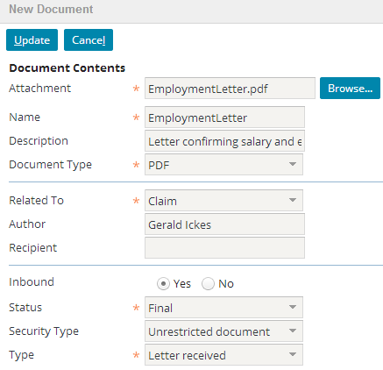
Adding existing documents as attachments
WCS
|EOS~022|
Notes:
|EON~022|
To add an electronic document which already exists on your computer (or in a location you can navigate to):
Select the "Link an existing document to this claim" menu item.
Navigate to the document by clicking the Browse button.
Specify the information about the document.
Click Update.

Slide 23
Adding documents by using a template
User Machine
ClaimCenter
Doc Storage
Adding a document by using a template is a multi-step process which involves:
Selecting the template
Generating the document
Modifying the document text
Specifying any additional values
Saving the document
|EOS~023|
Notes:
|EON~023|
The steps described in this section assume the Guidewire Document Assistant is not enabled.

Slide 24

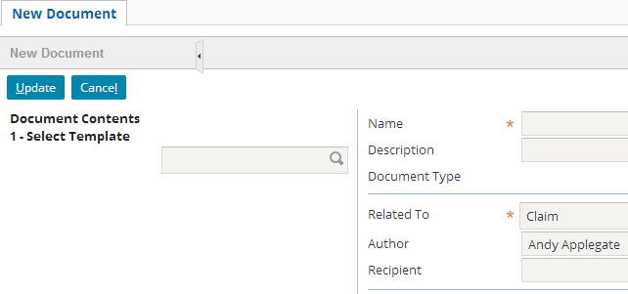
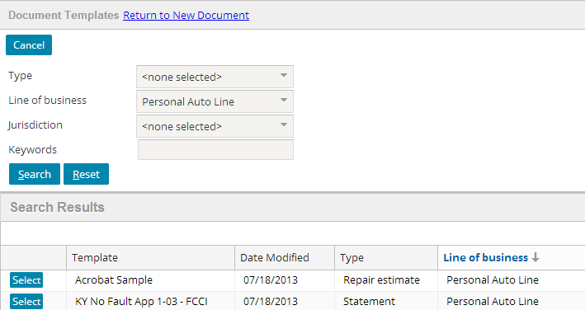
Adding document via template Step 1: Select the template
PSA
|EOS~024|
Notes:
|EON~024|
To select the template from which to generate a new document:
Click the "Create a from a template" menu item.
In the New document screen, click the search icon.
In the document templates screen, search for and select the appropriate template. The “Line of business” will be set to the LOB of the claim and the “Jurisdiction” to the claim’s jurisdiction, if available.

Slide 25
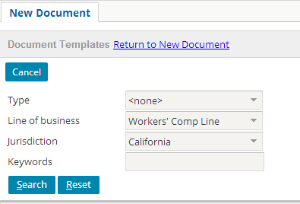
Adding document via template Step 1: Select the template
WCS
|EOS~025|
Notes:
|EON~025|
To select the template from which to generate a new document:
Click the "Create from a template" menu item.
In the New document screen, click the search icon.
In the document templates screen, search for and select the appropriate template. The “Line of business” will be set to the LOB of the claim and the “Jurisdiction” to the claim’s jurisdiction, if available.

Slide 26
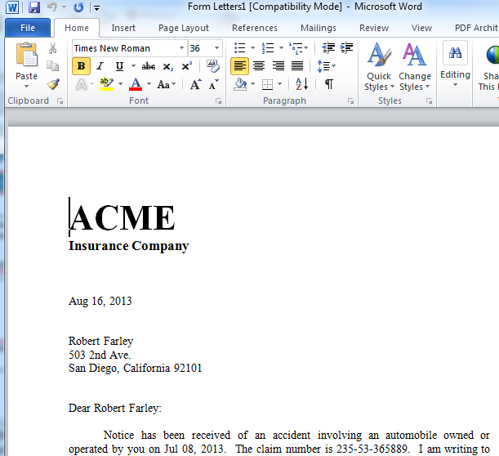
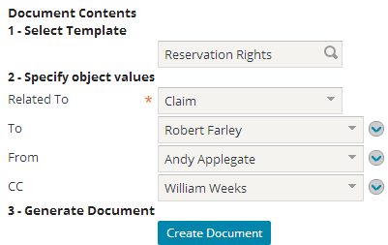

Adding document via template Step 2: Generate the document
|EOS~026|
Notes:
|EON~026|
Once you have selected the appropriate template, you typically also need to specify which objects ClaimCenter will use when generating the document. For example, a Reservation Rights is sent to someone and from someone. Before generating the document, you need to specify which claimant the letter is addressed to (Robert Farley in the example above) and which adjuster the letter is coming from (Andy Applegate in the example above).
When you are done specifying the objects, click Create Document. ClaimCenter will then download an executable, depending on the type of document. In the case of a MS Word document, the executable will be a Javascript file. Your browser may be configured to automatically execute this file type, otherwise click the downloaded file to run and document will appear in the desktop application associated with the file extension, and with the specified object values in the file. In the example shown in the slide, that is MS Word.
In some ClaimCenter configurations the Guidewire Document Assistant automatically includes the specified object values in the file and opens the file in the appropriate application. However, Guidewire does not recommend enabling this feature due to inconsistent browser support.

Slide 27
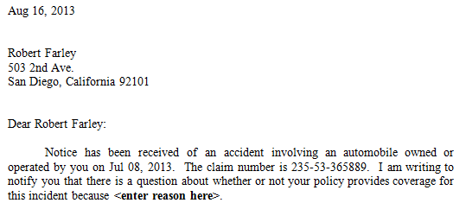
Object values in template documents
PSA
system date
contact: Jim Means
claim: 000-00-001003
|EOS~027|
Notes:
|EON~027|
The slide above shows how information from the claim and the specified objects are used in the document. For example:
The system date is used to insert a date in the letter.
The specified claimant is used to insert the claimant's name and mailing address.
The associated claim is used to insert the data of the loss date and the claim number.

Slide 28
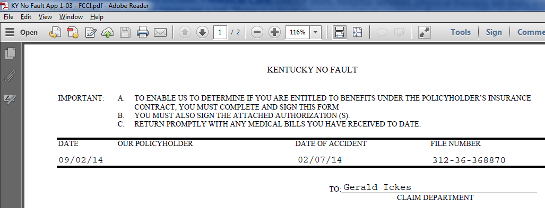
Object values in template documents
WCS
system date
adjuster: Gerald Ickes
claim: 312-36-368870
Claim loss date
|EOS~028|
Notes:
|EON~028|
The slide above shows how information from the claim and the specified objects are used in the document. For example:
The system date is used to insert a date in the form.
The specified adjuster is used to insert the adjuster’s name.
The associated claim is used to insert the data of the loss date and the claim number.

Slide 29
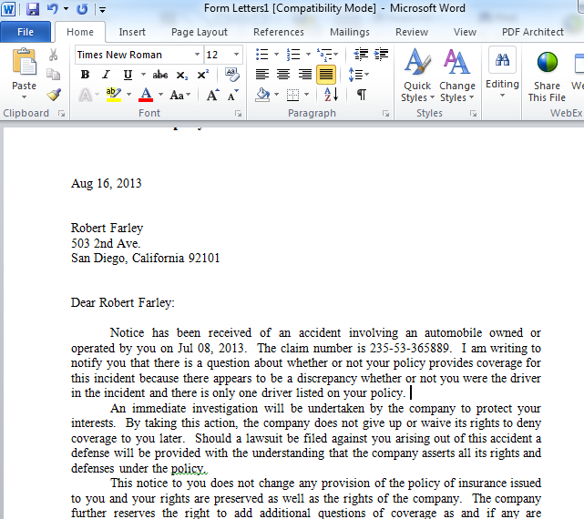
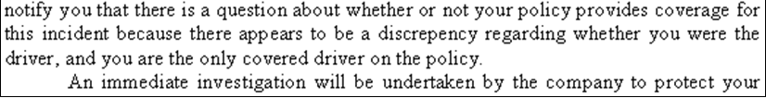
Adding document via template Step 3: Modify the document text
|EOS~029|
Notes:
|EON~029|
The document text is modifiable. It is common practice for certain values in the document to be "boilerplate" text which the adjuster is expected to replace. The adjuster should review the document, modify it as appropriate, and then save and close the modified document.

Slide 30
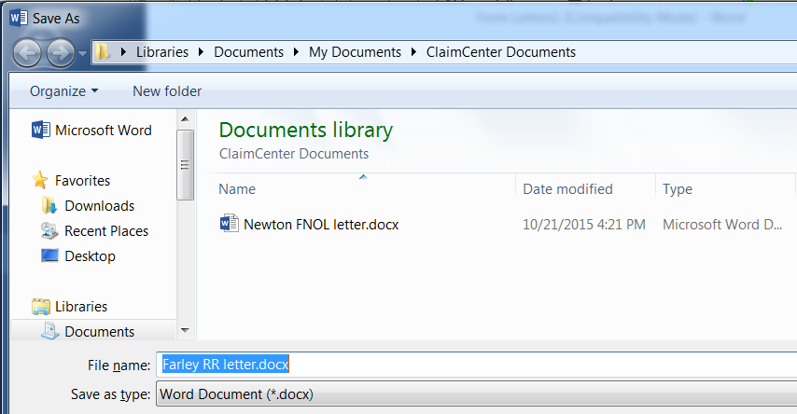
Adding document via template Step 3a: Save the document
|EOS~030|
Notes:
|EON~030|
You will save the document to your desktop in a location designated for your local claim documents and with a name that is easily identifiable. You will return to this familiar location in the next step in order to upload the file to the ClaimCenter document management system.

Slide 31
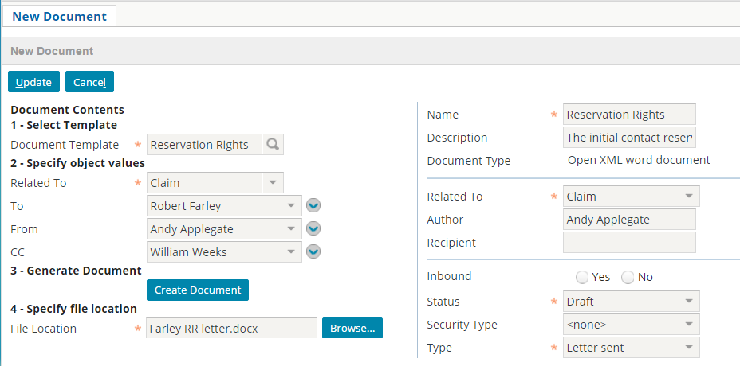
Adding document via template Step 3b: Specify the document location
|EOS~030|
Notes:
|EON~030|
You will browse to the local desktop location you saved your document in in order to identify to ClaimCenter where the file may be uploaded from.

Slide 32
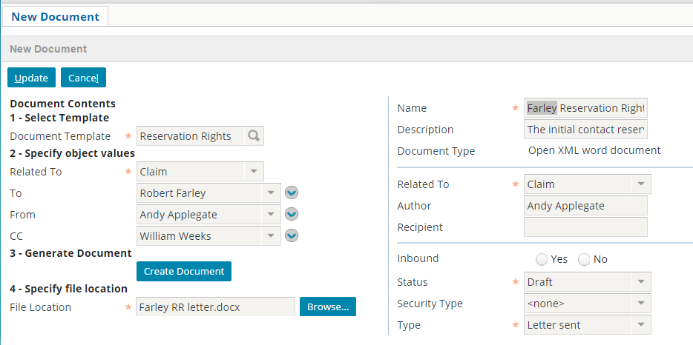
Adding document via template Step 4: Specify any additional values
|EOS~030|
Notes:
|EON~030|
Once the document has been modified, you specify any additional values about the document, including;
The Name will default to the Template name, but good practice is to make this more identifiable with the letter’s content. In the screen shot the name was changed to include the insured’s name. This name will be used to identify the uploaded copy, as opposed to the temporary local file name on the desktop.
Required fields that may need to be set, such as Status and Type (category) (In the base application Document Type (MIME type) is automatically set.)
Non-required fields which may need to be specified based on the business scenario (such as what the document is related to and whether it is sensitive)

Slide 33
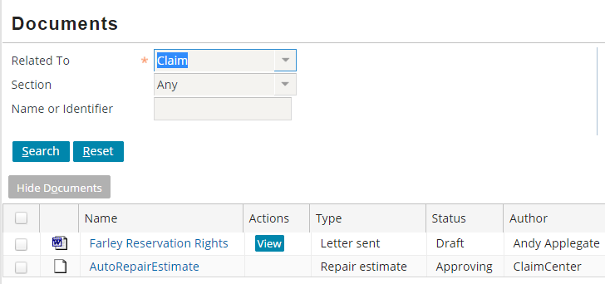
Adding document via template Step 5: Upload the document
|EOS~031|
Notes:
|EON~031|
When you are done, click Update. This uploads the local copy of the document from your machine to ClaimCenter.
Note that the name given to the uploaded document is the same you specified in the Name field. The uploaded document is no longer associated with the local copy saved to your desktop.

Slide 34
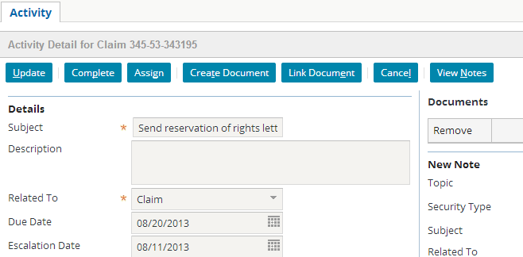
Documents and activities
|EOS~032|
Notes:
|EON~032|
Recall that activities are created from activity patterns. An activity pattern can be associated to a document template. When this is done, every activity created from the pattern has a "Create document" button. Clicking this button lets a user create a document using the template specified in the activity pattern.
All activities, regardless of the pattern from which they were created, can be linked to existing claim documents. To upload (link) an existing document to an activity, click the Link document button in the Activity Detail toolbar. This displays a screen of existing documents for the claim. You can choose the appropriate document, which then becomes linked to the activity.

Slide 35
Lesson outline
Document basics
Creating documents
Creating emails
Working with documents
|EOS~033|
Notes:
|EON~033|

Slide 36
Outbound email
Emails are a form of document that may be sent from ClaimCenter
Optionally stored as a document of the claim
May use templates to produce
Emails are used by Adjusters . . .
to send claim status information to the insured
to send documents to the attorney or an outside vendor
Emails can automatically be associated with activities
Emails can be sent automatically via business rules
|EOS~034|
Notes:
|EON~034|
How to generate emails automatically via business rules is not within the scope of this course, but is a task performed by a rule writer.

Slide 37
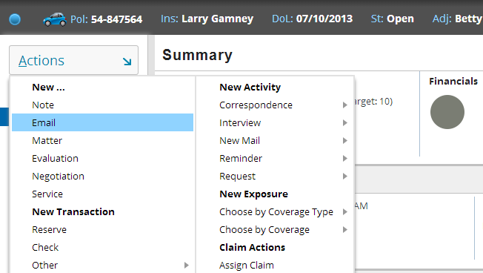
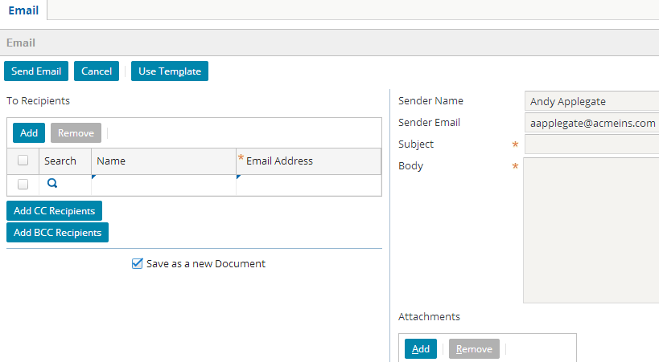
Creating a new email – menu action
|EOS~035|
Notes:
|EON~035|
Emails are created by a menu action separate from that of the new document. But similar to the new document menu action, a worksheet is opened up for creating the new email.
The checkbox to “Save as a new document” is the default behavior when creating a new email. This results in a copy of the sent email being stored as a document.

Slide 38
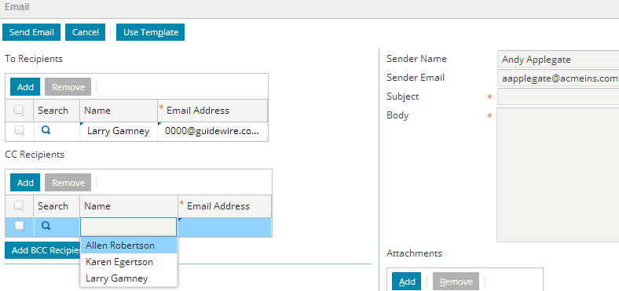
Creating new email – recipients
All claim parties involved will display as possible recipients
Recipients may be searched for using Address Book
An Email address will automatically be displayed if available
|EOS~036|
Notes:
|EON~036|
An bug in ClaimCenter 8.x may prevent the name from “auto-completing”. Entering the name using upper-case may resolve the issue.

Slide 39
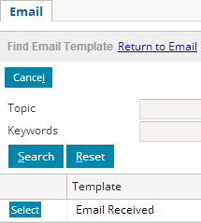
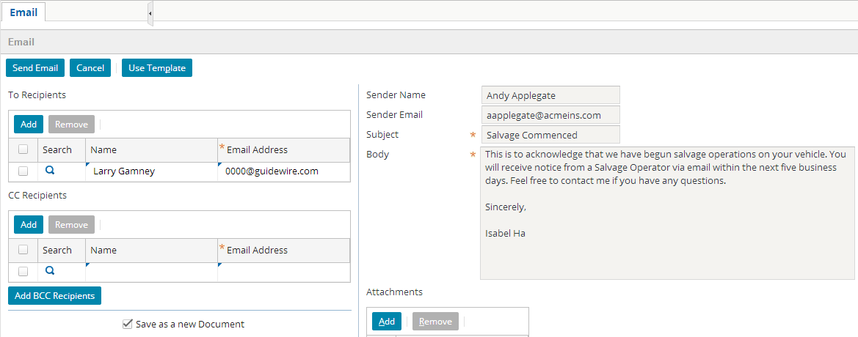
Creating new email – message body
PSA
Enter text manually or use pre-defined templates
Optionally add claim-related documents
|EOS~037|
Notes:
|EON~037|
Most (if not all) of the body text of the email was pre-populated with the contents from the template. The adjuster has begun entering her name and contact info to personalize the message. Any portion of the template is modifiable by the adjuster.

Slide 40
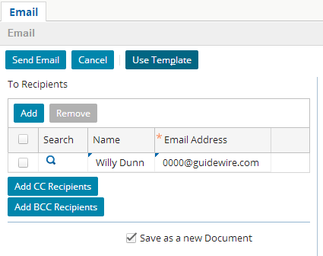
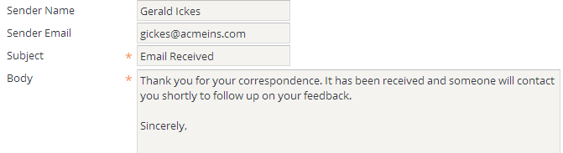
Creating new email – message body
WCS
Enter text manually or use pre-defined templates
Optionally add claim-related documents
|EOS~038|
Notes:
|EON~038|
Most (if not all) of the body text of the email was pre-populated with the contents from the template. The adjuster has begun entering her name and contact info to personalize the message. Any portion of the template is modifiable by the adjuster.

Slide 41
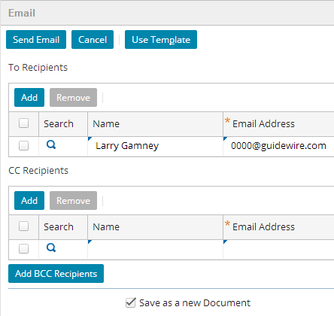
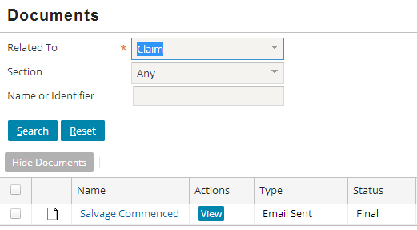
Sending new email
Clicking the Send Email button causes the email to be sent to the recipients
If you check “Save as a new document” the email is stored as one of the Claim documents
|EOS~039|
Notes:
|EON~039|

Slide 42
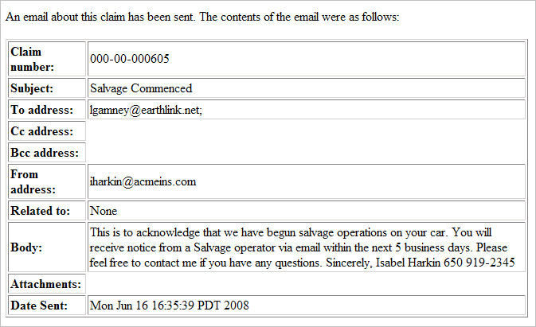
Viewing a sent email
|EOS~040|
Notes:
|EON~040|

Slide 43
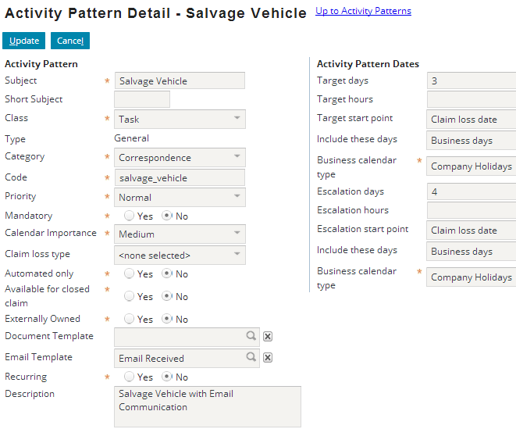
Associating email templates with activities
|EOS~041|
Notes:
|EON~041|

Slide 44
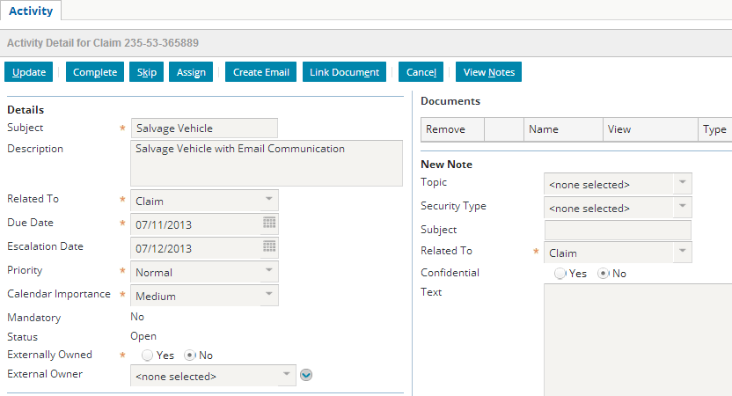
Sending emails from activities
When activity is open the Create Email button displays
Selecting the Create Email button opens up a popup in the worksheet containing a New Email screen
|EOS~042|
Notes:
|EON~042|

Slide 45
Lesson outline
Document basics
Creating documents
Creating emails
Working with documents
|EOS~043|
Notes:
|EON~043|

Slide 46
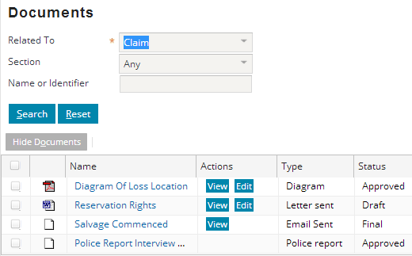
The documents screen
All documents, regardless of how they were created, appear on the documents screen
However, a document may not be listed if it is marked sensitive or hidden
|EOS~044|
Notes:
|EON~044|
You can hide a document, which simply prevents the document from being displayed in the document list by default. Hiding a document is analogous to "logically deleting" the document. It is still listed inside the database and can still be seen in ClaimCenter, but it has also been flagged as a document which is potentially irrelevant to the processing of the claim.
There is a search criteria which lets you specify that hidden documents should be returned in the search.
Recall that sensitive documents are visible only to you, your supervisors, and people with permission to view sensitive documents.

Slide 47
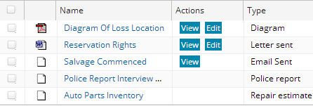
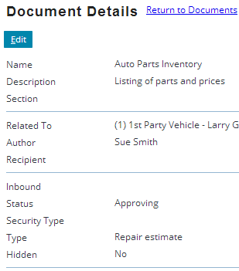
"Known to exist" (paper) documents
You can view or edit the data about the document, but because it is only known to exist, you cannot view or edit the document itself
|EOS~045|
Notes:
|EON~045|

Slide 48

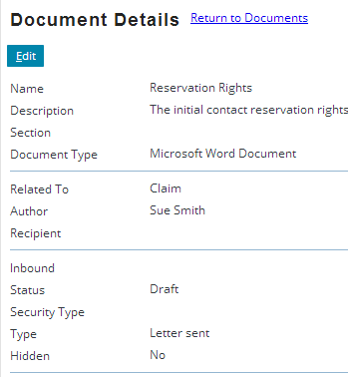
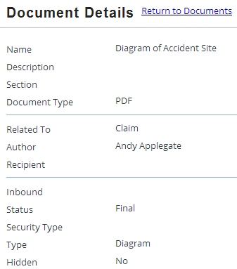
Viewing data about electronic documents
Data about stored documents may be viewed and edited unless the Status is set to Final
|EOS~046|
Notes:
|EON~046|
If a document is electronic (which means it is stored in the document management system), then you can both view and edit the data about the document as well as view the document itself. The slide shows how to view and edit the data about the document.

Slide 49
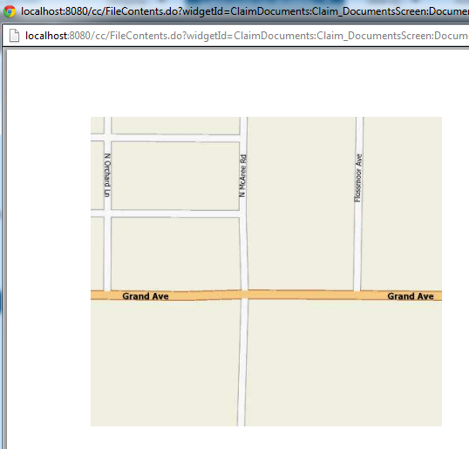
Viewing electronic documents
|EOS~047|
Notes:
|EON~047|
If a document is electronic (which means it is stored in the document management system), then you can both view the data about the document as well as view the document itself. The slide shows how to view the document itself.
In some cases, such as when the status is final, you can view a document but you cannot edit it. When this occurs, the Upload Changes field will not be visible (shown on next slide).

Slide 50

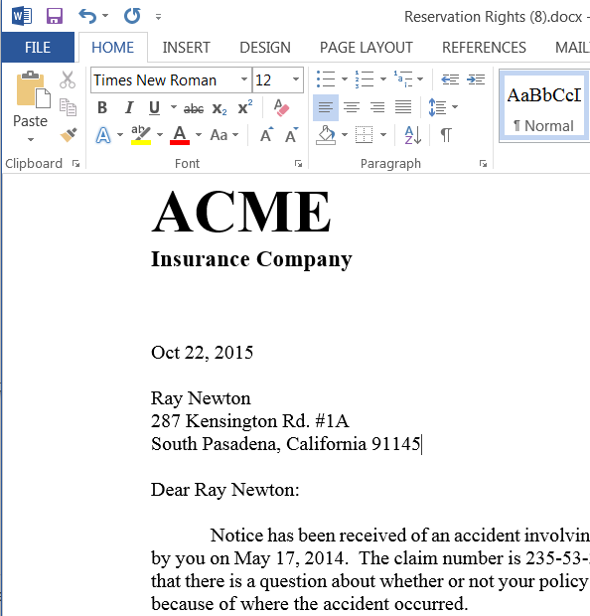
Editing electronic documents Step 1 – Retrieve document, edit and save
2. Edit document
1. Retrieve document
3. Save a local copy
User Machine
ClaimCenter
Doc Storage
|EOS~048|
Notes:
|EON~048|
Assuming you have sufficient permissions, you can edit electronic documents. To edit a document, click the View button. When you do this, ClaimCenter downloads a copy of the document to your machine and opens it in the appropriate application (such as opening a Word document in Word).
Make changes within your desktop application (e.g. Word) and then save it to a location where it can be uploaded from.

Slide 51
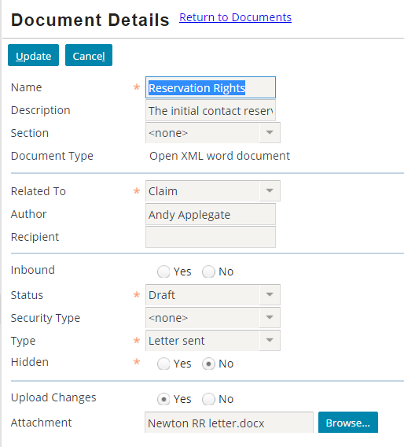
Editing electronic documents Step 2 – Upload changes
1. Select document name and edit document details
3. Upload local copy
User Machine
ClaimCenter
Doc Storage
2. Set Upload to Yes, Browse to local copy
|EOS~048|
Notes:
|EON~048|
1. To upload your local changed document, you select the document Name link which opens the Document Details screen.
2. You then select the Edit button in order to set Upload Changes to Yes. You identify the local copy to be uploaded by browsing to its location (saved in the previous step).
3. Clicking the Update button causes ClaimCenter to upload the changed local document to the Document Storage System.

Slide 52
Lesson objectives review
You should now be able to:
Describe the functionality of documents
Create documents
Create emails
Work with documents
|EOS~049|
Notes:
|EON~049|

Slide 53
Review questions
What is the primary difference between a document "known to exist" and an electronic document?
What is the significance of a document's MIME type?
What are the two ways that electronic documents can be added to ClaimCenter?
When a document already exists in ClaimCenter and you choose to edit it, where is the edited copy stored while it is being edited? What must you do to have the edited copy replace the master copy?
Under what circumstance might a user edit a document created from a template before uploading it to the document management system?
|EOS~050|
Notes:
|EON~050|
Answers
1. A document "known to exist" is not stored in the document management system (and therefore cannot be viewed or edited). An electronic document is stored in the document management system (and therefore can be viewed and possibly edited).
2. A document's MIME type identifies what kind of document the document is, which is used by the user's machine to determine the application to use when viewing the document.
3. documents can be added by:
- Uploading (linking) an existing document
- Creating a new document from a template
4. The edited copy is stored on your machine. To have it replace the master copy, you must click the Upload button on the documents screen.
5. A user might edit a document if there is text in the document that varies greatly and can only be specified by a user (such as the reason for a reservation of rights letter). Typically, a user does not have to edit a document to provide names, addresses, claim numbers, dates, and any other information which is already stored by ClaimCenter. This information can automatically be inserted into the document.

Slide 54
Notices
Copyright © 2001-2014 Guidewire Software, Inc. All rights reserved.
Guidewire, Guidewire Software, Guidewire ClaimCenter, Guidewire PolicyCenter, Guidewire BillingCenter, Guidewire Reinsurance Management, Guidewire ContactManager, Guidewire Vendor Data Management, Guidewire Client Data Management, Guidewire Rating Management, Guidewire InsuranceSuite, Guidewire ContactCenter, Guidewire Studio, Guidewire Product Designer, Guidewire Live, Guidewire DataHub, Guidewire InfoCenter, Guidewire Standard Reporting, Guidewire ExampleCenter, Guidewire Account Manager Portal, Guidewire Claim Portal, Guidewire Policyholder Portal, ClaimCenter, BillingCenter, PolicyCenter, InsuranceSuite, Gosu, Deliver Insurance Your Way, and the Guidewire logo are trademarks, service marks, or registered trademarks of Guidewire Software, Inc. in the United States and/or other countries.
All other trademarks are the property of their respective owners.
This material is confidential and proprietary to Guidewire and subject to the confidentiality terms in the applicable license agreement and/or separate nondisclosure agreement.
This file and the contents herein are the property of Guidewire Software, Inc. Use of this course material is restricted to students officially registered in this specific Guidewire-instructed course, or for other use expressly authorized by Guidewire. Replication or distribution of this course material in electronic, paper, or other format is prohibited without express permission from Guidewire.
Guidewire products are protected by one or more United States patents.
|EOS~051|
Notes:
|EON~051|

