Slide 1
Notes
4 September 2014
|EOS~001|
Notes:
|EON~001|
Guidewire training materials contain Guidewire proprietary information that is subject to confidentiality and non-disclosure agreements. You agree to use the information in this manual solely for the purpose of training to implement Guidewire software solutions. You also agree not to disclose the information in this manual to third parties or copy this manual without prior written consent from Guidewire. Guidewire training may be given only by Guidewire employees or certified Guidewire partners under the appropriate agreement with Guidewire.

Slide 2
Lesson objectives
By the end of this lesson, you should be able to:
Describe the functionality of notes
Work with notes
This lesson uses the notes section for additional explanation and information. To view the notes in PowerPoint, choose View→Normal or View→Notes Page. If you choose to print the notes for the lesson, be sure to select “Print hidden slides.”
|EOS~002|
Notes:
|EON~002|

Slide 3
Lesson outline
Notes basics
Working with notes
|EOS~003|
Notes:
|EON~003|

Slide 4
Notes
Claimant reported that the driver was a teenage boy, so there may be a question of coverage.
A note is a detailed record of the actions or thinking behind the processing of a claim
Notes are typically created by users
|EOS~004|
Notes:
|EON~004|
Notes can be created in business rules, and in some cases it may make sense for a given business rule to create and attach a note to a claim after some automatic action has been taken. But the majority of notes associated to a given claim are user-created notes.

Slide 5
Note fields
Topic: Coverage Subject: Coverage in question Related To: Entire claim Confidential: No Text: Claimant reported...
Topic - the general category of the note
Subject - a short description of the note content
Related To object - whether the note is appropriate to the entire claim or to a particular exposure or contact
Confidential - whether the note is visible to everyone or to only you, your supervisors, and people with permission to view confidential notes
Text - the text of the note itself
|EOS~005|
Notes:
|EON~005|
A note can be attached to the entire claim, or to any of the following sub-objects: exposures, contacts, or matters.
When you create a note, you can mark it as confidential. A confidential note that you create is visible only to you, your hierarchy of supervisors, and anyone who explicitly has permission to view all confidential notes.
Notes may also be set to a specific security type which determines which users may be allowed to see this note. This concept of access control for notes and other claim subobjects is covered in the Permissions and Access Control Lists lessons.

Slide 6
Note templates
Witness Statement Template Topic: Investigation Text: When did it occur? Where did it occur?
Witness Statement Note Topic: Investigation Text: When did it occur? October 7 at 2:35 pm Where did it occur? The corner of 5th and Main
A note template is a template for commonly created notes
A user can create a note using a template, which will automatically set the topic, set the subject, and/or add text to the text field
|EOS~006|
Notes:
|EON~006|

Slide 7
Lesson outline
Notes basics
Working with notes
|EOS~007|
Notes:
|EON~007|

Slide 8
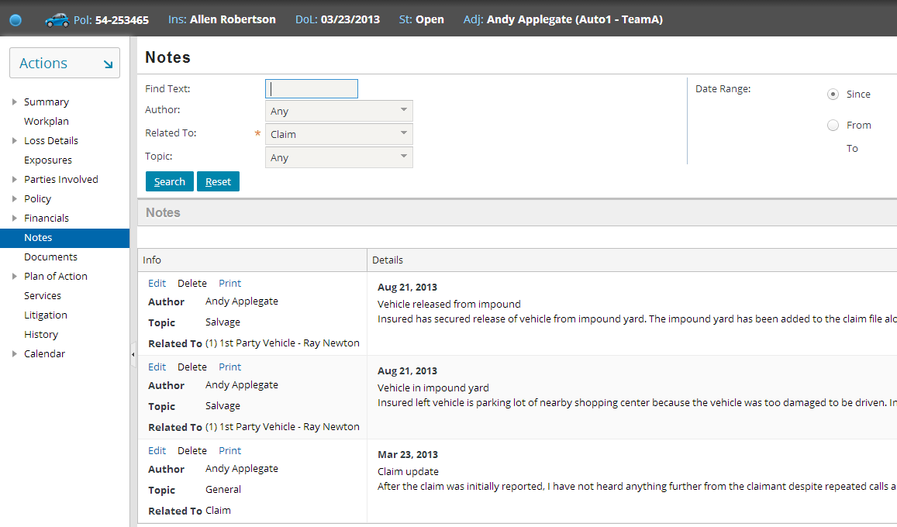
Viewing claim notes
|EOS~008|
Notes:
|EON~008|
To view the notes for a given claim, navigate to the claim and click the Notes page link. If the claim has any notes, they are displayed in the screen.

Slide 9
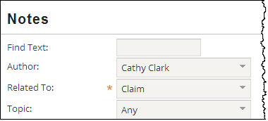
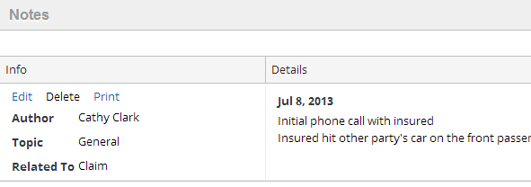
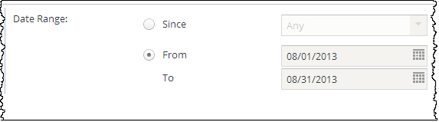
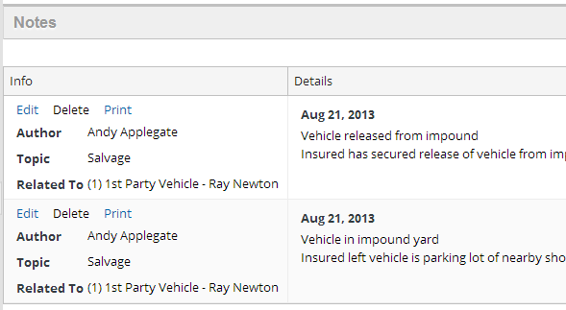
Filtering and searching for claim notes
|EOS~009|
Notes:
|EON~009|
Use the search controls at the top of the screen to filter out notes you don't wish to see. For example, you could view all notes related to a given contact on the claim, or between certain dates. One portion of the three search/filter is shown at a time in the above due to screenshot size limitations.

Slide 10
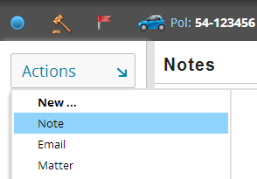
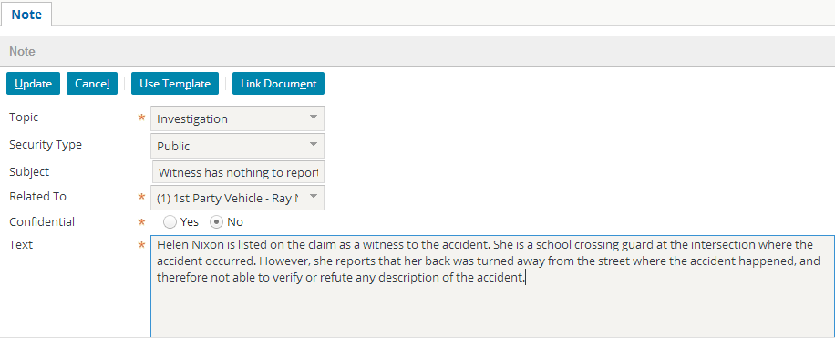
Adding notes to a claim
|EOS~010|
Notes:
|EON~010|
To create a new note for a claim:
Navigate to the claim.
Click New Note.
Enter the information about the note as appropriate.
Click Update.

Slide 11
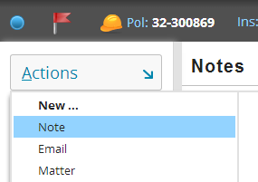
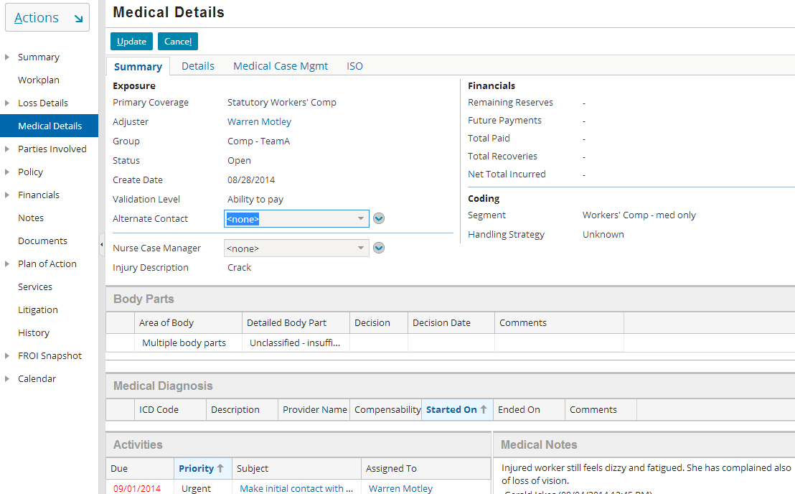
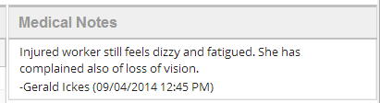
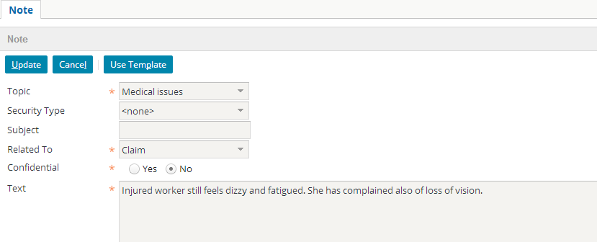
Medical Notes on Workers’ Comp Claims
WC Line of Business
|EOS~011|
Notes:
|EON~011|
Use of the “Medical Issues” topic when adding a note on a WC (Workers’ Compensation) claim will add the note with the added functionality of showing that note in read-only mode on the Medical Details exposure. The topic is the only requirement to make the note show up on the exposure. The note does not have to be related to the exposure.
Workers’ Compensation claims in ClaimCenter use designated menu links for all exposures. Because of the simplicity of exposures on WC claims and the fact that each claim has only one claimant, all medical costs are associated with a single “Medical Details” exposure.

Slide 12
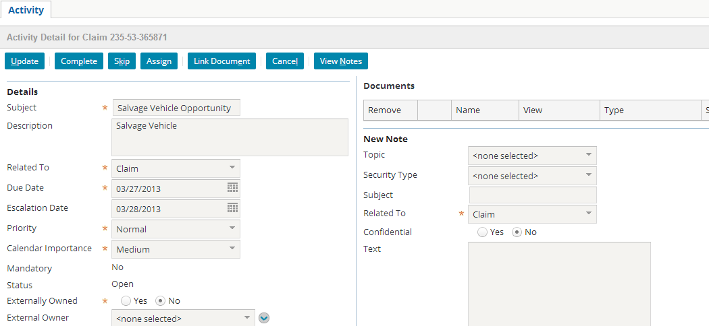
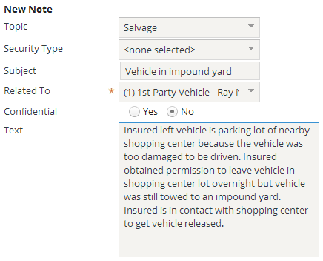
Creating an activity note
|EOS~012|
Notes:
|EON~012|
You can create one or more notes that are associated with a specific activity. These notes can record the actions or thinking behind the processing of a activity.
To create a note related to an activity:
Navigate to the activity.
In the New Note section, complete the fields as appropriate.
Click Update.
An activity can also be linked to a document. Documents are discussed in the "Documents" lesson.
Activities are discussed in the Activities lesson.

Slide 13
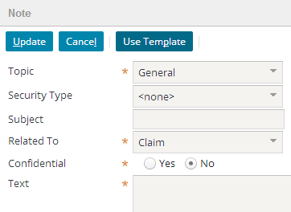
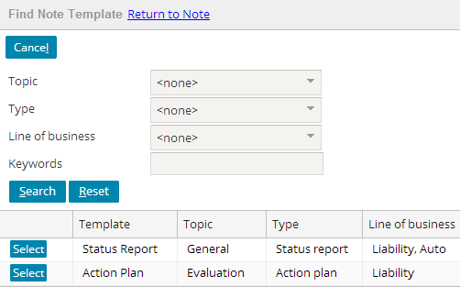
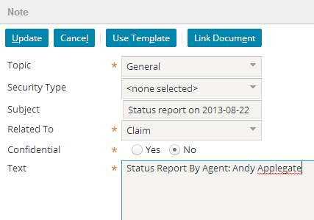
Using a Note Template
|EOS~013|
Notes:
|EON~013|
You can also use a Note template to generate a note. To select a note template:
Within the New Note screen, click Use Template. This displays the Find Note Template screen.
Enter in criteria to identify the desired template and click Search. From the search results list, click the Select button corresponding to the desired template.
The note template will potentially populate the Topic, Subject, and Text fields. Some of the fields may include dynamic template data values, such as a subject of "Accident statement on <current date>" or a text line of "Status report by: <user name>". Users can still modify these fields or, in the case of the Text field, add additional text.

Slide 14
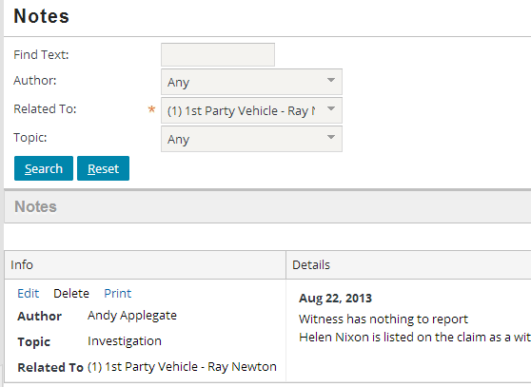
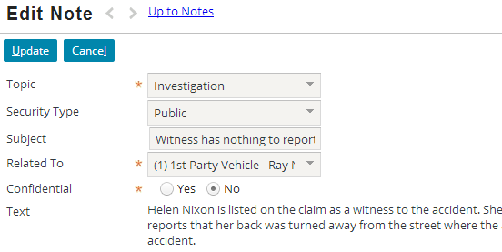
Editing notes
editable
read-only
|EOS~014|
Notes:
|EON~014|
To edit a note, click the Edit link from the Notes list.
In the base application, the text of a note cannot be edited once it has been created. This is usually mandated to provide a true reflection of the actions taken on a claim. This behavior is configurable, and any field can be editable or not once the note has been created.

Slide 15
Lesson objectives review
You should now be able to:
Describe the functionality of notes
Work with notes
|EOS~015|
Notes:
|EON~015|

Slide 16
Review questions
For each of the following descriptions, identify if it is a description of activities, documents, and/or notes. Some descriptions apply to multiple types of objects.
It has an owner.
It involves integration to a third-party system.
In the base application, it has an attribute which, when selected, makes it viewable only by you, your supervisors, and people with the appropriate permissions.
You can specify that it pertains to the entire claim or to a single sub-object.
It has a MIME type.
It has a due date.
It can be created using a template.
|EOS~016|
Notes:
|EON~016|
Answers
1. Activities
2. Documents
3. Documents and notes (The setting for documents is "sensitive". The setting for notes is "confidential".)
4. Activities, documents, and notes
5. Documents
6. Activities
7. Documents and notes (though one could argue that it is all three if activity patterns are thought of as a "template" for activities)

Slide 17
Notices
Copyright © 2001-2014 Guidewire Software, Inc. All rights reserved.
Guidewire, Guidewire Software, Guidewire ClaimCenter, Guidewire PolicyCenter, Guidewire BillingCenter, Guidewire Reinsurance Management, Guidewire ContactManager, Guidewire Vendor Data Management, Guidewire Client Data Management, Guidewire Rating Management, Guidewire InsuranceSuite, Guidewire ContactCenter, Guidewire Studio, Guidewire Product Designer, Guidewire Live, Guidewire DataHub, Guidewire InfoCenter, Guidewire Standard Reporting, Guidewire ExampleCenter, Guidewire Account Manager Portal, Guidewire Claim Portal, Guidewire Policyholder Portal, ClaimCenter, BillingCenter, PolicyCenter, InsuranceSuite, Gosu, Deliver Insurance Your Way, and the Guidewire logo are trademarks, service marks, or registered trademarks of Guidewire Software, Inc. in the United States and/or other countries.
All other trademarks are the property of their respective owners.
This material is confidential and proprietary to Guidewire and subject to the confidentiality terms in the applicable license agreement and/or separate nondisclosure agreement.
This file and the contents herein are the property of Guidewire Software, Inc. Use of this course material is restricted to students officially registered in this specific Guidewire-instructed course, or for other use expressly authorized by Guidewire. Replication or distribution of this course material in electronic, paper, or other format is prohibited without express permission from Guidewire.
Guidewire products are protected by one or more United States patents.
|EOS~017|
Notes:
|EON~017|

