Slide 1
Exposures
19 May 2014
|EOS~001|
Notes:
|EON~001|
Guidewire training materials contain Guidewire proprietary information that is subject to confidentiality and non-disclosure agreements. You agree to use the information in this manual solely for the purpose of training to implement Guidewire software solutions. You also agree not to disclose the information in this manual to third parties or copy this manual without prior written consent from Guidewire. Guidewire training may be given only by Guidewire employees or certified Guidewire partners under the appropriate agreement with Guidewire.

Slide 2
Lesson objectives
By the end of this lesson, you should be able to:
Describe the primary information tracked in an exposure
Create exposures
This lesson uses the notes section for additional explanation and information. To view the notes in PowerPoint, choose View→Normal or View→Notes Page. If you choose to print the notes for the lesson, be sure to select “Print hidden slides.”
|EOS~002|
Notes:
|EON~002|

Slide 3
Lesson outline
Review of the claims process
Exposure basics
Creating exposures
|EOS~003|
Notes:
|EON~003|

Slide 4
Review: The claims process (business perspective)
Litigation
Fraud Detection
Intake
Special Investigations
Adjudication
Payment
Recovery
|EOS~004|
Notes:
|EON~004|
During intake, the carrier is informed of a potentially covered loss. For auto and property claims, this is often referred to as First Notice of Loss (FNOL). For workers' comp claims, this is known as First Report of Injury (FROI).
Adjudication is the process of determining if you are going to pay a claim, and if so, how much you are going to pay.
Once the loss has been assessed and the payment has been approved, the carrier can provide the payments to the claimants. The payment phase involves creating, approving, and issuing the checks.
In some cases, the carrier may also attempt to recover funds paid to the claimant by obtaining money from a third party's carrier if the third party was at fault (which is known as "subrogation") or by taking possession of a significantly damaged property and selling all or parts of it to a third party (which is known as "salvage").
Litigation is an umbrella term for several activities which involve the resolution of disputes.
Fraud detection refers to the activities around detecting claim activity that is indicative of fraud and could warrant further investigation. This is typically a process which is ongoing throughout every portion of the claims process.
If a claim is considered to be suspicious, then it is referred to the special investigations unit. They will investigate the activity and determine the validity of claim. Their investigation runs parallel to the normal claim processing.

Slide 5
Previous lessons covered intake process
segment: normal
Isabel Harkin
claimants
insured
workplan
3rd-party claimant
|EOS~005|
Notes:
|EON~005|
The claim is created during the intake process by a CSR or adjuster through the new claim wizard. The user who creates the claim must specify the relevant policy and the claimants. They also typically detail as much information about the loss, including the incidents, as possible.
In the example above, the claim is an auto claim in which the insured hit a 3rd party. The insured is at fault, has incurred vehicle damage, and has suffered an injury. The 3rd party's car was not damaged, but the 3rd party suffered a minor concussion.
Once the claim is created, ClaimCenter business rules segment the claim, which is the act of classifying the claim (for example as a "fast track", "normal" or "complex" claim) so that the right strategies can be used to process the claim. The business rules also assign an owner to the claim and create a series of activities known as the workplan which identify work that must be done to process the claim. All of this is referred to as "claim set-up".
In the example above, the claim is considered to be normal (it is more complex than just a broken windshield, but not so complex that it involved a death). It is assigned to Isabel Harkin and activities are created for the workplan.
The process of creating a claim was covered in the “New Claim Wizard” lesson.

Slide 6
This lesson: Exposures
segment: normal
Isabel Harkin
claimants
collision
insured
med.pay
liability
3rd-party claimant
|EOS~006|
Notes:
|EON~006|
Once the decision to pay on the claim has been made, exposures are created. Each exposure tracks a potential payment from a single coverage to a single claimant.
Exposures can be created automatically by business rules. (This is often done for workers' comp claims, and when it is done, it usually occurs along with claim setup.) Exposures can also be created manually by adjusters.
In the example above, three exposures are required: one to indemnify the insured for damage done to his car, one to indemnify the insured for the medical bills related to his injury, and one to indemnify the 3rd party for her concussion.
This lesson focuses on the manual creation of exposures.

Slide 7
Reserves Lesson
segment: normal
Isabel Harkin
claimants
collision
insured
med.pay
liability
3rd-party claimant
|EOS~007|
Notes:
|EON~007|
A reserve line is an amount of money set aside for expected payments related to a given exposure. An exposure can have multiple reserve lines, which occurs if there will be two or more payments from the exposure and the carrier wants to track the money separately. For example, the collision coverage exposure will require an indemnification payment to the insured (to fix the damage done to the car) as well as an expense payment to the auto inspector vendor (for the auto inspection).
Reserve lines can be created automatically by business rules. (This is often done for all exposures, and when it is done, it usually occurs when the exposure is set up.) Reserve lines can also be created manually by adjusters.
The “Reserves” lesson focuses on how to create manual reserves and how to review reserves.

Slide 8
Adjudicating Claims Lesson
payable!
Isabel Harkin
claimants
collision
insured
payable!
med.pay
payable!
liability
payable!
3rd-party claimant
|EOS~008|
Notes:
|EON~008|
Most or all of the work to be done on the claim is detailed in the workplan activities. Once reserves have been created, those activities are completed.
The claim and each of its exposure has a maturity level, often referred to as a validation level. Typically, the final level is "ability to pay". When a claim is at ability to pay, checks can be written for it. When an exposure is at ability to pay, the money in its reserve line(s) can be used for checks. Gaining the ability to write checks against a claim and use the reserve lines of its exposures is a prerequisite to making payments.
In many cases, the claim and its exposures become payable as a natural result of the completion of all of the activities. However, the two are not required to be functionally connected. Therefore, it is possible that all activities could be complete and yet the claim or one of its exposures is not payable. (It is also possible that a claim and all of its exposures are payable, but there are still open activities.)
The Adjudicating Claims lesson focuses on various tools that can used during claim adjudication. These tools can assist in the completion of activities as well as in bringing the claim and its exposures to payable status.

Slide 9
Payments Lesson
payable!
Isabel Harkin
claimants
collision
insured
payable!
med.pay
pay to: insured
payable!
liability
payable!
pay to: 3rd-party claimant
3rd-party claimant
|EOS~009|
Notes:
|EON~009|
Once the claim and its exposures are payable, payments can be created.
Money is transferred from the carrier to the payees through checks. Each check gets its money from one or more reserve lines.
In the example above, there are two checks. The first check is payable to the insured. It is for his collision loss and medical payments. Consequently, the check gets its money from two reserve lines from two different exposures. The second check is payable to the 3rd party. The money comes from the third exposure's reserve line.
The Payments lesson focuses on payments.

Slide 10
Closing Claims Lesson
payable!
CLOSED
Isabel Harkin
claimants
collision
insured
CLOSED
payable!
med.pay
CLOSED
pay to: insured
payable!
liability
CLOSED
payable!
pay to: 3rd-party claimant
3rd-party claimant
|EOS~010|
Notes:
|EON~010|
When the financial obligation associated with an exposure has been satisfied, the exposure can be closed. If an exposure results in one payment, then the exposure is typically closed when that one payment is made. If an exposure results in multiple payments (which could occur if there is a recurring payment, possibly for ongoing medical treatment), then the exposure is typically closed when the final payment is made.
When all of the activities are complete, all the payments have been made, and all the exposures are closed, the claim can be closed. In some cases, a claim may be closed as soon as the payment is made (and the last indemnification exposure is closed). In other cases, the claim may remain open beyond the last payment (possibly because the claim involves recovery which is taking place after the last payment, or possibly because there is lingering activity work to complete, such as verification that legal documents have been filed with the appropriate government agency).
The Closing Claims lesson discusses closing exposures and claims.

Slide 11
Specialized Claims Processes Lesson
Litigation
Fraud Detection
Special Investigations
collision
med.pay
liability
Recovery
|EOS~011|
Notes:
|EON~011|
Specialized claims processes are the processes that happen with only some claims.
Recovery is a specialized process which is relevant only for claims where there is a recovery opportunity. Claims without property that is considered a total loss and without third parties who are at fault and do not have insurance may have no recovery opportunities.
Litigation is a specialized process which is relevant only for claims where there is a dispute between parties which needs to be resolved.
Special Investigations is a specialized process which is relevant only for claims which are considered potentially fraudulent.
Consult the “specialized claim processes” lesson for more information on these topics.

Slide 12
Lesson outline
Review of the claims process
Exposure basics
Creating exposures
|EOS~012|
Notes:
|EON~012|

Slide 13
Claims with multiple claim payments
policy coverages
claimants
For many claims, a single case of loss involves:
More than one coverage
More than one claimant
Claims systems need mechanism for tracking progress of each possible claim payment
|EOS~013|
Notes:
|EON~013|
In property and casualty insurance, the goal is to restore a policyholder to the same financial position after the loss as he was in prior to the loss (without allowing the policyholder to profit from the loss).
An example of a single incident of loss with more than one coverage and more than one claimant would be driver Larry Gamney who hit another car driven by Judy Rand with her son Carl in the passenger seat. Both cars had body damage and Carl suffered whiplash.
Assuming that the insured is Larry Gamney, the coverages involved are:
Collision (covering damage to the insured's car (the damage to Larry Gamney's car))
Liability - property damage (covering damage to a third-party car (the damage to Judy Rand's car))
Liability - bodily injury (covering bodily injury done to a third party (Carl Rand's whiplash))
The claimants involved are:
Larry Gamney
Judy Rand
Carl Rand

Slide 14
Exposures
coverage
exposure
policy
claimant
An exposure is an object associated with a claim which is used to track potential payments from a claim
Every exposure is linked to one coverage (where the money is "coming from") and one claimant (where the money is going to)
|EOS~014|
Notes:
|EON~014|

Slide 15
Example: Claim with multiple exposures
Larry Gamney was driving and hit Judy Rand's car. Both cars were damaged, and Judy's son Carl suffered whiplash.
Claim 000-00-000605 Type: Auto
Coverage: collision Claimant: Larry Gamney
Coverage: liability – property damage Claimant: Judy Rand
Coverage: liability – auto bodily injury Claimant: Carl Rand
|EOS~015|
Notes:
|EON~015|
In this claim, Larry Gamney was driving his car and hit Judy Rand's car while Judy was driving. Damage was done to both cars, and Judy's son Carl suffered an injury. This claim might result in three payments:
A payment to Larry Gamney to repair his car. (This is covered by his collision coverage.)
A payment to Judy Rand to repair her car. (This is covered by Larry Gamney's liability - property damage coverage. Keep in mind that collision coverage typically covers only damage to the policy holder's vehicles. Damage done to third-party vehicles is typically covered by a separate coverage.)
A payment to either Judy Rand or the medical provider of Carl Rand to pay for the medical bills incurred as a result of his injury. Keep in mind that the exposure tracks a payment for a loss suffered by the claimant, but the payee of the payment is not always the claimant himself/herself. The payment could go to an individual representing the claimant (such as a parent when a minor is injured). The payment could also go to a vendor who made the claimant whole again (such as an auto shop which repaired collision damage or a medical facility that treated an injury.)
Because there are three possible payments, the claim has three exposures.

Slide 16
When are auto claim exposures created?
Reporter informs carrier of loss
Automated Claim Setup
User creates or reviews claim
Create and assign activities
Segment claim
Assign claim
FNOL imported into ClaimCenter
Typically, exposures are created here
Adjudication Process
|EOS~016|
Notes:
|EON~016|
Exposures can be created manually during the New Claim wizard. This typically happens only if the user entering the claim is an adjuster who is able to create the exposures at the same time.
Exposures can also be created automatically by rules. This happens when business rules can assume the need for an exposure based on information provided in the new claim wizard. In workers' comp claims, it is common practice to have the exposures created automatically during the "pre-setup" phase of claim setup (which occurs prior to segmentation). In Auto, a rule can be written such that if the loss cause is "collision", ClaimCenter creates an exposure associated with the insured as the claimant and the collision coverage. (However, this is not common practice for auto claims.)
Logically speaking, exposures are part of the adjudication process. In most cases, exposures are created after the claim has been created and assigned.

Slide 17
The primary elements of an exposure
The coverage
The claimant
The incident
The reserve line(s)
|EOS~017|
Notes:
|EON~017|
There are four primary elements of information within an exposure:
The coverage from the policy that (possibly) covers the loss
The claimant to whom payment will be made
The incident, which is the item which was lost or damaged
The reserve lines, which are the “buckets” of money set aside to make the payments
When an exposure is created, the user must specify the coverage, the claimant. and the incident.
An exposure is closed when the associated payments are made on each reserve line (or the associated final payments if a single exposure results in multiple payments to a given reserve line, such as a medical exposure which must cover an ongoing series of 20 physical therapy sessions). The adjudication process is essentially the process of moving all of your exposures to payment. During adjudication, additional information may be gathered about the item lost or damaged. (For example, information about the specific damage done to an auto may be collected.) This information is used to establish an assessment of the loss. (For example, an auto repair shop reviews the damage and identifies the money needed to repair the car.) This information is used to complete the payment. (For example, if an auto repair shop assesses the damage at $1200 and the assessment is approved, then the carrier may issue a check for $1200.)

Slide 18
Important attributes of an exposure
Status: Open Primary Adjuster: Isabel Harkin Assignment Group: LA Auto Adjusters Exposure Type: Vehicle damage Validation Level: New loss completion
Exposures also have:
A status (open or closed)
An assigned user and group
An exposure type
A validation level
|EOS~018|
Notes:
|EON~018|
An exposure's status can be set to open or closed. An open exposure is an exposure that is still progressing through the adjudication phase or that still has payments remaining on it (if multiple recurring payments are being made, such as for a series of physical therapy sessions). A closed exposure is one in which the final payment has been made. A closed exposure can be reopened by a user who has permission to do this.
An exposure is assigned to a group and a user in that group. The user is responsible for adjudicating the exposure (gathering the required information, determining the amount to pay, and then issuing the payment). It is common for an exposure to be owned by the same user who owns the claim, although there are cases where the exposure owner and the claim owner are different users. (This occurs most often when the exposure requires specialized knowledge, such as an exposure based on a liability coverage where death was involved.)
The exposure's group may influence which other users have the ability to act on the exposure. (For example, ClaimCenter can be configured so that users in the owner's group can see and/or edit the exposure.) This type of access is controlled by access control lists (ACLs) and is discussed in detail in the "Access Control Lists" lesson.
Exposure types and validation levels are discussed on the next slides.

Slide 19
One detail view per coverage is unwieldy
Collision DV
Collision
Liability – Vehicle Property Damage DV
Liability – Vehicle Property Damage
Comprehensive – Fire Damage DV
Comprehensive – Fire Damage
Auto Bodily Injury DV
Auto Bodily Injury
Liability Injury DV
Liability Injury
|EOS~019|
Notes:
|EON~019|
A carrier offers hundreds of coverages. When processing a claim, the adjuster needs to gather information relevant to the coverage. But, it would be impossible to develop a detail view for each coverage. This could lead to having hundred of detail views.

Slide 20
Exposure types
Collision
Vehicle Damage
Vehicle Damage DV
Liability – Vehicle Property Damage
Damage description Airbags deployed? Total loss?
Comprehensive - Fire Damage
Bodily Injury
Auto Bodily Injury
Bodily Injury DV
Primary doctor Injury type
Liability Injury
|EOS~020|
Notes:
|EON~020|
An exposure type is a set of information to gather about a loss. Each exposure type is mapped to one or more coverages, and each exposure type is used by a single detail view. This reduces the number of detail views needed to a manageable amount, and it improves business efficiency by letting adjusters capture similar sets of data across different coverages in the same way.
For example, a "Vehicle Damage" exposure type would include a set of information to gather about a damaged vehicle (reflected by the incident type), such as a description of the damage, whether or not airbags had been deployed, and whether or not the car was a total loss. The Collision, Comprehensive - Weather Damage, and Comprehensive - Fire Damage coverages could all be tied to a single exposure type - Vehicle Damage - because all three coverages require the same basic information about the damage to the vehicle.
In some cases, an exposure type may be used by a single coverage. For example, Towing and Labor coverage may be the only coverage tied to a Towing and Labor exposure type because no other coverage requires the specific set of information that this coverage does.

Slide 21
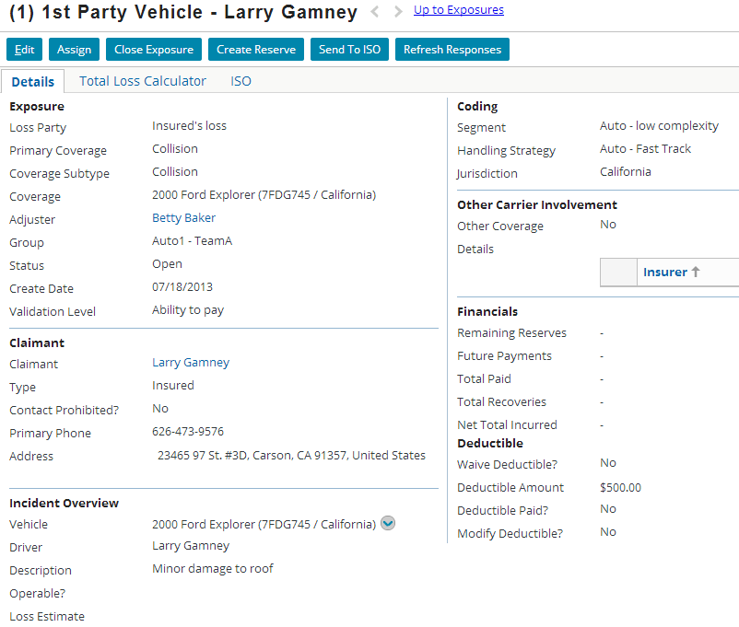
Example: Vehicle damage exposure DV
|EOS~021|
Notes:
|EON~021|
In the example above:
The coverage is collision.
The claimant is Larry Gamney.
The incident is a 2000 Ford Explorer.
The additional information includes details about other carriers involved in the event. (This would typically be used to capture information about the insurance carrier of the driver of the other car and/or other people who experienced a loss, such as pedestrians or passengers in the insured's car who are not covered on the insured's policy.)

Slide 22
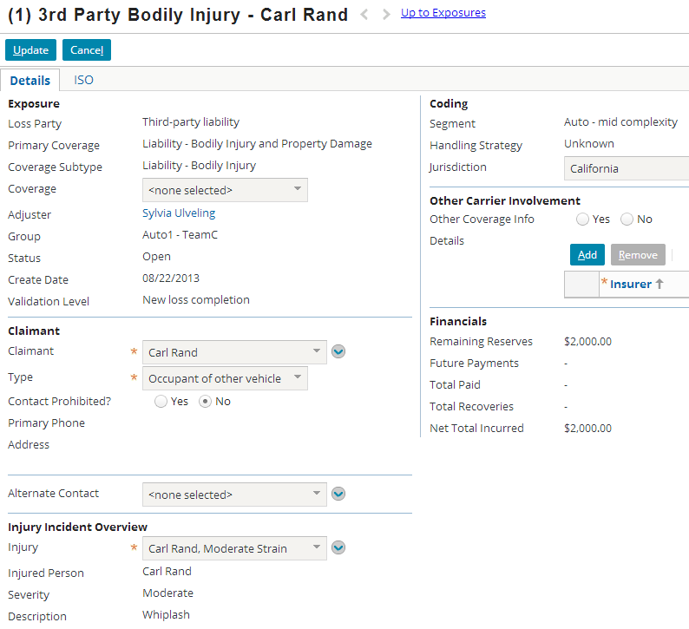
Example: Bodily injury exposure DV
|EOS~022|
Notes:
|EON~022|
In the example above:
The coverage is liability - bodily injury.
The claimant is Carl Rand.
The incident is a neck strain.
The additional information includes details about other carriers involved in the event.

Slide 23
Lesson outline
Review of the claims process
Exposure basics
Creating exposures
|EOS~023|
Notes:
|EON~023|

Slide 24


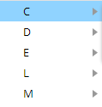




Choosing the coverage
Two ways to choose coverage as basis for exposure:
by CoverageType
Displays list of all possible coverages for the type of policy, as defined in LOB model
By Coverage
Displays list of covered objects on this policy
|EOS~024|
Notes:
|EON~024|
The base application allows for exposures to be created from either method. There is a menu directly off of the New Exposure page action which has two choices: "Choose by Coverage Type" (which then displays the options shown in the top screenshot above) and "Choose by Coverage" (which then displays the options shown in the bottom screenshot above.)
When creating exposures by the "Choose by Coverage Type" option (which is shown in the top screenshot), ClaimCenter lists all coverages for the claim's type of policy. These coverages may or may not actually be on the policy selected at the start of the claim wizard. In some cases, users need this option because the policy system may be unavailable or because the policy is not up-to-date and the adjuster wanted to allow for adding coverages that the customer believes her or she has. Coverages are defined in the LOB (Line of Business) model, which is a way to identify and categorize all the possible types of coverages provided by a carrier.
When creating exposures by the "Choose by Coverage" option (which is shown in the bottom screenshot), ClaimCenter lists all the coverages known to be on the policy. These coverages can also be seen off of one of the Claim file's Policy screens.
When using the “Choose by Coverage Type” option, a specific risk is not associated with the exposure.

Slide 25
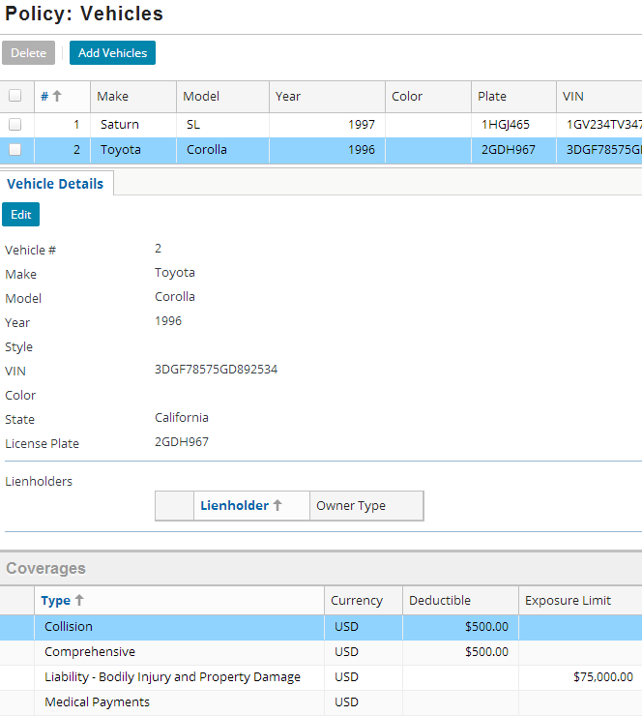
Choose by coverage
Coverages listed on Vehicles Details card (on Policy) match coverages listed in the New Exposure menu
|EOS~025|
Notes:
|EON~025|
Note that the four coverages listed on the Vehicles Details card match the coverages listed in the New Exposure menu.

Slide 26
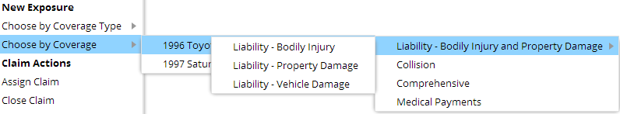
Coverages and sub-coverages
Coverages
Sub-Coverages
Some coverages have "sub-coverages"
This occurs when policy has a coverage (such as liability) which includes several types of losses which must be tracked in different ways
|EOS~026|
Notes:
|EON~026|
In the example above, there are three coverages without sub-coverages (Collision, Comprehensive and Medical Payments). These are coverages which cover only a single type of loss from a financial perspective. The claims process always tracks claims against any of these coverages in the same way.
The example above also includes a coverage with sub-coverages: Liability – Bodily Injury and Property Damage. This coverage has three sub-coverages (Vehicle Damage, Bodily Injury and Property Damage) because the information that must be gathered for each type of loss is substantially different. (For example, the information gathered for a property damage loss would include descriptions of the type of real property – not vehicles.) The sub-coverages allow ClaimCenter to navigate to a screen appropriate for the given type of loss.

Slide 27
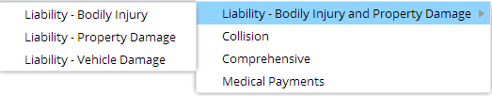
Coverages and exposure types
u
n
*
*
*
^
*
Vehicle (Damage)
u
Bodily Injury
^
Med Pay
n
Property (Damage)
Each coverage and sub-coverage maps to exposure type
Exposure type determines detail view to use and information to collect to adjudicate exposure
|EOS~027|
Notes:
|EON~027|
Roughly speaking, the four exposure types listed above track the following information:
Vehicle (damage) - Location of and damage done to the vehicle (such as whether the airbags were deployed)
Property (damage) – Description of the real property damaged by the insured vehicle (such as a house or commercial property)
Med Pay - Information about an injury done to a person listed on the policy (such as a passenger in the vehicle and the details about their injuries)
Bodily Injury - Information about an injury done to a third party (such as the primary doctor that treated the injury as well as insurance provider and policy number)
The Med Pay coverage and Bodily Injury coverages are tied to separate exposure types. However, in the base product, these exposure types are virtually identical to each other – although separate exposure types makes it simple to enable the capture of additional and unique data fields.

Slide 28
Coverage verification
Is this Medical Costs? Bodily injury? PIP?
Coverage verification is a set of configurable rules that indicate selected coverage is inappropriate based on:
Cause of loss
Collision when loss cause is "Theft"
Other existing exposures
Comprehensive when collision exposure already exists
Fault rating
Liability when fault is with third party
|EOS~028|
Notes:
|EON~028|
Mistakes in coverage selection can be costly to insurers. ClaimCenter defines (configurable) rules that warn the user about inappropriate or invalid coverage selections for new exposures.

Slide 29
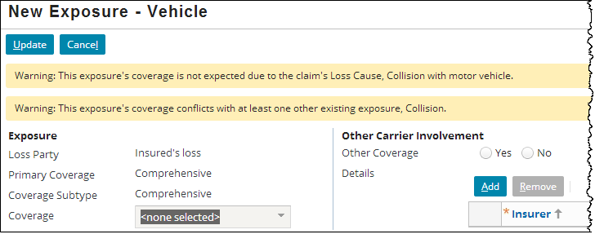
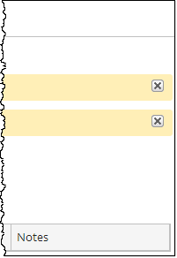
Coverage verification warning messages
ClaimCenter warns the user against the inappropriate selection by generating error messages in an alert bar
End users can hide them by clicking the “x" on the far right end (may require horizontal scrolling)
|EOS~029|
Notes:
|EON~029|

Slide 30
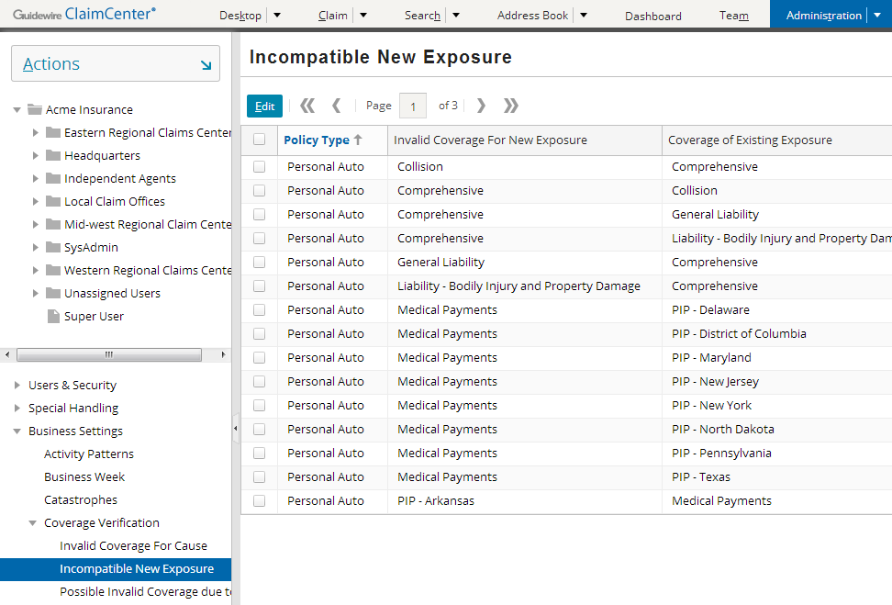
Defining coverage verification rules
Rules are easily defined by a business analyst
Rules can be changed in real time in response to changing business requirements
|EOS~030|
Notes:
|EON~030|
Users with permissions to change settings in the Administration screen may work with coverage verification rules. Permissions are discussed in the “Permissions” lesson.

Slide 31
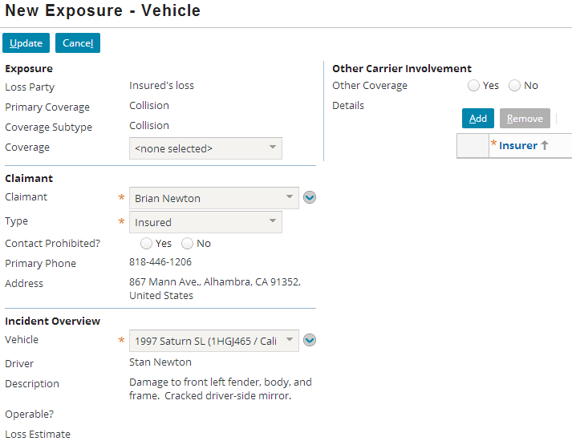
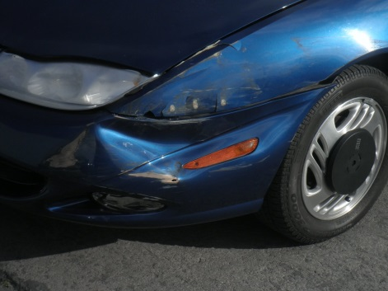
New vehicle damage exposure DV
|EOS~031|
Notes:
|EON~031|
In the example above:
The coverage is collision.
The claimant is Brian Newton.
The incident is a 1997 Saturn SL.
The additional information includes details about other carriers involved in the event. (This would typically be used to capture information about the insurance carrier of the driver of the other car and/or other people who experienced a loss, such as pedestrians or passengers in the insured's car who are not covered on the insured's policy.)

Slide 32
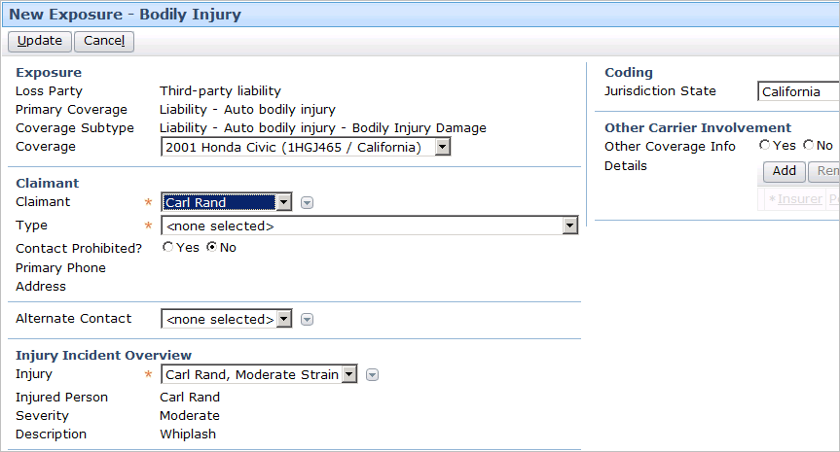
New bodily injury exposure DV
|EOS~032|
Notes:
|EON~032|
In the example above:
The coverage is liability - auto bodily injury.
The claimant is Carl Rand.
The incident is a Carl Rand’s neck strain.
The additional information includes details about other carriers involved in the event.

Slide 33
Exposure setup
Exposure Setup
Segment
Assign
Workplan
Initial Reserves
Immediately after creation, exposure goes through setup
Segmented
Assigned to a group and user
Exposure-specific activities created and assigned
Initial reserves created
|EOS~033|
Notes:
|EON~033|
Recall that whenever a claim is created, it goes through an automatic setup process which consists of three high-level stages:
The claim is segmented (it is classified so that the system knows what strategy to adopt when executing automatic adjudication logic).
The claim is assigned to a group and user.
The claim's workplan (a series of activities for adjudicating the claim) is generated, and the activities in the workplan are assigned.
Whenever an exposure is created, it also goes through an automatic setup process which consists of the same three high-level stages, plus one additional stage:
The exposure is segmented (it is classified so that the system knows what strategy to adopt when executing automatic adjudication logic).
The exposure is assigned to a group and user.
The exposure's workplan (a series of activities for adjudicating the exposure) is generated, and the activities in the workplan are assigned.
Initial reserves are created for the exposure, if possible. This occurs when business rules can use the existing information to arrive at a reasonable dollar amount for the initial reserve.
If an exposure is created during the new claim wizard, then the rules are executed in this order:
First exposures are segmented, and then the claim is segmented. (This is because the claim segment may be based on the segments of its exposures.)
Then, the claim is assigned and then the exposures are assigned. (This is because, in most cases, an exposure is simply assigned to the claim owner.)
Finally, the claim workplan activities are created and assigned, and then the exposure workplan activities are created and assigned. (This order is somewhat arbitrary, as neither process typically influences the other.)

Slide 34
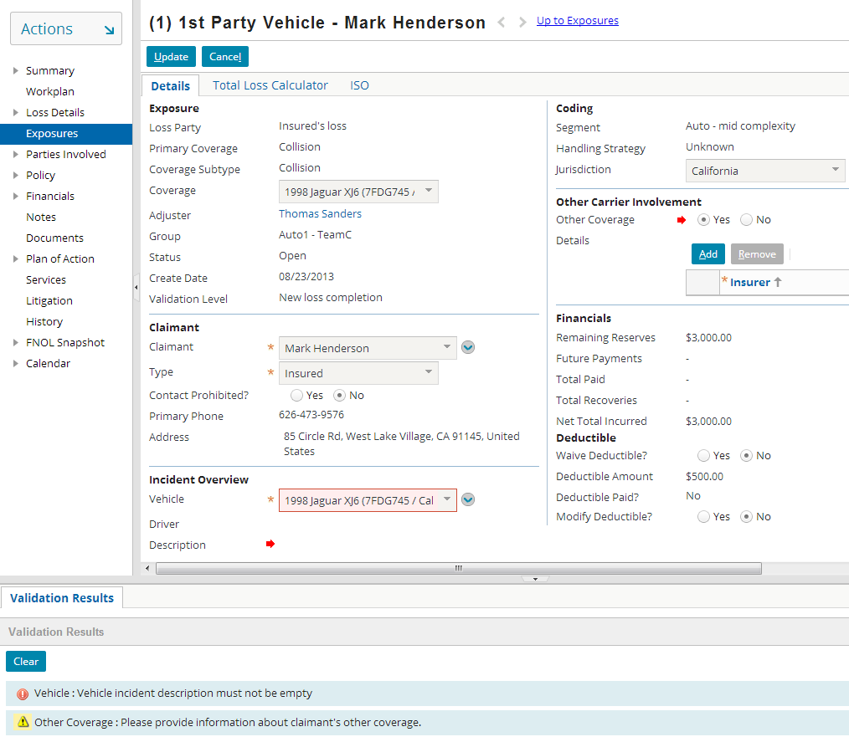
Validating exposures
Error
Warning
|EOS~034|
Notes:
|EON~034|
Recall that ClaimCenter contains a set of rules that define the data that must be present within a claim in order for it to be considered a valid "new loss" claim. These rules are run at the end of the new claim wizard.
ClaimCenter also has a set of rules that define the data that must be present within an exposure for the exposure to be considered a valid "new loss" exposure. These rules are also run any time an exposure is created.
Each rule can produce one of two possible results:
The rule could warn the user of a certain situation. The situation does not need to be attended to immediately, but at some point in the future it will prevent the claim from moving forward within its life cycle. Validation warnings appear in the Validation Results screen with a yellow yield sign icon.
The rule could throw an error. If an error is thrown, the claim cannot be saved until the error is fixed. Validation errors appear in the Validation Results screen with a red arrow icon.
If an exposure has no warnings or errors, then the exposure is immediately saved and the Validation Results screen is not displayed.
If an exposure has only warnings, then the user only needs to click the Finish button a second time. Upon the second click, the exposure is saved. The Validation Results screen remains visible until the user clicks the Clear button. (You do not need to clear the validation results to save the exposure or vice versa.)
If an exposure has errors (or warnings and errors), then the exposure cannot be saved. The issues causing the errors must be attended to, or the new exposure must be canceled.

Slide 35
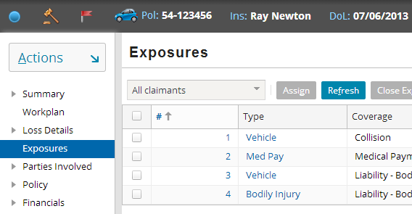
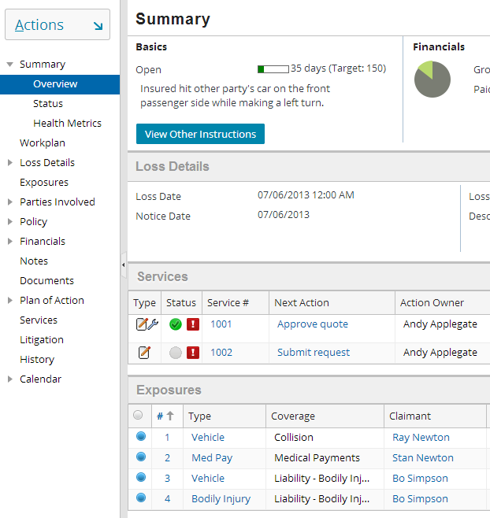
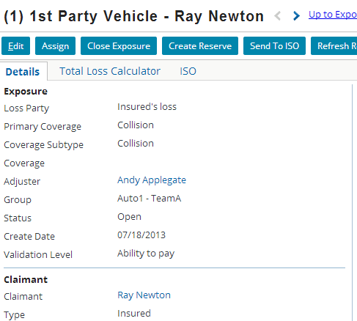
Viewing existing exposures
|EOS~035|
Notes:
|EON~035|
Once created, exposures are listed on both the Summary screen (Overview menu link) and in the Exposures list. Clicking the link in the Type column of either list takes you to detailed information about the exposure.

Slide 36
Lesson objectives review
You should now be able to:
Describe the primary information tracked in an exposure
Create exposures
|EOS~036|
Notes:
|EON~036|

Slide 37
Review questions
What are the four primary elements of information in an exposure?
Of those elements, which must you specify when you create an exposure?
What is an exposure type? Why would exposures associated with two different coverages have the same exposure type?
What is measured by an exposure's validation level?
What three high-level things occur during exposure setup?
|EOS~037|
Notes:
|EON~037|
Answers
1. The coverage, the claimant, the incident, the reserve line(s).
2. The coverage, the claimant, and the incident.
3. An exposure type is a group of fields or set of information that must be gathered for an exposure. Two exposures from different coverages may have the same exposure type if the information needed for both coverages is the same (such as vehicle damage covered by collision and by comprehensive).
4. The exposure's maturity (or how close it is to being at "ability to pay").
5. Segmentation, assignment, and creation and assignment of workplan activities.

Slide 38
Notices
Copyright © 2001-2014 Guidewire Software, Inc. All rights reserved.
Guidewire, Guidewire Software, Guidewire ClaimCenter, Guidewire PolicyCenter, Guidewire BillingCenter, Guidewire Reinsurance Management, Guidewire ContactManager, Guidewire Vendor Data Management, Guidewire Client Data Management, Guidewire Rating Management, Guidewire InsuranceSuite, Guidewire ContactCenter, Guidewire Studio, Guidewire Product Designer, Guidewire Live, Guidewire DataHub, Guidewire InfoCenter, Guidewire Standard Reporting, Guidewire ExampleCenter, Guidewire Account Manager Portal, Guidewire Claim Portal, Guidewire Policyholder Portal, ClaimCenter, BillingCenter, PolicyCenter, InsuranceSuite, Gosu, Deliver Insurance Your Way, and the Guidewire logo are trademarks, service marks, or registered trademarks of Guidewire Software, Inc. in the United States and/or other countries.
All other trademarks are the property of their respective owners.
This material is confidential and proprietary to Guidewire and subject to the confidentiality terms in the applicable license agreement and/or separate nondisclosure agreement.
This file and the contents herein are the property of Guidewire Software, Inc. Use of this course material is restricted to students officially registered in this specific Guidewire-instructed course, or for other use expressly authorized by Guidewire. Replication or distribution of this course material in electronic, paper, or other format is prohibited without express permission from Guidewire.
Guidewire products are protected by one or more United States patents.
|EOS~038|
Notes:
|EON~038|

