Slide 1
Reserves
12 January 2015
|EOS~001|
Notes:
|EON~001|
Guidewire training materials contain Guidewire proprietary information that is subject to confidentiality and non-disclosure agreements. You agree to use the information in this manual solely for the purpose of training to implement Guidewire software solutions. You also agree not to disclose the information in this manual to third parties or copy this manual without prior written consent from Guidewire. Guidewire training may be given only by Guidewire employees or certified Guidewire partners under the appropriate agreement with Guidewire.

Slide 2
Lesson objectives
By the end of this lesson, you should be able to:
Define financial terms used by ClaimCenter for managing reserves
Create reserve lines
This lesson uses the notes section for additional explanation and information. To view the notes in PowerPoint, choose View→Normal or View→Notes Page. If you choose to print the notes for the lesson, be sure to select “Print hidden slides.”
|EOS~002|
Notes:
|EON~002|

Slide 3
Lesson outline
Reserve basics
Working with reserve lines
|EOS~003|
Notes:
|EON~003|

Slide 4
Financials
+$3000
-$3000
Exposure
Reserve Line
Check
Payee
Fundamental purpose of exposure is to track information about payment from coverage to claimant
"Financials" is umbrella term for process of setting aside money for and then issuing payments
|EOS~004|
Notes:
|EON~004|
Most students with any length of experience in claims adjustment will be very familiar with the business processes around financials. The purpose of this first section is largely to define the terms used by Guidewire when describing the functionality of ClaimCenter and the specific behaviors of the base application.

Slide 5
Reserve lines
Coverage: collision Claimant: Jim Means
Reserve Line 1 to pay for damage done to insured's car
Reserve Line 2 to pay for auto inspection required by the carrier
A reserve line is an amount of money set aside for expected payments related to a given exposure
Every exposure ultimately has one or more reserve lines
|EOS~005|
Notes:
|EON~005|
A reserve line can be thought of as a "T-account" set aside for one specific aspect of exposure processing. It contains both credits and debits, and its size is equal to the sum of the credits minus the sum of the debits.
In the insurance industry, the term "reserve" is sometimes used to refer to the total amount of money set aside for exposure payment. (For example, "The exposure has a reserve of $3000.") At other times, it is used to mean an increase in the amount of money set aside for exposure payment. (For example, "I added a $500 reserve because the vehicle damage was more extensive than originally reported.") To clarify any possible confusion, this course uses the term "reserve line" to refer to the total amount of money set aside for exposure payment, and "reserve transaction" to refer to an increase in the amount of money set aside for exposure payment.
Recall that state regulations require insurance companies to err on the side of solvency and to be very conservative in recording expected liabilities for claims that have been reported and even for claims that are not yet known but which can be statistically predicted. For the purpose of ClaimCenter, reserve lines are set for a specific exposure to estimate the probable future payments.
There is no technical requirement for an exposure to have a reserve line. You can create and even close exposures without creating reserve lines. However, the primary reason one creates exposures is so that payments can be made to claimants, and you cannot make payments to claimants without reserve lines.
Technically, ClaimCenter also allows for claim-level reserve lines. However, in practice, this is rarely used. This course assumes all reserve lines are associated to exposures.

Slide 6
Cost types
Coverage: collision Claimant: Jim Means
Reserve Line 1 (damage to car) Cost type: Claim Cost
Reserve Line 2 (required inspection) Cost type: Expense
Every reserve line is categorized by a "cost type", which describes if the money is for indemnity or expense
Indemnity reserves (claim cost) are used to indemnify claimants ("make them whole" / "restore them to the original state")
Expense reserves are used to cover costs incurred by the carrier as a result of processing this portion of the claim
|EOS~006|
Notes:
|EON~006|
The adjudication of an exposure can result in two broad types of payments: indemnity and expense.
An indemnity payment is a payment made to a claimant to make them whole again. For example, if the exposure is for collision coverage to the insured, then the indemnity payment is intended to repair or replace the damaged vehicle. The process of indemnification involves restoring the claimant back to the state they were in before the loss or damage. The goal is to restore a policyholder to the same financial position after the loss as that prior to the loss, without the policyholder profiting from the loss.
An expense payment is a payment made to cover costs incurred by the carrier while processing the exposure. For example, if the exposure is for collision coverage to the insured, an independent auto inspector may have been hired to survey and assess the auto damage. The expense payment goes to the inspector for services rendered. This is a cost that the carrier incurred as a result of processing the claim and cannot be passed on to the claimant. Therefore, it is an expense.
A claims processing system can have more than two cost types. Typically, each cost type ultimately belongs to either indemnity or expense. For example, the base application has four cost types: Claim Cost (indemnity), Adjusting and other expense (expense), Defense and cost containment expense (expense), and Unspecified (neither).

Slide 7
Cost categories
Coverage: collision Claimant: Jim Means
Reserve Line 1 (damage to car) Cost type: Claim Cost Cost category: Auto body
Reserve Line 2 (required inspection) Cost type: Expense Cost category: Vehicle inspection
Every reserve line is further categorized by "cost category"
A cost category is a specific classification of a cost type used to track payments, identify leakage, predict future reserves, or control reserve creation and approval
|EOS~007|
Notes:
|EON~007|
Cost categories can be shared across multiple cost types. For example, "vehicle inspection" could be a cost category for both Expense (when the carrier requires the inspection and/or hires a third-party inspector) and Indemnity (when the claimant gets an inspection and the relevant coverage covers it).

Slide 8

Reserve lines are unique
Coverage: liability - auto damage Claimant: Marcus Sato
Coverage: collision Claimant: Brittany Turner
Cost type: Claim Cost Cost ctgry: Auto body
Cost type: Claim Cost Cost ctgry: Auto body
Cost type: Expense Cost ctgry: Inspection
Cost type: Claim Cost Cost ctgry: Towing
Cost type: Claim Cost Cost ctgry: Auto body
Every reserve line is uniquely defined by its exposure, cost type, and cost category (except when using Multicurrency Reserving)
You cannot have two reserve lines on the same exposure with the same cost type and cost category (and currency)
$
|EOS~008|
Notes:
|EON~008|
Every reserve line is uniquely defined by its exposure, cost type, and cost category*. The example above contains four valid reserve lines:
Exposure 1, claim cost, auto body
Exposure 1, expense, inspection
Exposure 2, claim cost, auto body
Exposure 2, claim cost, towing
In the example above, the third reserve line on the first exposure cannot be created because it is not a unique combination of exposure, claim cost, and claim category.
The exception to this is when Multicurrency Reserving is enabled in ClaimCenter. This feature is explained on the next two slides. This slide uses dollar symbols on the reserve lines to indicate that the reserves are in US dollars.
If using Multicurrency Reserving, every reserve line is uniquely defined by its exposure, cost type, cost category and currency.

Slide 9
Basic transactions
reserve transaction
+$2000
reserve transaction
+$500
payment transaction
-$2250
reserve transaction
+$500
payment transaction
-$500
Transactions modify the amount of money in a reserve line
A reserve transaction modifies the amount of money set aside for the reserve line
A payment transaction moves money from a reserve line to a payment to a claimant or other party
|EOS~009|
Notes:
|EON~009|
In most cases, a reserve transaction can be thought of as adding money to a reserve line. (However, there are circumstances where the amount of money set aside may have been deemed too high, and a reserve transaction will be used to subtract money from a reserve line without actually paying that money to a claimant or other party.)
In most cases, a payment transaction can be thought of as subtracting money from a reserve line. (However, there are circumstances where a payment transaction credits money to a reserve line, possibly because an error occurred and the payee returned the money to the carrier.)

Slide 10


Multicurrency: background
Transactions may occur in one or more currencies other than the base currency
Base application supports multicurrency in the following available currencies:
AUD – Australian dollar
CAD – Canadian dollar
EUR – European Union euro
GBP – British pound
JPY – Japanese yen
RUB – Russian ruble
USD – U.S. dollar
reserve transaction
+€50,0
payment transaction
-€47
base:
|EOS~010|
Notes:
|EON~010|
ClaimCenter’s Multicurrency Reserving feature allows for flexibility in the ability to process reserve and other financial transactions in multiple currencies (US Dollar, Euro, GBP, Canadian Dollar, etc.).
The example above shows processing reserves and payments in Euros (€), even though in the example, ClaimCenter’s base currency is GBP.
Multicurrency reserving also allows the ability to process reserves in Euros (€), but payments in British Pounds (£).

Slide 11
Example: Multicurrency transactions
- Insured lives in London, UK - has accident in Calais, France - covered by a British carrier (GBP)
Dr. Gareth Baker bill: £283
Jean-Paul's Garage bill: €417 (base = £330)
ClaimCenter financial transactions can be in more than one currency
There is one “base” and any number of “transaction” currencies
Using the transaction exchange rate, non-base transactions are displayed in both the transaction and base currencies
|EOS~011|
Notes:
|EON~011|
The ClaimCenter multicurrency feature allows you to set reserves, make payments, write checks and collect recoveries in more than one currency. It knows the base ClaimCenter currency, but accounts for these transactions in the currencies in which they were made. Finally, it adjusts for exchange rate fluctuations that change payment amounts.
Every instance of ClaimCenter uses a single base currency, but many tasks can now be performed using another transaction currency. In particular, a ClaimCenter user may:
Create payments, issue checks, and receive recoveries in any currency.
Create reserves and recovery reserves in any currency; all of them, no matter their currency, still contribute to the aggregate reserves and recovery reserves, which are always displayed in units of the base currency.
Search for checks and recoveries in any particular currency - or in all currencies.
Create bulk invoice payments and write their associated checks in any currency.
View financial summaries which include all transactions, independent of their currency.
Adjust the actual amount, in the base currency, of a check and its payment(s), after the check has been cashed and the actual amount of the check in the base currency (which has changed because of exchange rate fluctuations) is known.
Add a Preferred Currency field to contacts, which tells ClaimCenter the default currency to use when writing a check to that contact (vendor).
Enter exchange rates manually when needed, or automatically get them from an outside provider.
Periodically update exchange rates obtained from an outside provider.
For more information on this topic, consult the “Multicurrency Reserving” lesson in the ClaimCenter 7.0 - 8.0 New Configuration Features course.

Slide 12
Recovery transactions
recovery reserve transaction
+$3500
-$3500
recovery transaction
There are two transaction types specific to recoveries
A recovery reserve transaction denotes money which the carrier expects to get from subrogation or salvage
A recovery transaction denotes money which has been collected from subrogation or salvage
A single reserve line can include both recovery and non-recovery transactions. That single line can contain multiple balances, each tracked separately.
|EOS~012|
Notes:
|EON~012|
Recall the following definitions:
Recovery is a general term that refers to all forms of recouping some of the indemnity payments made on a claim. There are two primary forms of recovery: subrogation and salvage.
Subrogation is the act of the carrier getting financial reimbursement from a 3rd party when someone insured by the carrier suffers a loss and it is not the insured's fault. For example, if Jim Means is insured by Acme Insurance and his car is hit by Florence Rigby, then Acme Insurance can attempt to collect money from Florence Rigby's insurance company to cover the money which Acme must pay to Jim Means for his loss. Subrogation is relevant only when there is a 3rd party who is responsible for the loss.
Salvage is the act of the carrier paying the full value of damaged property, taking possession of it, and then attempting to recoup some of the cost by reselling the property (or portions of it). For example, if Jim Means has an insured car which is damaged in a collision to the point where it can no longer be driven, Acme Insurance could pay the full value of the car to Jim Means, take possession of it, and then sell any salvageable parts to a scrap yard.
The example shown above is for a collision exposure in which the vehicle is a total loss. The carrier plans to pay the insured for the full value of the vehicle, which is $3500. The carrier then expects to be able to sell the vehicle to a salvage yard and recoup $3500.
Recovery, subrogation and salvage are discussed in the “Specialized Claim Processes” lesson.

Slide 13

Financials approval
+$50,000
ClaimCenter reviews every transaction (including reserve transactions) to determine if it requires approval
Financials approval is discussed in the “Financials Approval” lesson of this course
|EOS~013|
Notes:
|EON~013|

Slide 14
Lesson outline
Reserve basics
Working with reserve lines
|EOS~014|
Notes:
|EON~014|

Slide 15
Who creates reserve transactions?
A reserve can be created automatically by business rules
When this occurs, it typically occurs during exposure setup
A reserve can be created manually by an adjuster
|EOS~015|
Notes:
|EON~015|
During exposure set-up, there is an Initial Reserve rule set which is executed after the exposure workplan is generated. It is this rule set which is typically used to create reserves automatically.

Slide 16
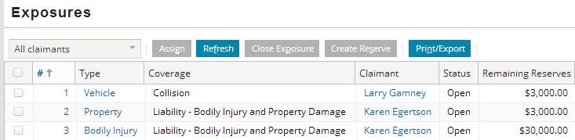
Automatic reserves: example
if exposure segment = "complex" AND exposure type = "bodily injury" AND injury severity = "major (hospitalization)"
then create reserve line with: - cost type of "Claim Cost" - cost category of "Medical" - reserve amount of "$30,000"
|EOS~016|
Notes:
|EON~016|
Business rules can create reserve transactions and use attributes from the claim and its sub-objects (such as the claim's segment) to determine cost type, cost category, and/or reserve amount. In the example above, complex exposures with injuries involving hospitalization are given an initial reserve of $30,000 upon creation of the exposure.
The exposures screen lists every exposure and, among other things, the amount of money left in the reserve line. Just by observing the exposures list, you cannot tell if the reserve line was created automatically or manually. However, if you have just created the exposure(s) and have not created a manual reserve transaction, then you know the reserve line was created automatically.

Slide 17
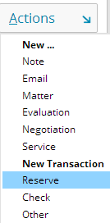
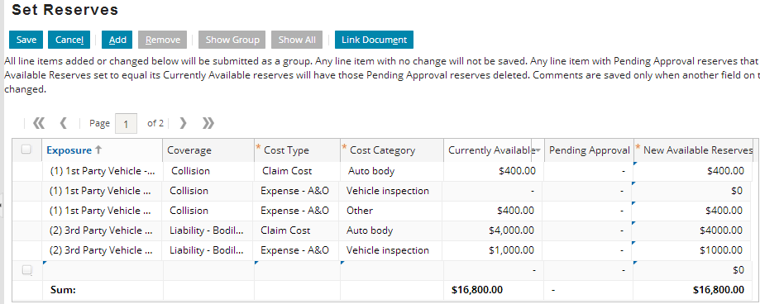
Creating a manual reserve transaction
Reserve transactions can be created manually through the New Transaction menu
|EOS~017|
Notes:
|EON~017|
The Set Reserves list contains two buttons, Show Group and Show All, which are available only when you navigate to the Set Reserves list from the Transaction Detail screen. This navigation is accomplished in the base application by going to the Transactions list, navigating to a specific transaction, and clicking the Edit button.) If you choose to edit an existing transaction, then ClaimCenter navigates to the Set Reserves list, but only the selected transaction is shown in the list. The results are shown in the screenshot below, (which is visible if you view PowerPoint in Notes view (View > Notes Page)).
The Show Group button displays all reserve lines of reserves submitted with the given reserve. The Show All button displays all transactions (in which case the view is identical to the screenshot shown in the slide above).

Slide 18
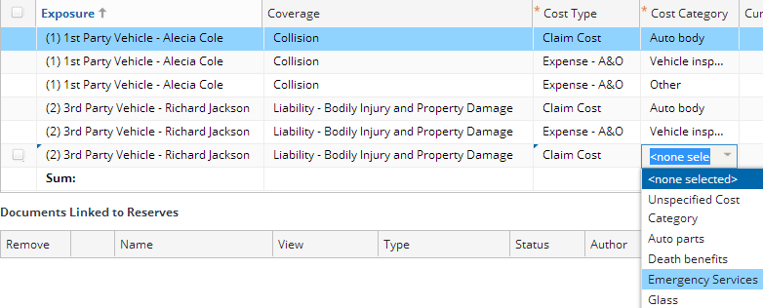
Categorizing the reserve transaction
Specify the related exposure, cost type, and cost category
You cannot select an existing exposure/type/category combination
|EOS~018|
Notes:
|EON~018|
In the base application, after you choose the exposure and cost type, the Cost Category dropdown is filtered to prevent you from choosing any value that would result in a duplicate set of information. This is appropriate since such a choice would be a modification to the existing reserve line and this is done by modifying the reserve line, discussed later in this lesson. In the above example, because there already is a “Claim Cost” cost type and “Auto body” cost category on the “(2) 3rd Party Vehicle – Richard Jackson” Exposure.
Cost Category is a dependent dropdown for which Cost Type is the parent dropdown.

Slide 19
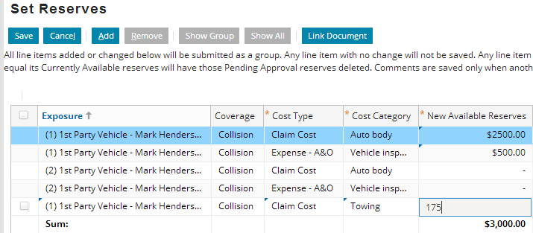
Specifying the amount
In addition to categorizing the reserve line, you must specify the amount of money to be added to it by the initial reserve transaction
|EOS~019|
Notes:
|EON~019|
ClaimCenter does have approval rules which can set a reserve transaction to pending approval if the amount exceeds the user's authority limits. Financial approvals is discussed in detail in the "Supervisors" lesson.

Slide 20
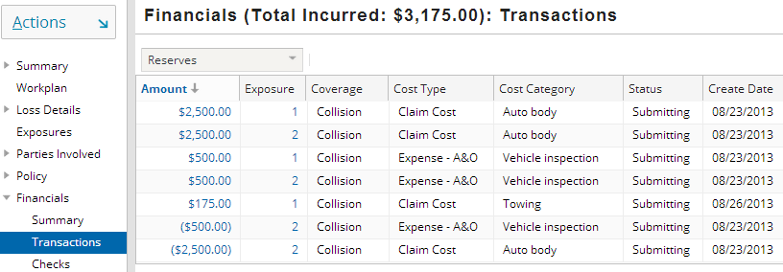
The completed reserve transaction
The reserve transaction can be seen from the Financials - Transactions list
Note that this is a list of reserve transactions, not a list of reserve lines
|EOS~020|
Notes:
|EON~020|
When you complete your work on the Set Reserves page, ClaimCenter navigates you to the list of financial transactions for the claim. The resulting reserve line can also be seen from the Financials Summary page, which is discussed on the next slide.

Slide 21

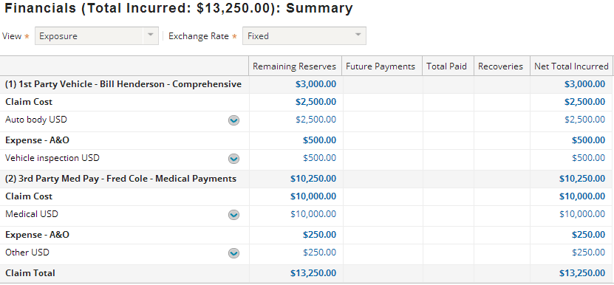
Viewing existing reserve lines
View dropdown
Reserve lines
Status of each reserve line
The Summary menu link lists reserve lines for the claim
Each reserve line has its own context menu ( )
|EOS~021|
Notes:
|EON~021|
The Summary screen provides a high-level summary of the financials for a claim.
The View dropdown is discussed on the next slides. Depending on the selected view, reserve lines are listed individually or summed together by exposure, claimant, or coverage.
Summary information is displayed only in the base currency. This is because each value could be the result of multiple transactions across three or more currencies.

Slide 22
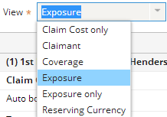
Summary screen views - exposure
Exposure view contains 3 levels:
1st level – exposure
2nd level – cost type
3rd level – cost category
|EOS~022|
Notes:
|EON~022|
An example of the "exposure only" view is shown below (which is visible if you view PowerPoint in Notes view (View > Notes Page)). Note that the "exposure only" view lists each reserve line, but it omits the aggregate "Claim Cost" and aggregate "Expense" lines. The aggregates can be seen in the Exposure view in bold in the slide screenshot above. Exposures (1) and (2) each have two aggregates ("Claim Cost" and "Expense - A&O").

Slide 23
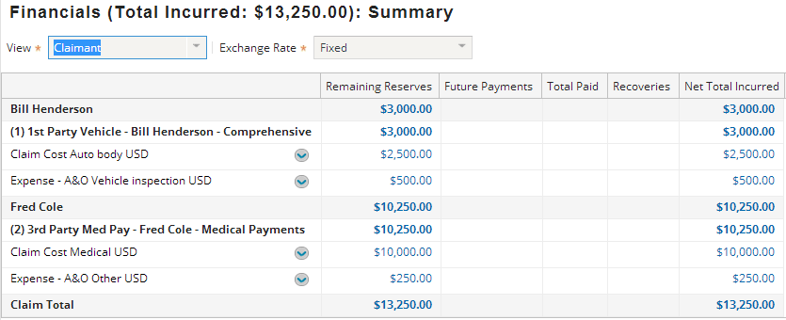
Summary screen views - claimant
Claimant view contains 3 levels:
1st level – claimant
2nd level – exposure
3rd level – cost type & category
|EOS~023|
Notes:
|EON~023|
An example of the "claim cost only" view is shown below (which is visible if you view PowerPoint in Notes view (View > Notes Page)). Note that the "claim cost only" view omits expense reserve lines, such as the "vehicle inspection" reserve line on the first exposure shown above.

Slide 24
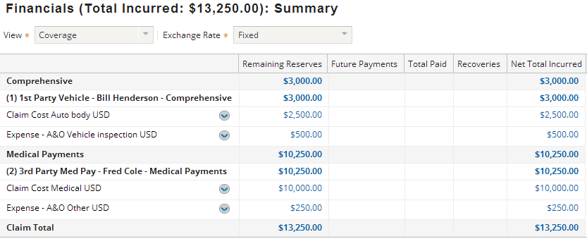
Summary screen views - coverage
Coverage view contains 3 levels
1st level – coverage
2nd level – exposure
3rd level – cost type & category
|EOS~024|
Notes:
|EON~024|
Note that each of the views change the way in which the reserve lines are grouped together, but because no information is omitted from one view to the next, the number of reserve lines remains the same. Every screenshot shows three reserve lines (which can be easily identified visually by the three context menu buttons).

Slide 25
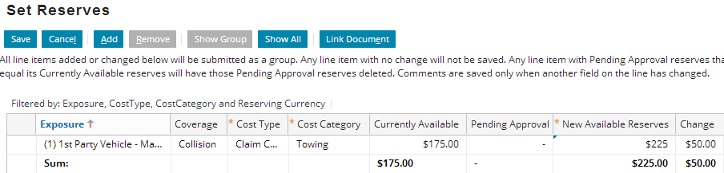
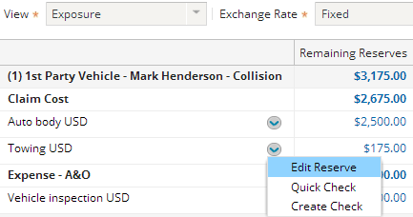
Modifying an existing reserve line amount
+$500
$2500
$3000
To add money to an existing reserve line, enter the new reserve line amount in the New Available Reserves column
ClaimCenter automatically calculates the amount that the transaction needs to be to affect the change
|EOS~025|
Notes:
|EON~025|
There are two ways to navigate to edit a specific reserve in ClaimCenter.
From the Financials Summary screen, you can click the down-arrow to the left of a reserve and select "Edit Reserve", as the screenshot above demonstrates.
From the Reserve Details screen, you can click the "Edit" button.
Note the distinction between a reserve transaction ($500) and the reserve line (now at $3000).

Slide 26
Lesson objectives review
You should now be able to:
Define financial terms used by ClaimCenter for managing reserves
Create reserve lines
|EOS~026|
Notes:
|EON~026|

Slide 27
Review questions
A reserve line is defined uniquely by what three values?
What are the two most common (or most fundamental) cost types?
What is the difference between a reserve line and a reserve transaction?
Can you create more than one reserve line against the same cost type / cost category combination (assuming Multicurrency Reserving is disabled)?
|EOS~027|
Notes:
|EON~027|
Answers
1. Exposure, cost type, and cost category
2. Indemnity and expense.
3. A reserve line is an amount of money set aside to cover indemnity and expense payments related to an exposure. A reserve transaction is a transaction which modifies the amount of money in a reserve line, typically by adding to it.
4. Against a different exposure, yes, but not against the same exposure. If Multicurrency Reserving is enabled, you can create more than one reserve line against the same cost type/cost category combination as long as each is in a different currency.

Slide 28
Notices
Copyright © 2001-2014 Guidewire Software, Inc. All rights reserved.
Guidewire, Guidewire Software, Guidewire ClaimCenter, Guidewire PolicyCenter, Guidewire BillingCenter, Guidewire Reinsurance Management, Guidewire ContactManager, Guidewire Vendor Data Management, Guidewire Client Data Management, Guidewire Rating Management, Guidewire InsuranceSuite, Guidewire ContactCenter, Guidewire Studio, Guidewire Product Designer, Guidewire Live, Guidewire DataHub, Guidewire InfoCenter, Guidewire Standard Reporting, Guidewire ExampleCenter, Guidewire Account Manager Portal, Guidewire Claim Portal, Guidewire Policyholder Portal, ClaimCenter, BillingCenter, PolicyCenter, InsuranceSuite, Gosu, Deliver Insurance Your Way, and the Guidewire logo are trademarks, service marks, or registered trademarks of Guidewire Software, Inc. in the United States and/or other countries.
All other trademarks are the property of their respective owners.
This material is confidential and proprietary to Guidewire and subject to the confidentiality terms in the applicable license agreement and/or separate nondisclosure agreement.
This file and the contents herein are the property of Guidewire Software, Inc. Use of this course material is restricted to students officially registered in this specific Guidewire-instructed course, or for other use expressly authorized by Guidewire. Replication or distribution of this course material in electronic, paper, or other format is prohibited without express permission from Guidewire.
Guidewire products are protected by one or more United States patents.
|EOS~028|
Notes:
|EON~028|

