Slide 1
Adjudicating Claims
18 March 2014
|EOS~001|
Notes:
|EON~001|
Guidewire training materials contain Guidewire proprietary information that is subject to confidentiality and non-disclosure agreements. You agree to use the information in this manual solely for the purpose of training to implement Guidewire software solutions. You also agree not to disclose the information in this manual to third parties or copy this manual without prior written consent from Guidewire. Guidewire training may be given only by Guidewire employees or certified Guidewire partners under the appropriate agreement with Guidewire.

Slide 2
Lesson objectives
By the end of this lesson, you should be able to:
Describe the issues involved in the adjudication process
Describe ClaimCenter functionality relevant to:
The adjudication of auto claims
The adjudication of workers' comp claims
Describe how claims and exposures mature to the point where payments can be made against them
This lesson uses the notes section for additional explanation and information. To view the notes in PowerPoint, choose View→Normal or View→Notes Page. If you choose to print the notes for the lesson, be sure to select “Print hidden slides.”
|EOS~002|
Notes:
|EON~002|

Slide 3
Lesson outline
Adjudication basics
Adjudication
The end of adjudication
|EOS~003|
Notes:
|EON~003|

Slide 4
Adjudication: The business perspective
Litigation
Fraud Detection
Intake
Adjudication is the process of determining:
If you are going to pay a claim, and
If so, how much you are going to pay
Adjudication
Payment
Recovery
|EOS~004|
Notes:
|EON~004|
Adjudication can be thought of as everything that takes place between the creation of the claim (intake) and the payment of the claim (payment).

Slide 5
Adjudication: The functional perspective
payable!
Dana Evans
Within ClaimCenter, adjudication is the process of:
Completing the relevant activities on the claim and its exposures
Moving the claim and its exposures to the "ability to pay" level of maturity
collision
payable!
med.pay
payable!
liability
payable!
|EOS~005|
Notes:
|EON~005|
The claim and each of its exposure has a maturity level, often referred to as a validation level. Typically, the final level is "ability to pay". When a claim is at ability to pay, checks can be written for it. When an exposure is at ability to pay, the money in its reserve line(s) can be used for checks. Gaining the ability to write checks against a claim and using the reserve lines of its exposures is a prerequisite to making payments.
In many cases, the claim and its exposures become payable as a natural result of the completion of all of the activities. However, the two are not required to be functionally connected. Therefore, it is possible that all activities could be complete and yet the claim or one of its exposures is not payable. (It is also possible that a claim and all of its exposures are payable, but there are still open activities.)

Slide 6
Common questions during adjudication
What is the extent of the carrier's responsibility?
Was there a coverage in effect for the loss?
Are there terms associated to the coverage?
What occurred during the loss?
Where, when, and how did the loss occur?
What other parties were involved?
Is there relevant information from other agencies?
For auto claims, this could include metro reports
For workers' comp claims, this could include medical bill reviews
How much will it cost to indemnify each claimant?
Should damaged property be repaired or replaced?
|EOS~006|
Notes:
|EON~006|
There can be two issues around the existence of a coverage. 1) Was the coverage in effect at the time of the loss? 2) Do any of the coverages on the policy cover the loss? In some cases, a claim is not paid because the policy was not in effect, the policy was in effect but the appropriate coverage was not effective at the time of the loss, or there is no coverage on the policy that covers the loss the insured suffered.
The two most common coverage terms that are relevant to claims are deductibles and limits. If the loss suffered by the insured is less than or equal to the deductible, then the carrier does not have to issue a payment. The amount of the payment has an upper bounds of any limit placed on the coverage.
Metropolitan Reporting Bureau provides a nationwide police accident and incident reports service in the United States. (This is often referred to casually as "metro reports".) Many insurance carriers use this system to obtain police accident and incident reports to improve record-keeping and to reduce fraud. ClaimCenter’s built-in support for this service decreases deployment time for Metropolitan Reporting Bureau integration projects, particularly for personal lines carriers. For more information about Metropolitan’s services, refer to their web site: http://www.metroreporting.com.

Slide 7
Lesson outline
Adjudication basics
Adjudication
The end of adjudication
|EOS~007|
Notes:
|EON~007|

Slide 8
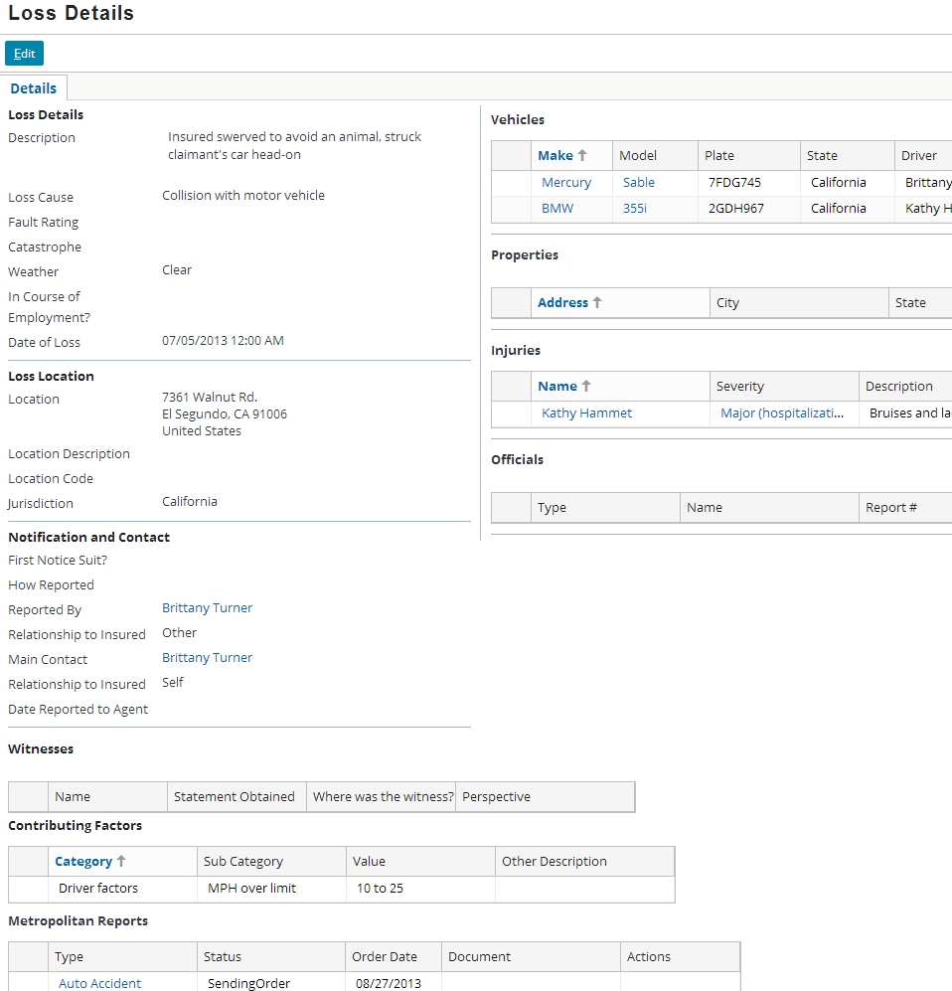
General loss information
General loss information is often captured on the Loss Details screen, such as information about:
Party at fault
Loss location
Notification info
Officials involved
Witnesses
Contributing factors
|EOS~008|
Notes:
|EON~008|
The adjudication functionality needed within ClaimCenter varies widely...
...from carrier to carrier
...from one line of business to the next
Therefore, this lesson discusses possible approaches to common adjudication requirements for each primary line of business, but it does not attempt to comprehensively cover every issue and approach every carrier might take.
The details listed above could be relevant for the following reasons:
Party at fault (Fault Rating) - This is used to determine who has the liability for the damage. It can impact who is responsible for paying losses. (If the insured is at fault, then the carrier must pay for the loss if the insured has the appropriate liability coverage. If the third party is at fault, then the carrier may attempt to get payment from the third party's insurance carrier. This is known as subrogation.)
Loss location - This is used to record where the loss occurred.
Notification and Contact - This records who reported the claim, and who the carrier should contact with issues about the claim.
Officials - This records any government officials, such as police officers, who were involved in the loss and/or may have information about what occurred.
Witnesses - This records any non-government officials who may have information about what occurred.
Contributing factors - This is discussed on the next slide.

Slide 9
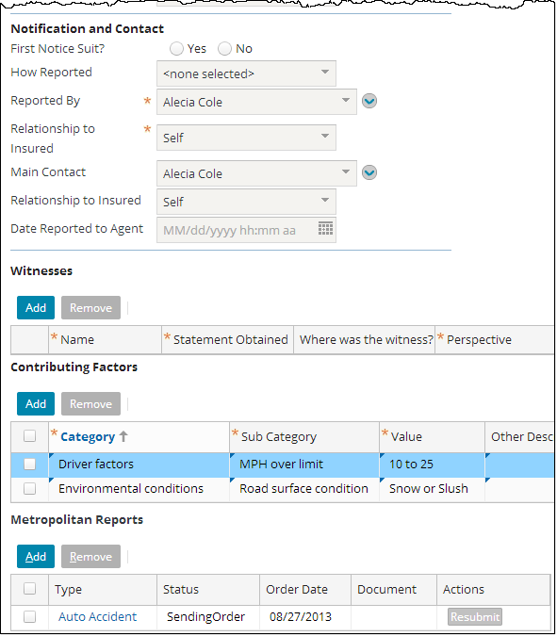
General loss information: Example
Each row in the Contributing Factors list is a series of dependent dropdowns which let users specify factors that contributed to the loss
|EOS~009|
Notes:
|EON~009|

Slide 10
Using information from external-to- carrier systems
The Loss Details screen can contain information from external systems, such as metropolitan reports
|EOS~010|
Notes:
|EON~010|
Metropolitan Reporting Bureau provides a nationwide police accident and incident reports service in the United States. (This is often referred to casually as "metro reports".) Many insurance carriers use this system to obtain police accident and incident reports to improve record-keeping and to reduce fraud. ClaimCenter’s built-in support for this service decreases deployment time for Metropolitan Reporting Bureau integration projects, particularly for personal lines carriers. For more information about Metropolitan’s services, refer to their web site: http://www.metroreporting.com.

Slide 11

Metropolitan Reporting Bureau integration
request for reports
Metropolitan Reporting Bureau
reports
Some instances of ClaimCenter have an integration point to Metropolitan Reporting Bureau
This system provides a nationwide police accident and incident reports service in the United States used by carriers to improve record-keeping and to reduce fraud
Information exchange
ClaimCenter sends a request for reports, identifying a given person, vehicle, and/or incidence of crime
ClaimCenter receives one or more police reports that may detail accidents, reported crimes, and so on
|EOS~011|
Notes:
|EON~011|
The effort around planning and configuring this integration point is typically minimal. Integration with Metropolitan Reporting Bureau is commonplace, and the integration components are provided in the ClaimCenter base application.
The planning for this integration point should happen as early as possible, because the information is coming from a system which is external to the carrier. (In other words, the carrier does not own or control the system ClaimCenter is connecting to.) Additional time may be needed to account for issues such as slow responses from the party managing the system, issues pertaining to firewalls, data system documentation which is incomplete, and so on.
There is only one Metropolitan Reporting Bureau with which a given instance of ClaimCenter can be integrated.

Slide 12
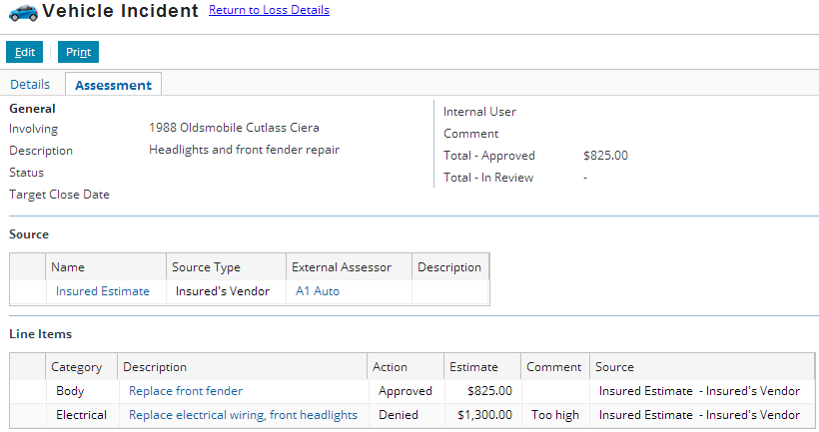
Assessments
The Assessment screens evaluate the value of lost or damaged property and monitor the services required to indemnify the insured
Description of property to be assessed
A source is a person who provided an assessment.
A line item has its own description, amount, and status (approved or denied).
|EOS~012|
Notes:
|EON~012|
The Assessments card shown above is provided in the base application for Auto losses (it is also available for Property and Contents losses). It is used to track the possible costs associated to repairs for a particular lost or damaged property (Incident).
For auto losses, an assessment consists of three sets of information:
Sources, which are people or businesses who provide assessments (such as auto repair shops)
Line items, which are the assessment items broken down to the smallest meaningful level. (For example, if damage has been done to a car's windshield and fender, then there might be two line items, one for the assessment of the windshield and another for the fender.
Event lines, which identify action taken by the carrier related to the assessment (such as requesting an assessment, approving an assessment, or noting repairs have been completed) (Shown on next slide)
The assessment is summarized at the top of the screen (General detail view).
NOTE: Assessments work independently of Services (Service Requests). The assessment feature is not integrated with Services. While some terminology and parties involved in the process are similar, the two pieces of functionality are separate. For example, a source vendor on an assessment is not retrieved from vendors providing services on the claim or on incidents.

Slide 13
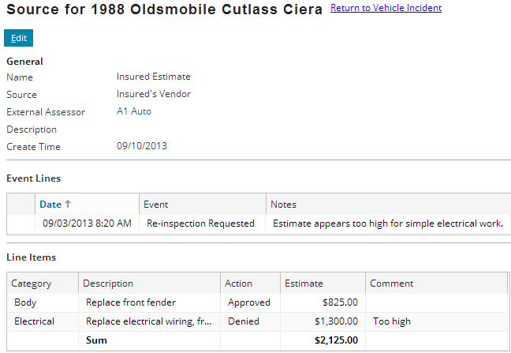
Assessment event lines
An event line is an action taken by the carrier
|EOS~013|
Notes:
|EON~013|
The example above shows a scenario in which the insured provided an estimate from his own mechanic, and one item (electrical) was excessively high. The front fender repair cost, however, has been approved. The adjuster owning the assessment requests a re-inspection from an approved vendor, which yielded a much lower amount for the headlight repair. The new line item would be entered on the Source popup for the approved vendor and visible on the assessment summary (which are visible if you view PowerPoint in Notes view (View > Notes Page)).

Slide 14
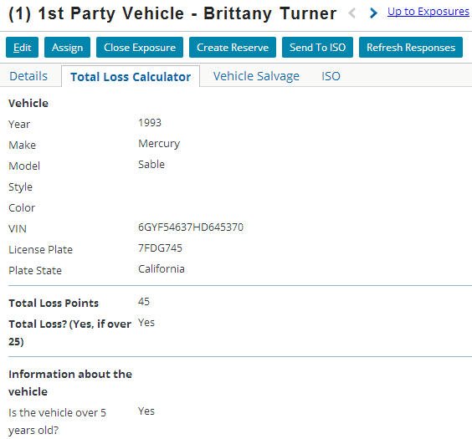
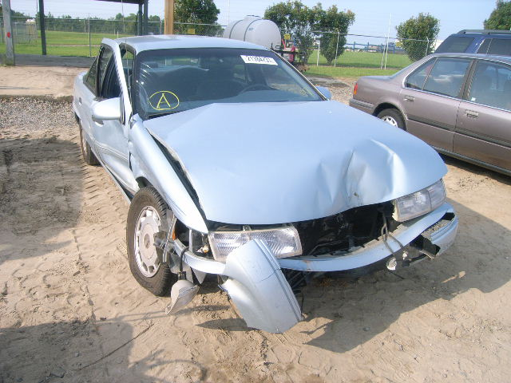

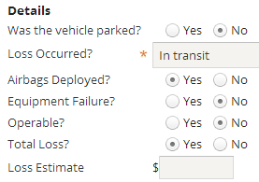
Total loss calculator
Vehicle incidents could make use of a total loss calculator
This is a series of questions which uses business rules to determine if the incident should be considered a total loss
|EOS~014|
Notes:
|EON~014|
In the example shown above, the information from the vehicle incident is used to populate the Total Loss Calculator. The Total Loss Calculator is on a card which is part of the exposure card view. It is visible only for exposures which have an exposure type of "vehicle (damage)". For exposures using other exposure types (such as an injury exposure), the card is not visible.
In the base application, when the total loss calculation is complete, the outcome (whether the loss is total or not) is also reflected on the Incident card.

Slide 15
Medical Bill Review integration
vendor data, claim data, bills
Medical Bill Review System
re-priced bills
Some instances of ClaimCenter have an integration point to an MBR (medical bill review) system
This system provides information about the standard amount of money being charged within the industry for a given medical service
Information exchange
ClaimCenter sends information about vendors who have provided service (typically weekly or monthly) as well as claim data and bills from these vendors (typically daily)
ClaimCenter receives re-priced bills that reflect the industry standard amount for the service
|EOS~015|
Notes:
|EON~015|
When processing claims pertaining to medical services, carriers want to know if a given vendor is charging for services above and beyond the average charge for the service. The purpose of MBR (medical bill review) system integration is to get information about what the standard charges are for a given service so that excessive costs are not incurred by the carrier. This integration point is typically used for workers' comp claims.
This integration point is typically not the one requiring the greatest amount of effort to plan and configure, but the effort involved is significant enough that it also cannot usually be considered minimal.
The planning for this integration point should happen as early as possible, because the information is coming from a system which is external to the carrier. (In other words, the carrier does not own or control the system ClaimCenter is connecting to.) Additional time may be needed to account for issues such as slow responses from the party managing the system, issues pertaining to firewalls, data system documentation which is incomplete, and so on.
A given instance of ClaimCenter may be integrated with one or more MBRs such as Mitchell DecisionPoint.

Slide 16
Lesson outline
Adjudication basics
Adjudication
The end of adjudication
|EOS~016|
Notes:
|EON~016|

Slide 17
The end of adjudication
At the conclusion of the adjudication process, the carrier should know that a given claim will be paid and what amount each payee will receive
However, there isn't always a single event that occurs for all claims that indicates adjudication is done and payments can be made
Intake
Adjudication
when?
Payment
|EOS~017|
Notes:
|EON~017|

Slide 18
Validation levels and adjudication
New Loss Completion
Valid for ISO
Send to External (Systems)
Ability to Pay
Recall that ClaimCenter uses a set of validation levels to track and enforce claim and exposure maturity
The adjudication process ends when the claim and its exposures reach "ability to pay"
Intake
Adjudication
Payment
|EOS~018|
Notes:
|EON~018|
In the base application, there are five levels of maturity:
Load save - This is the level a claim must be at in order to be imported from an external system. A claim at this stage has not yet been touched by a user via ClaimCenter.
New loss completion - This is the level a claim must be at to be saved (or modified by a user if the claim is imported).
Valid for ISO - This level is used to signify that the claim has the minimal information needed for filing with ISO.
Send to external (systems) - This level is used to signify that the claim has the minimal information needed to send information about it to external systems within the carrier, such as a policy administration system which is trying to assess policy renewal rates.
Ability to pay - This is the level a claim must be at in order to have payments written against it.
The Valid for ISO and Send to external (systems) levels are fully configurable. The other three levels are internal levels required by ClaimCenter and cannot be removed. You can also add additional levels not found in the base application.
These levels are referred to as "validation levels" because they are used both to validate whether a change can be made to a claim or exposure as well as what level of maturity to assign to the claim or exposure.

Slide 19
Each level has conditions
New Loss Completion
Valid for ISO
Send to External (Systems)
Ability to Pay
Driver of vehicle is specified
Loss location has city, state, zip
Total loss calculation completed
At least one assess- ment exists
If insured at fault, fault rating specified
Loss location has county
Mailing address for all third-party claimants
|EOS~019|
Notes:
|EON~019|
Every maturity level (validation level) has one or more conditions associated to it. These conditions identify what must be true of the claim or exposure in order to achieve that level of maturity. The example above is a set of claim maturity conditions in which:
A claim must have a specified driver and, if the insured is at fault, a specified fault rating to achieve the "new loss completion" level.
A claim must have a city, state, and zip code for the loss location to achieve the "valid for ISO" level.
A claim must have the total loss calculation completed for all exposures involving vehicle losses, and the county of the loss location must be specified to achieve the "Send to external (systems)" level.
A claim must have at least one assessment and the mailing address for all third-party claimants to achieve the "ability to pay" level.
Maturity levels are enforced in a cumulative fashion. In other words, a claim must meet all the rules at and below a given level to achieve that level. In the example above, a claim cannot reach the "valid for ISO" level simply by having a city, state, and zip code for the loss location. It must also still meet all the conditions of the "new loss completion" level. To reach "ability to pay", a claim must essentially meet all the conditions at all levels.
Validation rules can also be tied to a claim's loss date. This gives you the ability to phase new requirements into ClaimCenter (or relax old ones) without making the requirements active at the same time. For example, a new law might state that, as of January 1, 2009, a given personal auto's medical payments coverage cannot cover passengers in a car unless they are family members of the policy holder. You could create this as a validation rule which stated "IF loss date >= Jan. 1, 2009 AND coverage is 'medical payments' AND claimant's relationship to insured is not 'family member' THEN throw a validation error".

Slide 20
The "New Loss" level
New Loss Completion
Valid for ISO
Send to External (Systems)
Ability to Pay
Driver of vehicle is specified
Loss location has city, state, zip
Total loss calculation completed
At least one assess- ment exists
If insured at fault, fault rating specified
Loss location has county
Mailing address for all third-party claimants
|EOS~020|
Notes:
|EON~020|
In order to be saved initially, a claim or exposure must meet all of the rules specified for the "new loss completion" level. In the example above, a claim has been created with:
A specified driver
A specified fault rating
No zip code for the loss location
No total loss calculation complete
No county for the loss location
No assessments
A mailing address for the one third-party claimant
The claim meets all the rules for the "new loss completion" level, so the save is permitted and the claim is created. (If the user attempts to create a claim with no driver specified or a claim with the insured at fault and no fault rating specified, then the user will not be able to finish the new claim wizard and error message identifies exactly why the claim cannot yet be saved.)
In the base application, if a claim is created from an imported FNOL, then it starts at a lower level known as the "load save" level (which is not shown in the diagram above). The rules at the "load save" level specify the minimal amount of information an FNOL must have in order to be imported into ClaimCenter. However, the claim must meet all rules at the "new loss" level before any changes can be made to it.
Theoretically, a claim or exposure could be created that meets all the conditions for "new loss completion" and one or more additional levels beyond "new loss completion". In this case, the claim would start at the furthest level possible. For simplicity sake, this discussion assumes that the logic at each level is robust enough that it is unlikely a new claim or exposure will meet more than the first level when it is first created.

Slide 21
Promotion to more mature levels
New Loss Completion
Valid for ISO
Send to External (Systems)
Ability to Pay
Driver of vehicle is specified
Loss location has city, state, zip
Total loss calculation completed
At least one assess- ment exists
If insured at fault, fault rating specified
Loss location has county
Mailing address for all third-party claimants
|EOS~021|
Notes:
|EON~021|
The maturity level of every claim and exposure is managed by the rules engine.
The rules engine has a series of "validation rules" for claims and exposures. The validation rules store the conditions. Whenever a change is made to a claim or exposure, the rules engine reviews the validation rules.
If the change violates a condition at the object's current level or any previous levels, then the change is prevented. This prevents objects from slipping backwards in the business process.
If the change does not violate any condition and the object's current level or any previous levels, then the change is allowed.
When the change is allowed, the rules engine automatically checks to see if the object meets all of the conditions at the next level. If any condition is not met, then the object remains at its current level of maturity. If all of the conditions are met, then the object is advanced to that level and this process is repeated.
In the example above, the user provided a city, state, zip code, and county for the loss location and then saved the claim. The change did not violate the conditions at the "new loss" level, so the change was allowed. The rules engine checked to see if the claim now meets the "valid for ISO" level. It does, so the claim is advanced to that level. It then checks to see if it meets the "send to external" level. It meets some but not all of the conditions at the "send to external" level. (The total loss calculation has not been completed.) So, the claim is promoted no further than "valid for ISO".

Slide 22
Objects cannot move backwards
New Loss Completion
Valid for ISO
Send to External (Systems)
Ability to Pay
Driver of vehicle is specified
Loss location has city, state, zip
Total loss calculation completed
At least one assess- ment exists
If insured at fault, fault rating specified
Loss location has county
Mailing address for all third-party claimants
|EOS~022|
Notes:
|EON~022|
ClaimCenter does not allow claims or exposures to move backwards in terms of object maturity. Once a claim or exposure has reached a given level, then any change that would cause a condition at or below that level to become false is prevented. For example, in the scenario above:
If the user attempts to save a change in which the city, state, or zip code has been removed from the loss location, the save will be prevented. This is because the change would cause a condition at the claim's current level to become untrue.
If the user attempts to save a change in which the driver of the vehicle becomes unspecified, the save will be prevented. This is because the change would cause a condition below the claim's current level to become untrue.
If the user attempts to save a change in which the county has been removed from the loss location, the save will be allowed. This causes a condition to become untrue, but the condition is associated to a level above the claim's current level. The only conditions which must remain true are those at or below the claim's current level.
If the user attempts to save a change in which the vehicle license plate is remove, the save will be allowed. This is because no validation condition references the license plate.
ClaimCenter prevents objects from regressing in maturity because at any given point, ClaimCenter may take action on a claim or exposure based on its level. (For example, ClaimCenter might send the claim to the ISO ClaimDatabase once it reaches the "Valid for ISO" level.) If the object is allowed to regress, then systems outside of ClaimCenter would have inaccurate information about the claims. (For example, the ISO ClaimDatabase would have misleading information about a claim.)

Slide 23
The "Ability to Pay" level
New Loss Completion
Valid for ISO
Send to External (Systems)
Ability to Pay
Driver of vehicle is specified
Loss location has city, state, zip
Total loss calculation completed
At least one assess- ment exists
If insured at fault, fault rating specified
Loss location has county
Mailing address for all third-party claimants
|EOS~023|
Notes:
|EON~023|
Eventually, enough changes are made to the object that it reaches the "ability to pay" level. At this point, all conditions at all levels have been satisfied. From a business perspective, you can consider this the end of the adjudication process. A claim which is at "ability to pay" is ready to have checks written against it.

Slide 24
"Ability to pay" and the payment wizard
1
2
3
The payment wizard is a series of screens that guide users through the process of creating checks
For a given claim, you can start the payment wizard only if the claim is at "ability to pay"
In order to use money in a reserve line, the exposure which owns the reserve line must be at "ability to pay"
|EOS~024|
Notes:
|EON~024|

Slide 25
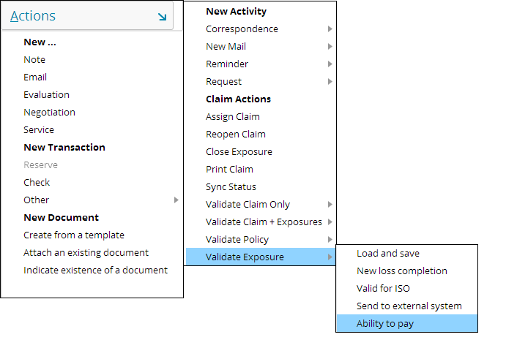
Objects that are not at “ability to pay"
The Claim Actions menu contains a Validate Exposure sub-menu
You can use this to validate an exposure in focus to determine what must be done to move it to “ability to pay"
|EOS~025|
Notes:
|EON~025|
You can also validate policies. A user might want to validate a policy is the policy was unverified or if some other change was made to the policy object in ClaimCenter after it was retrieved from the policy administration system. Policy validation rules are similar to claim and exposure validation rules, except for the fact that the policy does not have an inherent maturity level.

Slide 26
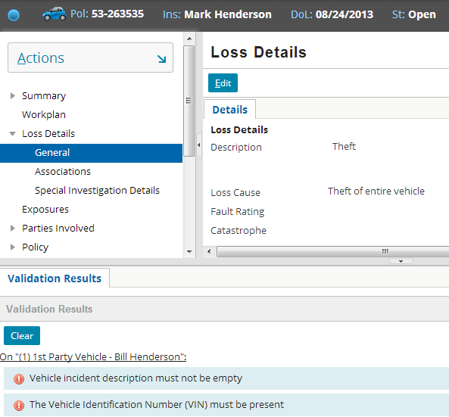
Validation results
|EOS~026|
Notes:
|EON~026|
The validation results screen lists all conditions with the policy, claim and/or its exposures which are preventing it from reaching the level specified from the Claim Actions menu. In the example above, the exposure is not at "ability to pay" because the vehicle incident has a description field which is empty.
ClaimCenter does not automatically report which level a condition is tied to. If you wanted a user to be aware of the level, you could add this to the message text. (For example, the text above could read "Vehicle: Vehicle incident description must not be empty. [Valid for ISO]".
If a user is interested in knowing what conditions they need to meet to achieve the next level, they can validate a claim and/or exposure for a specific level. (For example, if a claim is at "New loss" and you want to know what you need to do to make it "Valid for ISO" (as opposed to make it go all the way to "Ability to Pay"), then you can validate the claim and/or exposure specifically for the "Valid for ISO" level by selecting that level from the Validate menu.

Slide 27
Lesson objectives review
You should now be able to:
Describe the issues involved in the adjudication process
Describe ClaimCenter functionality relevant to:
The adjudication of auto claims
The adjudication of workers' comp claims
Describe how claims and exposures mature to the point where payments can be made against them
|EOS~027|
Notes:
|EON~027|

Slide 28
Review questions
What is the primary purpose of validation levels?
At the end of the new claim wizard:
What happens if the claim does not meet all the conditions at the "new loss completion" level?
What happens if it meets all "new loss completion" conditions, but none of the "ability to pay" conditions?
For a claim that is at "new loss completion":
When does ClaimCenter check to see if it can promote the claim to the next level?
What circumstances will make the promotion possible?
What ClaimCenter functionality is unavailable to claims that are not at "ability to pay"?
Once it is at "ability to pay", can a claim slip backwards to a less mature level?
|EOS~028|
Notes:
|EON~028|
Answers
1. Validation levels are used to track the maturity of a claim and its exposures during adjudication.
2. a) The claim cannot be saved. It must be modified until it meets all conditions or cancelled.
b) The claim is saved and is at least at the "new loss completion" level. It may be at a later level (such as "Valid for ISO" or "Send to External") if it meets all the conditions at these levels, but if it does not meet all the "ability to pay" conditions, then it will be below "ability to pay".
3. a) ClaimCenter checks every time a change is made to the claim or its sub-objects.
b) When the claim meets all conditions for the next level, it is promoted to that level.
4. You cannot start the payment wizard on claims that are not at ability to pay.
5. No. ClaimCenter prevents any change that would cause a claim to no longer meet the conditions for the level it is at or for any level below the level it is at.

Slide 29
Notices
Copyright © 2001-2014 Guidewire Software, Inc. All rights reserved.
Guidewire, Guidewire Software, Guidewire ClaimCenter, Guidewire PolicyCenter, Guidewire BillingCenter, Guidewire Reinsurance Management, Guidewire ContactManager, Guidewire Vendor Data Management, Guidewire Client Data Management, Guidewire Rating Management, Guidewire InsuranceSuite, Guidewire ContactCenter, Guidewire Studio, Guidewire Product Designer, Guidewire Live, Guidewire DataHub, Guidewire InfoCenter, Guidewire Standard Reporting, Guidewire ExampleCenter, Guidewire Account Manager Portal, Guidewire Claim Portal, Guidewire Policyholder Portal, ClaimCenter, BillingCenter, PolicyCenter, InsuranceSuite, Gosu, Deliver Insurance Your Way, and the Guidewire logo are trademarks, service marks, or registered trademarks of Guidewire Software, Inc. in the United States and/or other countries.
All other trademarks are the property of their respective owners.
This material is confidential and proprietary to Guidewire and subject to the confidentiality terms in the applicable license agreement and/or separate nondisclosure agreement.
This file and the contents herein are the property of Guidewire Software, Inc. Use of this course material is restricted to students officially registered in this specific Guidewire-instructed course, or for other use expressly authorized by Guidewire. Replication or distribution of this course material in electronic, paper, or other format is prohibited without express permission from Guidewire.
Guidewire products are protected by one or more United States patents.
|EOS~029|
Notes:
|EON~029|

