Slide 1
Financial Holds
28 August 2013
|EOS~001|
Notes:
|EON~001|
Guidewire training materials contain Guidewire proprietary information that is subject to confidentiality and non-disclosure agreements. You agree to use the information in this manual solely for the purpose of training to implement Guidewire software solutions. You also agree not to disclose the information in this manual to third parties or copy this manual without prior written consent from Guidewire. Guidewire training may be given only by Guidewire employees or certified Guidewire partners under the appropriate agreement with Guidewire.

Slide 2
Lesson objectives
By the end of this lesson, you should be able to:
Explain why some claims do not allow claim cost payments but do allow expense payments
Describe how ClaimCenter manages payments on claims whose coverage is in question
Describe how ClaimCenter manages payments on claims whose policies are unverified
Describe how ClaimCenter manages payments on claims that are incident only
Explain how claim cost payments can be prevented using financial holds
This lesson uses the notes section for additional explanation and information. To view the notes in PowerPoint, choose View→Normal or View→Notes Page. If you choose to print the notes for the lesson, be sure to select “Print hidden slides.”
|EOS~002|
Notes:
|EON~002|

Slide 3
Lesson outline
Preventing claim cost payments
Coverage in question
Unverified claim policy
Incident only claim
Financial holds
|EOS~003|
Notes:
|EON~003|

Slide 4
Preventing claim cost payments
Some claims are created, but carrier does not expect to make any claim cost payments
Merely keeping claims from getting to ability to pay does not allow for expense payments
Why no claim cost payments?
Coverage is in question
Claim is incident only
Claim’s policy is unverified
ClaimCenter uses financial holds functionality to allow for these possibilities
|EOS~004|
Notes:
|EON~004|
Some cases where a claim might be placed under a financial hold but expense payments still need to be paid:
Claim may not originally have been marked as a financial hold, so vendor might have performed a service before the claim was locked down
Claim might require legal or other consultation fee

Slide 5
Lesson outline
Preventing claim cost payments
Coverage in question
Unverified claim policy
Incident only claim
Financial holds
|EOS~005|
Notes:
|EON~005|

Slide 6
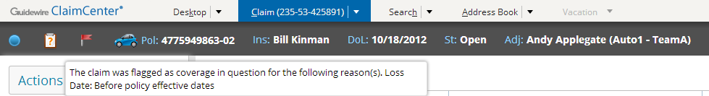
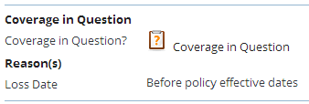
Coverage in question
Coverage in question (CiQ) is an indicator that a loss may not be covered by the claim’s policy
Question mark icon signifies CiQ:
If coverage is in question, the claim is flagged as such
In the Info Bar (with reason displayed as mouse over)
In High-Risk Indicators section on the Claim Status tab of Summary page
|EOS~006|
Notes:
|EON~006|

Slide 7
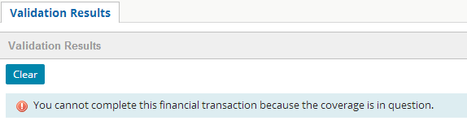
Setting coverage in question
Coverage in question status can be set manually (by editing claim status) or automatically based on data in the claim
In the base configuration, claims flagged as having coverage in question cannot make claim cost payments or create initial claim cost reserves
|EOS~007|
Notes:
|EON~007|

Slide 8

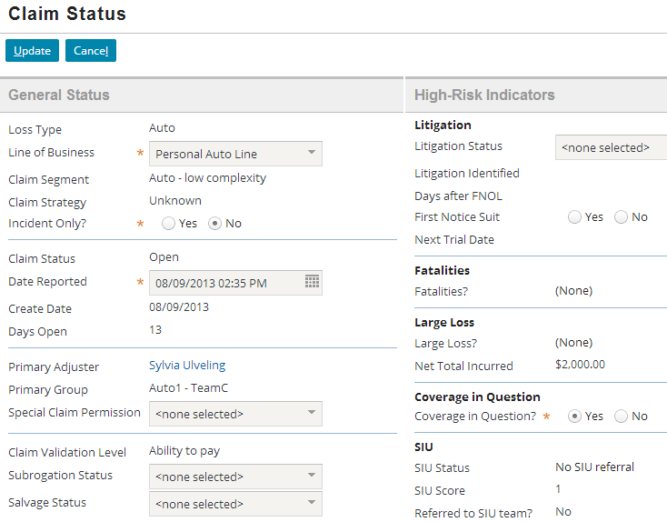
Setting coverage in question field manually
Set via radio button on Summary page’s Claim Status (menu link)
Once set, only user (typically a supervisor) with proper permissions can change
|EOS~008|
Notes:
|EON~008|
Click to add notes.

Slide 9
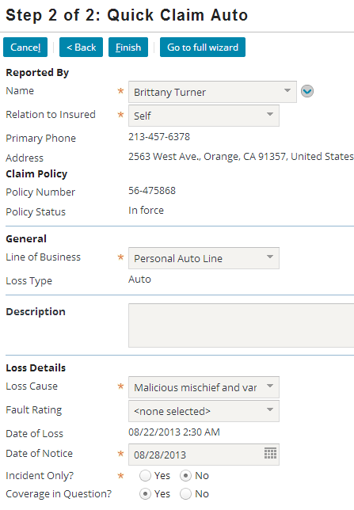
Setting coverage in question during claim creation
Use radio button to specify CiQ status
|EOS~009|
Notes:
|EON~009|

Slide 10

Coverage in question set to yes
Once a user has set CiQ field to yes, field displays an indicator that coverage is in question
Yes/no radio buttons not displayed unless user has role with the ability to unset coverage in question
In the base application, the “Unset the coverage in question field” permission is granted to the following roles: Claims Supervisor, Manager, New Loan Processing Supervisor, and Super User
|EOS~010|
Notes:
|EON~010|
CiQ permission can be added to any desired role. Note that this permission is not a function of being the “supervisor” of a group.
The code for the “Unset the coverage in question field” is unsetcovinquestion.

Slide 11
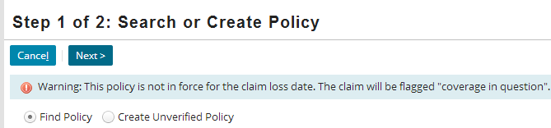

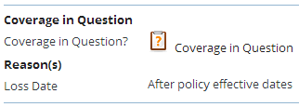
Setting coverage in question automatically
CiQ also set automatically based on configurable settings
In base ClaimCenter configuration, CiQ is automatically set to true if any of the following are true:
Loss date is before policy effective date
Loss date is after policy expiration date
Policy status something other than "In force" or "Archived"
Example
Claim with loss date before policy expiration date
Claim with loss date after policy expiration date
|EOS~011|
Notes:
|EON~011|
Information on configuring this functionality is available in the “Configuring Financial Holds” lesson of the Claim Center Application Configuration course.

Slide 12
Lesson outline
Preventing claim cost payments
Coverage in question
Unverified claim policy
Incident only claim
Financial holds
|EOS~012|
Notes:
|EON~012|

Slide 13
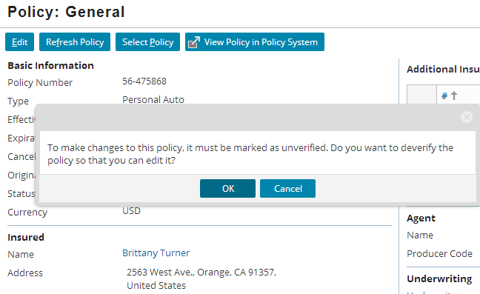

Unverified claim policy
Policy becomes unverified if the claim policy is edited or if the loss date is changed
Claim cost payments not made on unverified policies
|EOS~013|
Notes:
|EON~013|
Note that this slide refers to “claim policy” rather than just “policy.” This specifies that this is the policy instance associated with the claim, NOT the policy stored in the policy administration system.
Even if you cancel the changes on the policy, the policy remains unverified.

Slide 14
Lesson outline
Preventing claim cost payments
Coverage in question
Unverified claim policy
Incident only claim
Financial holds
|EOS~014|
Notes:
|EON~014|

Slide 15
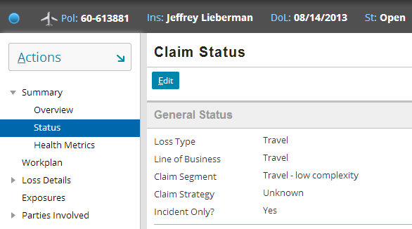
Incident only claim
Some claims are just informational
For incident only claims, no claim cost payments are made but expense payments might be needed
|EOS~015|
Notes:
|EON~015|
A common example of Incident only claims is a workers’ comp claim where ClaimCenter only collects information about the loss. If the claimant files a real claim later, ClaimCenter has the initial information to proceed.
In the base product, the “Incident only?” field can be set manually and appears on the Summary → Claim Status menu link as well as in the New Claim Wizard. Collecting information on incident only claims helps carriers combat fraud.
There is no mechanism for setting this field automatically in the base product, but it is configurable.

Slide 16
Lesson outline
Preventing claim cost payments
Coverage in question
Unverified claim policy
Incident only claim
Financial holds
|EOS~016|
Notes:
|EON~016|

Slide 17
Financial holds
Financial holds are a mechanism for preventing claim cost payments and reserves while allowing for other payments types
Financial holds result from configurable claim characteristics such as
Coverage is in question
Claim is incident-only
Claim policy is unverified
Hold status is not stored
No field is set or checked
Hold status is automatically updated every time a transaction is edited
|EOS~017|
Notes:
|EON~017|

Slide 18
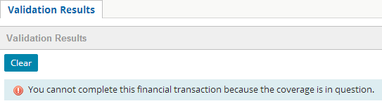
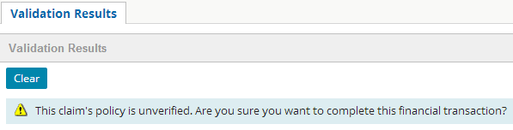
When financial holds apply
Claim cost initial reserves not created
Claim cost payments and reserves are prohibited
Other payments and reserves are allowed, but the user is warned
|EOS~018|
Notes:
|EON~018|
Payment transactions are usually only allowed (with a warning) for non-claim cost (indemnity) payments (such as Expenses). For claim cost transactions, an error prevents the transaction.

Slide 19
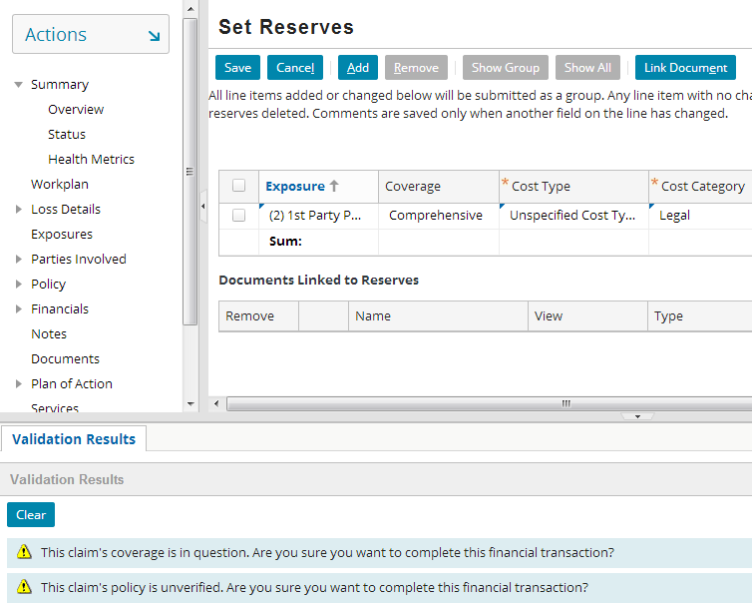
Financial holds and initial reserves
Attempting to create initial reserves for a claim with coverage in question or unverified policy leads to validation warning:
|EOS~019|
Notes:
|EON~019|
If the attempt was made to create claim cost reserves in this example (instead of expenses or unspecified), an error validation message would prevent the reserve from being created.

Slide 20
Lesson objectives review
You should now be able to:
Explain why some claims do not allow claim cost payments but do allow expense payments
Explain what happens when a claim’s coverage is in question
Explain when a claim's policy becomes unverified
Explain why incident only claims do not allow claim cost payments
Explain how claim cost payments can be prevented using financial holds
|EOS~020|
Notes:
|EON~020|

Slide 21
Review questions
What happens when a claim is subject to financial holds?
What are the three basic triggers for financial holds?
Can you configure additional reasons to trigger financial holds?
When is the "Incident only?" field on a claim automatically set?
When is the "Coverage in Question" field on a claim automatically set?
|EOS~021|
Notes:
|EON~021|
Answers
Claim cost reserves and payments are rejected. Expense reserves and payments return warnings but are allowed.
Coverage is in question, the claim is incident only, claim policy is unverified.
Yes. Details are provided in the “Configuring Financial Holds” lesson in Claim Center Application Configuration course.
Never. In the base application, that field can only be set manually.
When the loss date is outside of the policy effective dates, or the policy status is something other than In Force or Archived.

Slide 22
Notices
Copyright © 2001-2014 Guidewire Software, Inc. All rights reserved.
Guidewire, Guidewire Software, Guidewire ClaimCenter, Guidewire PolicyCenter, Guidewire BillingCenter, Guidewire Reinsurance Management, Guidewire ContactManager, Guidewire Vendor Data Management, Guidewire Client Data Management, Guidewire Rating Management, Guidewire InsuranceSuite, Guidewire ContactCenter, Guidewire Studio, Guidewire Product Designer, Guidewire Live, Guidewire DataHub, Guidewire InfoCenter, Guidewire Standard Reporting, Guidewire ExampleCenter, Guidewire Account Manager Portal, Guidewire Claim Portal, Guidewire Policyholder Portal, ClaimCenter, BillingCenter, PolicyCenter, InsuranceSuite, Gosu, Deliver Insurance Your Way, and the Guidewire logo are trademarks, service marks, or registered trademarks of Guidewire Software, Inc. in the United States and/or other countries.
All other trademarks are the property of their respective owners.
This material is confidential and proprietary to Guidewire and subject to the confidentiality terms in the applicable license agreement and/or separate nondisclosure agreement.
This file and the contents herein are the property of Guidewire Software, Inc. Use of this course material is restricted to students officially registered in this specific Guidewire-instructed course, or for other use expressly authorized by Guidewire. Replication or distribution of this course material in electronic, paper, or other format is prohibited without express permission from Guidewire.
Guidewire products are protected by one or more United States patents.
|EOS~022|
Notes:
|EON~022|

