Slide 1
Payments
30 January 2015
|EOS~001|
Notes:
|EON~001|
Guidewire training materials contain Guidewire proprietary information that is subject to confidentiality and non-disclosure agreements. You agree to use the information in this manual solely for the purpose of training to implement Guidewire software solutions. You also agree not to disclose the information in this manual to third parties or copy this manual without prior written consent from Guidewire. Guidewire training may be given only by Guidewire employees or certified Guidewire partners under the appropriate agreement with Guidewire.

Slide 2
Lesson objectives
By the end of this lesson, you should be able to:
Define financial terms used by ClaimCenter for managing payments
Create checks
Apply deductibles
Create and pay out auto first and final claims
This lesson uses the notes section for additional explanation and information. To view the notes in PowerPoint, choose View→Normal or View→Notes Page. If you choose to print the notes for the lesson, be sure to select “Print hidden slides.”
|EOS~002|
Notes:
|EON~002|

Slide 3
Lesson outline
Payment basics
Creating checks
Deductibles
Auto first and final
|EOS~003|
Notes:
|EON~003|

Slide 4
Checks and payees
Coverage: Collision
Coverage: Med. pay.
Check
Ray Newton (Payee)
A check is a single transfer of money from one or more reserve lines to one or more individuals or organizations
A payee is a person to whom a check is made payable
Payees include both claimants and people who provided services for the claim (such as inspectors)
|EOS~004|
Notes:
|EON~004|

Slide 5
The payment wizard
Checkset
1
2
3
Payment wizard
The payment wizard is a series of screens used to create checks
Every iteration of the payment wizard creates a "checkset", which contains one or more checks
|EOS~005|
Notes:
|EON~005|
A checkset is defined as the set of all checks created through one iteration of the payment wizard. Some checksets have multiple checks, and some checksets have only a single check.
Another term used within ClaimCenter configuration is a "check group". A check group is a set of checks within a single checkset which are scheduled to be paid on the same day. The term "check group" is useful for certain aspects of configuration, but typically it is not a term that business professionals need to use.

Slide 6
Payment transactions
Coverage: Collision
Checkset
-$2250
Coverage: Med. pay.
-$1465
Every checkset "gets" its money from one or more payment transactions
Each payment transaction comes from a reserve line, which can be from the same exposure or different exposures
|EOS~006|
Notes:
|EON~006|
The payment transactions that provide money for a checkset (that is, the payment transactions that provide money for a single iteration of the payment wizard) belong to the same transaction set.

Slide 7
Checks in a checkset
Checkset
Ray Newton (insured)
Paula Gellar (lawyer)
Taylor Duggan & Joe's Garage (auto inspector)
The money in a checkset "goes into" one or more checks
Each check has either:
A single payee, or
A set of "joint payees"
|EOS~007|
Notes:
|EON~007|
Joint payees are two or more different payees that are listed in the same ‘Pay To’ field of a single check. When multiple parties are listed in the same 'Pay To' field, all parties are required to sign the check before it can be deposited or cashed. An example of a check written to joint payees might be a payment to an auto inspector who was sub-contracted by an auto shop. The insurer might write the check to both parties as joint payees.
The ClaimCenter user interface and documentation also make reference to "multiple payees". This term is appropriate when a checkset has two or more checks and the checks have different payees. In other words, the term "multiple payees" is something that describes a checkset and occurs only at the checkset level. A single check never has multiple payees. It has either a single payee or a set of joint payees.

Slide 8
Checkset example 1: Single payment for single check
Checkset
Coverage: Comprehensive
$550
Ray Newton (insured)
-$550
Ray Newton receives a $550 check to repair damage done to his car during a hail storm
|EOS~008|
Notes:
|EON~008|

Slide 9
Checkset example 2: Multiple payments for single check
Coverage: Collision
Checkset
-$2250
$3715
Ray Newton (insured)
Coverage: Med. pay.
-$1465
Ray Newton receives a check for $3715 to cover:
Damage done to his car from a collision
Medical payments for an injury he got during the collision
|EOS~009|
Notes:
|EON~009|

Slide 10
Checkset example 3: Single payment for multiple checks
Checkset
Coverage: Collision
$2400
Ray Newton (insured)
-$3000
$600
Paula Gellar (lawyer)
An auto collision required litigation which ultimately ruled in favor of Ray Newton
He gets a check for $2400 ($3000 minus the 20% lawyer fee)
His lawyer gets a check for 20% of $3000 ($600)
|EOS~010|
Notes:
|EON~010|

Slide 11
Checkset example 4: Multiple payments for multiple checks
Coverage: Collision
Checkset
$3200
Ray Newton (insured)
-$2400
Coverage: Med. pay.
$800
Paula Gellar (lawyer)
-$1600
An injury-causing collision required litigation which ultimately ruled in favor of Ray Newton
Ray gets a check for $4000 minus the 20% lawyer fee
His lawyer gets a check for 20% of $4000, or $800
|EOS~011|
Notes:
|EON~011|

Slide 12

Financials approval
-$50,000
ClaimCenter reviews every transaction (including payment transactions) to determine if it requires approval
|EOS~012|
Notes:
|EON~012|
Financials approval is discussed in its own lesson in the Financial Approvals lesson of the ClaimCenter 8.0 Introduction course.

Slide 13
The life cycle of a check
Pending Approval
(Draft)
Rejected
Awaiting Submission
batch process
Requesting / Requested
External Check Processing
Issued
Cleared
|EOS~013|
Notes:
|EON~013|
A check can potentially go through several statuses during its life cycle.
Initially, a check is in a draft state while it is being created within the payment wizard.
When a check is initially created, the check's status is set to "Pending Approval". (Check approval is discussed in the "Supervisors" lesson.)
If the approval is denied, then the check is set to "Rejected".
If the approval is approved, or if no approval is required, the check advances to "Awaiting Submission" status. At this point, it has not yet been sent to the external check printing system.
A periodic batch process sends checks at "awaiting submission" status to the check printing system. Once sent to the check printing system, its status is "Requesting" or "Requested". (The exact status can depend on the implementation of the integration code.)
When the check printing system reports that the check has been issued, the status changes to "Issued".
When the payee(s) have cashed the check, it is "Cleared".
The "Pending Approval", "Rejected", and "Awaiting Submission" statuses are managed by ClaimCenter. The external check printing system largely manages the latter three steps, identifying that the check has been received, printed, and then cashed.

Slide 14
General ledger integration
summary level data or every transaction
General Ledger System
acknowledgement
Some instances of ClaimCenter have an integration point to a general ledger system, such as Oracle Financials
This system tracks finances for the carrier (reserves and payments), and the integration point exists so that the ledger system can stay abreast of the payments ClaimCenter is making
Information exchange
Depending on the carrier, ClaimCenter sends either summary-level data or detailed data about every transaction
ClaimCenter receives acknowledgement that the information has been received
|EOS~014|
Notes:
|EON~014|
This integration point is typically not the one requiring the greatest amount of effort to plan and configure, but the effort involved is significant enough that it also cannot usually be considered minimal.
A given instance of ClaimCenter is typically integrated with a single general ledger system.

Slide 15
Check processing integration
check data (and check number)
Check Processing System
status (and check number)
Every instance of ClaimCenter has an integration point to a check processing system
This system prints paper checks and/or manages electronic funds transfers
Information exchange
ClaimCenter sends check data (amount, line items, ...)
ClaimCenter receives the check status (such as requesting or issued)
Depending on the carrier, the check number may be generated by either system
|EOS~015|
Notes:
|EON~015|
This integration point is typically not the one requiring the greatest amount of effort to plan and configure, but the effort involved is significant enough that it also cannot usually be considered minimal. This is a "medium" level task because:
Testing of the integration point typically has to be run through accounting team
There are a number of exception cases that the integration point must deal with (such as what happens if the check printing machine runs out of paper, or what happens if and when a check number is skipped
The check processing integration point is the integration point that involves the greatest amount of passing back and forth of the status of an object (in this case, the check).
If the check processing is to be done by a system that is not owned by the carrier, then the planning for this integration point should happen as early as possible. Additional time may be needed to account for issues such as slow responses from the party managing the system, issues pertaining to firewalls, data system documentation which is incomplete, and so on.
A given instance of ClaimCenter may be integrated with one or more check processing systems. For some carriers, different lines of business can use different systems.

Slide 16
Financial institution integration
"clear to pay" file
Financial Institution
statements
Some instances of ClaimCenter have an integration point to a financial institution (bank)
The integration point exists so that ClaimCenter can track when checks have been paid
Information exchange
ClaimCenter sends a "clear to pay" file, which includes the check numbers and amounts for checks issued by ClaimCenter
ClaimCenter receives statements identifying the check status (cleared, voided, stopped)
|EOS~016|
Notes:
|EON~016|
A "clear to pay" file contains a list of check numbers and the corresponding check amounts for checks issued by ClaimCenter. It is used by the financial institution to verify at the time the check is paid that the payment amount is correct. "Clear to pay" files are used by most businesses that issue checks of any sort (including payroll and refund checks) to prevent fraud.
Some instances of ClaimCenter are not integrated directly with financial institutions. In these cases, the check processing systems are integrated with the financial institutions, and information about checks and their statuses comes to ClaimCenter through the check processing system.
This integration point is typically not the one requiring the greatest amount of effort to plan and configure, but the effort involved is significant enough that it also cannot usually be considered minimal.
If financial integration is to be done, then the planning for this integration point should happen as early as possible. Additional time may be needed to account for issues such as slow responses from the party managing the system, issues pertaining to firewalls, data system documentation which is incomplete, and so on.
A given instance of ClaimCenter may be integrated with one or more financial institutions.

Slide 17
The end of the reserve line
+$2500
-$1175
Final Payment
-$1325
Payment transactions are coded as "partial" or "final"
A final payment indicates that the financial obligation that the reserve line was created for has been met
When you create a final payment transaction, ClaimCenter:
Creates a second reserve transaction which reduces the line to zero (or "zeroes out" the reserve line)
|EOS~017|
Notes:
|EON~017|
Every payment transaction has a payment type. There are two possible values: partial and final.
A partial payment transaction is a transaction which will pay for some, but not all, of the financial obligation of the reserve line. The money remaining in the reserve line will presumably be used on some future check to complete the financial obligation.
A final payment transaction is a transaction which completes the financial obligation of the reserve line. Because the financial obligation has been met, there is no need to keep money set aside in the reserve line. Therefore, ClaimCenter can automatically create an additional reserve transaction which "zeroes out" the reserve line. Note that this is a reserve transaction and not a payment transaction. (A payment transaction is used only when the money in question is being put into a check.) Also note that this is an example of a reserve transaction which removes money from a reserve line as opposed to adding money to it.
The zeroing out of a reserve line is done for practical financial purposes. If the remaining money is known to not be needed anymore, then the money can be dedicated to the reserve line for some other claim.
A reserve line does not have a status. It is never assigned a value of "opened" or "closed". If you make a final payment on a reserve line, ClaimCenter automatically zeroes out the reserve line. But you could always manually add additional money to the reserve line. However, the terms "closing a reserve line" or "the reserve line is closed" are often used in the industry. These terms should be thought of as being synonymous with "zeroing out the reserve line".
A final payment may also close the exposure, if configured to do so, if this reserve line is the last open reserve associated with the exposure. Closing of exposures is covered in the lesson Closing Claims.

Slide 18
Lesson outline
Payment basics
Creating checks
Deductibles
Auto first and final
|EOS~018|
Notes:
|EON~018|

Slide 19
The payment wizard
1
2
3
Checks are created using the payment wizard
In the base application:
The fields vary based on the method of payment (automated check, manual check, EFT)
But, the basic steps are the same for all forms of payment
|EOS~019|
Notes:
|EON~019|

Slide 20
Basic steps of the payment wizard
Step 1: Specify checks and payees
Step 2: Specify the payment transactions (The wizard calculates the checkset total and each check amount.)
Step 3: Specify check instructions
Checkset
$1100
pay to: Ray Newton (insured)
2029 Oak Blvd.
-$1175
$275
-$200
pay to: Paula Gellar (lawyer) portion: 20%
030-227-12699
$1375
|EOS~020|
Notes:
|EON~020|
When you start the payment wizard, you create a checkset. Initially, the checkset has no checks in it.
(continued)

Slide 21
(Notes only slide)
|EOS~021|
Notes:
|EON~021|
During the first step, you specify the number of checks and payees for each check. If there are multiple payees, then you must specify the amount of money that will go to each of the secondary payees. This is specified either as a percentage or as a fixed amount.
During the second step, you specify one or more payment transactions. For each payment transaction, you must identify the reserve line from which the money will come and the amount of money. Once this is done, the total amount of the money in the checkset can be determined as well as the amount of each check.
During the third step, the check instructions are specified. This could include mailing information (if it is different than what is already known for the payee), routing information, and the date in which the check should be issued.

Slide 22
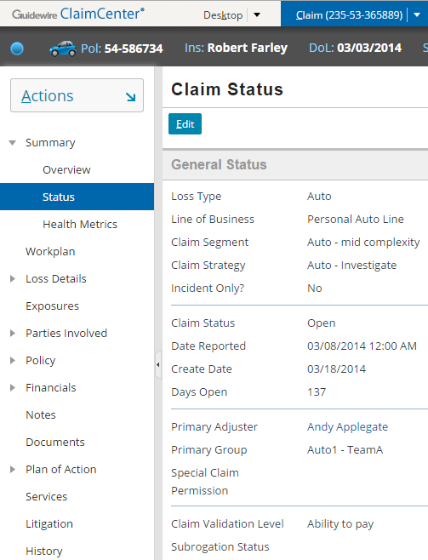
Prerequisites of the payment wizard: Claim at "ability to pay"
In order to initiate the payment wizard, the claim's validation level must be "ability to pay"
|EOS~022|
Notes:
|EON~022|

Slide 23
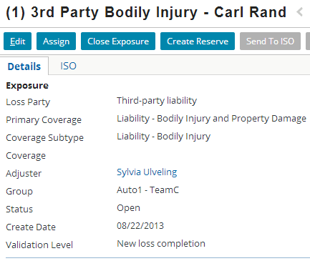
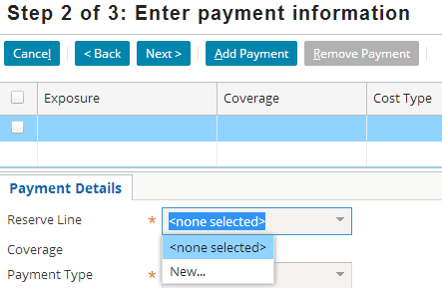
Prerequisites of the payment wizard: Exposure at "ability to pay"
In order to make checks from a given exposure's reserve lines, the exposure must be at "ability to pay"
|EOS~023|
Notes:
|EON~023|
In the example above, the claim is at "ability to pay", but its only exposure is not at "ability to pay". Consequently, the payment wizard can be started, but there is no access to any reserve lines. (Note that the dropdown does not list any reserve lines.)
You can create a payment if some, but not all, of the claim's exposures are at "ability to pay". In this case, the payment can make use only of reserve lines from the exposures at ability to pay.

Slide 24
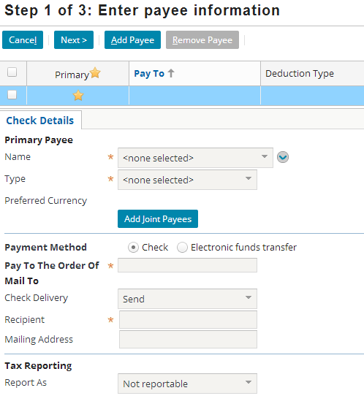
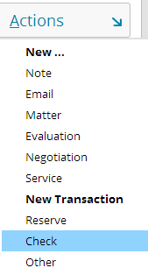
Initiating the payment wizard
The payment wizard is initiated through the New Transaction menu
|EOS~024|
Notes:
|EON~024|
Recall that each iteration creates a checkset of one or more checks.
Note that the menu choice “Other” allows the creation of a manual check, discussed later in this lesson.

Slide 25
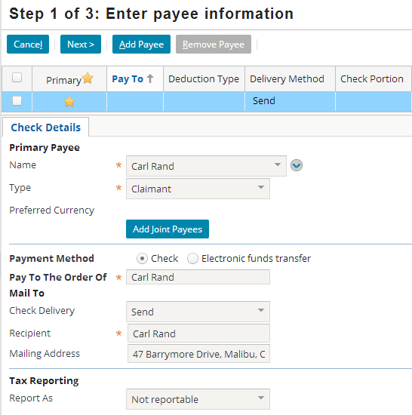
Step 1: Payees (Specifying the primary payee)
|EOS~025|
Notes:
|EON~025|
In the first step of the wizard, you specify who the check is to be paid to. At this point, you are working on the first check of the checkset. (Note the icon in the upper right corner of the slide, which denotes the checkset currently has only a single check in it.)
Each check can have a single payee or joint payees. To specify Joint Payees, click the Add Joint Payee button. ClaimCenter displays an editable list view in which you can add additional joint payees as shown in the screenshot below (which is visible if you view PowerPoint in Notes view (View > Notes Page)).

Slide 26
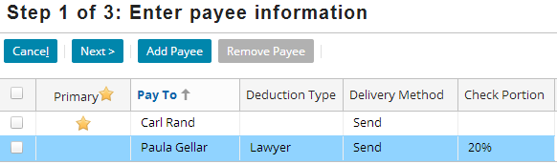
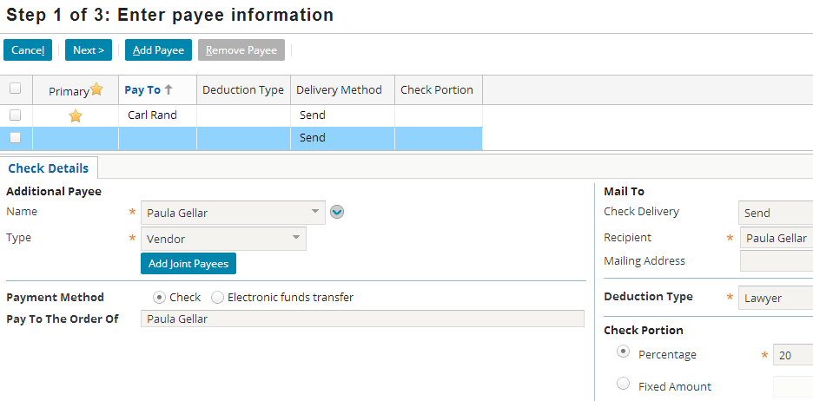
Step 1: Payees (Creating additional payees and checks)
v
u
|EOS~026|
Notes:
|EON~026|
Within the payment wizard, adding an additional payee (outside of joint payees) is synonymous to adding an additional check. When you add a payee, you create an additional check in the checkset. (Note the icon in the upper right corner of the slide, which denotes the checkset now has two checks in it.)
When you create an additional check, the first check is presumed to be for the primary payee, and all other checks are presumed to be for secondary payees. For each secondary payee, you must specify what portion of the money in the checkset will go to that payee. This can be done either as a percentage (as in the case above, where the lawyer Paula Gellar gets 20% of the total money in the checkset) or as a fixed amount. The money which has not been dedicated to secondary payees by percentage or fixed amount is then put into the check for the primary payee. These additional payees are sometimes called "split payees" because of the fact that they are taking a percentage or set portion of the payment from the primary payee.

Slide 27
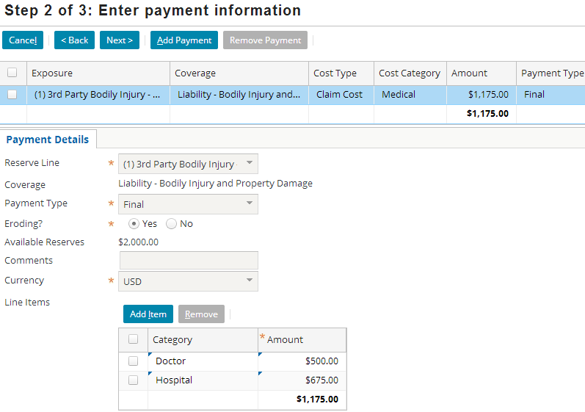
Step 2: Payment transactions (The first payment transaction)
-$1175
|EOS~027|
Notes:
|EON~027|
The second screen of the payment wizard lets you specify the payment transactions for the check. Every check consists of at least one payment transaction.
To create a payment transaction:
Select the appropriate reserve line. (Note that the dropdown lists exposure, cost type, and cost category. These three attributes in combination can be used to uniquely identify each reserve line.)
Identify if the payment is partial or final. (This is discussed on one of the following slides.)
Identify if the payment is eroding or not. (This is defined below.)
Optionally add comments.
Add one or more line items, each with a category and an amount. The total amount of all lines items cannot exceed the available reserves.
Most payment transactions reduce the reserve, but there are some cases where this doesn't occur. Some carriers don’t want to manage their reserves at a granular level; they only care about reserves as averages. In these cases, the payments are listed as not ”eroding", which results in payment transactions that do not affect the reserve line.
When selecting the reserve line, the base application allows for creation of a "New..." claim-level reserve line. This rarely-used option of not using an existing reserve line comes with two conditions: 1. The payment type must be "final".
2. An additional transaction is created equal to the amount of the payment. In summary, the reserve line is created and emptied in a single step.

Slide 28
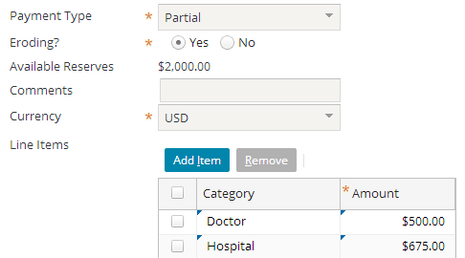
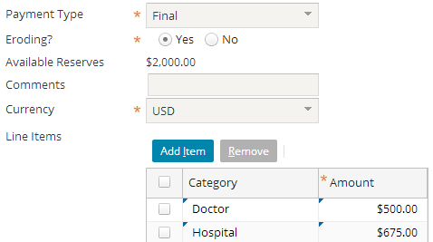
Payment types
Partial
+$2000
-$1175
Final
+$2000
-$1175
-$825
|EOS~028|
Notes:
|EON~028|
Recall that every payment transaction has a payment type. There are two possible values: partial and final.
A partial payment transaction is a transaction which will pay for some, but not all, of the financial obligation of the reserve line. The money remaining in the reserve line will presumably be used on some future check to complete the financial obligation.
A final payment transaction is a transaction which completes the financial obligation of the reserve line. Because the financial obligation has been met, there is no need to keep money set aside in the reserve line. Therefore, ClaimCenter automatically creates an additional reserve transaction which "zeroes out" the reserve line. Note that this is a reserve transaction and not a payment transaction. (A payment transaction is used only when the money in question is being put into a check.) Also note that this is an example of a reserve transaction which removes money from a reserve line as opposed to adding money to it.

Slide 29
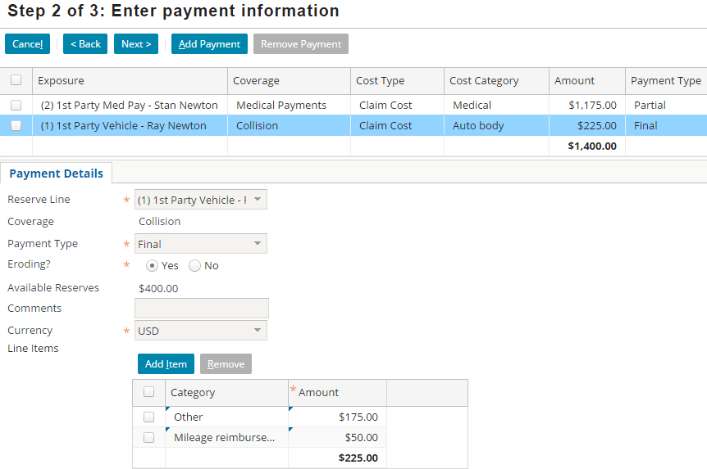
Step 2: Payment transactions (Additional payment transaction)
-$225
|EOS~029|
Notes:
|EON~029|
You can create additional payment transactions for the same check. To do this, click the Add Payment button. This creates a new, blank Payment Details card. On the new card, you can select a different reserve line. (Note that the first payment transaction is visible in the top list.)
Be aware of the fact that there is no correlation between the number of payment transactions and the number of checks. The example above has two payment transactions but one check. This is a common situation:
Two payment transactions for a single check. (For example, exposure A is for damage done to a third-party's car and exposure B is for an injury to the same third party. Because there are two exposures, there are two separate reserve lines and therefore two separate payment transactions. But, there will be only one check to the third party.)
One payment transaction for two checks. (For example, exposure A is for an injury to the insured. Litigation is involved, and the lawyer gets 20% of the settlement. There is only one exposure, and only one reserve line for the exposure. But two checks will be sent - one to the lawyer for 20% of the total payment and one to the insured for the remaining 80%.)

Slide 30
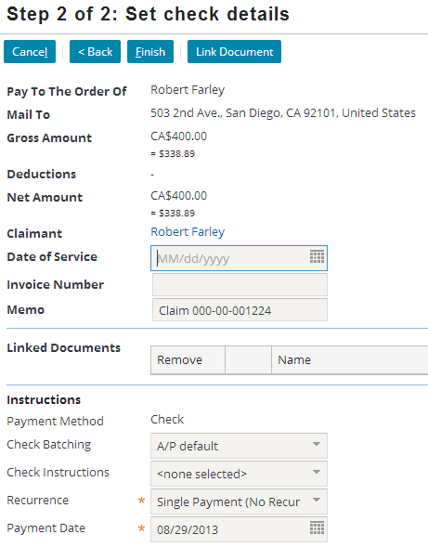
Multicurrency payments
Payments can be made in any currency
|EOS~030|
Notes:
|EON~030|
As with reserves, a payment may be made in a different currency than the base. The transaction will be stored using the exchange rate (automatic or manual), the transaction amount and the base (converted) amount.
In the example above, the gross amount is CA$400 (Canadian dollar), which is equal to $338.89 USD.

Slide 31
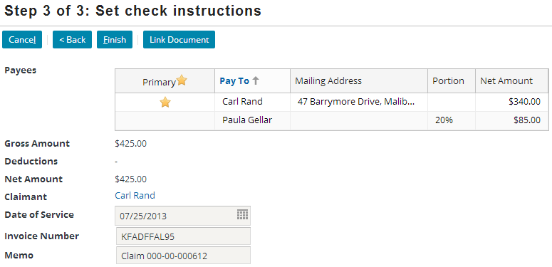
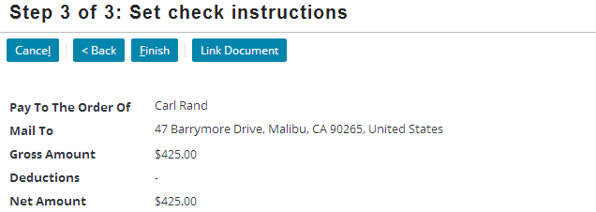
Step 3: Check instructions
|EOS~031|
Notes:
|EON~031|
In the final step of the payment wizard, you specify information about the check itself, such as the date of service and the invoice number.
If you have a single payee and a single check (as shown in the complete screenshot on the bottom), then the "Pay To" field and mailing address are simply displayed as fields. If you have multiple payees (across multiple checks, as shown in the insert at the top), then the "Pay To" and mailing address information are displayed in a list along with the net amount of each check.

Slide 32
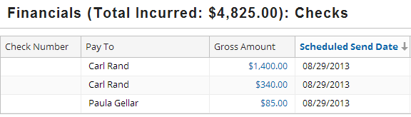
The completed check(s)
Exposure 1 Type: Claim cost Category: Medical
Pay to Carl Rand $1400
-$1400
Pay to Carl Rand $340
Exposure 2 Type: Claim cost Category: Auto body
-$425
Pay to Paula Gellar $85 (20%)
|EOS~032|
Notes:
|EON~032|
The completed checks are listed on the Financials Checks list. (If Ray Newton had been the only payee, then the Checks screen would show only a single line with Ray Newton in the Pay To column.

Slide 33
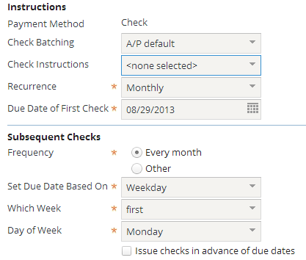
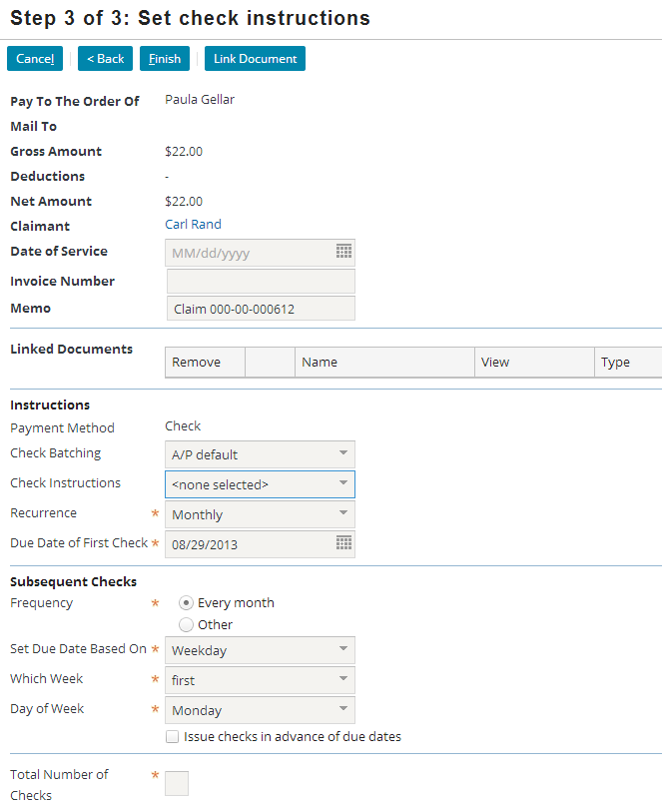
Fields unique to the automatic check payment method
All the fields shown here are unique to the automatic check payment method
|EOS~033|
Notes:
|EON~033|
In the base application, there are a series of fields that appear in the "Set check instructions" step only if the check is automatic or EFT. These fields let you specify additional information that the automatic or electronic system can take advantage of.

Slide 34
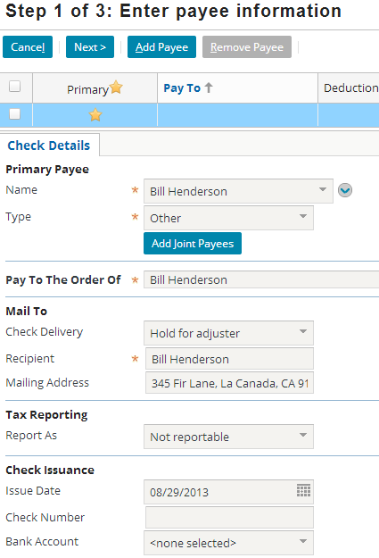
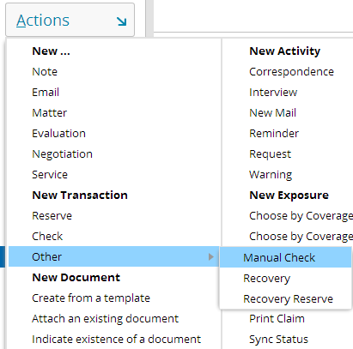
Fields unique to the manual check payment method
Manual payments are used to track hand-written checks (such as a check written by an inspector immediately after the inspection of a damaged vehicle or property)
|EOS~034|
Notes:
|EON~034|
In the base application, there are a series of fields that appear in the "Enter payee information" step only if the check is manual. These fields let you specify additional information needed to track the manual payment.

Slide 35
Lesson outline
Payment basics
Creating checks
Deductibles
Auto first and final
|EOS~035|
Notes:
|EON~035|

Slide 36
Deductible
A deductible is an amount of money that the insured must pay out of pocket for a loss. The carrier provides payment only for the amount above and beyond the deductible.
Deductible handling may be enabled or disabled with a simple configuration parameter adjustment
It is enabled in base product
In base ClaimCenter, deductible handling only works with personal auto claims, and only for first-party vehicle damage exposures
Can be extended to other LOB and exposures with configuration
|EOS~036|
Notes:
|EON~036|
It is possible to extend deductible for other lines of business and exposures, but that level of detail is beyond the scope of this class.

Slide 37
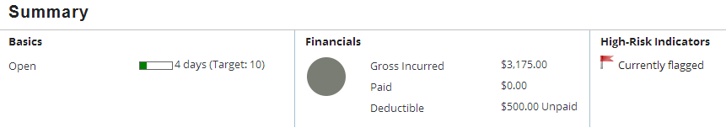
Viewing deductibles in ClaimCenter: Claim headline
Deductible amount and status visible in claim headline
|EOS~037|
Notes:
|EON~037|
The deductible seen in the screenshot above is for a particular exposure. In the rare case when more than one exposure on a single claim each has a deductible, there will be separate "Deductible" lines on the claim headline.
(This might occur if an insured experienced a collision between two of his cars on the same policy.)

Slide 38
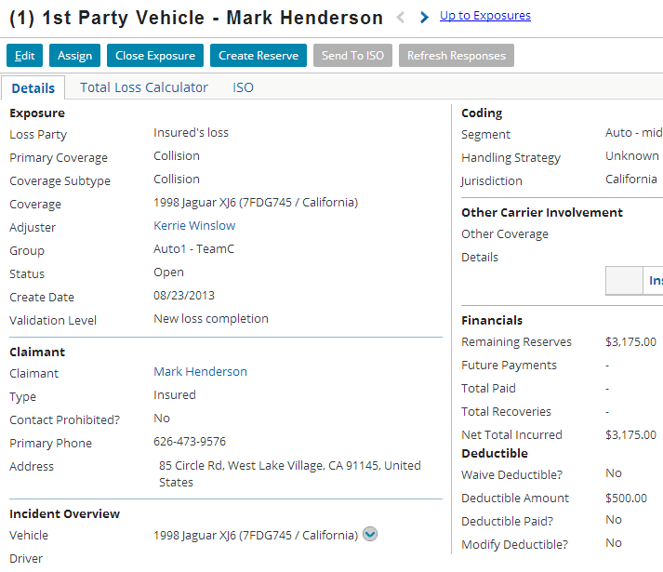
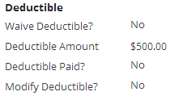
Viewing deductibles in ClaimCenter: Exposure detail page
Deductible information displayed with financials on exposure detail page
|EOS~038|
Notes:
|EON~038|
Note that the deductible information is on the exposure details page, not the loss details page, because the deductible is tied to an individual coverage, which relates to an individual exposure. Typically collision and comprehensive exposures have a deductible.

Slide 39
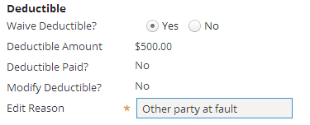
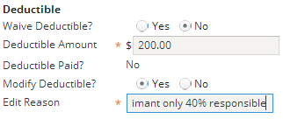
Changing the deductible
User can alter deductible on exposure detail page if deductible has not yet been applied
Waive deductible
Modify deductible
|EOS~039|
Notes:
|EON~039|
If the deductible has been waived, then there will be no deductible handing for this coverage.
If the deductible has been modified, then the new deductible value is what will be used when writing checks.
The ability to waive and modify deductibles is only granted to certain roles within a carrier (such as a Claims Supervisor or Manager)

Slide 40
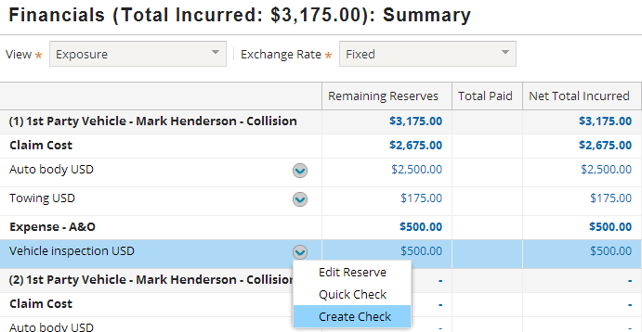
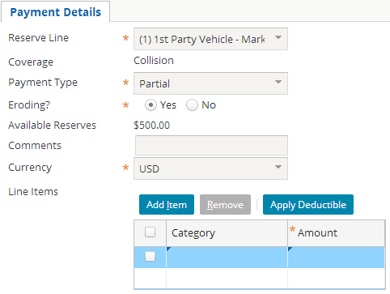
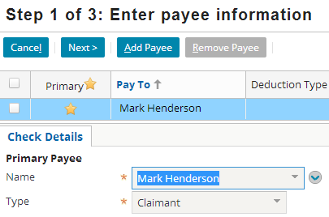
Writing a check
"Apply Deductible" button on step 2
|EOS~040|
Notes:
|EON~040|
The "Apply Deductible" button appears when:
The coverage has a deductible that has not been waived
The deductible has not yet been met
The deductible may be applied to any payment. It is not necessary for it to be the first payment.

Slide 41
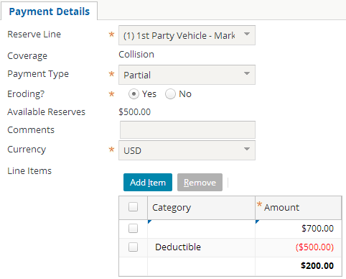
Apply the deductible
Deductible is applied to current payment
Line item added with negative value of deductible
Payment (and check) total reduced by value of deductible
"Apply Deductible" button disappears
|EOS~041|
Notes:
|EON~041|
In the screenshot above:
The adjuster creates a $700 payment.
The "Apply Deductible" button is active, so the adjuster clicks this button.
ClaimCenter creates a negative $500 line item, representing the $500 deductible being applied to this payment.
The payment total is reduced by the value of the deductible, resulting in a $200 payment.
The "Apply Deductible" button disappears because the deductible will not need to be applied again.

Slide 42

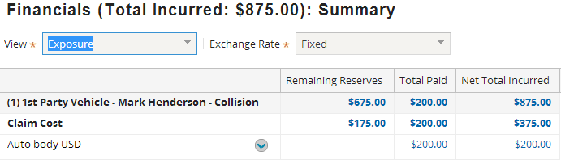
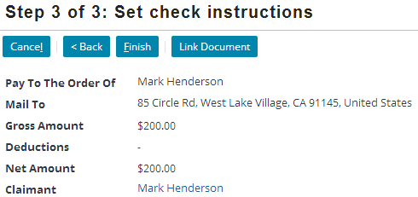

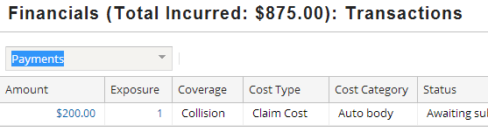
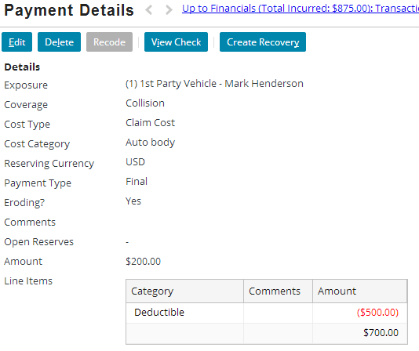
Complete the check
Amount of payment is net of deductible
Deductible not visible on any financial summary screens
Deductible detail is visible on payment details screen
|EOS~042|
Notes:
|EON~042|

Slide 43
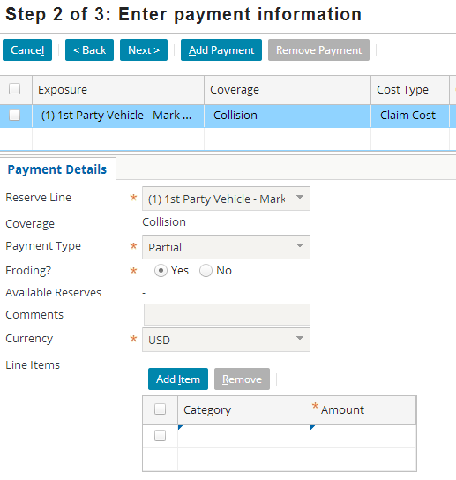
Additional payments against same reserve
No "Apply Deductible" button because deductible already applied
|EOS~043|
Notes:
|EON~043|

Slide 44
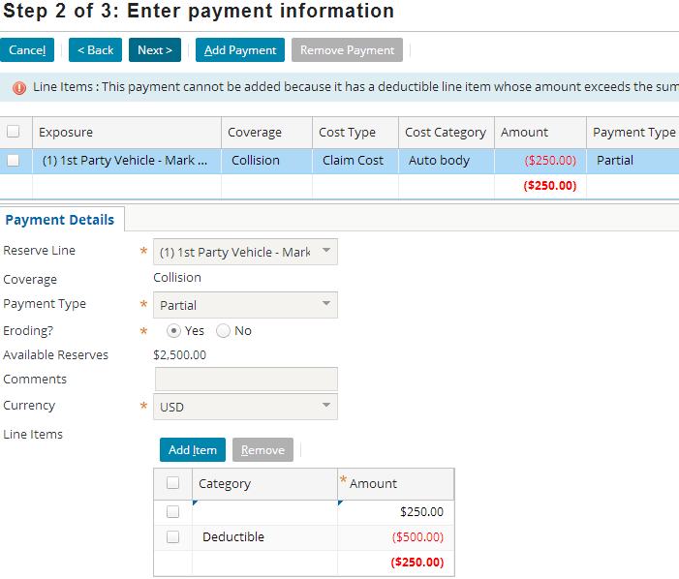
No partial deductible transactions
ClaimCenter will not allow you to apply the deductible against a payment that is less than the deductible amount
|EOS~044|
Notes:
|EON~044|
Note that it is the payment that must be above the deductible, not the check. You can create a check made up of multiple payments, but each payment is applied to its own coverage. Deductibles are applied to coverages. This is the case even if both payments are against the same coverage (and logically the same deductible.)
As a matter of process, if payment is made to a vendor that is not enough to cover the deductible, the adjuster can enter a note into ClaimCenter to record this fact. If a future payment brings the total paid over the value of the deductible, then the total payout can be entered into ClaimCenter as a single payment entry, with the deductible applied.
Using the example in the screenshot above:
Deductible is $500.
First payment is $250, which is less than the deductible, so the adjuster cannot enter a transaction into ClaimCenter. Instead, she enters a note identifying the terms of this payment.
Second payment of $350 is requested. The total payout is now $250 + $350 = $600, which is more than the $500 deductible. The Adjuster can now enter a payment of $600 (including individual line items for each of the real-world transactions), and apply the deductible. A check of $100 will be written, and the deductible will show as paid.

Slide 45
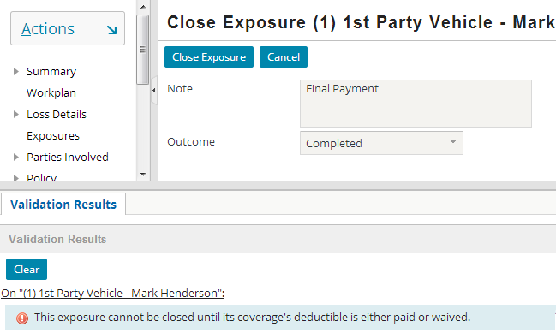
Ignoring the deductible
ClaimCenter will not let you close an exposure if there is an unmet deductible
|EOS~045|
Notes:
|EON~045|
You will need to modify/delete the deductible before closing the exposure.

Slide 46
Lesson Outline
Payment basics
Creating checks
Deductibles
Auto first and final
|EOS~046|
Notes:
|EON~046|

Slide 47
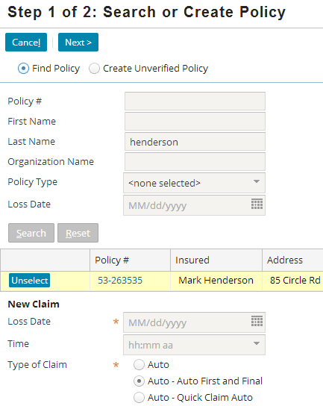
Auto first and final wizard
The auto line of business has a "First and Final" wizard
It is intended for simple claims that require no adjudication
Most common usage is for windshield damage
|EOS~047|
Notes:
|EON~047|
The most common use case for the “Auto First and Final” wizard is a claim which is filed for windshield damage. The user wishes to simply:
Create the claim,
Have an exposure and reserve line created automatically, and
Have the payment issued

Slide 48
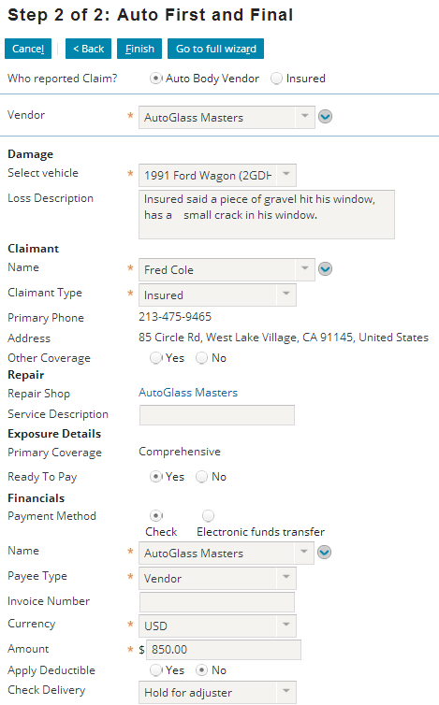
Completing auto first and final
The Auto First and Final Wizard completes all the steps in one
Vendor selection
Payment amount
Reserve creation
1
2
3
|EOS~048|
Notes:
|EON~048|
Once completing the final step, the summary screen shows the exposure has been created and all transactions have been completed with no remaining reserves (which is visible if you view PowerPoint in Notes view (View > Notes Page)).

Slide 49
Lesson objectives review
You should now be able to:
Define financial terms used by ClaimCenter for managing payments
Create checks
Apply deductibles
Create and pay out auto first and final claims
|EOS~049|
Notes:
|EON~049|

Slide 50
Review questions
Betty Baker went through the payment wizard one time. She specified three payees (and there were no joint payees or recurring payments). Based on this information alone:
Can you tell how many checksets there are?
Can you tell how many checks there are?
Can you tell how many payment transactions there are?
A check includes a $200 final payment from a $500 reserve line. Why does ClaimCenter create a second transaction? What is the dollar amount of this transaction?
What happens if you start the payment wizard when the claim is not at "ability to pay"?
What happens if you start the payment wizard when the claim is at "ability to pay" but none of its exposures are at "ability to pay"?
Are deductibles applied to payments or checks?
|EOS~050|
Notes:
|EON~050|
Answers
1. a) Yes. There is one. (Each iteration of the payment wizard creates one checkset.)
b) Yes. There are three. (Unless there are joint payees, each payee has a separate check. Unless there are recurring checks, then for three payees, there must be three checks.)
c) No. You can't tell. (The number of payment transactions is not tied to the number of payees.)
2. The second transaction is used to zero out the reserve line. The dollar amount of this transaction will be -$300, since there is $300 remaining after the $200 payment transaction.
3. Validation rules prevent you from starting the payment wizard if the claim is not at "ability to pay".
4. You can start the payment wizard for a claim at "ability to pay", but you can only access reserve lines associated to exposures at "ability to pay". If none of the exposures are at "ability to pay", then you cannot access any reserve lines, which means you cannot create any payment transactions for the check.
5. Payments. Deductibles are defined at the coverage level, and each payment is for a particular coverage. A check might include payments against multiple coverages.

Slide 51
Notices
Copyright © 2001-2014 Guidewire Software, Inc. All rights reserved.
Guidewire, Guidewire Software, Guidewire ClaimCenter, Guidewire PolicyCenter, Guidewire BillingCenter, Guidewire Reinsurance Management, Guidewire ContactManager, Guidewire Vendor Data Management, Guidewire Client Data Management, Guidewire Rating Management, Guidewire InsuranceSuite, Guidewire ContactCenter, Guidewire Studio, Guidewire Product Designer, Guidewire Live, Guidewire DataHub, Guidewire InfoCenter, Guidewire Standard Reporting, Guidewire ExampleCenter, Guidewire Account Manager Portal, Guidewire Claim Portal, Guidewire Policyholder Portal, ClaimCenter, BillingCenter, PolicyCenter, InsuranceSuite, Gosu, Deliver Insurance Your Way, and the Guidewire logo are trademarks, service marks, or registered trademarks of Guidewire Software, Inc. in the United States and/or other countries.
All other trademarks are the property of their respective owners.
This material is confidential and proprietary to Guidewire and subject to the confidentiality terms in the applicable license agreement and/or separate nondisclosure agreement.
This file and the contents herein are the property of Guidewire Software, Inc. Use of this course material is restricted to students officially registered in this specific Guidewire-instructed course, or for other use expressly authorized by Guidewire. Replication or distribution of this course material in electronic, paper, or other format is prohibited without express permission from Guidewire.
Guidewire products are protected by one or more United States patents.
|EOS~051|
Notes:
|EON~051|

