Slide 1
Financials Approval
7 October 2014
|EOS~001|
Notes:
|EON~001|
Guidewire training materials contain Guidewire proprietary information that is subject to confidentiality and non-disclosure agreements. You agree to use the information in this manual solely for the purpose of training to implement Guidewire software solutions. You also agree not to disclose the information in this manual to third parties or copy this manual without prior written consent from Guidewire. Guidewire training may be given only by Guidewire employees or certified Guidewire partners under the appropriate agreement with Guidewire.

Slide 2
Lesson objectives
By the end of this lesson, you should be able to:
Describe the functionality of authority limits
Describe the purpose of transaction approval rules
Describe how supervisors approve transactions
This lesson uses the notes section for additional explanation and information. To view the notes in PowerPoint, choose View→Normal or View→Notes Page. If you choose to print the notes for the lesson, be sure to select “Print hidden slides.”
|EOS~002|
Notes:
|EON~002|

Slide 3
Lesson outline
Authority limits
Transaction approval rules
Approving transactions
|EOS~003|
Notes:
|EON~003|

Slide 4
Review: Objects that implement financials
Exposure
Reserve Line
Check
Payee
+$3000
-$3000
Reserve Transaction
Payment Transaction
Exposure tracks payment from coverage to claimant
Reserve line is money set aside for exposure payments
Reserve transactions typically add money to it
Payment transactions move money to payments
Checks transfer money from carrier to payee
|EOS~004|
Notes:
|EON~004|
An exposure is a set of data used to track a potential payment from one coverage to one claimant.
A reserve line is an amount of money set aside for expected payments related to a given exposure. Every exposure ultimately has one or more reserve lines. Transactions modify the amount of money in a reserve line.
A reserve transaction modifies the amount of money set aside for the reserve line.
A payment transaction moves money from a reserve line to a payment to a claimant or other party.
A check is a single transfer of money from one or more reserve lines to one or more individuals or organizations.
A payee is a person to whom a check is made payable. Payees include both claimants and people who provided services for the claim (such as inspectors).

Slide 5

Financials approval
+$50,000
ClaimCenter reviews every transaction to determine if it requires approval
Two mechanisms for identifying transactions that require approval
Authority limits
Transaction approval rules
|EOS~005|
Notes:
|EON~005|
If a transaction does not require approval, it is acted on immediately. (For reserve transactions, the reserve line is immediately modified as stated by the transaction. For payment transactions, the payment is moved to "Awaiting Submission".)
If a transactions does require approval, it is put in a "pending approval" state.

Slide 6
Authority limits
Authority Limits
Claim Total Reserves: $15,000
$0K
$10K
$20K
Exposure Reserves (for Collision): $10,000
$0K
$10K
$20K
An authority limit is a rule which limits the transactions an adjuster can create without approval
It consists of a criteria (such as "total reserves for the entire claim") and an amount (such as $15,000)
|EOS~006|
Notes:
|EON~006|
An authority limit is associated to a user through an authority limit profile. This is discussed in an upcoming slide.
If an adjuster creates a transaction which meets the criteria of an associated authority limit, and the authority limit threshold is exceeded, then the transaction is immediately placed in a state of "pending approval" and an activity is generated and (typically) assigned to the supervisor of the group to approve or reject the transaction.
Authority limits can be tied to any type of transaction. They can be tied to a single exposure, a single payment, the entire claim, or a change in the size of the reserve line. They can be associated to a specific coverage. They can be associated to a specific cost type.

Slide 7
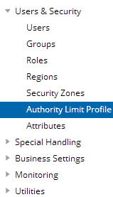
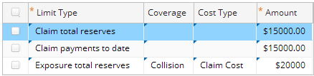
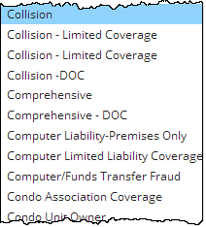
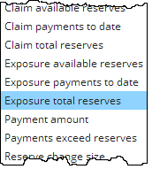

Authority limit options
Each criteria is a combination of:
A predefined limit type
An optional coverage
An optional cost type
An amount threshold
Each limit is a criteria plus an amount
Criteria
Amount
|EOS~007|
Notes:
|EON~007|
The options available in the Limit Type list cannot be modified: it maps to the AuthorityLimitType typelist, which is an internal (and therefore unmodifiable) typelist.
The Coverage and Cost Type lists can be modified.
The authority limit changes shown in the screenshot are made by a supervisor using the Administration screen > Users and Security > Authority Limit Profile. Note that the authority limit of $20,000 (third row in the screenshot) is limiting all exposure total reserves at a very granular level. Any other exposure reserves will be prevented, for example, an exposure total reserve of $10 on an “Unspecified” cost type.

Slide 8
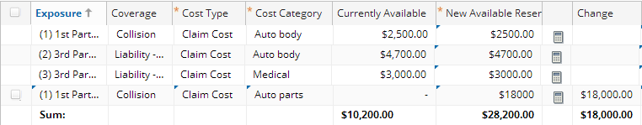
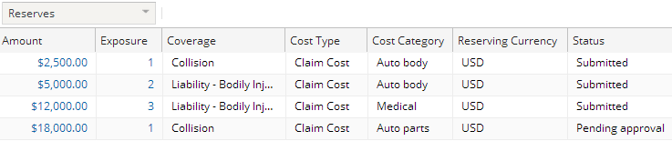
Exceeding an authority limit
Transaction will increase exposure total reserves for collision to over $20,000
|EOS~008|
Notes:
|EON~008|
When a transaction exceeds an authority limit, the transaction is saved, but the status is set to "Pending approval". From a financials standpoint, no further action is taken on the transaction until it is approved.
If the user enters a reserve amount (like shown) that exceeds a limit in error, the user can edit the reserve by clicking on the amount and then re-enter the correct amount. The approval is discarded.

Slide 9
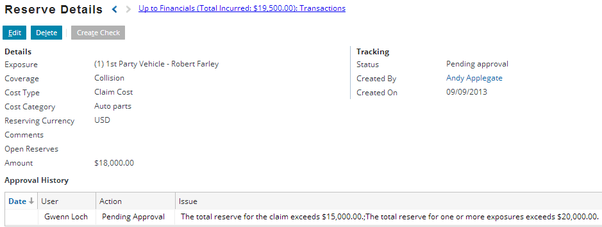
Viewing details about pending approval
|EOS~009|
Notes:
|EON~009|
You can view information about any transaction by clicking the Amount cell on the Transactions screen. The Transaction Detail screen identifies the status. If the status is pending approval, then the Issue column in the Approval History list provides further details about each issue.

Slide 10
Authority limit profiles
Adjuster Profile
Exposure Reserves (for Collision): $10,000
Dana Evans
$0K
$10K
$20K
Total Payments: $15,000
Peter Beebe
$0K
$10K
$20K
An authority limit profile is a collection of authority limits assigned to one or more users
Can be pre-defined (created once and shared across multiple users)
Can be custom (created for a single user)
|EOS~010|
Notes:
|EON~010|
An authority limit profile is a set of limits that specify threshold amounts for one or more types of transactions. When an authority limit profile is associated to a given user, if that user creates a transaction of a type listed in the profile which is at or exceeds the threshold amount, then the transaction is marked as requiring supervisor approval.
In the example above, if either Dana Evans or Peter Beebe creates a reserve transaction for an exposure tied to collision coverage and the total exposure reserves amount is now over $10,000, then the transaction will require approval. Also, if either Dana Evans or Peter Beebe creates any type of reserve transaction that causes the total payments for the claim to exceed $15,000, then the transaction will require approval.
Technically speaking, there is an entity used by ClaimCenter for financials processing known as a transaction set. Every transaction belongs to a transaction set. Transaction sets can have one or multiple transactions in them. Approval occurs at the transaction set level. If one transaction in the set requires approval, then the entire set requires approval. If the supervisor accepts the transaction, then the entire transaction set is accepted. If the supervisor rejects the transaction, then the entire transaction set is rejected. In practice, this level is typically transparent to an end user and is not discussed in detail here.

Slide 11
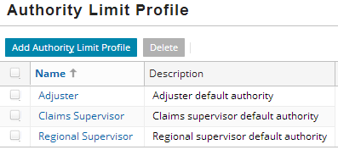
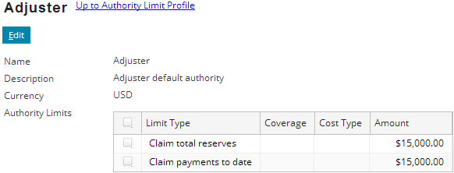
Creating pre-defined profiles
|EOS~011|
Notes:
|EON~011|
Pre-defined authority profile limits can be shared across multiple users. They are created and configured from the Administration tab's Authority Limit Profiles screen.
To configure an existing profile, click the profile name, click the Edit button, and add, remove, or modify limits as needed.
To create a new profile, click the Add Authority Limit Profile button. Then add limits as needed. The limits shown in the bottom screenshot (Adjuster) reflect the base application’s authority limits for any adjuster user. In a nutshell, total payments or reserves exceeding USD $15,000 require approval. Coverages and cost types are ignored.

Slide 12
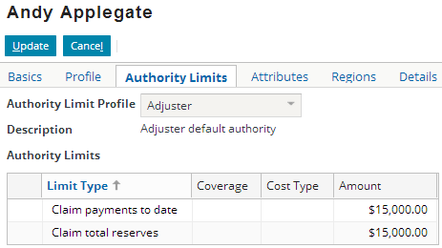
Assigning pre-defined profiles to users
Each user can have at most one authority profile
Profile is assigned through the User screen
|EOS~012|
Notes:
|EON~012|
To assign a pre-defined profile to a user, select the profile from the Authority Limit Profile dropdown. Note that when you choose a profile, the limits of the profile appear but are read-only. You cannot modify a pre-defined profile at the user level. You can modify it only at the profile level (which means the change you make will affect all users associated to that profile).

Slide 13
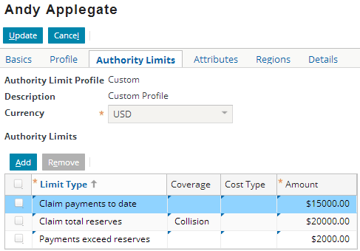
Assigning custom profiles to users
Can also assign a custom profile to a user
Specifies set of authority limits that are not shared with other users
|EOS~013|
Notes:
|EON~013|
You can create a custom profile by selecting Custom from the Authority Limit Profile dropdown. Once you select Custom, the Authority Limit list becomes editable. Any custom profile created for a user is unique for that user. It cannot be applied to other users (unless you manually recreate it for the next user), and any changes to a given custom profile have no affects on any other profile.

Slide 14
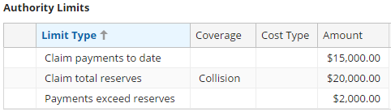
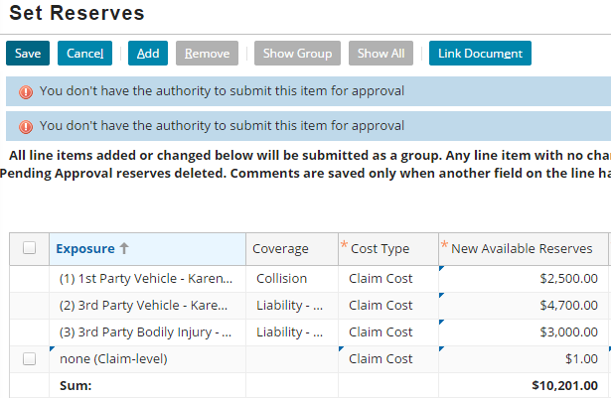
Limiting by Coverage/Cost Type
Limiting by coverage or cost type will prevent any transaction that doesn’t match the coverage or cost type with an error
|EOS~014|
Notes:
|EON~014|
In the example shown, “Andy Applegate” may only create collision reserves up to USD $20,000 without approval. Collision reserves exceeding USD $20,000 are sent for approval.
If he were to attempt creating a “Baggage” or “Comprehensive”, or reserve of any amount without Collision Coverage, it would be prevented with an error.
The example shows a claim-level reserve being prevented because the coverage is not Collision, even though the transaction is only $1. So, any other coverage value, or a blank coverage value, will be prevented.
Therefore, limit authority limits by coverage and/or cost type with caution. It may be best to set these kinds of granular limits on a user by user basis, or create a new profile with these limits and apply that profile only to select users that would never need (or be allowed to) create certain transactions.

Slide 15
Lesson outline
Authority limits
Transaction approval rules
Approving transactions
|EOS~015|
Notes:
|EON~015|

Slide 16


Transaction approval rules
Transaction Approval Rules
if segment is low complexity AND total reserves > $30,000 then require approval
Transaction approval rules implement approval logic that cannot be captured in an authority limit, such as
Logic beyond the given limit types
Logic tied to attributes other than coverage and cost type
Logic that cannot easily be associated to given users
|EOS~016|
Notes:
|EON~016|

Slide 17
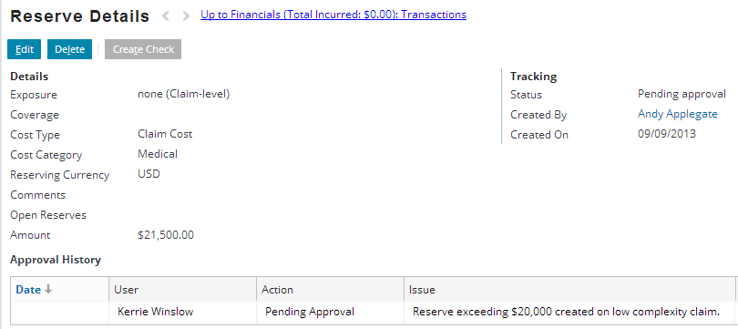
Transaction approval rules in the user interface
No distinction in the user interface between transactions which exceed authority limits and transactions which triggered transaction approval rules
|EOS~017|
Notes:
|EON~017|

Slide 18
Lesson outline
Authority limits
Transaction approval rules
Approving transactions
|EOS~018|
Notes:
|EON~018|

Slide 19
Review: Objects that require attention
Claims, when important activity on claim has occurred, such as:
Claim reported two weeks ago and fault rating has not be specified
Auto is total loss and salvage is now required
Lawyer for third-party claimant has been added
Activities, when still open as of escalation date
Transactions, when either:
Amount exceeds a given threshold
Given condition occurs
-$10,000
|EOS~019|
Notes:
|EON~019|
There are three types of objects which require attention: claims, activities, and transactions. However, the business reasons behind why they need attention and what is done in response to them needing attention varies from object type to object type. Therefore, this lesson uses the vague term "needing attention" when discussing all three object types simultaneously.

Slide 20
What causes a transaction to need attention?
$0K
$10K
$20K
new transaction
Transaction Approval Rules
if segment is low complexity AND total reserves > $30,000 then require approval
New transactions are checked against the user's authority limit profile and against transaction approval rules
Either set of logic can set the transaction to requiring approval
|EOS~020|
Notes:
|EON~020|

Slide 21
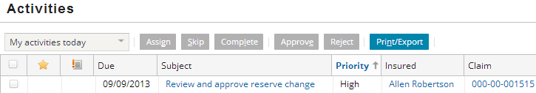
How does ClaimCenter respond?
|EOS~021|
Notes:
|EON~021|
When a transaction is classified as requiring approval:
The status of the transaction is set to "Pending approval".
An approval activity is created and routed to the appropriate individual (typically the supervisor of the group).

Slide 22
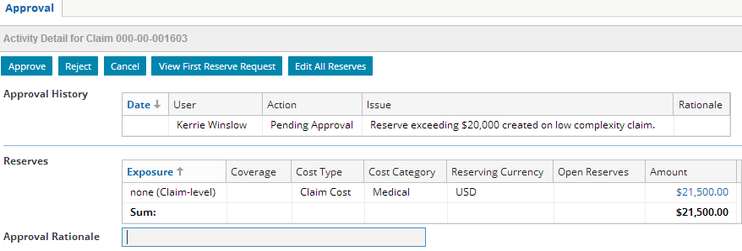
How does the supervisor respond?
Supervisor should:
Approve or reject transaction
Closes activity
Take action as appropriate if transaction is rejected
|EOS~022|
Notes:
|EON~022|
Most activities are closed by clicking either the "Complete" or "Skip" buttons. Approval activities do not have these buttons. Instead, they have "Approve" and "Reject" buttons. Either button closes the activity. Approving the activity advances the transaction to the next status (such as "Approved"). Rejecting the activity moves the transaction to the "Rejected" status.
In the base application, there is no additional behavior when a transaction is rejected. It may be appropriate for the supervisor to take additional action (such as discussing the claim with the adjuster). It may also be appropriate to configure ClaimCenter to execute a behavior automatically (such as adding a note to the claim identifying that a pending transaction was rejected). One common scenario is that the payment comes in on a bill in error, so the payment will not be issued until the bill is corrected.

Slide 23
Transactions that require attention
 | Cause | System Response | Supervisor Response
Claim | - Exception rules set claim to flagged | - Flag icon displayed in info bar and list views | - Attend to the issue, THEN - Remove claim flag
Activity | - Activity is open on or after escalation date | - Escalation rules executed - Escalated icon displayed in list views | - Attend to the issue (such as reassign activity)
Trans- action | - Amount exceeds authority limit profile, OR - Rules determine approval is required | - Transaction status set to "pending approval" - Approval activity created and routed to supervisor | - Approve or deny activity - If denied, address as appropriate
|EOS~023|
Notes:
|EON~023|

Slide 24
Lesson objectives review
You should now be able to:
Describe the functionality of authority limits
Describe the purpose of transaction approval rules
Describe how supervisors approve transactions
|EOS~024|
Notes:
|EON~024|

Slide 25
Review questions
Does a transaction require approval when it:
Is not flagged by transaction approval rules but exceeds the user's authority limits?
Does not exceed the user's authority limits but is flagged by transaction approval rules?
Exceeds the user's authority limits and is flagged by transaction approval rules?
An authority limit consists of a criteria and an amount. What three values can optionally be specified to create the condition?
What two things does ClaimCenter do when it determines that a transaction requires approval?
|EOS~025|
Notes:
|EON~025|
Answers
1. The answer for all three is the same. The transaction requires approval in all three cases.
2. Limit type, coverage, and cost type.
3. It sets the transaction status to "pending approval" and it creates an approval activity (which is typically routed to a supervisor).

Slide 26
Notices
Copyright © 2001-2014 Guidewire Software, Inc. All rights reserved.
Guidewire, Guidewire Software, Guidewire ClaimCenter, Guidewire PolicyCenter, Guidewire BillingCenter, Guidewire Reinsurance Management, Guidewire ContactManager, Guidewire Vendor Data Management, Guidewire Client Data Management, Guidewire Rating Management, Guidewire InsuranceSuite, Guidewire ContactCenter, Guidewire Studio, Guidewire Product Designer, Guidewire Live, Guidewire DataHub, Guidewire InfoCenter, Guidewire Standard Reporting, Guidewire ExampleCenter, Guidewire Account Manager Portal, Guidewire Claim Portal, Guidewire Policyholder Portal, ClaimCenter, BillingCenter, PolicyCenter, InsuranceSuite, Gosu, Deliver Insurance Your Way, and the Guidewire logo are trademarks, service marks, or registered trademarks of Guidewire Software, Inc. in the United States and/or other countries.
All other trademarks are the property of their respective owners.
This material is confidential and proprietary to Guidewire and subject to the confidentiality terms in the applicable license agreement and/or separate nondisclosure agreement.
This file and the contents herein are the property of Guidewire Software, Inc. Use of this course material is restricted to students officially registered in this specific Guidewire-instructed course, or for other use expressly authorized by Guidewire. Replication or distribution of this course material in electronic, paper, or other format is prohibited without express permission from Guidewire.
Guidewire products are protected by one or more United States patents.
|EOS~026|
Notes:
|EON~026|

