Slide 1
Contact Creation Criteria
22 May 2014
Notes:
Guidewire training materials contain Guidewire proprietary information that is subject to confidentiality and non-disclosure agreements. You agree to use the information in this manual solely for the purpose of training to implement Guidewire software solutions. You also agree not to disclose the information in this manual to third parties or copy this manual without prior written consent from Guidewire. Guidewire training may be given only by Guidewire employees or certified Guidewire partners under the appropriate agreement with Guidewire.

Slide 2
Lesson objectives
This lesson uses the notes section for additional explanation and information. To view the notes in PowerPoint, choose View→Normal or View→Notes Page. If you choose to print the notes for the lesson, be sure to select “Print hidden slides.”
By the end of this lesson, you should be able to:
Describe the role of contact creation criteria
List the elements that implement contact creation criteria
Configure contact creation criteria

Slide 3
Lesson outline
Creation criteria overview
Creation criteria logic
Configuring creation criteria
Notes:
Contact Creation Criteria - 3

Slide 4
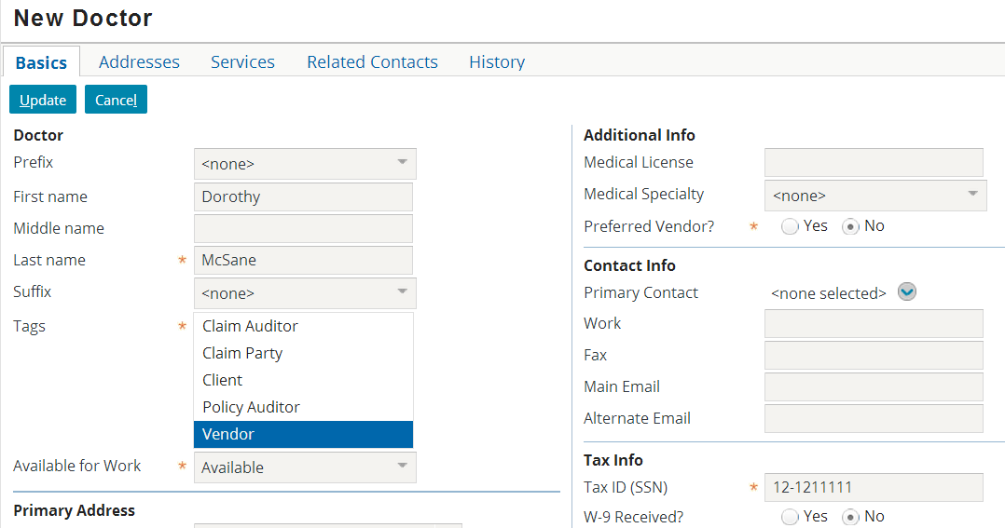
Fields marked as required
A "marked-as-required field" is a field which is flagged as requiring a value before data can be saved to the database
A field can be designated as required at either:
The database level (the corresponding column is non-null)
The UI (the widget's Required property is set to true)
Notes:
If a widget maps to a database column that is non-null, then the required asterisk is automatically displayed in the user interface.
If a widget's Required property is set to true, then the required asterisk is displayed in the user interface, whether the corresponding database column is null or non-null. (The default for the Required property is false.)

Slide 5
Limitations of required fields with ABContact
The fields that are required for an ABContact typically depend on the subtype of the ABContact, such as:
ABPersonVendor requires a Last Name and Tax ID
ABCompany requires a Name
This type of requiredness cannot be designated at the database level alone
If Tax ID is non-null, then all ABContacts must have a TaxID, even those that are not ABPersonVendors
This type of requiredness could be designated at the UI level, but this would be extremely difficult
Every widget that maps to a logically required field would need to be set to Required=true, regardless of where in the application it appeared
Notes:
In the Guidewire data model, a supertype entity and all of its subtypes are stored in a single table. For example, the ABContact entity and all of its subtypes are stored in the abcontact table. Some of the columns in this table do not apply to all ABContacts, but rather only to specific subtypes. For example, the DateOfBirth column applies only to ABContacts that are ABPersons. When a given row is written to the table, nulls are written to every subtype-specific column that doesn't apply to that row. For example, when an ABCompany row is written to the table, a null is written into the DateOfBirth column because DateOfBirth does not apply to ABCompanies. As a result of this, you cannot store subtype-specific required logic at the database level. If you made a column such as DateOfBirth required, then every ABContact would need to have a value for this column, including ABContacts that were not ABPersons. This would mean you could never save ABCompanies. There is no way in the Guidewire application to provide a DateOfBirth for an ABCompany, but the database will reject the save if no DateOfBirth is provided.
In general, Guidewire recommends that entity domain logic (logic that should always be true for a given entity, regardless or where or how the entity is used) should be coded at the data model level or through a Gosu class associated to the entity (such as an entity enhancement). Entity domain logic should not be captured in the user interface. This is because UI logic has effect only for the PCF in which it is specified. With UI logic alone, there is no automatic way of ensuring that every use of the entity follows exactly the same logic. The logic would need to be replicated in every UI screen that let users create or modify that type of entity, and this is considered bad practice as it is difficult to maintain multiple instances of code that must all do the same thing.

Slide 6
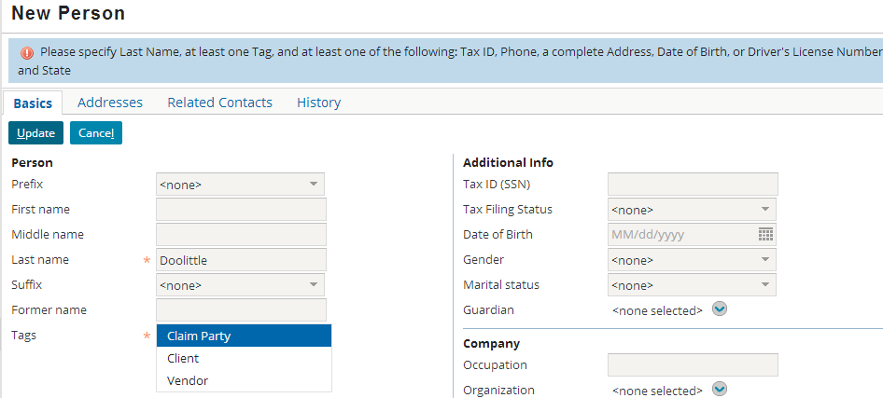
Contact creation criteria
Contact creation criteria is a set of subtype-specific logic that dynamically enforces requiredness based on the contact's subtype
It is configured in a Gosu class that is called whenever a contact is created or changed
Notes:
Contact creation criteria lets ContactManager enforce subtype-specific requirements without resorting to storing ABContact domain logic in the user interface.
Note that the example shown has all required fields specified, but errors still appear due to subtype-specific logic.

Slide 7
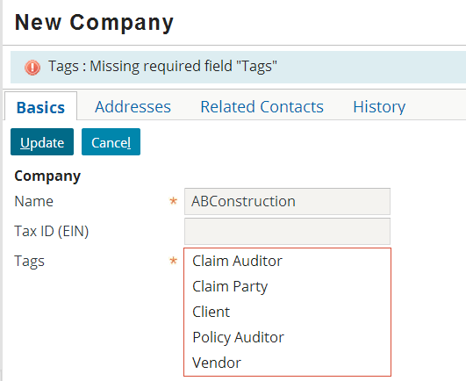
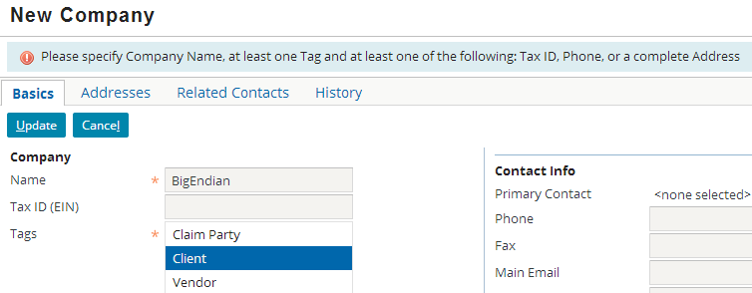
Flagging required data that is missing
When a "required field" is left blank, ContactManager simply names and flags the field
When contact creation criteria has not been met, no field is flagged, but a detailed custom message appears
Notes:
The "marked-as-required fields" check is always executed before the contact creation criteria check. So, if a contact fails both "marked-as-required field" logic and contact creation criteria logic, only the "marked-as-required fields" error is displayed. The checks occur in two phases to improve efficiency. The assumption is that most contacts that have insufficient data will fail at either the "required field" level or the contact creation criteria level, but not both. Therefore, if a contact fails as the "required field" level, ContactManager executes no further processing and returns the results immediately for the user to address.

Slide 8

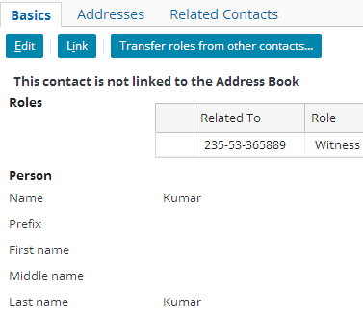

"Required" logic impacts the core applications
ContactManager
The required field logic for ContactManager contacts is not necessarily the same as the logic in the core applications
Be aware that differences in this logic can impact behavior in the core applications
Notes:
The fields needed to save an ABContact in ContactManager are not necessarily the same as in the core applications. For example, ClaimCenter will let you save a contact with just a name and a role on the claim. However, if a user attempts to link such a contact (to ContactManager), the linking will fail because the contact does not meet ContactManager's minimum requirements. This type of situation does not occur in with the PolicyCenter base application. In PolicyCenter, you must specify a name and a complete address in order to save the contact, and this meets ContactManager's minimum requirements.
When configuring contact creation criteria, you should consider whether or not a similar configuration should be done to the core application to prevent end users from getting into awkward business scenarios.

Slide 9
Lesson outline
Creation criteria overview
Creation criteria logic
Configuring creation criteria
Notes:
Contact Creation Criteria - 9

Slide 10
Elements that implement creation criteria
subtype logic map
SubTypeSpecific Logics map
subtype error messages
subtype “IsInvalid” methods
abPerson()
+
ErrorMsg!
abPersonVendor()
+
ErrorMsg!
Validate ABContact Creation Plugin
Validate ABContact Creation PluginImpl
+
ErrorMsg!
abCompany()
abPlace()
ErrorMsg!
+
Notes:
Contact creation criteria is implemented through three basic elements:
A subtype logic map (found in ValidateABContactCreationPluginImpl)
A set of subtype-specific methods (also found in ValidateABContactCreationPluginImpl)
A set of subtype-specific error messages (declared as display keys under the Java.TooLooseContactCreateCriteriaException node)
Whenever a contact is created, ContactManager calls the ValidateABContactCreationPlugin. In the base application, this plugin references the ValidateABContactCreationPluginImpl class (in the gw.plugin.contact package).
First, this class identifies the subtype of the contact.
Then, using the subtype logic map (which is named _subTypeSpecificsLogic), the class maps the contact to an inner "Logic" class that details the criteria the contact must meet in order to be created. Each of these Logic classes has an execute() method that returns either true or false.
If the method returns true, the contact is saved to the database.
If the method returns false, then the contact is not saved to the database. The class locates the error message corresponding to the subtype and returns this error message for display in the user interface.

Slide 11
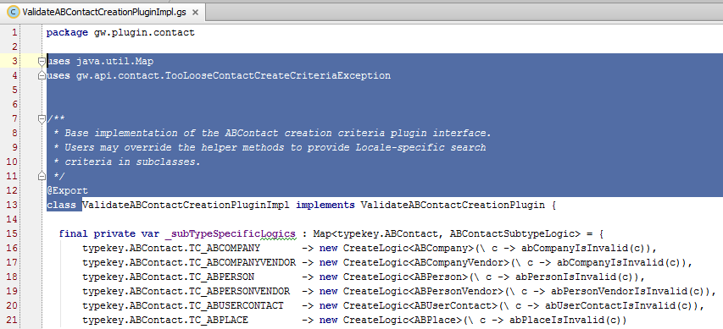
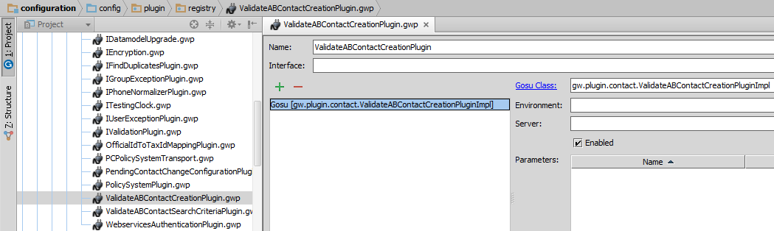
The ValidateABContactCreationPlugin plugin
Notes:
In the base application, the ValidateABContactCreationPlugin plugin references the gw.plugin.contact.ValidateABContactCreationPluginImpl class. Typically, there shouldn't be a need to completely reimplement this plugin. Rather, it should be sufficient to simply modify the existing code in the ValidateABContactCreationPluginImpl class.

Slide 12
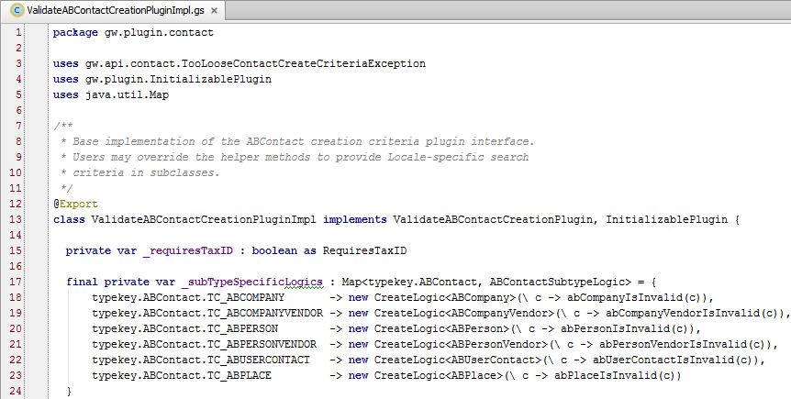
The SubTypeSpecificLogics map
Notes:
_subTypeSpecificLogics is a map which associates subtypes of ABContact to the appropriate subtype-specific Logic class.

Slide 13
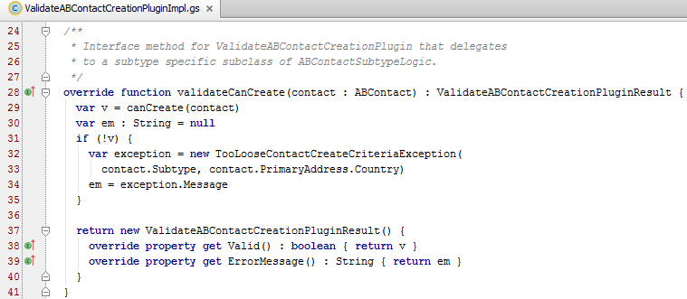
The validateCanCreate() method
The validateCanCreate() method manages the exception of creation criteria logic
It calls the method that executes the subtype-specific logic
If the logic isn't met, it throws an exception that details what the minimum creation requirements are for the contact
Notes:
The following walks through the code for the validateCanCreate() method that begins on line 28:
Line 29 creates a variable called "v". Although it is not explicitly stated, the variable's datatype is boolean. It then passes the contact to the canCreate() method. canCreate() calls the logic class appropriate for the contact's subtype. If the contact passes this logic, then canCreate() returns true. Otherwise, it returns false. canCreate() is discussed in detail on the next slide.
Line 30 creates a string that will be used for the error message, if any.
Lines 31 through 33 checks the results of canCreate(). If it was false, then an exception is created. The message for the exception is set to a standard error message for the contact's subtype. (For example, if the contact was an ABPerson, then the standard "ABPerson failed to meet minimum creation criteria" exception message is used.) Error messages are discussed in detail in a later slide.
Lines 37 through 39 return the boolean and the error message to the internal code that requested the check for minimum creation criteria.

Slide 14
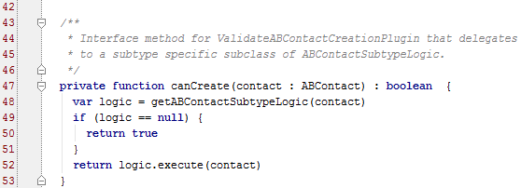
The canCreate method()
The canCreate() method uses the map to create a variable which is an instance of the appropriate Logic class
If there is no Logic class for the subtype or any of its supertypes, then the save is allowed
If there is a Logic class for the subtype or at least one of its supertypes, the execute() method of the lowest level is called
Notes:
If there is no Logic class, there is no defined validation for that level, and therefore every contact of that type is considered valid.
If there is no Logic class for a given subtype (such as ABAttorney), but there is a Logic class for one of its supertypes (such as ABPersonVendor), then the logic in the supertype class is executed. If there is logic for multiple supertype classes (such as ABPersonVendor and ABPerson), then the lowest level of logic is executed (in this case, ABPersonVendor).

Slide 15
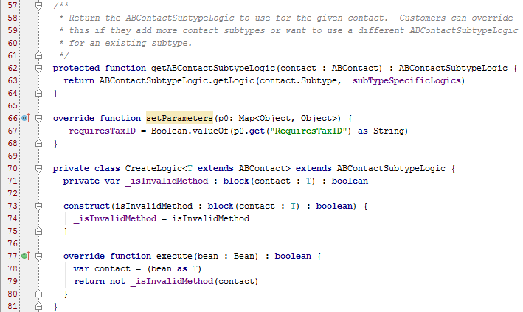
The getABContactSubtypeLogic() method
Notes:
Lines 62-63: The getABContactSubtypeLogic() method selects the correct logic depending on the contact subtype using the getLogic() method of the SubTypeSpecificLogics map (Line 17).
Lines 66-68: The setParameters() function uses the “RequiresTaxID” parameter as a Boolean (previously defined on line 15). This is an application-level plugin parameter that is to be used as an “on/off” switch for controlling whether or not Tax ID is required for contacts, as will be seen in the next slide. Depending on business requirements, legal requirements, and country/region, a “Tax ID” is not always required upon contact creation, even for some companies and vendors. Generally, requiring a “Tax ID” is a North America-specific business requirement. In the base application, “RequiresTaxID” is true.
Line 70: The CreateLogic (for subtype-specific Logic class) was created on line 18 to map to each subtype.
NOTE: While the comments mention adding subtypes, this practice is not recommended.
Line 77 overrides the parent's execute() function.
Lines 82-92 contain whitespace and/or comments.

Slide 16
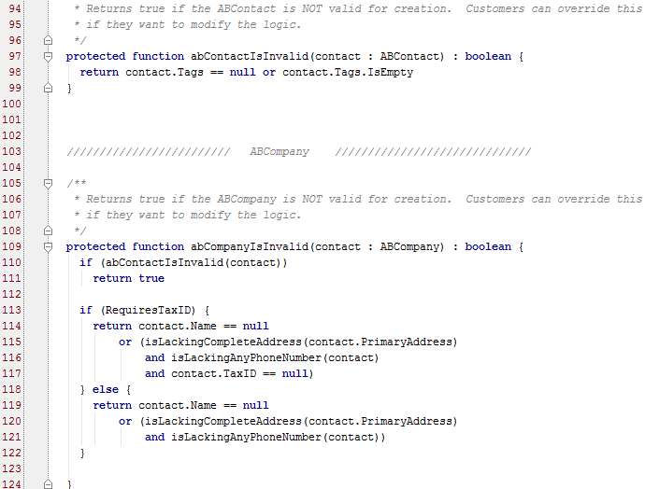


Subtype-specific methods and Tax ID
Tax ID required
Tax ID not required
Notes:
Now, the ValidateABContactCreationPluginImpl class declares a set of “is invalid” methods, one for each subtype for which there is specific logic. The most simplistic is the logic for ABContact itself (lines 97-98), which means ANY contact requires tags before a save is allowed.
In lines 109 and onwards, the subtype-specific abCompanyIsInvalid() method is more sophisticated because a Name, TaxID and other information is required before a save is allowed.
Line 113: Note the use of RequiresTaxID. As explained, it is more likely that a non-US, non-North American implementation (such as Japan) will not require Tax IDs, so this serves as a gatekeeper for logic requiring or ignoring Tax ID. This structure of using this parameter exists in all the remainder of the subtype-specific methods.
Lines 127-144 handle the logic for ABCompanyVendors, lines 147-171 for ABPersons, and so on (for all other subtypes) until line 220.

Slide 17
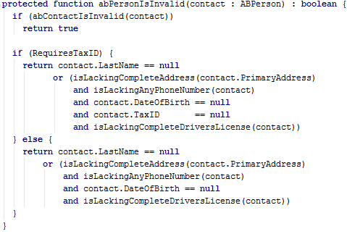
Example: ABPerson subtype method
Tax ID is required
Notes:
The error message at the bottom explains the logic well.
If RequiresTaxID is true, an ABPerson in ContactManager requires not only just a Last Name but one of the following:
A Tax ID (Social Security Number)
A phone number
A complete address
A Date of Birth
A Driver’s License Number and State
If RequiresTaxID is false, an ABPerson in ContactManager requires not only just a Last Name but one of the following:
A phone number
A complete address
A Date of Birth
A Driver’s License Number and State

Slide 18
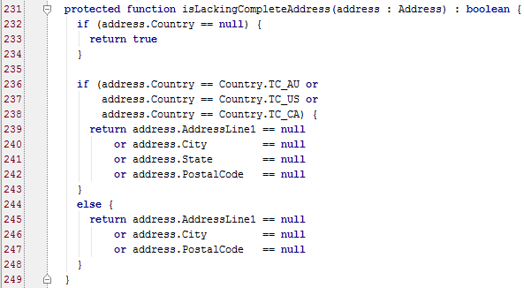
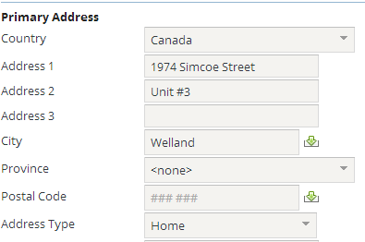
Helper methods
The subtype-specific methods make user of helper methods, which appear at the end of the ValidateABContactCreationPluginImpl class
isLackingCompleteAddress() (depending on the Country)
isLackingAnyPhoneNumber() (ABContact)
isLackingAnyPhoneNumber() (ABPerson – additionally checks cell phone #s)
isLackingCompleteDriversLicense()
Notes:
The helper methods at the end of the ValidateABContactCreationPluginImpl class handle checks for complete phone numbers, addresses and driver licenses for specific subtypes (such as ABPerson). In the example above, if an address is to be provided in addition to name and tag, and the country is either TC_AU (Australia), TC_US (United States) or TC_CA (Canada), then the State (or Province) is a required part of that address.
You can write code that uses these helper methods, and you can add helper methods of your own or customize these helper methods in the base application. The use of these helper methods is not required.
In Canada, Provinces are equivalent to States, and Postal Codes (format ### ###) equivalent to Zip Codes.

Slide 19
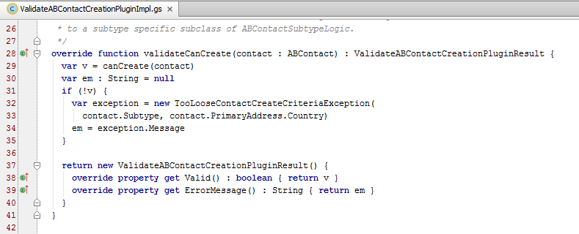
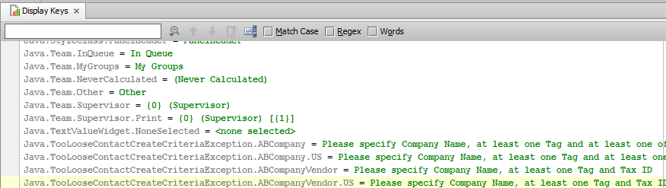
Error messages
If false is returned, an exception is thrown
The exception is hard-coded to use the following display key as the error message: Java.TooLooseContactCreateCriteriaException.<Subtype>
Notes:
Creation criteria logic is enforced through a set of hierarchical classes. This gives you the flexibility of specifying different aspects of logic at different levels of the subtype hierarchy. However, one disadvantage to this approach is that each subtype is limited to a single error message. Therefore, the error messages for creation criteria logic tend to be less specific than those seen in other validation scenarios.
When a user fails to provide sufficient criteria to save a contact, a message must be displayed in the user interface to alert them to what has happened. But, contact creation criteria is specified in a Gosu class, and Gosu classes are not tightly coupled with the user interface. To ensure that a message can be displayed, the validateCanCreate() method create an exception instance with an appropriate message and then throws this exception to the internal code that called it. The internal code can then throw this to the user interface code so that the message can be displayed to the user.

Slide 20
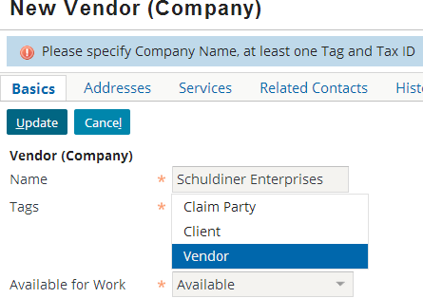
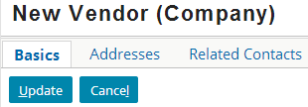
Flow of creation criteria logic
use ABCompanyVendor method
SubTypeSpecific Logics map
it's an ABCompanyVendor!
Contact has no Tax ID!
Validate ABContact Creation PluginImpl
+
ErrorMsg!
ABCompanyVendor method
Notes:
In the example above, the user is attempting to create a new ABCompanyVendor with no TaxID specified. Logic is executed in the following way:
The ValidateABContactCreationPlugin is called. This in turn calls the validateCanCreate() method in gw.plugin.contact.ValidateABContactCreationPluginImpl.
The validateCanCreate() method looks at the ABContact's subtype and determines it's an ABCompanyVendor. It then uses the _subTypeSpecificsLogics map to determine that the abCompanyVendorIsInvalid() method should be called to validate the contact.
The abCompanyVendorIsInvalid() method is called. The plugin parameter RequiresTaxID is true. Following the if…else statement, the method returns false because Tax ID is null.
The validateCanCreate() method sees that the execute() method returned false. It then creates an exception. The message of the exception is set to the display key stored in Java.TooLooseContactCreateCriteriaException.ABCompanyVendor.
The save is blocked, and the display key in Java.TooLooseContactCreateCriteriaException.ABPerson ("Please specify Company Name, ...") is displayed.

Slide 21
Lesson outline
Minimum creation criteria overview
Minimum creation criteria logic
Configuring minimum creation criteria
Notes:
Contact Creation Criteria - 21

Slide 22
Configuring creation criteria
You can modify the logic for a given ABContact Subtype
This is appropriate when the carrier requirement pertains to a subtype for which there is already a minimum creation method:
ABCompany
ABCompanyVendor
ABPerson
ABPersonVendor
ABUserContact
ABPlace
You can create a new ABContact Subtype method
This is appropriate when the carrier requirement pertains to a subtype for which there isn't already a method in ValidateABContactCreationPluginImpl.gs

Slide 23
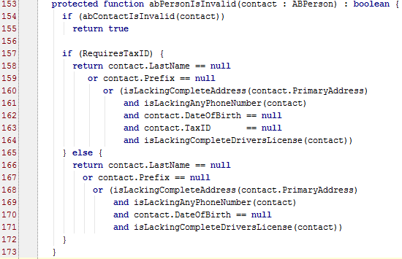
Modifying an existing subtype method
To modify an existing method, make the changes needed for the relevant subtype
For example, this change makes Prefix (Mr., Mrs., Ms., etc…) a required field for creating ABPerson contacts
Notes:
Note that contact.FirstName is not required (only contact.LastName is required) in the base application. First Names are generally not required for contacts; in ClaimCenter, a First Name is not required for a Person (subtype of Contact).
Also note that this example covers both scenarios (RequiresTaxID == true and RequiresTaxID == false). This may not be completely realistic given your business scenario but keep in mind you have to factor in added logic in potentially two places.

Slide 24
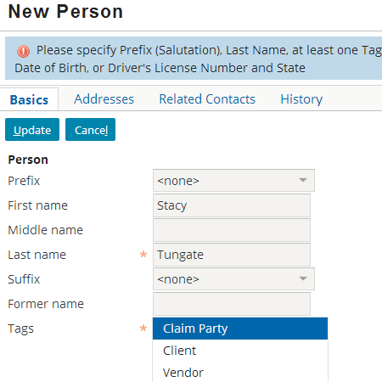
Modifying an existing class: Error message
Modify the existing error message in the display key settings to reflect the change in required fields for the contact
Notes:
In the example above, when a Prefix has not been specified, the ABPerson error message is displayed. This message (display key) has been modified to indicate Prefix (also known as a “Salutation”) is required.

Slide 25
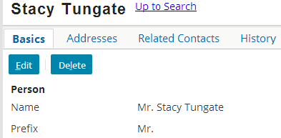
Modifying an existing class: End result
Notes:
Now that the Prefix (Mr.) has been specified, the contact can be saved. Again, the error will persist even if a SSN (Tax ID), complete address, or Driver’s License number is provided.

Slide 26
Steps to create a new subtype method
Create the method
Override the appropriate method
Provide the logic for both branches of RequiresTaxID if necessary
Add the class to the SubTypeSpecificLogics map
Create display key(s) for the error message
Run Reload Changed Classes and ALT+SHIFT+L to deploy your changes
The following slides show an example of making Medical License and Doctor Specialty required fields for ABDoctor contacts
Notes:
To deploy the changes listed above, you must be running in a debug process in Studio. To deploy changes to display keys, use ALT+SHIFT+L in ClaimCenter.
Choose Run → Debug… to run the server in a debug process in a Console window in Studio. Use Run → Reload Changed Classes to deploy the changes.
If you are not running in a debug process you must restart the server to deploy the changes. More on deploying changes is found in the Configuration Fundamentals 8.0 training course.

Slide 27
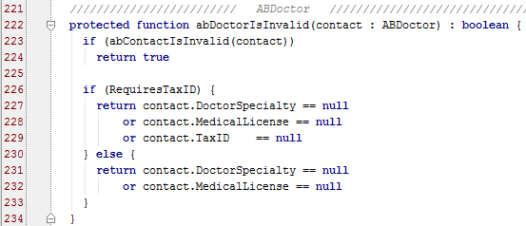
Step 1: Create the new method
New method
Doctor-specific logic for both Tax ID situations
Check ABContact creation criteria (are there tags?) first
Notes:
The key word "protected" is an access modifier that controls whether or not other methods can access this method. Specifically, "protected" means the method can be accessed by methods declared in the same class or in the same package, but it cannot be accessed by methods declared in classes outside of the package. Access modifiers are used to isolate classes so that only the classes that should have access to a given class actually have access. Methods like this one do not necessarily follow the same inheritance model as the ABContact subtype itself. For example, abDoctorIsInvalid checks to see if the contact has a medical license number and medical specialty. This logic is not relevant to ABPersonVendor contacts, even though ABPersonVendor is a subtype of ABPerson.
Template for Logic method:
protected function subtypeNameIsInvalid(contact : Subtype) : boolean {
if (<abContactIsInvalid or abPersonIsInvalid>(contact))
return true
//logic i.e.
return contact.Prefix == null
}
Regarding the use of abContactIsInvalid or abPersonIsInvalid on line 2 of the template: You can check logic at either level, however it may be more clear to use the former because of the requirement to check if Tax ID is required.

Slide 28
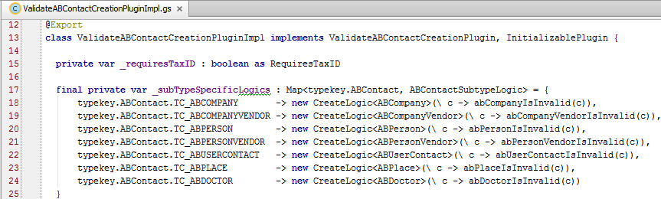
Step 2: Add class to SubTypeSpecificLogics map

Slide 29
Step 3: Create display key for error message
The display key must be a child of Java.TooLooseContactCreateCriteriaException, and it must be named after the appropriate subtype
Notes:
Unlike subtypes and object-oriented classes, display keys are not hierarchical. A given display key does not "inherit" anything from any other display key. Therefore, when you create a display key that is to be an error message for a given subtype, you should be certain to include text to identify any requirements that will be inherited from the Logic class's parents. (For example, the error message shown above details the need for Medical License and Medical Specialty, which are specific to ABDoctors. But it also specifies the requirements for at least one Tag, which are specified at the ABContact level.)

Slide 30
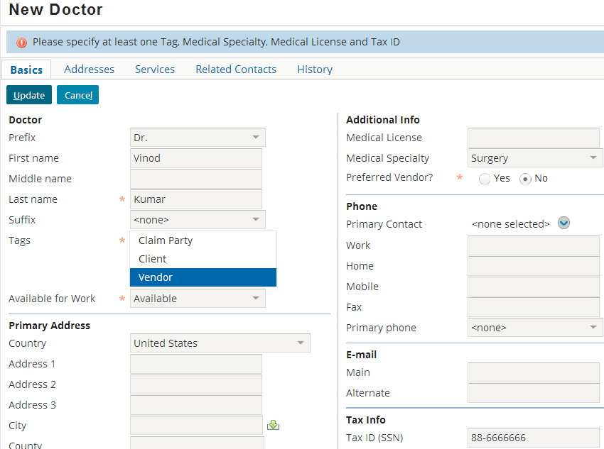
Creating a new Logic class: End result
Notes:
In the example above, when a Medical License and/or Medical Specialty has not been specified, the ABDoctor error message is displayed. This message is based on the parent class's message (ABPerson), but it also specifies Medical License and Medical Specialty are required.

Slide 31
Lesson objectives review
You should now be able to:
Describe the role of minimum contact creation criteria
List the elements that implement minimum contact creation criteria
Configure minimum contact creation criteria

Slide 32
Review questions
Assume that a customer requirement specifies every ABCompany must have an "Incorporation Date" specified
Could you implement this by specifying the IncorporationDate is non-null?
Could you implement this by specifying the IncorporationDate field is required on the New Company detail view?
What is the purpose of the _subTypeSpecificLogics map in ValidateABContactCreationPluginImpl?
Describe how you would create a method to handle creation criteria for ABAttorney contacts.
If you create creation logic for the ABLawFirm subtype, where should the error message for the logic be stored?
Notes:
Answers
1. a) No. (If you did this, then all ABContacts, including non-company ABContacts (such as ABDoctors), would need to have an Incorporation Date.)
b) You could implement it this way, but this is not recommended. Domain logic should not be implemented at the UI level.
2. This map identifies the Logic class to use to evaluate whether or not a contact of a given subtype can be created.
3. You could create a new protected method, such as:
protected function abVendorPersonAttorneyIsInvalid(contact : ABAttorney) : boolean {}
4. It should be stored in a display key named Java.TooLooseContactCreateCriteriaException.ABLawFirm.

Slide 33
Notices
Copyright © 2001-2014 Guidewire Software, Inc. All rights reserved.
Guidewire, Guidewire Software, Guidewire ClaimCenter, Guidewire PolicyCenter, Guidewire BillingCenter, Guidewire Reinsurance Management, Guidewire ContactManager, Guidewire Vendor Data Management, Guidewire Client Data Management, Guidewire Rating Management, Guidewire InsuranceSuite, Guidewire ContactCenter, Guidewire Studio, Guidewire Product Designer, Guidewire Live, Guidewire DataHub, Guidewire InfoCenter, Guidewire Standard Reporting, Guidewire ExampleCenter, Guidewire Account Manager Portal, Guidewire Claim Portal, Guidewire Policyholder Portal, ClaimCenter, BillingCenter, PolicyCenter, InsuranceSuite, Gosu, Deliver Insurance Your Way, and the Guidewire logo are trademarks, service marks, or registered trademarks of Guidewire Software, Inc. in the United States and/or other countries.
All other trademarks are the property of their respective owners.
This material is confidential and proprietary to Guidewire and subject to the confidentiality terms in the applicable license agreement and/or separate nondisclosure agreement.
This file and the contents herein are the property of Guidewire Software, Inc. Use of this course material is restricted to students officially registered in this specific Guidewire-instructed course, or for other use expressly authorized by Guidewire. Replication or distribution of this course material in electronic, paper, or other format is prohibited without express permission from Guidewire.
Guidewire products are protected by one or more United States patents.

