Slide 1
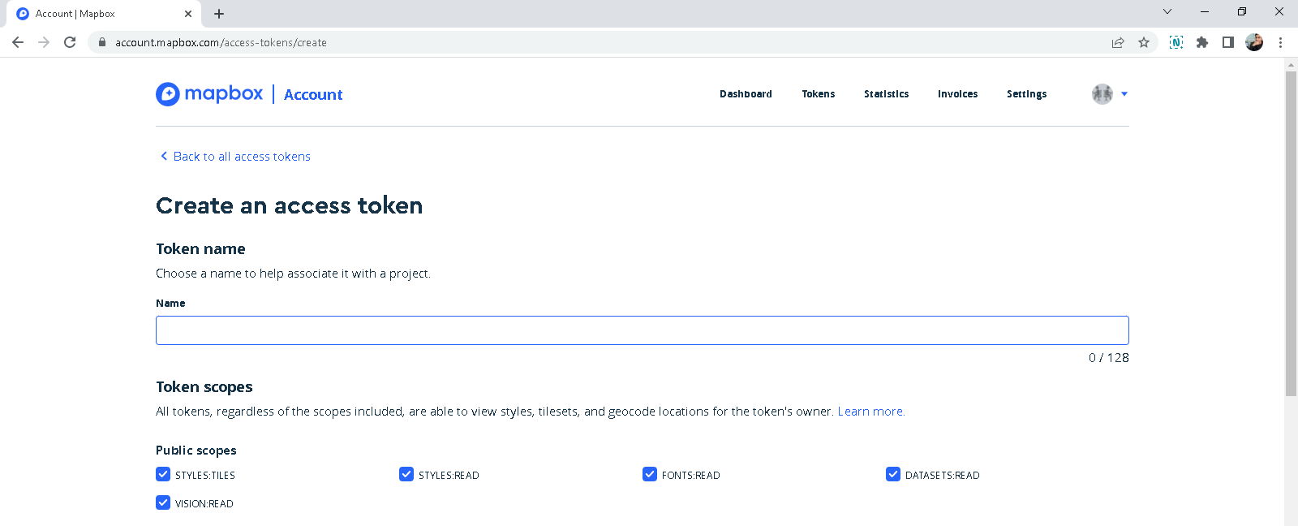
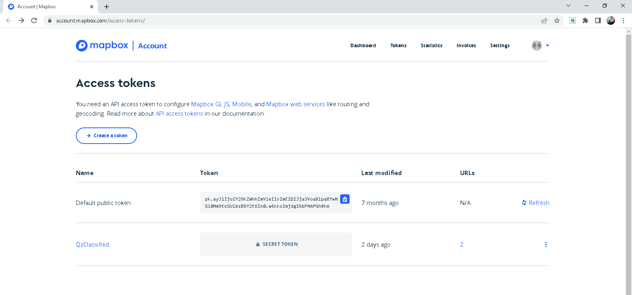
https://account.mapbox.com/access-tokens/

Slide 2
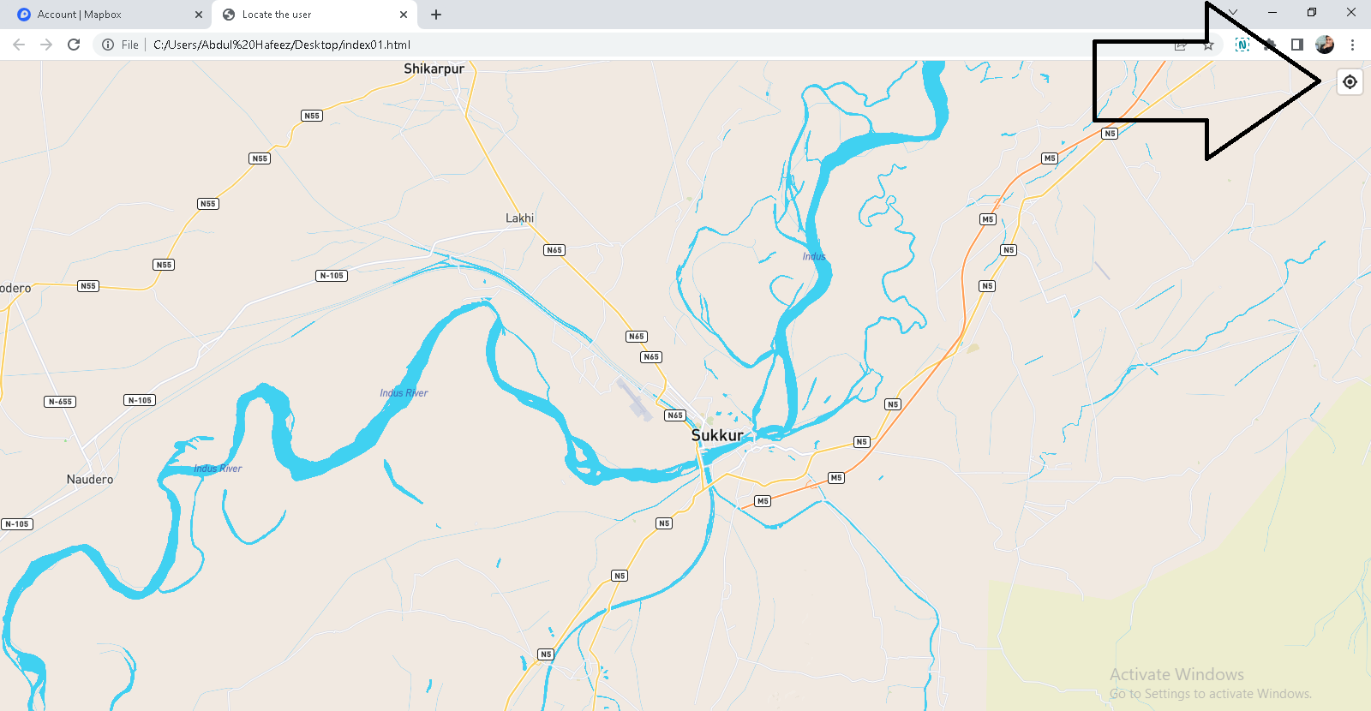
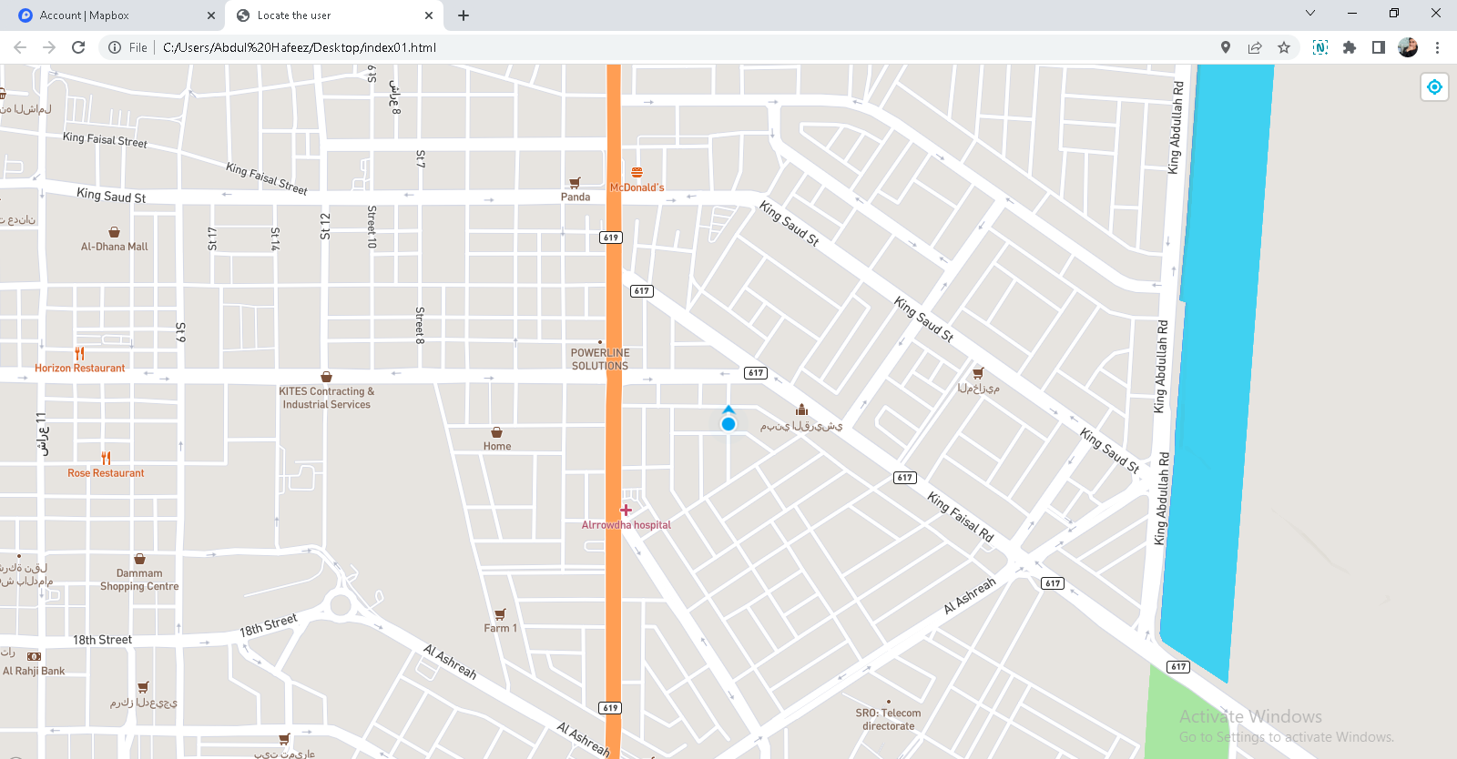
<!DOCTYPE html>
<html>
<head>
<meta charset="utf-8">
<title>Locate the user</title>
<meta name="viewport" content="initial-scale=1,maximum-scale=1,user-scalable=no">
<link href="https://api.mapbox.com/mapbox-gl-js/v2.8.2/mapbox-gl.css" rel="stylesheet">
<script src="https://api.mapbox.com/mapbox-gl-js/v2.8.2/mapbox-gl.js"></script>
<style>
body { margin: 0; padding: 0; }
#map { position: absolute; top: 0; bottom: 0; width: 100%; }
</style>
</head>
<body>
<div id="map"></div>
<script>
mapboxgl.accessToken = 'pk.eyJ1IjoiY29kZWhhZmVleiIsImEiOiJja3VoaXlpaXYwMG10Mm9tcGU1bzB6Y2t6In0.w6kkoImjdgI6bPMAPGh8hA';
const map = new mapboxgl.Map({
container: 'map', // container ID
style: 'mapbox://styles/mapbox/streets-v11', // style URL
center: [68.833297, 27.722129], // starting position
zoom: 10 // starting zoom
});
// Add geolocate control to the map.
map.addControl(
new mapboxgl.GeolocateControl({
positionOptions: {
enableHighAccuracy: true
},
// When active the map will receive updates to the device's location as it changes.
trackUserLocation: true,
// Draw an arrow next to the location dot to indicate which direction the device is heading.
showUserHeading: true
})
);
</script>
</body>
</html>

