Slide 1

Mongo DB
www.codehafeez.com

Slide 2
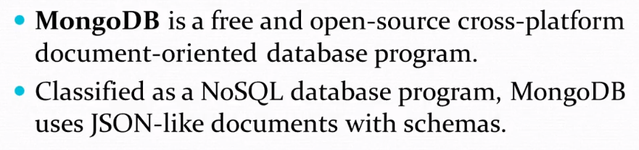
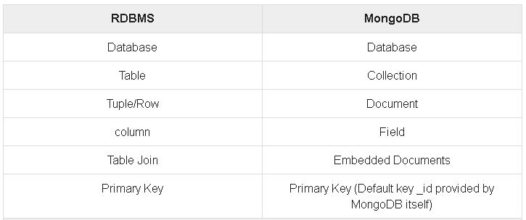
MongoDB is NoSQL language.
MongoDB is a cross-platform, document oriented database that provides, high performance, high availability, and easy scalability. MongoDB works on concept of collection and document.
npm install mongodb

Slide 3
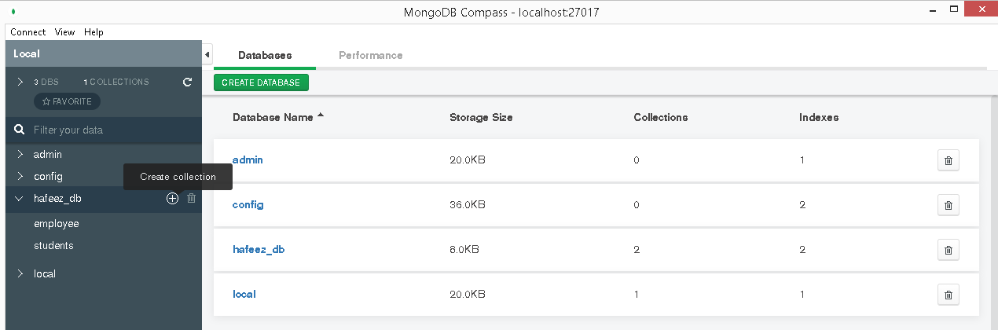

Slide 4
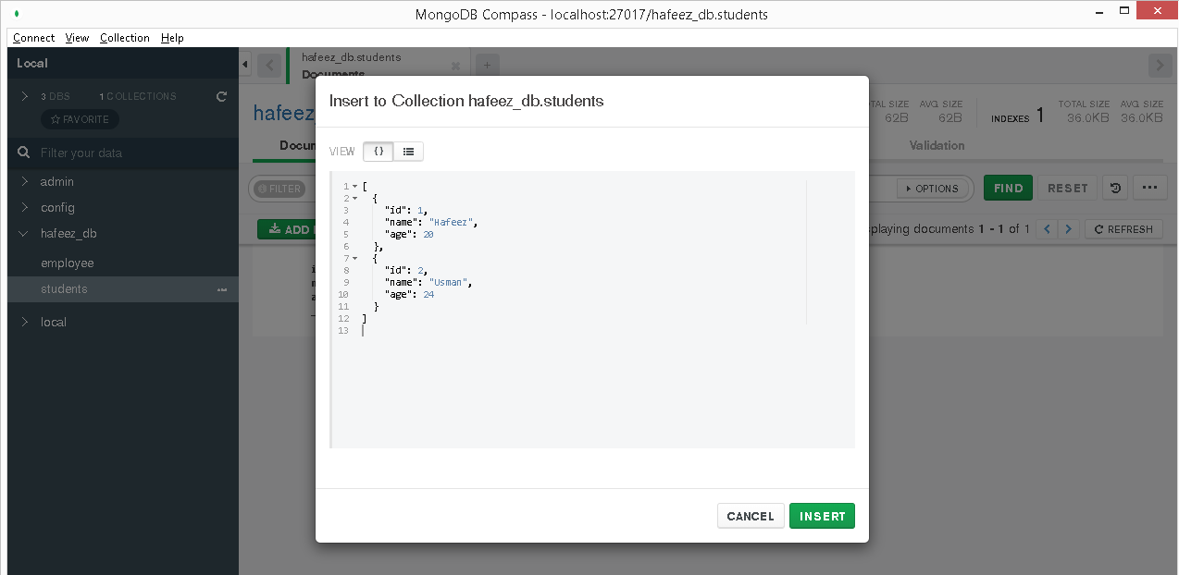
[
{
"id": 1,
"name": "Hafeez",
"age": 20
},
{
"id": 2,
"name": "Usman",
"age": 24
}
]

Slide 5
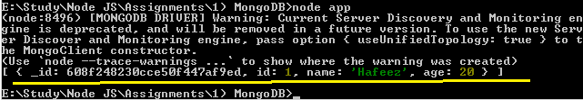
// npm install mongodb
var MongoClient = require('mongodb').MongoClient;
var url = "mongodb://localhost:27017/";
MongoClient.connect(url, function(err, db) {
if (err) throw err;
var dbo = db.db("hafeez_db");
var query = { name: "Hafeez" };
dbo.collection("students").find(query).toArray(function(err, result) {
if (err) throw err;
console.log(result);
db.close();
});
});
Read Data MongoDB using NodeJS

